Slide 1

Proposed Website
Navigation Flow Of Pages

Slide 2
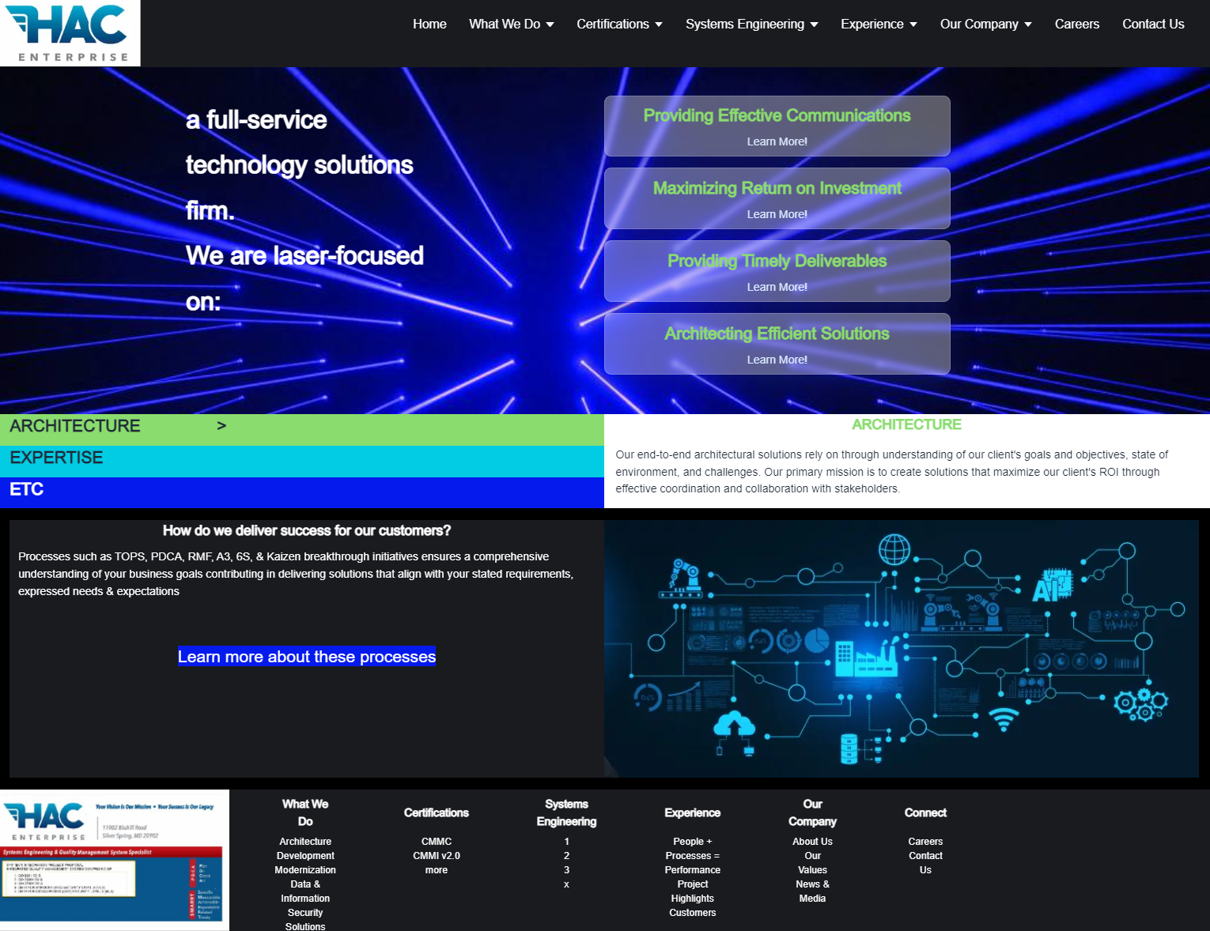

Nav Step 1:
HAC Website
Home
Demo page at https://hacenterprises.vercel.app/
Not final version (many links need to be added, resizing changed…)
Elements on this page can be reused through other pages (Header, for example)
Click on “Systems Engineering” Heading

Slide 3
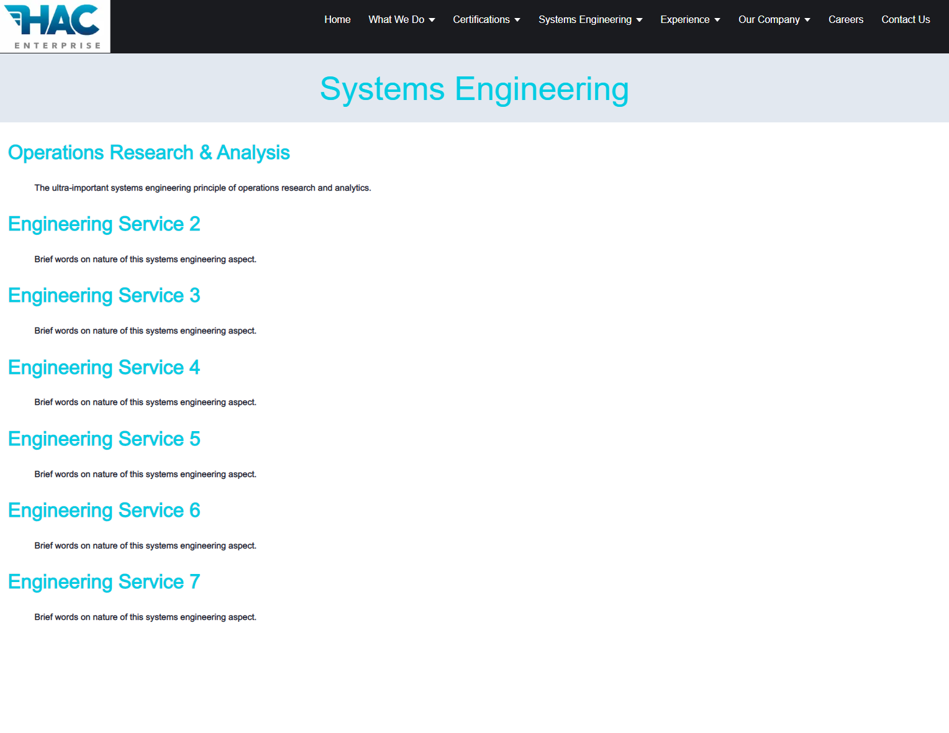
Nav Step 2:
Choose Topic
(Systems Eng.)
Top Category Page (Sys. Engineering)
Responsive page at https://hacenterprises.vercel.app/systems_engineering
Similar style could be used for the Certifications page
Click on “Operations Research and Analysis” Item

Slide 4
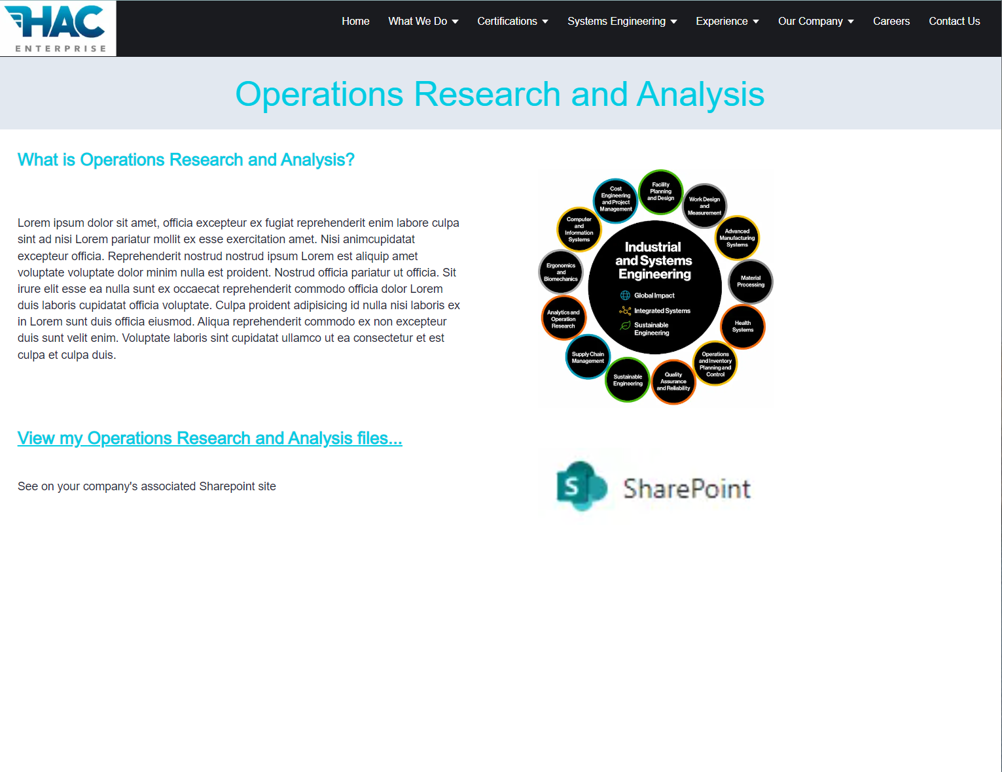
Nav Step 3:
Choose Subtopic
(Ops Research
& Analysis)
Specific Topic Page (Sys. Engineering -> Ops Research & Analysis)
Responsive page at https://hacenterprises.vercel.app/systems_engineering/op_research_and_analytics
Click on “View my Operations Research and Analysis files…” link

Slide 5
Nav Step 4:
Authentication
Authentication Step
Responsive page at N/A

Slide 6
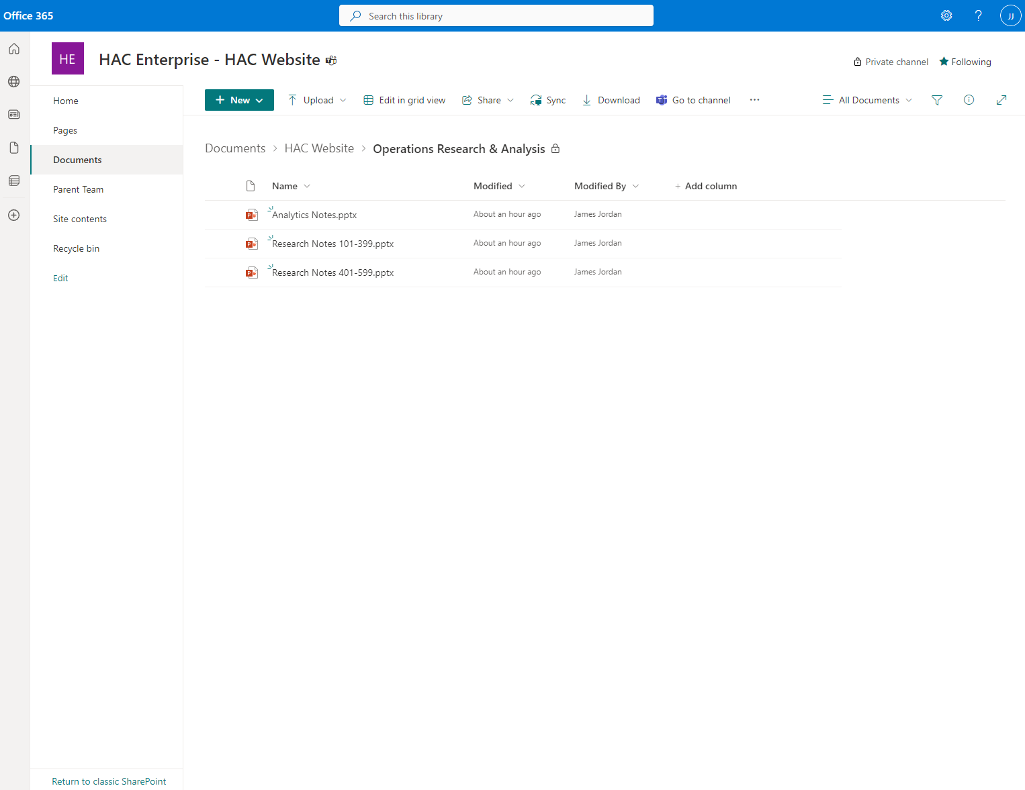
Nav Step 5:
Destination
(Company’s Drilled
SharePoint Folder)
Authentication Step
Corresponding page will open in your company’s customized SharePoint site
Information-rich security content will be served in familiar PowerPoint format

