Slide 1
WEB & AI DEVELOPMENT BOOTCAMP
LIVE EVENT
CodeWeekend 2026 Demo Day
24
GRADUATES ONE STAGE
An online celebration of talent, persistence, and what becomes possible when opportunity meets code.
const future = students.build();
WHEN
TIME
WHERE
Thursday, 27 August 2026
7:30–10:30 PM AFT
Live online

Slide 2
WELCOME
DEMO DAY 2026
Welcome, everyone.
Thank you to our guests, mentors, partners, employers, friends, and families for joining us. Today we celebrate 24 graduates of the Web & AI Development Bootcamp — and the projects they are ready to share.
This is not only a graduation. It is a live look at what emerging developers can imagine, build, and explain in their own words.

Slide 3
ABOUT CODEWEEKEND
MISSION
A room full of next steps.
CodeWeekend began in Kabul in 2014 as a grassroots gathering for developers. Today we are a Canadian non-profit delivering free, practical technology education for Afghan youth — with programs focused on women and girls.
2014
100+
280+
$0
Founded in Kabul
Community events
Bootcamp applicants
Student tuition

Slide 4
THE JOURNEY
WEB & AI DEVELOPMENT BOOTCAMP
From curiosity to craft.
Across the bootcamp, students learned by making — strengthening fundamentals, collaborating, shipping practice projects, and growing the confidence to take an idea from a blank screen to a working product.
01
02
03
04
Learn
Build
Struggle
Grow
Core web technologies, modern AI tools, and the habits of professional builders.
Hands-on projects that turn lessons into working interfaces, flows, and features.
Debugging, iteration, and resilience when something breaks — then rebuilding better.
Capstone work that shows how far each graduate has come, in their own voice.

Slide 5
WHAT STUDENTS BUILD
CAPSTONE SHOWCASE
Tonight's projects are the capstone.
These demos are the strongest expression of months of learning — not the only thing students worked on. Practice projects, collaboration, and continuous iteration prepared each graduate to design, build, and present a final product.
What you will see tonight: working Web & AI applications, explained by the people who made them.

Slide 6
THE PROGRAMME
COME CURIOUS. LEAVE CONNECTED.
How tonight unfolds.
01
Live project demos
20+ PRESENTATIONS
Graduates present their strongest Web and AI projects, with questions from the audience and judges.
02
Audience Choice
FIVE CATEGORIES
Celebrate standout work across five categories that honor craft, creativity, and impact.
03
Awards & recognition
COMMUNITY APPLAUSE
We celebrate execution, problem-solution fit, creativity, presentation, and growth.
04
Open networking
REAL CONVERSATIONS
Meet graduates, employers, mentors, partners, and friends in focused online rooms.

Slide 7
AUDIENCE CHOICE
FIVE CATEGORIES
Celebrate standout work.
01
02
03
04
05
Most Innovative Project
Most Creative Presentation
Most Impactful Project Idea
Best Use of AI
Best User Experience
Original thinking in product and technology
Storytelling that holds the room
Solutions with real-world meaning
AI that serves the problem, not the hype
Clear, thoughtful, human-centered design

Slide 8
THE 2026 GRADUATES
24 BUILDERS
Meet the cohort.
Asma Mehraban
Asma Samadi
Basira Mehrzad
Bibi Hawa Abdul Shukoor
PostPlanner-AI
TravelGenie – AI Travel Planning Assistant
MorningFocus
DataNest AI
Bibi Mariam Abdul Shukoor
Bibi Zhara Abdul Shukoor
Fareshta Foladi
Farzana Ebrahimi
CareerMatch - AI-Powered Personalized Jo…
HR Pilot – AI-Powered Recruitment Platform
BrainNote AI
QuickHelp AI – AI-Powered Support & Resp…
Hamisha Noori
Hanifa Yousufi
Jamila Waziry
Lima Rahimzai
DevTrack
MindfulDiary
AfghanBuddy (AI-Powered Travel Discovery…
PitchPilot
Mahdia Hassani
Marwa Qadeer
Maryam Hamrah
Maryam Moostamandy
SafeNet
GiftMatch AI
Launchpad
TidySpace – AI Cleaning Assistant
Rahimah ANsari
Roqia stanikzai
Samira Hakimi
Sana Waziry
CatchyReminders
AI Movie Analyzer
MeetMind – AI Meeting Assistant
SmartReceipt
Shabnam Ahmadi
Sima Gulestani
Zahra Ahmadi
Zarara Kazimi
Emoji Translator
HireFlow
Freela
AidLink – AI-Powered Platform Connecting…

Slide 9
LIVE DEMOS
NOW PRESENTING
Project showcase
Each graduate will share their capstone. Listen for the problem, the solution, and the craft behind the build.

Slide 10
STUDENT SHOWCASE
01 / 24
Web & AI Developer
Asma Mehraban
Jaba Saraj/ Parwan/ Afghanistan
CAPSTONE PROJECT
PostPlanner-AI
PostPlanner AI is an AI-powered social media content management platform designed to help creators and businesses create, organize, and manage social media content more efficiently.

Slide 11
STUDENT SHOWCASE
02 / 24
Aspiring Backend Developer
Asma Samadi
Kabul, Afghanistan
CAPSTONE PROJECT
TravelGenie – AI Travel Planning Assistant
TravelGenie is an AI-powered travel planning web application that helps users plan their trips in an easier and more organized way. Users can enter details about their destination, travel dates, budget, and…

Slide 12
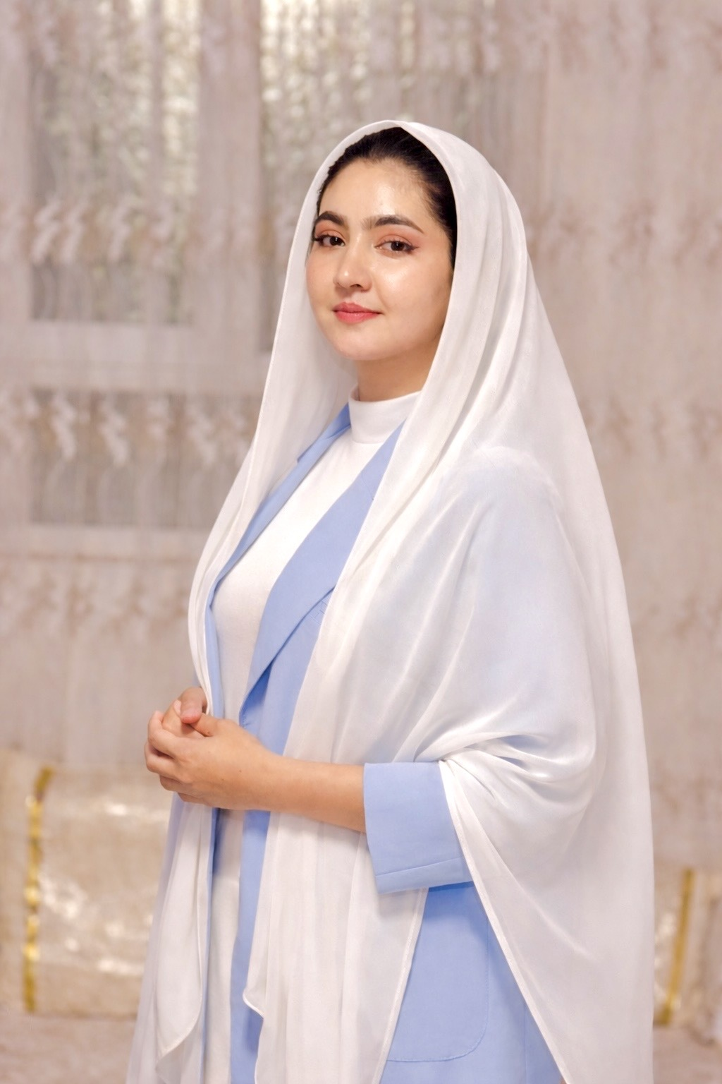
STUDENT SHOWCASE
03 / 24
Web & AI Developer
Basira Mehrzad
Herat , Afghanistan
CAPSTONE PROJECT
MorningFocus
**MorningFocus** is an AI-powered productivity web application that helps users stay focused on what matters most each day. Instead of managing long and overwhelming to-do lists, the app encourages users to set up to…

Slide 13
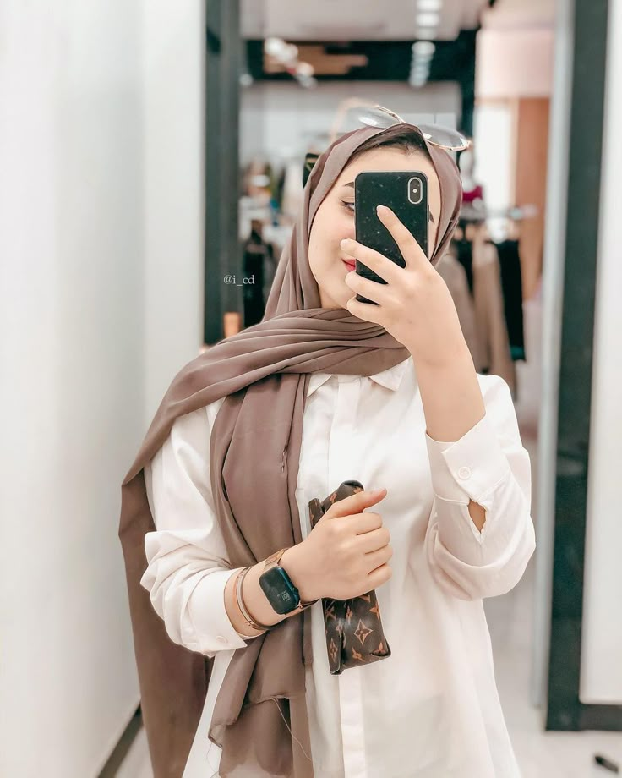
STUDENT SHOWCASE
04 / 24
Full-Stack Web Developer
Bibi Hawa Abdul Shukoor
Kabul, Afghanistan
CAPSTONE PROJECT
DataNest AI
DataNest AI is a full-stack AI-powered document intelligence platform designed to help users upload, organize, search, and interact with their documents using artificial intelligence. The application allows users to…

Slide 14
STUDENT SHOWCASE
05 / 24
Frontend Developer
Bibi Mariam Abdul Shukoor
Kabul Afghanistan
CAPSTONE PROJECT
CareerMatch - AI-Powered Personalized Job Matching System
CareerMatch is an AI-powered job matching platform designed to help job seekers find relevant career opportunities based on their skills, experience, interests, and preferences. The purpose of this project is to make…

Slide 15
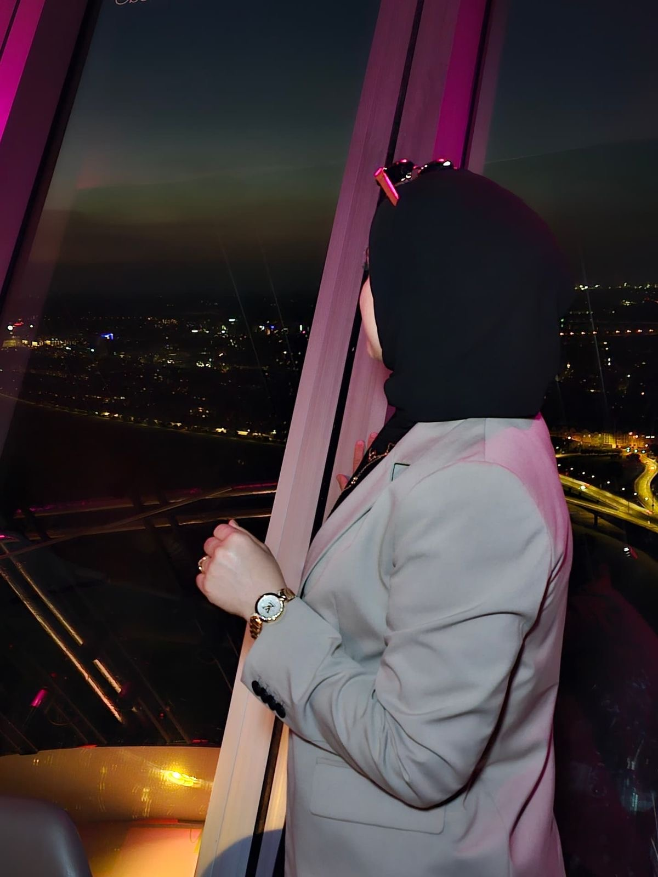
STUDENT SHOWCASE
06 / 24
Front-End Web Developer
Bibi Zhara Abdul Shukoor
Kabul Afghanistan
CAPSTONE PROJECT
HR Pilot – AI-Powered Recruitment Platform
HR Pilot is an AI-powered recruitment platform designed to streamline the hiring process by helping recruiters manage jobs and candidates more efficiently. The platform allows users to create and manage job postings,…

Slide 16
STUDENT SHOWCASE
07 / 24
Frontend Developer
Fareshta Foladi
Herat_Afghanistan
CAPSTONE PROJECT
BrainNote AI
BrainNote AI is an AI-powered note-taking web application designed to help users capture, organize, search, and manage their ideas more effectively. Users can create colorful notes, pin important content, mark…

Slide 17
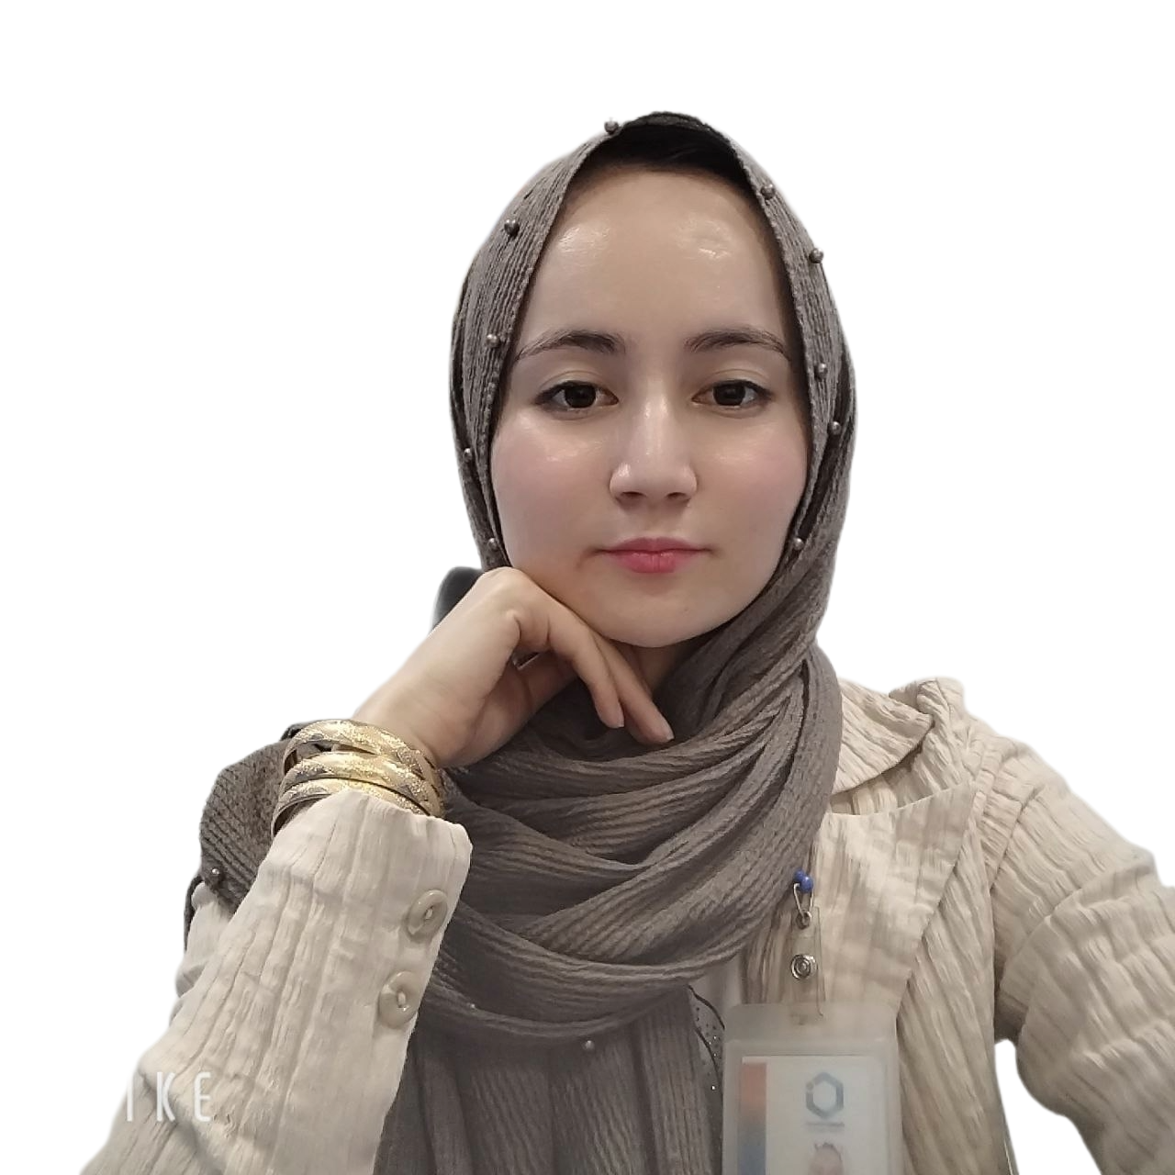
STUDENT SHOWCASE
08 / 24
Junior Frontend Developer
Farzana Ebrahimi
Herat, Afghanistan
CAPSTONE PROJECT
QuickHelp AI – AI-Powered Support & Response System
QuickHelp AI

Slide 18
STUDENT SHOWCASE
09 / 24
Aspiring Frontend Developer
Hamisha Noori
Mazar-e-Sharif, Balkh,
CAPSTONE PROJECT
DevTrack
DevTrack is an AI-powered web application designed to help developers analyze their GitHub projects, identify areas for improvement, and receive personalized recommendations for improving their code quality and…

Slide 19
STUDENT SHOWCASE
10 / 24
Frontend Developer skilled programming
Hanifa Yousufi
Kabul
CAPSTONE PROJECT
MindfulDiary
Most journaling apps are just a text box. You write, it saves, and that's the end of it — your words sit there, unanswered. MindfulDiary is built on a simple belief: journaling feels more worthwhile when something…

Slide 20
STUDENT SHOWCASE
11 / 24
Full-Stack Developer
Jamila Waziry
Kabul
CAPSTONE PROJECT
AfghanBuddy (AI-Powered Travel Discovery & Smart Tour Planning Platform)
AfghanBuddy is an AI-powered travel platform designed to help users discover Afghanistan’s destinations, culture, history, and natural beauty. The platform allows users to explore destinations, get personalized…

Slide 21
STUDENT SHOWCASE
12 / 24
Frontend Developer
Lima Rahimzai
Kabul, Afghanistan
CAPSTONE PROJECT
PitchPilot
PitchPilot is an AI-powered startup coach designed to help people with startup ideas transform them into structured business concepts. The platform helps users analyze their ideas, generate SWOT analysis, and create…

Slide 22
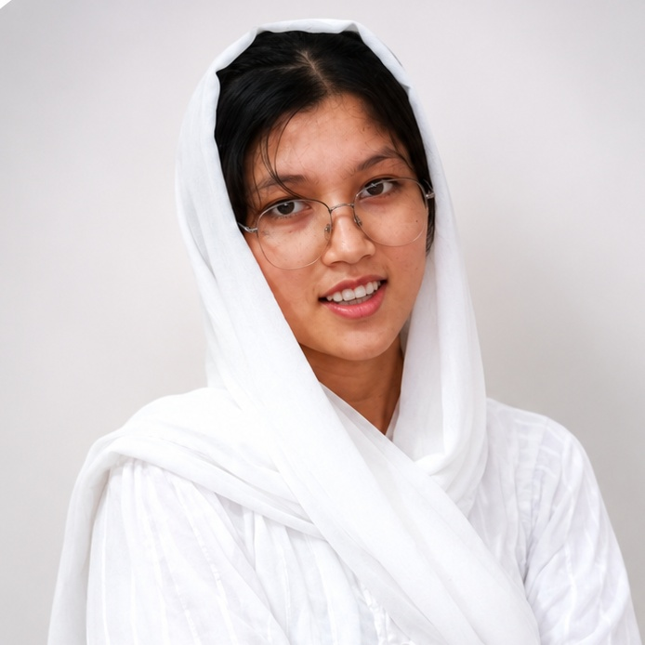
STUDENT SHOWCASE
13 / 24
Frontend Developer
Mahdia Hassani
Kabul Afghanistan
CAPSTONE PROJECT
SafeNet
SafeNet is an AI-powered cybersecurity awareness platform that helps users identify online threats, understand common scams, and develop safer digital habits. Users can paste suspicious emails, messages, or website…

Slide 23
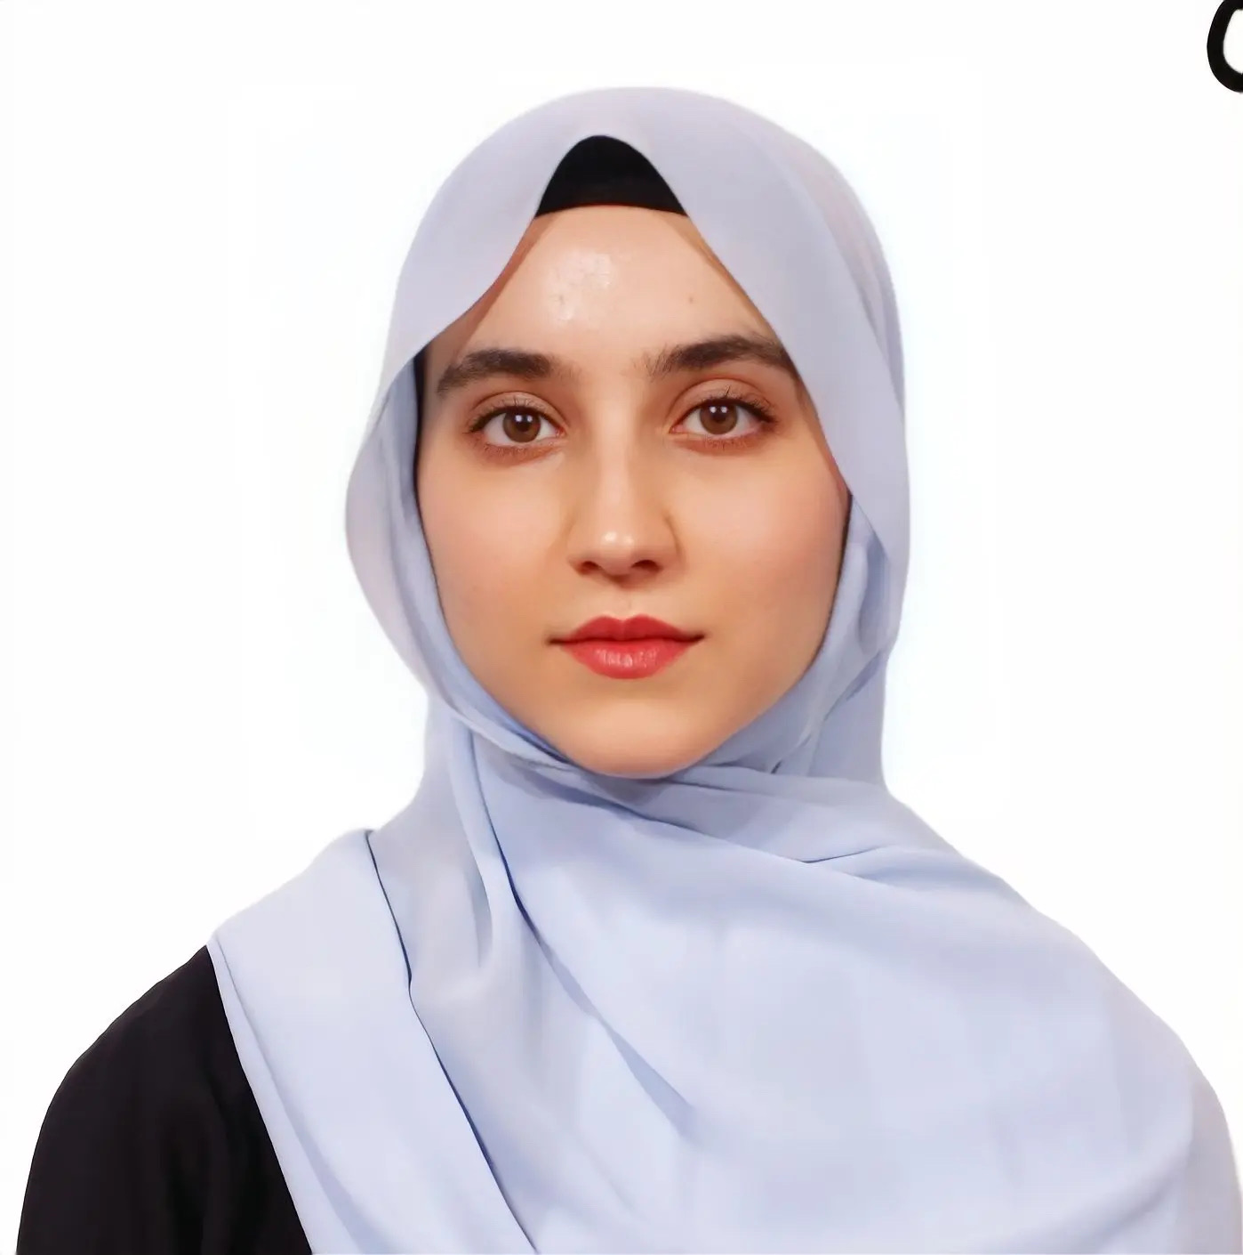
STUDENT SHOWCASE
14 / 24
Aspiring Frontend Developer
Marwa Qadeer
Charah-E-Qambar, Kabul, Afghanistan
CAPSTONE PROJECT
GiftMatch AI
GiftMatch AI is an AI-powered gift recommendation platform that helps users organize important occasions such as birthdays and generate personalized gift ideas. Users can create profiles for friends and family, save…

Slide 24
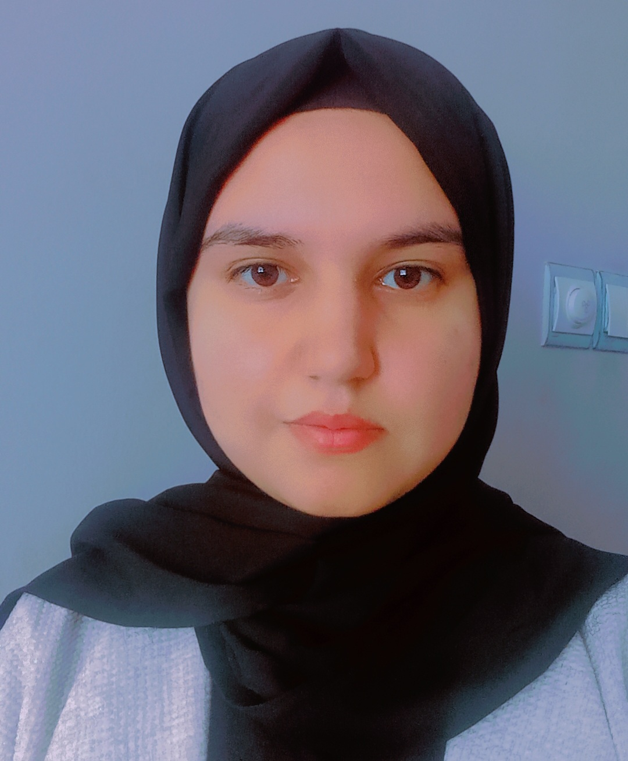
STUDENT SHOWCASE
15 / 24
IT Student
Maryam Hamrah
Mazar-i-Sharif, Afghanistan
CAPSTONE PROJECT
Launchpad
Launchpad is an AI-powered career roadmap platform designed to help learners create a personalized path toward their career goals. The platform guides users by generating customized learning roadmaps, recommending…

Slide 25
STUDENT SHOWCASE
16 / 24
Frontend Developer
Maryam Moostamandy
Parwan, Afghanistan
CAPSTONE PROJECT
TidySpace – AI Cleaning Assistant
TidySpace is an AI-powered cleaning assistant designed to help users organize and manage their cleaning tasks more easily. The platform provides a modern and user-friendly interface where users can explore cleaning…

Slide 26
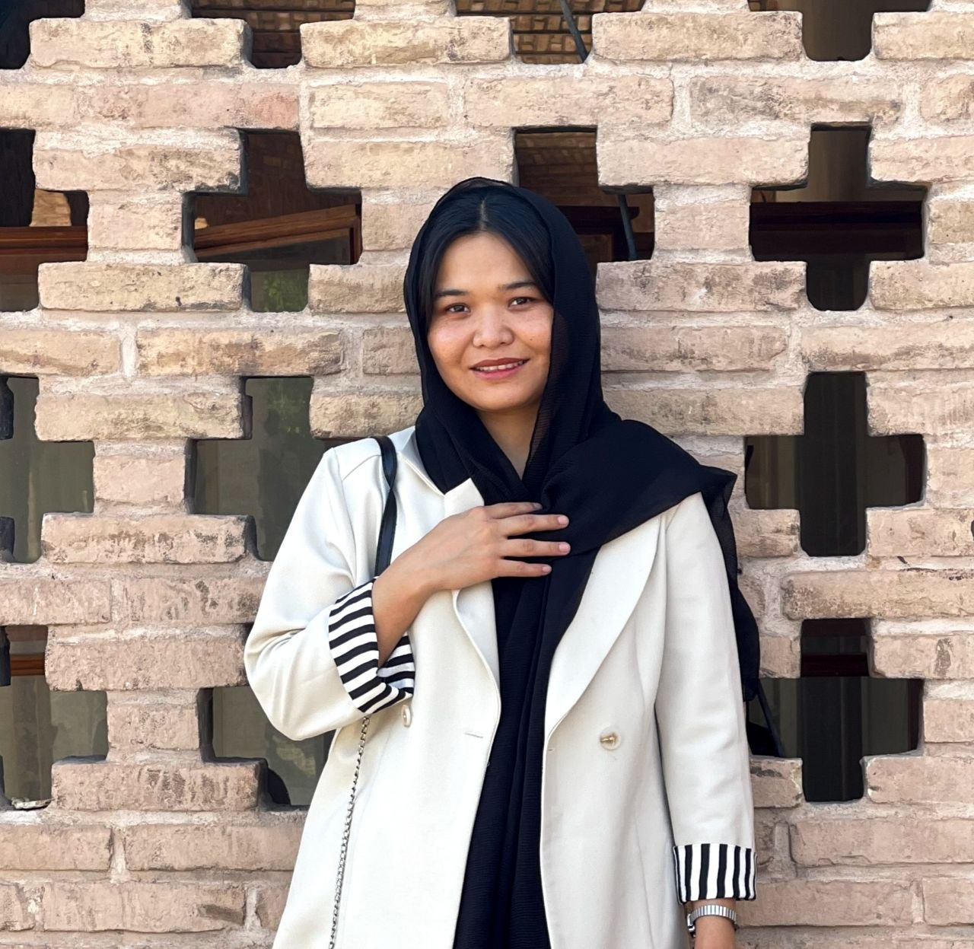
STUDENT SHOWCASE
17 / 24
Frontend Web Developer
Rahimah ANsari
Herat, Afghanistan
CAPSTONE PROJECT
CatchyReminders
CatchyReminders is an AI-powered reminder application that transforms boring tasks that are easy to ignore into funny, engaging, and personalized reminders. By using different AI personalities, the application makes…

Slide 27
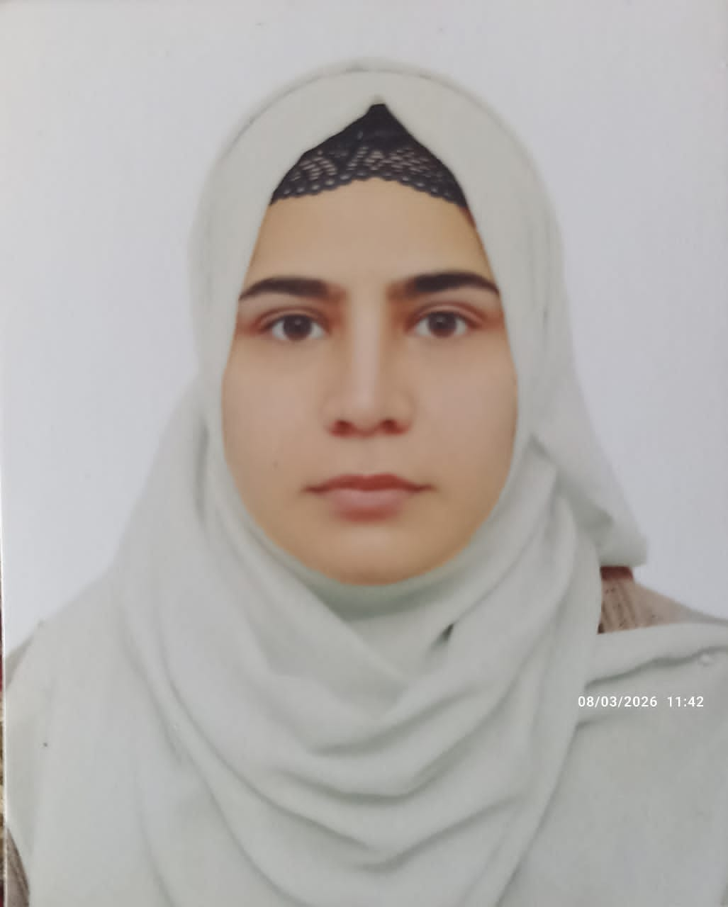
STUDENT SHOWCASE
18 / 24
Aspiring Frontend web developer, React and JavaScript learner and code weekend participant
Roqia stanikzai
Kabul, Afghanistan
CAPSTONE PROJECT
AI Movie Analyzer
It is an AI film tracker that reads your movie review and tells you what kind of movies you love.

Slide 28
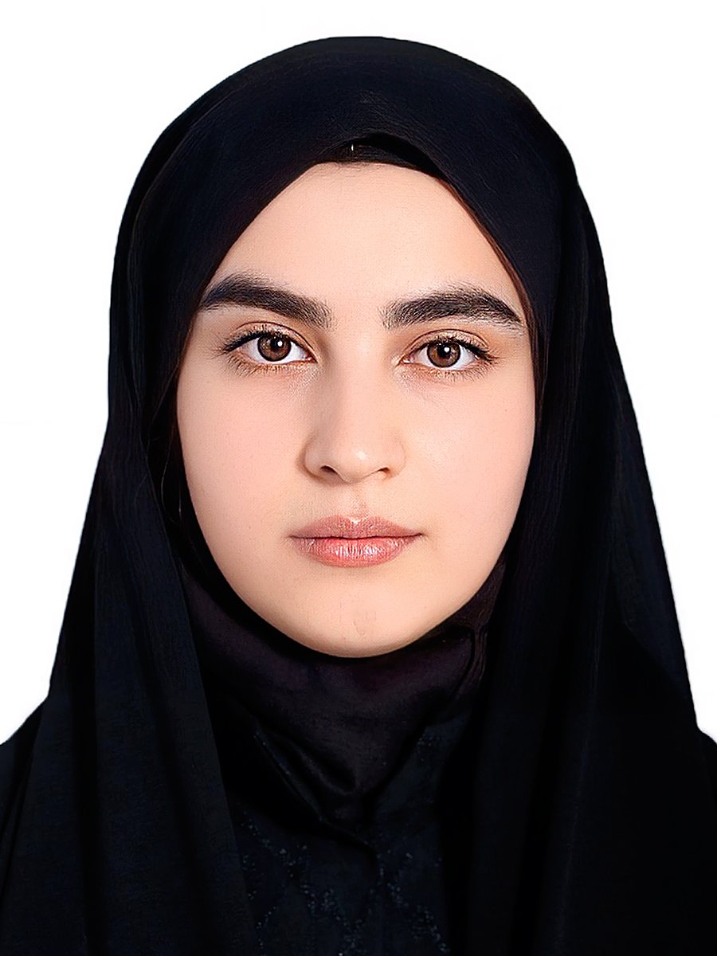
STUDENT SHOWCASE
19 / 24
AI & Full-Stack Web Developer
Samira Hakimi
Herat, Afghanistan
CAPSTONE PROJECT
MeetMind – AI Meeting Assistant
MeetMind is a full-stack AI-powered meeting assistant that helps users organize meetings more efficiently. Users can create and manage meetings, upload meeting notes and documents, and receive AI-generated summaries…

Slide 29
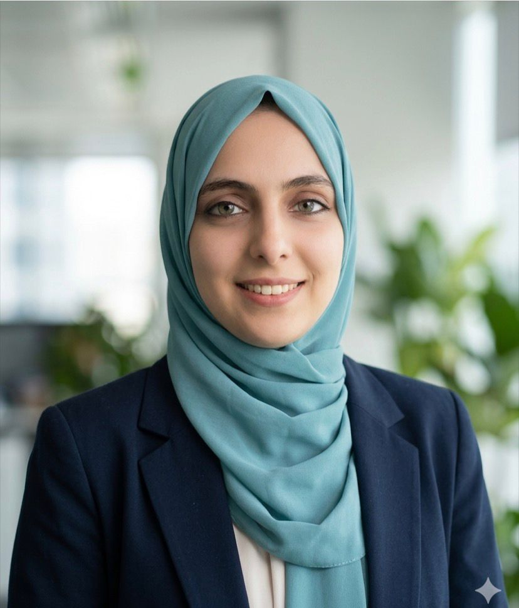
STUDENT SHOWCASE
20 / 24
Web Developer
Sana Waziry
Kabul, Afghanistan
CAPSTONE PROJECT
SmartReceipt
SmartReceipts is an AI-powered expense management application designed to help users track, organize, and analyze their spending. Users can record expenses, automatically categorize them using AI, view spending…

Slide 30
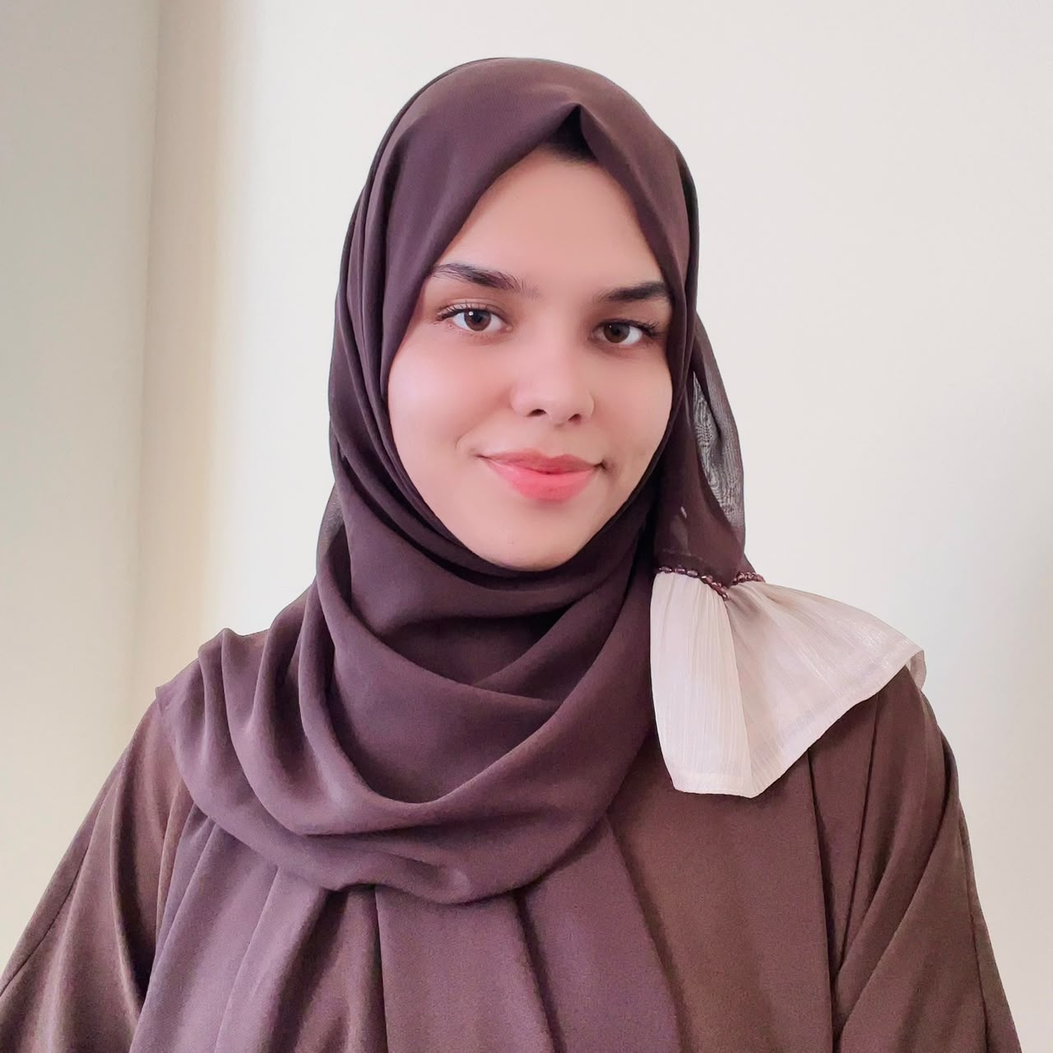
STUDENT SHOWCASE
21 / 24
Where creativity meets code — that's where I build.
Shabnam Ahmadi
Kabul, Afghanistan
CAPSTONE PROJECT
Emoji Translator
Emoji Translator is an AI-powered web application that transforms ordinary sentences into creative, emoji-only messages. It allows users to express themselves in a playful and visual way — without using any words.…

Slide 31
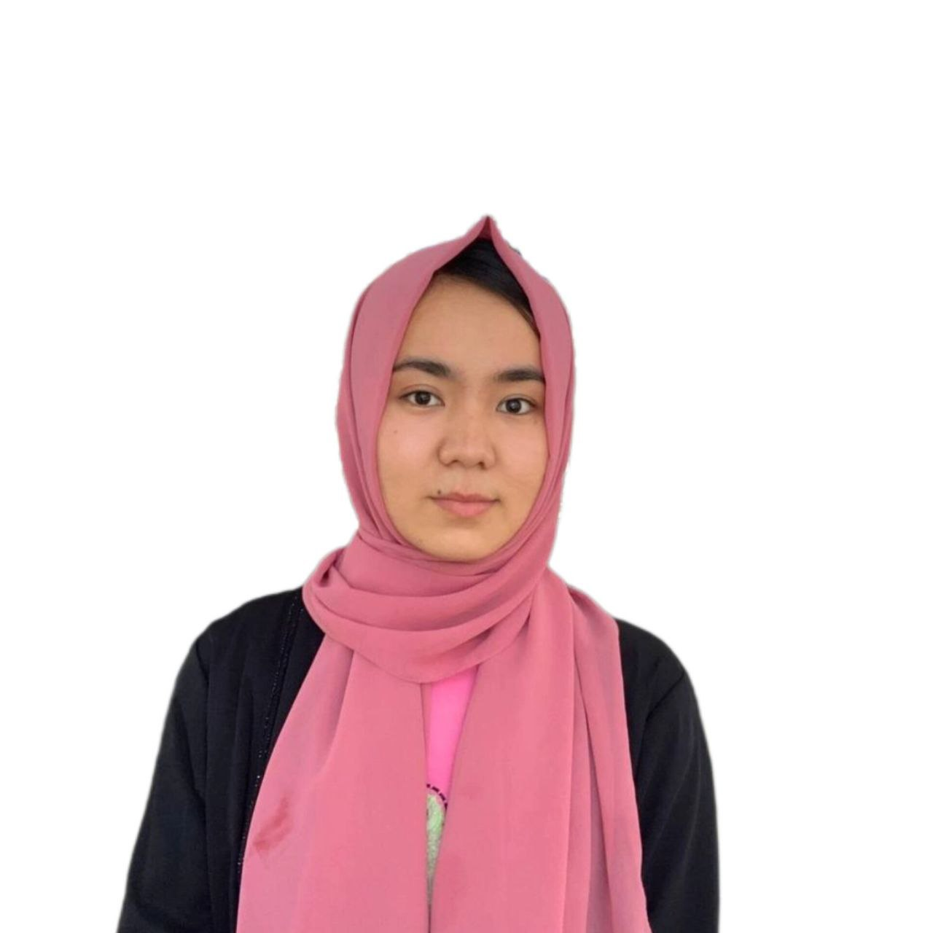
STUDENT SHOWCASE
22 / 24
Frontend Developer
Sima Gulestani
Afghanistan
CAPSTONE PROJECT
HireFlow
HireFlow is an AI-powered career assistant designed to help job seekers improve their resumes, understand skill gaps, and prepare effectively for interviews.

Slide 32
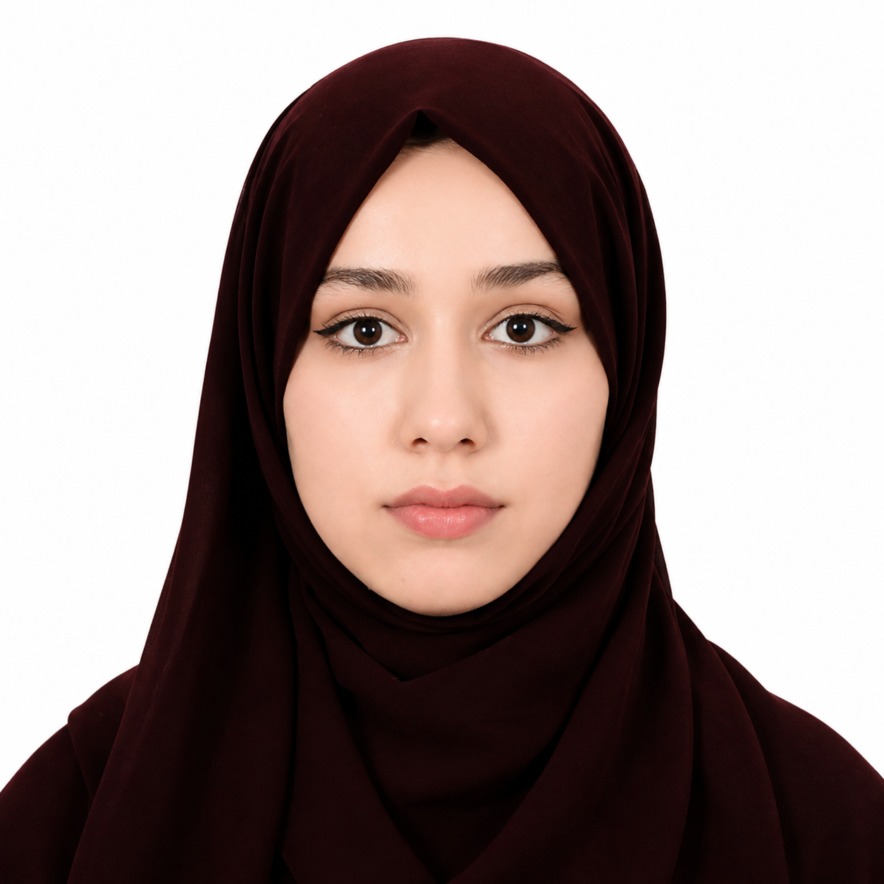
STUDENT SHOWCASE
23 / 24
Frontend Developer
Zahra Ahmadi
Kabul Afghanistan
CAPSTONE PROJECT
Freela
AI freelance assistant that generates proposals and matches freelancers with suitable projects

Slide 33
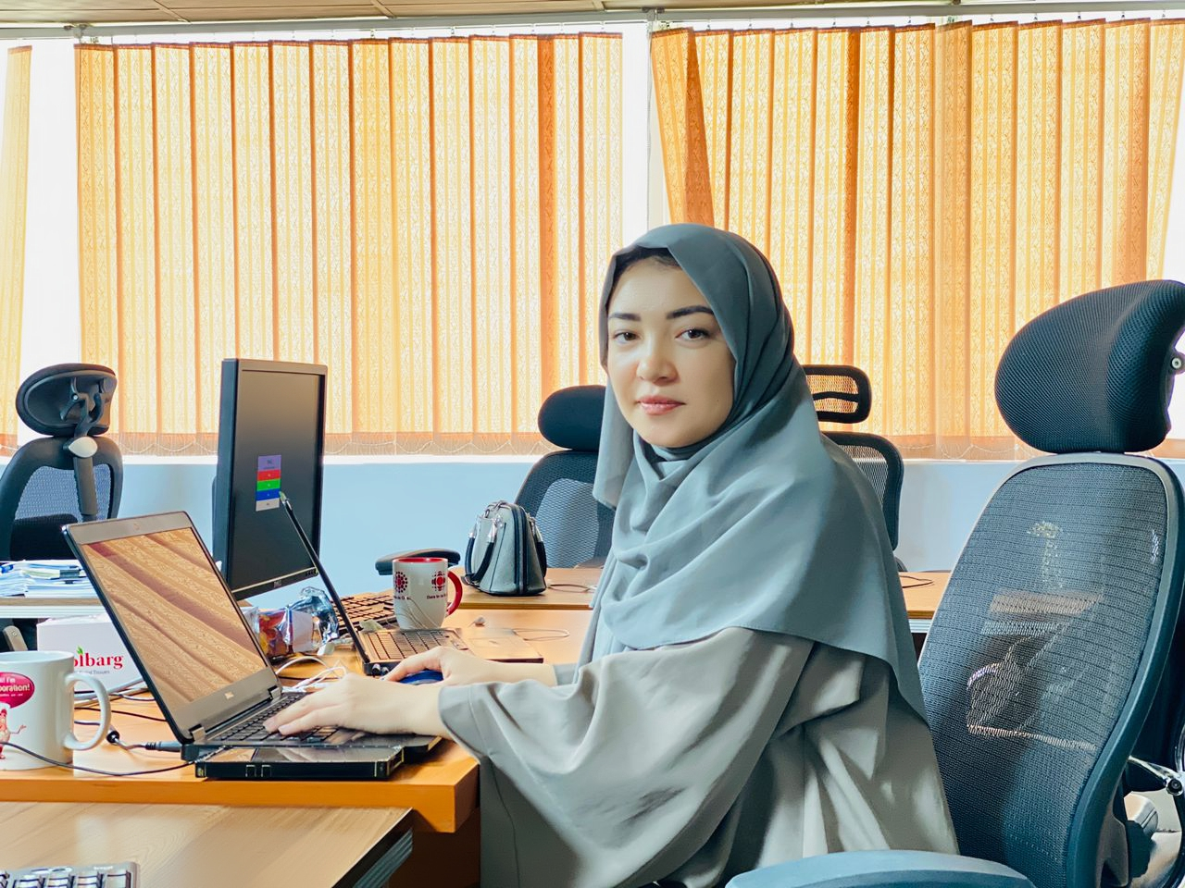
STUDENT SHOWCASE
24 / 24
Frontend Developer
Zarara Kazimi
Kabul afghanistan
CAPSTONE PROJECT
AidLink – AI-Powered Platform Connecting People with NGOs and Support Services
AidLink is an AI-powered web platform designed to help individuals quickly find NGOs, humanitarian organizations, and essential support services based on their needs and location. The platform simplifies access to…

Slide 34
WITH THANKS
OPPORTUNITY IS BUILT TOGETHER
Opportunity is built together.
Linda Norgrove Foundation
GiveInternet
Supporting women in Afghanistan through education and empowerment, including scholarships and vital student support for this cohort.
Helping bridge the digital divide so learners can access the internet and tools they need to participate, practice, and complete the bootcamp.

Slide 35
CELEBRATION
WHAT THIS MEANS
What they carried here.
These graduates did more than finish assignments. They learned in public, built through constraints, and turned limited access into finished products others can use and understand.
Tonight is proof of persistence — and a beginning for what comes next.

Slide 36
CLOSING
CODEWEEKEND 2026 DEMO DAY
Thank you.
To our students, mentors, partners, judges, guests, and supporters — thank you for believing in this work and showing up for it.
Students
Mentors
Partners
Community
const future = students.build();

