Slide 1
WEB & AI DEVELOPMENT BOOTCAMP
HOST DECK
CodeWeekend
Demo Day
2026
24
GRADUATES
Talent. Persistence. What becomes possible when opportunity meets code.
27 Aug
Thursday
7:30 PM
AFT
Live
Online

Slide 2
WELCOME
OPEN THE NIGHT
Welcome — and thank you
for showing up for these builders.
01
Mentors & partners
You helped make this learning possible.
02
Guests & employers
You’re meeting the next wave of talent.
03
Friends & families
You’re celebrating courage and craft.

Slide 3
THE PROGRAMME
FOUR BEATS
How tonight moves.
01
Live demos
20+ graduates share Web & AI projects — then take questions.
02
Audience Choice
You vote across five awards that honor craft and impact.
03
Awards
We celebrate the work, the growth, and the room.
04
Networking
Meet builders, mentors, and partners in breakout rooms.

Slide 4
AUDIENCE CHOICE
FIVE AWARDS · ONE VOTE SET
Vote for the work that moved you.
Watch every demo with these five awards in mind.
01
Best Overall Project — Audience Choice
Which project deserves Best Overall?
Problem · idea · execution · usefulness · craft · presentation
YOUR MAIN AWARD
02
Most Innovative
Most original idea?
Creativity and a fresh approach to the problem
03
Best Technical Execution
Strongest technical build?
Functionality, quality, and technology used well
04
Best UX & Design
Best experience & design?
Usability, clarity, visuals, thoughtful craft
05
Best Real-World Impact
Strongest real-world potential?
Who benefits — and what happens after Demo Day

Slide 5
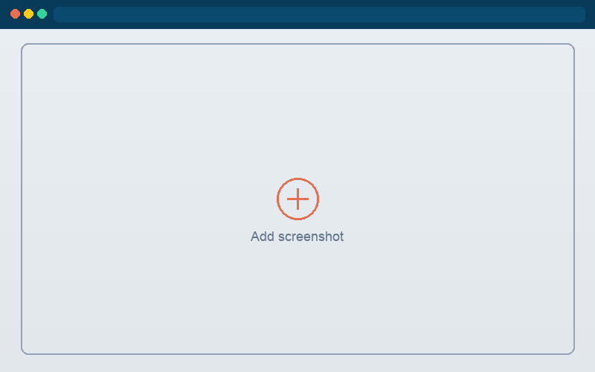
Tonight’s projects
24 · DROP SCREENSHOTS IN
Asma Mehraban
Asma Samadi
Basira Mehrzad
Bibi Hawa Abdul Shukoor
Bibi Mariam Abdul Shukoor
Bibi Zhara Abdul Shukoor
PostPlanner-AI
TravelGenie
MorningFocus
DataNest AI
CareerMatch - AI-Powered…
HR Pilot
Fareshta Foladi
Farzana Ebrahimi
Hamisha Noori
Hanifa Yousufi
Jamila Waziry
Lima Rahimzai
BrainNote AI
QuickHelp AI
DevTrack
MindfulDiary
AfghanBuddy (AI-Powered…
PitchPilot
Mahdia Hassani
Marwa Qadeer
Maryam Hamrah
Maryam Moostamandy
Rahimah ANsari
Roqia stanikzai
SafeNet
GiftMatch AI
Launchpad
TidySpace
CatchyReminders
AI Movie Analyzer
Samira Hakimi
Sana Waziry
Shabnam Ahmadi
Sima Gulestani
Zahra Ahmadi
Zarara Kazimi
MeetMind
SmartReceipt
Emoji Translator
HireFlow
Freela
AidLink

Slide 6
LIVE DEMOS
CUE THE FIRST PROJECT
Let’s begin.
Listen for the problem, the solution, and the craft — then vote.
▶

