Slide 1
Overview of Modern Processor
Architecture
Parallel Execution Capabilities
JinHui Lin
ShenZhen University
2025-06-02

Slide 2
What Affects CPU Performance?
Instruction Count to be executed
This depends on:
• Program objectives
• ISA(Instruction Set Architecture)
• Code quality
• Programming language used
• Compiler behavior
• etc.
JinHui Lin Overview of Modern Processor Architecture 2025-06-02 1 / 13

Slide 3
What Affects CPU Performance?
Instruction Count to be executed
This depends on:
• Program objectives
• ISA(Instruction Set Architecture)
• Code quality
• Programming language used
• Compiler behavior
• etc.
Not within the scope of today’s discussion
JinHui Lin Overview of Modern Processor Architecture 2025-06-02 1 / 13

Slide 4
What Affects CPU Performance?
Clock Frequency
This depends on:
• Front-end CPU design
• Back-end design
• Manufacturing process
• etc.
JinHui Lin Overview of Modern Processor Architecture 2025-06-02 2 / 13

Slide 5
What Affects CPU Performance?
Clock Frequency
This depends on:
• Front-end CPU design
• Back-end design
• Manufacturing process
• etc.
Not within the scope of today’s discussion
JinHui Lin Overview of Modern Processor Architecture 2025-06-02 2 / 13

Slide 6
What Affects CPU Performance?
IPC (Instructions Per Cycle)
The number of instructions that can be executed per cycle
This essentially equates to—“the CPU’s ability to parallelize serial
instructions”
JinHui Lin Overview of Modern Processor Architecture 2025-06-02 3 / 13

Slide 7
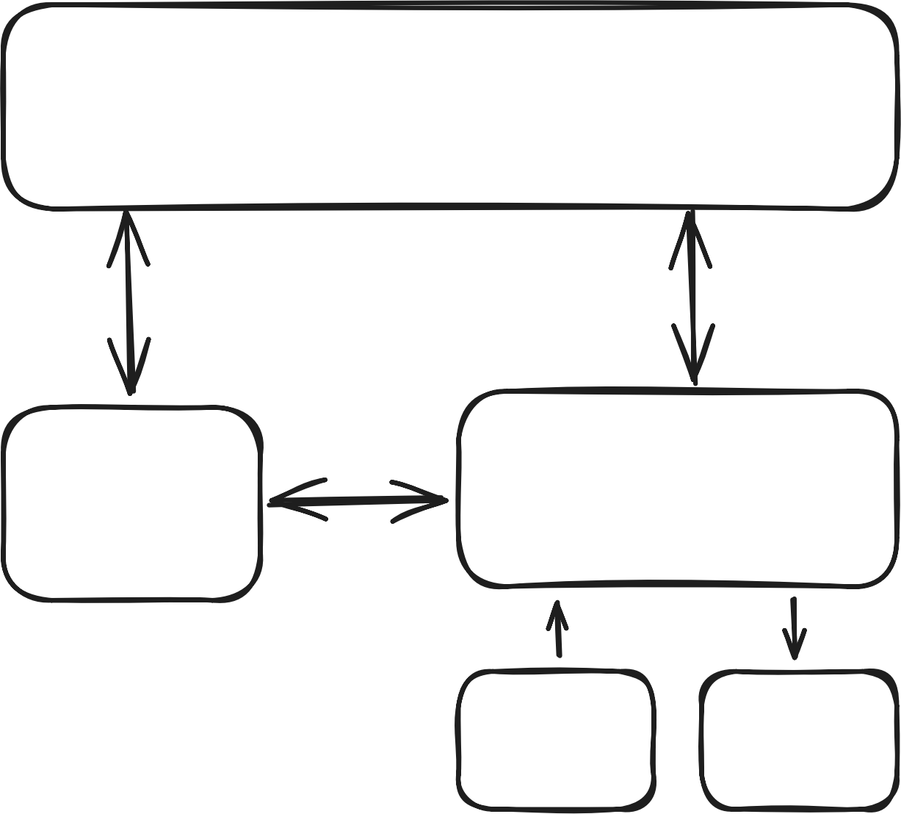
Basic Computer Architecture
Classical Von Neumann Computer
Architecture
Memory
Control Unit
Arithmetic logic Unit
Input Output
JinHui Lin Overview of Modern Processor Architecture 2025-06-02 4 / 13

Slide 8
Basic Computer Architecture
Classical Von Neumann Computer
Architecture
Even today, this architecture can
still be used to explain computer architecture.
Memory
Control Unit
Arithmetic logic Unit
Input Output
JinHui Lin Overview of Modern Processor Architecture 2025-06-02 4 / 13

Slide 9
Basic Computer Architecture
Classical Von Neumann Computer
Architecture
Even today, this architecture can
still be used to explain computer architecture.
Although there are minor
differences in some areas (such as internal registers, cache, MMIO, etc.)
Memory
Control Unit
Arithmetic logic Unit
Input Output
JinHui Lin Overview of Modern Processor Architecture 2025-06-02 4 / 13

Slide 10
Basic Computer Architecture
Classical Von Neumann Computer
Architecture
Even today, this architecture can
still be used to explain computer architecture.
Although there are minor
differences in some areas (such as internal registers, cache, MMIO, etc.)
Its operation process is essentially
a cycle of“fetch->execute”
Memory
Control Unit
Arithmetic logic Unit
Input Output
JinHui Lin Overview of Modern Processor Architecture 2025-06-02 4 / 13

Slide 11
Pipelining
Pipelining is a classic CPU parallelization acceleration technique. By
dividing CPU execution into multiple stages and executing these stages
simultaneously, it increases frequency without significantly reducing IPC, thereby improving performance.
Modern CPUs rarely do not use pipelining technology. Even the
microcontroller (MCU) in your washing machine likely has at least a two-stage pipeline (Arm CortexM0+).
JinHui Lin Overview of Modern Processor Architecture 2025-06-02 5 / 13

Slide 12
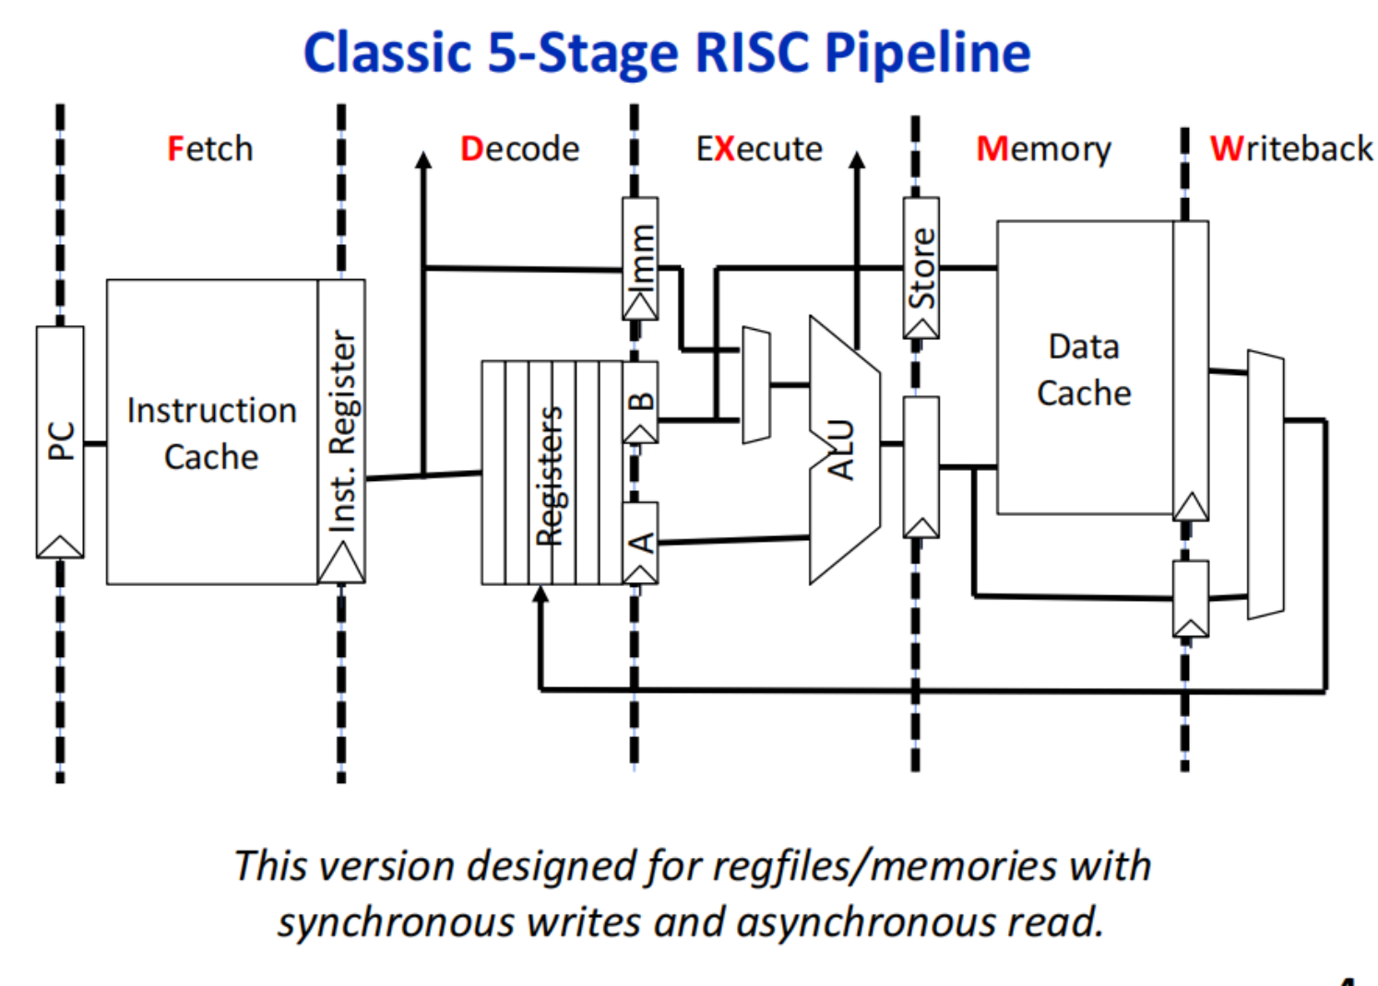
Pipelining
A classic pipeline stage division
JinHui Lin Overview of Modern Processor Architecture 2025-06-02 6 / 13

Slide 13
Pipelining
A classic pipeline stage division
However, pipelining cannot be executed arbitrarily.
Some special instruction and
instrcution sequence may have data dependencies, which can lead to
data hazards.
JinHui Lin Overview of Modern Processor Architecture 2025-06-02 6 / 13

Slide 14
Pipelining
A classic pipeline stage division
However, pipelining cannot be executed arbitrarily.
Some special instruction and
instrcution sequence may have data dependencies, which can lead to
data hazards.
The solution is through speculative
execution, guessing the jump
result, and flushing the pipeline if
incorrect.
JinHui Lin Overview of Modern Processor Architecture 2025-06-02 6 / 13

Slide 15
Branch Prediction
If speculative execution is correct, it can significantly improve
performance, so the accuracy of speculation becomes crucial.
JinHui Lin Overview of Modern Processor Architecture 2025-06-02 7 / 13

Slide 16
Branch Prediction
If speculative execution is correct, it can significantly improve
performance, so the accuracy of speculation becomes crucial.
Branch prediction algorithms:
• Static branch prediction
Determines branch prediction direction at compile time.
• Dynamic branch prediction
Records the historical jump results of branch instructions and uses these historical results to predict the next jump.
JinHui Lin Overview of Modern Processor Architecture 2025-06-02 7 / 13

Slide 17
Out-of-Order Execution
By reordering instructions, data hazards are avoided in advance.
JinHui Lin Overview of Modern Processor Architecture 2025-06-02 8 / 13

Slide 18
Out-of-Order Execution
By reordering instructions, data hazards are avoided in advance.
Basic idea of out-of-order execution:
• Add an instruction queue
• Reorder it to avoid hazards
• After execution, write back in the original order
JinHui Lin Overview of Modern Processor Architecture 2025-06-02 8 / 13

Slide 19
Superscalar
Superscalar refers to the CPU’s ability to execute multiple instructions in the same cycle.
JinHui Lin Overview of Modern Processor Architecture 2025-06-02 9 / 13

Slide 20
Superscalar
Superscalar refers to the CPU’s ability to execute multiple instructions in the same cycle.
Basic idea of superscalar:
• Fetch multiple instructions simultaneously and push them into the instruction queue
• Based on instruction dependencies, push non-dependent instructions into the backend for simultaneous execution
• After execution, write back in the original order
JinHui Lin Overview of Modern Processor Architecture 2025-06-02 9 / 13

Slide 21


Register Renaming
Register renaming is another way to avoid hazards.
The basic idea is shown in the figure:
mul A, $t1, $t2
add B, A, $t3
sw B, 0($sp)
add $t0, $s0, $t1
mul $t0, $t1, $t2
add $t0, $t0, $t3
sw $t0, 0($sp)
add $t0, $s0, $t1
JinHui Lin Overview of Modern Processor Architecture 2025-06-02 10 / 13

Slide 22
Register Renaming
Tomasulo algorithm:
• Maintain a renaming table for each logical register
• When an instruction needs to write to a register, allocate a new physical register
• Update the renaming table, mapping the logical register to the new physical register
• Subsequent instructions reading this logical register will use the latest physical register
• When an instruction completes, release the physical register that is no longer needed
JinHui Lin Overview of Modern Processor Architecture 2025-06-02 11 / 13

Slide 23
Summary
Key optimization technologies in modern processor architecture:
JinHui Lin Overview of Modern Processor Architecture 2025-06-02 12 / 13

Slide 24
Summary
Key optimization technologies in modern processor architecture:
• Pipelining: Divides instruction execution into multiple stages for parallel execution
• Branch prediction: Reduces pipeline stalls by predicting branch jump direction
• Out-of-order execution: Reorders instructions to avoid data hazards
• Superscalar: Executes multiple instructions in the same cycle
• Register renaming: Avoids register hazards through physical register mapping
JinHui Lin Overview of Modern Processor Architecture 2025-06-02 12 / 13

Slide 25
Thank You
If you have any questions, please feel free to discuss.
JinHui Lin Overview of Modern Processor Architecture 2025-06-02 13 / 13

