Slide 1

Weather Forcasting Simulation A C++ Project
D
A
The Weather Forecasting Simulation project utilizes C++ to simulate real-world weather forecasting scenarios. This project demonstrates proficiency in C++ programming, generating random weather data for various locations.
Presenting : Anushka Deshmukh

Slide 2


D
A
Objectives
Simulate weather forecasting for multiple locations
Generate random weather data (temperature, humidity, condition)
- Display weather data in a user-friendly format
Demonstrate C++ programming skills

Slide 3
D
A
Working Model
The program uses a struct to store weather data and functions to generate and display data.
Input
Process
Initialize random number generator Simulate weather forecasting
Output
Display weather data for each location
Loop
Loop through locations Generate random weather data Display weather data
End
End Program
None

Slide 4


D
A
Code Review
(Overview)
The code consists of 4 main functions: 1. generateWeatherData, 2. displayWeatherData, 3. simulateWeatherForecasting, 4. main."

Slide 5
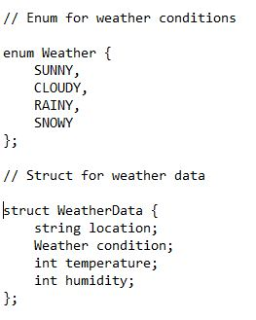

D
A
Code Review
(Enum and Struct)
The enum defines weather conditions.
The struct stores location, condition, temperature, and humidity

Slide 6
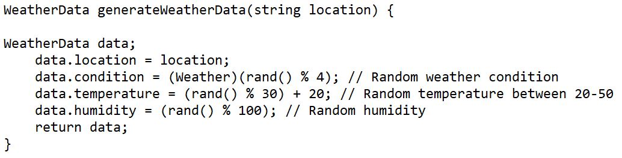

D
Code Review
(generateWeatherData)
A
This function generates random weather data for a given location.

Slide 7
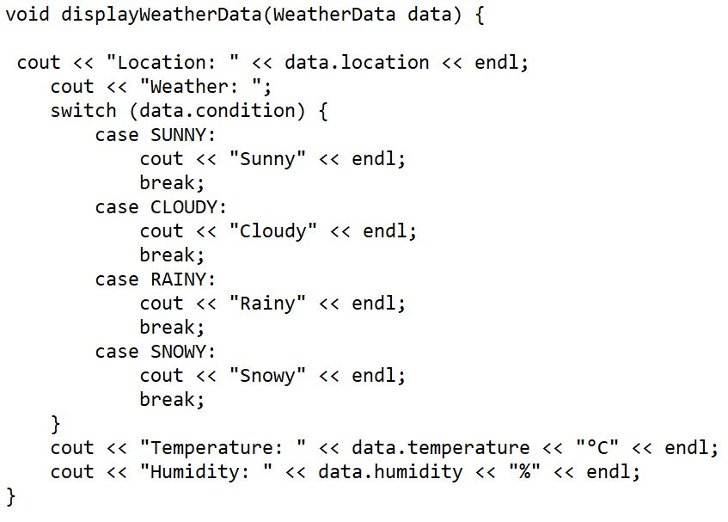
D
A
Code Review
(displayWeatherData)
This function displays weather data in a user-friendly format

Slide 8

D
A
Application
Weather forecasting systems
Climate modeling
Emergency response systems
Research and development

Slide 9


D
A
Conclusion
The Weather Forecasting Simulation project demonstrates C++ programming skills and simulates real-world weather forecasting

Slide 10

Thank You

