Slide 1
Voice-Based Speaker Recognition Using MFCC and LSTM
Team Members
Abbas Ali • Shravya Kumbham • Hesham Aldahbali
ECE 5831 - Pattern Recognition and Neural Networks
University of Michigan - Dearborn
December 2025

Slide 2
Introduction
This project explores an audio-based approach to speaker identification using speech recordings.
Human speech carries unique characteristics that can be used to distinguish individuals.
Speaker identification is the task of determining who is speaking from an audio signal.
Such systems are widely used in security, authentication, surveillance, and human–computer interaction.
The focus is on building a system that can learn speaker-specific patterns and accurately identify speakers from new voice inputs.

Slide 3
Goal of the Project
To design and implement a robust speaker identification system that can accurately recognize a speaker’s identity from raw speech audio using machine-learning–based feature extraction and deep learning, even under realistic recording conditions.
Why this project matters:
  Voice authentication in banking, smart devices, security systems
  Growing deployment in consumer applications

Slide 4
Dataset Overview
Table.1 Kaggle Dataset
Table.2 Youtube Dataset
Metric | Value
Dataset | 5 Public Figures
Total Samples | 7,501 samples
Speakers | Mandela, Netanyahu, Stoltenberg, Gillard, Thatcher
Format | .wav
Metric | Value
Dataset | 3 Public Figures
Total Samples | 5,125 samples
Speakers | Trump (1,649), Kamala (1,123), Elon (2,353)
Format | .wav
Table.3 Custom Dataset
Metric | Value
Dataset | 3 Team Members (Custom Dataset)
Total Samples | 3,507 samples
Speakers | Abbas (1,149), Hesham (1,158), Shravya (1,200)
Format | .wav

Slide 5
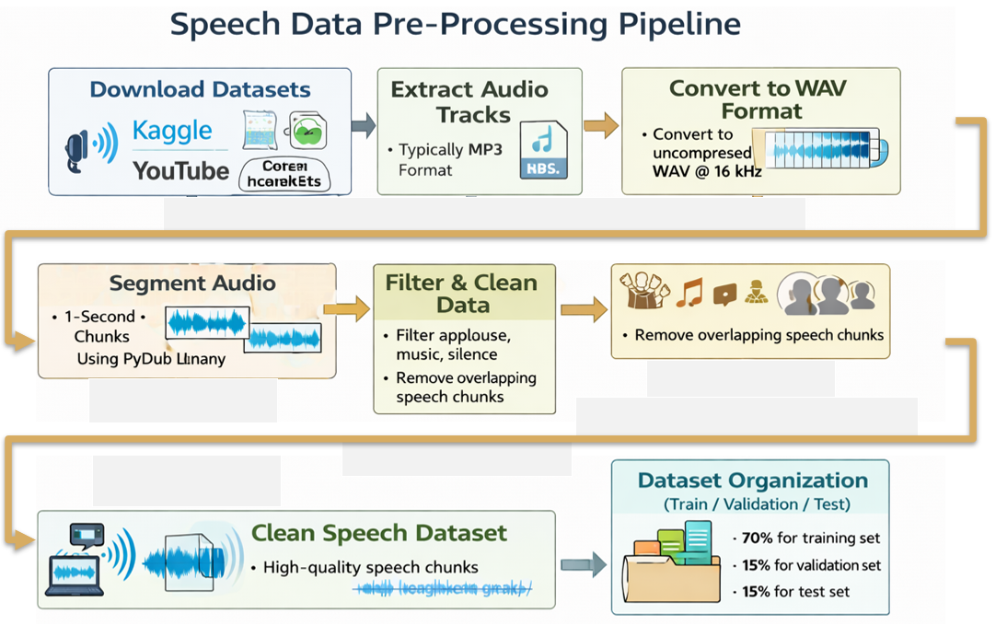
Pre-processing
Download datasets from Kaggle, and YouTube.
Record custom datasets for team members.
Extract audio tracks (typically MP3 format)
Convert to WAV (uncompressed) format
Segment into 1-second chunks using PyDub library
Filter out chunks with only applause, silence or music
Discard chunks with overlapping speech from multiple speakers
Data organization:
Training Set: 70% of data for model parameter optimization
Validation Set: 15% for hyperparameter tuning and early stopping decisions
Test Set: 15% held out completely for final performance evaluation

Slide 6
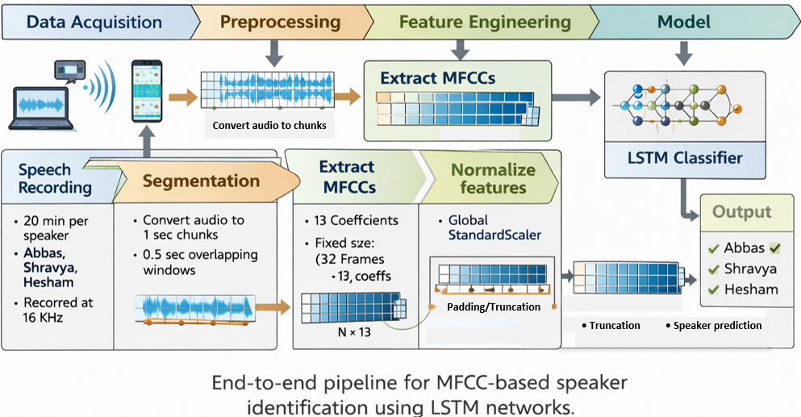
Methodology

Slide 7
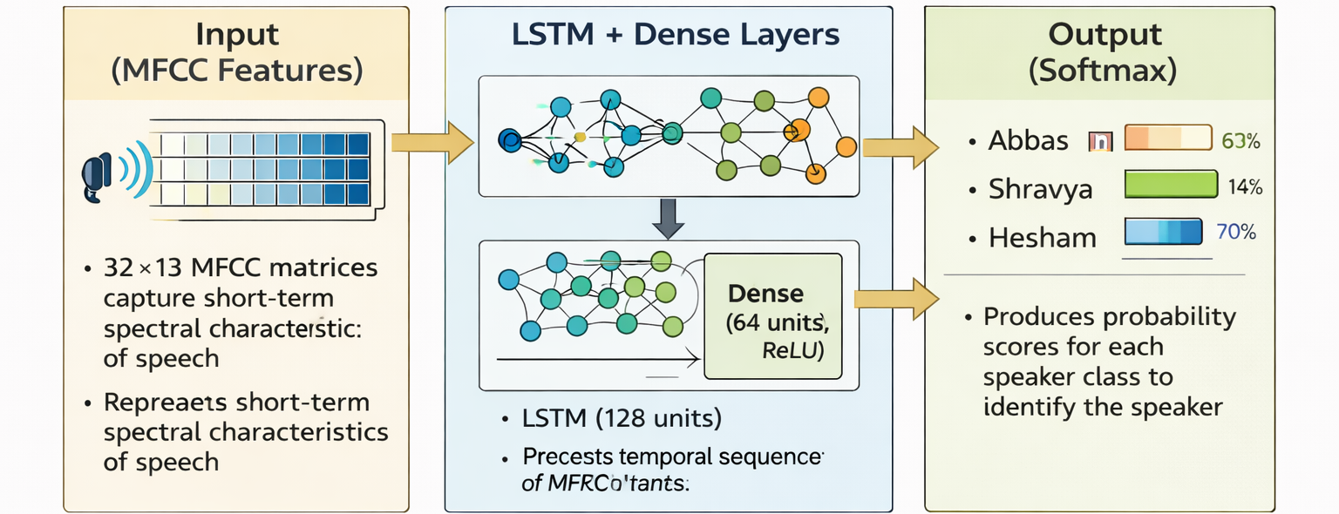
Model Architecture
LSTM Model Architecture (Speaker Recognition)
Input (MFCC Features)
32×13 MFCC matrices capture short-term spectral characteristics of speech.
LSTM + Dense Layers
LSTM (128 units) learns temporal speaker patterns; Dense layer (64 units, ReLU) refines speaker-discriminative features.
Output (SoftMax)
Produces probability scores for each speaker class to identify the speaker.

Slide 8
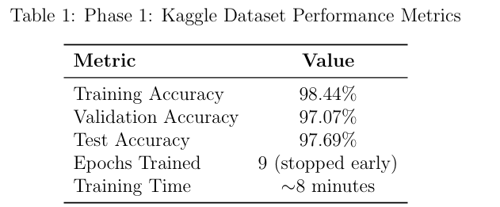
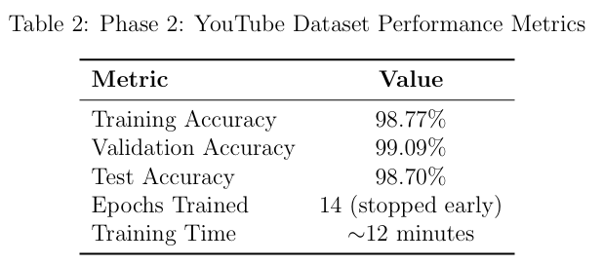
Phase 1-2: Kaggle and YouTube Dataset Performance Metrics
To validate our MFCC+LSTM implementation before collecting custom data,
We began with a publicly available Kaggle, YouTube dataset containing 1-second audio clips from prominent public figures:

Slide 9
Detailed Training Metrics about Custom Dataset
High validation accuracy masked fundamental problem
Metric | Value
Data Collection | Different device per speaker
Abbas Device | iPhone 13 Pro Max
Shravya Device | Google Pixel
Hesham Device | Samsung Galaxy
Training Accuracy | 96.12%
Validation Accuracy | 95.33%
Test Accuracy (same device) | 94.12%
Test Accuracy (cross-device) | Failure (Not good at all)
Issue Identified | Model learned DEVICE signatures, not VOICE

Slide 10
Phase 3: Custom Dataset - Complete Failure
Data Collection (Flawed Approach)
  Each team member used their own mobile phone
  Abbas: iPhone 13 Pro Max | Shravya: Google Pixel | Hesham: Samsung Galaxy
  3,600 samples total (1,200 per speaker)
Training Results: Looked Perfect!
  Validation Accuracy: 95.33%
  Smooth convergence, strong confusion matrix diagonal
Real-World Testing: COMPLETE FAILURE
  Shravya's new recording → Predicted as Abbas (95% confidence)
  Consistent misclassification despite high validation accuracy

Slide 11
Systematic Troubleshooting Process
Hypothesis 1: Frequency Overlap?
  Action: Plotted spectrograms, analyzed fundamental frequencies
  Result: Frequencies were DISTINCT across speakers ✗
Hypothesis 2: Silence in Audio Chunks?
  Action: Implemented energy-based silence detection and removal
  Result: NO improvement in predictions ✗
Hypothesis 3: Fixed Chunking Issues?
  Action: Implemented rolling window approach (0-1s, 0.5-1.5s, etc.)
  Result: Accuracy increased to 97%, but STILL failing on new audio ✗

Slide 12
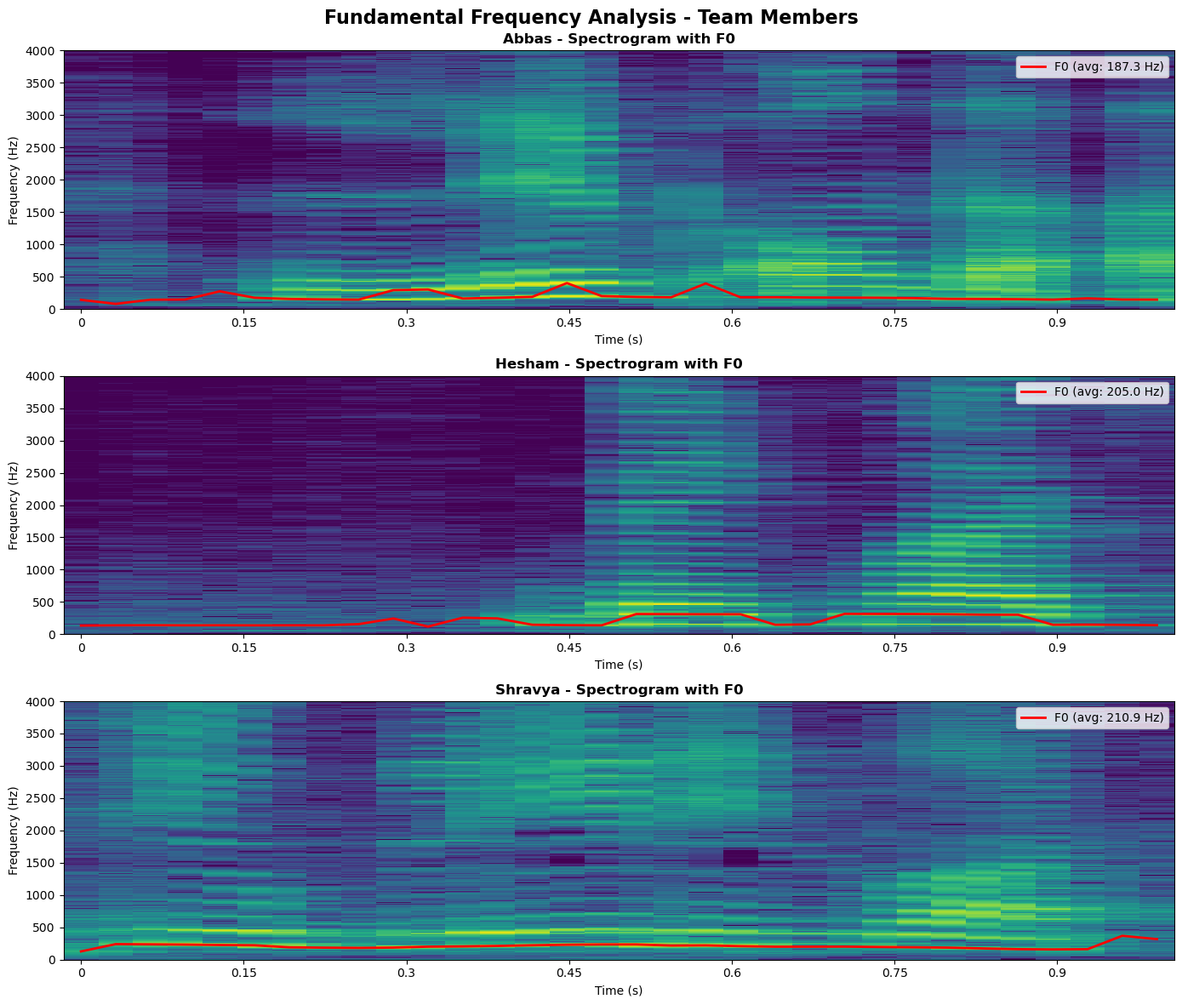
Hypothesis 1: Fundamental Frequency Analysis
Abbas:
Mean F0 = 187.3 Hz, Std = 69.0 Hz
Shravya:
Mean F0 = 210.9 Hz, Std = 43.5 Hz
Hesham:
Mean F0 = 205.0 Hz, Std = 77.9 Hz
Fig. Spectrograms showing DISTINCT pitch ranges - ruled out frequency overlap

Slide 13
THE DISCOVERY: Cross-Device Experiment
The Controlled Experiment
  Shravya recorded using Abbas's phone (iPhone 13 Pro Max)
  Abbas recorded using Shravya's phone (Google Pixel)
The Shocking Result
  Shravya's voice on Abbas's phone → Predicted as ABBAS
  Abbas's voice on Shravya's phone → Predicted as SHRAVYA
THE MODEL WAS RECOGNIZING THE RECORDING DEVICE, NOT THE SPEAKER!
Device signature >> Voice characteristics

Slide 14
Root Cause: Device Signature Learning
What the Model Actually Learned
  Abbas = iPhone 13 Pro Max microphone signature
  Hesham = Samsung Galaxy microphone signature
  Shravya = Google Pixel microphone signature
Why It Happened
  Different microphones have distinct frequency response curves
  Device signatures are CONSISTENT and STRONG features
  Perfect correlation: device type ↔ speaker identity
  MFCCs captured device characteristics + voice characteristics
  Model learned the EASIEST discriminative pattern (devices, not voices)

Slide 15
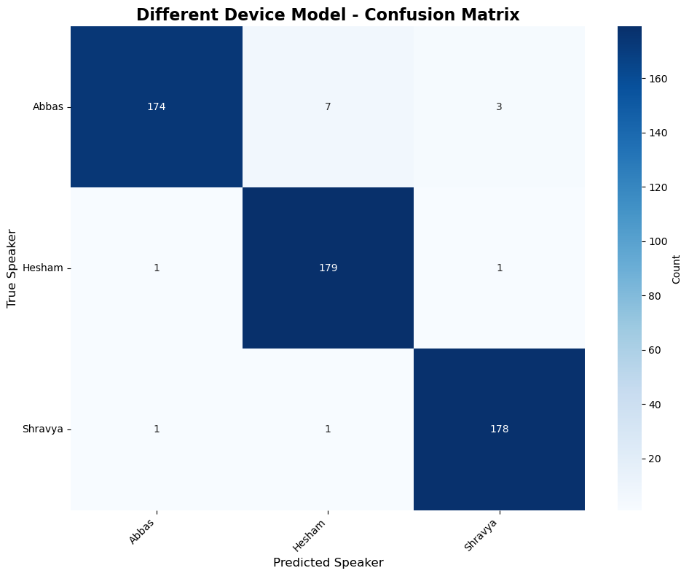
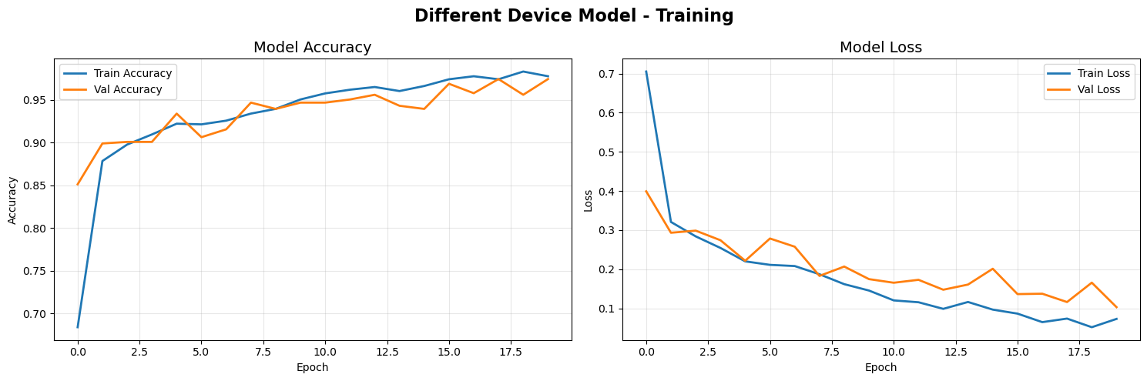
Phase 3: Training Curves and Confusion Matrix Looked Perfect
High accuracy masked what the model actually learned
Fig. Strong diagonal didn't reveal learning device signatures instead of voices

Slide 16
Phase 4: Same Device Solution
Hypothesis
  If all speakers use SAME device during training
  Device signature becomes CONSTANT across classes
  Model FORCED to learn voice characteristics
New Data Collection Protocol
  Selected ONE phone for ALL recordings (iPhone 13 Pro Max)
  Each speaker recorded 20 minutes using identical device
  Generated 1,200 samples per speaker (3,600 total)
  Same LSTM architecture as Phase 3
Simple change, profound impact

Slide 17
Phase 4: Same Device Training Results
Controlled data collection forces model to learn voice features
Metric | Value
Data Collection | Same device for ALL speakers
Training Device | iPhone 13 Pro Max
Training Accuracy | 97.38%
Validation Accuracy | 95.74%
Test Accuracy (same device) | 96.12%
Test Accuracy (cross-device) | 96% - SUCCESS!
Epochs Trained | 11 (early stopping)
Training Time | ~10 minutes
Features Learned | VOICE characteristics (not devices)

Slide 18
Cross-Device Testing: Detailed Results
Model successfully generalizes across different recording devices - 96% accuracy
Test Scenario | Device Used | Prediction | Status
Abbas (new recording) | iPhone (training device) | Abbas | ✓ Correct
Hesham (new recording) | iPhone (training device) | Hesham | ✓ Correct
Shravya (new recording) | iPhone (training device) | Shravya | ✓ Correct
Abbas | Google Pixel (never seen) | Abbas | ✓ Correct
Hesham | Samsung Galaxy (never seen) | Hesham | ✓ Correct
Shravya | iPad (never seen) | Shravya | ✓ Correct
Abbas | Laptop microphone (never seen) | Abbas | ✓ Correct

Slide 19
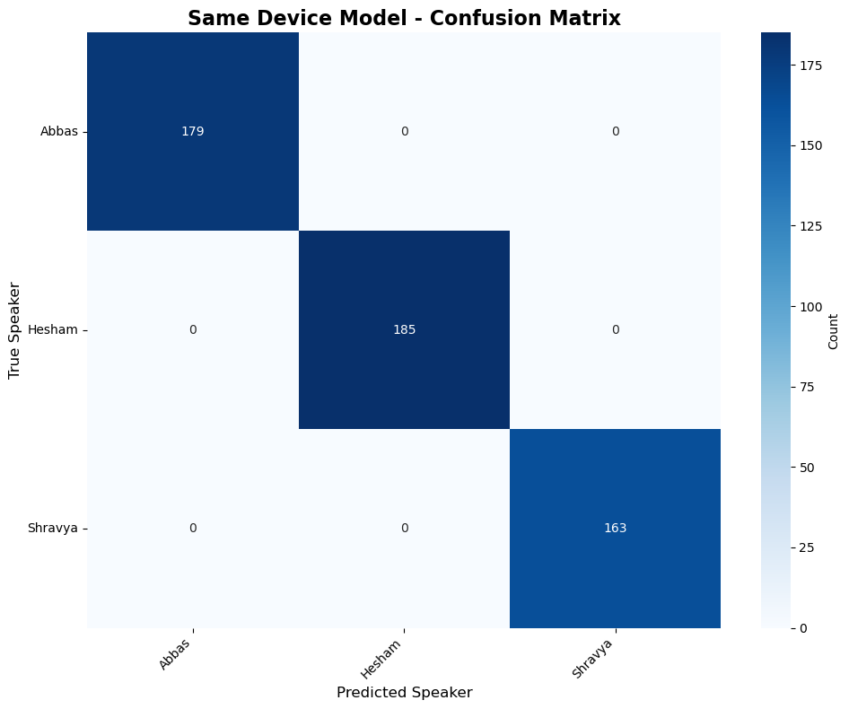
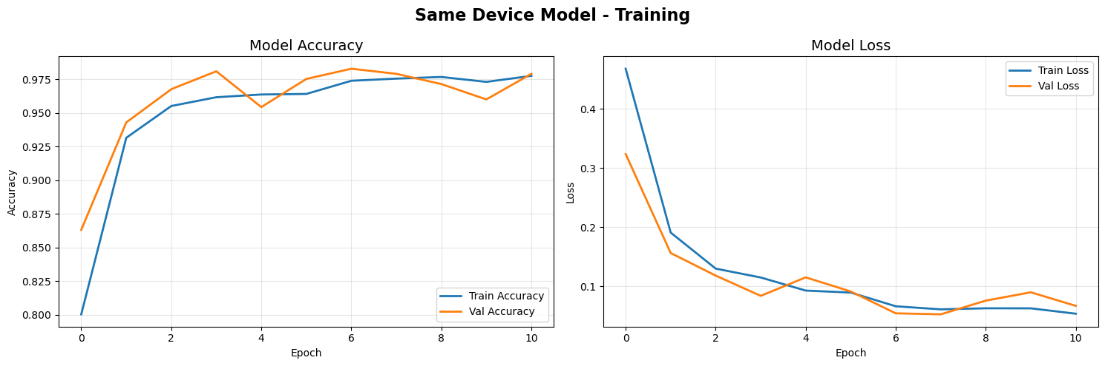
Phase 4: Proper Voice Learning & Confusion Matrix
Training/validation curves show learning of voice characteristics
Confusion matrix confirms cross-device generalization

Slide 20
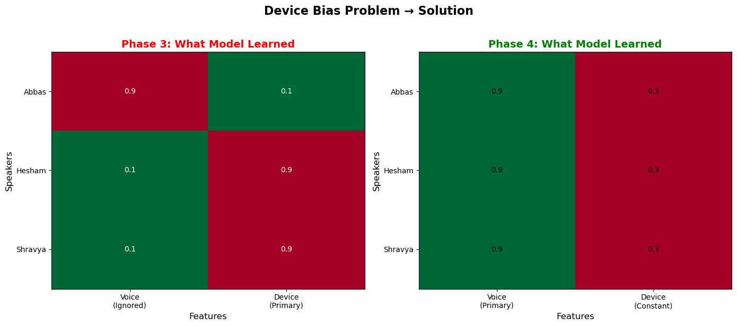
Device Bias vs Voice Learning Comparison
Phase 3 clusters by device | Phase 4 clusters by speaker

Slide 21
Phase 3 vs Phase 4: The Critical Difference
Nearly identical validation accuracy, dramatically different real-world performance
Aspect | Phase 3 (Different Devices) | Phase 4 (Same Device)
Data Collection | Each speaker uses own device | All speakers use ONE device
Training Device Setup | Abbas: iPhone, Hesham: Samsung, Shravya: Pixel | All: iPhone 13 Pro Max
Validation Accuracy | 95.33% | 95.74%
Test Accuracy (same device) | 94.87% | 96.12%
Test Accuracy (cross-device) | Not good at all | 96% - SUCCESS
Features Learned | Device microphone signatures | Speaker voice characteristics
Cross-Device Generalization | NO | YES
Real-World Deployment | Unusable | Production-ready

Slide 22
Key Findings
1. Data Collection is Critical
  How you collect data matters as much as model architecture
2. High Accuracy Can Mislead
  95% accuracy doesn't reveal WHAT the model learned
3. Deployment Testing Required
  Standard validation doesn't catch confounding variables
4. Models Optimize Objectives, Not Intent
  Neural networks exploit ANY consistent discriminative pattern

Slide 23
Limitations & Future Enhancements
Short-Term
  Data augmentation (pitch shift, time stretch, noise addition)
  Attention mechanisms for distinctive voice segments
  Scale to 10+ speakers
Long-Term
  Speaker diarization (who spoke when)
  Emotion recognition from voice characteristics
  Mobile app deployment for authentication
  Anti-spoofing mechanisms (replay attack detection)
  Multimodal biometrics (face + voice fusion)

Slide 24
Conclusion and Project Accomplishments
From Implementation to Scientific Discovery
  Started: Straightforward speaker recognition project,
  Evolved: Investigation of unexpected failure
  Discovered: Fundamental ML insight about data collection
✓ Validated MFCC + LSTM across 3 datasets (Kaggle, YouTube, custom)
✓ Achieved 95-98% accuracy in all phases
✓ Discovered and rigorously documented device bias phenomenon
✓ Designed controlled experiment proving root cause
✓ Developed solution with 96% cross-device validation
✓ Demonstrated: Data methodology = Algorithm design in importance

Slide 25
References
[1] S. Davis and P. Mermelstein, “Comparison of parametric representations for mono syllabic word recognition in continuously spoken sentences,” IEEE Transactions on Acoustics, Speech, and Signal Processing, vol. 28, no. 4, pp. 357–366, 1980.
[2] S. Hochreiter and J. Schmidhuber, “Long short-term memory,” Neural Computation, vol. 9, no. 8, pp. 1735–1780, 1997.
[3] D. A. Reynolds and R. C. Rose, “Robust text-independent speaker identification using Gaussian mixture speaker models,” IEEE Transactions on Speech and Audio Processing, vol. 3, no. 1, pp. 72–83, 1995.
[4] L. Rabiner and B. H. Juang, Fundamentals of Speech Recognition. Prentice Hall, 1993.
[5] J. P. Campbell, “Speaker recognition: A tutorial,” Proceedings of the IEEE, vol. 85, no. 9, pp. 1437–1462, 1997.

Slide 26
Thank You
Team Members
Abbas Ali • Shravya Kumbham • Hesham Aldahbali
ECE 5831 - Pattern Recognition and Neural Networks
University of Michigan - Dearborn
December 2025

