Slide 1
HOTEL BOOKING CANCELLATION ANALYSIS
Python & Pandas Data Analysis Project
KEY POINTS • Analyzing reservation cancellations, pricing patterns, hotel type, booking sources, and revenue impact.

Slide 2
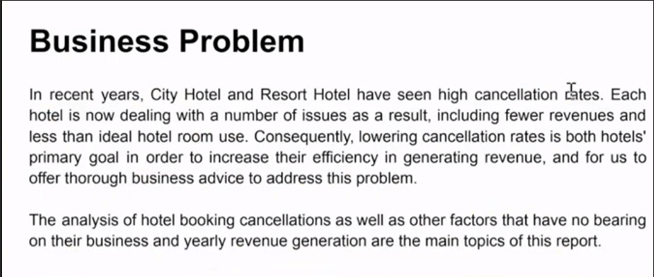
Business Problem
• City Hotel and Resort Hotel have seen high cancellation rates.
• Each hotel is now dealing with fewer revenues and less than ideal hotel room use.
• Lowering cancellation rates is both hotels' primary goal in order to increase their efficiency in generating revenue, and for us to offer thorough business advice to address this problem.
• The analysis of hotel booking cancellations as well as other factors that have no bearing on their business and yearly revenue generation are the main topics of this report.
KEY POINTS • Primary goal: lower cancellation rates, improve room utilization, and increase revenue efficiency.

Slide 3
Assumptions
• No unusual occurrences between 2015 and 2017 will have a substantial impact on the data used.
• The information is still current and can be used to analyze a hotel's possible plans in an efficient manner.
• There are no unanticipated negatives to the hotel employing any advised technique.
• The hotels are not currently using any of the suggested solutions.
• The biggest factor affecting the effectiveness of earning income is booking cancellations.
• Cancellations result in vacant rooms for the booked length of time.
• Clients make hotel reservations the same year they make cancellations.

Slide 4
Research Questions & Hypothesis
Research Questions
• What are the variables that affect hotel reservation cancellations?
• How can we make hotel reservation cancellations better?
• How will hotels be assisted in making pricing and promotional decisions?
Hypothesis
• More cancellations occur when prices are higher.
• When there is a longer waiting list, customers tend to cancel more frequently.
• The majority of clients are coming from offline travel agents to make their reservations.

Slide 5
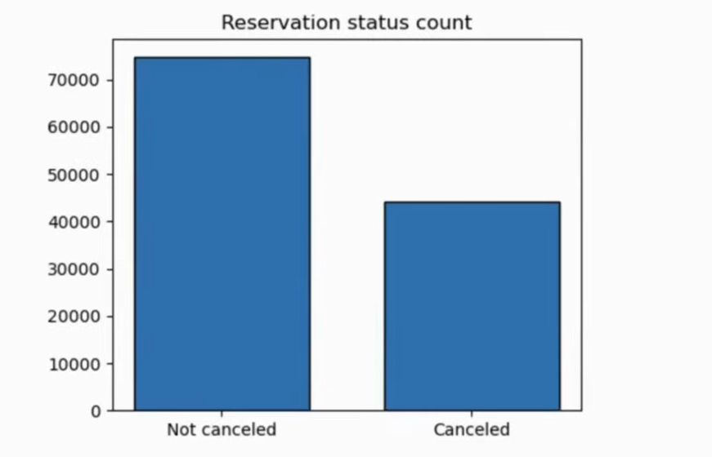
Analysis & Finding: Reservation Status
• The accompanying bar graph shows the percentage of reservations that are canceled and those that are not.
• It is obvious that there are still a significant number of reservations that have not been canceled.
• There are still 37% of clients who canceled their reservation, which has a significant impact on the hotels' earnings.
KEY POINTS • 37% of clients canceled their reservations, creating a significant earnings impact.

Slide 6
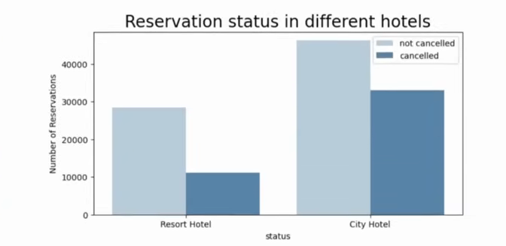
Reservation Status in Different Hotels
• In comparison to resort hotels, city hotels have more bookings.
• It's possible that resort hotels are more expensive than those in cities.
KEY POINTS • City hotels have more bookings than resort hotels; resort hotels may be relatively more expensive.

Slide 7
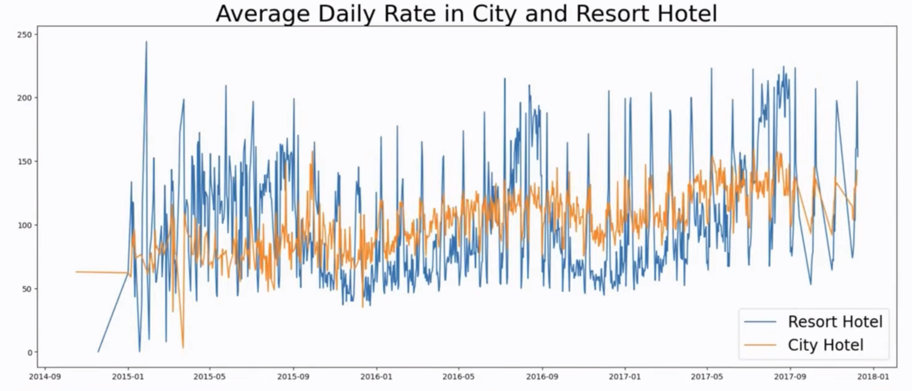
Average Daily Rate: City vs Resort Hotel
• The line graph above shows that, on certain days, the average daily rate for a city hotel is less than that of a resort hotel, and on other days, it is even less.
• It goes without saying that weekends and holidays may see a rise in resort hotel rates.
KEY POINTS • Weekend and holiday demand may increase resort hotel rates.

Slide 8
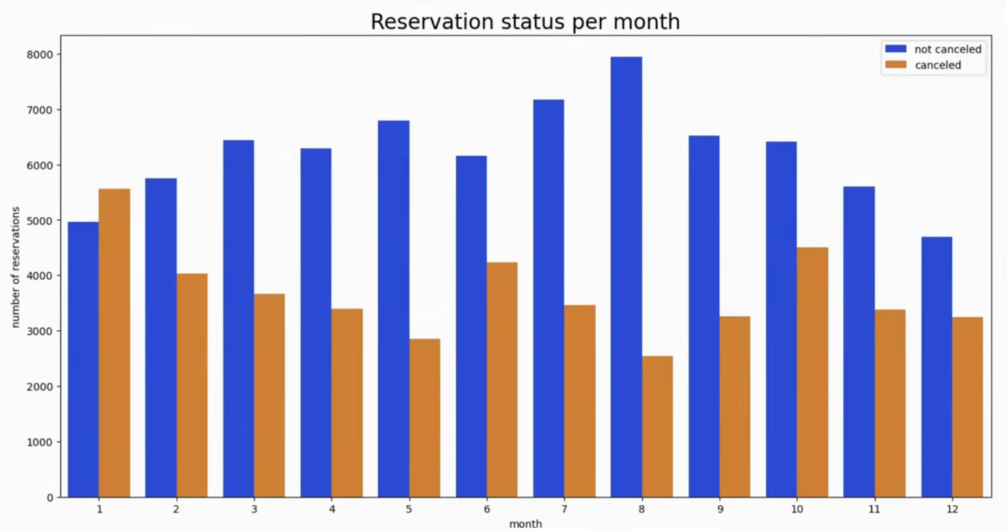
Reservation Status per Month
• We have developed the grouped bar graph to analyze the months with the highest and lowest reservation levels according to reservation status.
• As can be seen, both the number of confirmed reservations and the number of canceled reservations are largest in the month of August, whereas January is the month with the most canceled reservations.
KEY POINTS • August has the largest confirmed and canceled reservation counts; January has the most canceled reservations.

Slide 9
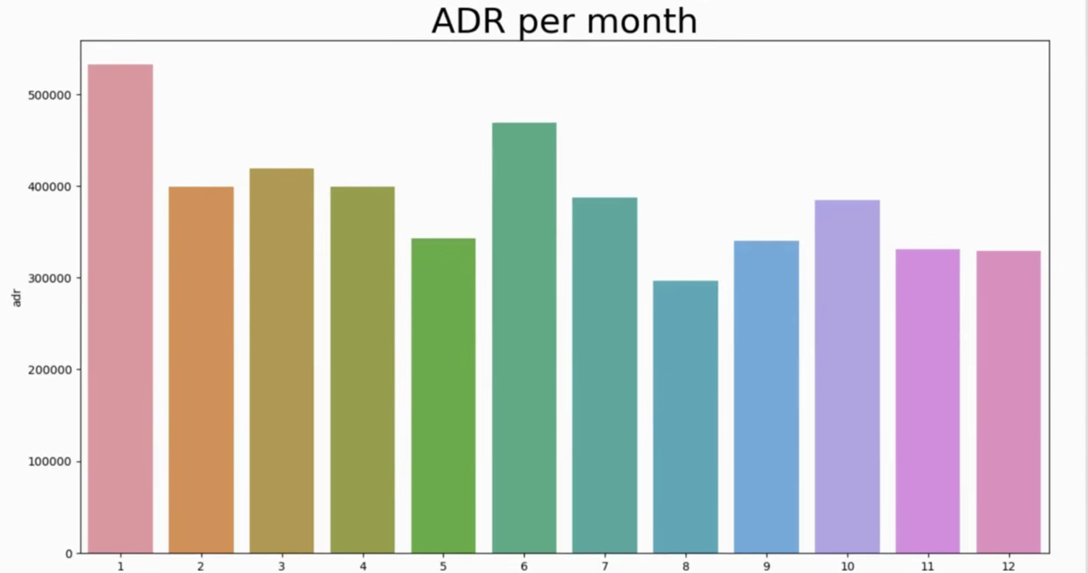
ADR for Each Month
• This bar graph demonstrates that cancellations are most common when prices are greatest and are least common when they are lowest.
• Therefore, the cost of the accommodation is solely responsible for the cancellation.
KEY POINTS • The analysis links higher accommodation prices with higher cancellation frequency.

Slide 10
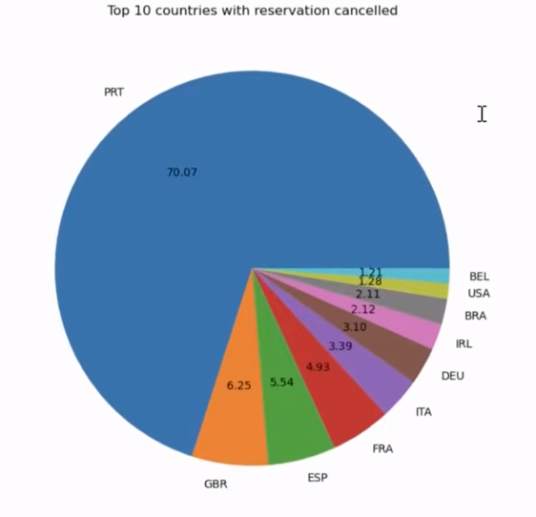
Top Countries with Reservation Cancellations
• Now, let's see which country has the highest reservation canceled.
• The top country is Portugal with the highest number of cancellations.
KEY POINTS • Portugal is identified as the top country with the highest number of cancellations.

Slide 11
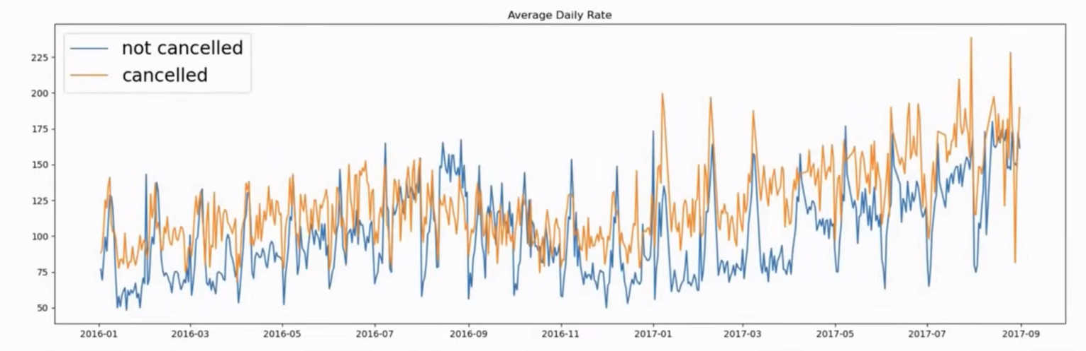
Average Daily Rate: Cancelled vs Not Cancelled
• As seen in the graph, reservations are canceled when the average daily rate is higher than when it is not canceled.
• It clearly proves all the above analysis, that the higher price leads to higher cancellation.
KEY POINTS • Key conclusion: higher prices are strongly associated with higher cancellation.

Slide 12
Where Guests Make Reservations
• Let's check the area from where guests are visiting the hotels and making reservations.
• Is it coming from Direct or Groups, Online or Offline Travel Agents?
• Around 46% of the clients come from online travel agencies, whereas 27% come from groups.
• Only 4% of clients book hotels directly by visiting them and making reservations.
46%
Online Travel Agencies
27%
Groups
4%
Direct bookings
KEY POINTS • 46% come from online travel agencies, 27% from groups, and only 4% book directly.

Slide 13
Suggestions
• Cancellation rates rise as the price does. In order to prevent cancellations of reservations, hotels could work on their pricing strategies and try to lower the rates for specific hotels based on locations. They can also provide some discounts to the consumers.
• As the ratio of the cancellation and not cancellation of the resort hotel is higher in the resort hotel than the city hotels. So the hotels should provide a reasonable discount on the room prices on weekends or on holidays.
• In the month of January, hotels can start campaigns or marketing with a reasonable amount to increase their revenue as the cancellation is the highest in this month.
• They can also increase the quality of their hotels and their services mainly in Portugal to reduce the cancellation rate.

