Slide 1
DS 203 PROJECT
ASSIGNMENT 7
GROUP 56
SUBRAM DAS - 210100153
CHETAN JADHAV - 210100050
ARYAN JANI - 19d100002

Slide 2
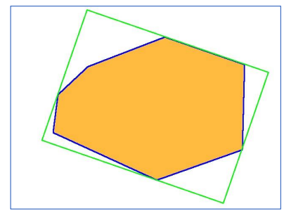
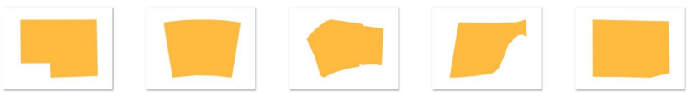
PROBLEM DESCRIPTION
1183 images for plan view of buildings are given of size 640x480 pixels
Grouping of images into families needs to be done based on their different shapes and features using different ML models
Classify the images into Low, Medium, and High Complexity layouts using some criteria to decide the classification
Assuming the length, width is known of the tight fitting box, the layout area and permissible layout complexity, make a recommendation system to provide the closest design image families of the inputs given
FIG: Tight Fitting Box
FIG: some images of the plan view

Slide 3
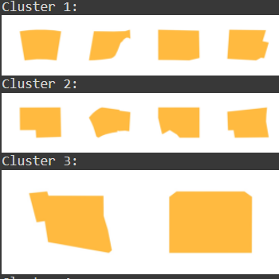
Summary of our solution
Extracted different features from the images using CV2 contour and canny functions
Used Elbow method for finding the number of clusters for the K Nearest Neighbours Model
For Classification of Low, Medium and High Complexity layouts, the features extracted from images were used and Kmeans for n =3 model was implemented
For the recommendation system for images, the features extracted from images, length, and width extracted from tight fitting box and cluster labels were taken as final features and Nearest Neighbours and Neural Networks were used
FIG: images for different clusters

Slide 4
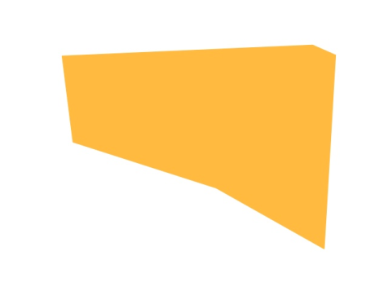
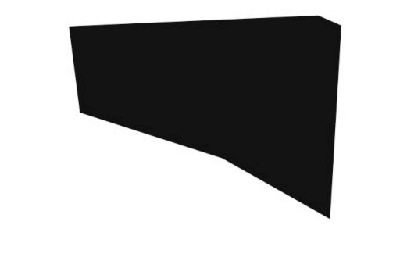
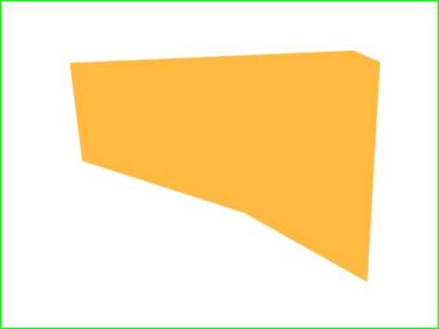
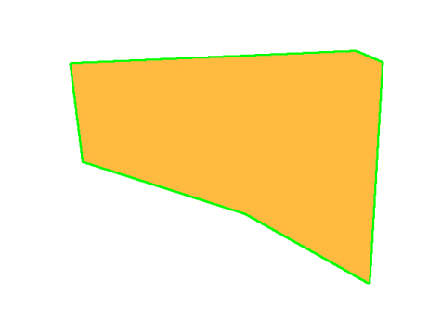
Feature extraction
After unzipping the images in Google Colab, the contour features namely edges, area and perimeter were extracted from each of the images.
Firstly, by converting the given image to a grayscale image.
Since the image is yellow, the grayscale is seen to be almost black as grayscale images represent intensity values where pure yellow has low intensity in the red and green channels, and almost no intensity in the blue channel
Used two methods for detecting edges, Binary thresholding and Canny method
Since the image was not able to grayscale, thresholding didn’t give a proper edge detection
Canny Method gave a perfect edge detection as it operates by first computing the image gradient to identify regions of rapid intensity change, which typically correspond to edges.
FIG: Original image
FIG: grayscaled image
FIG: edge detection using binary thresholding
FIG: edge detection using canny method

Slide 5
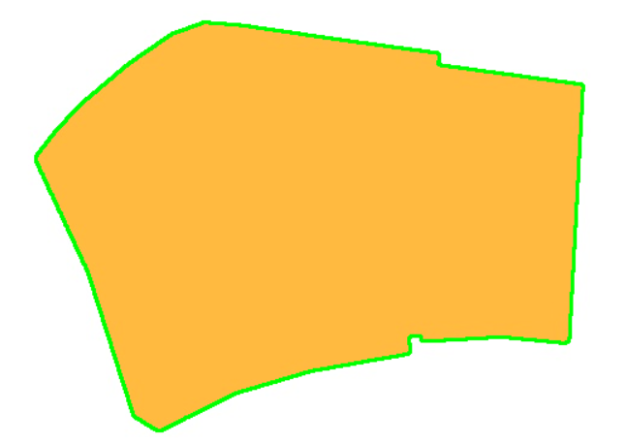
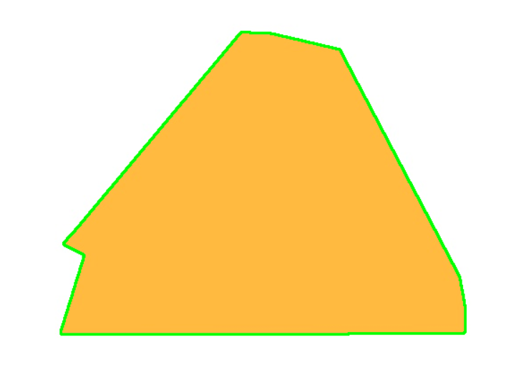
Feature extraction
After the contouring and edge detection is completed, Area, Perimeter and the Number of Edges are taken as the features for the respective images
As an architect, these parameters would be the best ones for a building layout design
FIG: Area, perimeter, and edges extracted after the canny method edge detection

Slide 6

Image duplicates
One of the prepossessing steps was to remove the duplicates in the images’ zip file
After removing the duplicates only 173 unique images were left
This was done by using the area, perimeter, and number of edges taken during the feature extraction process
This was needed because when done using all 1183 pictures, the clustering was done with one image coming several times which was not required
Moreover, as an architect one layout image is enough to tackle the customer layout demands and requests
FIG: during clustering same images pop up leading to bias

Slide 7
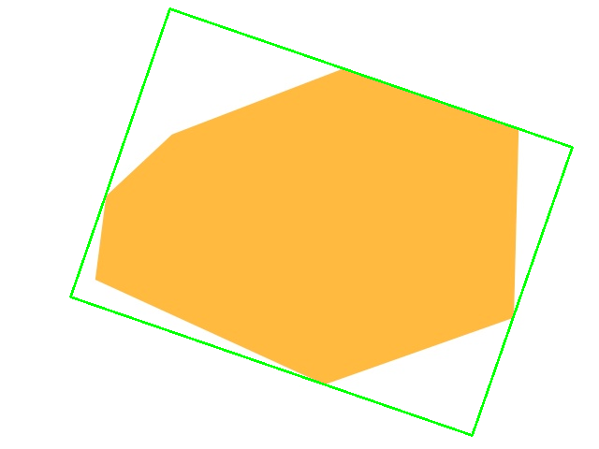
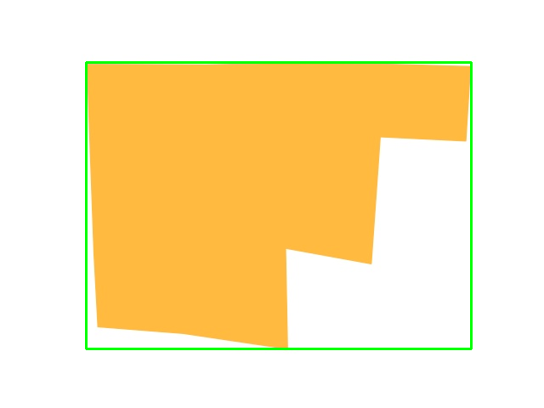
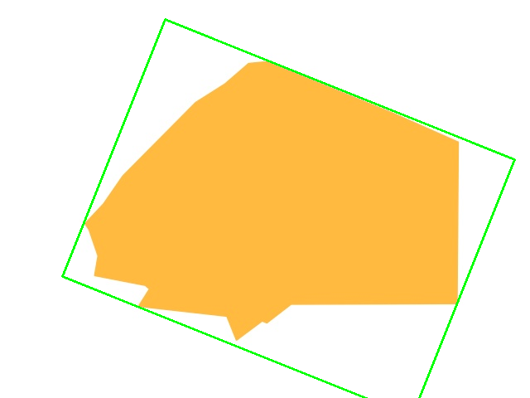
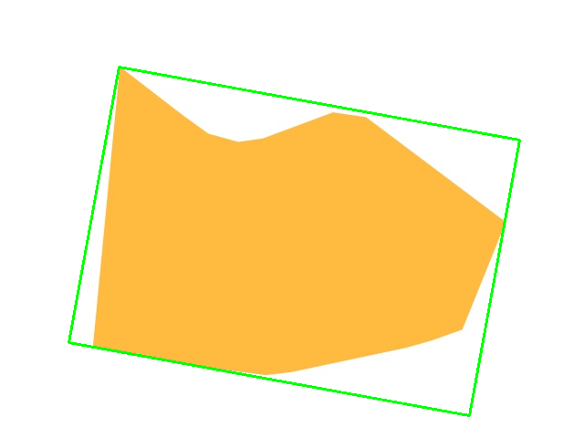
Tight fitting box
For getting the length and width of the tight fitting box, after edge detection and contouring minAreaRect function helps in getting the box
This is needed as an architect to get the best possible layout for the customer design requirements
Moreover, this can also be used as a feature for clustering and other predictive analysis
FIG: Tight-fitting box over some of the images

Slide 8
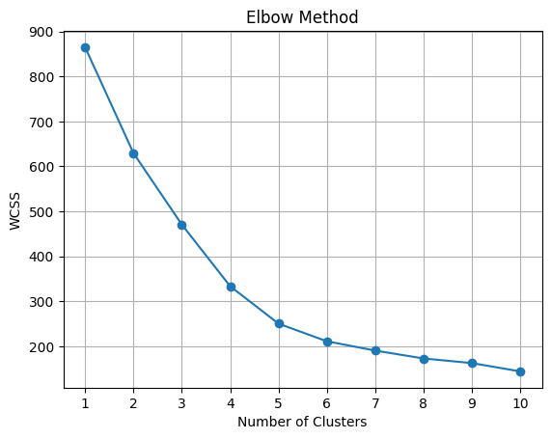
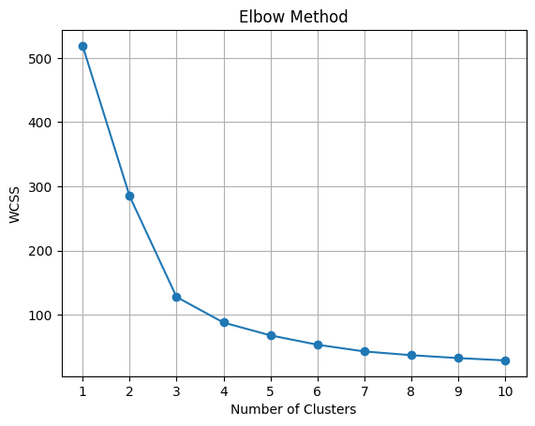
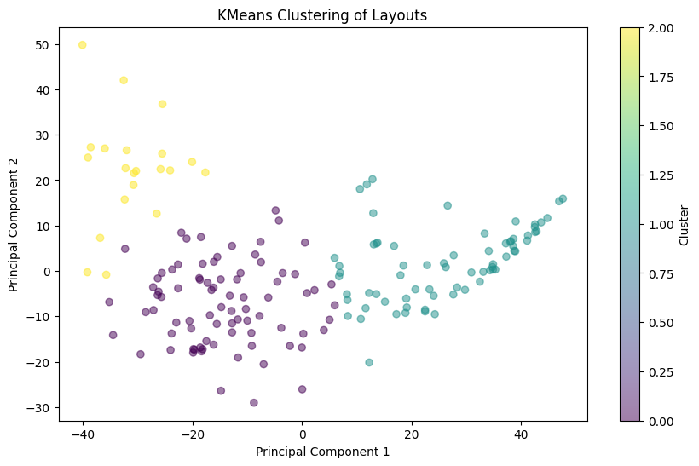
Finding cluster families
For finding the number of clusters for the unique layouts, elbow method is used
Features used is firstly only Area, Perimeter and Number of Edges
Secondly Length, Width of Tight Fitting Box along with Area, Perimeter and Number of Edges
For First Case, the number of clusters can be seen to be around 3 or 4.
For Second Case, the number of clusters is around 6
FIG: (first case) Elbow method for Area, perimeter and edge number
FIG: (second case) Elbow method for length, width along with Area, perimeter and edge number
FIG: pca analysis for the vgg16 features for 3 clusters

Slide 9














Using kmeans for n = 4, 5, 6
Cluster 1
Cluster 1
Cluster 1
Cluster 2
Cluster 2
Cluster 2
Cluster 3
Cluster 3
Cluster 3
Cluster 4
Cluster 4
Cluster 4
Cluster 5
Cluster 6
FIG: some of the images
case for kmeans with n=4 clusters
Cluster 5
FIG: some of the images
case for kmeans with n=5 clusters
FIG: some of the images
case for kmeans with n=6 clusters

Slide 10
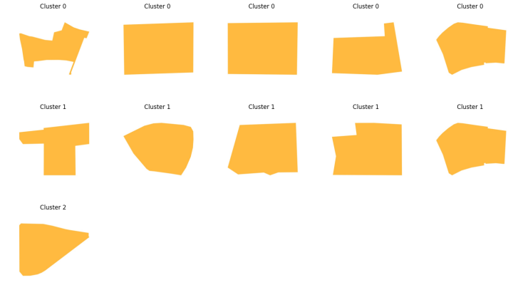






complexity analysis
For Low, Medium and High Complexity Analysis of the images, Three Different Models were taken Kmeans, Hierarchical and CNN pretrained VGG16 model
Kmeans and Hierarchical models produced the same type of clustered images when features of Area, Perimeter and Number of Edges were provided
VGG16 went on to extract 4096 features from each of the images and produced clusters which were somewhat different from the other two
FIG: hierarchical clustering
FIG: kmeans clustering
FIG: vgg16 clustering

Slide 11
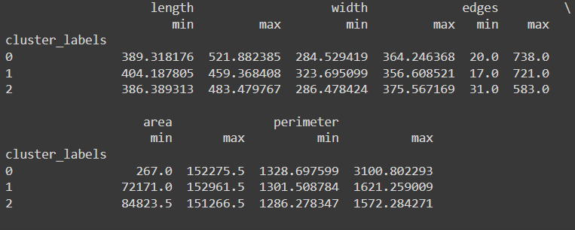


complexity analysis
For the criteria part, Number of edges are a good part to start with as high number of edges would have a higher complexity in building layouts rather than lower edges
Other criterias would be the area and perimeter. Area gives a better representation of the land needed for the layout physically
Other criterias might be the number of sharp corners and the valleys in the image
FIG: minimum and maximum values of the features for each clusters
FIG: some images denoting the different edges and corners complexities
High complexity
medium complexity

Slide 12
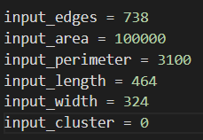
Layout recommendation system
For the Layout Recommendation System, two models were tried out
Unsupervised Nearest Neighbour
Neural Network with 6 input features namely Area, Perimeter, Number of Edges, Length and Width of the Bounding Box and two hidden layers
For both the models, 5 image predictions are done after training it over the entire 173 images and its extracted features
FIG: input features for the recommendation sytem
FIG: images recommended for the inputs by Nearest neighbour

Slide 13
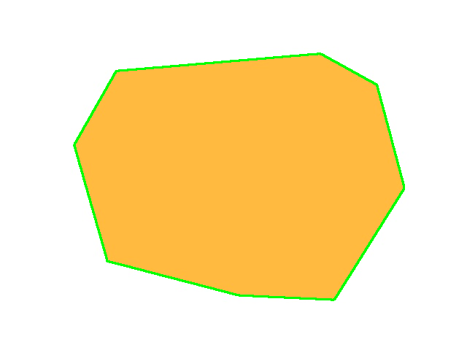
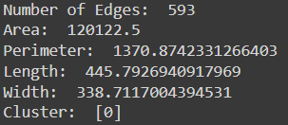
Layout recommendation system
Checking if the recommendation falls in the similar cluster and have the features close to the actual features of the image
The original features are almost in a close range of the given input features apart from the perimeter which might have caused because of the scaling and more importance given to the other 5 parameters
However, since we have just used the area, perimeter, edges, length and width of the image as features some recommendation may not be close and be far off. In such case, a CNN model with higher features are more better but qualitatively expressing the meaning of every feature would be very difficult in such a case
FIG: image /content/images/0131.jpg
FIG: input features to the model
FIG: original features and the cluster of the model

Slide 14
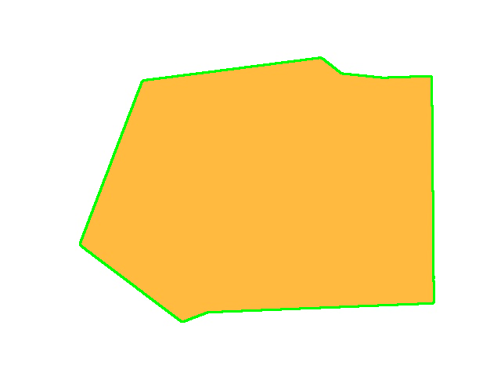
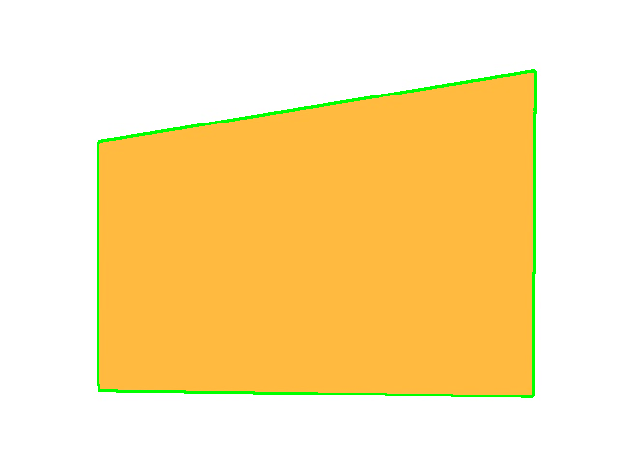
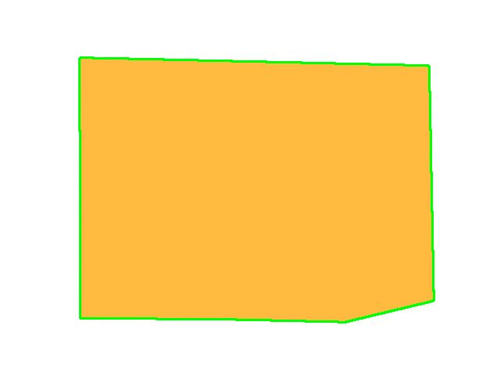
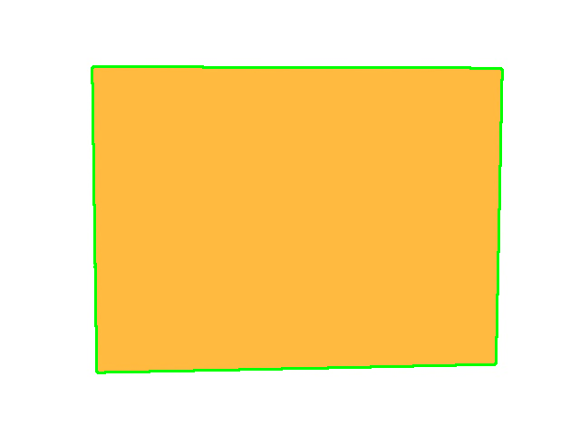
Layout recommendation system
FIG: other images recommended by the nearest neighbour

Slide 15
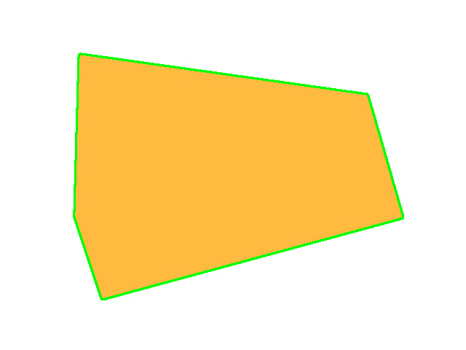
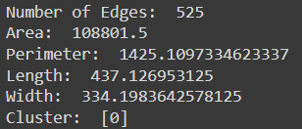
Layout recommendation system
For the Neural Network with the hidden layers, apart from scaling, the y labels which are the image paths were encoded in numericals for better model predictions
To predict more number of images, MultiLabelBinarizer was used, so that during prediction it gives out the probabilities for all the images and thresholding can be done to find out the best ones
The input and original features are fairly closer. Also it is a little better than the Nearest Neighbour System. Reason may be of the scalling, encoding and the extra training of the model
FIG: image from the neural network recommendation
FIG: input features given to the model
FIG: the original features of the model

Slide 16
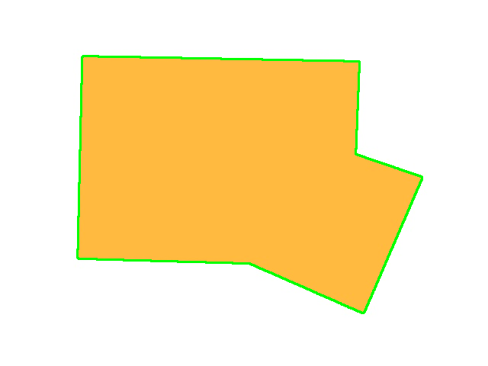

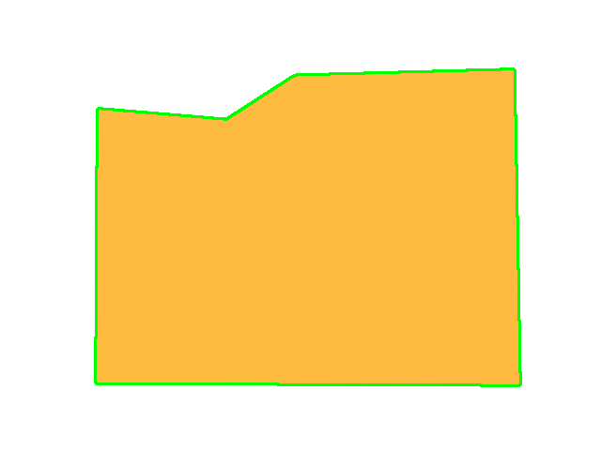
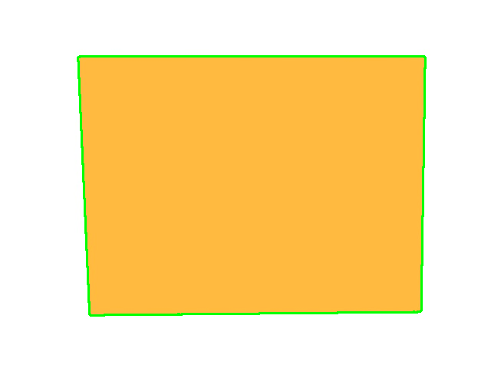
Layout recommendation system
Another optimization which was done was to give more importance to some features say area and cluster after scaling so that the model recommends based on the customer requests. This can be automated using functions and other customer requests
FIG: images from the neural network recommendation for the input feature

Slide 17
Other ideas based on the image data and information
Using the features extracted from the images, we could possible create some layouts for the buiding with low, medium or high complexities given the length and width of the tight-fitting boundaries using Generative Adversarial Networks
For better training of the model, image augmentations can be done like rotation and flipping
Importance scaling of features can be done for taking in client requests more accurately and recommending better layout images. This can also be automated using functions instead of manually scaling

Slide 18
Summary of all the questions asked
For grouping the images into families, Elbow method was used for number of clusters and three methods were implemented
KMEANS
HIRARCHICAL
VGG16 PRETRAINED MODEL
For Low, Medium and High Complexity criteria, Number of corners and Area of the images can be taken
For Recommendation system, two models were used
Nearest Neighbour
Neural Network doing somewhat better than the former
Importance Scaling of features as per customer requests and Innovative designs of layouts can be made using GANs

Slide 19
Learning, experiences and hurdles
Learnt about Image Handling and Feature Extraction which made sense physically and practically to a customer/ architect
Using the recommendation system and tunning it based on the parameters was a good learning
Learning about which algorithm to use and why was a good outcome of the project
Learnt a lot using CHATGPT and Google searches
One of the hurdles was being lost while doing the recommendation system and trying out different parameters and hyperparameters in the models

Slide 20
Thank you

