Slide 1

Online Retail Data Analysis & Customer Segmentation
Project Report: Data Visualisation and Interpretation Lab
Session: AUG – DEC 2025 | Programme: B.TECH. CS - DATA SCIENCE
Submitted By: Paras Joshi (R2142230909) & Chirag Garg (500121978)

Slide 2

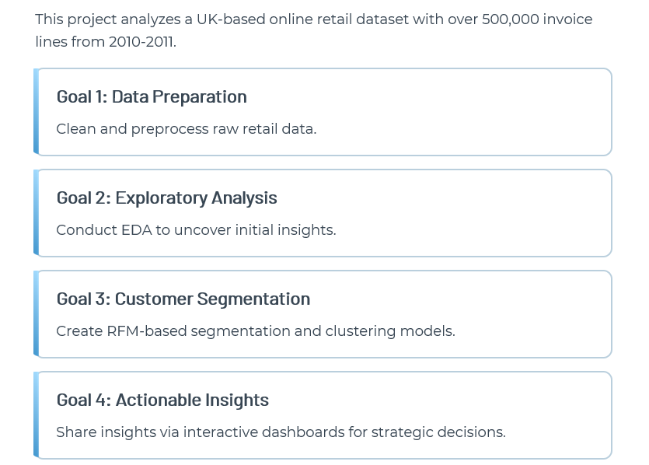
Introduction: Project Overview

Slide 3
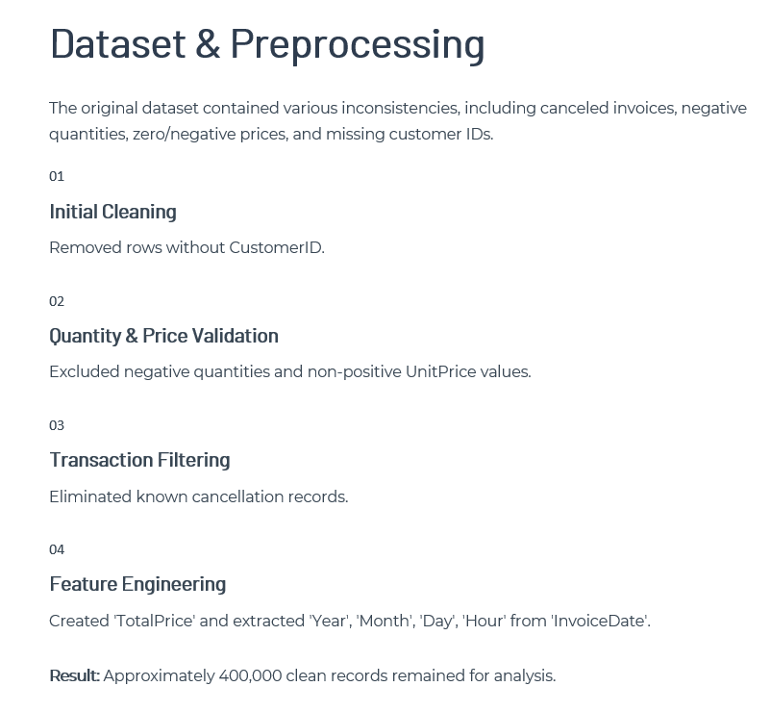


Slide 4

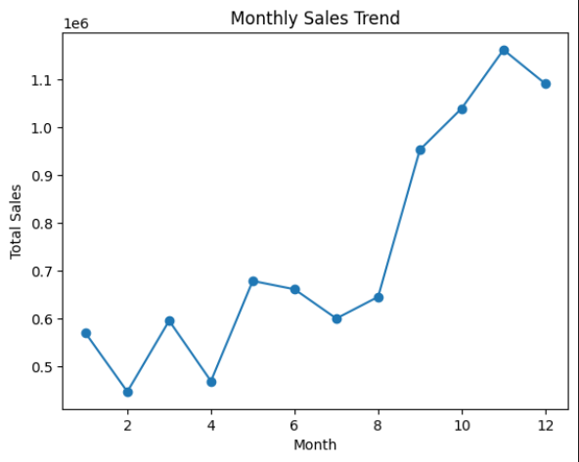
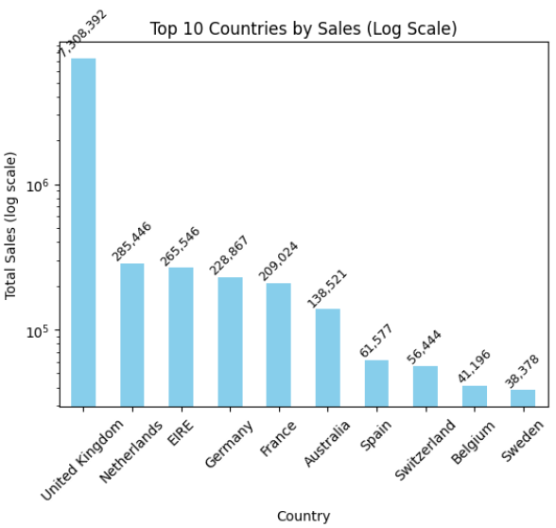

Slide 5
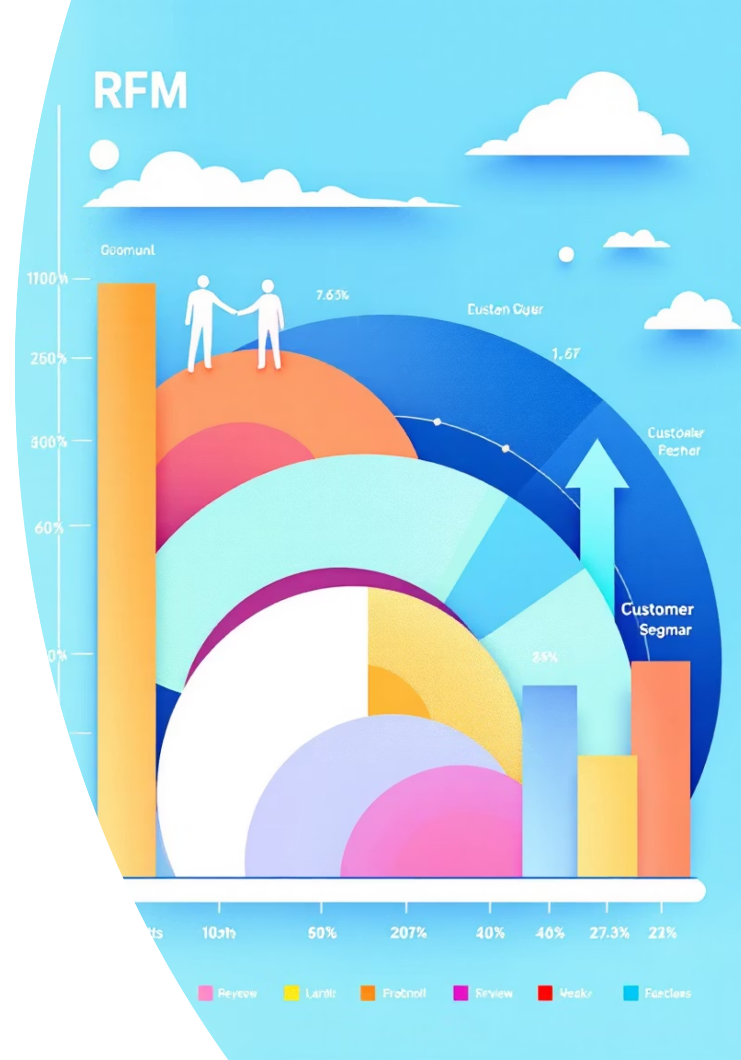
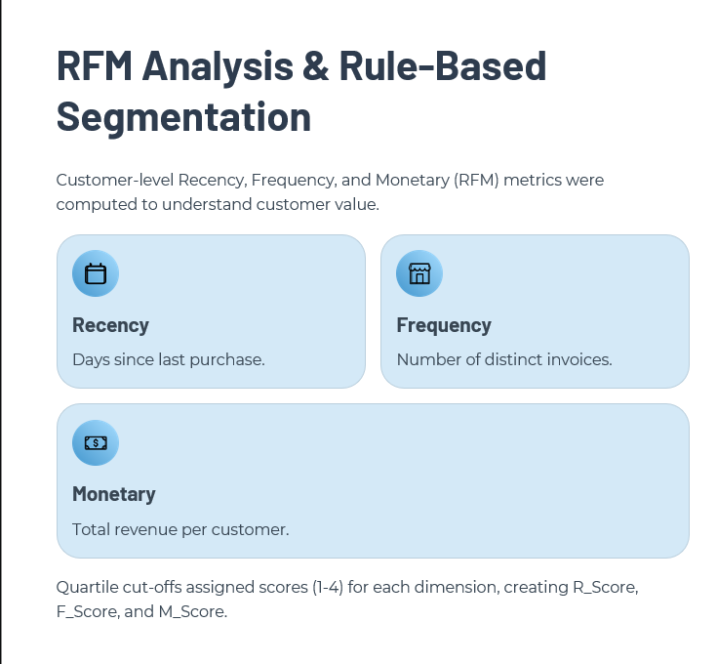

Slide 6

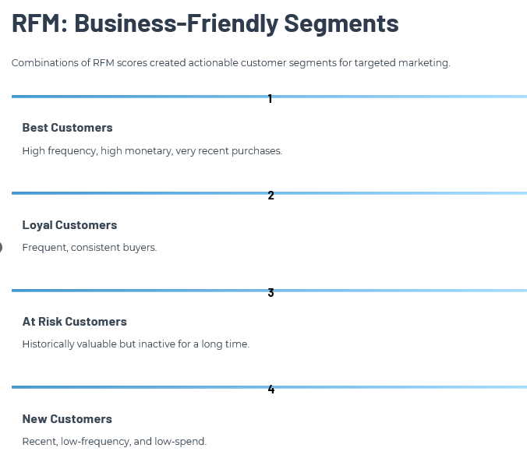

Slide 7

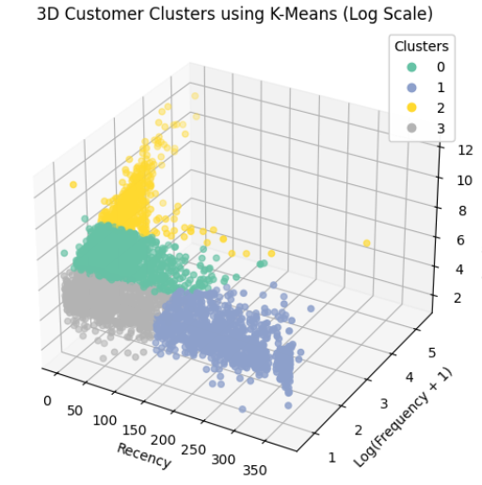


Slide 8

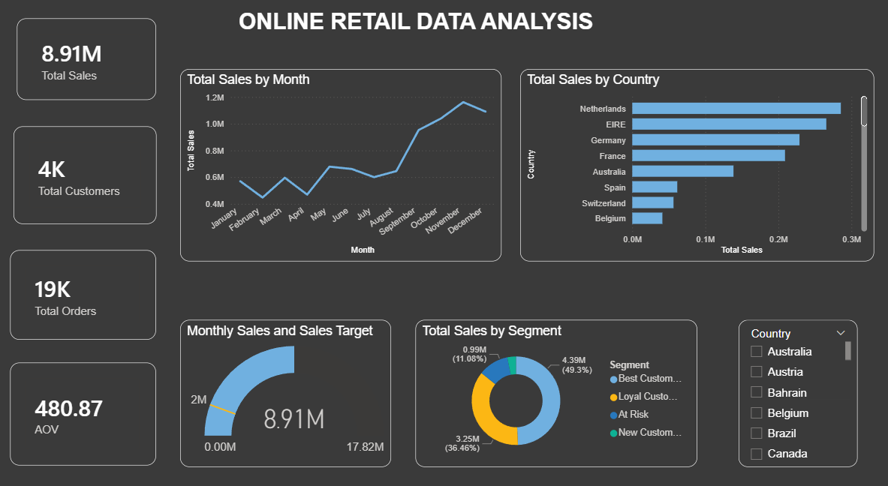

Slide 9
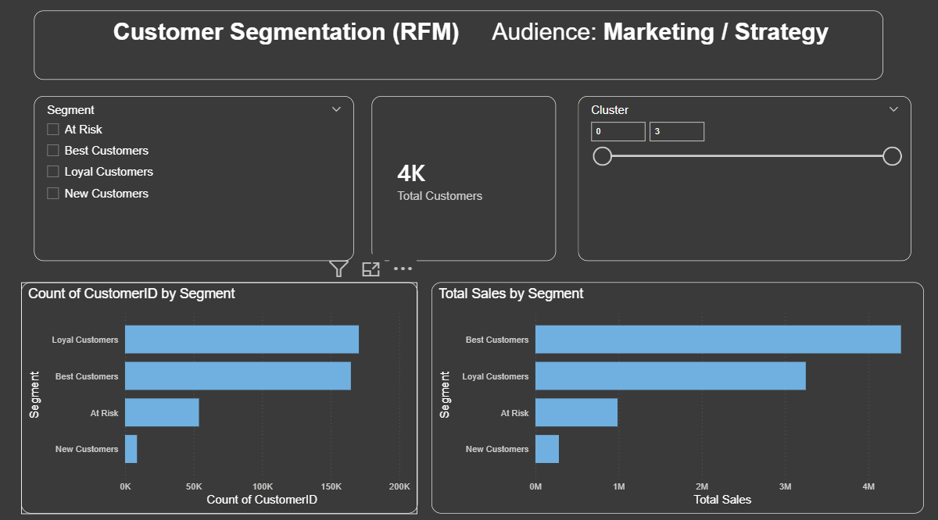

Slide 10

