Slide 1
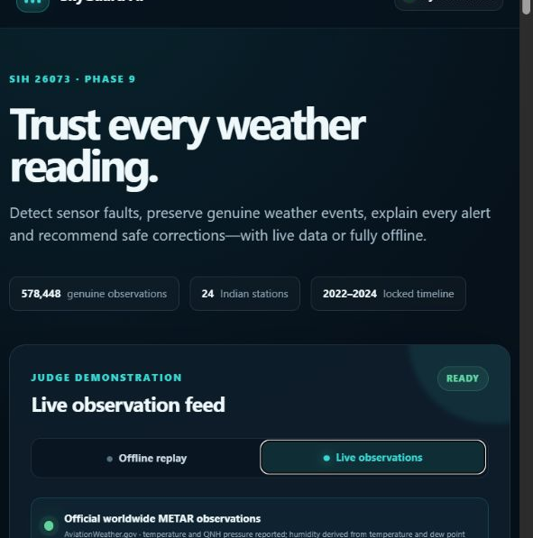
SIH 26073 · PHASE 9
SkyGuard AI
A self-healing weather observation network
Detect faults. Preserve genuine weather. Explain every decision. Run live or fully offline.
578,448 observations
24 Indian stations
51 tests pass
Software · AI/ML · Disaster management
Notes:
Open with the decision: SkyGuard is an end-to-end software solution for the AWS anomaly problem, with both controlled offline proof and genuine live observations.

Slide 2
SIH PROBLEM FIT
The problem is trust—not just thresholding
Detect
spikes, drift, frozen and transport faults
Three signals
Temperature
Pressure
Relative humidity
Distinguish
genuine weather from sensor failure
A spike may be a failed sensor—or a real regional event. The system must know the difference in real time.
Explain
severity, confidence and root cause
Act
correct safely and recommend maintenance
MANDATORY SOFTWARE SCOPE: COMPLETE
02
Notes:
Frame the challenge as trustworthy observations. Emphasize that the public statement asks for real-time anomaly detection, genuine-weather separation, confidence, explanation and sensor health.
[Sources]
- https://sih-fit.vercel.app/problem/SIH26073
- https://github.com/jeevansai-hub/SIH-2026-/blob/main/ps_2026/README.md
[/Sources]

Slide 3
DELIVERY JOURNEY
Nine phases turned a concept into evidence
01–03
04–06
07–09
Data & benchmark
Models & safe repair
Platform & delivery
Verified source data, 13-fault library and 72 online-safe features.
Calibrated detection, weather protection, diagnosis, correction and health.
Streaming API, dashboard, genuine live feed, verification and SIH package.
ALL PHASES COMPLETE
03
Notes:
Use this timeline to show that the project was built in dependency order: provenance first, models second, delivery last.

Slide 4
SYSTEM ARCHITECTURE
One pipeline serves offline proof and live operation
INPUT
QUALITY
DECISION
ACTION
OUTPUT
NOAA benchmark
Live METAR
Replay scenarios
Schema + QC
Temporal features
Neighbour context
Fault probability
Weather decision
Root cause + abstain
Correction + interval
Health score
Maintenance priority
Dashboard
REST API
CSV incident report
→
→
→
→
Frozen 2024 model policy
No future leakage · explicit unknown outcome · corrections remain advisory
04
Notes:
Walk left to right. Both offline replay and live observations enter the same quality, feature and decision path. The frozen policy prevents demo-time threshold changes.

Slide 5
DATA EVIDENCE
The benchmark is genuine, hashed and leakage-safe
NOAA/NCEI Global Hourly ISD · India · 2022–2024
Evidence | Value | Validation
Processed observations | 578,448 | Deduplicated
Stations / clusters | 24 / 4 | Metadata checked
Source files | 72 observations | SHA-256 manifest
Clean candidates | 98.4761% | Range + quality screened
Model split | 2022 / 2023 / 2024 | Train / select / locked test
Unseen station holdout | 4 stations | Never trained
Fault library | 546 episodes | 13 classes + weather
14/14 SOURCE CHECKS PASS
05
Notes:
This is the foundation of the credibility story. The fault labels are controlled injections, but the underlying meteorological observations and metadata are genuine official data.
[Sources]
- https://www.ncei.noaa.gov/products/land-based-station/integrated-surface-database
[/Sources]

Slide 6
LOCKED 2024 RESULTS
The model catches episodes with low false-alarm pressure
WEATHER PROTECTION
87.97% F1
824 regional-weather rows · 1.699% fault FPR
EVENT DECISION
99.19%
Accuracy is contextual; use F1/AUCPR for faults
FALSE ALARMS
0.031/day
Per station-day on unseen time
06
Notes:
Do not call 99.19% the model's only accuracy. Anomalies are rare, so present precision, recall, F1, AUCPR, false alarms and episode recall together.

Slide 7
SAFE REPAIR
Correction improved values—but automation stays gated
TEMPERATURE
PRESSURE
HUMIDITY
1.66 °C
1.56 hPa
12.92% RH
corrected MAE
corrected MAE
corrected MAE
85.64% error reduction
98.63% error reduction
57.86% error reduction
87
automatic temperature/pressure repairs
HUMIDITY: REVIEW ONLY
zero measured false corrections across both locked 2024 holdouts
Coverage is limited by missed detection and affected-sensor inference; advisory output remains the default.
07
Notes:
This directly resolves the earlier limitation: we improved review coverage, calibrated uncertainty by split, and added strict automatic gates. We did not claim all corrections are safe to apply automatically.

Slide 8
LIVE OPERATION
Genuine live observations now use the same decision path
REPORTING
12 / 14
configured Indian stations
SNAPSHOT
400
genuine observations
REFRESH
5 min
optional dashboard schedule
Reported: temperature + QNH pressure · Derived: relative humidity
08
Notes:
Switch the live mode on during the demo. Be precise: the feed is genuine METAR terminal data. Humidity is derived from temperature and dew point. Live alerts are signals; benchmark accuracy comes from the locked labelled tests.
[Sources]
- https://connect.aviationweather.gov/data/api/
[/Sources]

Slide 9
SIH COMPLIANCE
Every mandatory software output is demonstrated
Statement requirement | SkyGuard implementation | Status
Real-time anomaly detection | Streaming engine + live refresh + cache | Complete
Faults and communication errors | 13-class benchmark + stateful QC | Complete
Temporal / seasonal learning | Causal rolling, EWMA and seasonal features | Complete
Multivariate consistency | Cross-sensor and calibrated event model | Complete
Weather vs sensor failure | Neighbour agreement + regional scenario | Complete
Confidence and explanation | Calibration, abstention, evidence text | Complete
Health and maintenance | Sensor score, priority and action | Complete
Correction / imputation | Uncertainty-aware advisory correction | Optional done
Dashboard and deployability | Offline/local web UI, API and report export | Complete
Production gap: replace the public METAR adapter with the official IMD AWS endpoint and validate on confirmed field faults.
09
Notes:
This is the honest compliance answer: complete for the SIH software prototype, not yet an operational IMD deployment. Hardware is not required for this team-constrained solution.
[Sources]
- https://sih-fit.vercel.app/problem/SIH26073
[/Sources]

Slide 10
READY FOR SIH DEMONSTRATION
Trust every weather reading.
FINAL PROOF
51
SkyGuard detects, distinguishes, diagnoses, explains, corrects safely and prioritizes maintenance—live or fully offline.
automated tests pass
14 / 14
final delivery checks
PHASES 0–9 COMPLETE
Next pilot step
Connect the official IMD AWS stream and collect confirmed maintenance labels for operational acceptance.
SkyGuard AI · SIH 26073
Notes:
Close on the outcome and ask judges to test both scenarios: one-station drift and regional weather. Then show the live feed. Do not overclaim production readiness.

