Slide 1

National Institute of Technology Raipur
Department of Information Technology
Decentralised Multispectral UAV Swarms for Search and Rescue
Early-fusion perception, delay-tolerant networking and energy-aware self-organisation
Presented by
Devesh Agarwal (23118030)
Sankalp Mittal (23118089)
Naman Chaudhary (23118069)
Guided by
Dr. Rayanoothala Praneetha Sree
B.Tech, Information Technology, Semester 7
Notes:
Introduce the team and the guide. One sentence: we built and evaluated a UAV swarm that finds people in disaster areas, even when the radio network is mostly down and a UAV may be lost.

Slide 2
The problem: finding survivors with a UAV swarm
Perception
Communication
Coordination
Visible cameras fail in shadow and smoke; thermal cameras struggle when people and background have the same temperature.
Over multi-km areas the UAVs are mostly out of radio range, so alerts cannot rely on a connected network.
No central planner, different batteries, and a lost UAV is invisible: in flight, silence is normal.
Our approach
Every UAV runs perception, mesh communication and control on its own view of the swarm, with no central planner, and the three parts are evaluated together over 1,620 simulated missions.
Decentralised Multispectral UAV Swarms for Search and Rescue
2 / 11
Notes:
The first hours decide who is found alive. A swarm covers more area faster, but three problems arise together: seeing people in poor light, getting alerts out over a mostly disconnected network, and coordinating without a central planner while UAVs can be lost silently. Existing coordination methods assume a connected network or announced failures, and perception, networking and control are rarely evaluated together. That is the gap this project fills.

Slide 3
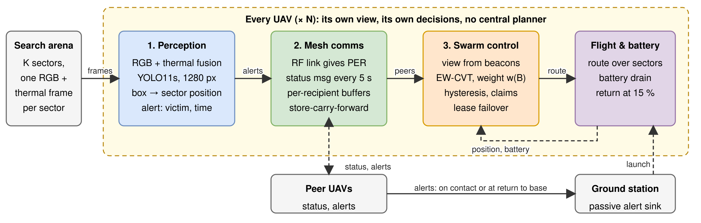
System architecture
Perception
Fused RGB + thermal detection turns frames into alerts
Mesh communication
Buffered, store-carry-forward alert delivery
Swarm control
Energy-aware sectors, failure detection, failover
Decentralised Multispectral UAV Swarms for Search and Rescue
3 / 11
Notes:
Every UAV runs the same three components. The ground station is a passive sink. Perception: 4-channel RGB+thermal YOLO11s. Mesh: lossy radio, per-recipient buffers, store-carry-forward, status beacons every 5 s. Control: own view of peers, EW-CVT weights, hysteresis, claims, lease failover.

Slide 4
Perception: RGB + thermal early fusion
• YOLO11s, 1280 px, one class (person)
• Trained on the NII-CU multispectral aerial dataset
• Visible + thermal stacked into 4 channels: cheap enough for onboard use
• Box centre is mapped into the sector bounds (sector-based georeferencing)
AP50 under degraded conditions
Input | Day | Night | Washout
Fused (proposed) | 99.8 | 94.3 | 61.8
Thermal only (RGB masked) | 89.0 | 89.0 | 0.0
Comparison with the base paper
Daytime AP50 / AP75 | AP50 | AP75
YOLOv3 4-channel (Speth et al. 2022) | 97.9 | 76.9
YOLO11s 4-channel (proposed) | 99.8 | 85.8
Indicative only: 150 of 485 frames and a newer architecture. Washout is the hardest case (recall 0.39).
Decentralised Multispectral UAV Swarms for Search and Rescue
4 / 11
Notes:
The visible and thermal frames are stacked into one four-channel tensor, so only the first convolution changes and the cost is almost nil. The thermal kernel is initialised from the pretrained red kernel. Night: RGB x 0.12 plus noise. Washout: thermal contrast cut to 25 percent plus noise. Both are synthetic degradations of daytime frames. RGB-only scores zero because the network was never trained without the thermal plane. Comparison with Speth et al. is indicative only: 150 of 485 frames, newer architecture.

Slide 5
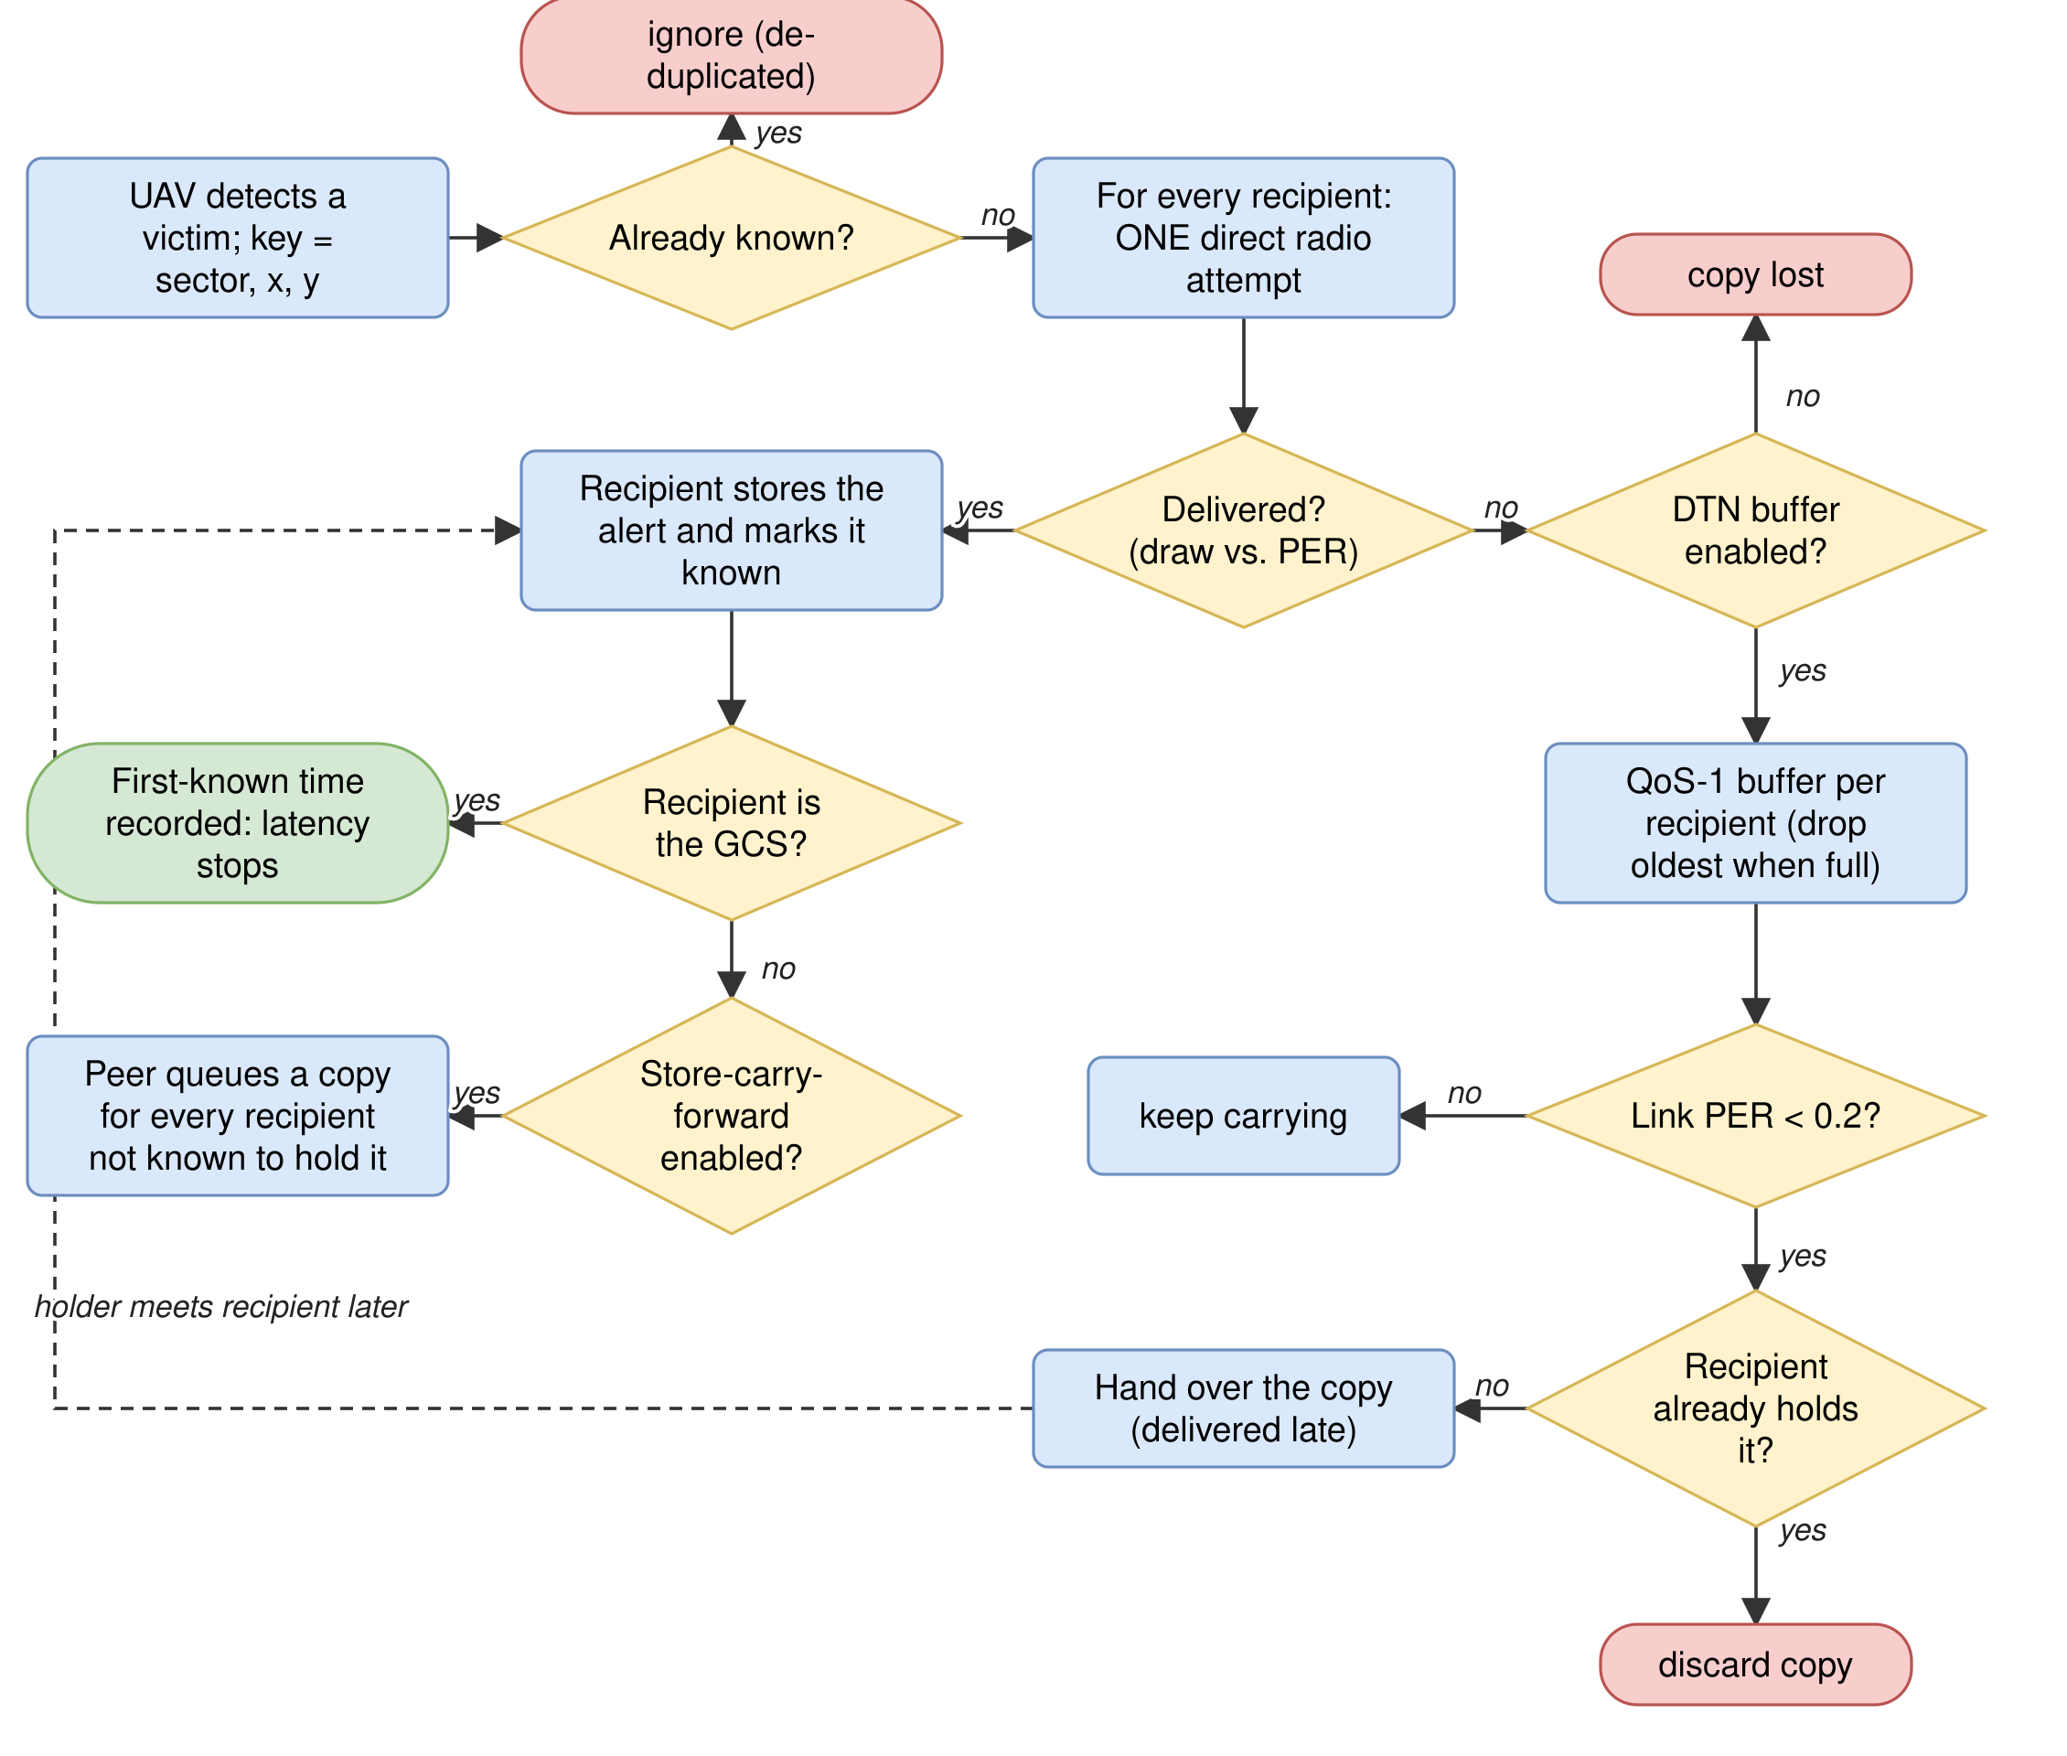
Delay-tolerant alert delivery
Direct attempt first
One attempt to every UAV and the ground station; the swarm is mostly out of range, so most fail
Buffer, then carry
Failed copies wait in per-recipient buffers and are handed over on contact, usually at base
Epidemic relaying
Receivers carry copies onward, so alerts survive the loss of their finder
Decentralised Multispectral UAV Swarms for Search and Rescue
5 / 11
Notes:
In a multi-km arena the first direct attempt succeeds only 3 to 6 percent of the time. Alerts are kept in per-recipient QoS-1 buffers and flushed when the link PER drops below 0.2, usually at return to base. Any UAV that received an alert is a carrier, so an alert survives the loss of its finder. Radio: log-distance path loss, exponent 2.5, 4 dB shadowing, PER 0.5 at about 520 m.

Slide 6
Energy-aware coordination without a planner
Energy-weighted centroidal Voronoi tessellation (EW-CVT)
w_i = (B_i / B_max)^α d(s,i) = ‖c_s − g_i‖² / max(0.01, w_i)
Each sector goes to the UAV with the smallest weighted distance: weak batteries get smaller territories
Energy weighting
Hysteresis
Claim and yield
Larger α: more reserve (min battery 15.6 → 20.3%) but a longer mission (377 → 488 s)
Commit a new partition only on a real battery and centroid change: commits fall 296 → 31 per mission
A UAV keeps its claims unless a better claim arrives, so sectors rarely flip between UAVs
Decentralised Multispectral UAV Swarms for Search and Rescue
6 / 11
Notes:
Weight w = (B/Bmax)^alpha. alpha = 0 is plain Voronoi; larger alpha shrinks the territory of weak UAVs, raising the minimum battery from 15.6 to 20.3 percent at alpha 0 to 3 but lengthening the mission from 377 to 488 s. Hysteresis: commit only if battery fell at least 2 percent of Bmax and the centroid moved at least 5 m, or the believed live set changed. In the per-tick re-planning test (sigma 2 percent) commits fall 296 to 31 and sector flips 13.5 to 2.5; in the full decentralised system the effect is small because claims are already sticky. Claim-and-yield: keep claims unless a better claim (smaller d) arrives.

Slide 7
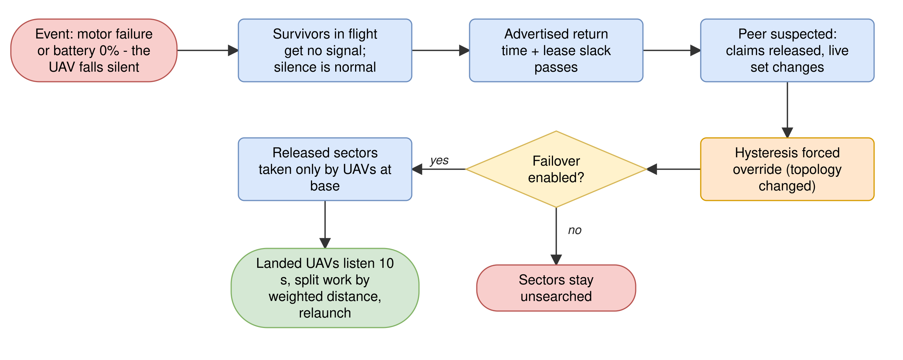
Failure detection and failover
• Silence is normal in flight, so a quiet peer is not a failed peer
• Each peer advertises its expected return; overdue by the slack means suspected
• Only UAVs at base take over released work
Slack (s) | Failover (s) | Wrong suspicions
20 | 192 | 11.2 of 15.6
60 (default) | 231 | 8.3 of 12.6
240 | 411 | 0.4 of 4.7
Decentralised Multispectral UAV Swarms for Search and Rescue
7 / 11
Notes:
In flight silence tells nothing, because a quiet peer may be out of range or landed. So each peer advertises when its route should bring it home; if it is still missing slack seconds later (60 s by default) it is suspected and its claims are released. Released work is taken only by UAVs at base. Slack trades speed against false alarms: 20/60/120/240 s gives failover 192/231/293/411 s and wrong suspicions 11.2 of 15.6 down to 0.4 of 4.7.

Slide 8
Experimental setup
Simulation
Question | Proposed | Compared with
Alert forwarding | Epidemic | Spray-and-wait, buffer only
Sector allocation | EW-CVT with failover | Static partition
Detection | Fused RGB + thermal | Thermal only; Speth et al.
• 6 UAVs over a 5 × 5 km arena, 25 sectors, real NII-CU frames
• UAV 2 fails silently at t = 80 s in the loss scenario
• Arenas of 1.5, 3 and 5 km; swarms of 2 to 12 UAVs
• 1,620 paired missions; paired differences with 95% confidence intervals
Components are also removed one at a time (buffer, forwarding, failover, hysteresis, energy weighting) to measure their individual effect.
Decentralised Multispectral UAV Swarms for Search and Rescue
8 / 11
Notes:
Simulation: a kinematic mission simulator that runs the full perception, mesh and control logic on real multispectral frames. A seed fixes the frame in each sector and every launch battery, so each variant sees identical worlds. Results are paired differences with 95 percent confidence intervals. Transit 50 m/s, search 32 m/s; launch batteries 20 to 100 percent; battery sensor noise 1.5 points; UAV 2 fails silently at t = 80 s in the loss scenario.

Slide 9
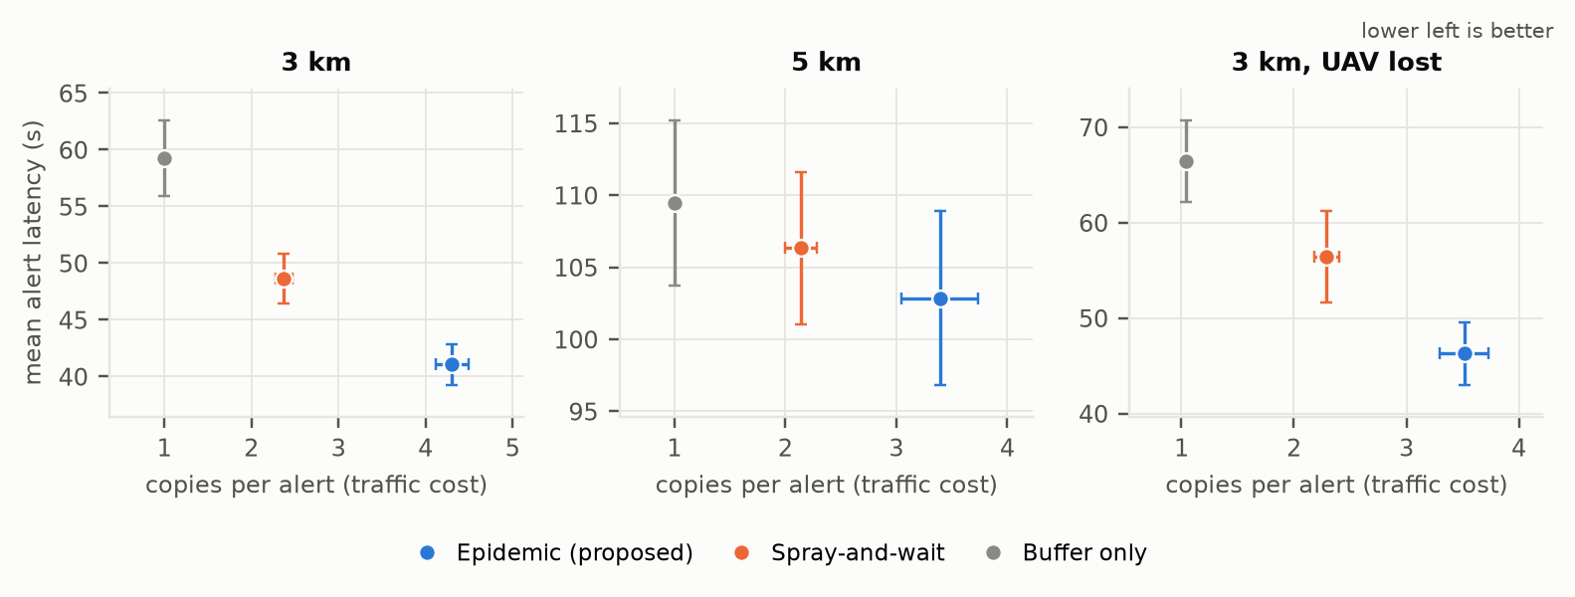
Results: alert delivery
3.4% → 98.0%
−7.6 s
+1.9 copies
victims known to the operator at 5 km, without vs. with the buffer
alert latency vs. spray-and-wait at 3 km
per alert vs. spray-and-wait: the price of epidemic
Decentralised Multispectral UAV Swarms for Search and Rescue
9 / 11
Notes:
Without the buffer the operator learns of only about 3 percent of victims at 5 km; with it 98 percent. Epidemic forwarding has the lowest alert latency in every scenario but keeps the most copies. At 3 km its latency is 7.6 +/- 1.7 s below spray-and-wait and about 18 s below buffer only, with about 1.9 more copies than spray-and-wait. With a UAV lost the operator recall is 0.978 (epidemic), 0.967 (spray-and-wait) and 0.958 (buffer only).

Slide 10
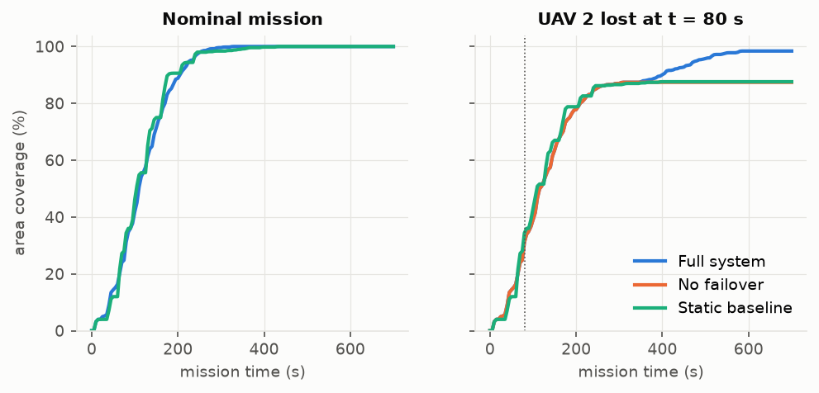
Results: coordination and failure recovery
98.4% vs 87.4%
231 s
554 s vs 353 s
coverage after a UAV loss, with vs. without failover
mean failover latency at 5 km (143 s at 3 km)
mission time with a loss: the price of recovery
• With failover the swarm recovers nearly all the lost area, but only after the loss is noticed
• Without a loss all variants reach full coverage in about 350 s
• Decentralisation costs minutes of failover latency
Decentralised Multispectral UAV Swarms for Search and Rescue
10 / 11
Notes:
Failover drives the coverage gain after a loss: 98.4 percent against 87.6 percent for the static partition (87.4 percent with failover removed from the full system). The price is a longer mission: 554 s against 353 s, because survivors take over the lost work. The swarm cannot know of the loss until the lost UAV is overdue at base, so failover takes 231 s at 5 km, 143 s at 3 km and 102 s at 1.5 km. EW-CVT has no duplicate scans in the nominal case.

Slide 11
Conclusion and future work
Conclusions
Limitations and future work
• Buffering is the largest effect: operator knowledge 3.4% → 98.0%
• Failover recovers 11 points of coverage after a UAV loss
• Epidemic relaying is fastest, at the price of more copies
• Decentralisation costs minutes of failover latency
• Simulation only: next, camera and wind models and ArduPilot + ns-3 co-simulation
• Train separate RGB-only and thermal-only detectors
• Status messages carrying third-party state for earlier failure detection
Thank you. Questions?
Decentralised Multispectral UAV Swarms for Search and Rescue
11 / 11
Notes:
All results come from simulation, and the unfavourable results are reported together with the favourable ones. Limitations: kinematic simulator, one static frame per sector, a modality ablation that masks one plane of a fused network, and simplified decentralisation (common launch, single-hop status messages). Thank the audience and invite questions.

