Slide 1

National Institute of Technology Raipur
Department of Information Technology
Decentralised Multispectral UAV Swarms for Search and Rescue
Early-fusion perception, delay-tolerant networking and energy-aware self-organisation
Presented by
Devesh Agarwal (23118030)
Sankalp Mittal (23118089)
Naman Chaudhary (23118069)
Guided by
Dr. Rayanoothala Praneetha Sree
B.Tech, Information Technology, Semester 7
Notes:
Introduce the team and the guide. One sentence: we built and evaluated a UAV swarm that finds people in disaster areas, even when the radio network is mostly down and a UAV may be lost.

Slide 2
Why a UAV swarm for search and rescue?
The first hours after an earthquake or flood decide who is found alive. A swarm of small UAVs covers a wide area much faster than ground teams, but three practical problems arise together.
1 Perception
2 Communication
3 Coordination
Visible cameras fail in shadow, dusk and smoke. Thermal cameras show warm people, but struggle when people and background have nearly the same temperature.
Over multi-kilometre areas the UAVs are mostly out of radio range. A design that assumes a connected network would deliver almost nothing.
No central planner is available, and UAVs have different batteries. A UAV can be lost unnoticed, because in flight silence is normal.
Problem: design a swarm that detects people, delivers alerts over an intermittent network, and re-organises itself without a central planner.
Decentralised Multispectral UAV Swarms for Search and Rescue
2 / 16
Notes:
The first hours decide who is found alive. A swarm covers more area faster, but three practical problems arise together. Perception, communication and control depend on each other, so we study them together.

Slide 3
Objectives and contributions
Objectives
Contributions
• Build a 4-channel RGB + thermal early-fusion person detector and test it by day, night and thermal washout
• Design delay-tolerant alert delivery with per-recipient buffers and store-carry-forward relaying
• Design decentralised coordination that works on stale local views
• Evaluate every component with ablations and baselines, with confidence intervals
• Integrated decentralised architecture: perception + mesh + control on every UAV
• EW-CVT partition with dual-threshold hysteresis, claim-and-yield assignment and lease-based failure detection
• Per-recipient QoS-1 buffers with epidemic store-carry-forward relaying under a physical radio model
• 1,620 paired simulated missions, with ablation and comparison with spray-and-wait, buffering only and a static partition
Decentralised Multispectral UAV Swarms for Search and Rescue
3 / 16
Notes:
Four objectives, matched by four contributions.

Slide 4
Related work and the research gap
Family | Strength | Limitation for a sparse swarm
Consensus | Provable agreement | Needs repeated exchanges over connected links
Voronoi coverage control | Smooth, well-studied partition | Assumes agents see each other; ignores energy unless weighted
Unreliable failure detectors | Formal treatment of suspicion | Rely on heartbeats, which fails when silence is normal
Delay-tolerant routing | Works without end-to-end paths | Usually studied apart from control
Multispectral detection | Better detection in poor light | Seldom evaluated inside a mission with a radio model
Research gap
A swarm that perceives with fused RGB + thermal frames, delivers alerts over a mostly disconnected network, and re-organises from stale local views, with a failure detector that does not mistake silence for failure.
Decentralised Multispectral UAV Swarms for Search and Rescue
4 / 16
Notes:
Each family is strong in its own area, but assumes either a connected network or announced failures.

Slide 5
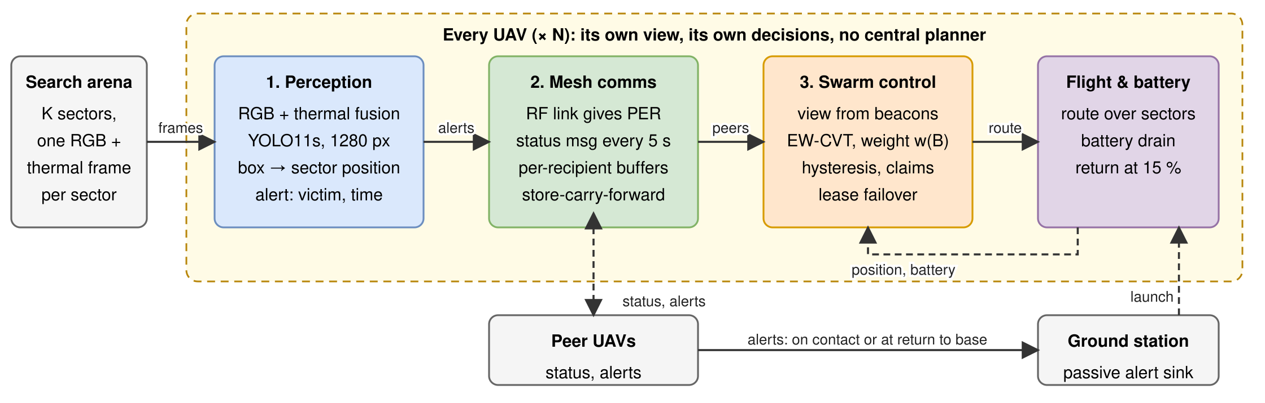
System architecture
Perception
4-channel RGB + thermal YOLO11s turns frames into victim alerts
Mesh communication
Lossy radio, per-recipient buffers, store-carry-forward, status beacons every 5 s
Swarm control
Own view of peers, EW-CVT weights, hysteresis, claims, lease failover
Decentralised Multispectral UAV Swarms for Search and Rescue
5 / 16
Notes:
Every UAV runs the same three components. The ground station is a passive sink.

Slide 6
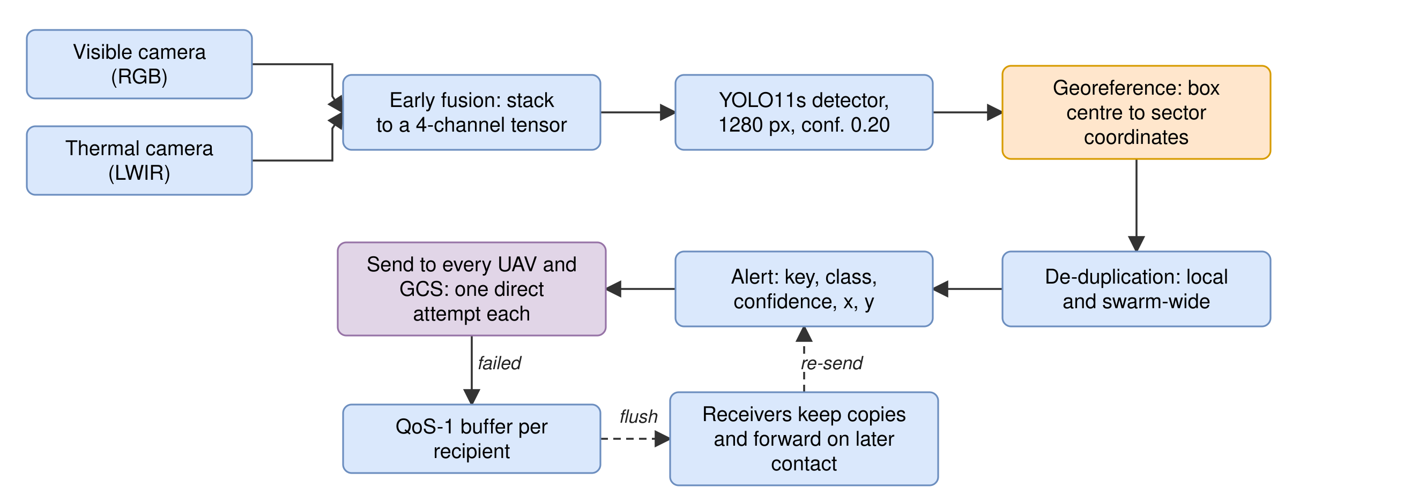
Perception: RGB + thermal early fusion
• YOLO11s, 1280 px input, one class (person)
• Trained on the NII-CU multispectral aerial dataset
• Thermal kernel initialised from the pretrained red kernel; no colour jitter
• Cheap enough for onboard use: only the first convolution changes
• Georeferencing is sector-based
• Alerts are de-duplicated locally and swarm-wide
Decentralised Multispectral UAV Swarms for Search and Rescue
6 / 16
Notes:
Early fusion stacks the planes into one four-channel input, so it adds almost no computation.

Slide 7
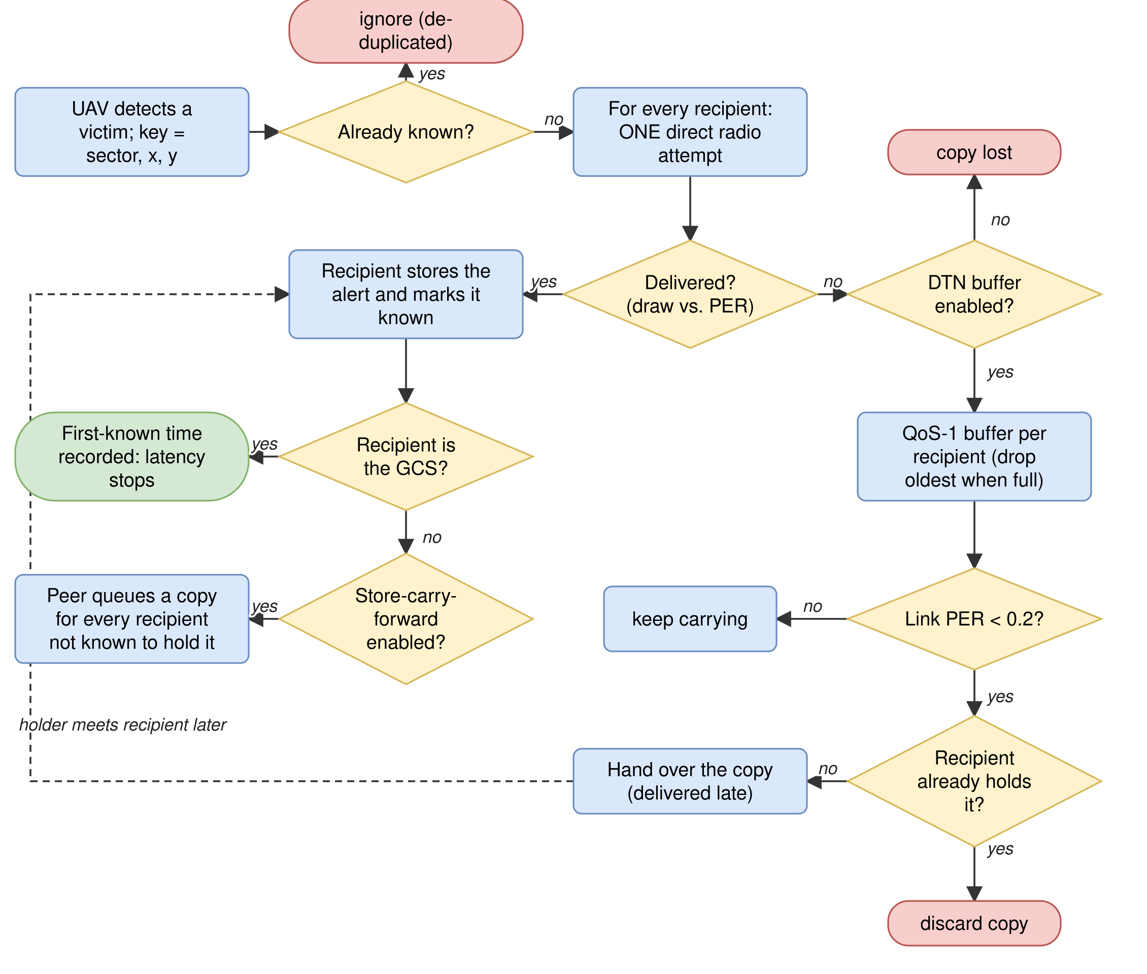
Delay-tolerant alert delivery
Radio model
Log-distance path loss (exponent 2.5), 4 dB shadowing, 15 dB obstruction loss
PER = 0.5 at about 520 m (2.4 GHz, 33 dBm)
Alert handling
One direct attempt to every UAV and the GCS; failures go to a per-recipient buffer
Buffers flush when link PER < 0.2, usually at return to base
Epidemic forwarding: receivers carry copies onward
Status beacons
Every 5 s, single-hop, not buffered
Decentralised Multispectral UAV Swarms for Search and Rescue
7 / 16
Notes:
First direct attempt succeeds only 3 to 6 percent of the time; buffers and epidemic relaying deliver the rest.

Slide 8
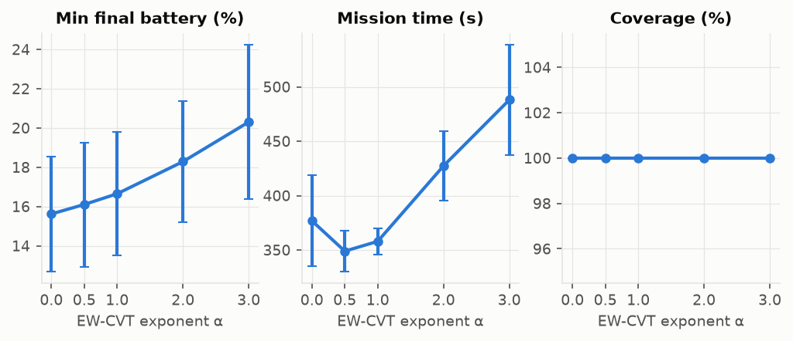
Energy-weighted territory partitioning (EW-CVT)
Weight of UAV i
w_i = (B_i / B_max) ^ α
Preferred owner of sector s
d(s,i) = ‖c_s − g_i‖² / max(0.01, w_i)
• α = 0: plain Voronoi; larger α shrinks low-battery territories
• Launch partition: converged CVT (15 Lloyd iterations)
• α is a dial between speed and energy safety, not a free improvement
α | Min battery % | Mission time (s) | Aborts
0 | 15.6 | 377 | 0.95
1 | 16.7 | 358 | 0.90
2 | 18.3 | 427 | 0.45
3 | 20.3 | 488 | 0.30
Decentralised Multispectral UAV Swarms for Search and Rescue
8 / 16
Notes:
Weight w = (B/Bmax)^alpha. Larger alpha shrinks weak UAVs' territory: more reserve, longer mission.

Slide 9
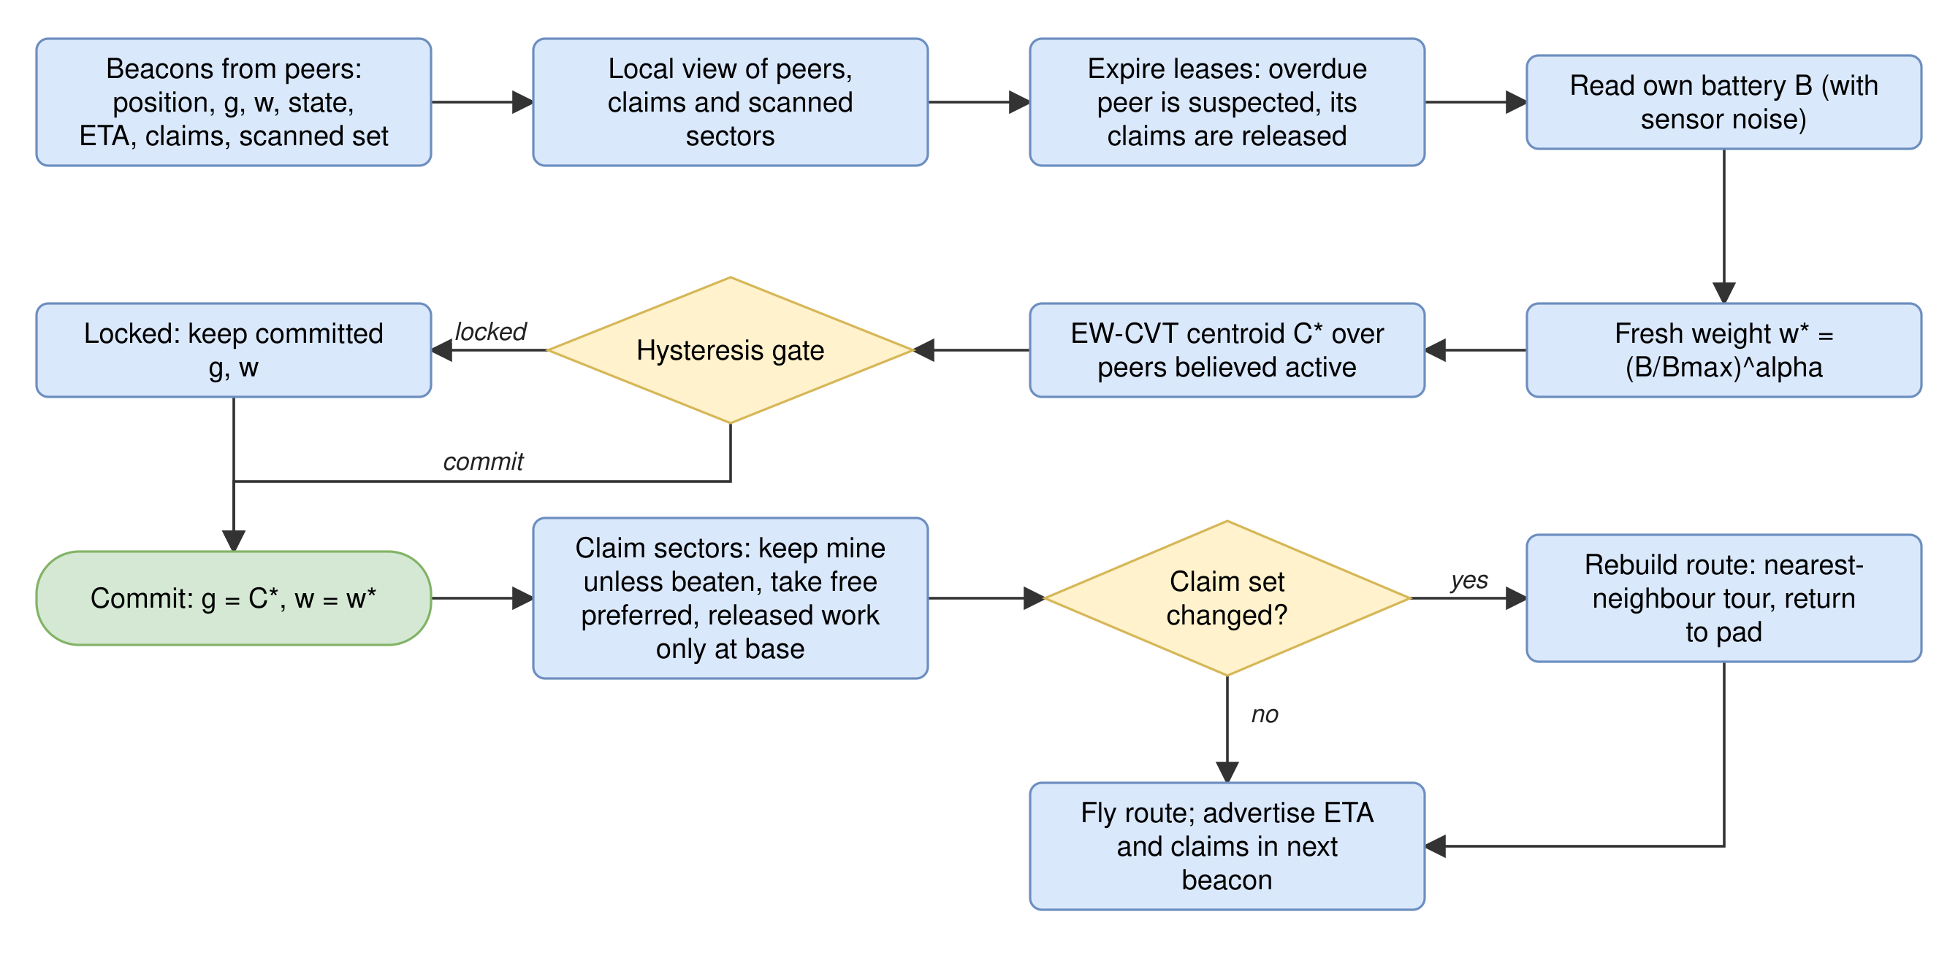
Decentralised control loop
Claims use only committed values, so a locked gate means few ownership flips and little re-routing.
Decentralised Multispectral UAV Swarms for Search and Rescue
9 / 16
Notes:
Runs on every UAV every 5 seconds, from that UAV's own view only.

Slide 10
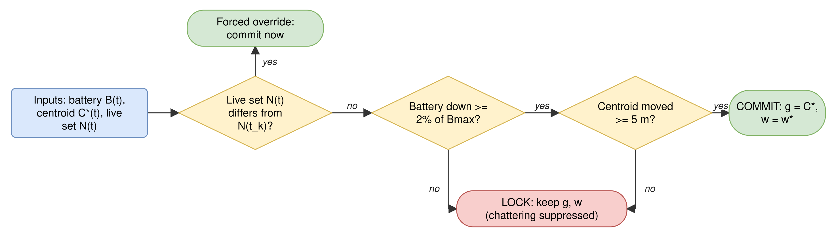
Hysteresis gate and claim-and-yield
Dual-threshold hysteresis
Commit only if battery fell ≥ 2% of Bmax AND the centroid moved ≥ 5 m, or the believed live set changed
Per-tick test, σ = 2%: commits 296 → 31 per mission
Claim-and-yield
Claim a sector if you are its preferred owner and nobody holds a valid claim
Keep claims unless a better claim arrives; then yield
Decentralised Multispectral UAV Swarms for Search and Rescue
10 / 16
Notes:
Commits fall about tenfold with hysteresis in the per-tick test.

Slide 11
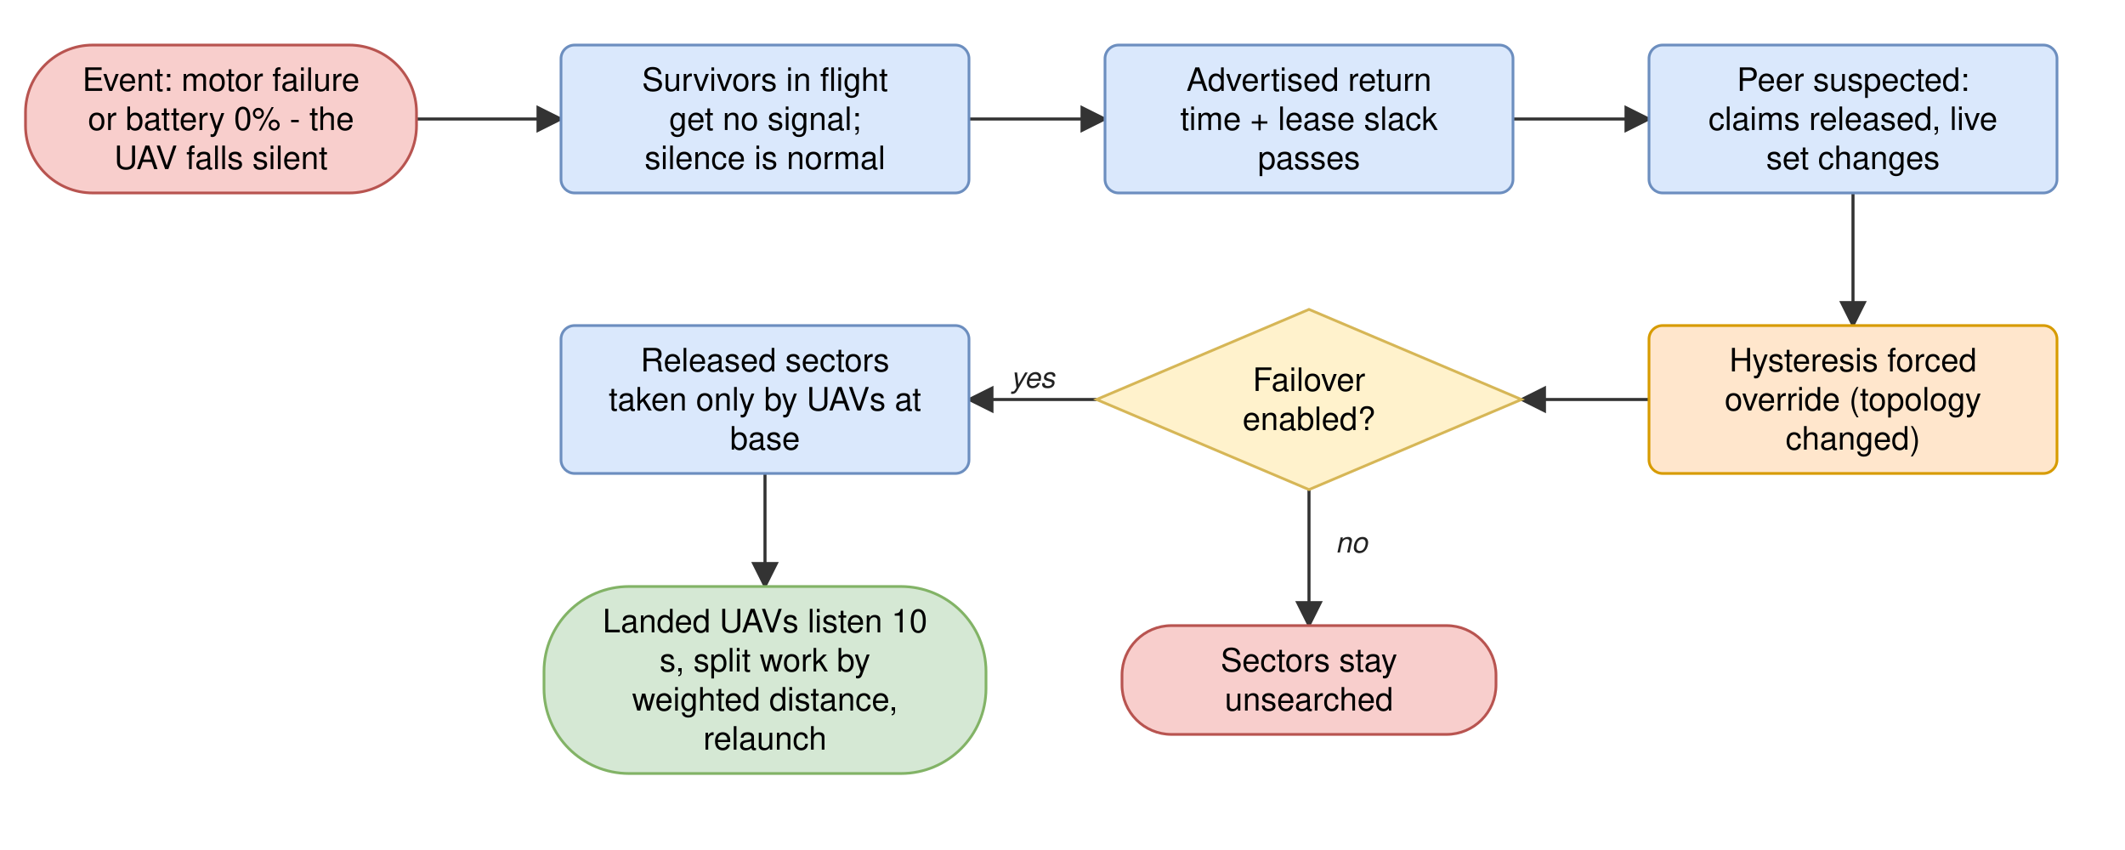
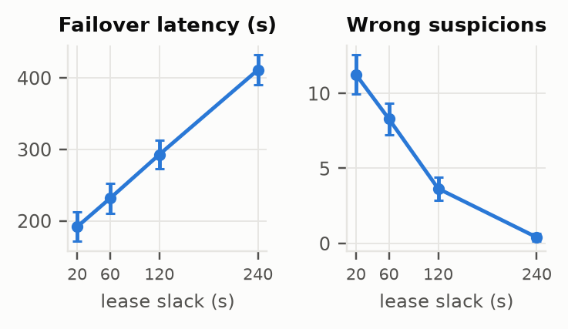
Lease-based failure detection and failover
Slack (s) | Failover (s) | Wrong suspicions
20 | 192 | 11.2 of 15.6
60 (default) | 231 | 8.3 of 12.6
120 | 293 | 3.6 of 8.0
240 | 411 | 0.4 of 4.7
• Sortie lease: each peer advertises its expected return time
• Suspected after 60 s past the lease (default); withdrawn if the peer is heard again
• Only UAVs at base take over released work
• UAV aborts at 15% battery; lost at 0%
Decentralised Multispectral UAV Swarms for Search and Rescue
11 / 16
Notes:
Silence is normal in flight, so each peer advertises its expected return; overdue by the slack means suspected.

Slide 12
Experimental setup
Simulation
Question | Proposed | Baselines
Forwarding | Epidemic | Spray-and-wait (L = 3); buffer only
Allocation | EW-CVT | Static partition
Detector | Fused RGB + thermal | Thermal only (RGB masked); Speth et al. 2022
• 6 UAVs, 5 × 5 km arena, 25 sectors; each sector shows one NII-CU frame
• Transit 50 m/s, search 32 m/s; launch batteries 20 to 100%
• Loss scenario: UAV 2 fails silently at t = 80 s
• Arenas of 1.5, 3 and 5 km; swarms of 2 to 12 UAVs
• 1,620 paired missions; mission cap 1,500 s
Detector conditions
Day: frames unchanged
Night: RGB × 0.12 plus noise
Thermal washout: thermal contrast cut to 25% plus noise
Decentralised Multispectral UAV Swarms for Search and Rescue
12 / 16
Notes:
Kinematic simulator with real multispectral frames; paired seeds; 95 percent confidence intervals.

Slide 13
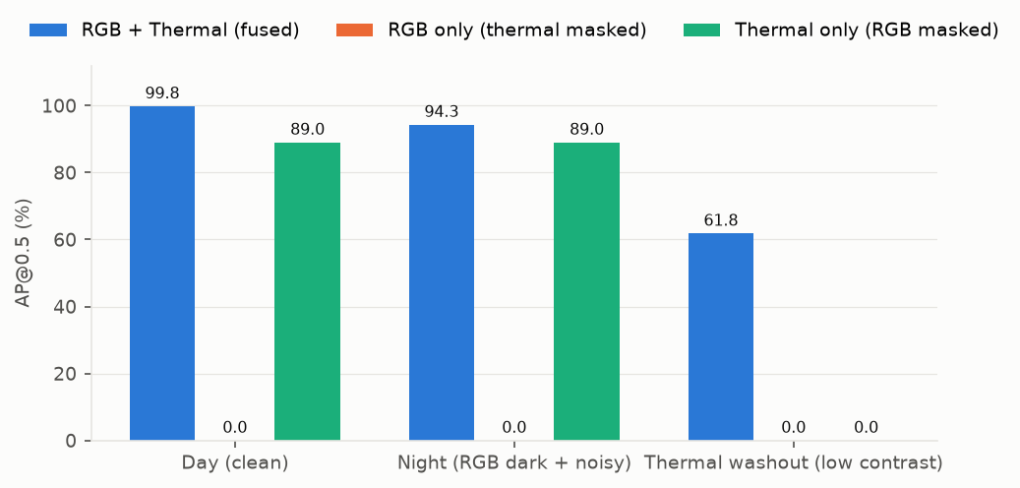
Results: detection
Input | Day AP50 | Night AP50 | Washout AP50 | Washout recall
Fused RGB + thermal (proposed) | 99.8 | 94.3 | 61.8 | 0.386
Thermal only (RGB masked) | 89.0 | 89.0 | 0.0 | 0.000
Model (Speth et al. 2022 vs ours) | AP50 | AP75
YOLOv3, RGB | 92.4 | 44.5
YOLOv3, thermal (FIR) | 97.5 | 72.7
YOLOv3, RGB + FIR ensemble | 97.3 | 54.7
YOLOv3, 4-channel | 97.9 | 76.9
YOLO11s, 4-channel (proposed) | 99.8 | 85.8
99.8
94.3
AP50, daylight
AP50, night
Indicative only: 150 of 485 frames, newer architecture.
Decentralised Multispectral UAV Swarms for Search and Rescue
13 / 16
Notes:
Fused model reaches AP50 99.8 by day; washout is the hardest case.

Slide 14
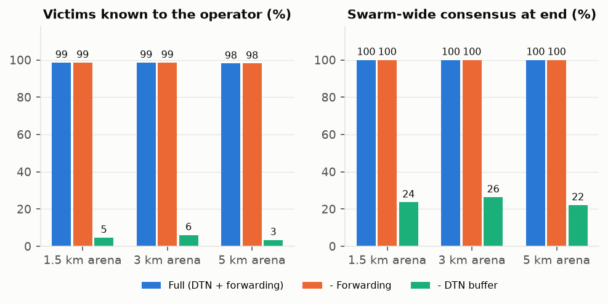
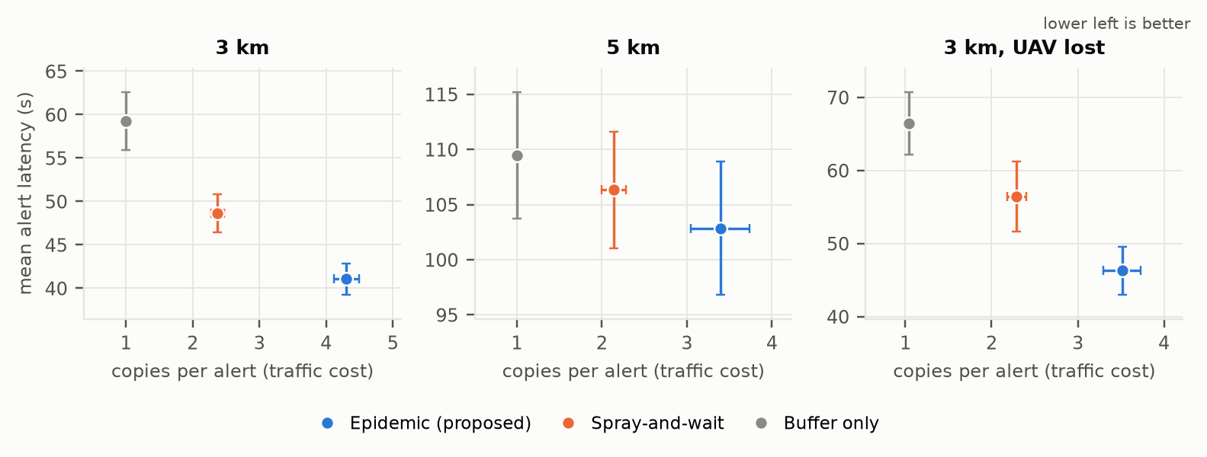
Results: delay-tolerant networking
3.4% → 98.0%
−7.6 s
+1.9
victims known to the operator, 5 km: without vs. with DTN buffer
alert latency vs. spray-and-wait at 3 km
copies per alert vs. spray-and-wait
At 3 km: epidemic 41.0 s / 4.30 copies; spray-and-wait 48.6 s / 2.37; buffer only 59.2 s / 1.00.
Decentralised Multispectral UAV Swarms for Search and Rescue
14 / 16
Notes:
Buffering is the largest effect; epidemic forwarding is fastest at the price of more copies.

Slide 15
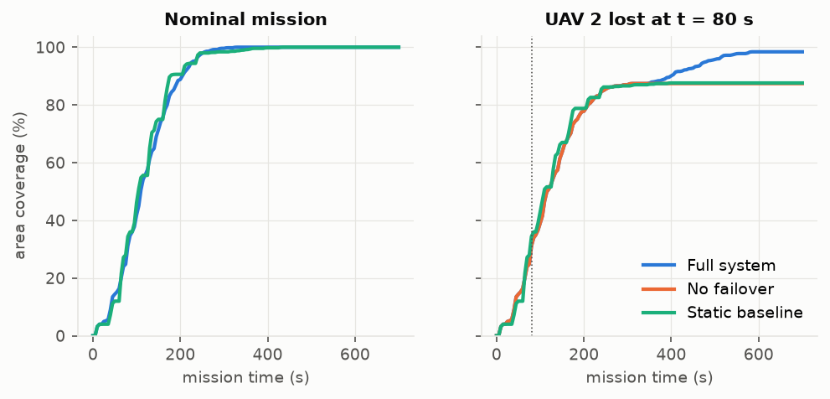
Results: coordination and failure recovery
98.4% vs 87.4%
231 s
0.00
coverage after a UAV loss: with vs. without failover
mean failover latency at 5 km
duplicate scans, EW-CVT, no loss
Policy | Cover. nominal | Cover. UAV lost | Time lost (s)
EW-CVT (proposed) | 100.0 | 98.4 | 554
Static partition | 100.0 | 87.6 | 353
• Without a loss all policies reach full coverage
• EW-CVT has the highest minimum battery (18.8% vs 17.9%)
We credit failover, not the weighting, with the coverage gain.
Decentralised Multispectral UAV Swarms for Search and Rescue
15 / 16
Notes:
Failover drives the coverage gain after a loss; the price is a longer mission.

Slide 16
Conclusion, limitations and future work
Conclusions
Limitations
Future work
• Buffering is the largest effect: 3.4% → 98.0% at 5 km
• Failover recovers 11 points of coverage
• Epidemic relaying is fastest, at the price of more copies
• Decentralisation costs minutes of failover latency
• Fused detector: AP50 99.8 by day, 94.3 at night
• Simulation only; kinematic model, no wind
• One static frame per sector; same-site train and validation
• Modality ablation masks one plane of a fused network
• Simplified decentralisation
• Train separate RGB-only and thermal-only detectors
• Third-party state in status messages
• Camera, wind and energy models
• ArduPilot + ns-3, then hardware
Thank you. Questions?
Decentralised Multispectral UAV Swarms for Search and Rescue
16 / 16
Notes:
All results come from simulation.

