Slide 1


SANGUIS PROVIDUS
AFRICA HACKATHON 2026
DELIVERED BY
FORECASTING AND STOCK-OUT EARLY WARNING
TEAM MEDIBORA
Lets a blood bank officer see which blood groups will run short, days ahead, and lets a regional centre put the same blood on the right shelves.
BUILDING BETTER BLOOD SYSTEMS FOR AFRICA · TEAM MEDIBORA · KENYA
Notes:
Sanguis Providus means 'foreseeing blood'. One promise: see the shortage coming, and share the blood you already have before anyone runs out. Everything we show runs on the organisers' synthetic dataset. We will say that once and mean it throughout.

Slide 2
A HOSPITAL LEARNS A BLOOD GROUP HAS RUN OUT WHEN THE REQUEST ARRIVES
01 · THE PROBLEM
WHO FEELS IT
HOW BIG IT IS
The blood bank officer at a county hospital, who orders by habit, and the regional centre officer who supplies eight hospitals.
1 in 8
One laptop, patchy 3G, one to three deliveries a week, and a median 5.2 hours for an emergency delivery.
requests not fully met: 12.9% of 17,430 in the synthetic starter dataset, computed by our pipeline.
TERUMO BCT AFRICA HACKATHON 2026 · TEAM MEDIBORA
02
Notes:
Meet Joseph, a blood bank officer at a maternity hospital. He finds out O positive has run out when a request for a bleeding mother cannot be filled. Then it is a phone call and a wait: the median emergency delivery in the dataset takes 5.2 hours. One in eight requests is not fully met, and for O negative patients 44% of units requested are never issued. These numbers come from our own pipeline run on the starter dataset, not from a real hospital.

Slide 3

WHERE THE CURRENT WORKFLOW BREAKS
02 · HOW IT WORKS TODAY
1
2
3
4
Drives collect blood
Centre sends routine deliveries
Blood lands on the wrong shelf
Hospital runs out and calls
By each hospital's usual order
Breaks here: spare units sat nearby on 61% of shortage days
Emergency delivery, median 5.2 hours
Over half from schools and universities
The cost today: 1 in 8 requests not fully met, while 23% of red cell and whole blood units are wasted.
549 to 749
units requested a week: demand is nearly flat
345 to 2,230
collections a week: supply is what swings
37%
fewer collections when schools close
TERUMO BCT AFRICA HACKATHON 2026 · TEAM MEDIBORA
03
Notes:
This is what our research into the data found, and it changed our plan. Demand is almost flat all year: 549 to 749 units a week. Supply is what swings: 345 to 2,230 collections a week, falling 37% when schools close. So a demand forecast alone cannot fix this. Then the finding that matters most: on 61% of the days a hospital ran short of a blood group, another hospital in the same region held at least two spare units of it. One hospital has 10% of its region's demand and 2% of its stock. The blood was enough. It was on the wrong shelf. Shortage and wastage are the same problem.

Slide 4
SANGUIS PROVIDUS: SEES THE SHORTAGE COMING AND SUGGESTS WHAT TO DO
03 · OUR SOLUTION
PERSON
SYSTEM
AI RECOMMENDS
PERSON APPROVES
Opens the morning brief
Projects each shelf 14 days
Suggests an order or a fairer split
Accepts, changes or rejects
Blood bank officer
Stock, expiry, deliveries
With reasons and the sum
Logged, cannot be edited
Built in 24 hours: forecasts, alerts, fair-share plan, audit log, offline brief.
Mocked: SMS sending, FHIR validation, DHIS2 codes.
TERUMO BCT AFRICA HACKATHON 2026 · TEAM MEDIBORA
04
Notes:
Four steps, and the AI never has the last word. Joseph opens one screen in the morning. The system walks every shelf 14 days forward: what is on it, what expires, what is due to arrive. It then suggests an order, or for the regional officer a fairer split of this week's units, always with plain reasons and the sum behind the number. A person accepts, changes or rejects, and changing or rejecting needs a reason. Nothing is ordered, moved or substituted on its own. We are open about what is mocked: no SMS is sent, the FHIR output is not validated, and the DHIS2 codes are stand-ins. The one-way copy to a central Oracle database has run once.

Slide 5
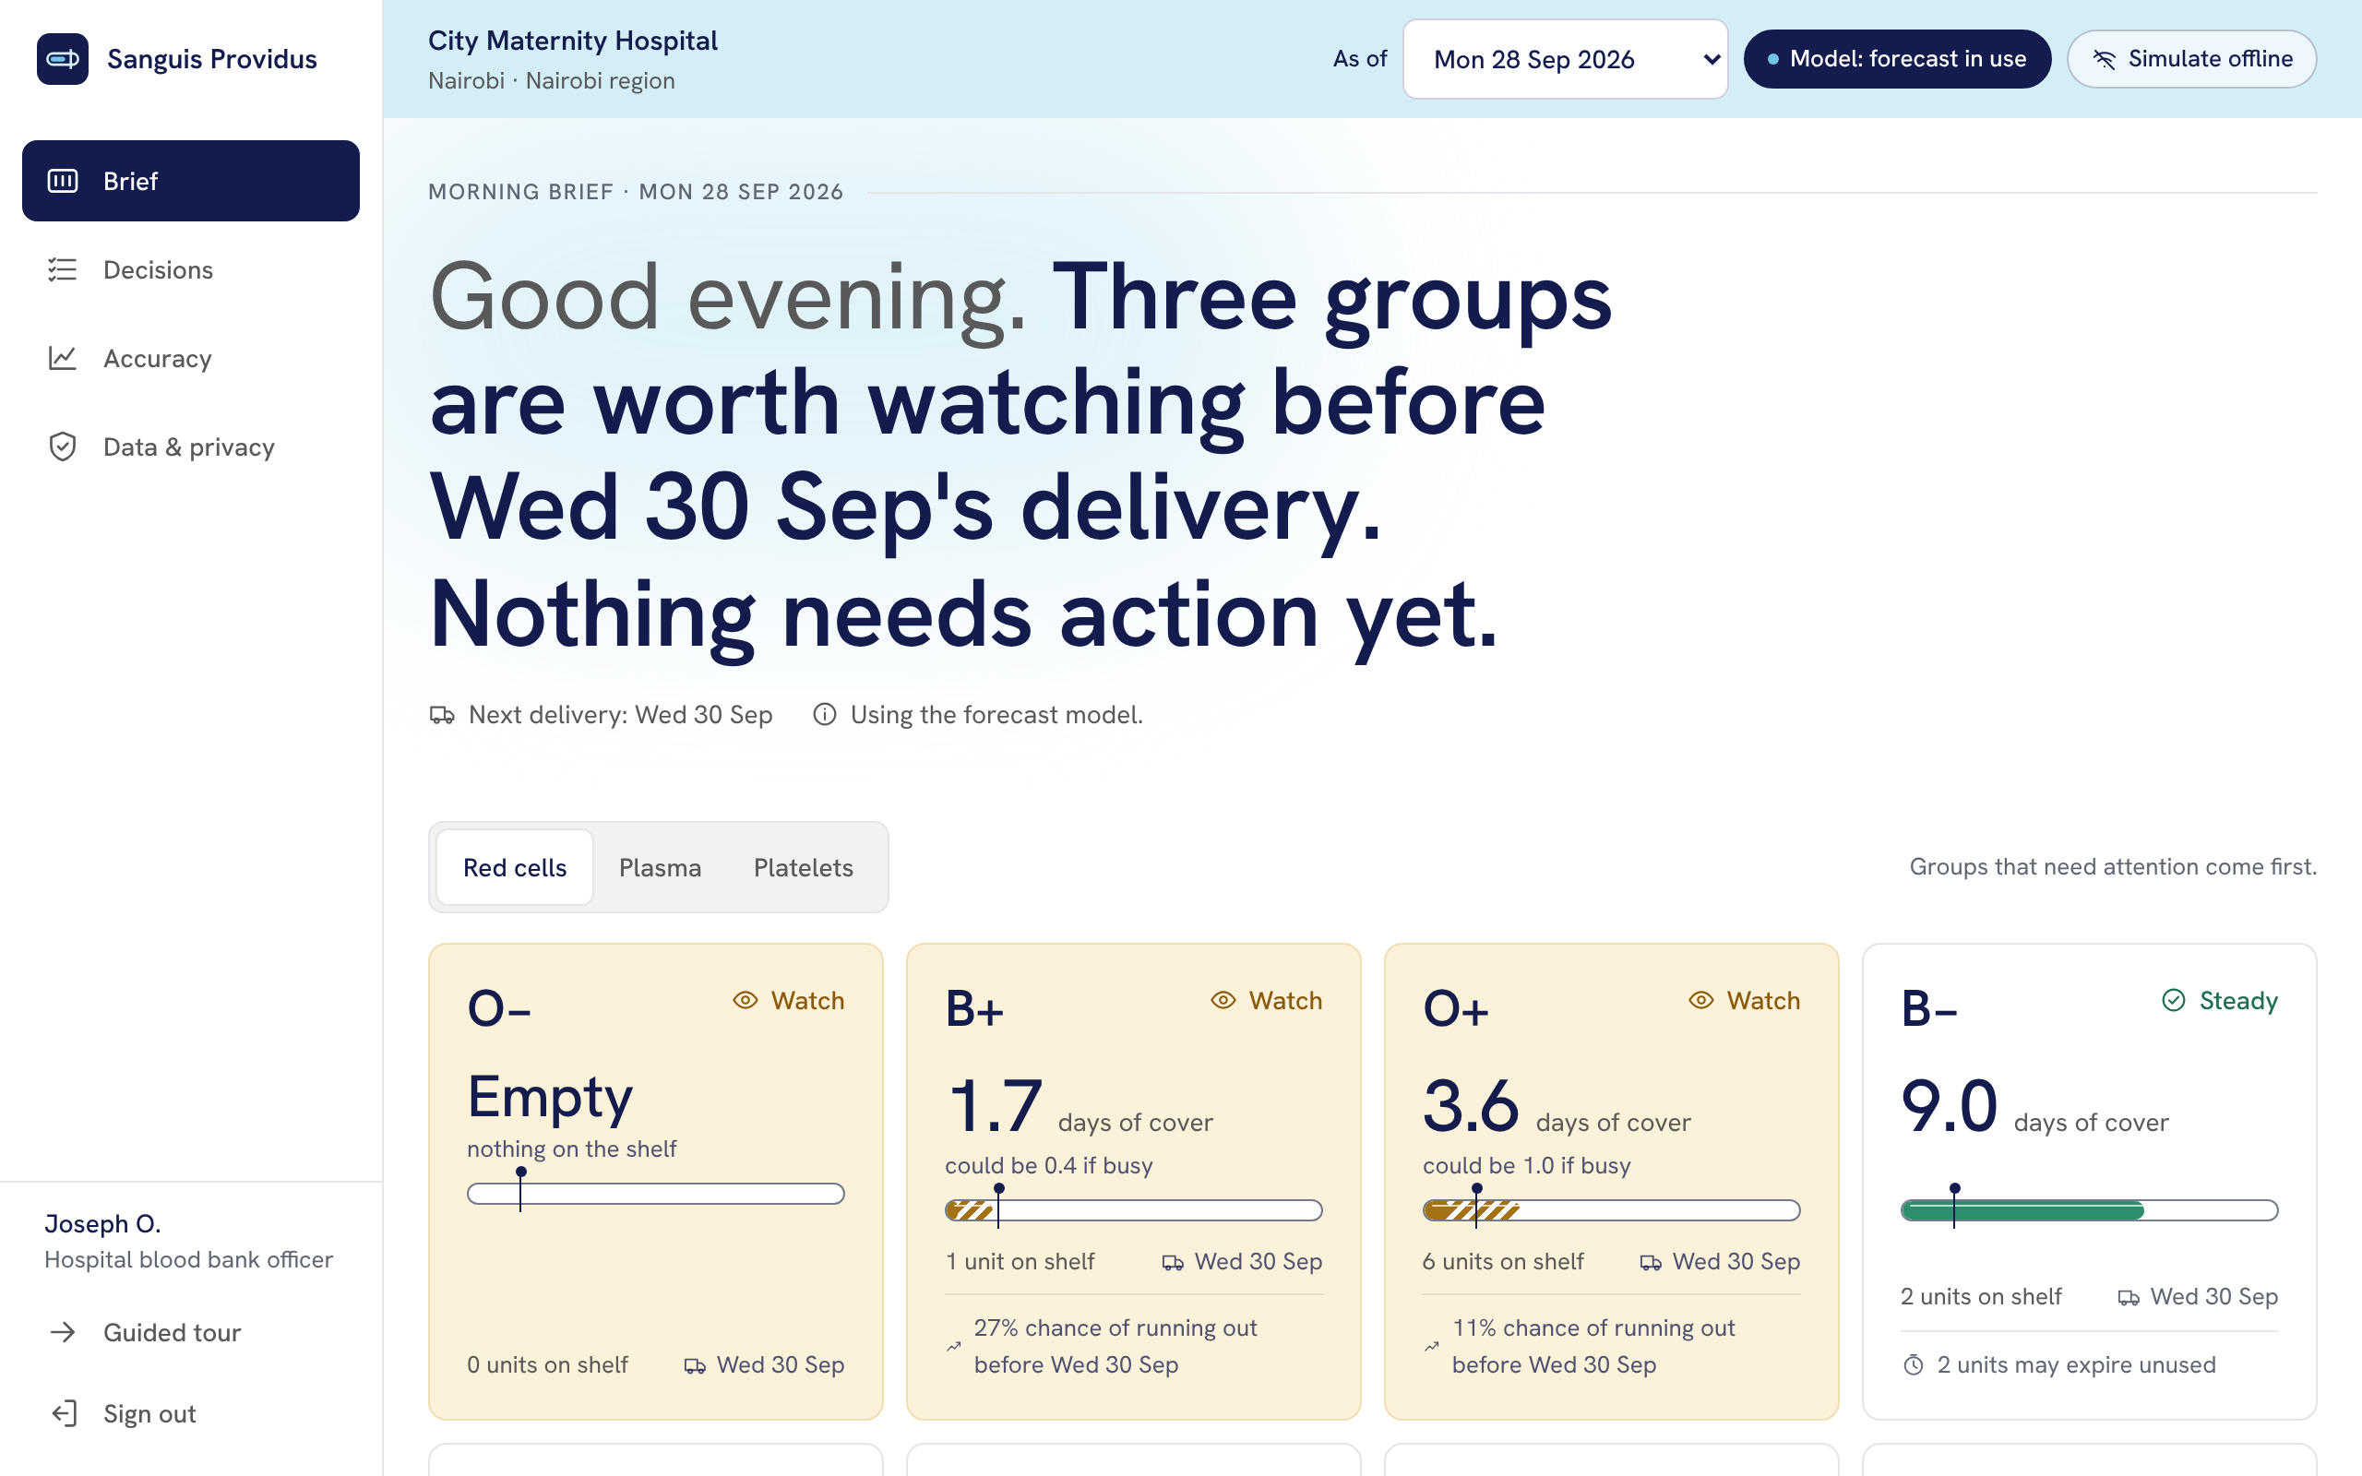
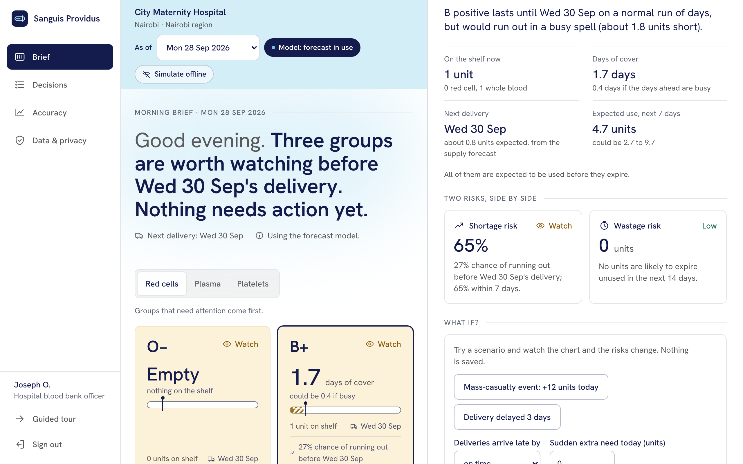
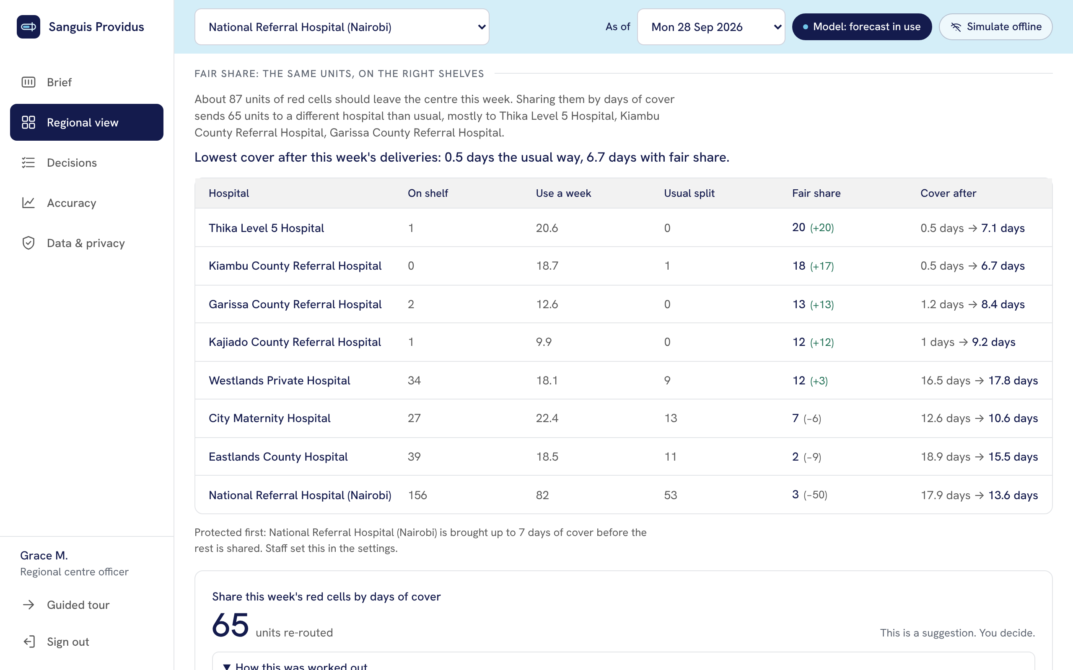
ONE MORNING, ONE DECISION, START TO FINISH
04 · LIVE DEMO · 5 MINUTES
WE WILL SHOW
WATCH FOR
THEN
Joseph's morning brief at City Maternity Hospital, on synthetic data
The warning, its reasons, a changed order, then Grace's fair-share plan for the region
We switch the AI off and finish the task anyway
TERUMO BCT AFRICA HACKATHON 2026 · TEAM MEDIBORA
05
Notes:
Left: the morning brief. One sentence first, then eight blood groups with days of cover. Middle: one blood group opened, with its 14-day projection, the chance of running out beside the units likely to expire, and the suggested order. Right: the regional officer's fair-share plan. In the live demo we use the guided tour built into the app, then we switch the model off on the Accuracy page and finish the task on the 4-week average. If the connection fails we play the recorded video.

Slide 6
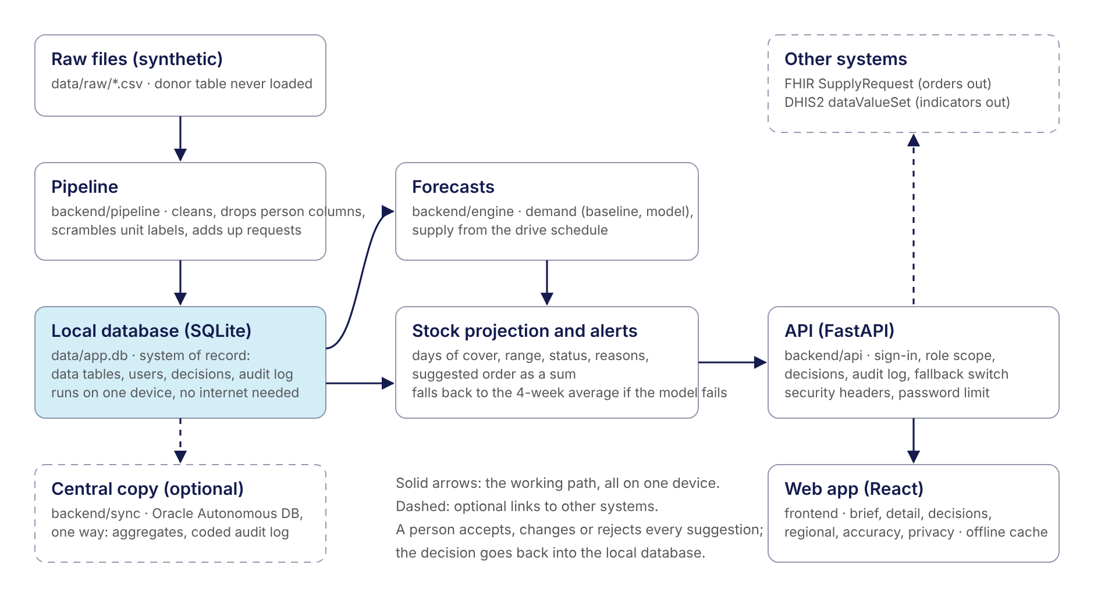
ARCHITECTURE AND WHERE IT FITS IN ABBIS
05 · HOW IT IS BUILT
STACK
Python, FastAPI, SQLite, scikit-learn, React. Runs offline on one laptop.
PLACE IN ABBIS
A planning layer: reads stock, request and drive counts, hands back approved orders.
STANDARDS
FHIR SupplyRequest, DHIS2 export
SECURITY
Role-based access, append-only audit log. No donor or patient identities are loaded.
TERUMO BCT AFRICA HACKATHON 2026 · TEAM MEDIBORA
06
Notes:
Everything on the solid arrows runs on one device with no internet: raw files, a pipeline that drops person-level columns, a local database, the forecasts, the projection, and the web app. Privacy is designed in. The donor register is never loaded and a test fails if any code names it. Unit labels are scrambled with a key that is thrown away. Each role sees only its own hospitals, enforced on the server. The app has a Data and privacy page: what we use, who sees what, where it is stored, what happens if something leaks, and a notice in English and Swahili. An accepted order is served as a FHIR-shaped SupplyRequest, and monthly indicators in a DHIS2 shape. Where it can fail: if the model errors, the 4-week average takes over and every screen says so.

Slide 7
WHICH BLOOD GROUPS WILL RUN SHORT, AND WHERE THIS WEEK'S UNITS SHOULD GO
06 · THE AI FEATURE
METHOD
Drive-schedule supply; boosted-tree demand
DOES IT BEAT A BASELINE?
WHY THIS?
Plain reasons, and the order shown as a sum
58%
4-week average
WHO DECIDES
The blood bank or regional officer accepts, changes or rejects. Every decision is in the audit log.
26%
Our model
IF IT FAILS
One switch, or any model error, falls back to the 4-week average. Every screen says so.
Error on cleared units per centre, 16 test Mondays. Demand: 71% to 68%.
32%
fewer units short in the fair-share replay
76%
of shortages warned of first (simple rule: 65%)
28%
of warnings were right: most are false alarms
TERUMO BCT AFRICA HACKATHON 2026 · TEAM MEDIBORA
07
Notes:
How the models work. Supply: for each regional centre we take the scheduled drives, the usual yield for that kind of venue, the share of donations that pass screening, and the testing wait, all learned only from days before the forecast date. Emergency appeals are never counted as planned. Demand: one gradient-boosting model trained across all hospitals on weekly requests, with lags, the school calendar and public holidays, giving a range, not a single number. We tested on 16 Mondays the models never saw. Supply error falls from 58% to 26%. Demand improves only from 71% to 68%, because demand is flat, and we say so. Warnings came before 76% of real shortages against 65% for a simple rule, but only 28% of warnings were followed by a shortage. And the fair-share replay: same blood, same requests, 32% fewer units that a hospital's own shelf could not supply; the best-stocked hospitals give up cover, and we show who. AI supports the officer. It never releases a unit, decides compatibility, or contacts a donor.

Slide 8
WHO BUILT IT, AND WHAT WE NEED NEXT
07 · THE TEAM
Linet Mugwanja
Jael Wainaina
Eugene Mutembei
Washington Adiado
Trixy W. Wainaina
Build lead
Research
Integration
Role to confirm
Role to confirm
Data, models and app
Feature list and pitch
SMS alerts, team repo
To confirm
To confirm
WHAT WE NEED TO TAKE THIS FURTHER
A pilot at one regional centre and its hospitals, with read access to anonymised stock and request counts, to test the forecasts and fair share on real shelves.
TERUMO BCT AFRICA HACKATHON 2026 · TEAM MEDIBORA
08
Notes:
We are five people from Kenya. Our one ask: a pilot at one regional blood centre and the hospitals it supplies, with read access to anonymised stock and request counts. That lets us test the supply forecast and the fair-share plan on real shelves, with a protected minimum for referral hospitals. Before real use we still need a data protection impact assessment, registration with the regulator, and an independent security test. Thank you.

