Slide 1
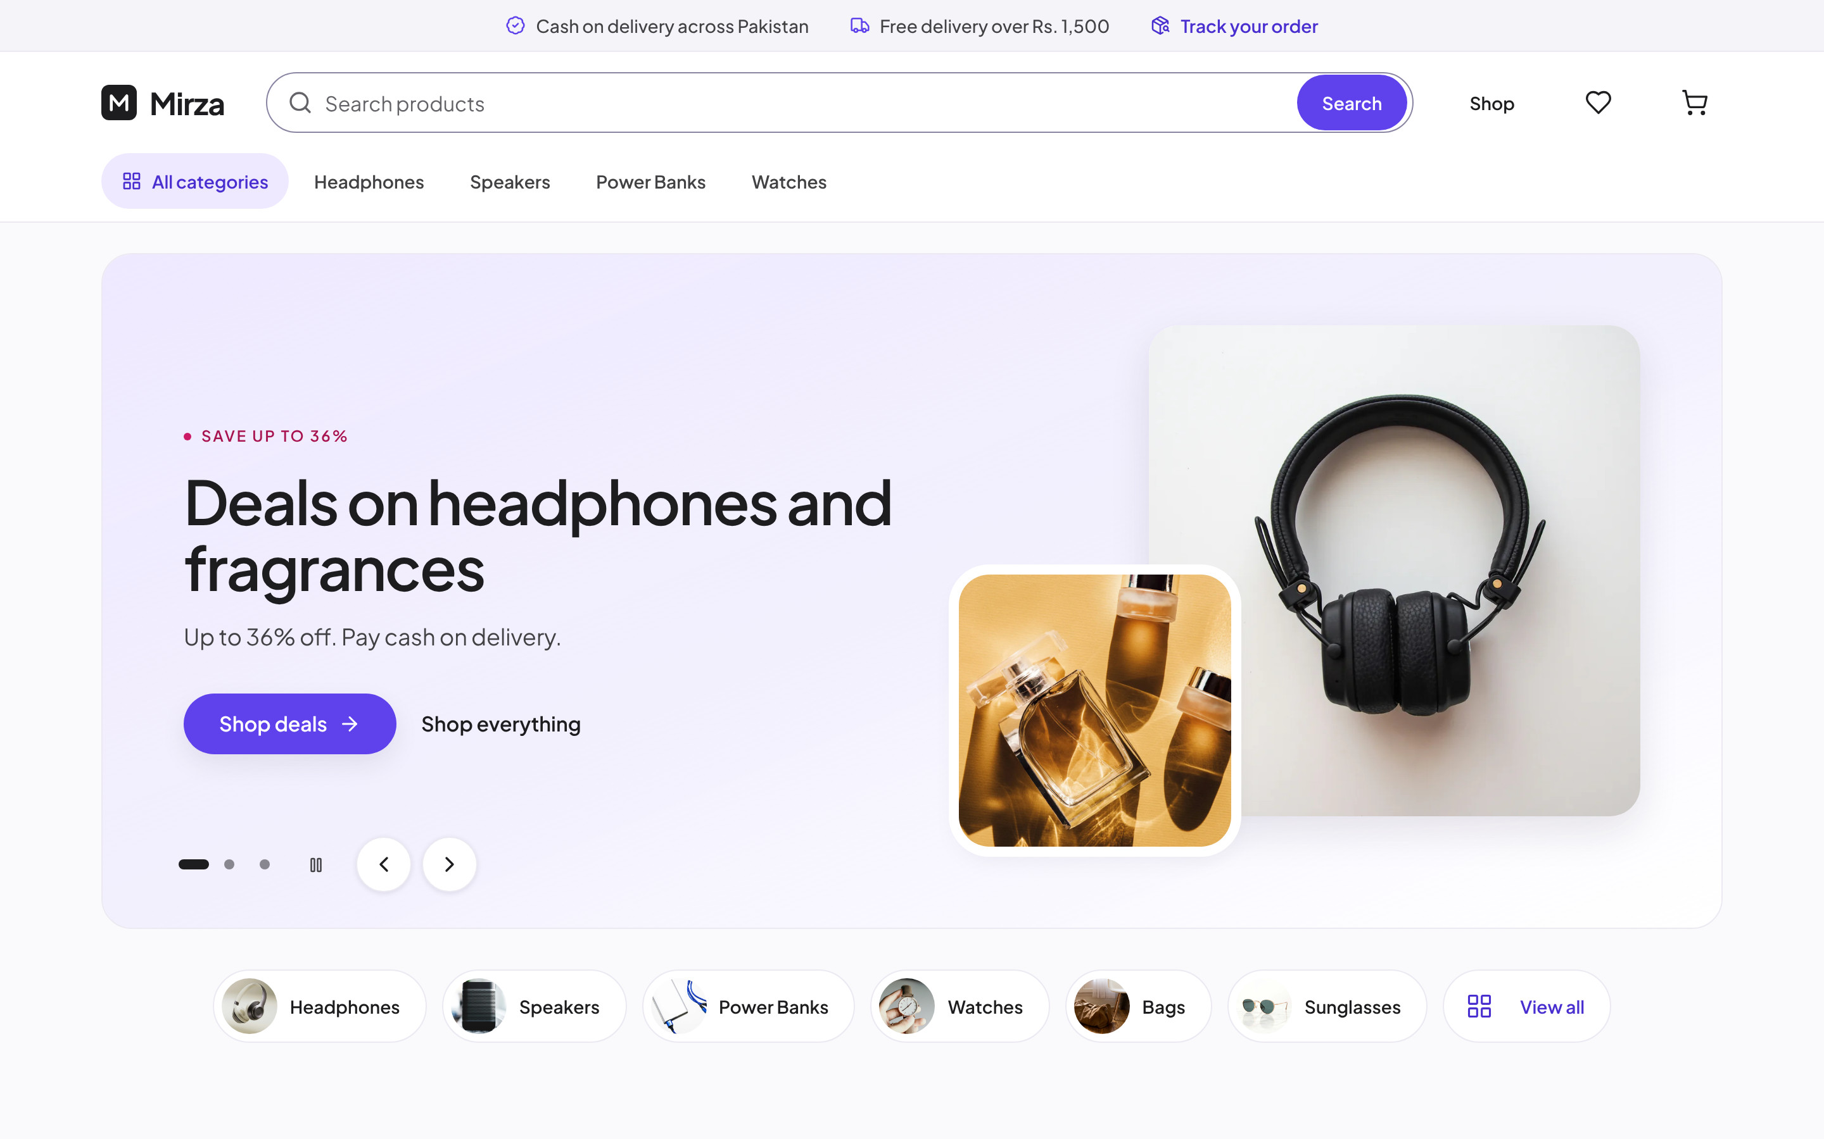
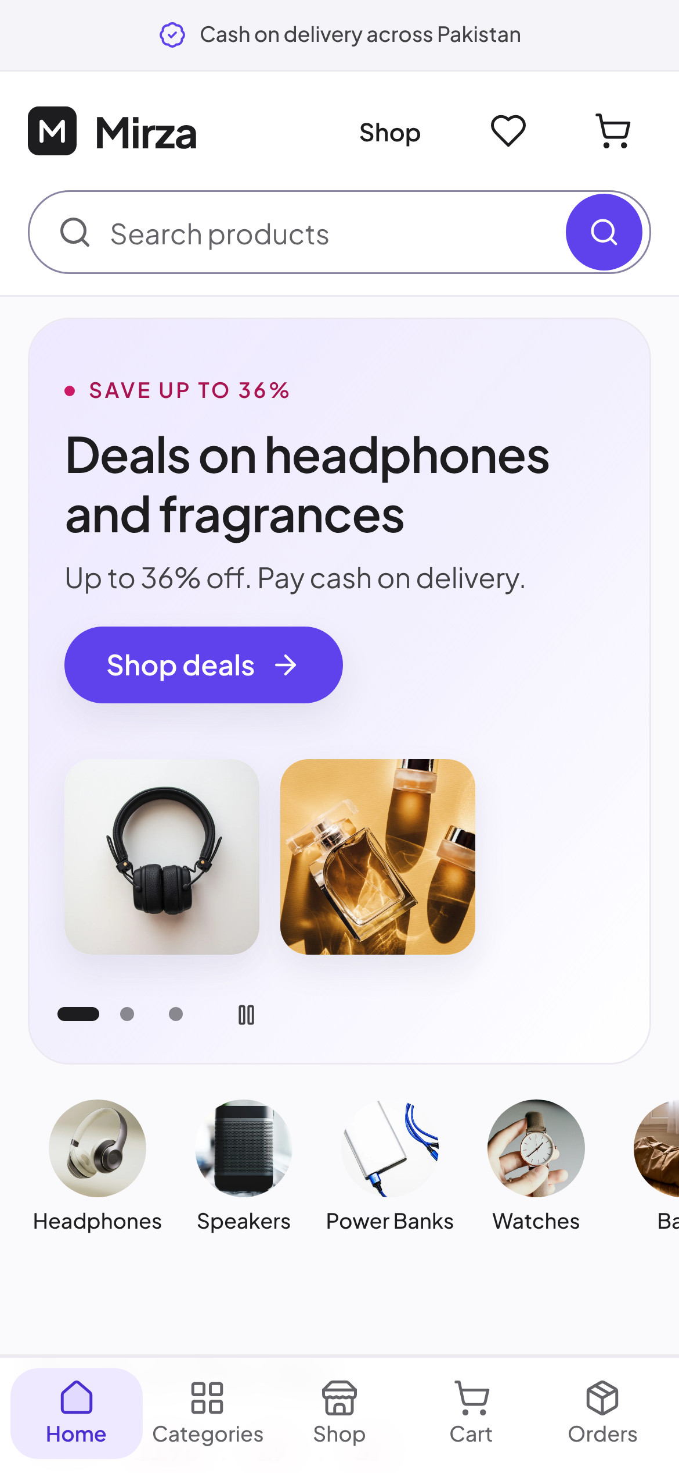
BRAND IDENTITY & ECOMMERCE SHOWCASE
Mirza
9:41
Electronics, fashion, home and beauty, delivered across Pakistan. Pay in cash when your order arrives.
Responsive storefront · Cash on Delivery · Guest checkout
Next.js · Payload CMS · PostgreSQL
Notes:
Cover

Slide 2
Mirza
02 · CONTENTS
INSIDE
Contents
BRAND
VISUAL IDENTITY
SHOWCASE
03
Introduction
11
Photography
15
Desktop: homepage
A brand guide and a visual tour of the live Mirza storefront, on desktop, tablet and phone.
04
Positioning & personality
12
Interface language
16
Desktop: homepage sections
05
Logo
13
Components
17
Desktop: shopping
06
Logo usage
14
Brand in use
18
Desktop: product detail
07
Colour: core palette
25
Do's and don'ts
19
Desktop: cart & wishlist
08
Colour: supporting palette
20
Mobile: homepage
09
Typeface
21
Mobile: shopping
10
Type hierarchy
22
Mobile: product
23
Mobile: shopping journey
24
Responsive
Brand Identity & Ecommerce Showcase
02 / 26
Notes:
Contents

Slide 3

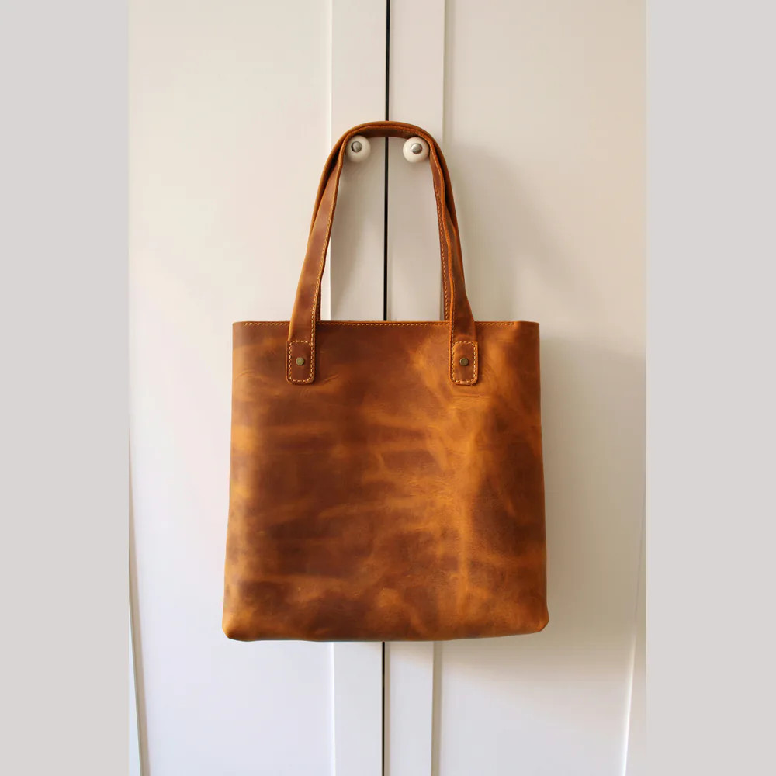
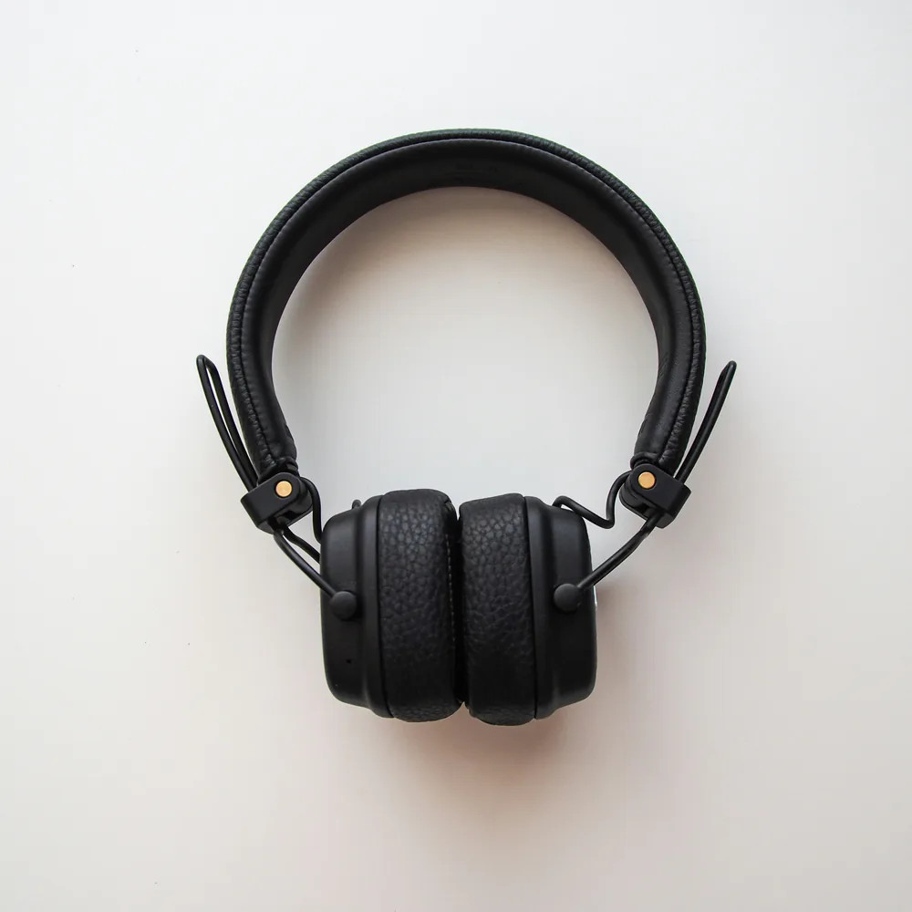
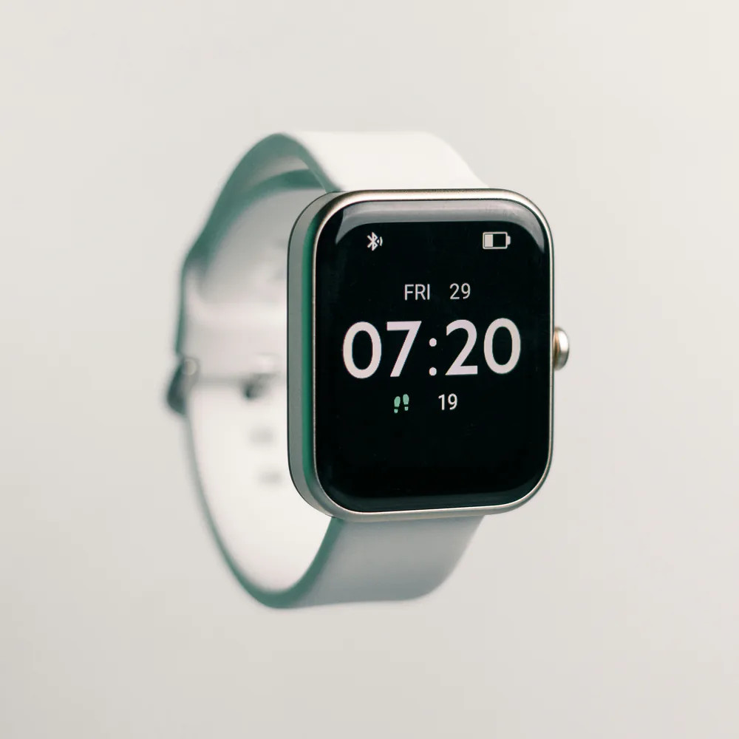
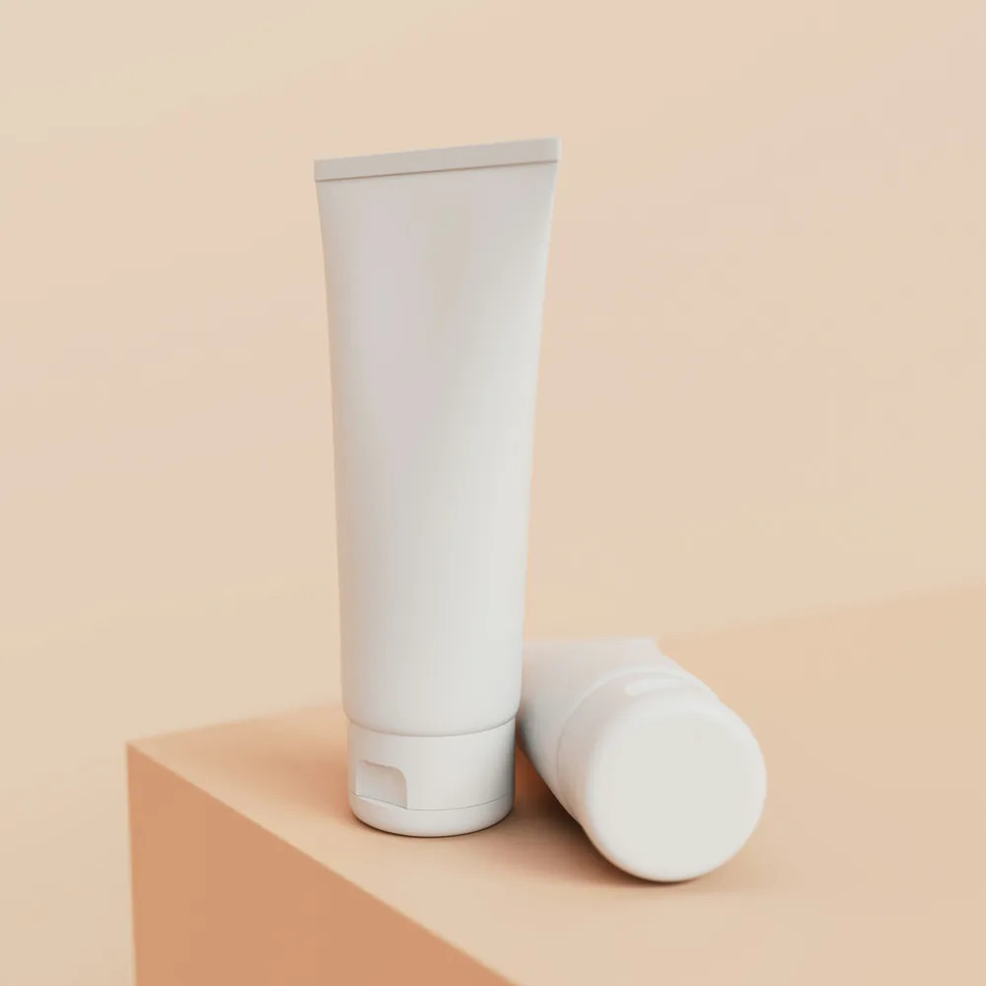
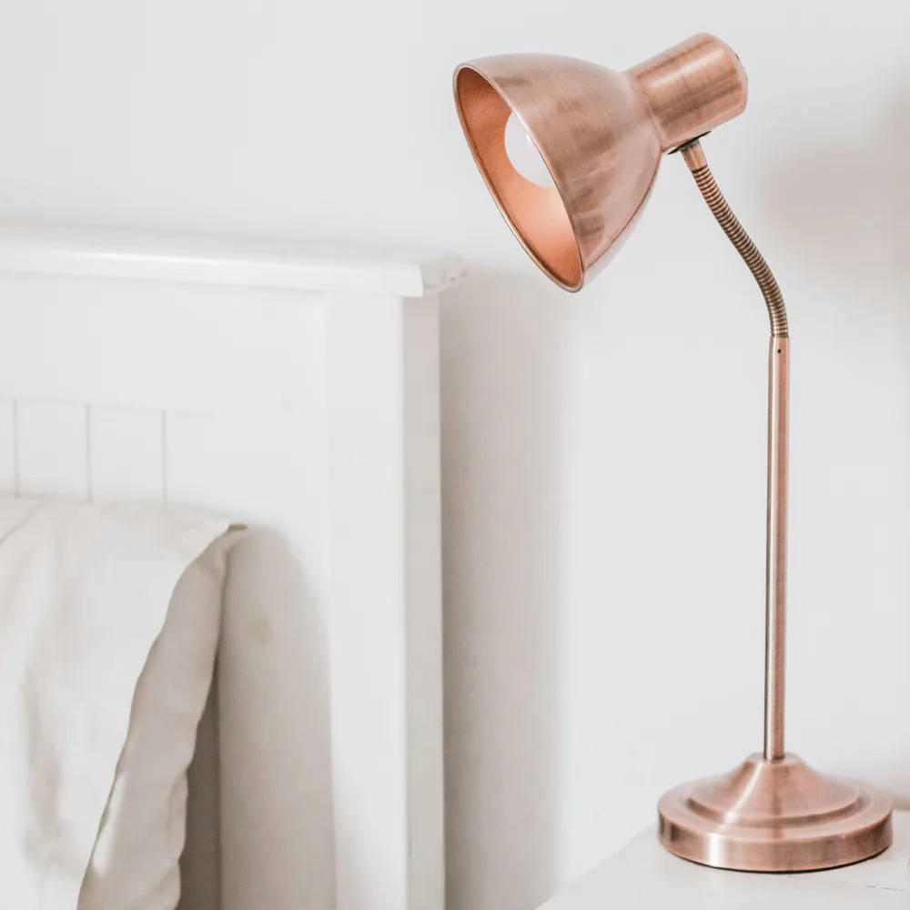
Mirza
03 · INTRODUCTION
BRAND OVERVIEW
Everyday shopping,
made calm and certain.
Mirza is a single-store online shop for Pakistan. It sells a curated range of electronics, fashion, home and beauty products, delivers nationwide and lets every customer pay in cash when the parcel arrives. No account is needed to order.
SHORT DESCRIPTION
Electronics, fashion, home and beauty, delivered across Pakistan. Pay in cash when your order arrives.
VISUAL DIRECTION
Neutral, airy surfaces so product photography reads true; one confident violet for every action; a single modern sans-serif; soft 16 to 24 px corners; hairlines instead of heavy borders.
Real catalogue photography from the storefront.
Brand Identity & Ecommerce Showcase
03 / 26
Notes:
Brand introduction

Slide 4
Mirza
04 · POSITIONING & PERSONALITY
PERSONALITY
POSITIONING
For shoppers across Pakistan who want good everyday products without risk, Mirza is the online store where you order in a minute and pay only when it arrives.
Clear
Prices, delivery cost and stock are visible before you tap anything.
Trustworthy
Cash on delivery, no account, honest discounts. Nothing hidden.
Modern
A clean, photo-first interface with generous space and one accent colour.
Single store · Curated catalogue · Cash on Delivery · Nationwide delivery
Warm
Plain, friendly words. The store talks like a helpful shopkeeper, not a bank.
1
2
3
Cash on delivery
Delivery across Pakistan
No account needed
VOICE, IN THE STORE'S OWN WORDS
Pay the courier in cash when the parcel arrives. No card needed.
Rs. 200 delivery, free on orders of Rs. 1,500 or more.
Order with your name, phone number and address. Track it with your order number.
"Order now, pay when it arrives"
"No account needed: just your name, phone number and address."
"Pay the courier when your parcel arrives."
The three promises shown in the storefront footer and order steps.
Brand Identity & Ecommerce Showcase
04 / 26
Notes:
Positioning & personality

Slide 5
Mirza
05 · LOGO
PRIMARY LOGO
The Mirza lockup
A near-black square monogram, an "M" drawn as one continuous stroke, beside the store name set in Plus Jakarta Sans Bold.
Monogram
Favicon and admin
Mirza
Mirza
Wordmark, inverse
Footer and dark surfaces
Mirza
Lockup
Storefront header
Brand Identity & Ecommerce Showcase
05 / 26
Notes:
Logo

Slide 6
Mirza
06 · LOGO USAGE
LOGO USAGE
Space, size and backgrounds
CLEAR SPACE
MINIMUM SIZE
½ × mark
Mirza
Lockup: 28 px monogram
(the storefront header size)
Monogram alone: 16 px
(the favicon size)
Mirza
APPROVED BACKGROUNDS
Mirza
Mirza
Mirza
Mirza
Keep a margin of at least half the monogram's height on every side. Nothing else (text, photos, edges) enters it.
#FAFAFC
#F5F4F8
#EEE9FF
#1D1D1F
On near-black, use the white wordmark on its own, as the storefront footer does: the monogram is near-black itself and would disappear. The store name in the lockup comes from the admin Settings, so a renamed store renames the logo.
Brand Identity & Ecommerce Showcase
06 / 26
Notes:
Logo usage

Slide 7
Mirza
07 · COLOUR
COLOUR
Core palette
Every colour below is a design token in the storefront (app/globals.css). Neutral surfaces let the photos speak; violet marks every action.
primary-dark
accent
accent-soft
#4A2FD0 RGB 74 47 208
#E2DAFF RGB 226 218 255
#EEE9FF RGB 238 233 255
Hover and pressed states.
Soft fills, decorative tints.
Hero, announcement bar, selected chips.
primary
#5F42EC RGB 95 66 236
The one action colour: buttons, links, selected tabs, focus rings. White on primary: 6.04:1.
ink
ink-2
ink-3
muted
disabled
#1D1D1F RGB 29 29 31
#424245 RGB 66 66 69
#515154 RGB 81 81 84
#636368 RGB 99 99 104
#A1A1A6 RGB 161 161 166
Headings, prices, logo.
Body copy.
Secondary copy.
Captions, meta.
Disabled controls.
Brand Identity & Ecommerce Showcase
07 / 26
Notes:
Colour: core palette

Slide 8
Mirza
08 · COLOUR
COLOUR
Surfaces, lines and status
SURFACES AND LINES
page
surface
surface-muted
line
line-2
line-3
line-input
#FAFAFC RGB 250 250 252
#FFFFFF RGB 255 255 255
#F5F4F8 RGB 245 244 248
#ECE9F2 RGB 236 233 242
#E2DFEA RGB 226 223 234
#CBC6D8 RGB 203 198 216
#8A84A3 RGB 138 132 163
Page
Cards
Photo wells
Card hairline
Dividers
Hover line
Form fields
STATUS
CONTRAST (WCAG)
Aa
6.04:1
Aa
9.3:1
Aa
5.47:1
sale
sale-strong
sale-soft
amber
success
success-soft
Aa
6.12:1
#A8144F RGB 168 20 79
#CC1966 RGB 204 25 102
#FFE4F0 RGB 255 228 240
#FFC247 RGB 255 194 71
#0B6E4F RGB 11 110 79
#E6F2EE RGB 230 242 238
Aa
5.39:1
Discount text
Sale label
Discount chip
Limited edition
In stock
Success tint
Sale colours are for real discounts only, amber only for "Limited edition". Cards use a hairline, not a shadow.
Brand Identity & Ecommerce Showcase
08 / 26
Notes:
Colour: supporting palette

Slide 9
Mirza
09 · TYPOGRAPHY
Aa
TYPOGRAPHY
One family,
four weights.
There is no secondary typeface. Hierarchy comes from size, weight and tight tracking on headings.
Regular
400
Body copy, descriptions
Plus Jakarta Sans
Medium
500
Announcement bar, small labels
The one typeface of the storefront: a geometric, friendly sans-serif with open shapes. Self-hosted variable font (weights 400 to 800), SIL Open Font License.
SemiBold
600
Headings, buttons, prices, nav
ABCDEFGHIJKLMNOPQRSTUVWXYZ
abcdefghijklmnopqrstuvwxyz 0123456789 Rs. 4,499
Bold
700
The wordmark
Brand Identity & Ecommerce Showcase
09 / 26
Notes:
Typeface

Slide 10
Mirza
10 · TYPOGRAPHY
TYPE HIERARCHY
Measured on the live storefront
HERO HEADING
Deals on headphones and fragrances
48 / 52 SemiBold −3%
Phone: 28 / 34
SECTION HEADING
Deals of the day
36 / 40 SemiBold −3%
Phone: 24 / 30
PRICE
Rs. 4,499
28 / 28 SemiBold −2%
Product page
WORDMARK
Mirza
24 / 30 Bold −3%
Header
LEAD
Up to 36% off. Pay cash on delivery.
18 / 26 Regular
Phone: 16 / 24
PRODUCT NAME
Aero Wave Wireless Headphones
16 / 24 SemiBold
Phone: 14 / 20
BODY
Picked by the store, across every category.
16 / 24 Regular
Phone: 14 / 20
NAVIGATION
Headphones · Speakers · Power Banks · Watches
14 / 20 SemiBold
EYEBROW
SAVE UP TO 36%
12 / 16 SemiBold +12% caps
Buttons: 16 / 24 SemiBold (hero), 14 / 20 SemiBold (product page). Body text never goes below 12 px.
Brand Identity & Ecommerce Showcase
10 / 26
Notes:
Type hierarchy

Slide 11
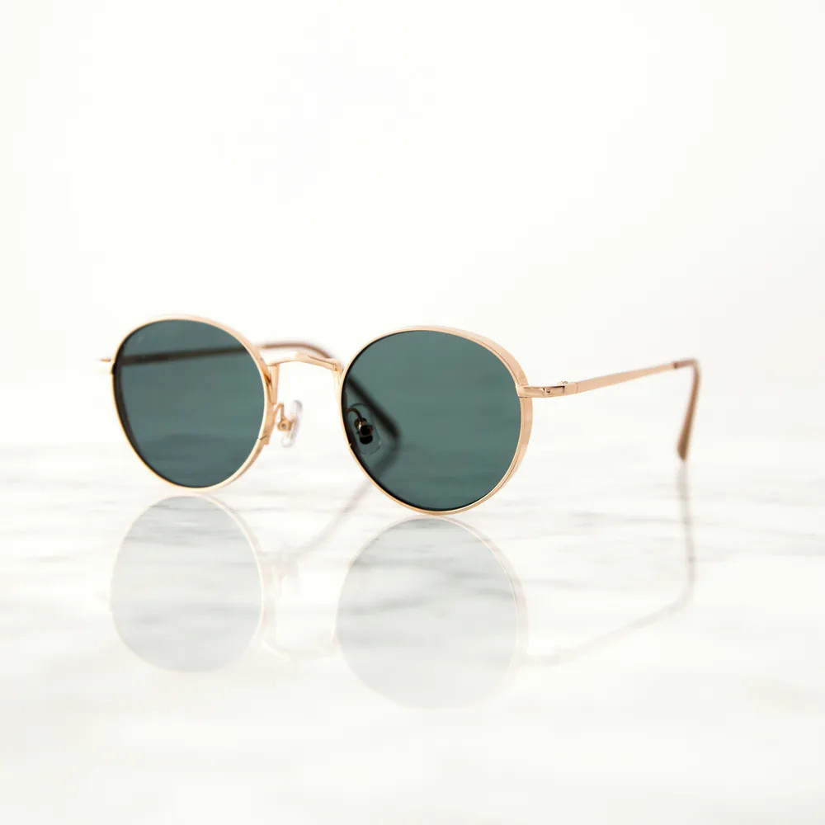
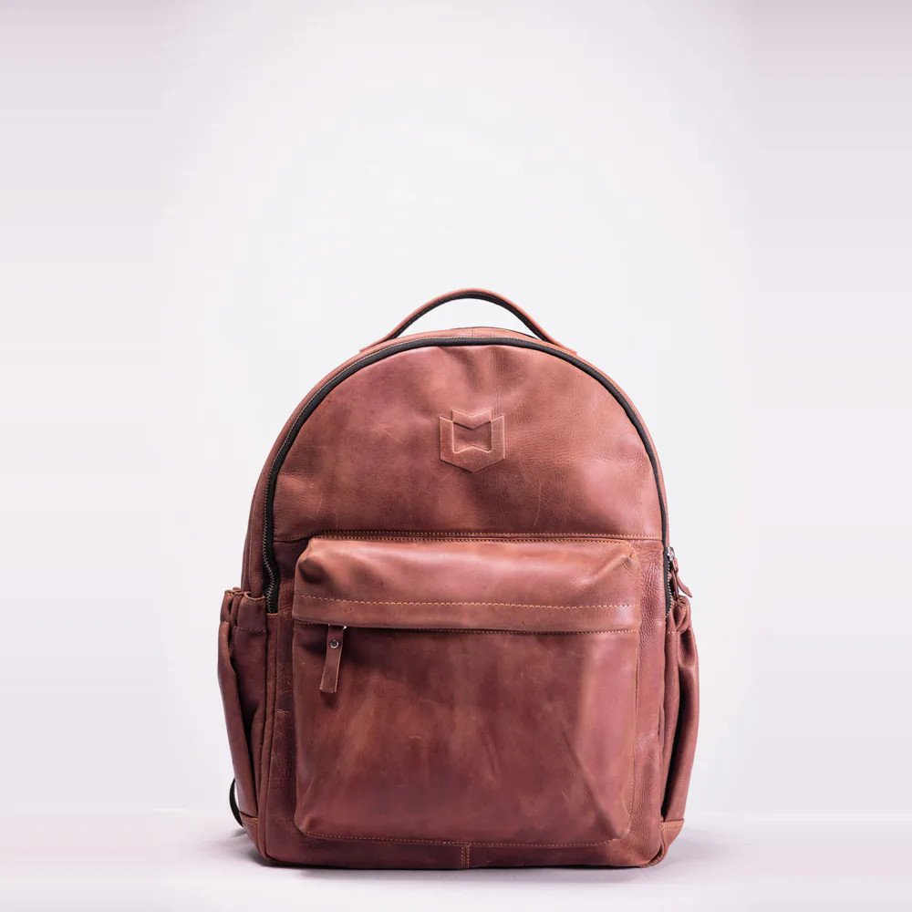
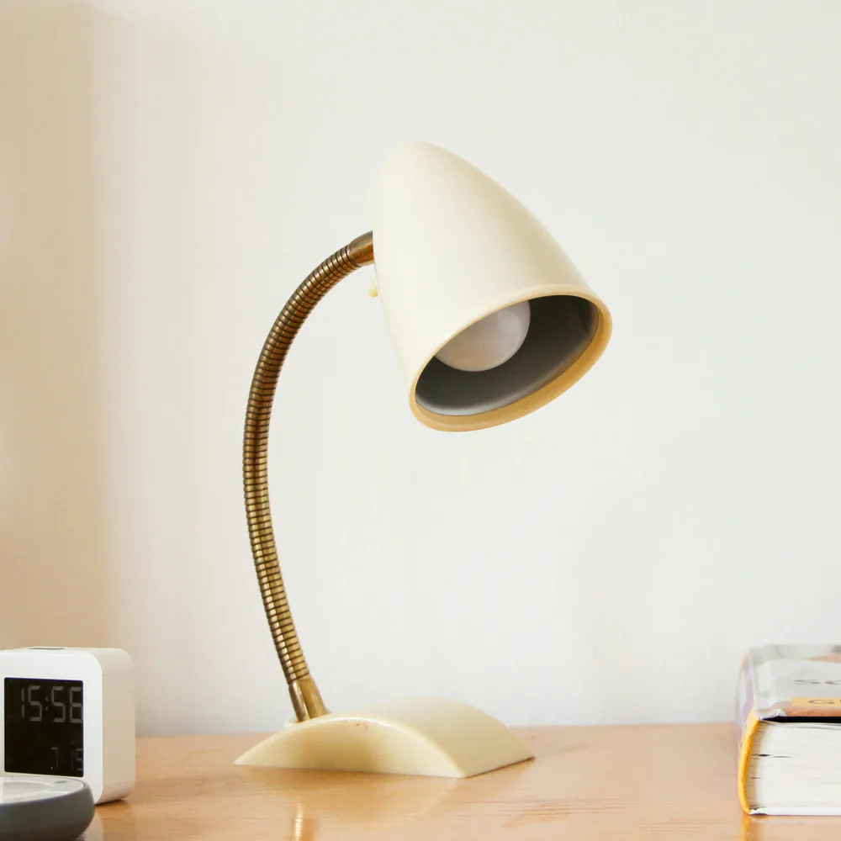
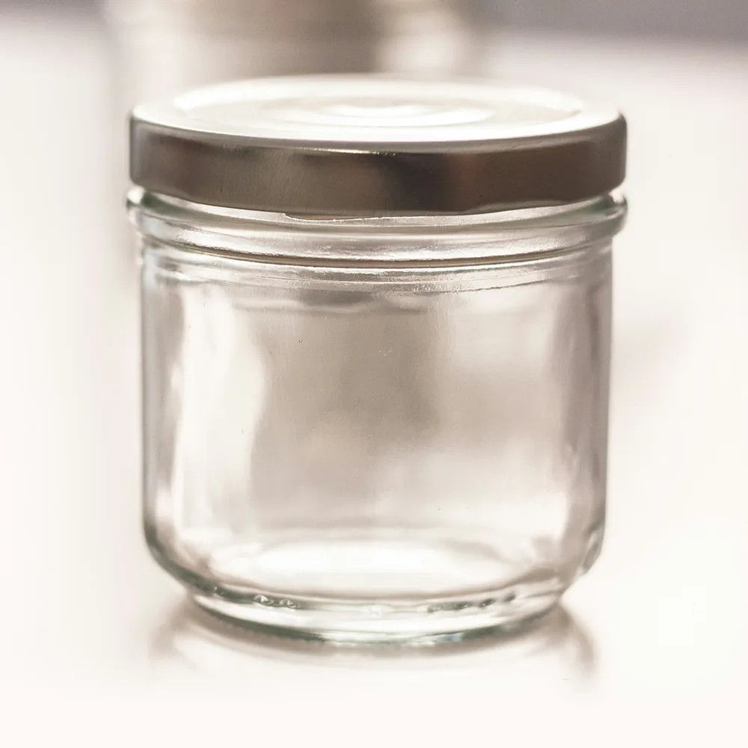
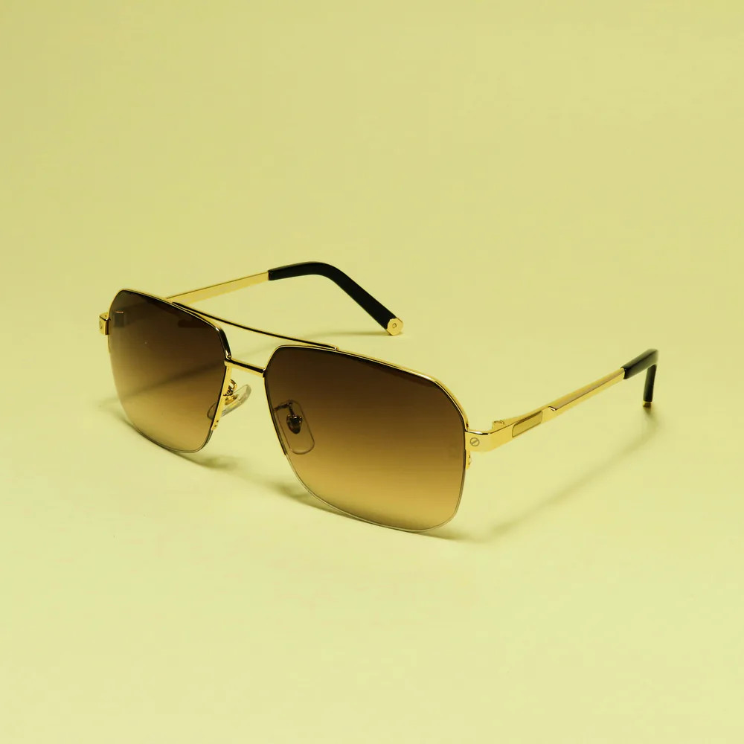
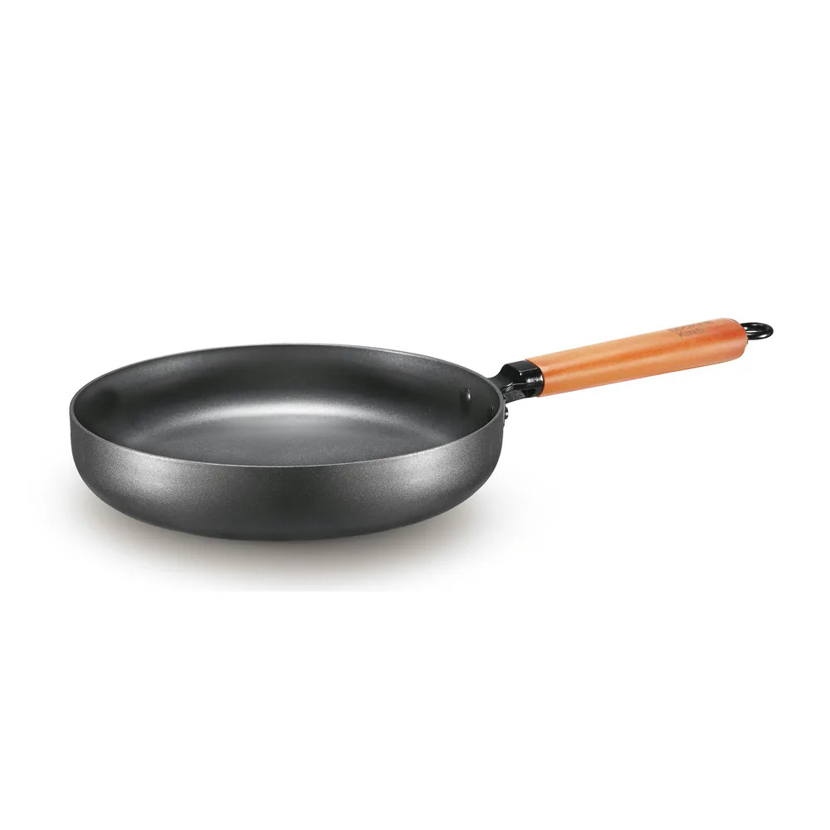
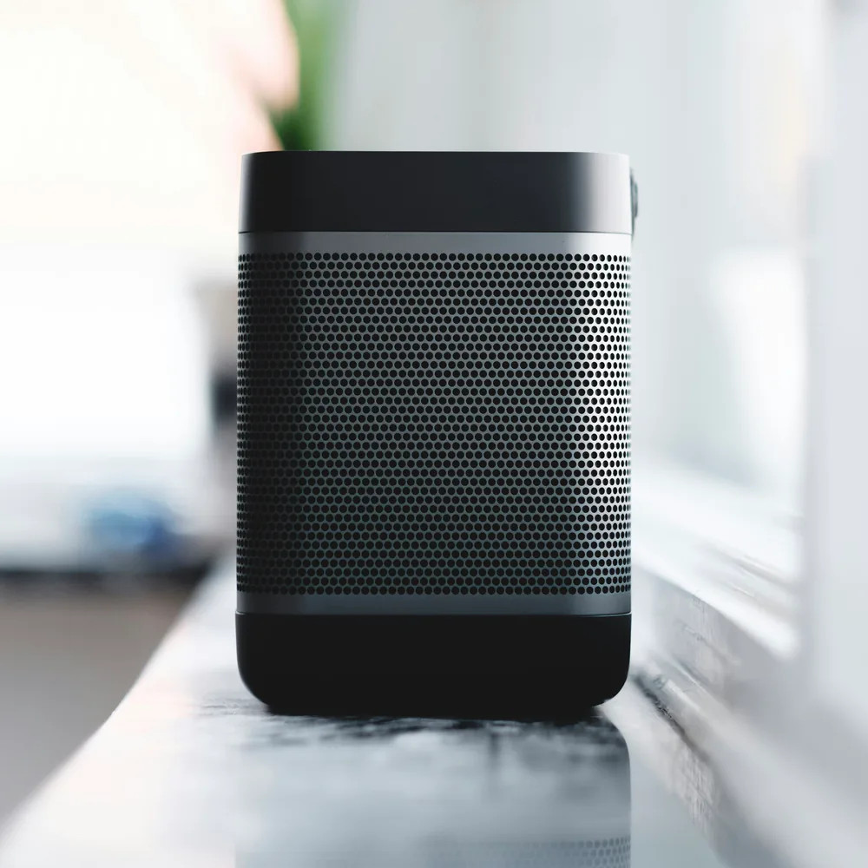
Mirza
11 · VISUAL IDENTITY
PHOTOGRAPHY
One product,
one calm frame.
Studio light
Soft, diffused side light with a gentle, natural shadow. No heavy filters or HDR.
Neutral backdrop
Seamless white to warm light grey. Colour comes from the product, not the backdrop.
Square and centred
One product per frame, filling 65 to 75% of a square, with a margin so nothing is cropped.
Unbranded
No logos, readable labels or recognisable designs; no people or faces.
Product photos are shown on a muted well (#F5F4F8) inside cards. Category images are 4:3 and appear as circles in the home shortcuts.
Brand Identity & Ecommerce Showcase
11 / 26
Notes:
Photography

Slide 12
Mirza
12 · VISUAL IDENTITY
INTERFACE LANGUAGE
Shape, depth, actions
CORNER RADIUS
ELEVATION
BUTTONS
Search products
12 px
Controls and fields
Add to cart
Buy now
Load more products
Cards: hairline, no shadow
Primary · Secondary (soft) · Quiet (outlined)
16 px
Cards and tiles
LABELS
New
Limited edition
Out of stock
−30%
In stock
Chip 0 1 4
Status and offer labels sit on the photo as small pills (components/ui/Badge.tsx).
SPACING
24 px
Panels and the hero
Float small 0 8 20
4
8
12
16
24
32
48
Float 0 12 32
A 4 px grid. Card padding 10 to 12 px, product grid gaps 12 px (phone) and 24 px (desktop).
Pill
Full
Every button
ICONOGRAPHY
Shadows only for floating controls and bars; colour rgba(16, 12, 40).
Lucide outline icons at 14 to 24 px, mostly 1.4 to 2 px strokes, in ink tones or white on dark.
Brand Identity & Ecommerce Showcase
12 / 26
Notes:
Interface language

Slide 13
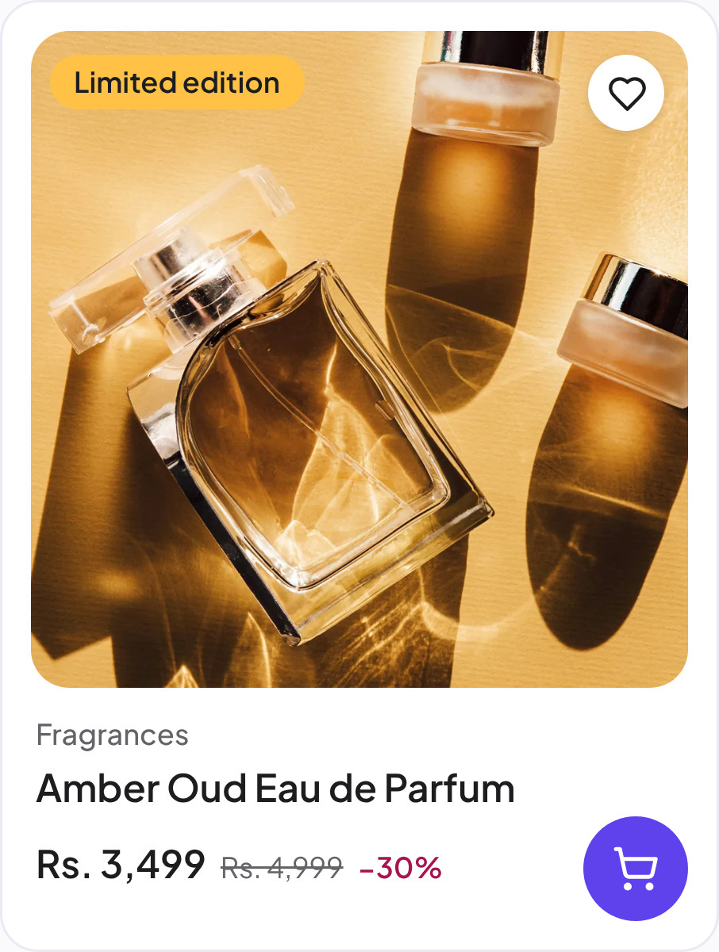
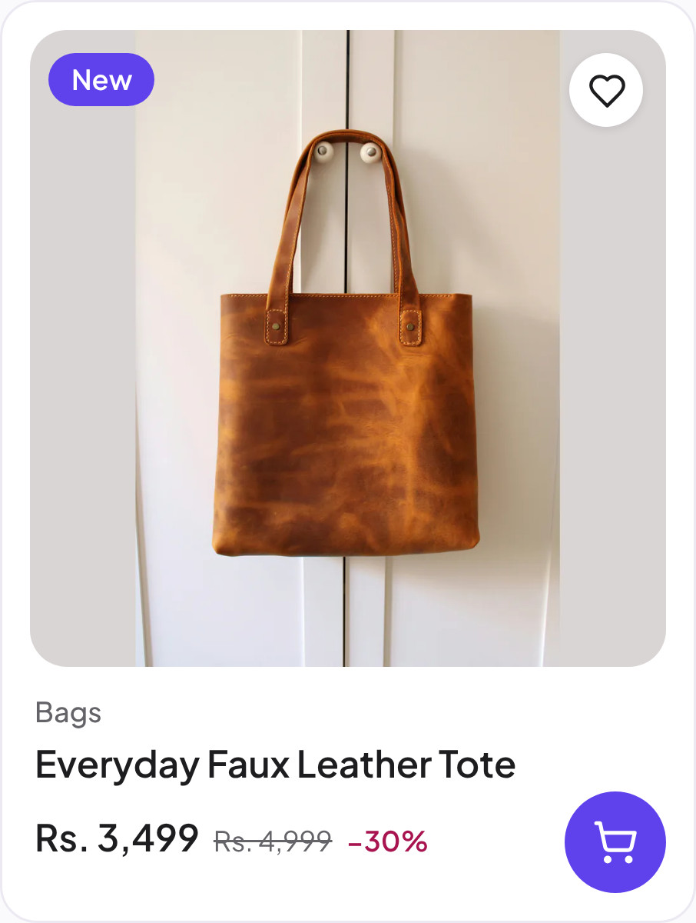
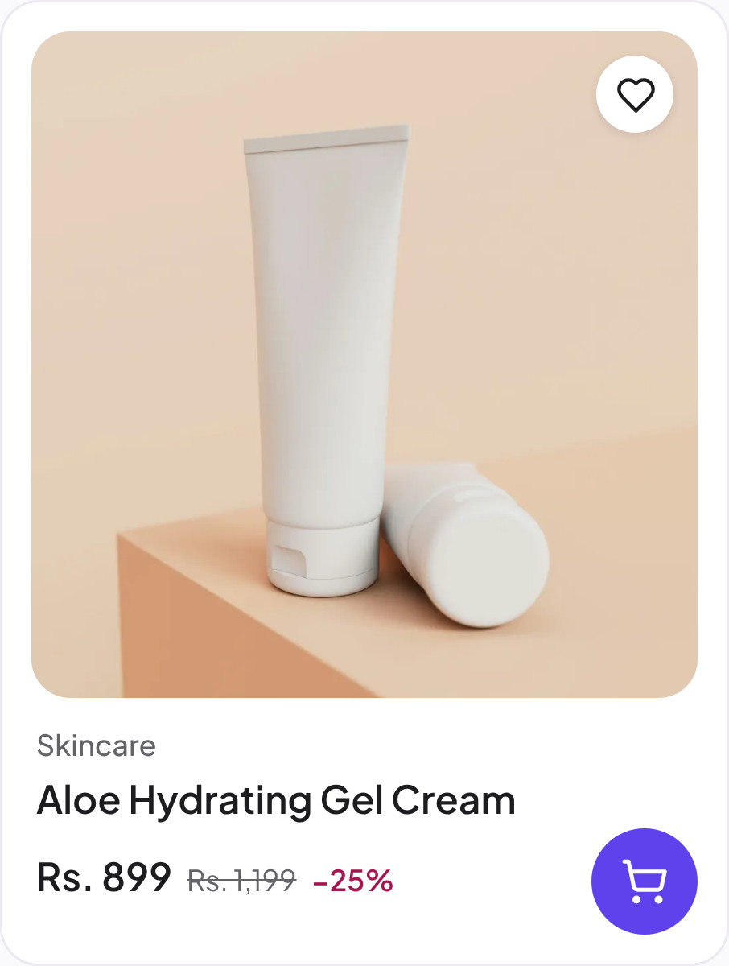
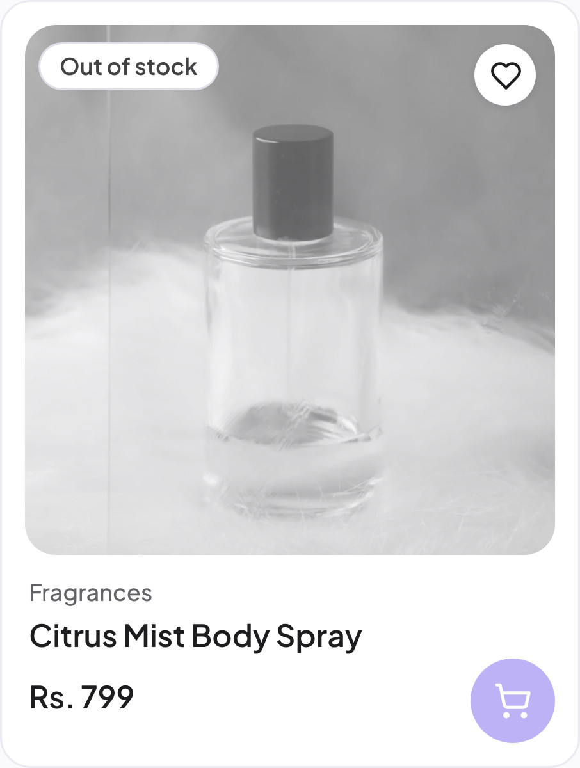
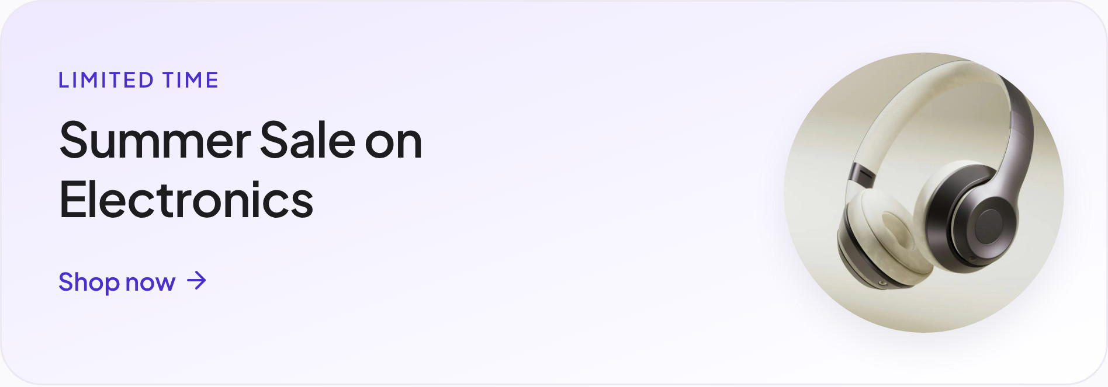
Mirza
13 · VISUAL IDENTITY
COMPONENTS
Captured from the live store
Product cards, the header and promotional elements, exactly as shoppers see them.
Promotional card
Category shortcuts
Listing cards: photo first, category, name, price with the was-price and discount, a round add-to-cart button.
Header: lockup, search, quick links, wishlist and cart, with the category row below.
Brand Identity & Ecommerce Showcase
13 / 26
Notes:
Components

Slide 14
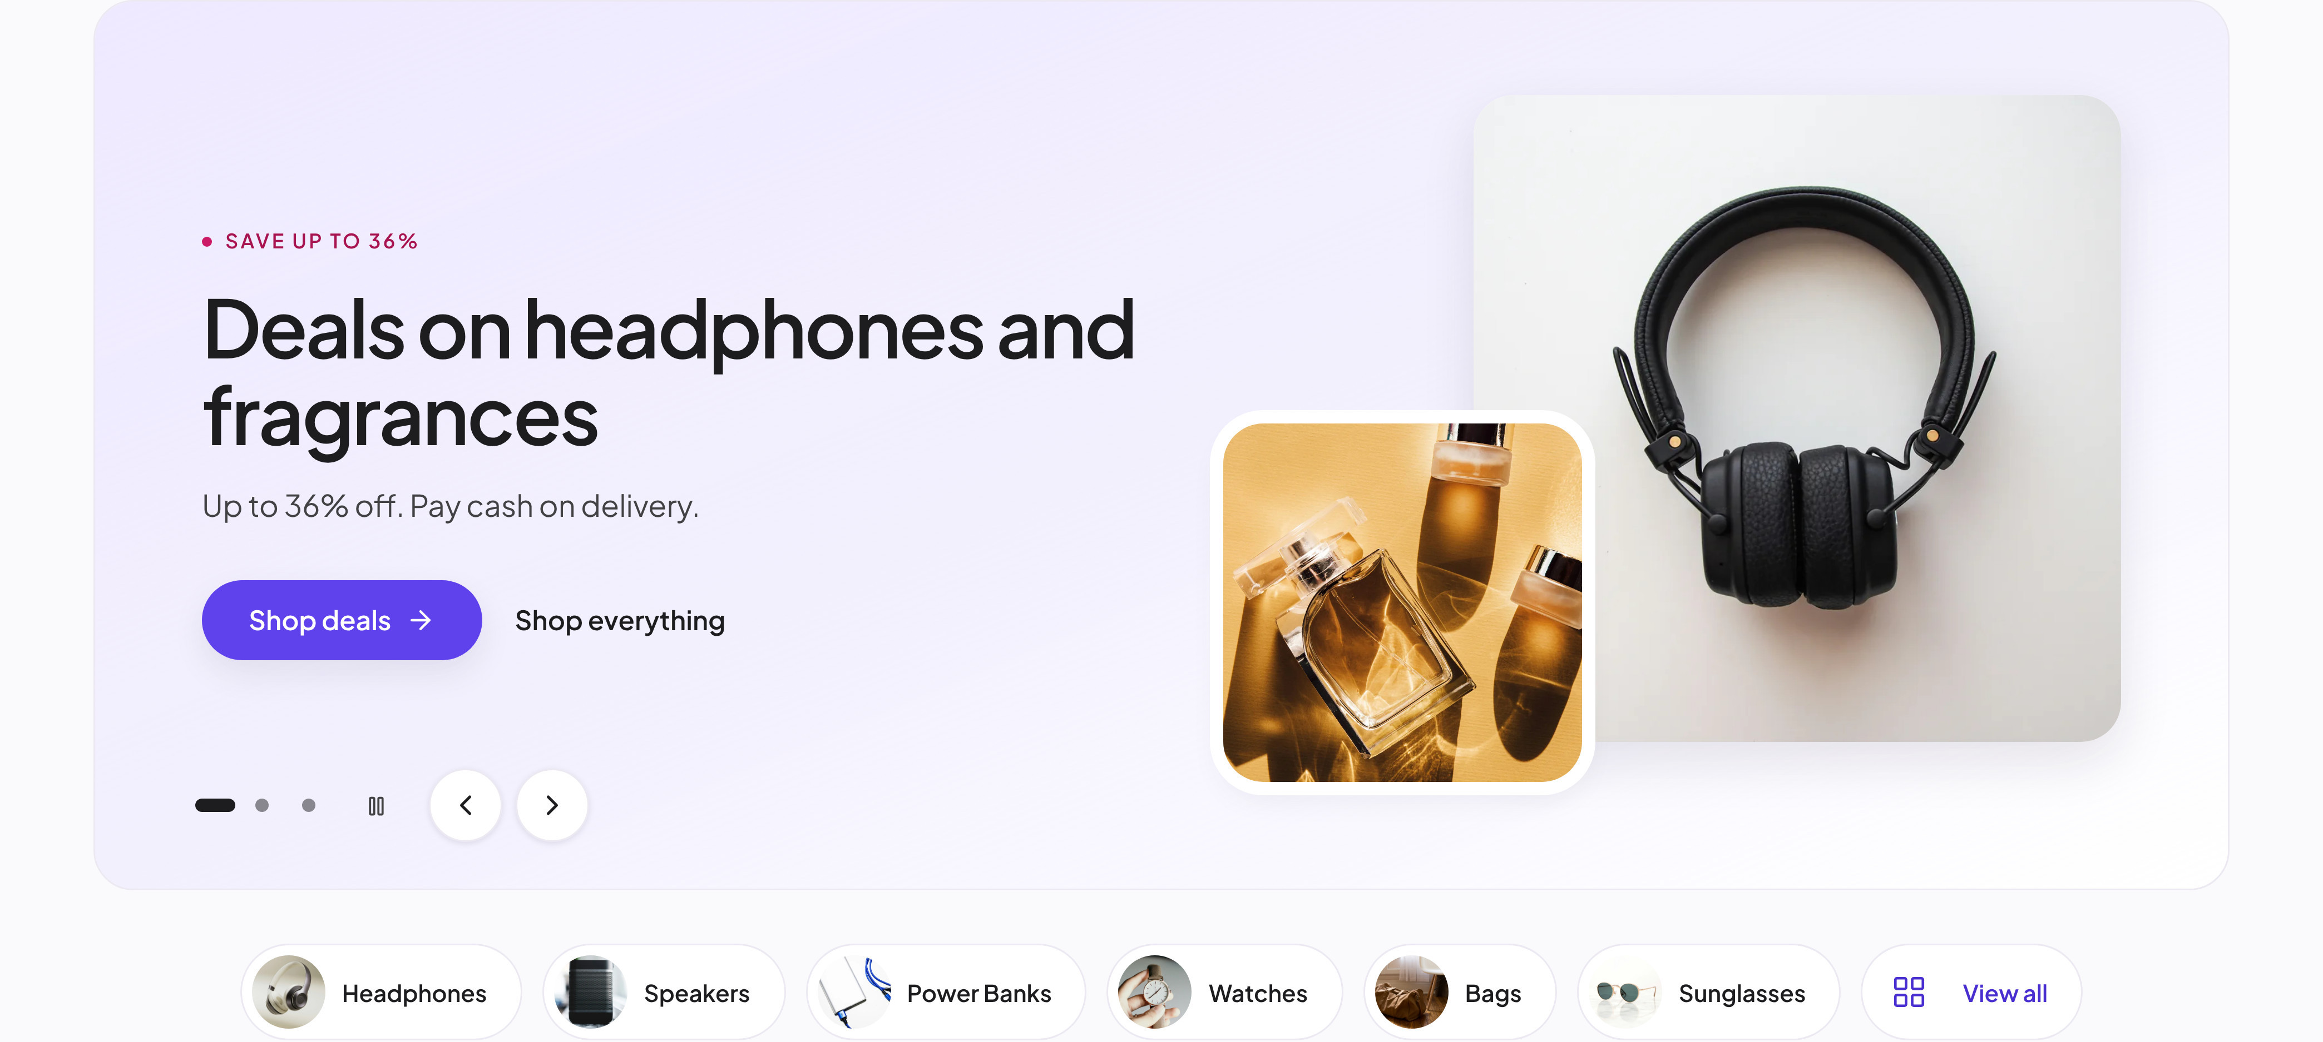
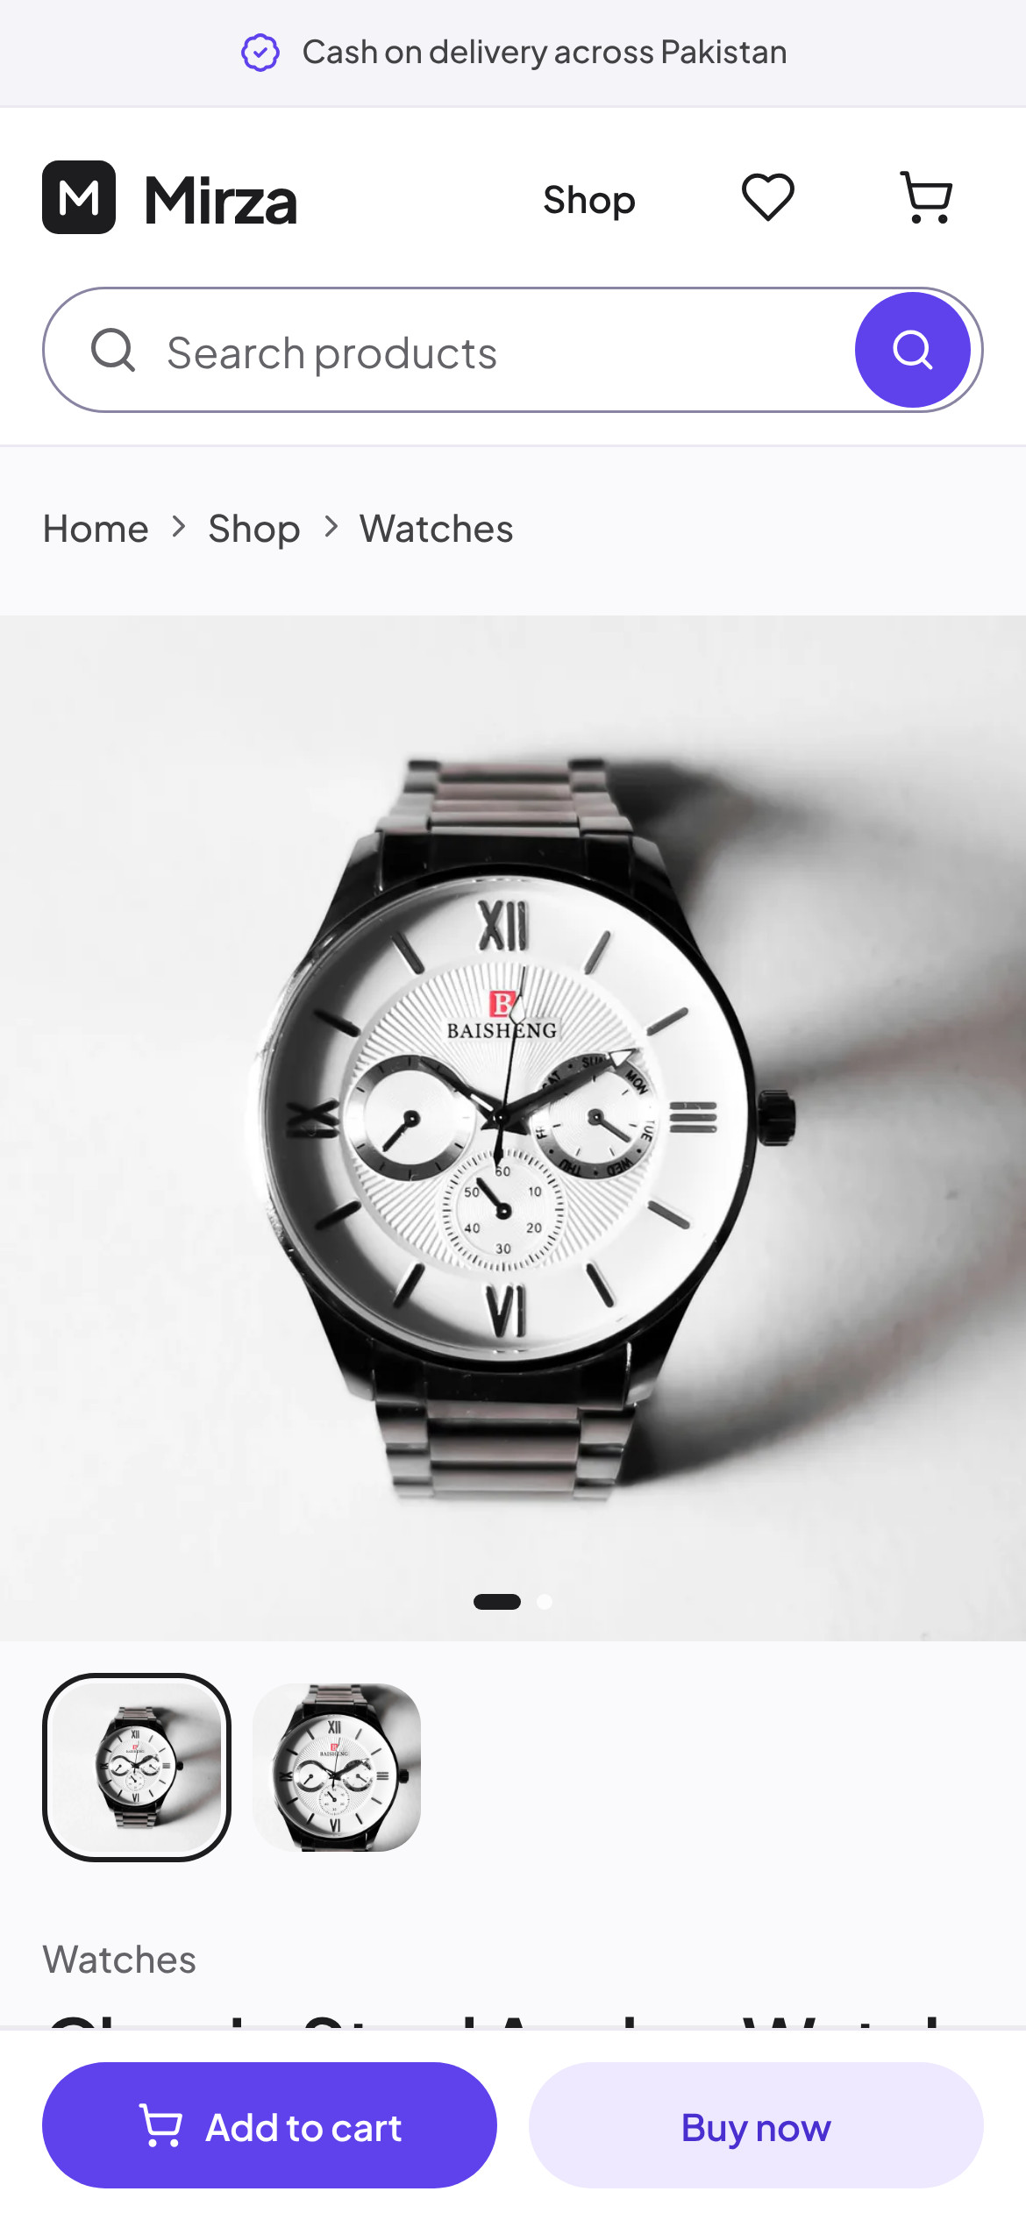
Mirza
14 · BRAND APPLICATIONS
BRAND IN USE
One identity across
the whole store
The header lockup, the violet actions, the soft hero panel and the photo-first cards repeat on every page, so a shopper always knows where they are, on any screen.
9:41
Brand Identity & Ecommerce Showcase
14 / 26
Notes:
Brand in use

Slide 15
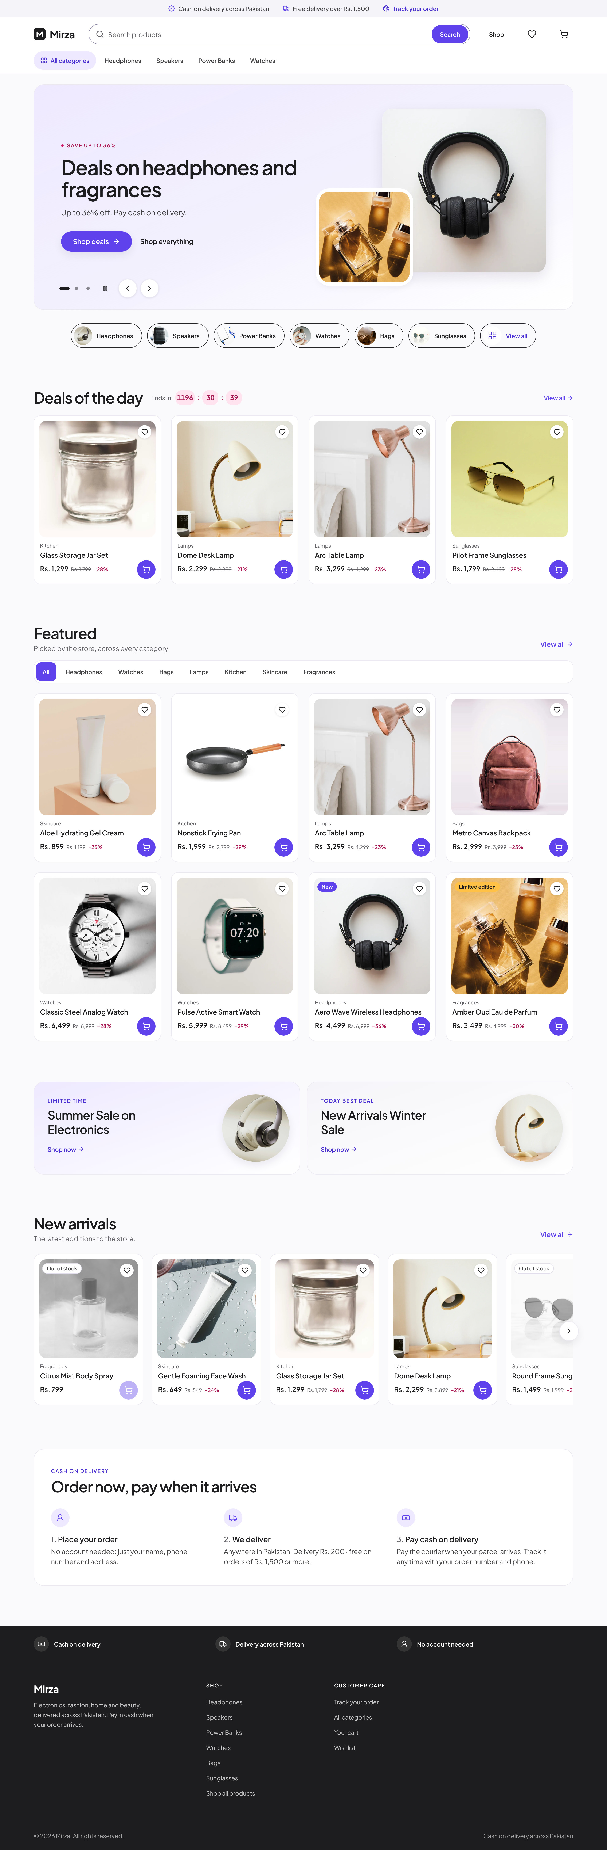
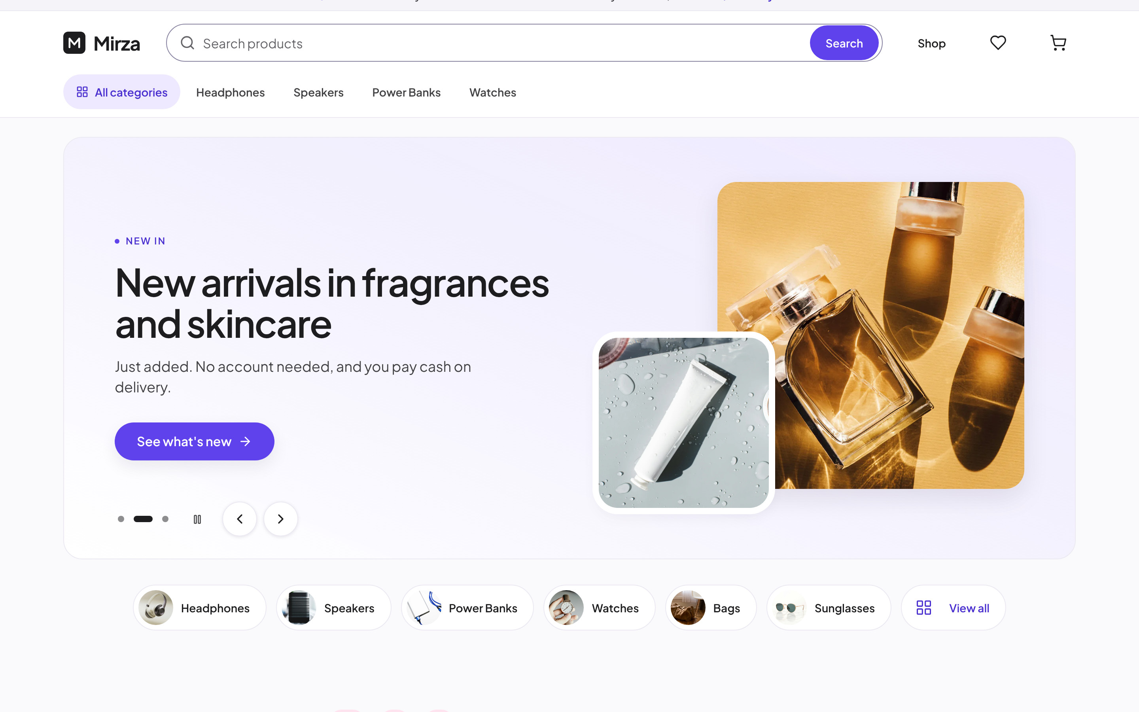
Mirza
15 · DESKTOP SHOWCASE
DESKTOP · HOMEPAGE
A storefront that
leads with the product
Announcement bar, search-first header, category row, a product-led hero slider and category shortcuts, all above the fold.
Brand Identity & Ecommerce Showcase
15 / 26
Notes:
Desktop homepage

Slide 16
Mirza
16 · DESKTOP SHOWCASE
DESKTOP · HOMEPAGE
Deals, featured picks
and promotions
Deals of the day with a live countdown, an admin-curated Featured grid with category tabs, and two promotional cards that link to sales.
Deals of the day, with a countdown to the end of the offer.
Brand Identity & Ecommerce Showcase
16 / 26
Notes:
Desktop homepage sections

Slide 17
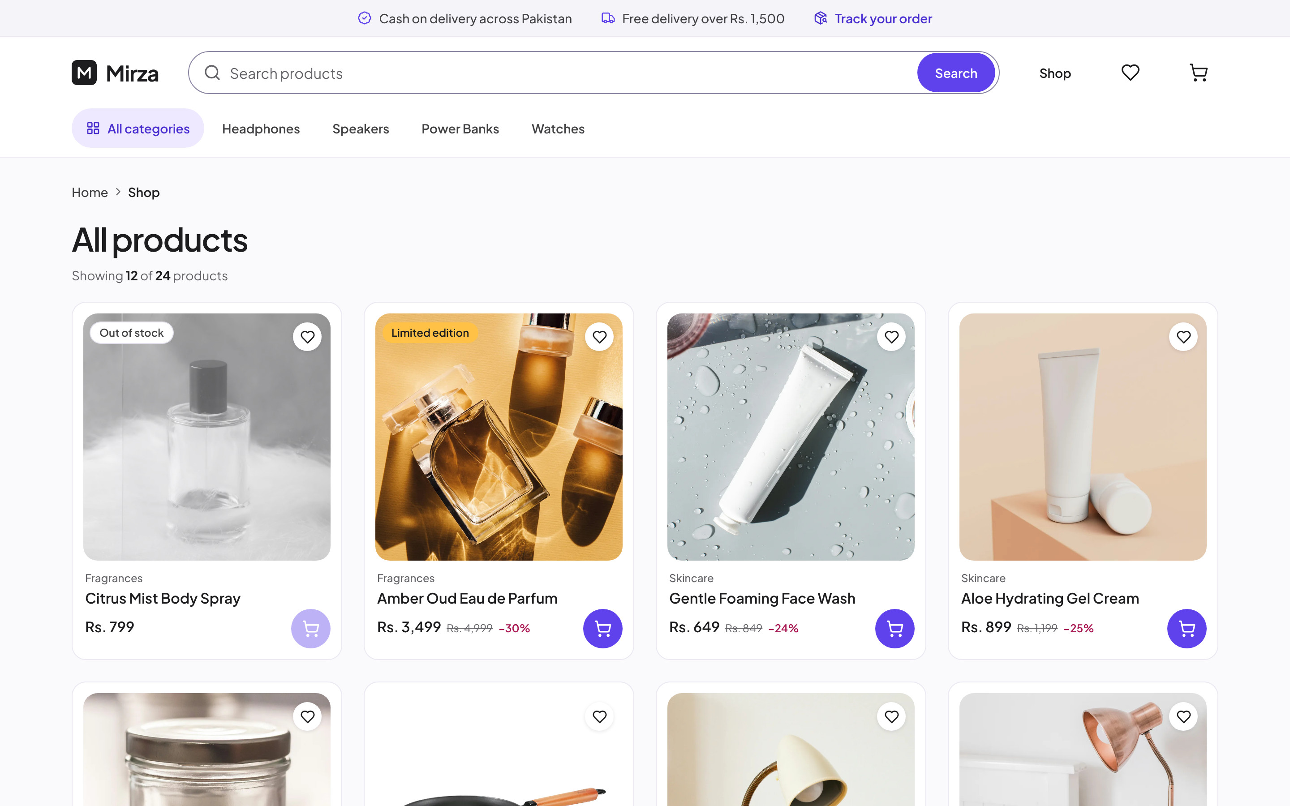
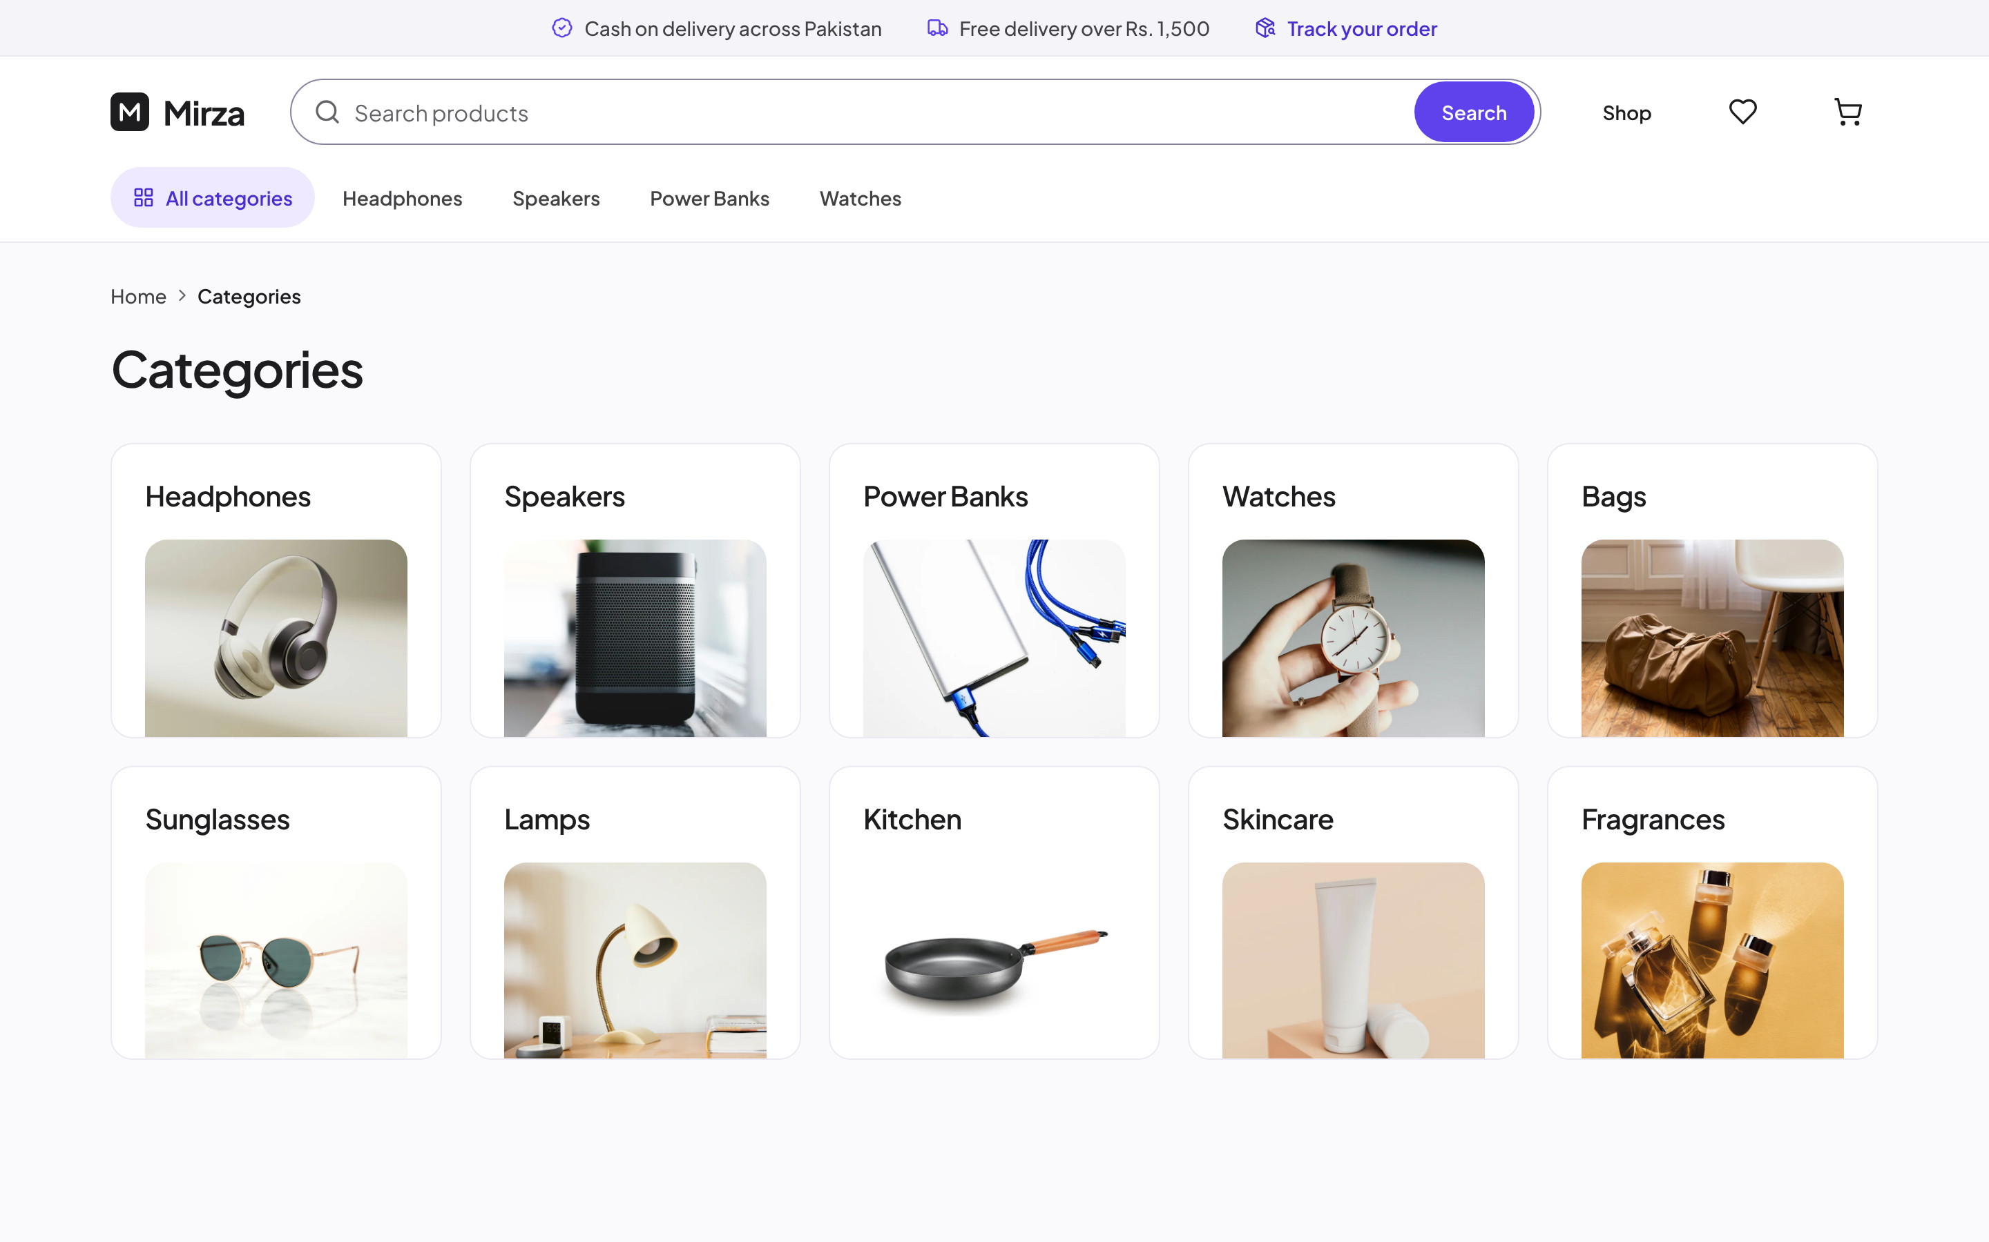
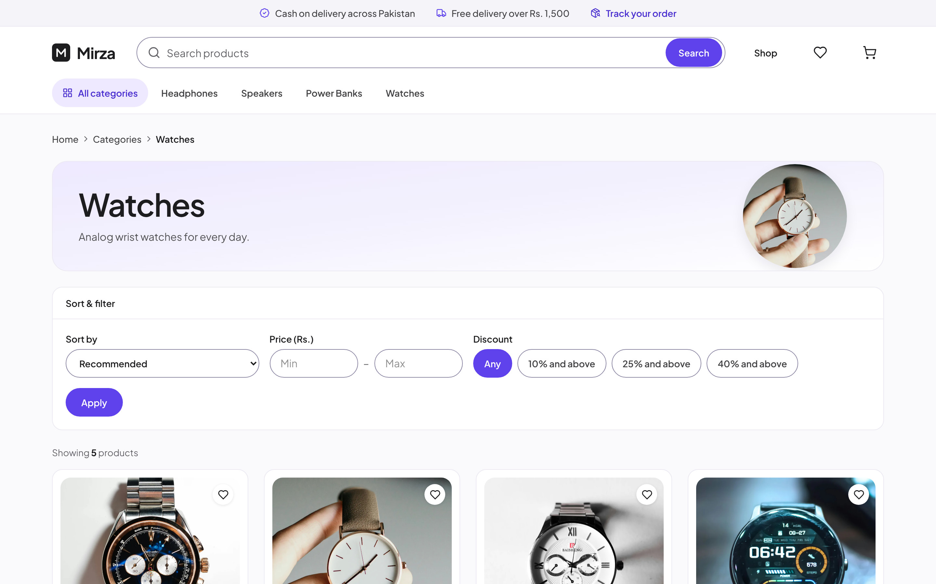
Mirza
17 · DESKTOP SHOWCASE
DESKTOP · SHOPPING
Browse by category,
filter, compare
Every category has its own page with sort, price and discount filters. Cards show stock, labels and discounts at a glance.
Brand Identity & Ecommerce Showcase
17 / 26
Notes:
Desktop shopping

Slide 18
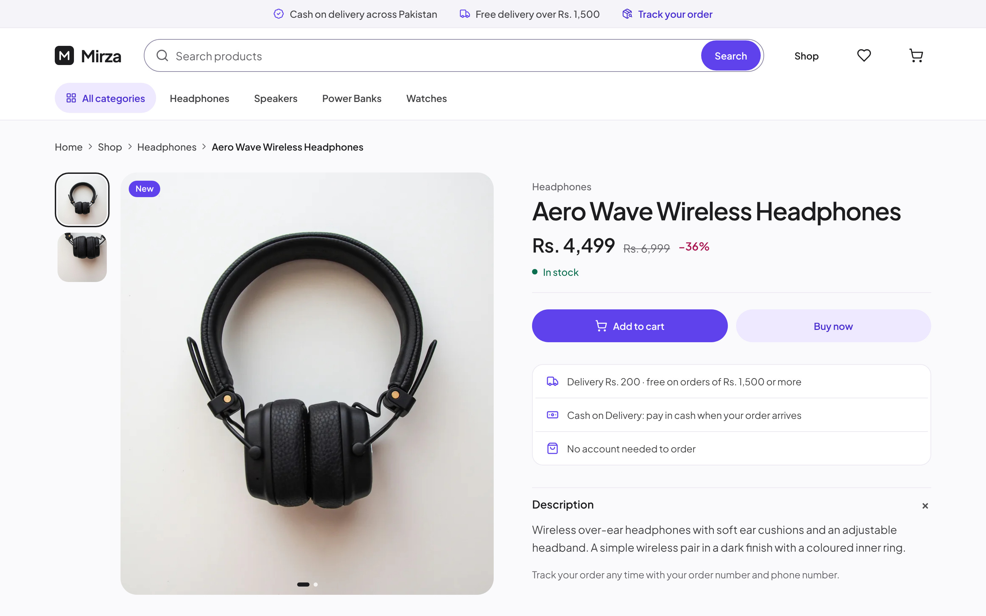
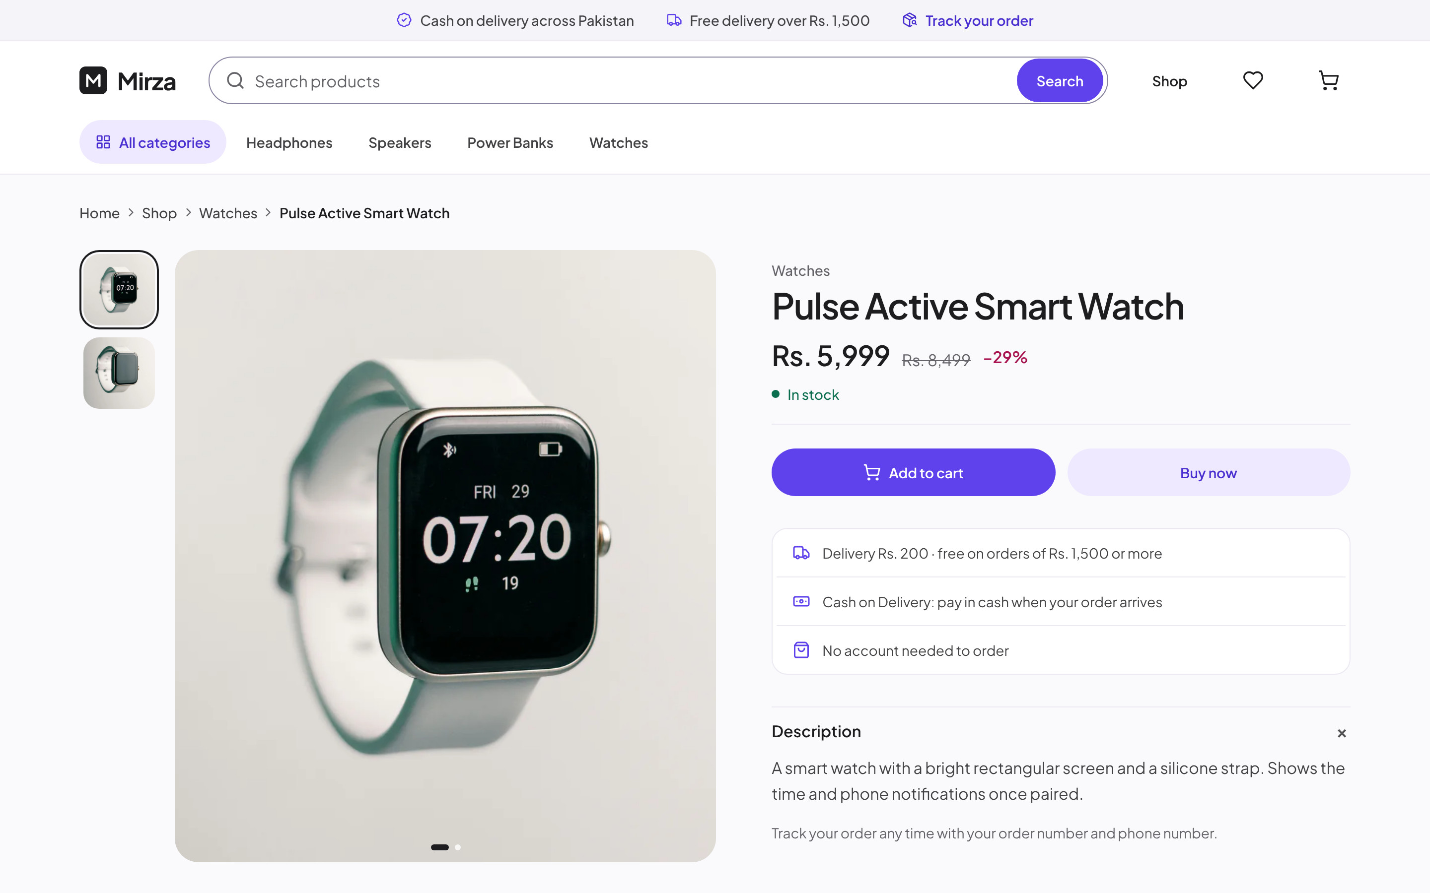
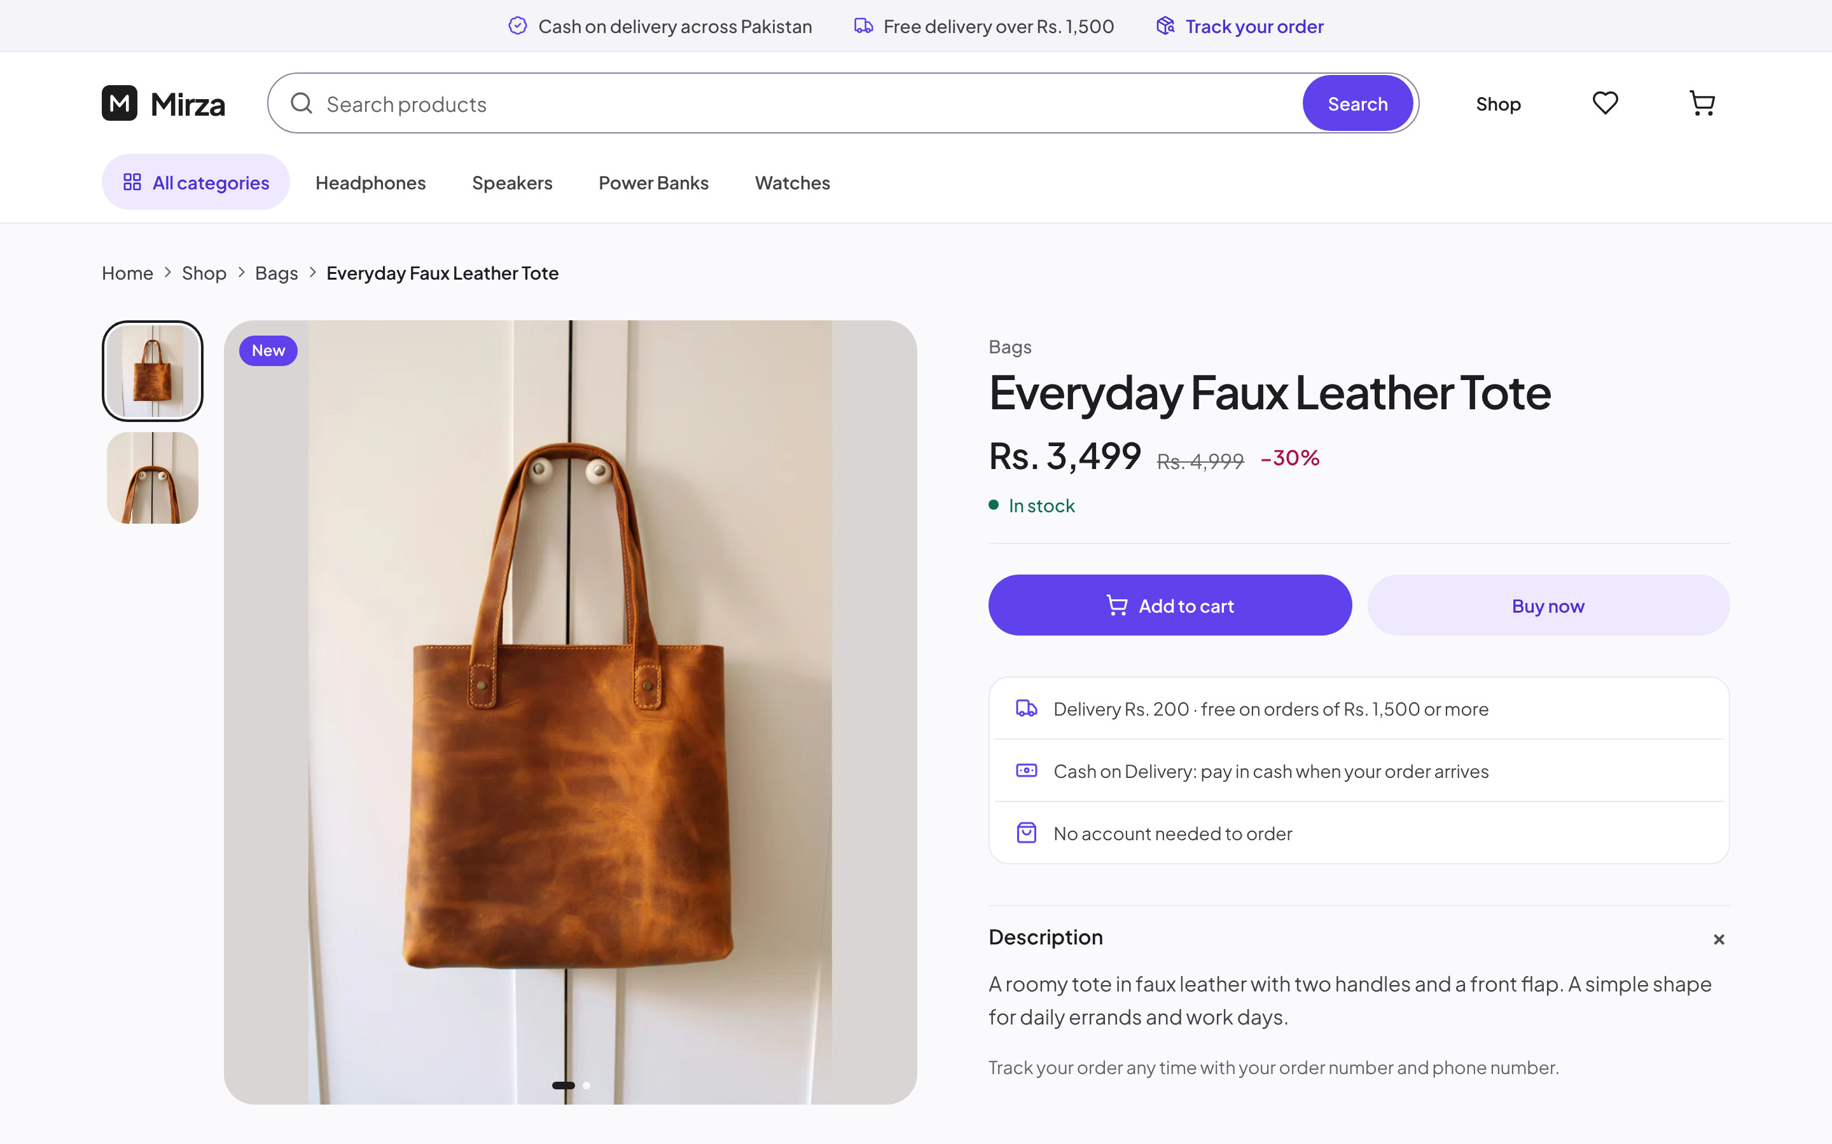
Mirza
18 · DESKTOP SHOWCASE
DESKTOP · PRODUCT
Everything needed
to decide
Gallery with thumbnails, price and saving, stock, delivery and payment promises, then two clear actions.
Brand Identity & Ecommerce Showcase
18 / 26
Notes:
Desktop product detail

Slide 19
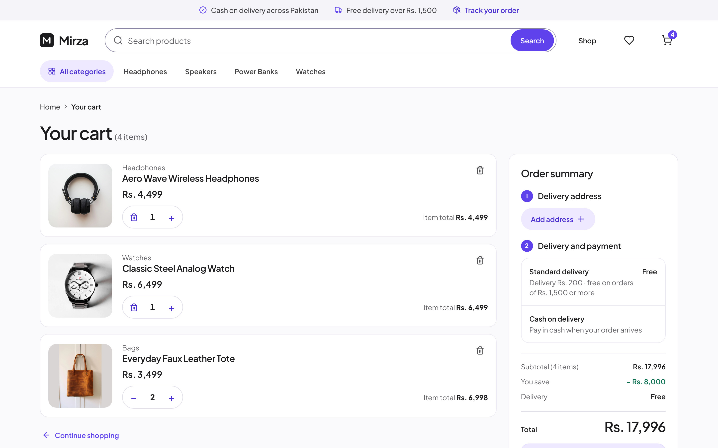
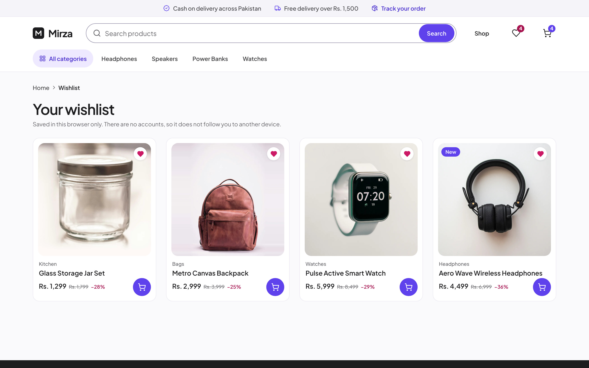
Mirza
19 · DESKTOP SHOWCASE
DESKTOP · CART
A cart that shows
the full price
Quantities, item totals, savings and delivery are calculated in the order summary before the shopper adds an address. Payment is cash on delivery.
Wishlist, saved in the browser. No account needed.
Brand Identity & Ecommerce Showcase
19 / 26
Notes:
Desktop cart & wishlist

Slide 20
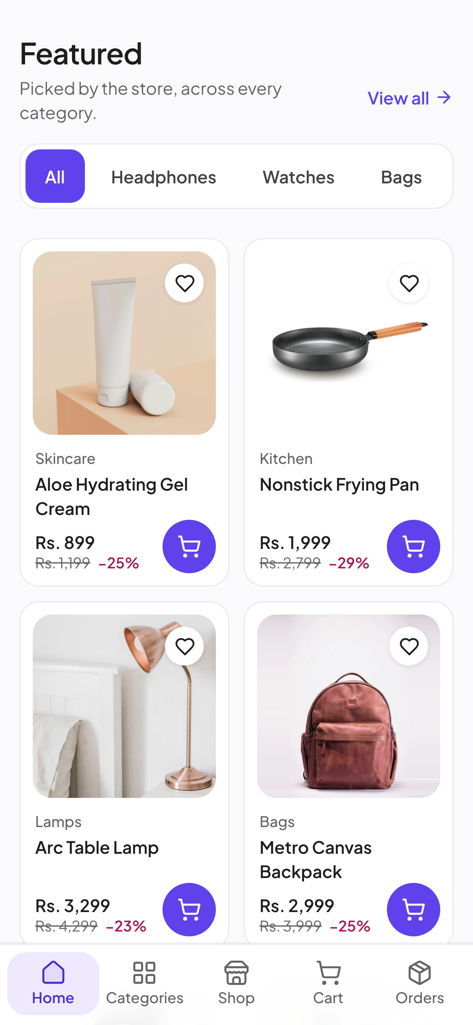
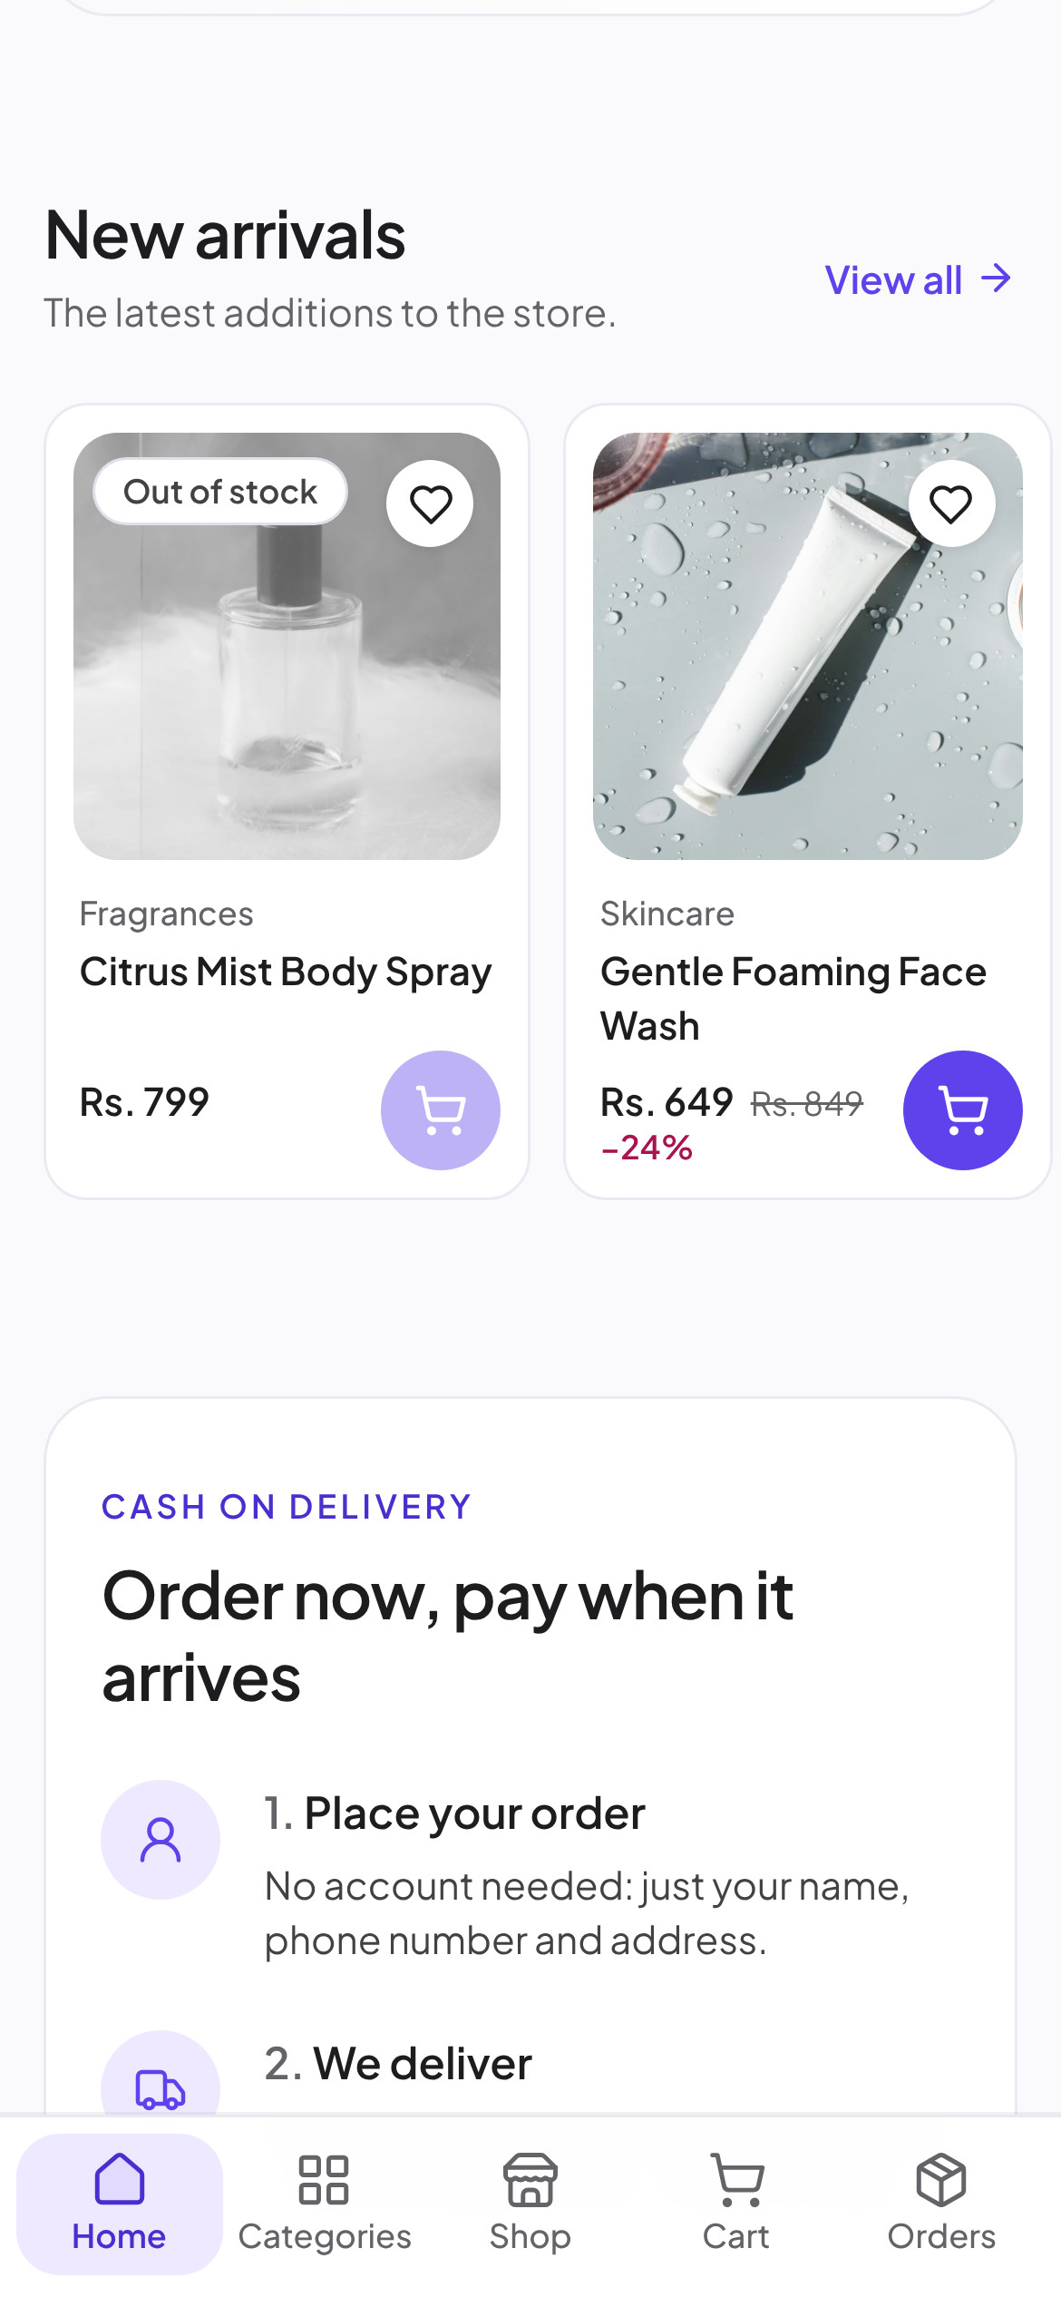
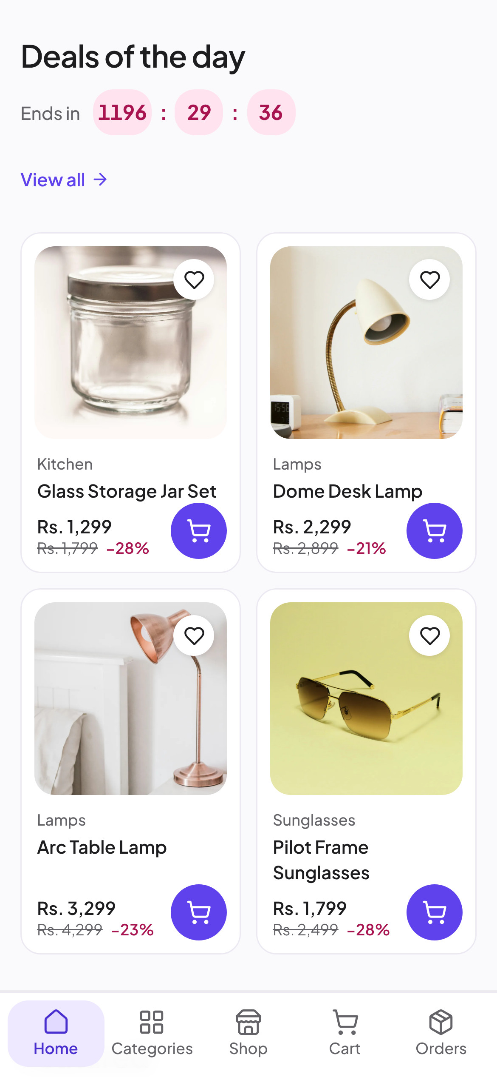
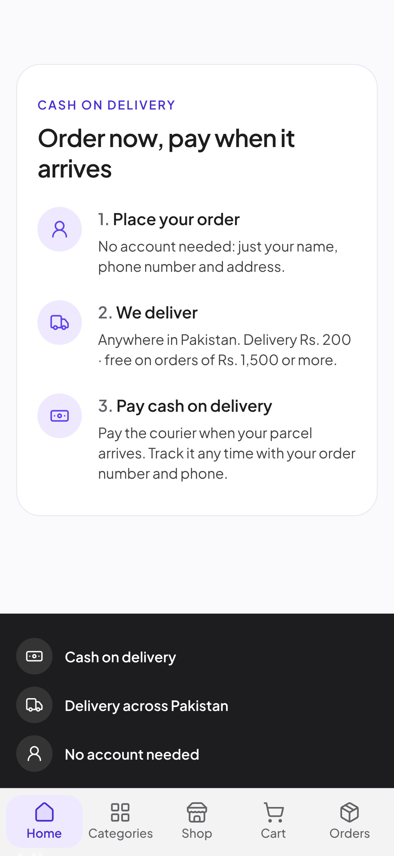
Mirza
20 · MOBILE SHOWCASE
MOBILE · HOMEPAGE
Built for the phone first
The responsive website at 390 px, captured on a phone-sized screen. Nothing to install.
9:41
9:41
9:41
9:41
9:41
Brand Identity & Ecommerce Showcase
20 / 26
Notes:
Mobile homepage

Slide 21
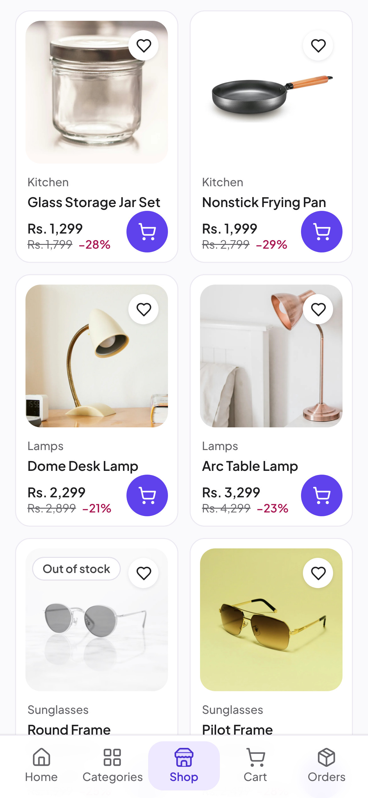
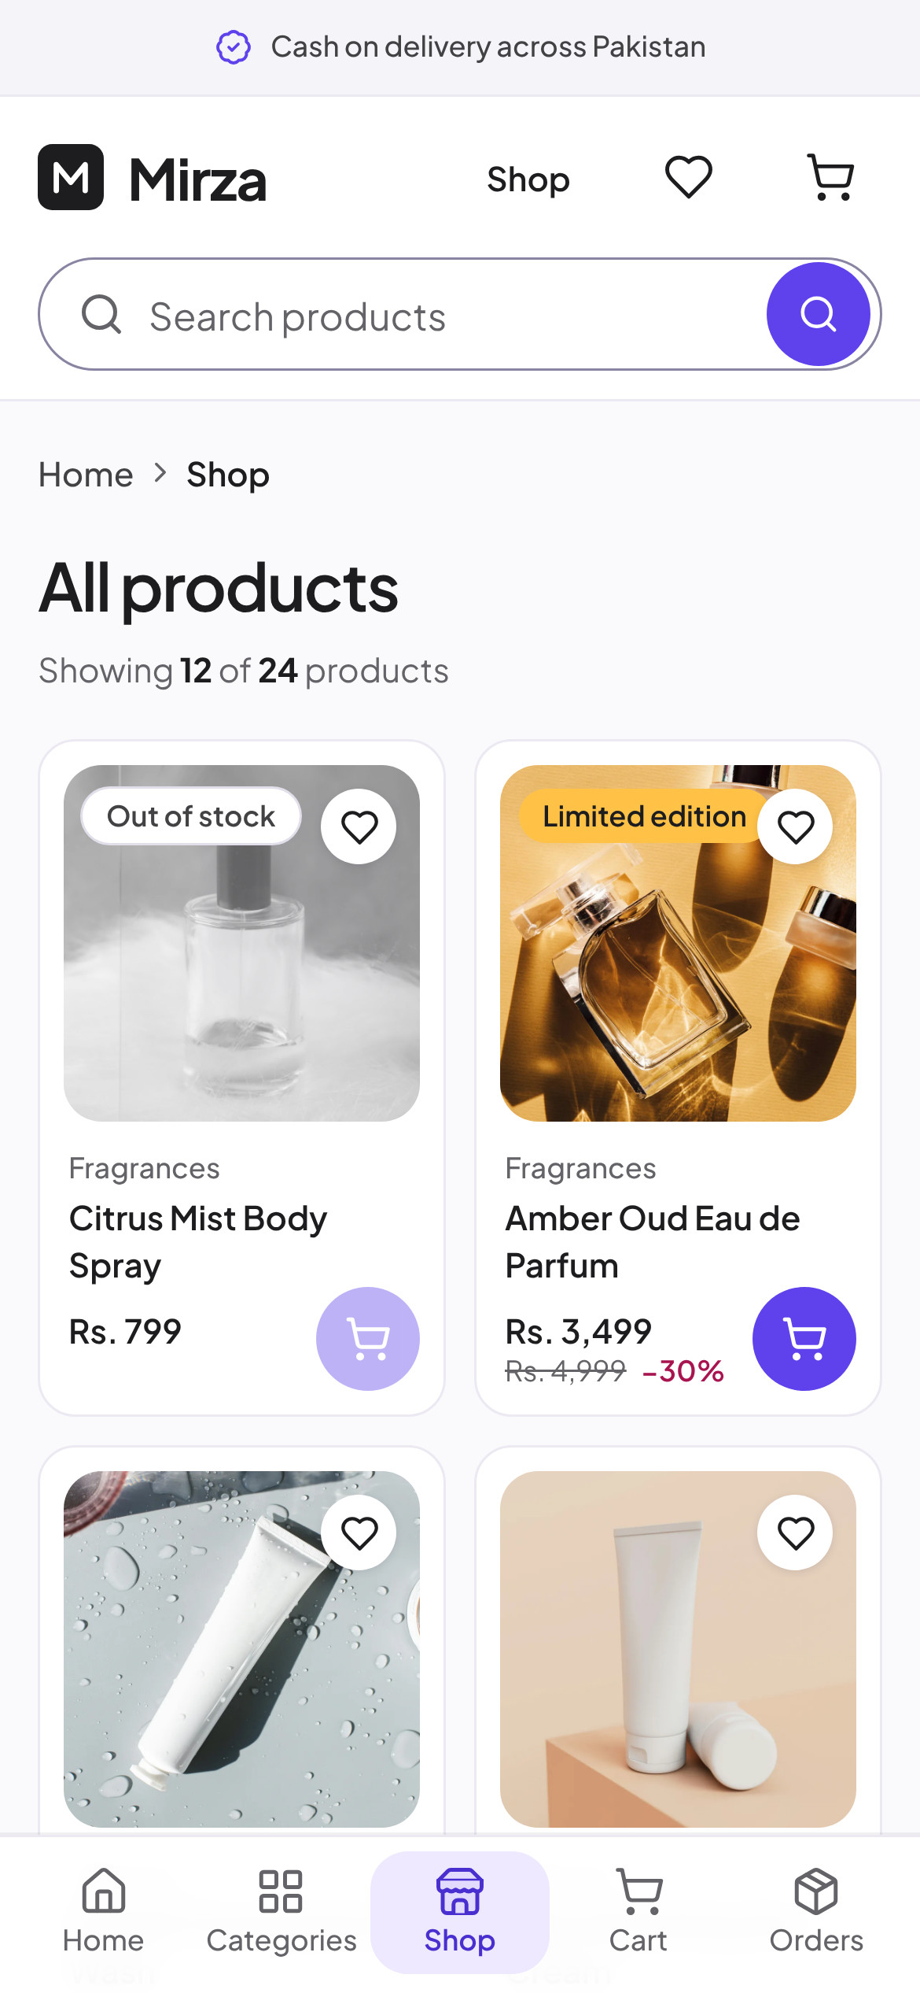
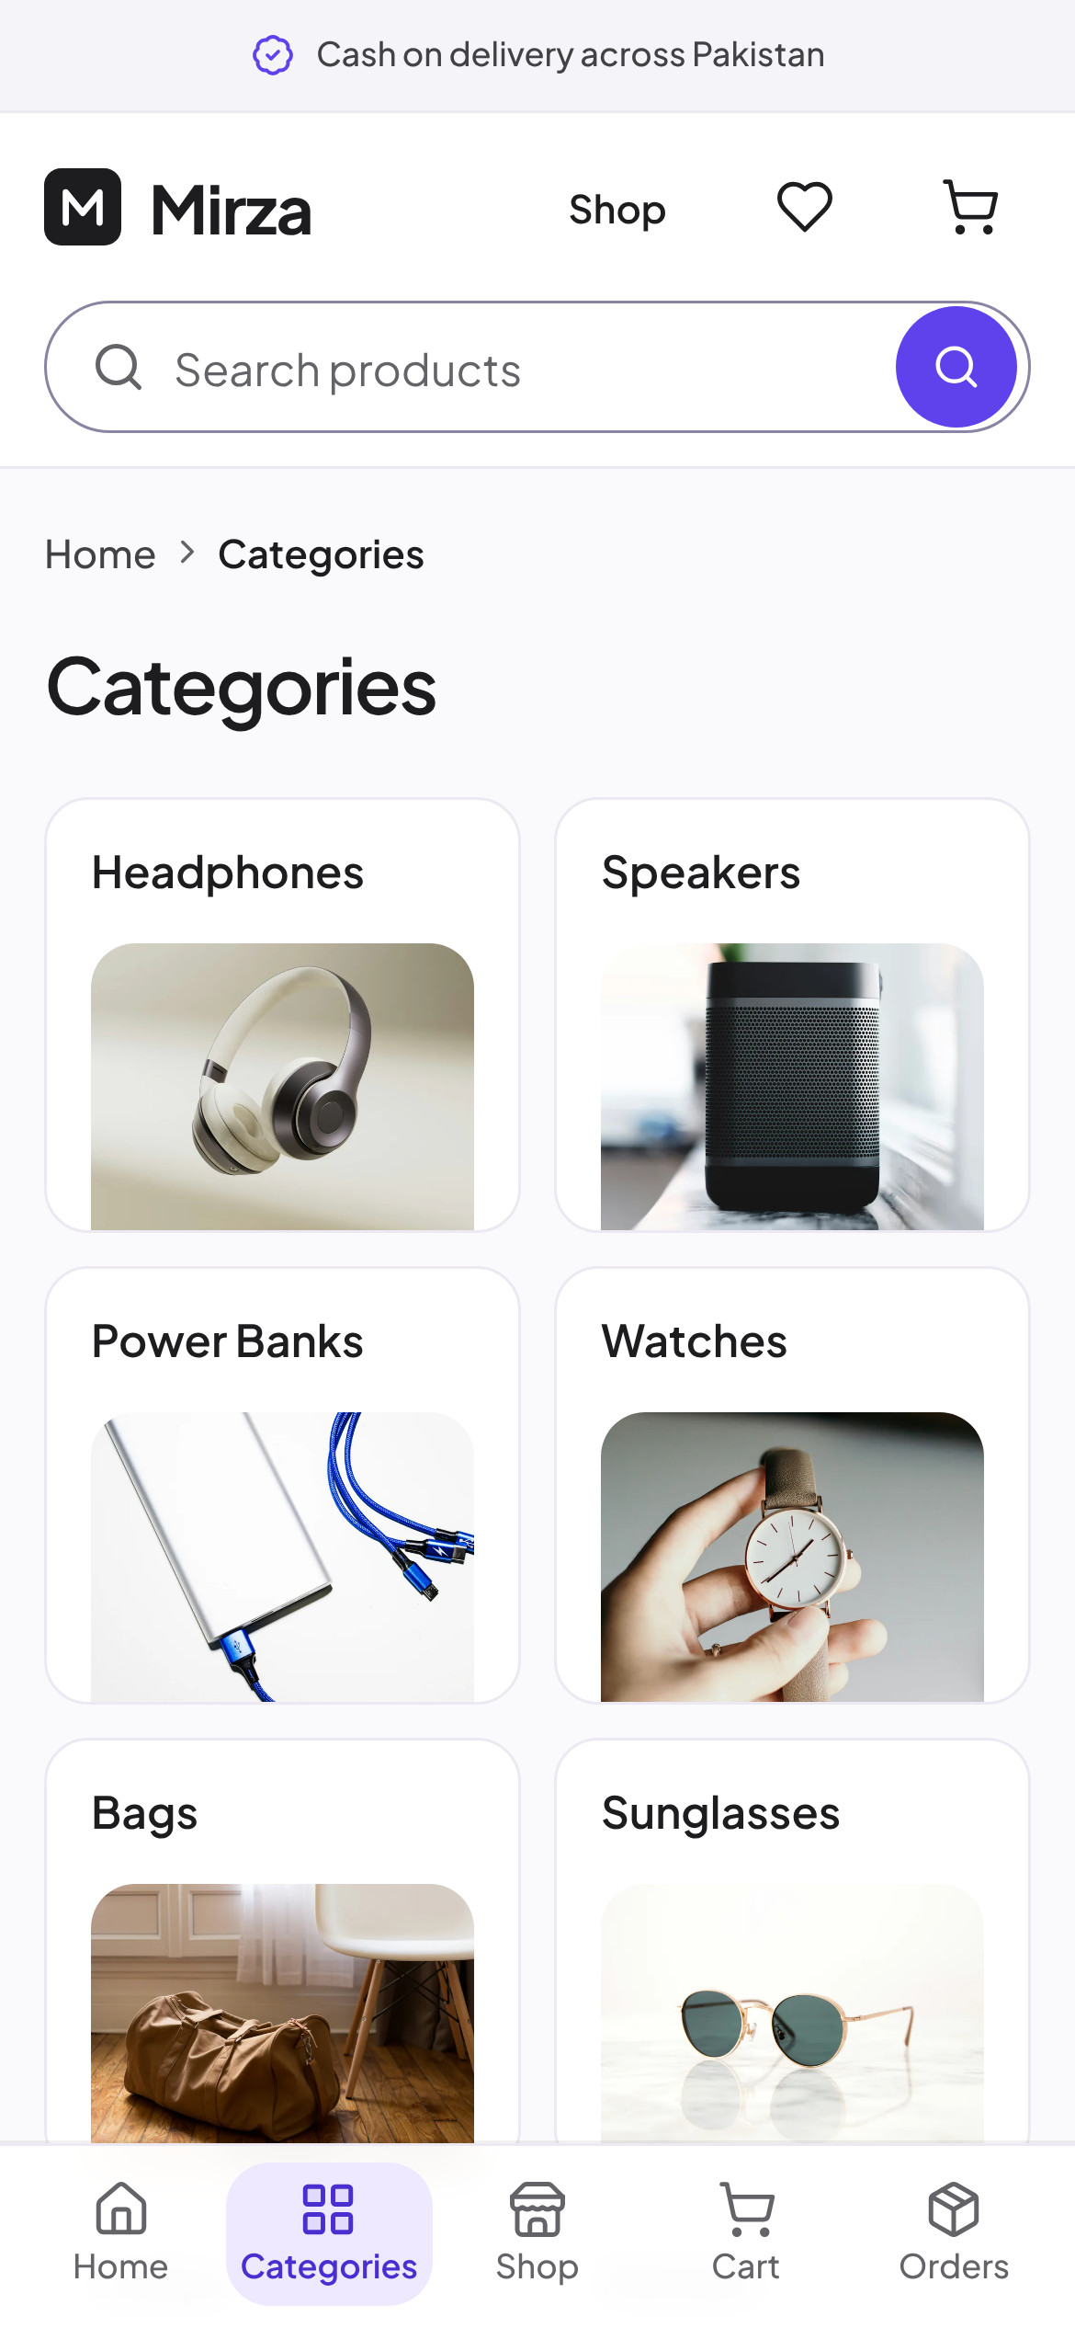
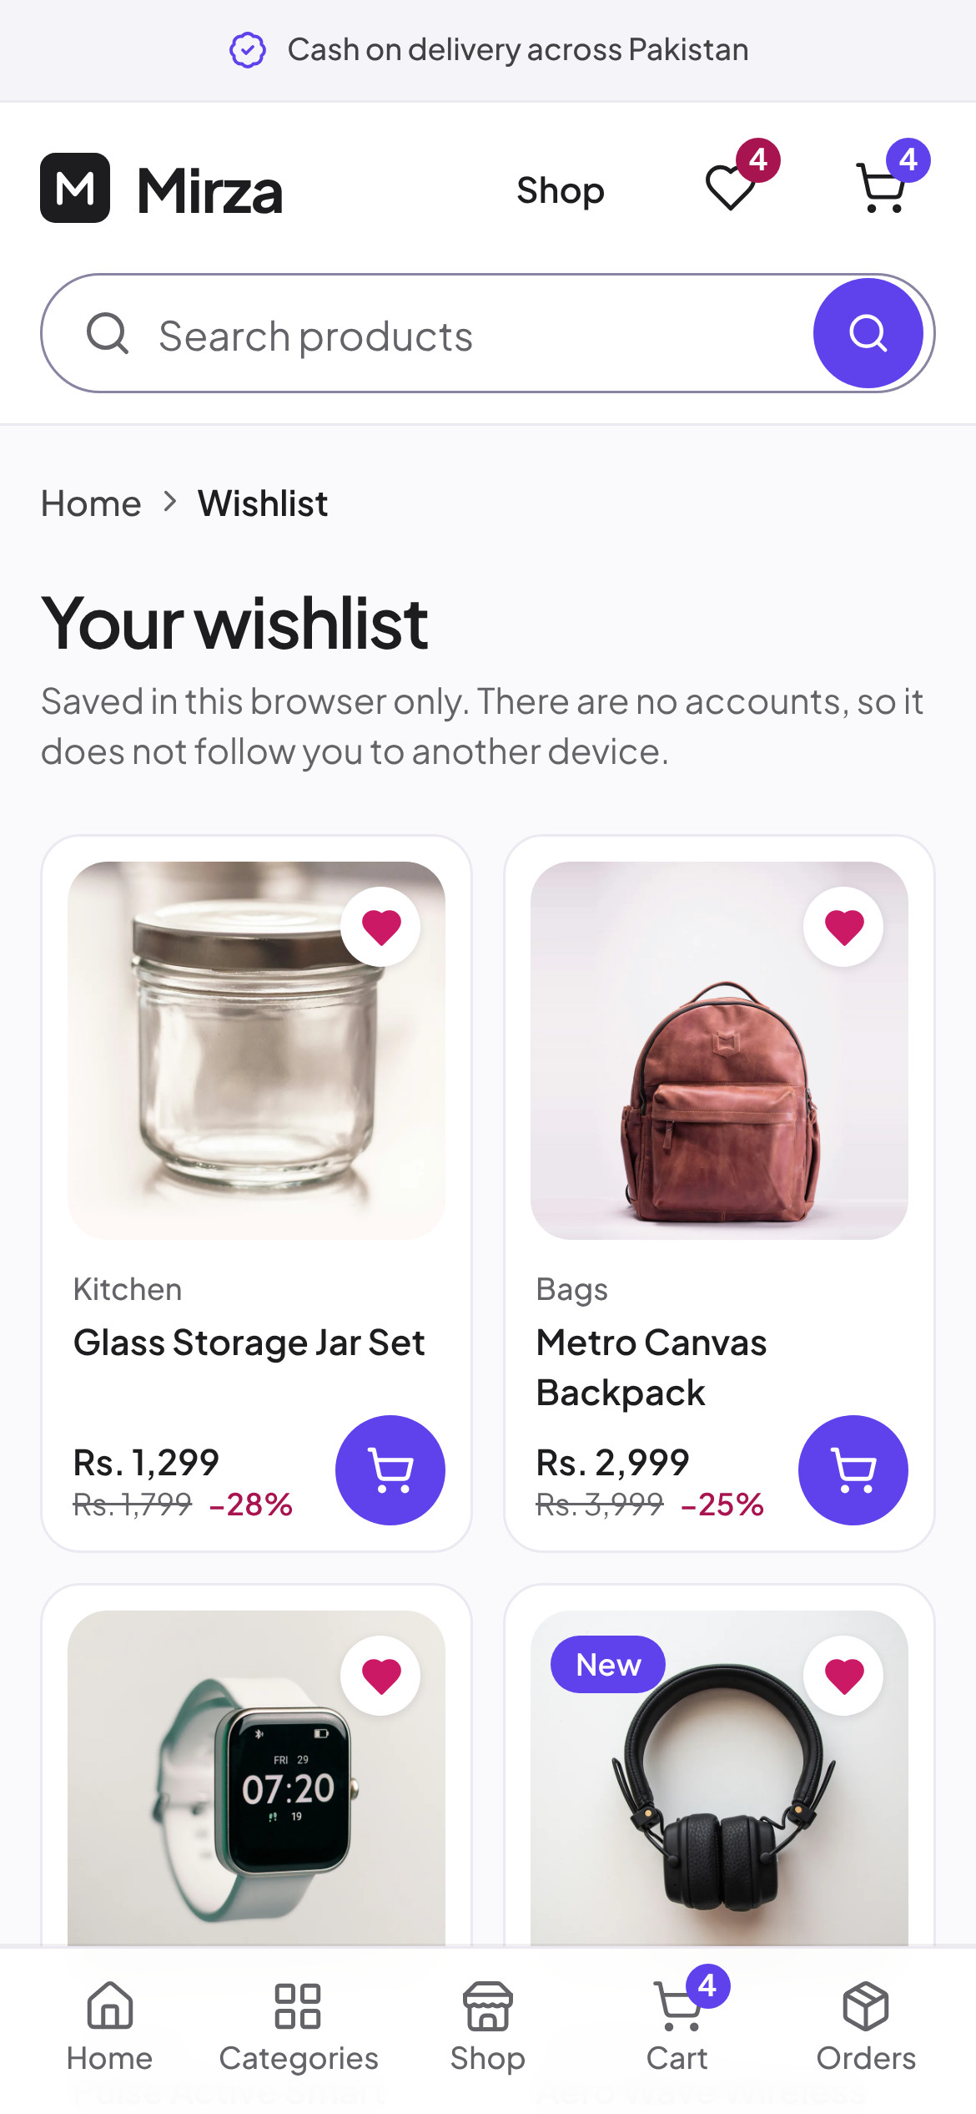
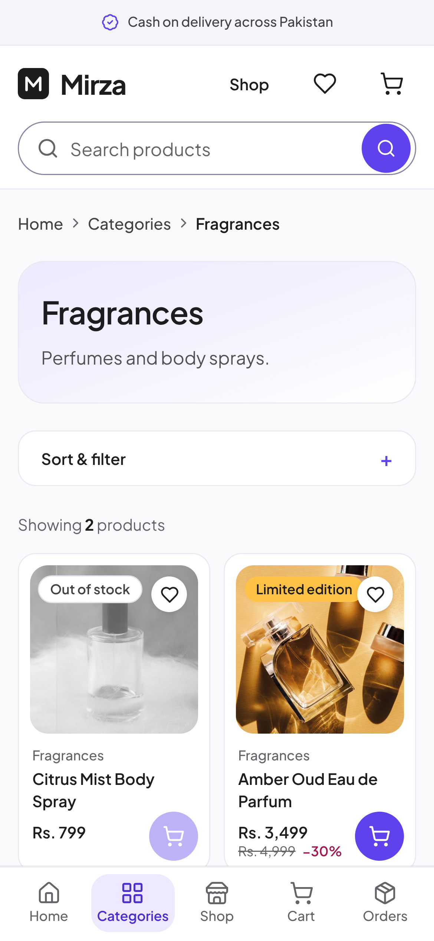
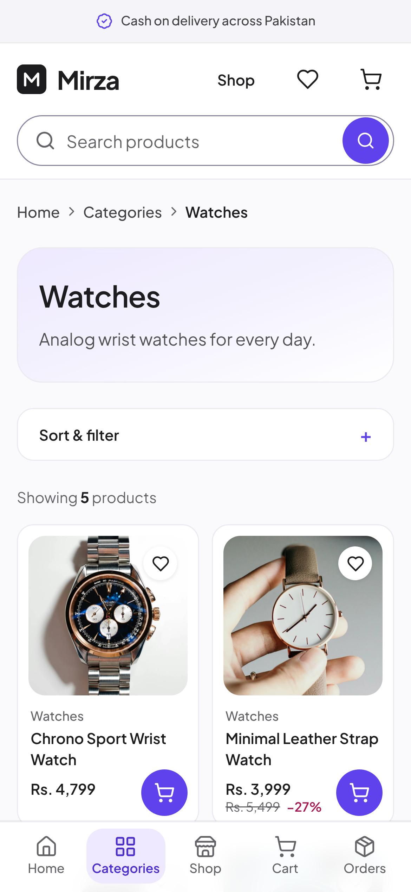
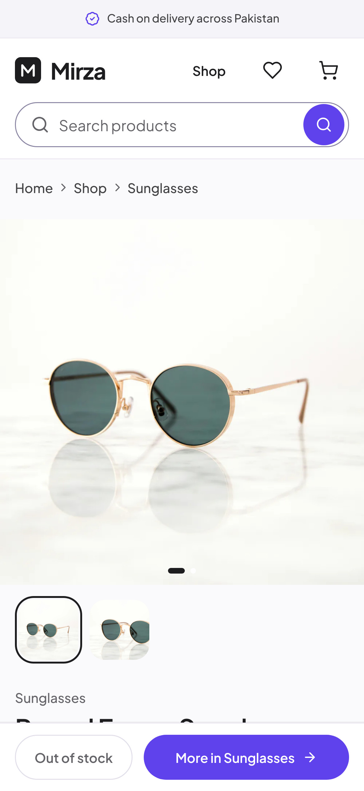
MOBILE · SHOPPING
Browse, filter
and save
Two-column grids, sticky bottom tabs, category pages with filters and a wishlist that needs no account.
Notes:
Mobile shopping

Slide 22
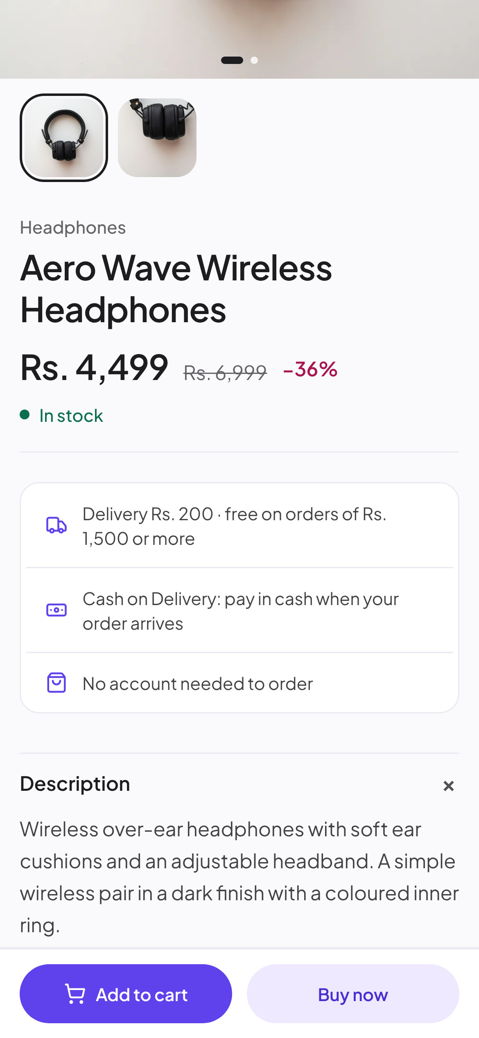
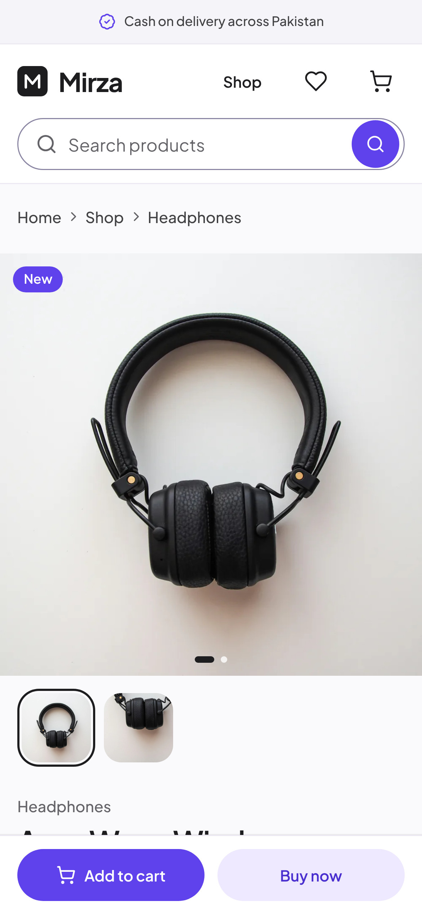
Mirza
22 · MOBILE SHOWCASE
MOBILE · PRODUCT
The product page,
in the hand
9:41
9:41
9:41
A full-width gallery, price and saving, stock, delivery and payment promises. "Add to cart" and "Buy now" stay pinned to the thumb.
01
Gallery
Swipe photos, tap thumbnails
02
Details
Price, saving, stock, delivery
03
Actions
Add to cart or buy now
Brand Identity & Ecommerce Showcase
22 / 26
Notes:
Mobile product

Slide 23
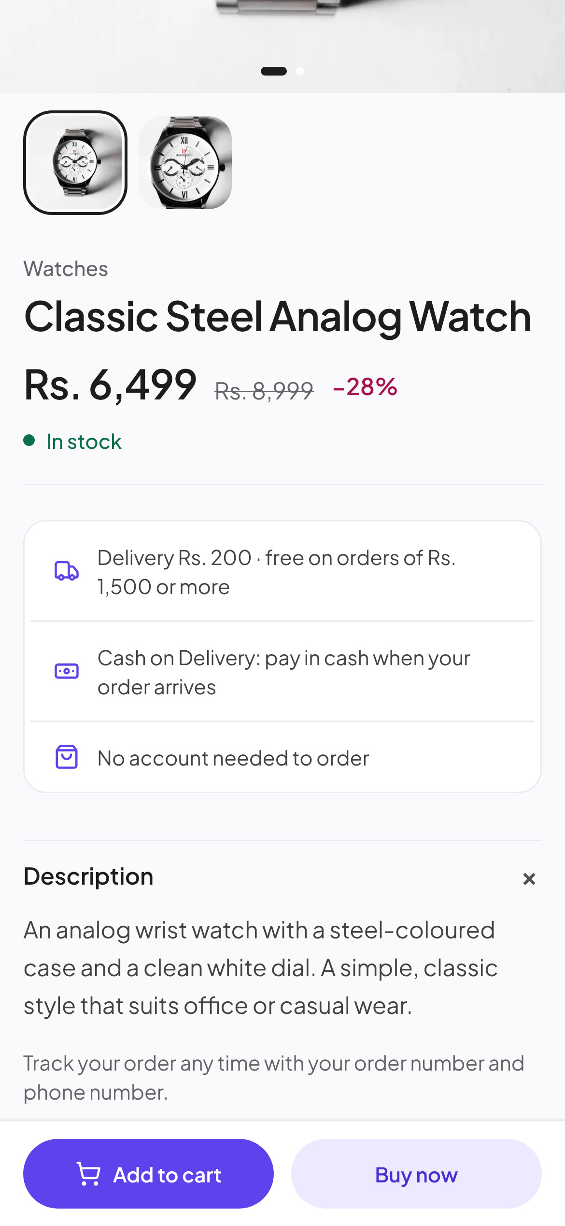
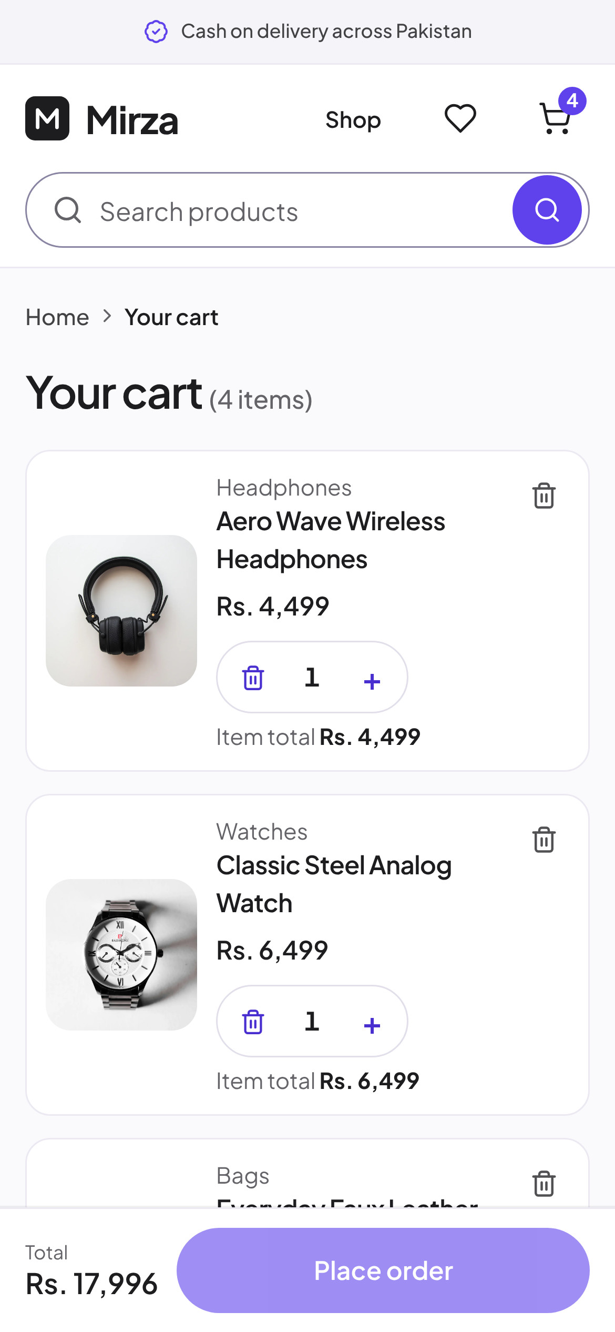
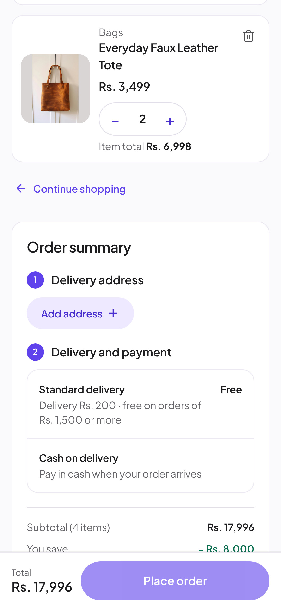
Mirza
23 · MOBILE SHOWCASE
MOBILE · SHOPPING JOURNEY
From browsing to a cash-on-delivery order
9:41
9:41
9:41
9:41
1
2
3
4
Browse
Choose
Review
Order
A category with filters
Price, stock, delivery
Cart with item totals
Address and cash on delivery
Brand Identity & Ecommerce Showcase
23 / 26
Notes:
Mobile shopping journey

Slide 24
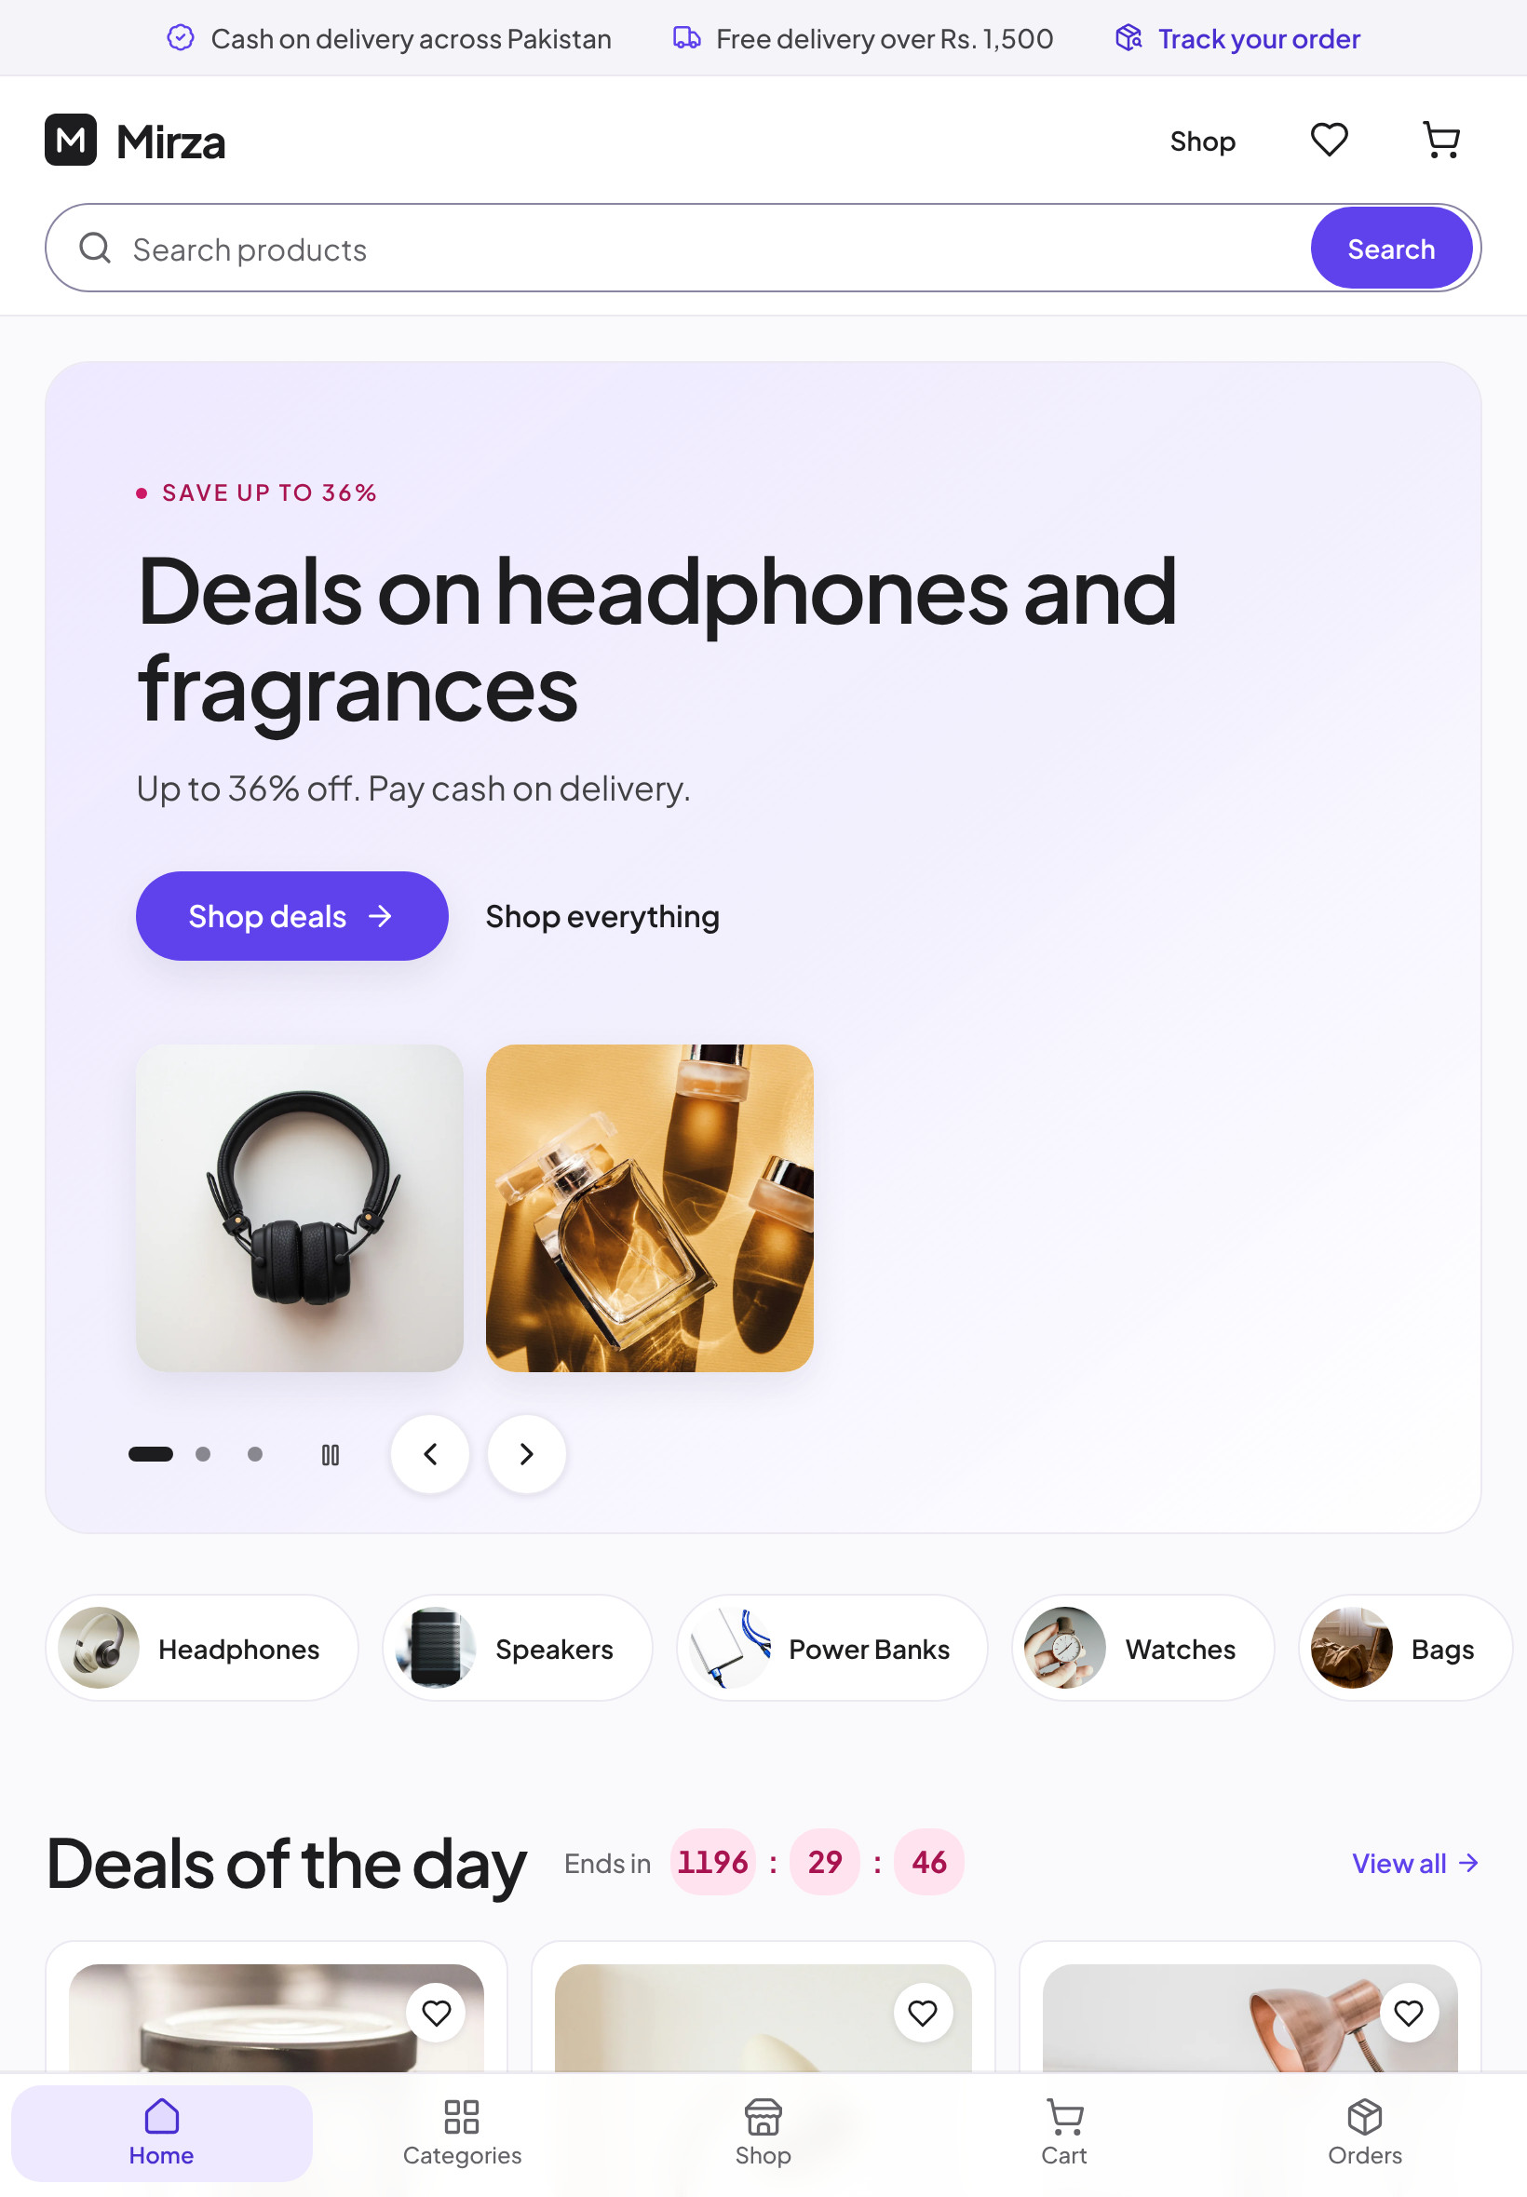
Mirza
24 · RESPONSIVE
RESPONSIVE
One store, every screen
Real captures at 1440 px, 820 px and 390 px. Each layout is the one the site serves at that width, not a scaled copy.
9:41
Brand Identity & Ecommerce Showcase
24 / 26
Notes:
Responsive

Slide 25
Mirza
25 · GUIDELINES
GUIDELINES
Do's and don'ts
Do
Don't
✓
Use the lockup exactly as supplied: monogram left, name right.
✕
Recolour, outline, stretch or rotate the logo.
✓
Keep violet (#5F42EC) for actions and selected states only.
✕
Put the near-black monogram on a dark background.
✓
Set everything in Plus Jakarta Sans; SemiBold for headings.
✕
Add a second accent colour or gradients on buttons.
✓
Show one product per square photo on a neutral backdrop.
✕
Mix in another typeface or use weights below 400.
✓
Say what happens: delivery cost, cash on delivery, no account.
✕
Use cluttered, filtered or branded product photos.
✓
Use sale colours only for a real discount.
✕
Promise payment methods or features the store does not offer.
Brand Identity & Ecommerce Showcase
25 / 26
Notes:
Do's and don'ts

Slide 26
Mirza
26 · MIRZA
Mirza
Electronics, fashion, home and beauty, delivered across Pakistan.
Pay in cash when your order arrives.
Responsive storefront · Guest checkout · Cash on Delivery · Admin-managed with Payload CMS
Brand Identity & Ecommerce Showcase
26 / 26
Notes:
Closing

