Slide 1

CSE 502: Web Technology
HTML5 Tag: Section
Md. Mahfuz Ibne Ali Ayon
BSSE 1421
Mohammad Ismail Hossain
BSSE 1433

Slide 2

What is Section Element?
The <section> element is designed to represent a standalone section within a document. It often contains related content with a common theme, making it ideal for dividing up content into logical blocks. Unlike a <div>, which is purely a generic container with no meaning, <section> gives semantic meaning to the content it wraps, signaling to the browser and search engines that the enclosed content is related.

Slide 3
How does Section Tag Work
Organizes Content: Browser understands that each <section> represents a distinct part of the page, aiding in both readability and navigation.
Applies Default Styling: <section> elements are block-level, so they will appear one below the other, taking up full width.

Slide 4
How does Section Tag Work
Accessibility Benefits: Screen readers recognize these sections as thematic groupings, allowing users to navigate efficiently.
SEO Benefits: Search engines index each <section> individually, allowing content to rank more accurately for relevant searches.

Slide 5
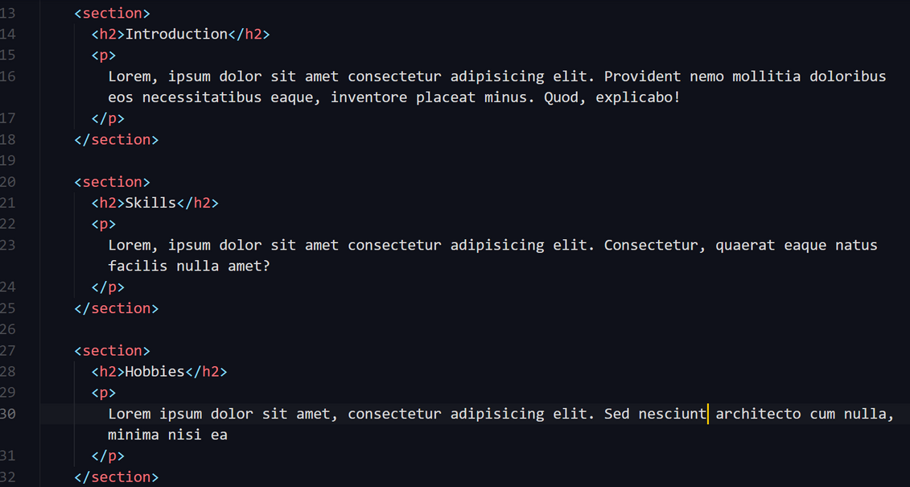
Sample code

Slide 6
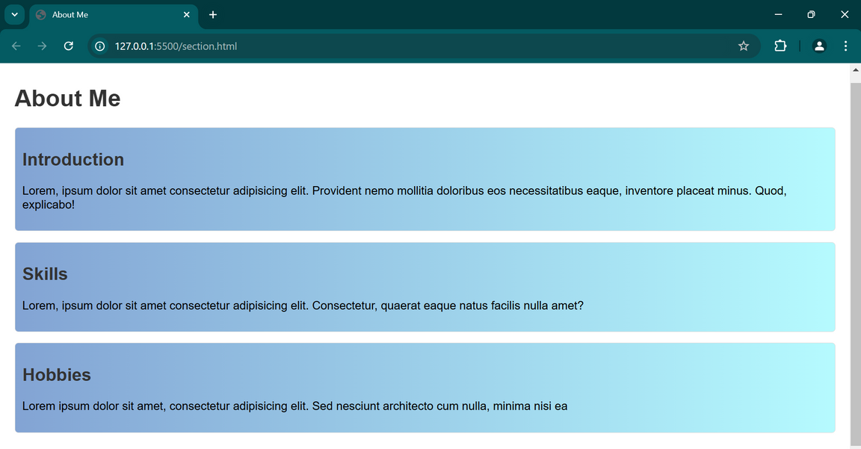
Output

Slide 7

Backward Compatibility
Fallback to Non-Semantic Tags:
If a user views a page with <section> tags in a legacy browser, they will still see the content, but without the semantic benefits that newer browsers provide.
JavaScript Interactions:
In modern browsers this supports. but in older browsers, the tag is ignored but any scripts targeting <section> will not have an effect.
Graceful Degradation
If an older browser encounters the <section> tag, it may ignore it but will still render the content inside, allowing users to access the information.
Styling and Scripting
Styles (CSS) and scripts (JavaScript) can still target <section> elements.

Slide 8
Thank You

