Slide 1
HI02H11_L02_S02 — मात्राओं की रेल
Page-by-page review · 18 pages

Slide 2
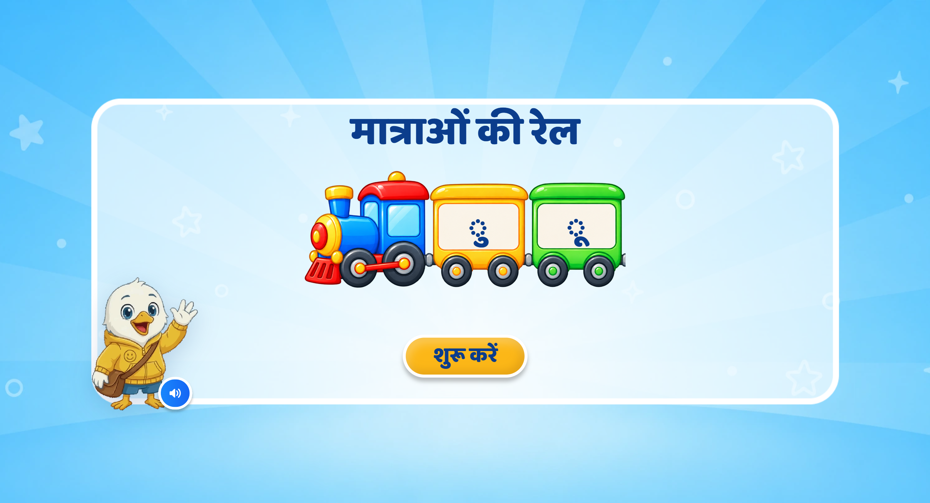
Page 1 · 01_landing.png
Recommendations
• LANDING — round 3. The two matras now ride in train bogies behind the locomotive, on the track, per «the matras can be shown inside two train bogies/cards». Train rolls in right to left with a whistle; the bogies pop in one by one, ु first, each with a sparkle. VO is the SME's new line («हेलो दोस्त! … आज हम मात्राओं के बारे में जानेंगे।»). The ◌ carrier is kept on each matra — a bare combining mark renders as a stray hook.

Slide 3
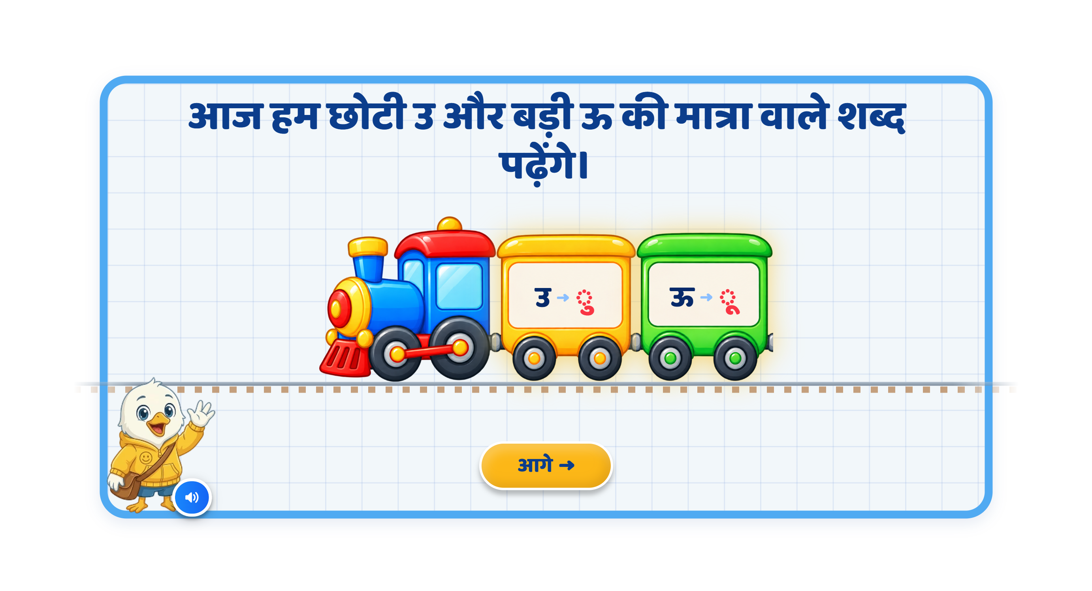
Page 2 · 02_MATRA_INTRO.png
Recommendations
• SCREEN 1 · MATRA_INTRO — each उ → ◌ु pair now sits inside a train-style bogie, for the «मात्राओं की रेल journey» continuity. One pair lights at a time while its new VO plays («यह है उ। इसकी मात्रा है — ु।»). Heading is one line and is the spoken line. आगे stays locked until both pairs are done.

Slide 4
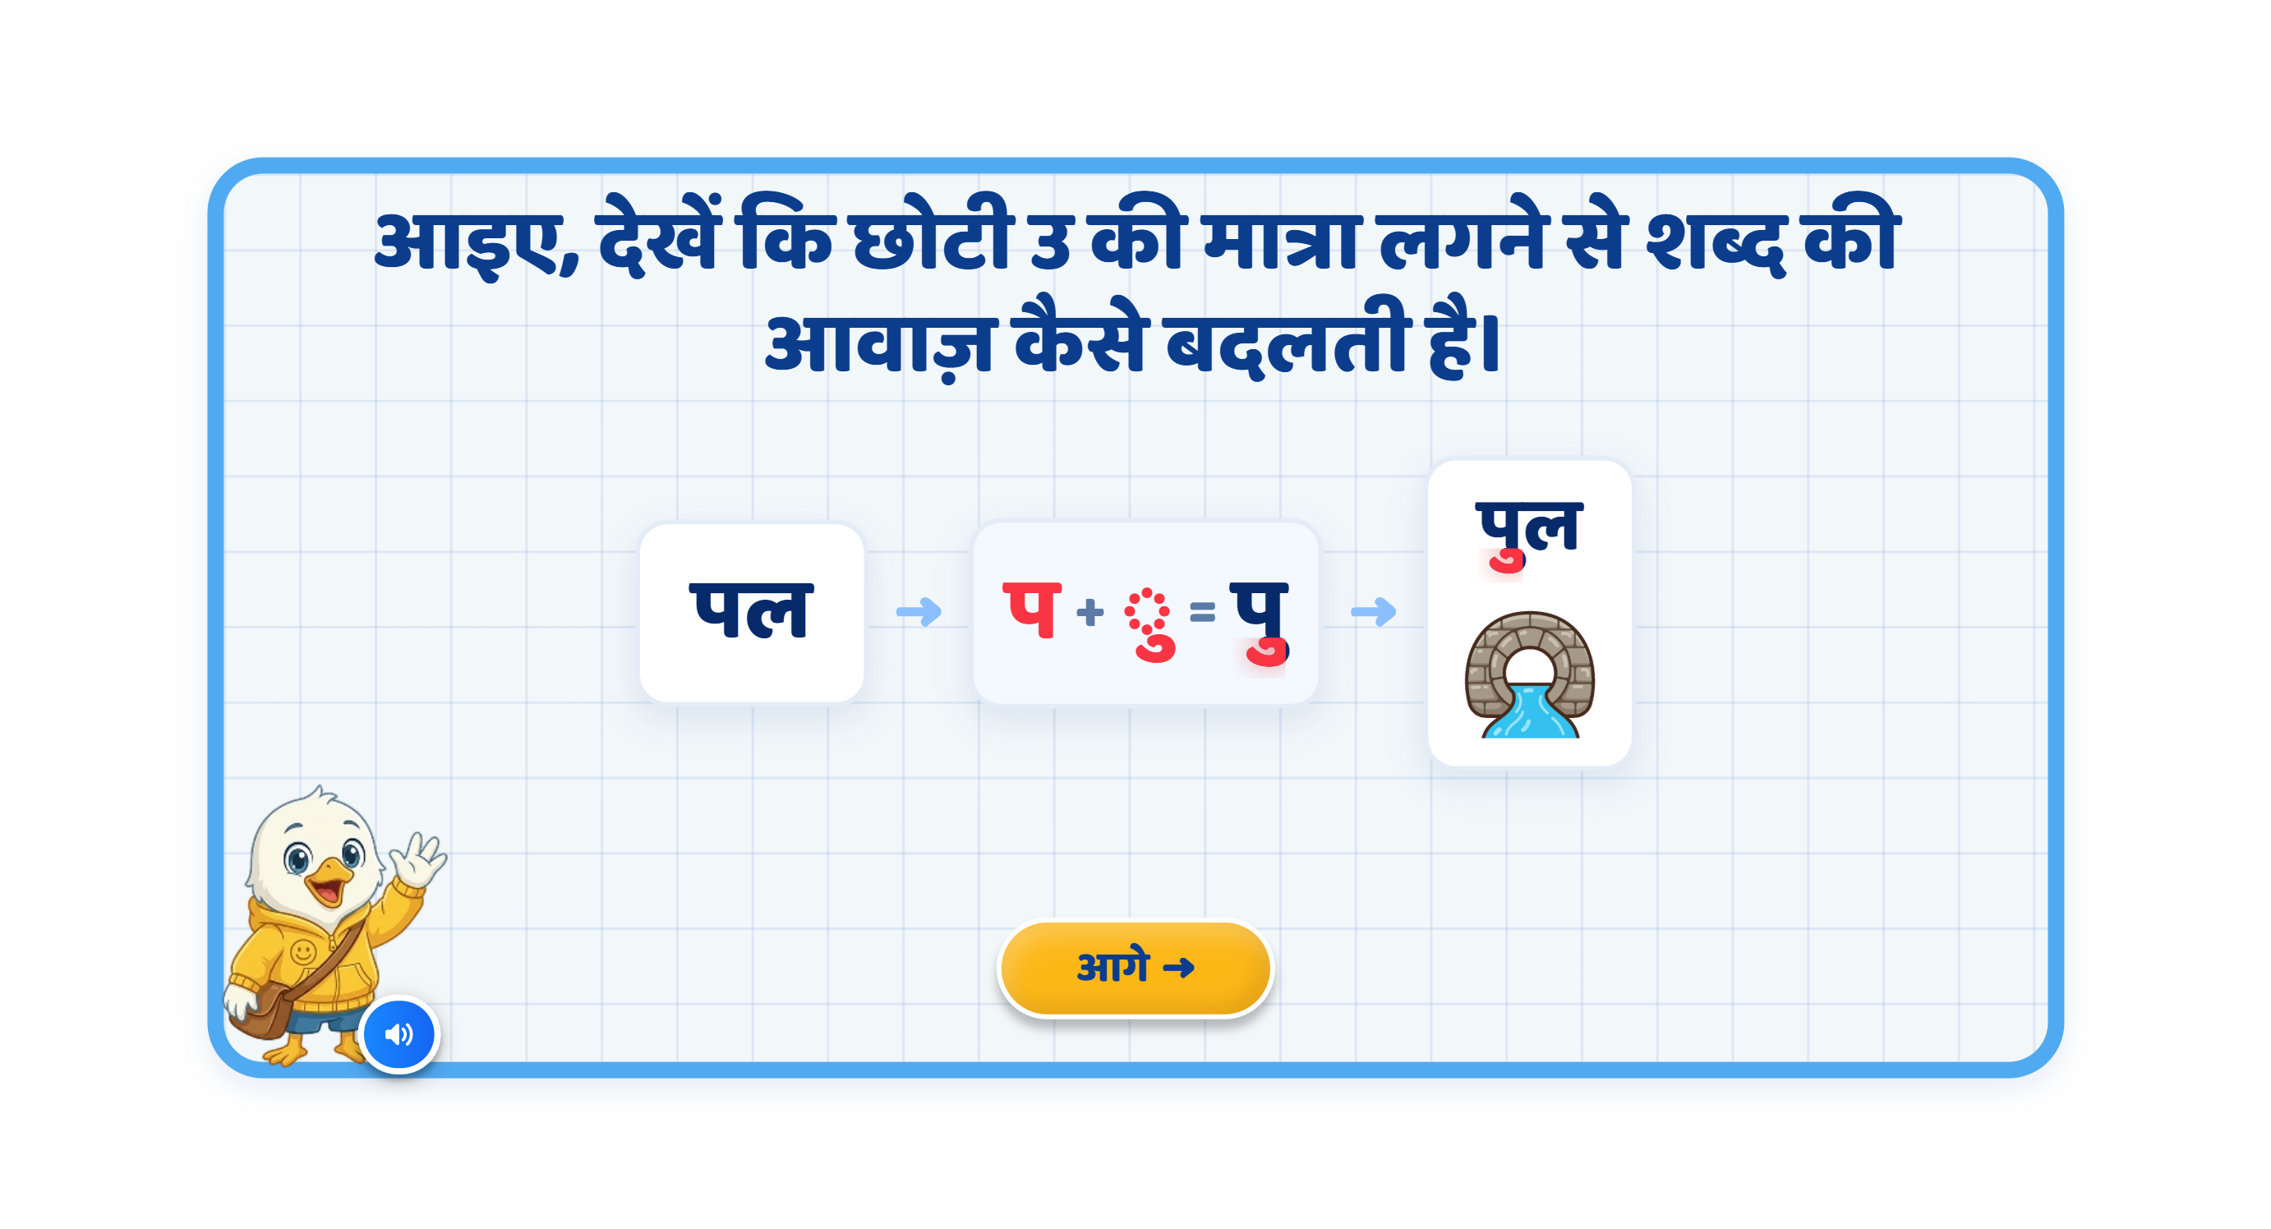
Page 3 · 03_MATRA_BUILD.png
Recommendations
• SCREEN 2 · MATRA_BUILD पल → पुल — VO reworded exactly as the note asks: «प के साथ …», not «के नीचे». The three round-2 panel captions are REMOVED («keep the screen clean and minimal; do not add unnecessary explanatory text»). Only the ु is red, in both पु and पुल. A new sound-differentiation beat speaks प · पु · पुल after the word is built.

Slide 5
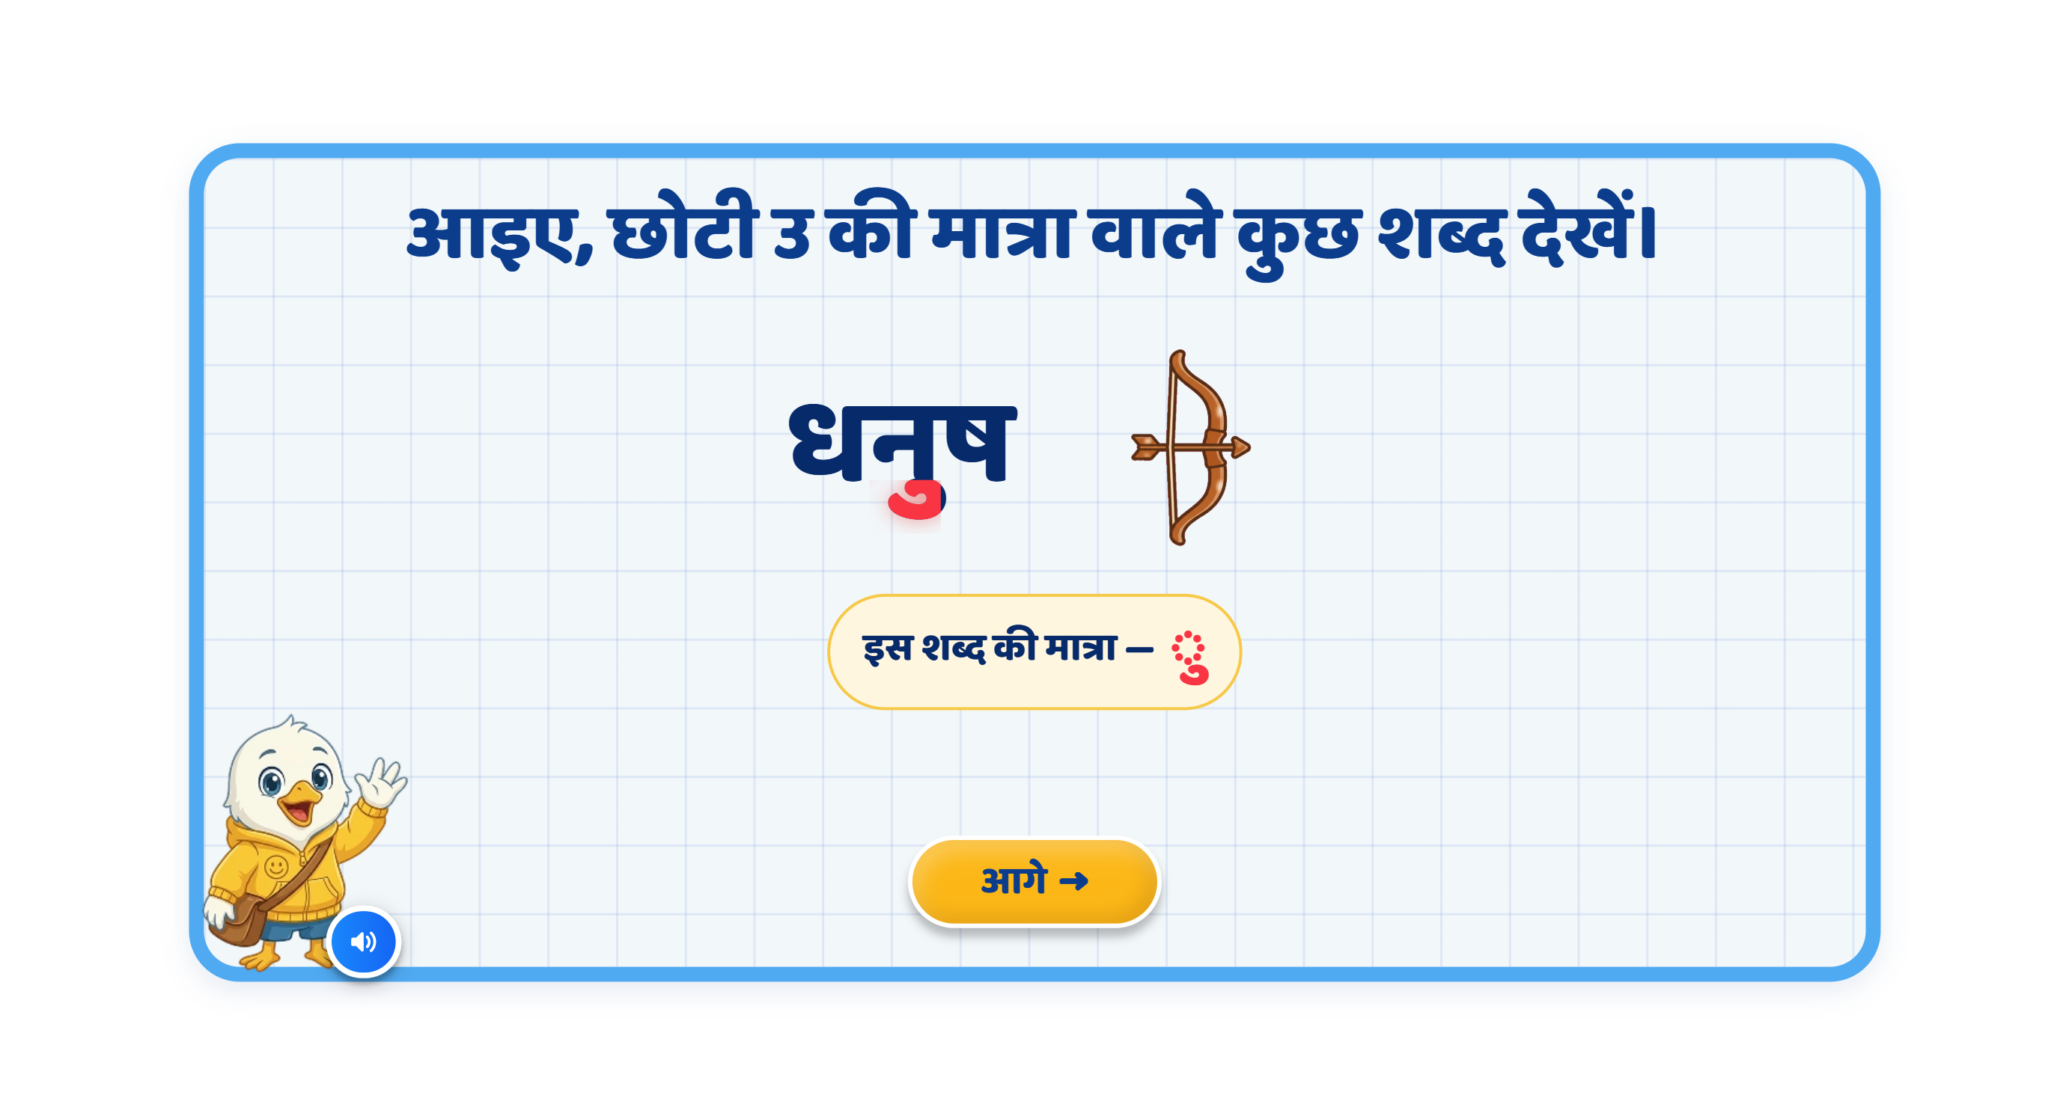
Page 4 · 04_MEET_PAIR.png
Recommendations
• SCREEN 3 · MEET_PAIR — both words changed, per the note: गुड़ and धनुष (round 2 had पुल · गुड़). The ु is highlighted inside each word, on the correct letter. ⚠️ The धनुष picture is not drawn yet and is showing its 🏹 fallback.

Slide 6
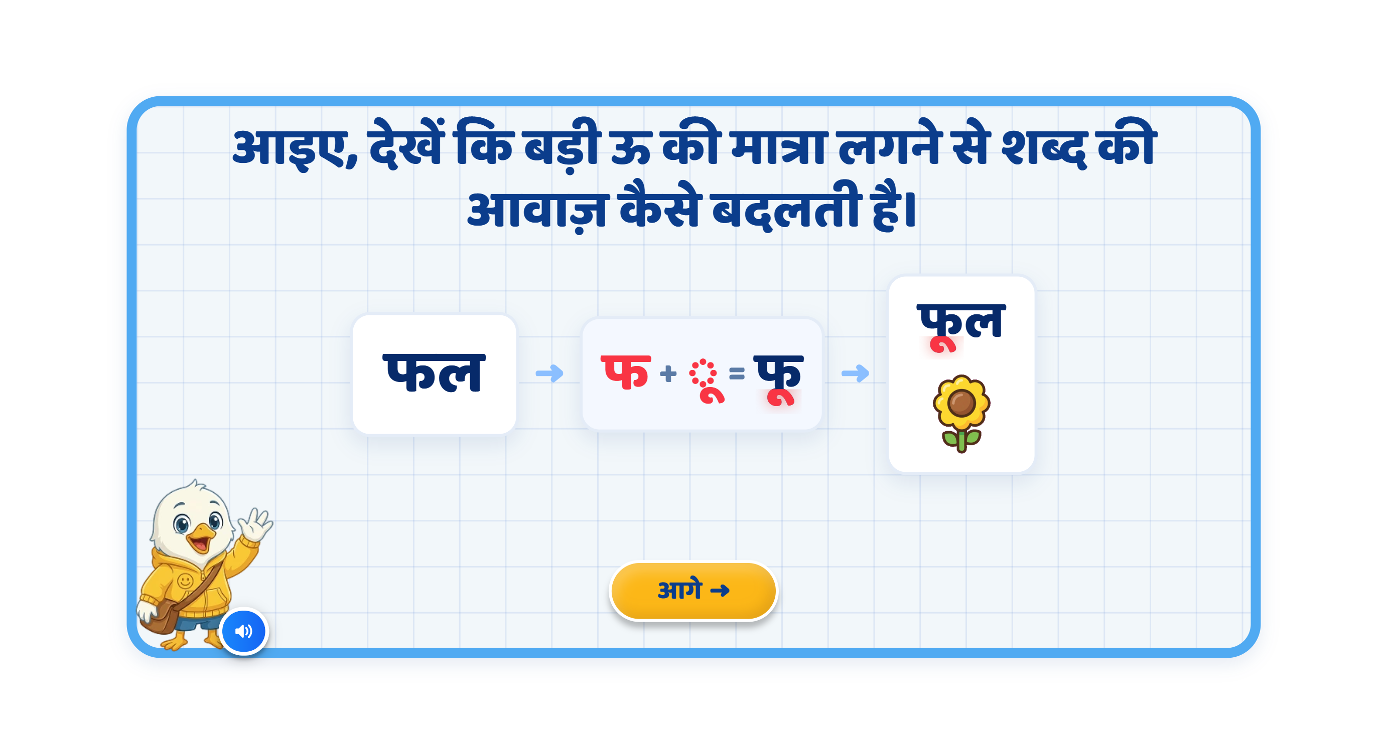
Page 5 · 05_MATRA_BUILD.png
Recommendations
• SCREEN 4 · MATRA_BUILD फल → फूल — same rewording and the same caption removal as page 03; flower appears only after the final word; sound differentiation फ · फू · फूल.

Slide 7
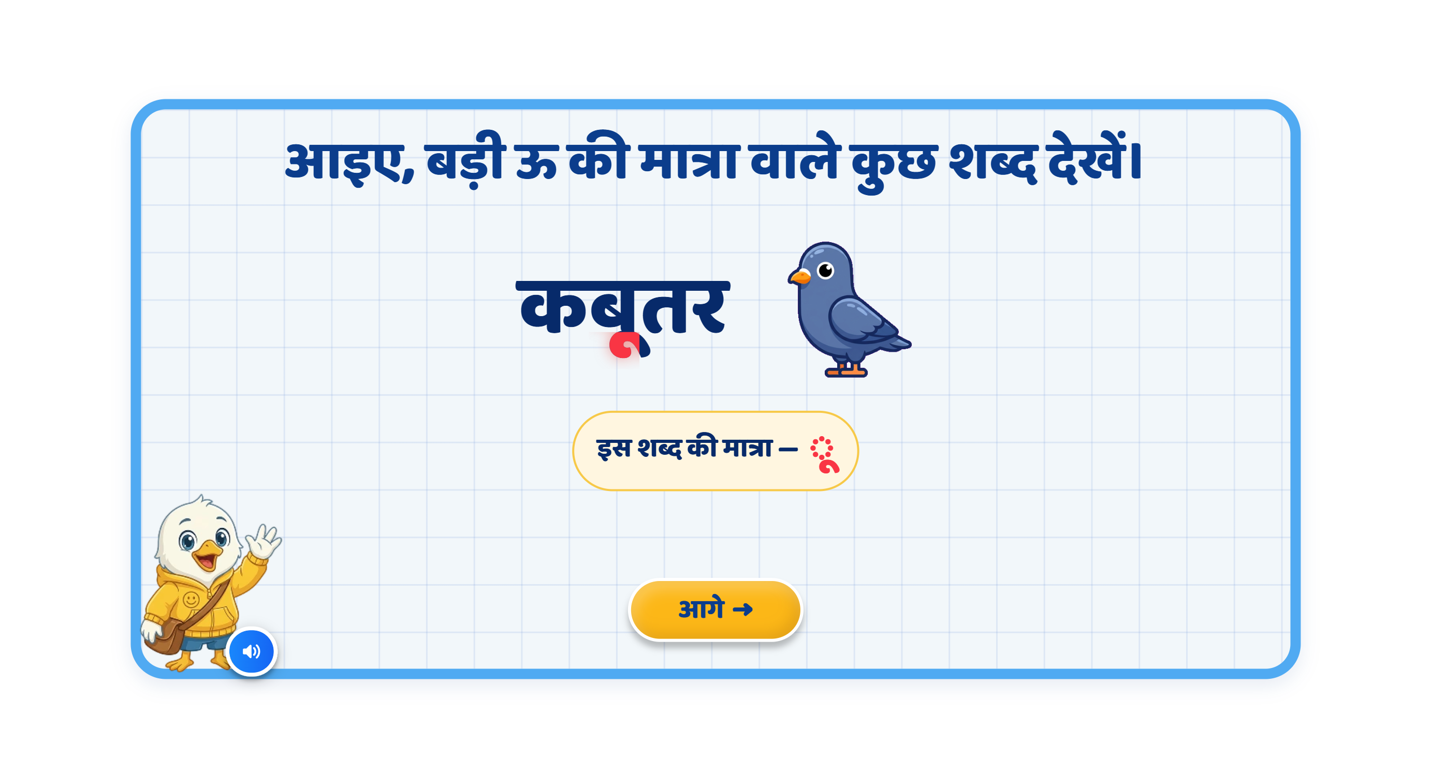
Page 6 · 06_MEET_PAIR.png
Recommendations
• SCREEN 5 · MEET_PAIR — both words changed to दूध and कबूतर (round 2 had फूल · दूध).

Slide 8
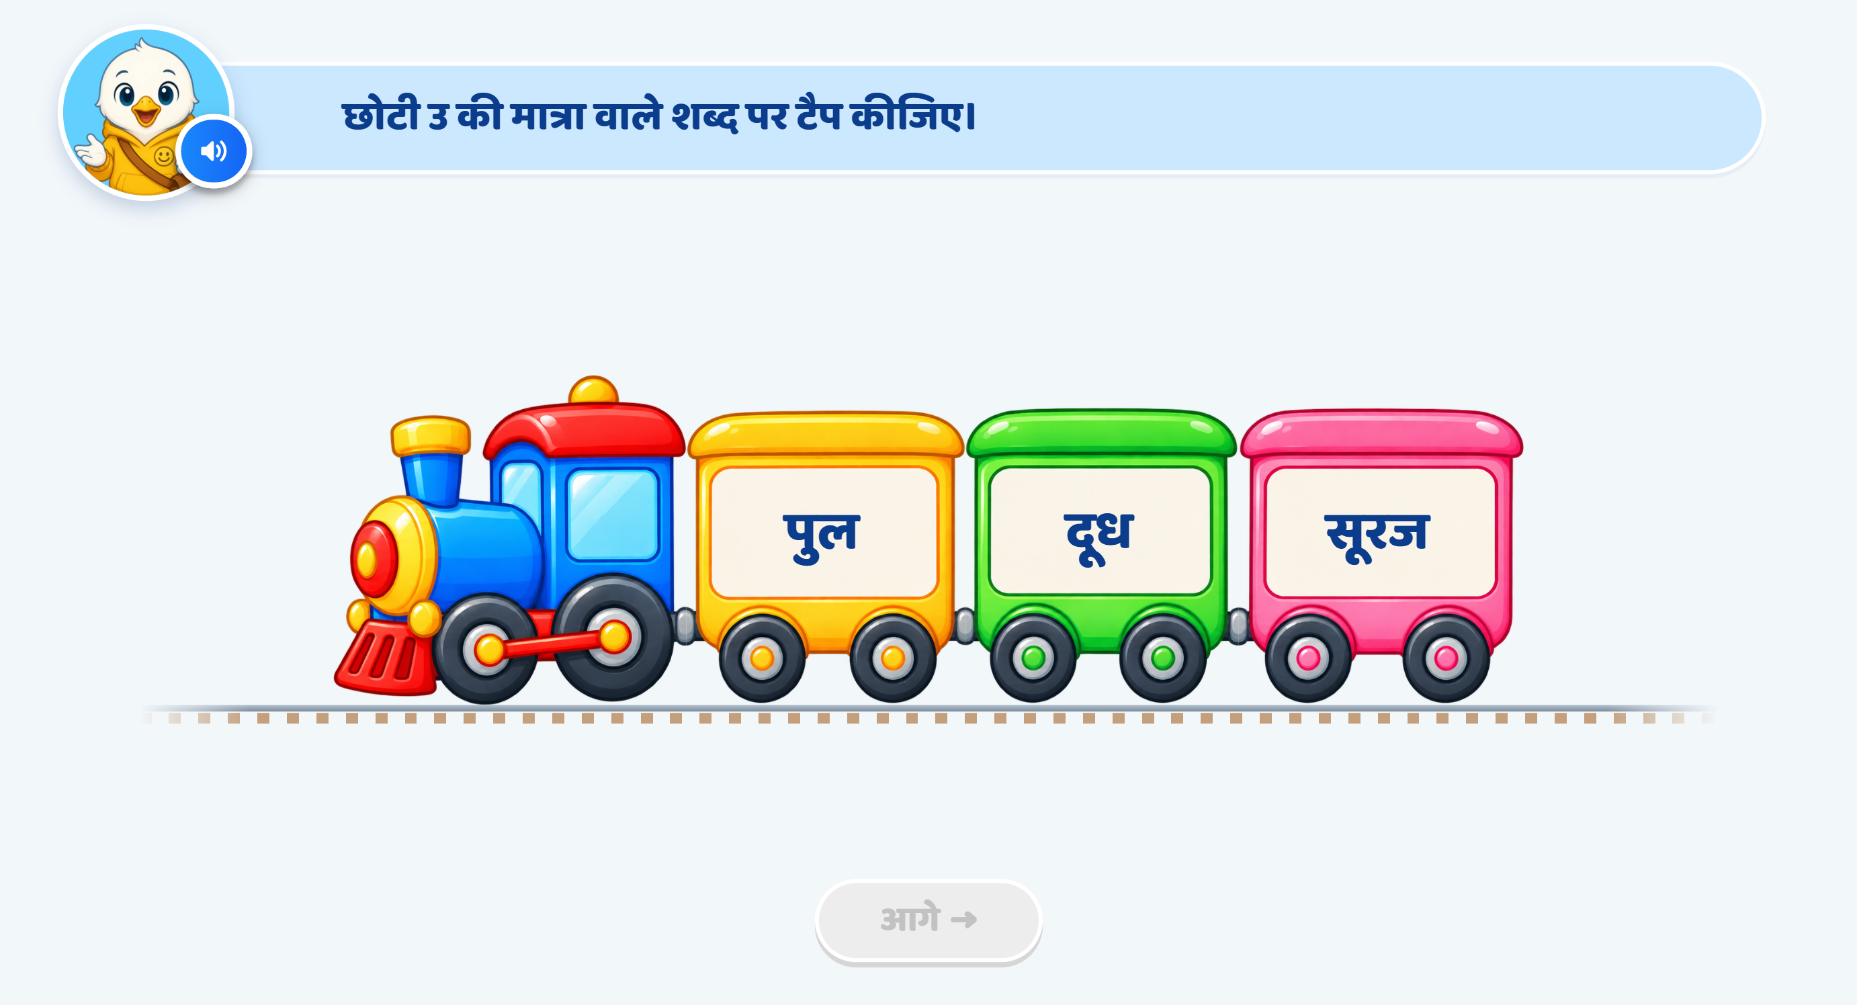
Page 7 · 07_TRAIN_TAP.png
Recommendations
• SCREEN 6 · TRAIN_TAP छोटी उ — heading and every clip now in the आप register. Driven wrong → wrong → right: miss 1 is hint VO with NO hand, miss 2 is hint VO PLUS the hand on पुल, and the third-try win is silent with the ु highlighted. The matra is never highlighted before the answer.

Slide 9
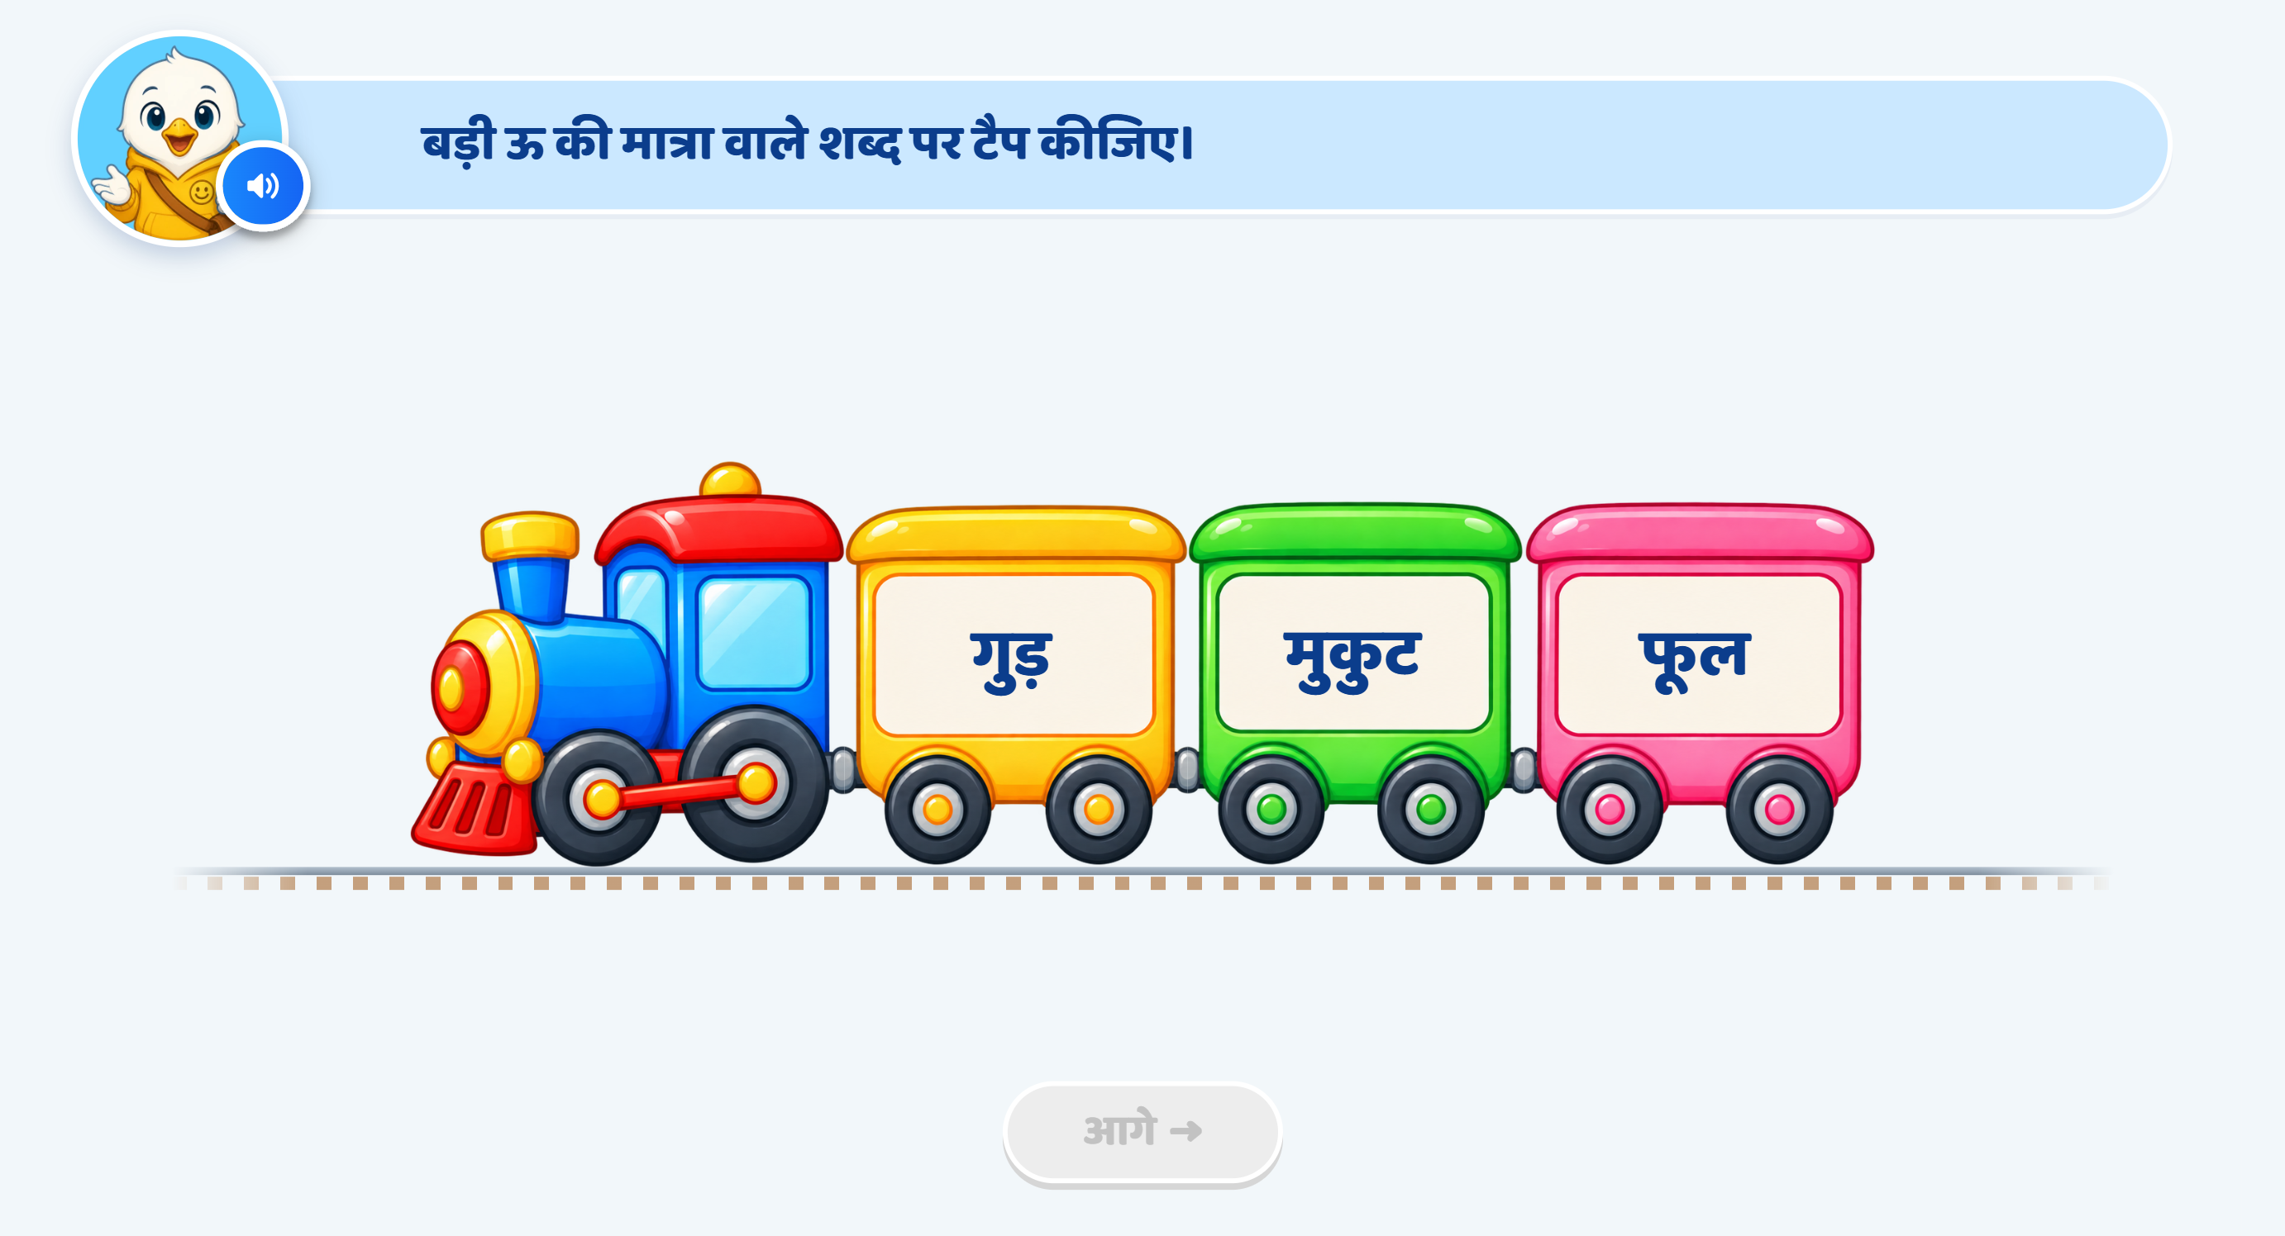
Page 8 · 08_TRAIN_TAP.png
Recommendations
• SCREEN 7 · TRAIN_TAP बड़ी ऊ — same ladder, ऊ wording, correct answer फूल. Verified the same way.

Slide 10
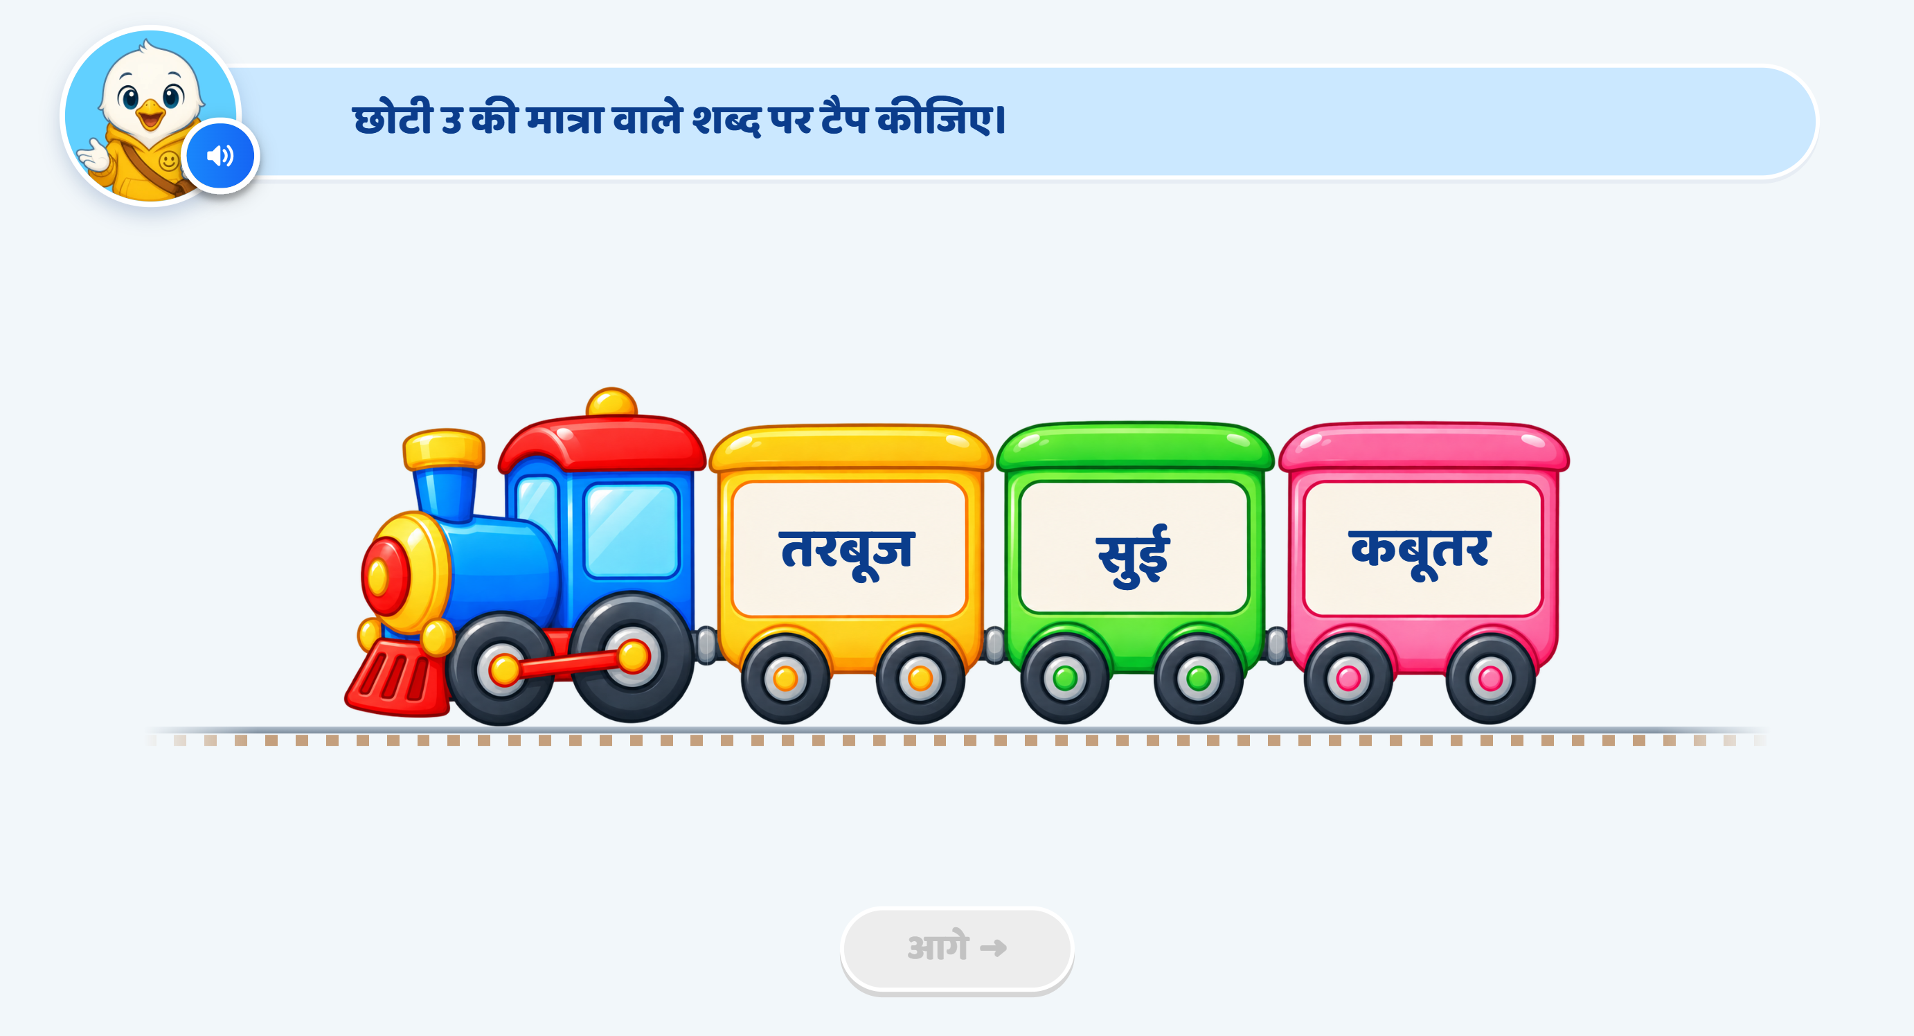
Page 9 · 09_TRAIN_TAP.png
Recommendations
• SCREEN 8 · TRAIN_TAP mixed — तरबूज · सुई · कबूतर, correct answer सुई. Shares its prompt and hint recordings with page 07, so the two screens can never speak the same sentence in two different takes.

Slide 11
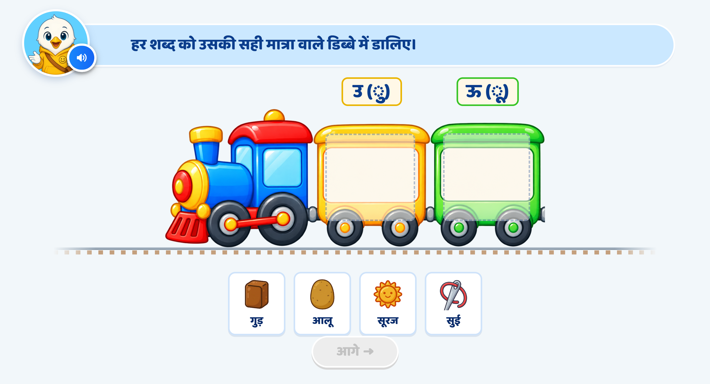
Page 10 · 10_TRAIN_SORT.png
Recommendations
• SCREEN 9 · TRAIN_SORT (words) — coach labels lose छोटी / बड़ी and become «उ (ु)» / «ऊ (ू)». Praise is now PER CARD («शाबाश! 'सुई' शब्द में उ की मात्रा है।») and there is no completion line at all, so the last card's own line is the last thing heard.

Slide 12
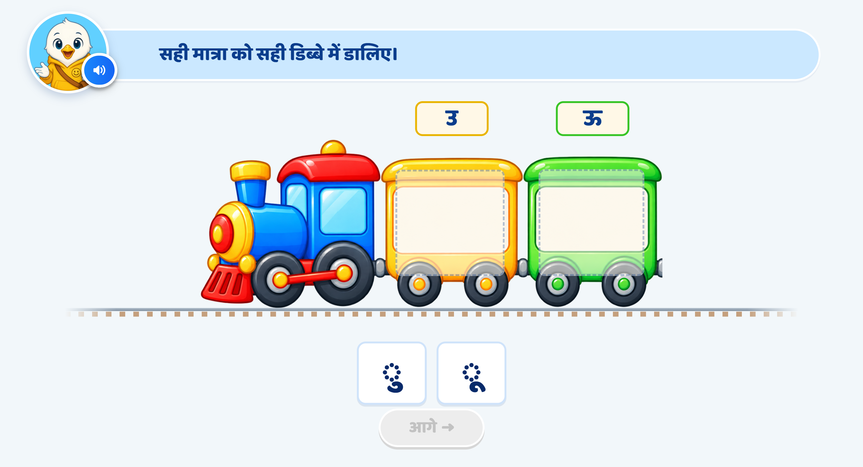
Page 11 · 11_TRAIN_SORT.png
Recommendations
• SCREEN 10 · TRAIN_SORT (matras) — the words पुल / फूल are gone from the coaches; the labels are now just उ and ऊ, with no matra symbol (which would have shown the answer). One card per coach, as asked.

Slide 13
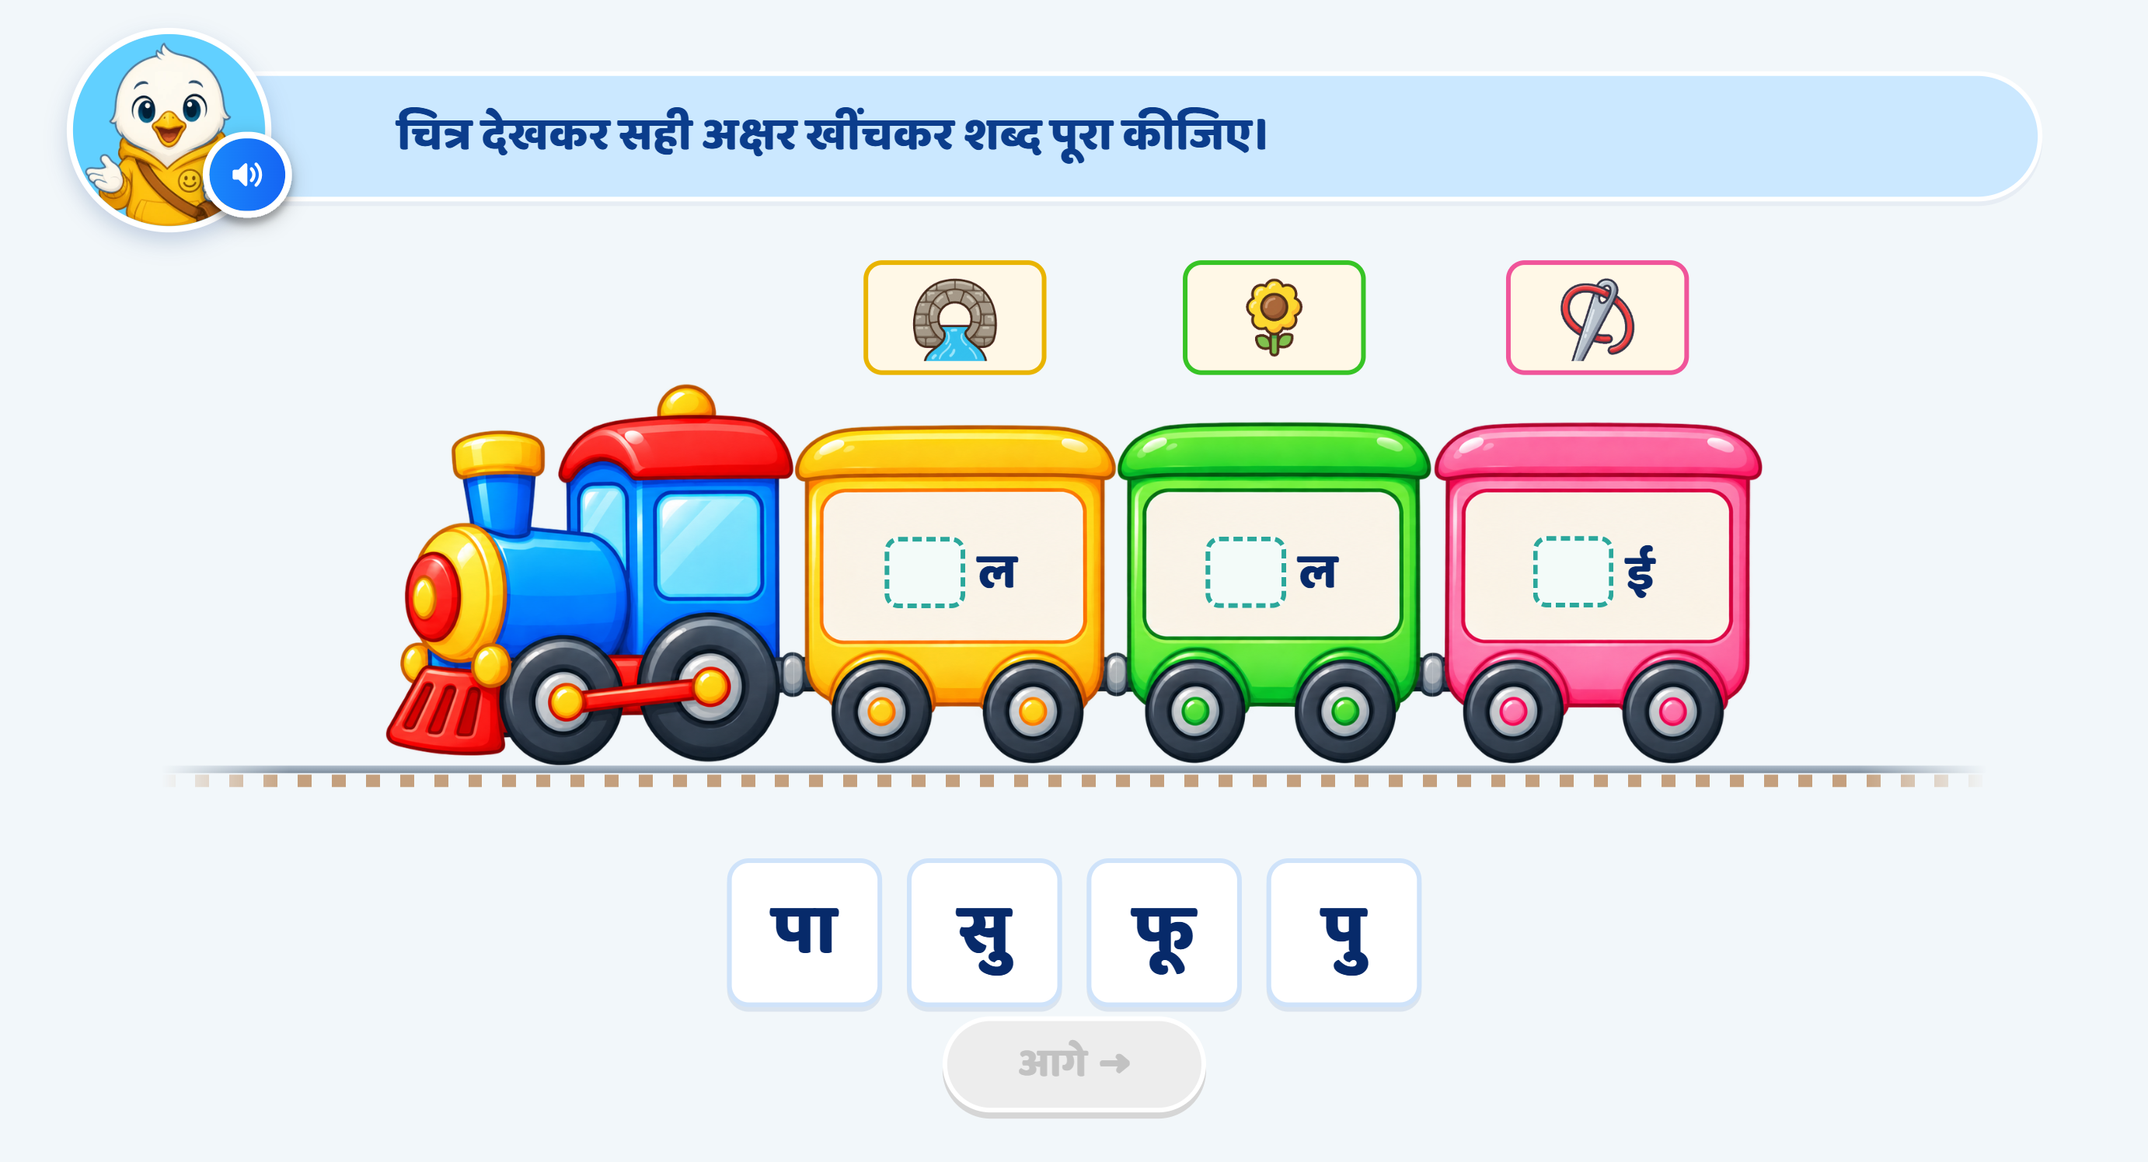
Page 12 · 12_WORD_BUILD.png
Recommendations
• SCREEN 11 · WORD_BUILD — REWRITTEN. The child no longer drags a bare matra; they drag a whole अक्षर into a blank that now sits FIRST: _ल · _ल · _ई with the picture above each coach. Options are पु · फू · सु plus the distractor पा. मी is removed, and the builder fails if it ever returns.

Slide 14
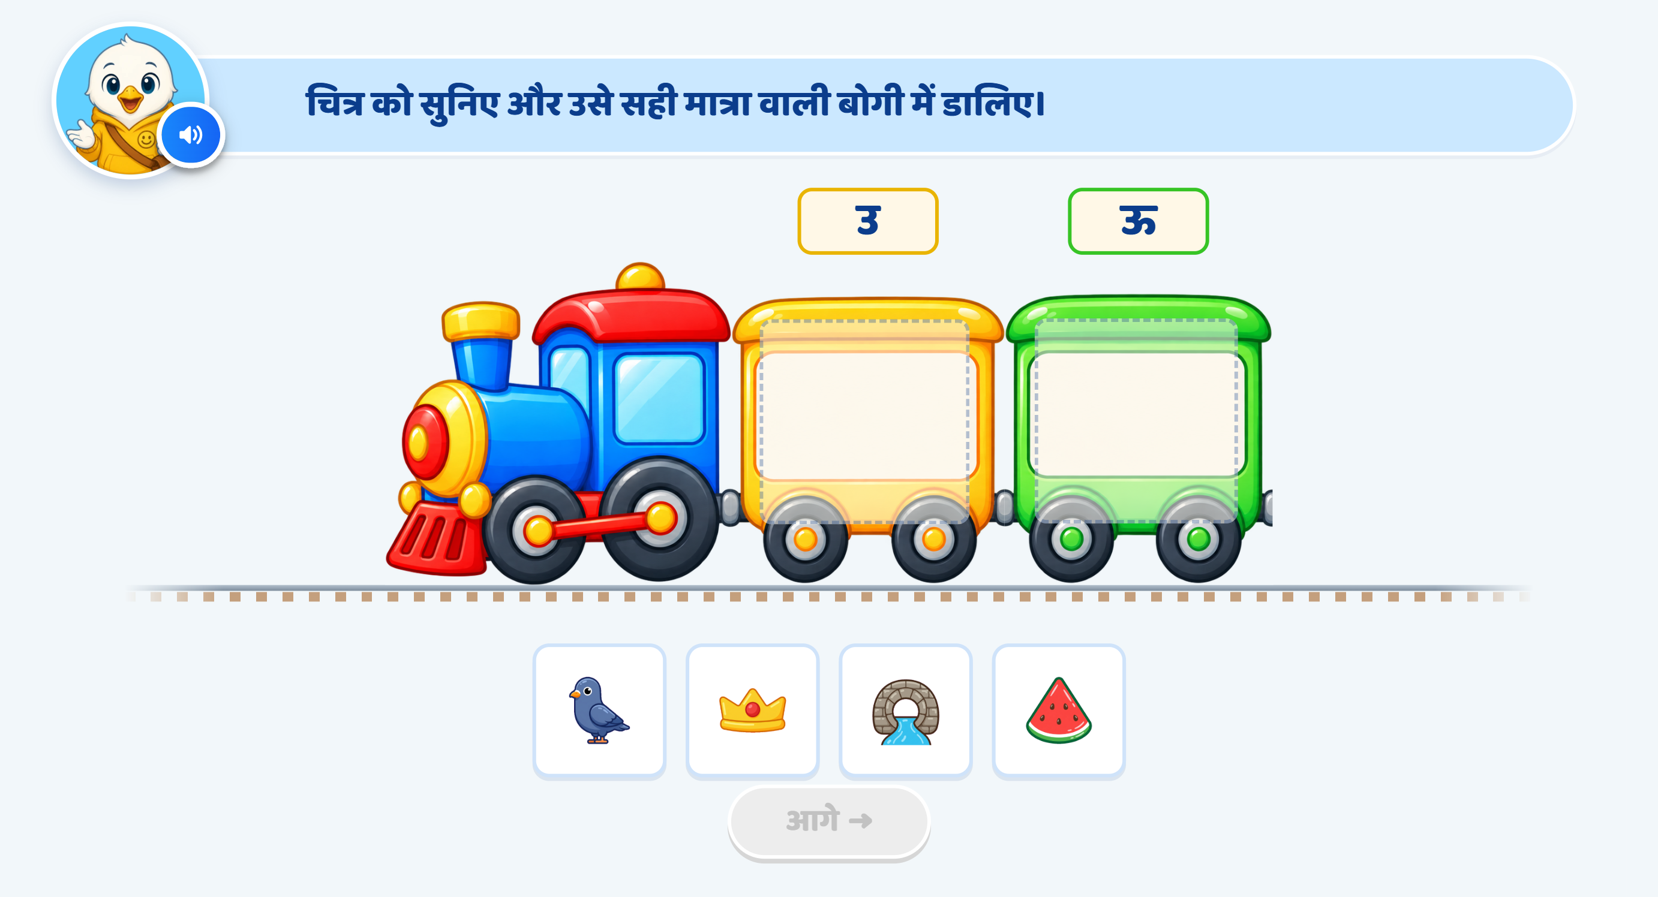
Page 13 · 13_TRAIN_SORT.png
Recommendations
• SCREEN 12 · TRAIN_SORT (pictures) — coach labels are now just उ and ऊ; no छोटी / बड़ी, no matra symbols, no picture names. The labels arrive one by one. Per-card praise as on page 10.

Slide 15
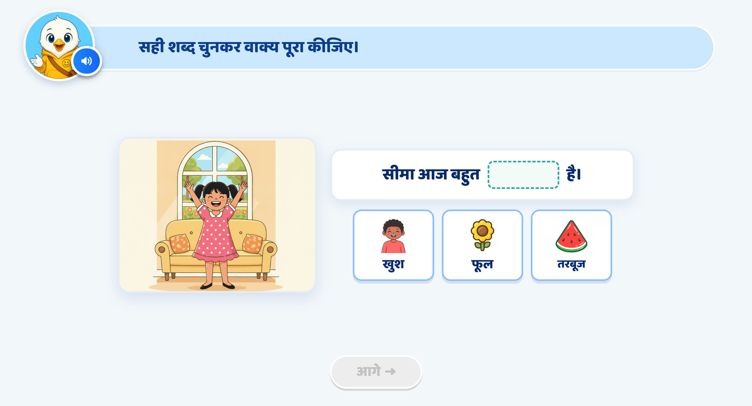
Page 14 · 14_SENTENCE_COMPLETE.png
Recommendations
• SCREEN 13 · SENTENCE_COMPLETE ① — NEW MODULE, replacing the poem. «सीमा आज बहुत ___ है।», answer खुश. Tapping an option speaks the word first and then judges, so a child who cannot decode it can still hear it. ⚠️ The scene illustration is not drawn yet and is showing its emoji fallback.

Slide 16
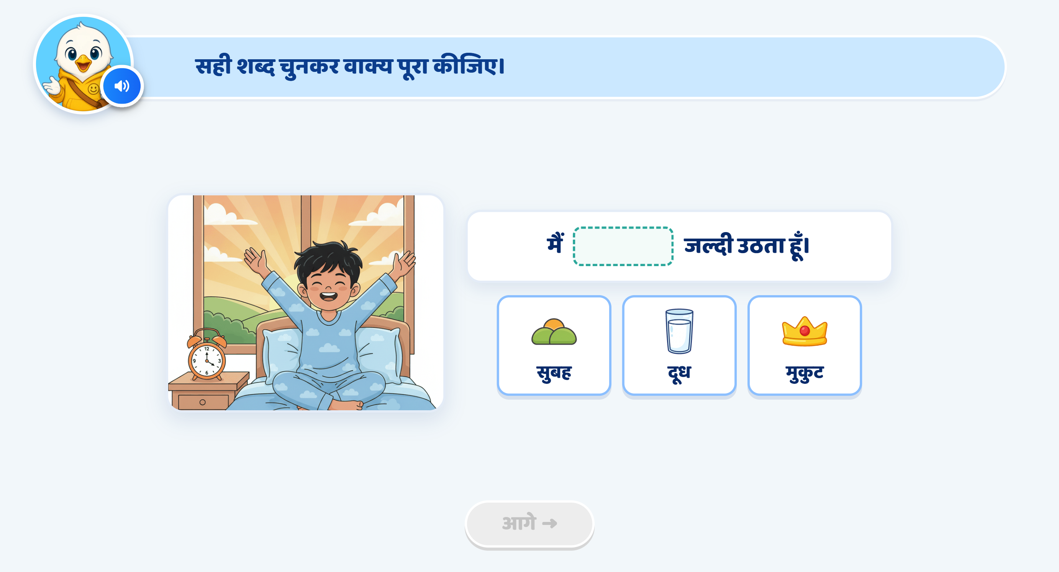
Page 15 · 15_SENTENCE_COMPLETE.png
Recommendations
• SCREEN 14 · SENTENCE_COMPLETE ② — «मैं ___ जल्दी उठता हूँ।», answer सुबह. NOTE FOR THE SME: this screen's praise line is written in the first person («शाबाश! मैंने सही शब्द चुनकर वाक्य पूरा किया।») unlike its three siblings, which read the completed sentence back. Shipped as written rather than normalised — please confirm.

Slide 17
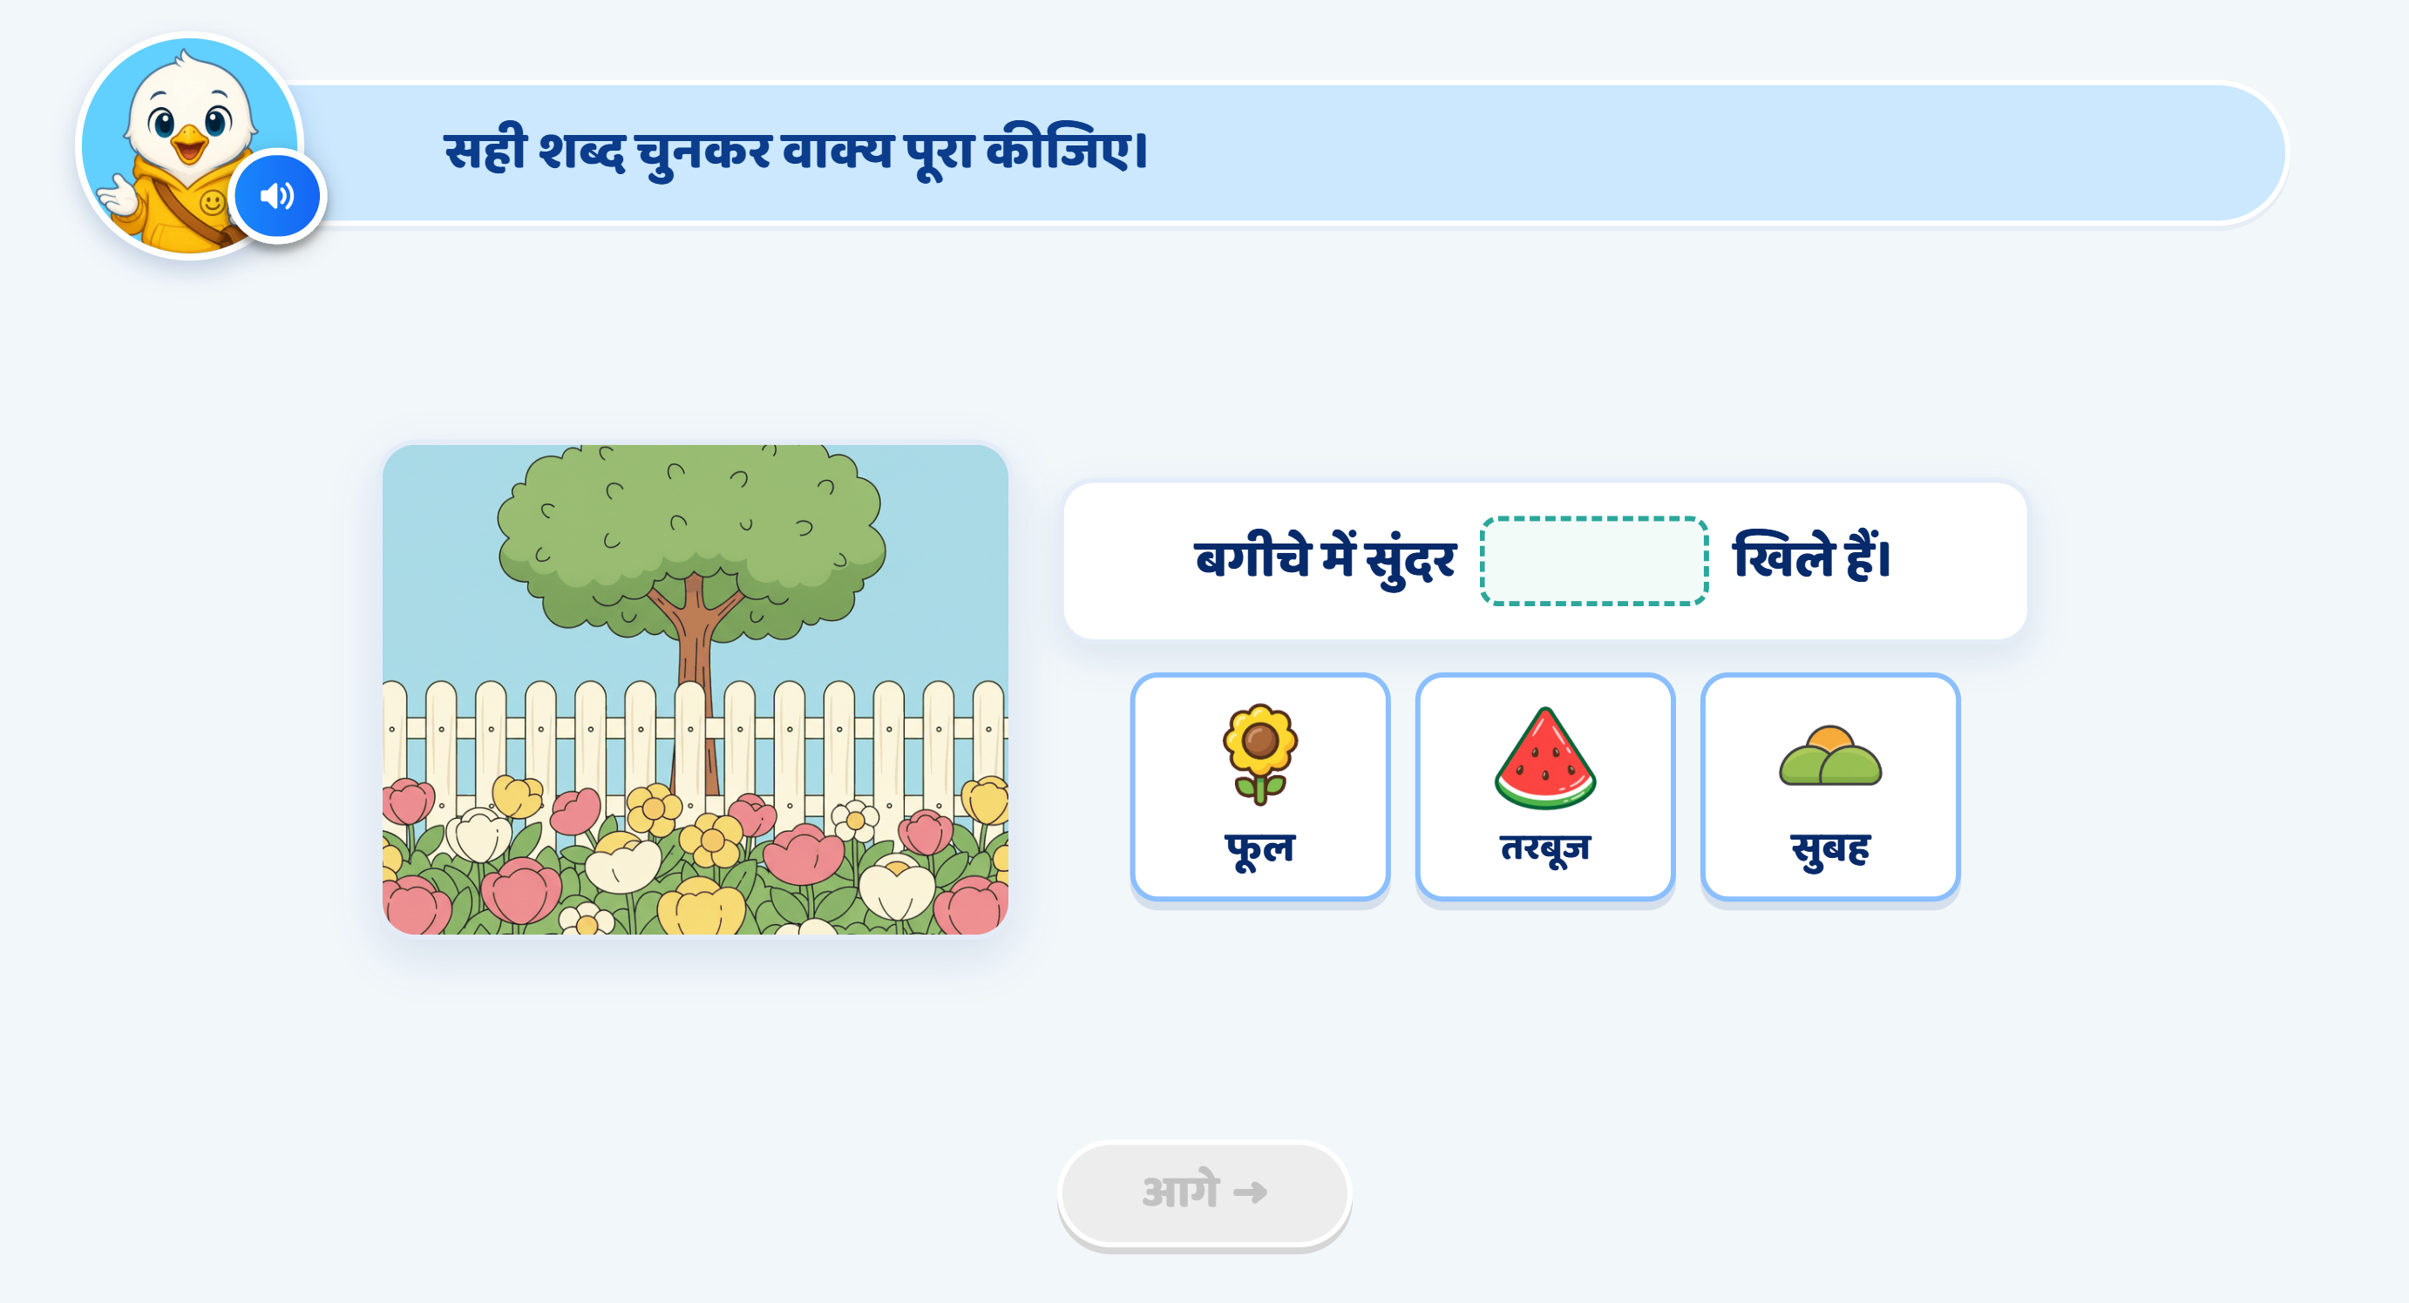
Page 16 · 16_SENTENCE_COMPLETE.png
Recommendations
• SCREEN 15 · SENTENCE_COMPLETE ③ — «बगीचे में सुंदर ___ खिले हैं।», answer फूल.

Slide 18
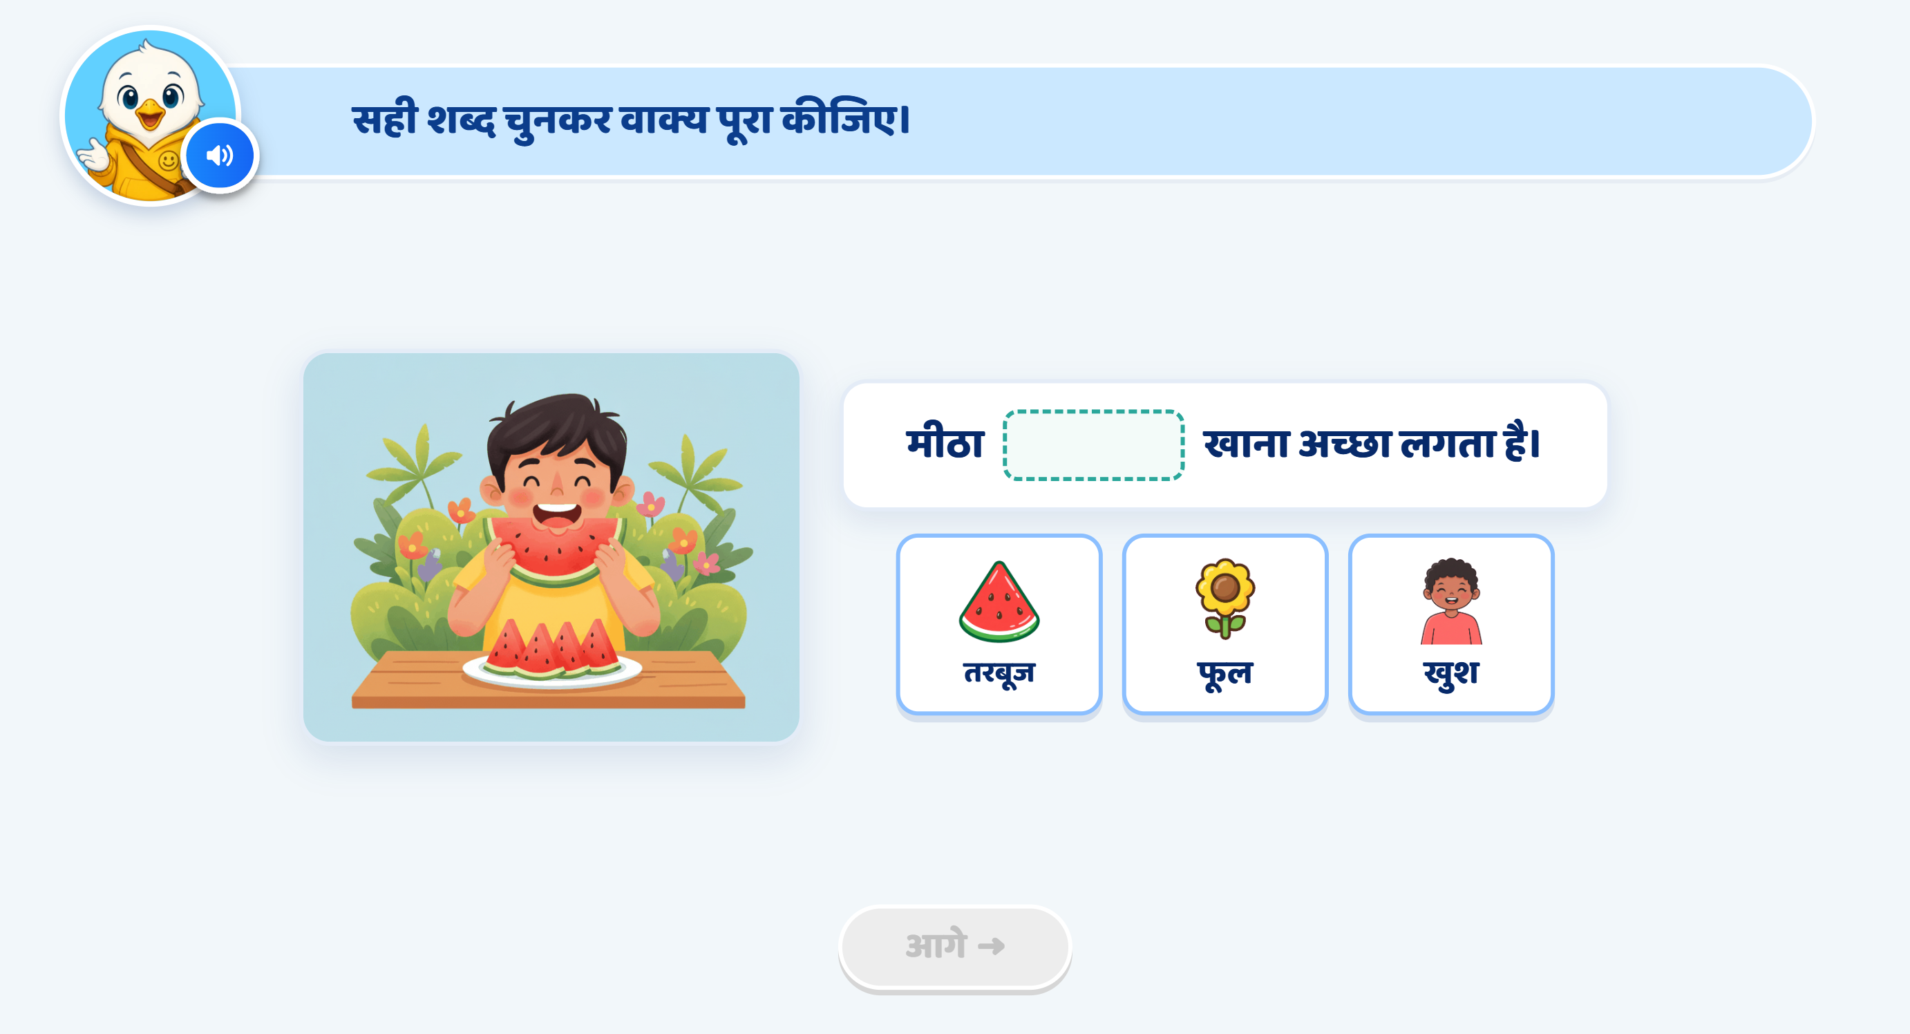
Page 17 · 17_SENTENCE_COMPLETE.png
Recommendations
• SCREEN 16 · SENTENCE_COMPLETE ④ — «मीठा ___ खाना अच्छा लगता है।», answer तरबूज. NOTE FOR THE SME: the speaker note and the mockup give DIFFERENT sentences here — the mockup draws «गर्मी में मीठा ___ …». The note's version ships. Say the word and the mockup's version is a one-line change.

Slide 19
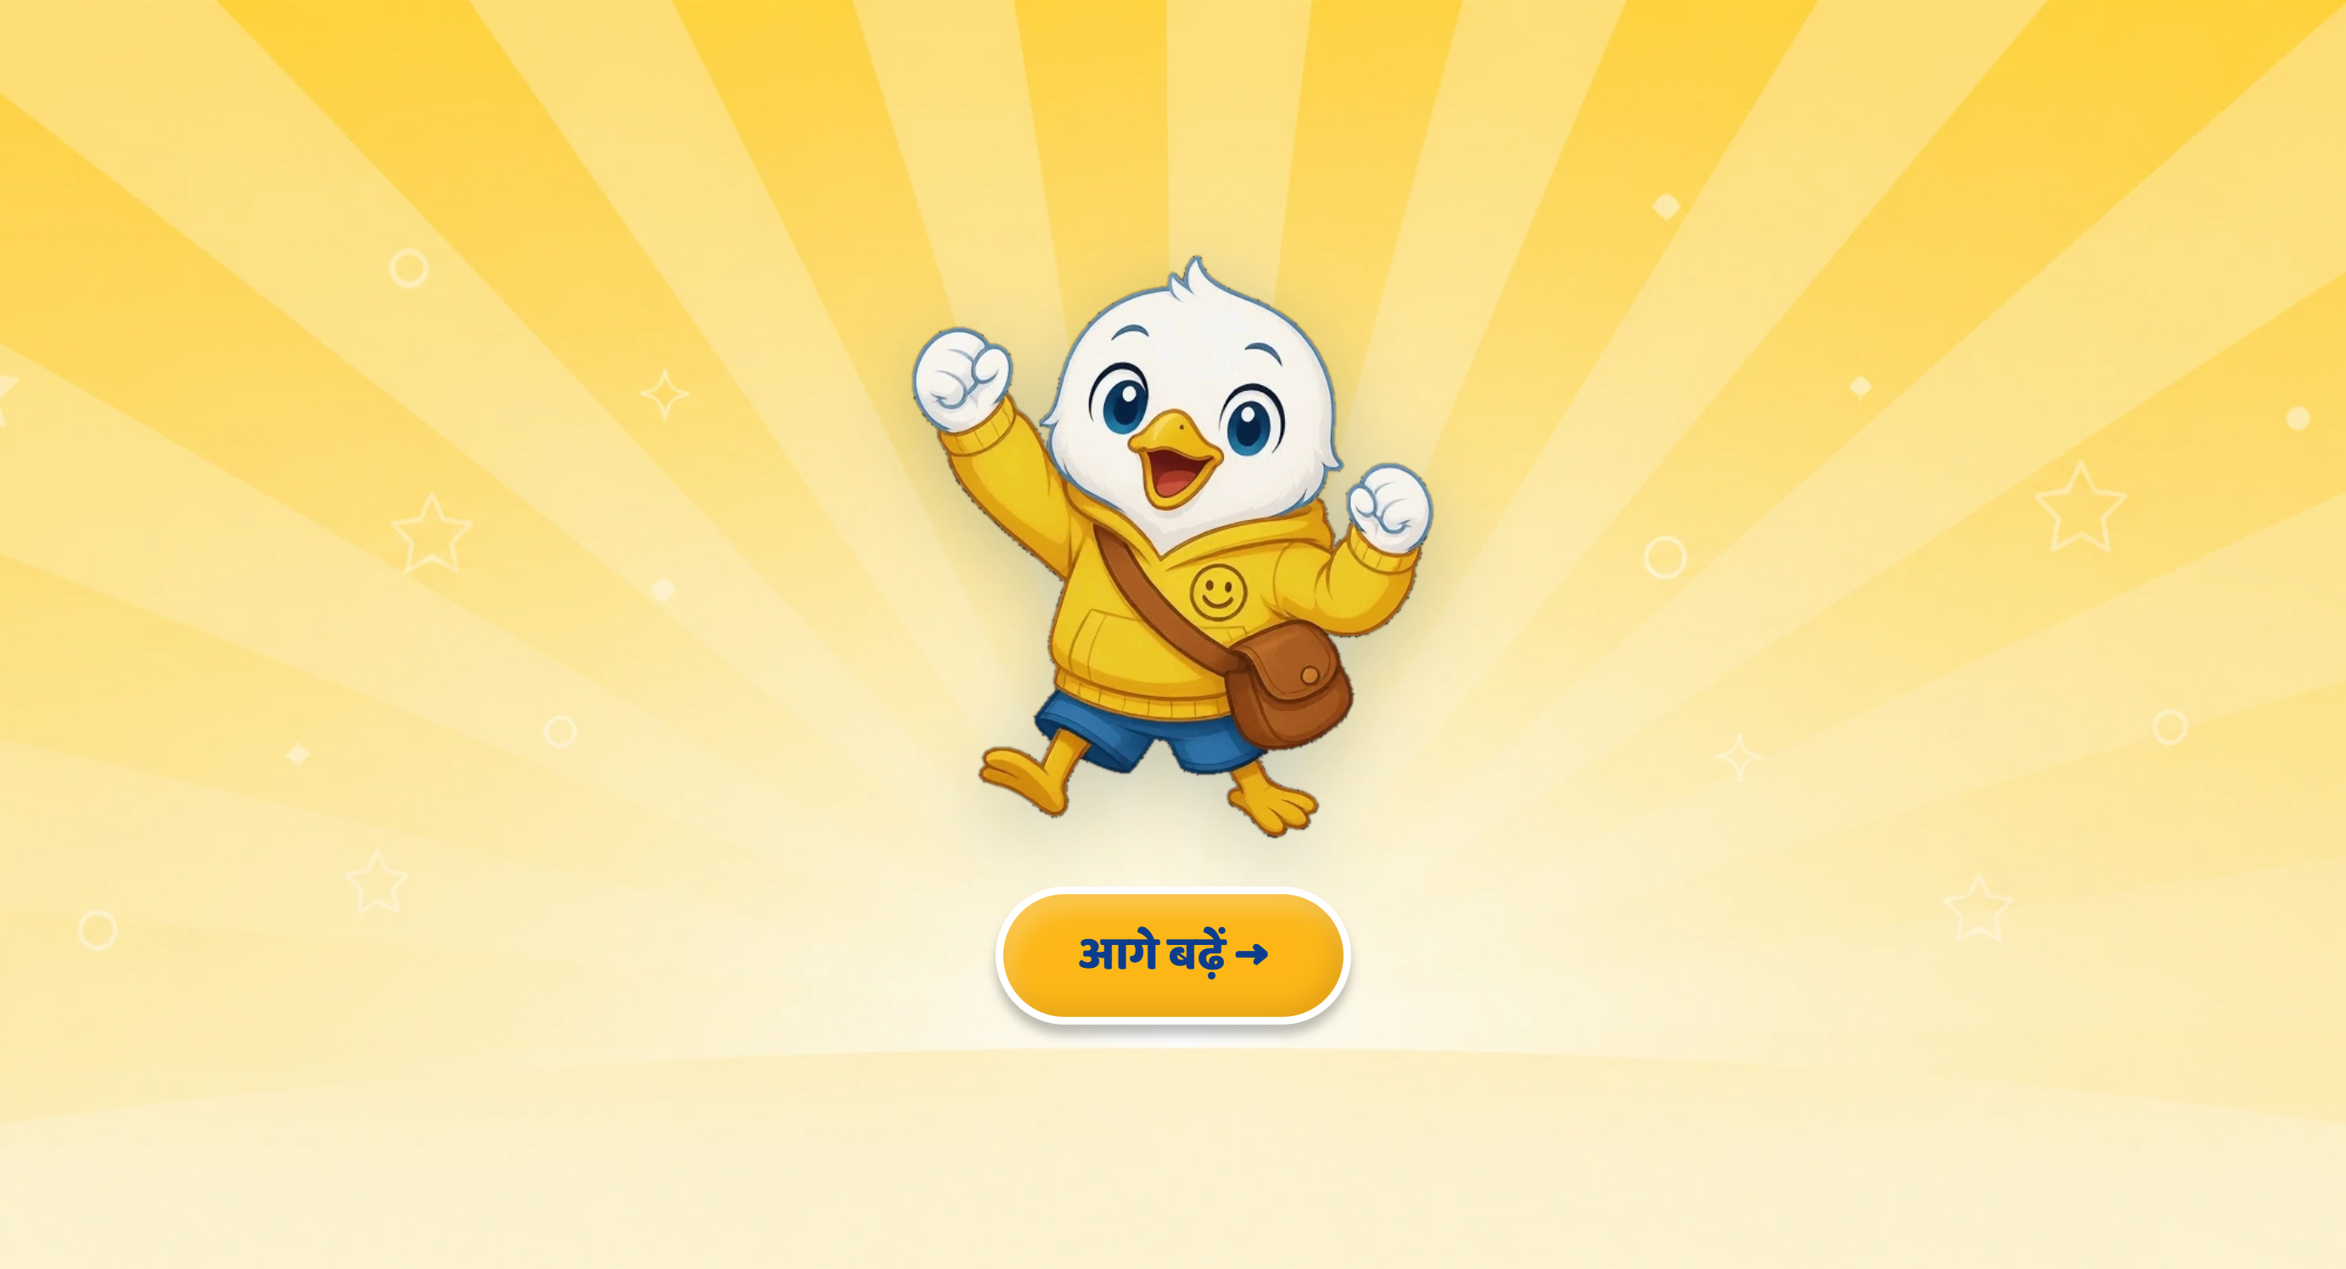
Page 18 · 18_CELEBRATION.png
Recommendations
• SCREEN 17 · CELEBRATION — the deck carries no recommendation on this page, so it is unchanged, register included: there is no imperative in it to flip.

