Slide 1
HI02H11_L02_S02 · मात्राओं की रेल · उ / ऊ — round 2
Page-by-page review · 17 pages

Slide 2
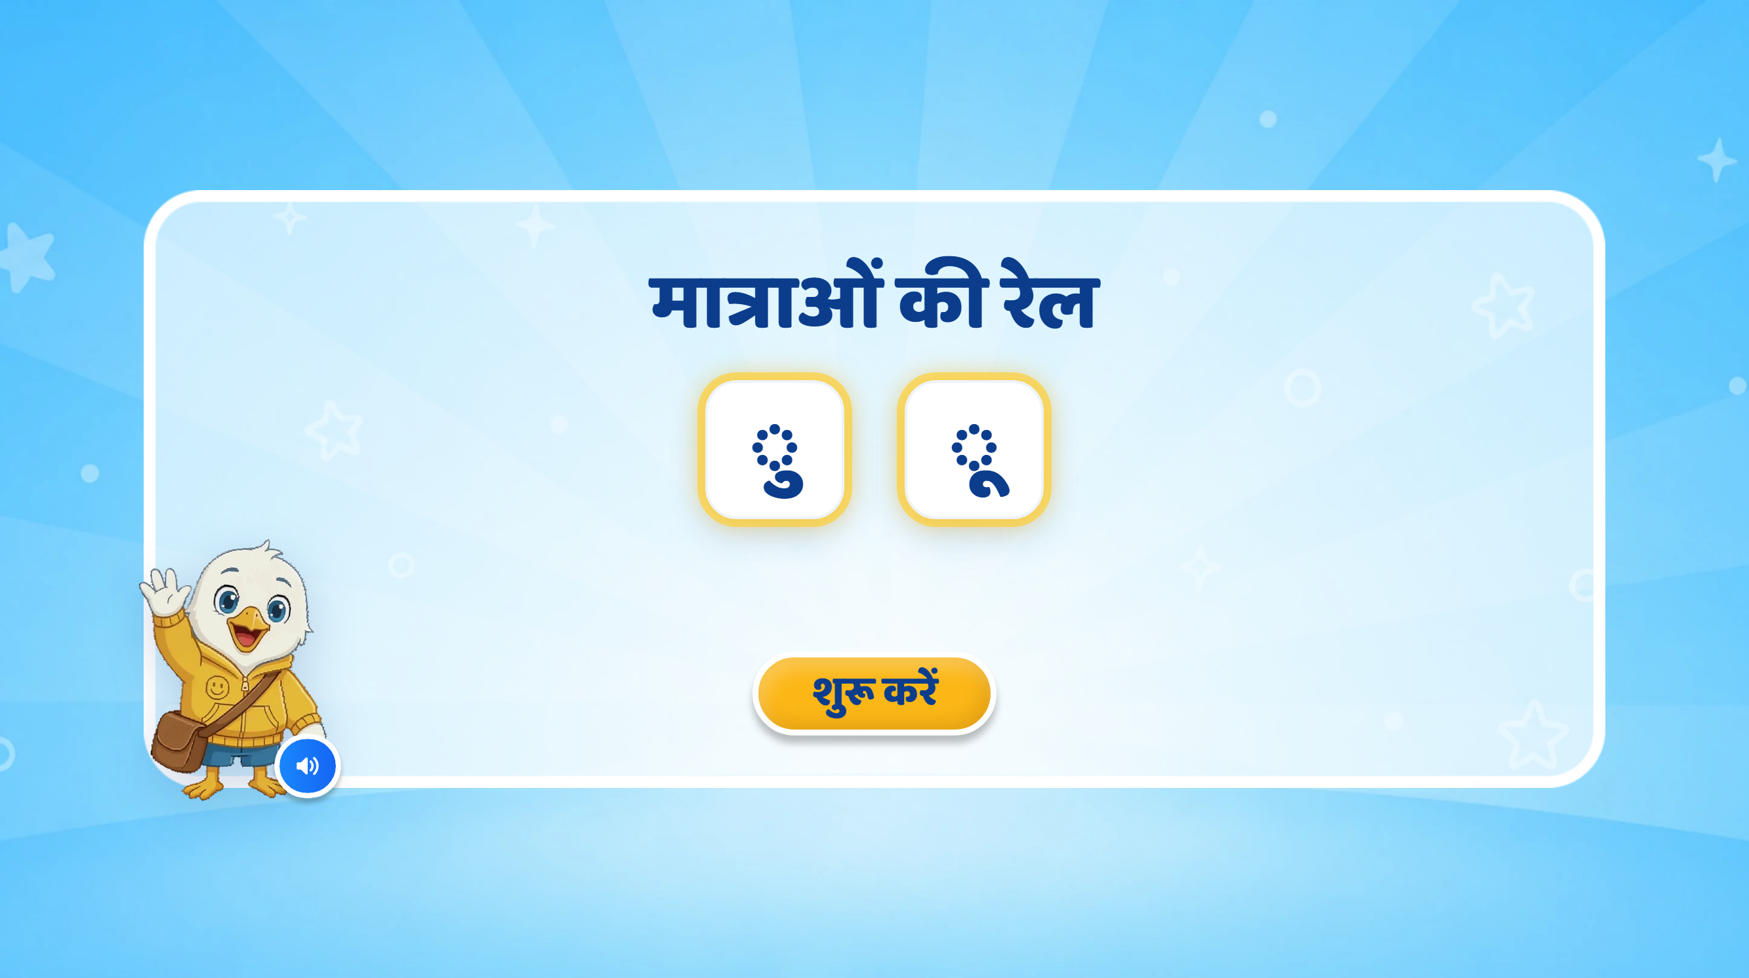
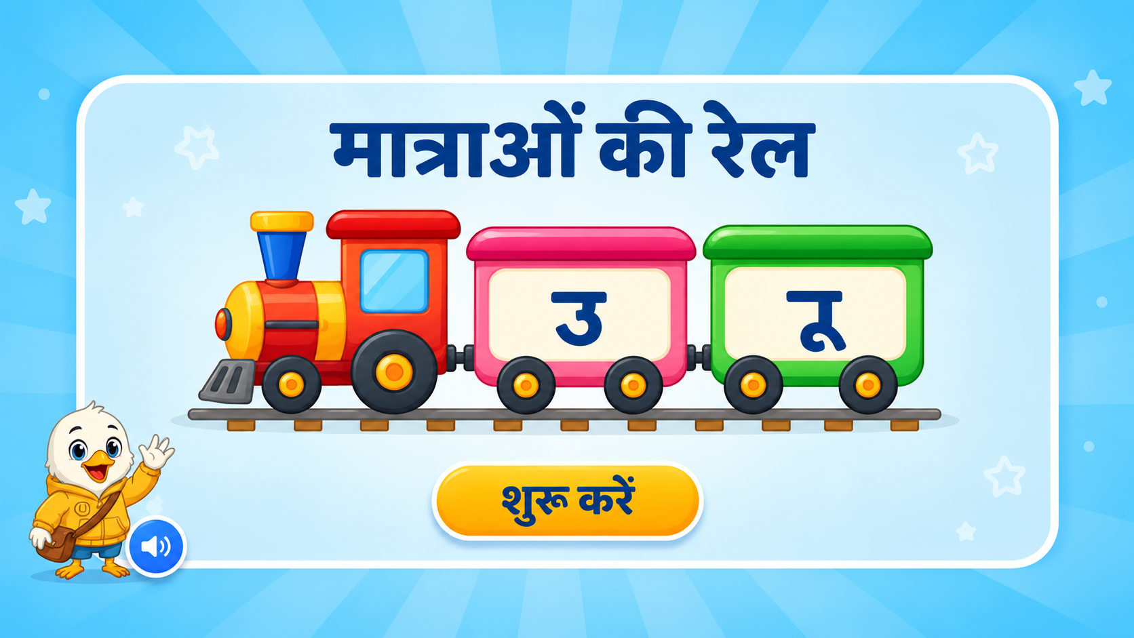
Page 1 · 01_landing.png
Notes:
Recommendations:
मात्राओं
की रेल
Screen Changes:
•Remove all extra text that is not required.
•Keep the screen clean and minimal.
•Show only two matra boxes/cards:
•1st box: ु
•2nd box: ू
•Keep the existing mascot and overall UI/UX style unchanged.
•Follow the same train-theme visual treatment used in the previous PPT. The matras can be shown inside two train bogies/cards so that the lesson visually continues as a “मात्राओं की रेल” journey.
Animation:
•If possible, bring the train onto the screen with a smooth right-to-left animation.
•The two matra boxes/bogies can appear one by one with a soft pop/fade animation.
•First show ु, followed by ू.
•Keep animations subtle and child-friendly.
SFX:
•Add a soft train arrival / whistle SFX when the train enters.
•Add a light sparkle/pop SFX when each matra appears.
VO:
“हेलो दोस्त! मैं हूँ स्विफ्टी। आज हम मात्राओं के बारे में जानेंगे।”
After this VO, the two matras ु, ू can appear one by one on screen.

Slide 3
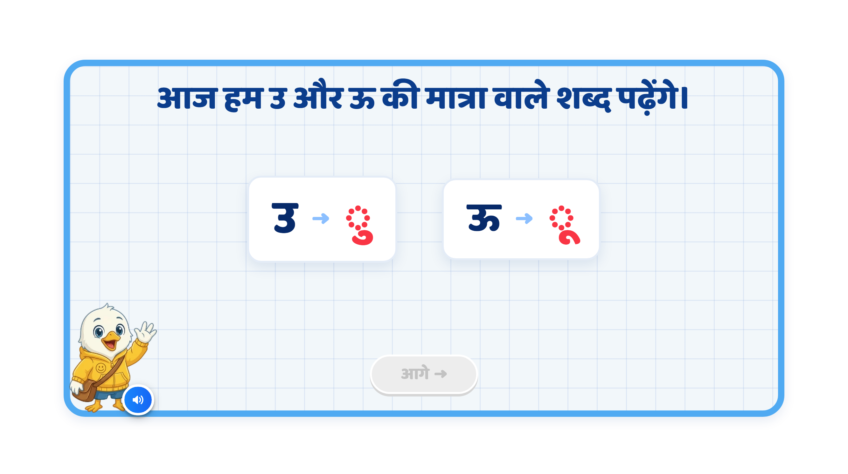
Page 2 · 02_MATRA_INTRO.png
Notes:
Recommendation
VO:
“आज हम छोटी उ और बड़ी ऊ की मात्रा वाले शब्द पढ़ेंगे।”
इसके बाद pair-wise VO इस तरह चल सकती है:
“यह है उ। इसकी मात्रा है — ु।”
“यह है ऊ। इसकी मात्रा है — ू।”
On Screen:
•Remove the current extra heading text from the top, if needed, so the screen stays clean and focused.
•Show the letter and its corresponding matra symbol as a pair, one by one.
•Keep only one pair active at a time.
•Each active pair should light up/highlight when its VO plays.
•Sequence should be:
•उ → ु
•ऊ → ू
•Keep the existing mascot and overall UI/UX style unchanged.
•If possible, keep the train-theme continuity by showing each pair inside a train-style card / bogie / box.
Animation:
•First उ appears, then ु appears beside it with a soft glow.
•After that, both can fade slightly / dim softly.
•Then ऊ appears, and ू appears beside it.
•Use a simple pop / fade animation.
•Do not add extra decorative elements.
•Keep animations subtle and child-friendly.
SFX:
•Add a soft pop / chime when each matra symbol appears.
•Keep SFX subtle so the VO remains clear.
Next Button:
•Keep the Next button disabled during the sequence.
•Activate it only after both pairs have been shown and spoken.
Note:
•This slide should work as the introduction to the two matras.
•The main learning goal is that the child clearly connects:
उ → ु
ऊ → ू
•Since this lesson has only two matras, show only these two pairs and do not overload the screen.

Slide 4
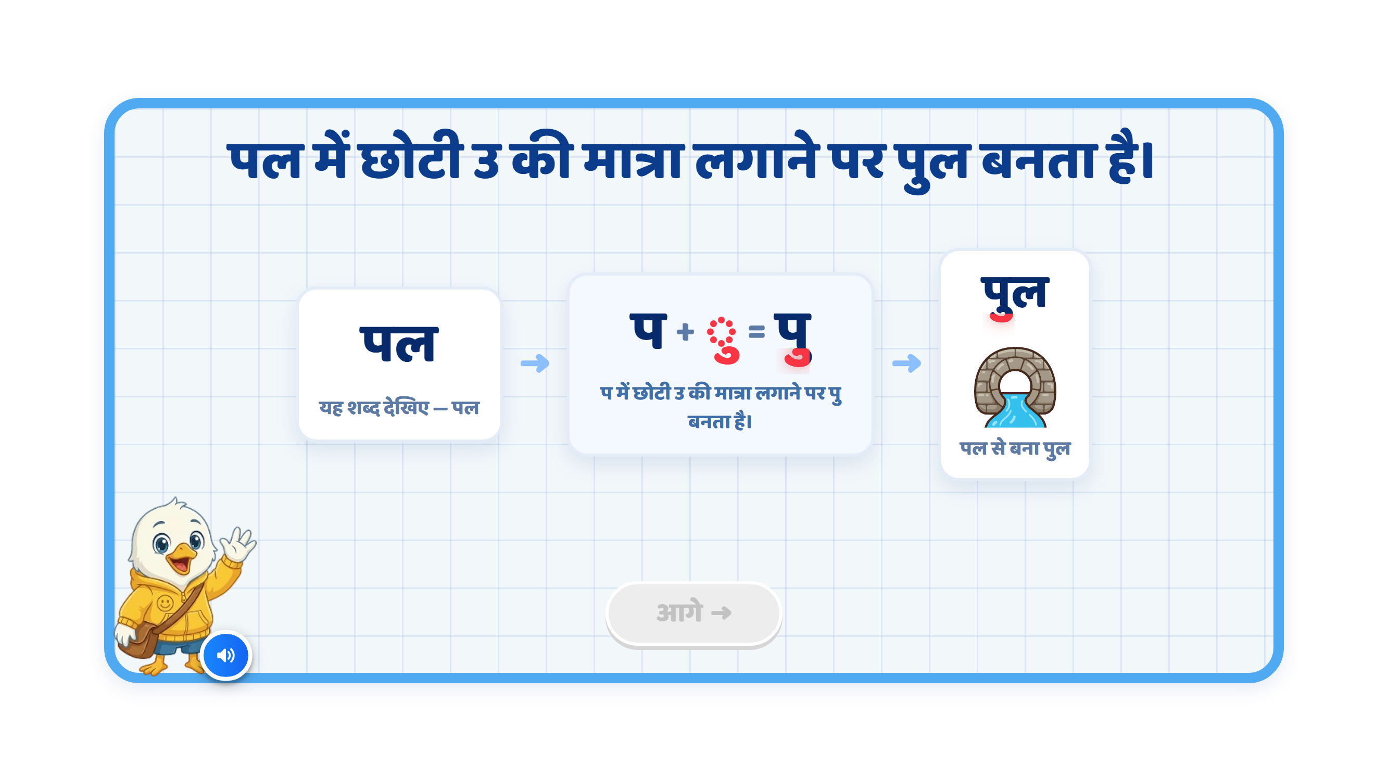
Page 3 · 03_MATRA_BUILD.png
Notes:
Recommendation
VO:
“आइए, देखें कि छोटी उ की मात्रा लगने से शब्द की आवाज़ कैसे बदलती है।”
पहले:
“यह शब्द देखिए — पल।”
फिर:
“प के साथ छोटी उ की मात्रा लगाने पर ‘पु’ बनता है।”
अंत में:
“अब ‘ल’ जुड़ने पर ‘पुल’ बनता है।”
On Screen:
•Keep the screen focused on only one word transformation.
•First show पल clearly on the left side.
•In the centre, show the transformation:
प + ु = पु
•Highlight only the ु मात्रा in red when it is introduced.
•After that, show the final word:
पुल
•In पुल, highlight the ु मात्रा again so the child clearly notices where the matra is placed.
•Show a simple and clear bridge image below or beside पुल.
•Keep the existing mascot and overall UI/UX style unchanged.
•Keep the screen clean and minimal. Do not add unnecessary explanatory text.
Sequence:
पल appears first.
VO reads: “यह शब्द देखिए — पल।”
Highlight प.
ु appears beside/below प.
Show: प + ु = पु
VO says: “प के साथ छोटी उ की मात्रा लगाने पर ‘पु’ बनता है।”
Then ल joins.
Final word पुल appears.
Highlight ु inside पुल.
Bridge image appears.
Animation:
•Use a simple step-by-step animation.
•Do not show all stages together at the beginning.
•First show पल.
•Then isolate/highlight प.
•The ु मात्रा should softly pop/slide into its correct position below प.
•As soon as the matra joins, visually transform:
प → पु
•Then ल can slide in to form:
पु → पुल
•After the word is completed, the bridge image can appear with a soft fade/pop animation.
•Keep the animation synced with the VO.
Sound Differentiation:
Make the pronunciation difference very clear:
प
पु
पुल
Give a short pause between each sound so the child can hear how the sound changes after adding ु.
SFX:
•Add a soft pop when ु appears.
•Add a light chime when प changes to पु.
•Add a small success sound when पुल is completed.
•Keep SFX subtle so the pronunciation remains clear.
Next Button:
•Keep the Next button disabled while the complete transformation is playing.
•Activate it only after प → पु → पुल has been fully demonstrated and the bridge image has appeared.
Note:
•Please avoid awkward phrasing such as:
“प में उ की मात्रा लगी, बना पु।”
•Use:
“प के साथ छोटी उ की मात्रा लगाने पर ‘पु’ बनता है।”
•The key visual learning should remain:
पल → प + ु = पु → पुल

Slide 5
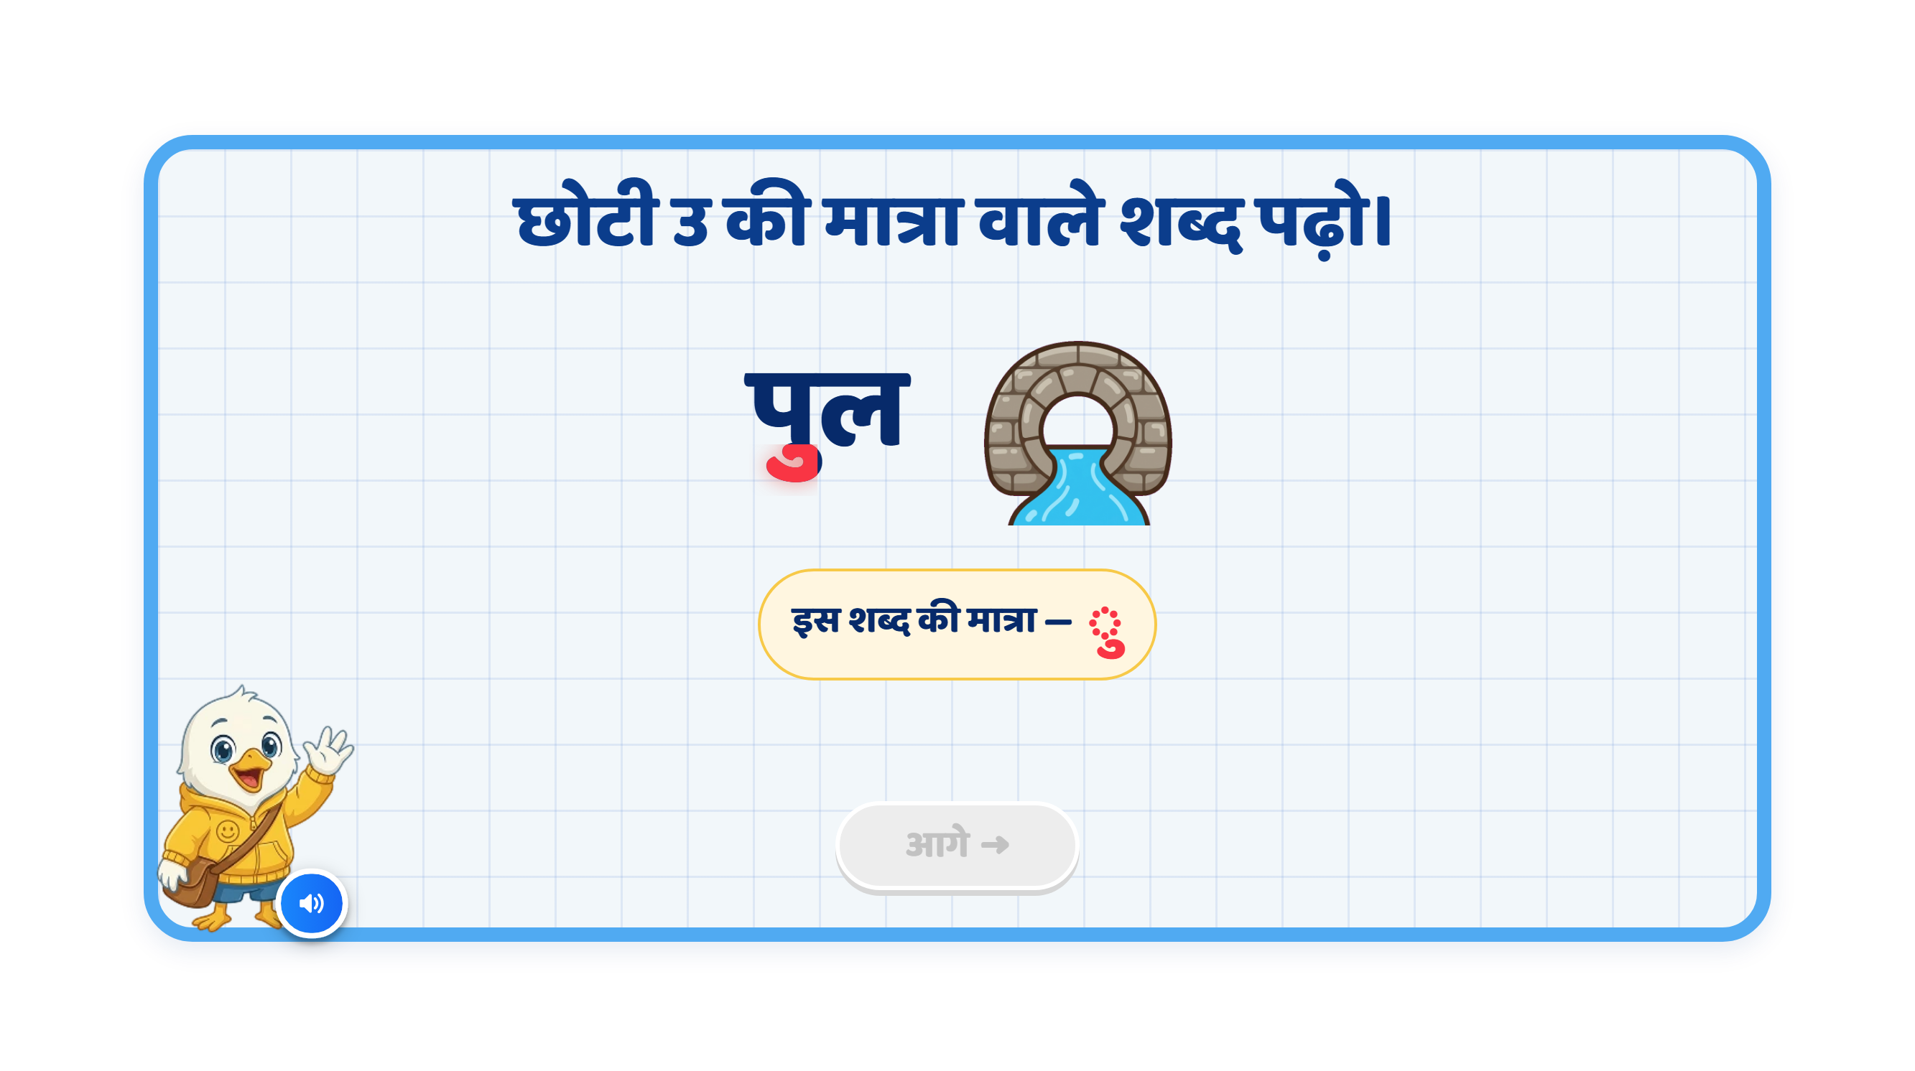
Page 4 · 04_MEET_PAIR.png
Notes:
Recommendation
VO:
“आइए, छोटी उ की मात्रा वाले कुछ शब्द देखें।”
पहले:
“गुड़
— बोलकर
देखिए।
इसमें
ग
पर
छोटी
उ की
मात्रा
लगी
है।”
फिर:
“धनुष
— बोलकर
देखिए।
इसमें
न
पर
छोटी
उ की
मात्रा
लगी
है।”
On Screen:
•Keep one example visible at a time.
•First show गुड़ with the jaggery image.
•Highlight only the ु matra in the word गुड़.
•After that, show the second example धनुष with a bow image.
•Highlight the ु matra in धनुष as well.
Sequence:
गुड़ word appears
Jaggery image appears
The ु matra in गुड़ gets highlighted
Then move to धनुष
धनुष word appears
Bow image appears
The ु matra in धनुष gets highlighted
Animation:
•Word should appear first, then image should appear.
•Use simple fade / pop-in animation.
•When VO says the matra part, the ु should glow/highlight.
•Keep animation one by one, not all together.
SFX:
•Soft pop sound when word/image appears
•Soft highlight chime when matra glows
•Keep SFX subtle
Next Button:
•Keep Next button disabled during the explanation.
•Activate it only after both examples are shown completely.

Slide 6
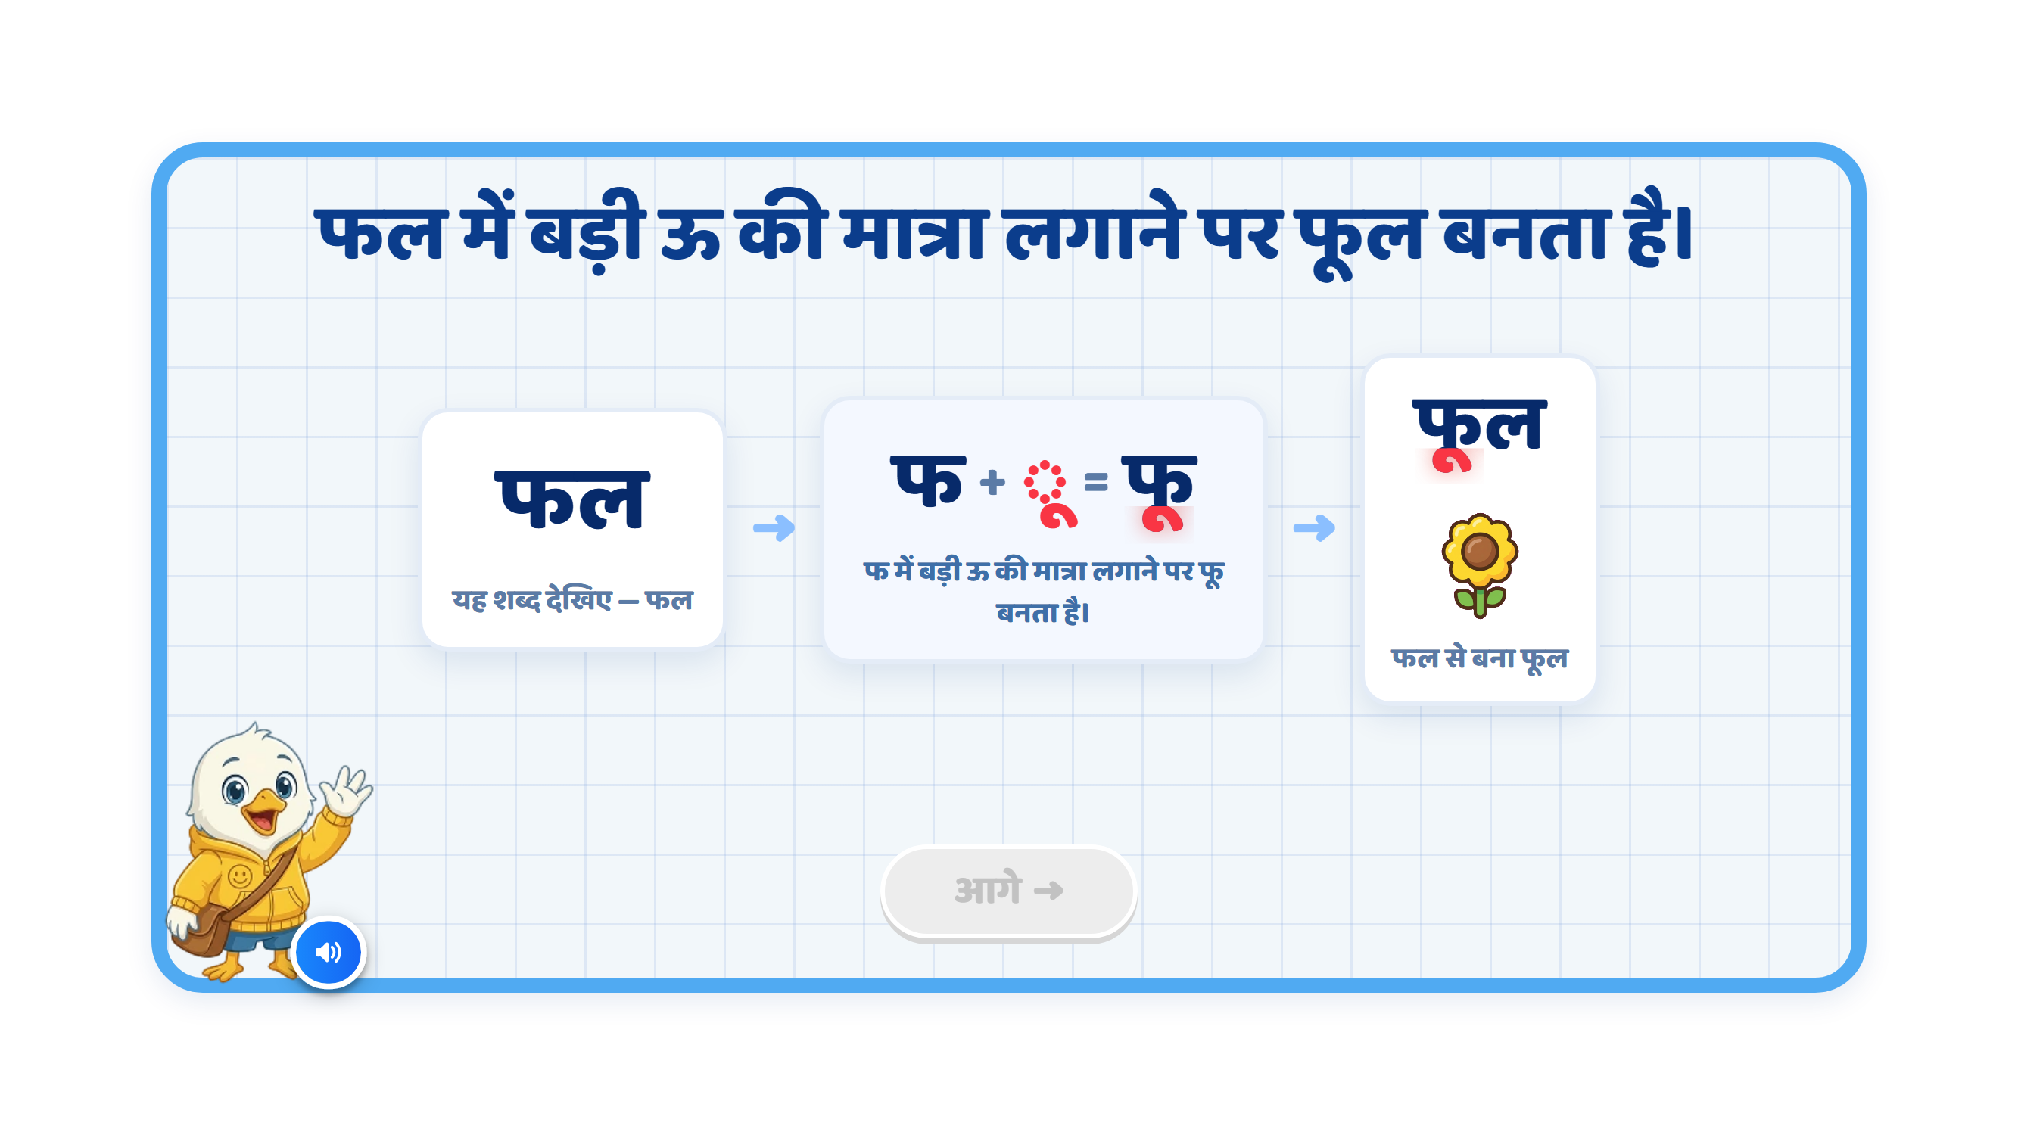
Page 5 · 05_MATRA_BUILD.png
Notes:
Recommendation
VO:
“आइए, देखें कि बड़ी ऊ की मात्रा लगने से शब्द की आवाज़ कैसे बदलती है।”
पहले:
“यह शब्द देखिए — फल।”
फिर:
“फ के साथ बड़ी ऊ की मात्रा लगाने पर ‘फू’ बनता है।”
अंत में:
“अब ‘ल’ जुड़ने पर ‘फूल’ बनता है।”
On Screen:
•Keep the screen focused on only one transformation.
•First show फल clearly on the left.
•Then show the transformation in the centre:
फ + ू = फू
•Highlight only the ू मात्रा in red when it is introduced.
•After that, show the final word:
फूल
•Highlight the ू मात्रा again inside फूल.
•Show the flower image only after the final word appears.
•Keep the existing mascot and overall UI/UX style unchanged.
•Keep the screen clean and minimal.
Sequence:
फल word appears.
VO reads: “यह शब्द देखिए — फल।”
Highlight फ.
The ू मात्रा appears and joins फ.
Show:
फ + ू = फू
VO says:
“फ के साथ बड़ी ऊ की मात्रा लगाने पर ‘फू’ बनता है।”
Then ल joins.
Final word फूल appears.
Highlight the ू मात्रा inside फूल.
Flower image appears.
Animation:
•Do not show all stages together at the beginning.
•First show फल.
•Then isolate/highlight फ.
•The ू मात्रा should softly pop/slide into its correct position.
•As soon as the मात्रा joins, visually transform:
फ → फू
•Then ल should join to form:
फू → फूल
•After the word is completed, the flower image can appear with a soft fade/pop animation.
•Keep the visual transformation synced with the VO.
Sound Differentiation:
Make the sound change very clear:
फ
फू
फूल
Give a short pause between each sound so the child can clearly hear how the sound changes after adding ू.
SFX:
•Soft pop when ू appears.
•Light chime when फ → फू is completed.
•Small success sound when फूल is formed.
•Keep SFX subtle so pronunciation remains clear.
Next Button:
•Keep the Next button disabled during the complete transformation.
•Activate it only after फ → फू → फूल has been fully demonstrated and the flower image appears.

Slide 7
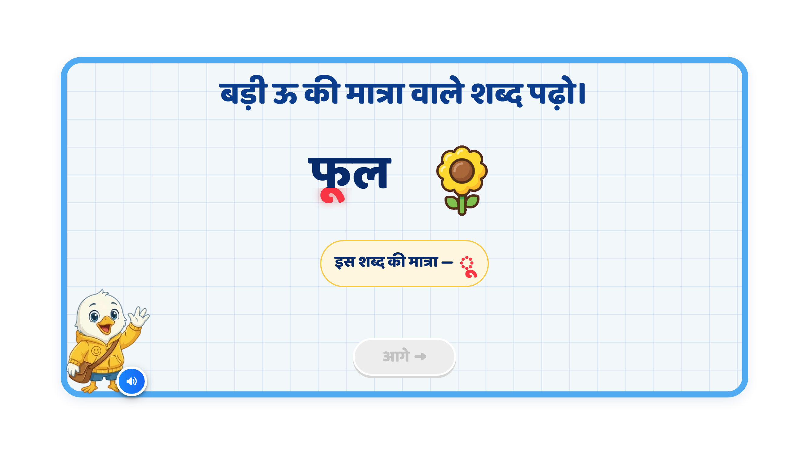
Page 6 · 06_MEET_PAIR.png
Notes:
Recommendation
VO:
“आइए, बड़ी ऊ की मात्रा वाले कुछ शब्द देखें।”
पहले:
“दूध
— बोलकर
देखिए।
इसमें
द
पर
बड़ी
ऊ की
मात्रा
लगी
है।”
फिर:
“कबूतर
— बोलकर
देखिए।
इसमें
ब
पर
बड़ी
ऊ की
मात्रा
लगी
है।”
On Screen:
•Keep one example visible at a time.
•First show दूध with the milk image.
•Highlight only the ू matra in the word दूध.
•After that, show the second example कबूतर with the pigeon image.
•Highlight the ू matra in कबूतर as well.
Sequence:
दूध word appears
Milk image appears
The ू matra in दूध gets highlighted
Then move to कबूतर
कबूतर word appears
Pigeon image appears
The ू matra in कबूतर gets highlighted
Animation:
•Word should appear first, then image should appear.
•Use simple fade / pop-in animation.
•When VO says the matra part, the ू should glow/highlight.
•Keep animation one by one, not all together.
SFX:
•Soft pop sound when word/image appears
•Soft highlight chime when matra glows
•Keep SFX subtle
Next Button:
•Keep Next button disabled during the explanation.
•Activate it only after both examples are shown completely.

Slide 8
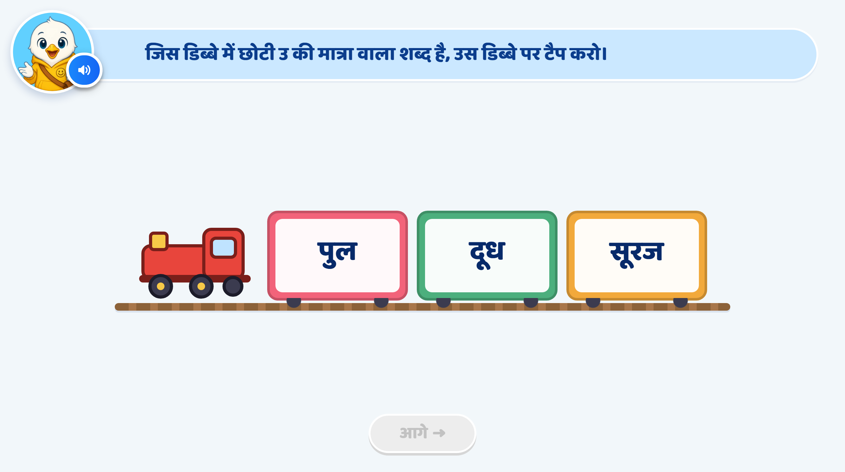
Page 9 · 09_TRAIN_TAP.png
Notes:
Recommendation
Heading / Question Text:
“छोटी उ की मात्रा वाले शब्द पर टैप कीजिए।”
Entry Animation
•Train comes through animation from right to left.
•Train stops at the centre of the screen.
•After the train stops, the three coaches पुल, दूध, सूरज appear clearly.
On Screen
•Keep the heading at the top:
“छोटी उ की मात्रा वाले शब्द पर टैप कीजिए।”
•Do not add any additional instruction text in the play area.
•Keep the three words clearly visible inside the train coaches:
•पुल
•दूध
•सूरज
•Do not highlight the matra before the child answers, as this would reveal the correct option.
VO:
“जिस डिब्बे में छोटी उ की मात्रा वाला शब्द है, उस डिब्बे पर टैप कीजिए।”
Correct Answer: पुल
•Show confetti / sparkle effect.
•The पुल coach should glow / highlight.
•Highlight the ु मात्रा inside पुल after the correct response.
•VO:
“शाबाश! ‘पुल’ शब्द में छोटी उ की मात्रा है।”
On 1st Wrong Attempt
•If the child taps दूध or सूरज, the selected coach should wiggle / shake.
•No hand nudge.
•Only hint VO should play.
VO:
“फिर से सोचिए। छोटी उ की मात्रा वाला शब्द कौन-सा है?”
On 2nd Wrong Attempt
•The wrong coach should again wiggle / shake.
•Hint VO should play.
•Show hand nudge on the पुल coach.
VO:
“ध्यान से देखिए और छोटी उ की मात्रा वाले शब्द पर टैप कीजिए।”
Correct Answer on 3rd Attempt
•Accept पुल as the correct answer.
•Show confetti / sparkle effect.
•Correct coach highlights.
•Highlight the ु मात्रा inside पुल.
•Next button becomes active.
•No additional VO.
SFX
•Soft train arrival / whistle sound when the train enters.
•Light tap sound on selection.
•Soft shake / error sound on a wrong attempt.
•Light success chime on the correct answer.
Next Button
•Keep the Next button disabled initially.
•Activate it only after the correct answer is accepted.

Slide 9
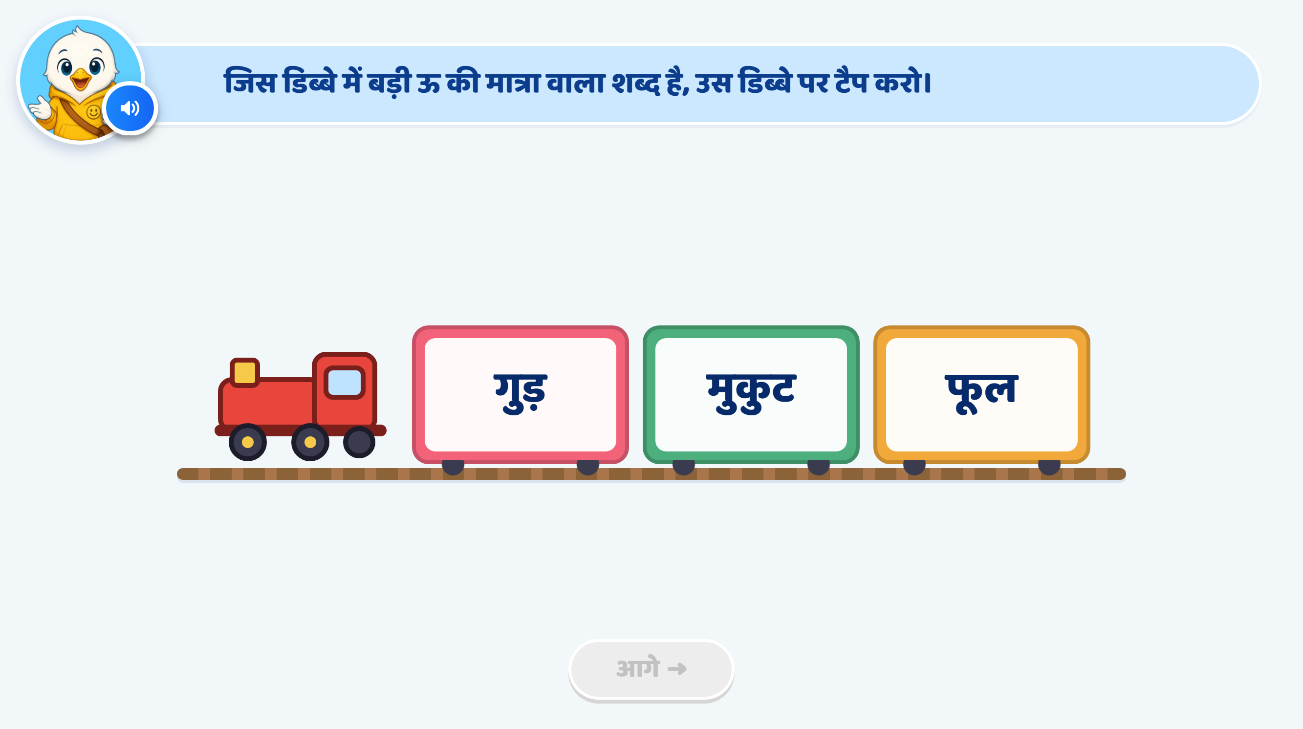
Page 10 · 10_TRAIN_TAP.png
Notes:
Recommendation
Heading / Question Text:
“बड़ी ऊ की मात्रा वाले शब्द पर टैप कीजिए।”
Entry Animation
•Train comes through animation from right to left.
•Train stops at the centre of the screen.
•After the train stops, the three coaches गुड़, मुकुट, फूल appear clearly.
On Screen
•Keep the heading at the top:
“बड़ी ऊ की मात्रा वाले शब्द पर टैप कीजिए।”
•Do not add any additional instruction text in the play area.
•Keep the three words clearly visible inside the train coaches:
•गुड़
•मुकुट
•फूल
•Do not highlight the matra before the child answers, as this would reveal the correct option.
VO:
“जिस डिब्बे में बड़ी ऊ की मात्रा वाला शब्द है, उस डिब्बे पर टैप कीजिए।”
Correct Answer: फूल
•Show confetti / sparkle effect.
•The फूल coach should glow / highlight.
•Highlight the ू मात्रा inside फूल after the correct response.
•VO:
“शाबाश! ‘फूल’ शब्द में बड़ी ऊ की मात्रा है।”
On 1st Wrong Attempt
•If the child taps गुड़ or मुकुट, the selected coach should wiggle / shake.
•No hand nudge.
•Only hint VO should play.
VO:
“फिर से सोचिए। बड़ी ऊ की मात्रा वाला शब्द कौन-सा है?”
On 2nd Wrong Attempt
•The wrong coach should again wiggle / shake.
•Hint VO should play.
•Show hand nudge on the फूल coach.
VO:
“ध्यान से देखिए और बड़ी ऊ की मात्रा वाले शब्द पर टैप कीजिए।”
Correct Answer on 3rd Attempt
•Accept फूल as the correct answer.
•Show confetti / sparkle effect.
•Correct coach highlights.
•Highlight the ू मात्रा inside फूल.
•Next button becomes active.
•No additional VO.
SFX
•Soft train arrival / whistle sound when the train enters.
•Light tap sound on selection.
•Soft shake / error sound on a wrong attempt.
•Light success chime on the correct answer.
Next Button
•Keep the Next button disabled initially.
•Activate it only after the correct answer is accepted.

Slide 10
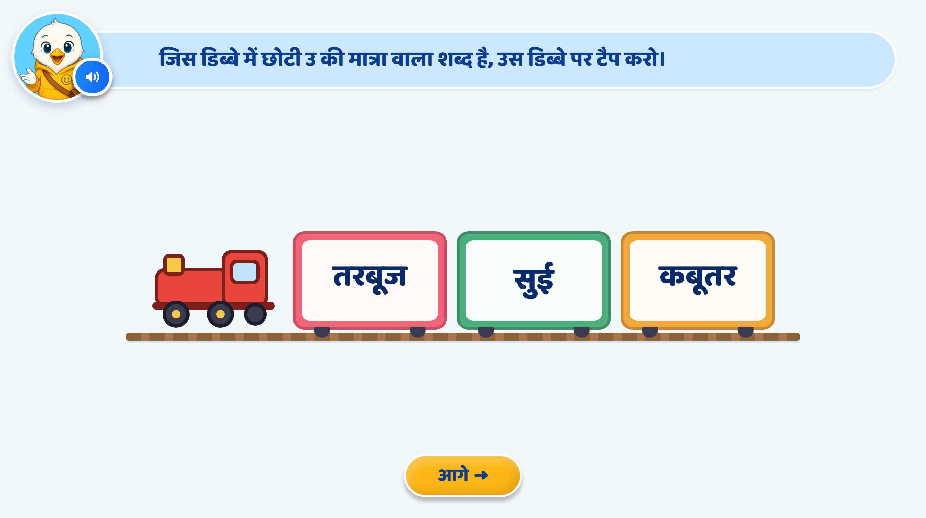
Page 11 · 11_TRAIN_TAP.png
Notes:
Recommendation
Heading / Question Text:
“छोटी उ की मात्रा वाले शब्द पर टैप कीजिए।”
Entry Animation
•Train comes through animation from right to left.
•Train stops at the centre of the screen.
•After the train stops, the three coaches तरबूज, सुई, कबूतर appear clearly.
On Screen
•Keep the heading at the top:
“छोटी उ की मात्रा वाले शब्द पर टैप कीजिए।”
•Do not add any additional instruction text in the play area.
•Keep the three words clearly visible inside the train coaches:
•तरबूज
•सुई
•कबूतर
•Do not highlight any matra before the child answers, as this would reveal the correct option.
VO:
“जिस डिब्बे में छोटी उ की मात्रा वाला शब्द है, उस डिब्बे पर टैप कीजिए।”
Correct Answer: सुई
•Show confetti / sparkle effect.
•The सुई coach should glow / highlight.
•Highlight the ु मात्रा inside सुई after the correct response.
•VO:
“शाबाश! ‘सुई’ शब्द में छोटी उ की मात्रा है।”
On 1st Wrong Attempt
•If the child taps तरबूज or कबूतर, the selected coach should wiggle / shake.
•No hand nudge.
•Only hint VO should play.
VO:
“फिर से सोचिए। छोटी उ की मात्रा वाला शब्द कौन-सा है?”
On 2nd Wrong Attempt
•The wrong coach should again wiggle / shake.
•Hint VO should play.
•Show hand nudge on the सुई coach.
VO:
“ध्यान से देखिए और छोटी उ की मात्रा वाले शब्द पर टैप कीजिए।”
Correct Answer on 3rd Attempt
•Accept सुई as the correct answer.
•Show confetti / sparkle effect.
•Correct coach highlights.
•Highlight the ु मात्रा inside सुई.
•Next button becomes active.
•No additional VO.
SFX
•Soft train arrival / whistle sound when the train enters.
•Light tap sound on selection.
•Soft shake / error sound on a wrong attempt.
•Light success chime on the correct answer.
Next Button
•Keep the Next button disabled initially.
•Activate it only after the correct answer is accepted.

Slide 11
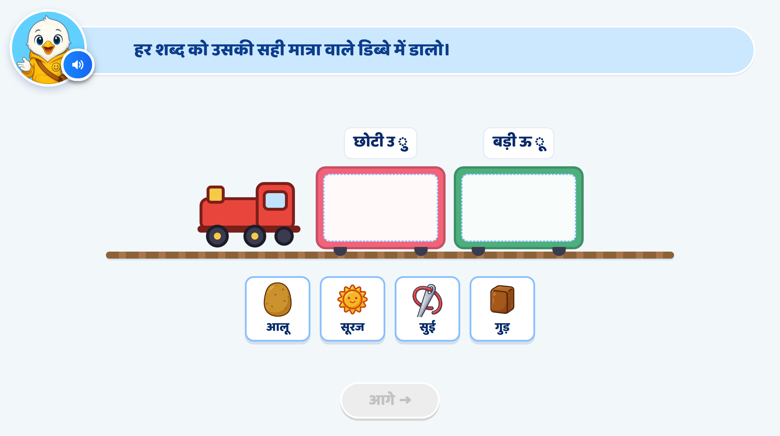
Page 12 · 12_TRAIN_SORT.png
Notes:
Recommendation
Entry Animation
•Train comes through animation from right to left.
•The train stops at the centre of the screen.
•Two coaches are visible.
•Each coach has one मात्रा label shown above it:
•उ (ु)
•ऊ (ू)
•The inside drop area of both coaches remains empty.
•Four draggable word cards appear below the train:
•आलू
•सूरज
•सुई
•गुड़
On Screen
•Keep the heading at the top:
“हर शब्द को उसकी सही मात्रा वाले डिब्बे में डालिए।”
•Do not add any additional instruction text in the play area.
•Keep only the two coach labels:
उ (ु)
ऊ (ू)
•Do not write छोटी or बड़ी on screen.
VO:
“हर शब्द को उसकी सही मात्रा वाले डिब्बे में डालिए।”
If additional support is required, VO can say:
“उ की मात्रा वाले शब्द को उ वाले डिब्बे में और ऊ की मात्रा वाले शब्द को ऊ वाले डिब्बे में डालिए।”
•Each word card can also play its word VO when tapped or dragged:
“आलू” / “सूरज” / “सुई” / “गुड़”
Drag and Drop
The child drags each word card into the correct coach.
•सुई → उ (ु)
•गुड़ → उ (ु)
•आलू → ऊ (ू)
•सूरज → ऊ (ू)
•More than one word can be placed inside each coach.
•While dragging, the selected card should slightly enlarge.
•When the card reaches a coach, that coach gets a soft highlight.
Correct Answer
•The word card snaps inside the correct coach.
•Small confetti / sparkle animation appears around that coach.
•The correctly placed card becomes locked and cannot be dragged again.
•VO example:
“शाबाश! ‘सुई’ शब्द में उ की मात्रा है।”
“शाबाश! ‘गुड़’ शब्द में उ की मात्रा है।”
“शाबाश! ‘आलू’ शब्द में ऊ की मात्रा है।”
“शाबाश! ‘सूरज’ शब्द में ऊ की मात्रा है।”
On 1st Wrong Attempt
•Wrong coach gives a short shake animation.
•The word card smoothly returns to its original position.
•No hand nudge.
•Only hint VO should play.
VO:
“फिर से सुनिए और सही मात्रा पहचानिए।”
On 2nd Wrong Attempt
•Wrong coach again gives a shake animation.
•The word card returns to its original position.
•Hint VO should play.
VO:
“ध्यान से देखिए, इस शब्द में कौन-सी मात्रा है?”
•A hand nudge appears on the correct coach / drop area.
•The correct coach also gives a soft pulse / glow.
Correct Answer on 3rd Attempt
•The child drags the word into the correct coach.
•Small confetti / sparkle animation appears.
•No VO.
•The word locks inside the coach.
Completion
When all four words are placed correctly:
•Both coaches give a soft glow.
•Train gives a small whistle / steam animation.
•Next button becomes active.
•No extra completion VO required.
SFX
•Soft train arrival / whistle sound.
•Light tap / pick-up sound when a card is selected.
•Soft drop sound when the card is placed.
•Soft shake / error sound on a wrong attempt.
•Light success chime on correct placement.
Next Button
•Keep the Next button disabled initially.
•Activate it only after all four words are placed correctly.

Slide 12
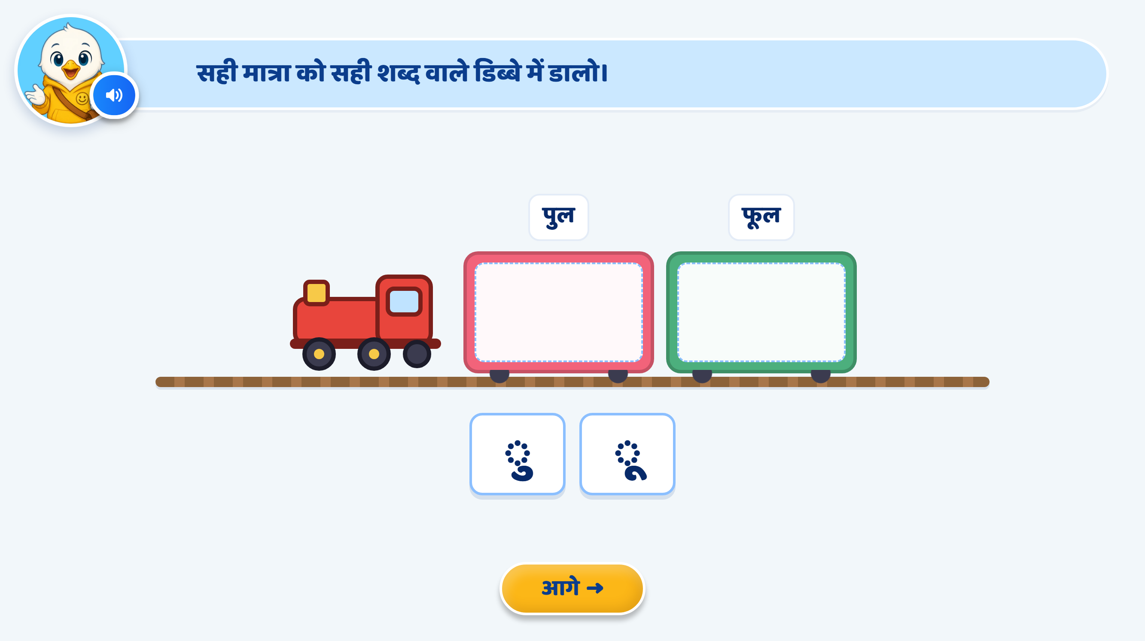
Page 13 · 13_TRAIN_SORT.png
Notes:
Recommendation
Entry Animation
•Train comes through animation from right to left.
•The train stops at the centre of the screen.
•Two coaches are visible.
•Remove the current words पुल and फूल from above the coaches.
•Replace them with only the letters:
•1st coach: उ
•2nd coach: ऊ
•Do not show the matra symbols in the coach labels.
•The inside drop area of both coaches remains empty.
•Two draggable matra cards appear below the train:
•ु
•ू
On Screen
•Keep the heading at the top:
“सही मात्रा को सही डिब्बे में डालिए।”
•Do not add any additional instruction text in the play area.
•Keep only the two coach labels:
उ
ऊ
•Do not use छोटी / बड़ी or matra symbols in the coach headings.
VO:
“सही मात्रा को उसके सही डिब्बे में डालिए।”
If additional support is required, VO can say:
“उ की मात्रा को उ वाले डिब्बे में और ऊ की मात्रा को ऊ वाले डिब्बे में डालिए।”
Drag and Drop
The child drags each matra card into the correct coach.
•ु → उ
•ू → ऊ
•Only one matra card can be placed inside each coach.
•While dragging, the selected matra card should slightly enlarge.
•When the card reaches a coach, that coach should get a soft highlight / glow.
Correct Answer
•The matra card snaps inside the correct coach.
•Small confetti / sparkle animation appears around that coach.
•The correctly placed card becomes locked and cannot be dragged again.
•VO for ु:
“शाबाश! यह उ की मात्रा है।”
•VO for ू:
“शाबाश! यह ऊ की मात्रा है।”
On 1st Wrong Attempt
•Wrong coach gives a short shake animation.
•The matra card smoothly returns to its original position.
•No hand nudge.
•Only hint VO should play.
VO:
“फिर से देखिए और सही मात्रा पहचानिए।”
On 2nd Wrong Attempt
•Wrong coach again gives a shake animation.
•The matra card returns to its original position.
•Hint VO should play.
VO:
“ध्यान से देखिए, यह किसकी मात्रा है?”
•A hand nudge appears on the correct coach / drop area.
•The correct coach should also give a soft pulse / glow.
Correct Answer on 3rd Attempt
•The child drags the matra into the correct coach.
•Small confetti / sparkle animation appears.
•No VO.
•The matra locks inside the coach.
Completion
When both matras are placed correctly:
•Both coaches give a soft glow.
•Train gives a small whistle / steam animation.
•Next button becomes active.
•No extra completion VO required.
SFX
•Soft train arrival / whistle sound.
•Light tap / pick-up sound when a matra card is selected.
•Soft drop sound when the matra is placed.
•Soft shake / error sound on a wrong attempt.
•Light success chime on correct placement.
Next Button
•Keep the Next button disabled initially.
•Activate it only after both matras are placed correctly.

Slide 13
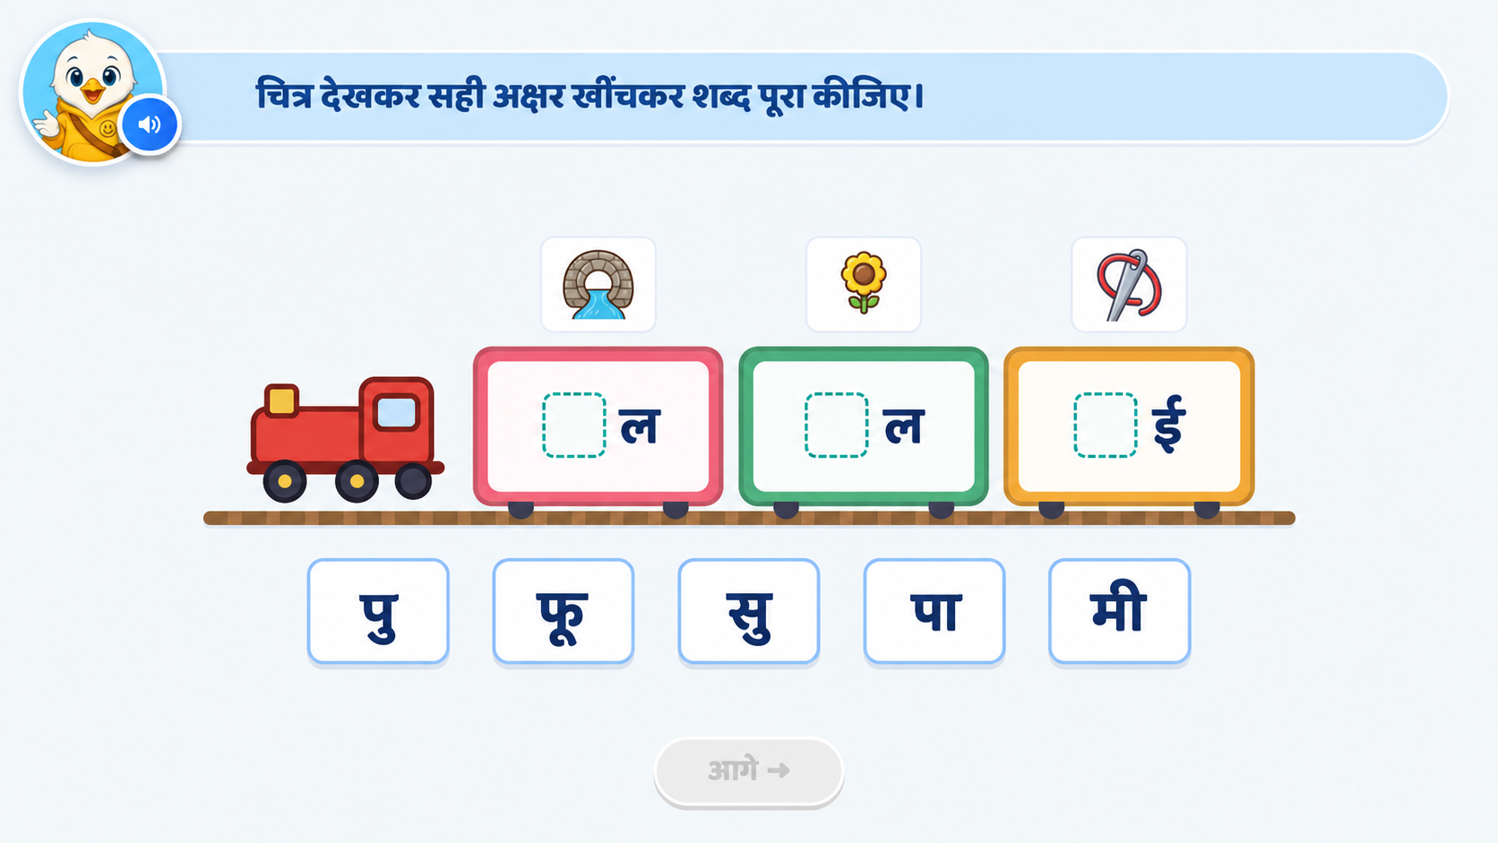
Page 14 · 14_MATRA_FILL.png
Notes:
Recommendation
Activity Concept
•This activity will be a word completion train activity.
•Show a train with three coaches.
•Each coach will contain an incomplete word with the first and last letters visible and a blank space in between where the missing अक्षर/मात्रा combination should be added.
•The child will look at the picture above the coach, understand the word, and drag the correct अक्षर option to complete the word.
Use these words:
•Bridge image:
_ल → पुल
Correct option:
पु
•Flower image:
_ल → फूल
Correct option:
फू
•Needle image:
_ई → सुई
Correct option:
सु
On Screen
•Train with three coaches.
•Keep only the last letter visible inside each coach:
•_ल
•_ल
•_ई
•Show related pictures above each coach:
•Bridge → पुल
•Flower → फूल
•Needle → सुई
•Below the train, show draggable options:
•पु
•फू
•सु
•Add 1–2 distractor options that do not match any picture.
•Remove मी as an option.
•Do not show complete words before the child answers.
VO
Intro VO:
“चित्र देखकर सही अक्षर से शब्द पूरा कीजिए।”
Optional word support VO when a card is tapped:
•“पु”
•“फू”
•“सु”
This will help the child connect the picture, sound, and correct word formation.
Drag and Drop Logic
•Child drags the correct अक्षर option into the blank space.
•Correct combinations:
•पु + ल = पुल
•फू + ल = फूल
•सु + ई = सुई
•While dragging, the selected option should slightly enlarge.
•When the option reaches the blank space, the coach gets a soft glow/highlight.
Correct Answer
When the child drops the correct option:
•Option snaps into the blank space.
•The complete word appears.
•Small sparkle/confetti animation appears.
•The completed word becomes locked.
•VO examples:
“शाबाश! पुल बन गया।”
“शाबाश! फूल बन गया।”
“शाबाश! सुई बन गई।”
On 1st Wrong Attempt
•Wrong coach/blank area gives a short shake animation.
•Option returns smoothly to its original position.
•No hand nudge.
•Only VO:
“फिर से सोचिए और चित्र को ध्यान से देखिए।”
On 2nd Wrong Attempt
•Wrong area shakes again.
•Option returns to its original position.
•VO:
“ध्यान से देखिए, कौन-सा अक्षर लगाने से शब्द पूरा होगा?”
•Show hand nudge on the correct blank space.
•Correct blank area gives a soft pulse/glow.
Correct Answer on 3rd Attempt
•Correct option snaps into place.
•Word completes.
•Small confetti/sparkle animation appears.
•No VO required.
Completion
When all three words are completed:
•All three coaches glow softly.
•Train gives a small whistle/steam animation.
•Next button becomes active.
•No extra completion VO required.
Animation
•Train enters from right to left and stops at the centre.
•Picture cards appear first.
•Incomplete words appear inside the coaches.
•Options slide up from the bottom.
•Keep animations subtle and child-friendly.
SFX
•Soft train arrival/whistle sound.
•Light tap sound when an option is selected.
•Soft drag/drop sound.
•Soft shake/error sound on wrong attempt.
•Light success chime on correct completion.
Developer Note
•Keep the existing train UI/UX style unchanged.
•Do not show complete words initially.
•Keep the activity VO-led.
•Focus on connecting:
Picture → Sound → Correct अक्षर → Complete Word

Slide 14
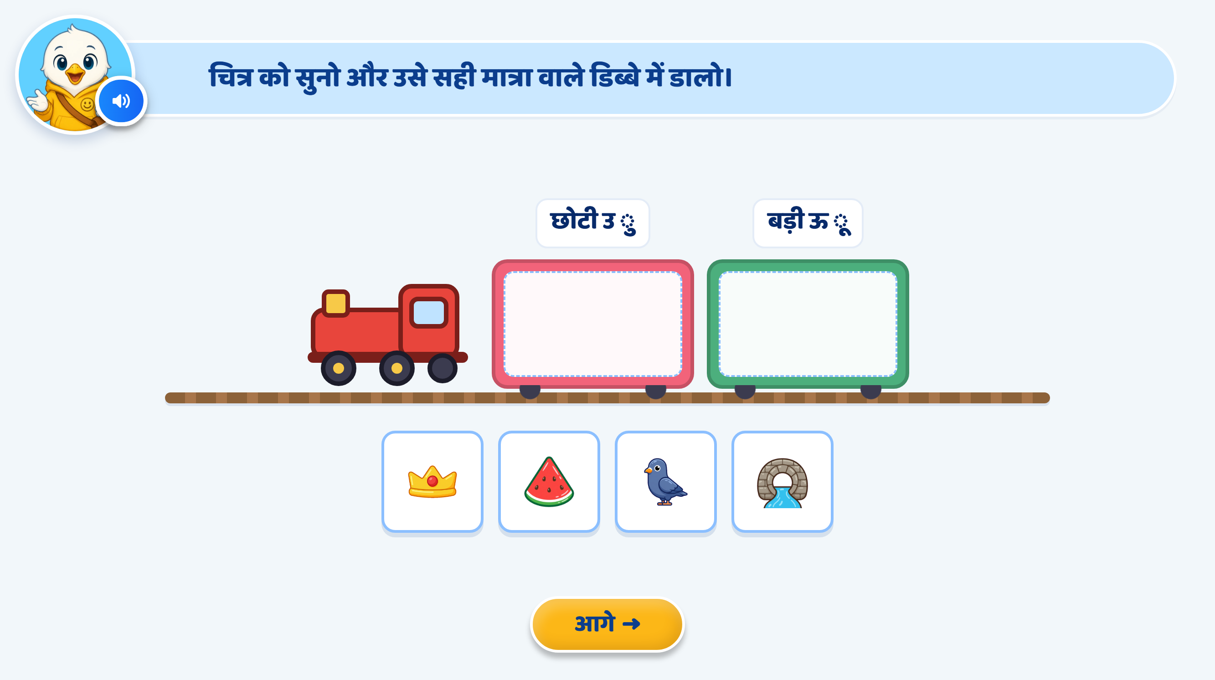
Page 15 · 15_TRAIN_SORT.png
Notes:
Recommendation
Activity Concept
•Show a train with two coaches.
•Each coach represents one matra category:
•उ
•ऊ
•Do not show छोटी / बड़ी or matra symbols in the coach labels.
•The inside area of each coach remains empty as the drop zone.
•At the bottom, show pictures only.
•Do not show any word text below the pictures.
On Screen
•Above the first coach: उ
•Above the second coach: ऊ
•Bottom section: picture cards only.
Use the current picture set:
•मुकुट → उ
•पुल → उ
•तरबूज → ऊ
•कबूतर → ऊ
•Keep all four pictures visually clear and easy to identify.
VO
Intro VO:
“चित्र को सुनिए और उसे सही मात्रा वाली बोगी में डालिए।”
When the child taps or starts dragging a picture, play only that picture’s name:
“मुकुट”
“तरबूज”
“कबूतर”
“पुल”
This makes the child listen to the word, identify whether it contains उ की मात्रा or ऊ की मात्रा, and then sort the picture.
Drag and Drop Logic
•The child drags the picture card into the correct coach.
•One coach can accept multiple pictures belonging to the same matra category.
•The word should not be displayed at any point during the question.
•While dragging, the selected picture card can slightly enlarge.
•When the picture reaches a coach, that coach can get a soft glow / highlight.
Correct Mapping
•मुकुट → उ
•पुल → उ
•तरबूज → ऊ
•कबूतर → ऊ
Correct Answer
•Picture snaps inside the correct coach.
•Small sparkle / confetti effect appears around that coach.
•The correctly placed picture becomes locked.
•VO examples:
“शाबाश! मुकुट में उ की मात्रा है।”
“शाबाश! पुल में उ की मात्रा है।”
“शाबाश! तरबूज में ऊ की मात्रा है।”
“शाबाश! कबूतर में ऊ की मात्रा है।”
On 1st Wrong Attempt
•Wrong coach gives a short wiggle / shake animation.
•Picture returns smoothly to its original position.
•No hand nudge.
•Only hint VO should play.
VO:
“फिर से सुनिए और सही मात्रा पहचानिए।”
On 2nd Wrong Attempt
•Wrong coach shakes again.
•Picture returns to the bottom.
•Hint VO should play.
VO:
“शब्द को ध्यान से सुनिए।”
•Show a hand nudge / soft pulse on the correct coach.
•The correct coach can also briefly glow.
Correct Answer on 3rd Attempt
•Picture snaps into the correct coach.
•Small confetti / sparkle effect appears.
•Picture becomes locked.
•No VO required.
Completion
Once all four pictures are correctly sorted:
•Both coaches glow briefly.
•Train gives a small whistle / steam animation.
•Next button becomes active.
•No extra completion VO required.
Animation
•Train enters from right to left and stops at the centre.
•Coach labels उ and ऊ appear one by one.
•Picture cards fade / slide up from the bottom.
•Keep animations subtle and child-friendly.
SFX
•Soft train arrival / whistle SFX.
•Light tap / pick-up sound when a picture is selected.
•Soft drop sound when the picture is placed.
•Soft error / shake sound on a wrong attempt.
•Light success chime on correct placement.
Next Button
•Keep the Next button disabled initially.
•Activate it only after all four pictures are sorted correctly.
Developer Note
•Keep the existing train UI/UX style unchanged.
•Coach labels should show only उ and ऊ.
•Do not show छोटी / बड़ी, ु / ू, or the picture names on screen.
•The activity should remain VO-led, so the child has to listen to the picture name and identify the correct matra category.
•Use respectful language throughout: सुनिए, पहचानिए, डालिए.

Slide 15
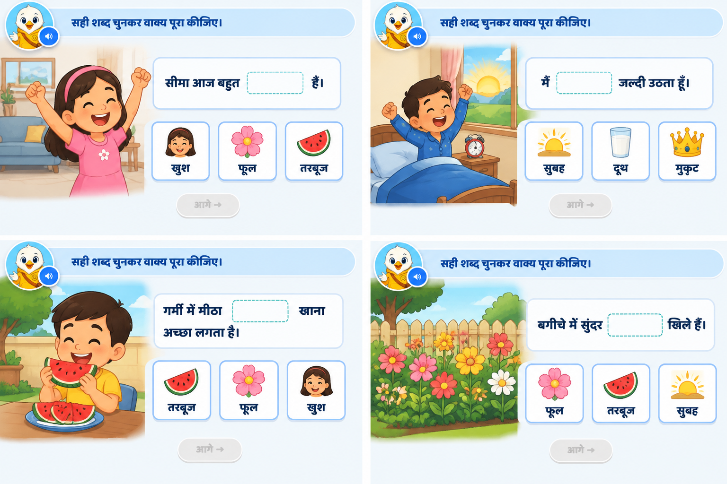
Page 16 · 16_POEM_SEARCH.png
Notes:
Recommendation
Activity Concept
•This activity will be a sentence completion activity.
•The child will look at the picture, understand the situation, read/listen to the sentence, and select the correct word to complete the sentence.
•The focus should be on helping the child understand how मात्रा वाले शब्द are used in meaningful sentences.
On Screen
•Keep the heading at the top:
“सही शब्द चुनकर वाक्य पूरा कीजिए।”
•Show one picture-based sentence activity at a time.
•Keep the main picture on one side and the sentence completion area on the other side.
•Sentence:
“सीमा आज बहुत ______ है।”
•Show a blank space for the missing word.
•Below the sentence, show three picture options:
•😊 खुश ✅
•🌸 फूल
•🍉 तरबूज
•Do not highlight the correct option before the child answers.
VO
Instruction VO:
“चित्र देखकर सही शब्द चुनकर वाक्य पूरा कीजिए।”
When an option is tapped, play the word VO:
“खुश”
“फूल”
“तरबूज”
This will encourage the child to listen to the word and connect it with the sentence meaning.
Correct Answer
Correct answer:
खुश
When the child selects the correct option:
•The option card snaps into the blank space.
•The sentence becomes complete:
“सीमा आज बहुत खुश है।”
•Show small sparkle/confetti animation.
•Correct option gets a soft glow/highlight.
VO:
“शाबाश! सीमा आज बहुत खुश है।”
On 1st Wrong Attempt
•Wrong option card gives a short shake/wiggle animation.
•Option returns to its original position.
•No hand nudge.
VO:
“फिर से सोचिए। कौन-सा शब्द वाक्य को पूरा करेगा?”
On 2nd Wrong Attempt
•Wrong option shakes again.
•Option returns to its original position.
VO:
“चित्र को ध्यान से देखिए और सही शब्द चुनिए।”
•Show hand nudge on the correct option (खुश).
•Correct option gives a soft pulse/glow.
Correct Answer on 3rd Attempt
•Correct option snaps into the sentence.
•Sentence completes.
•Small sparkle/confetti appears.
•No additional VO required.
Completion
After the correct answer:
•Next button becomes active.
•No extra completion VO required.
Animation
•Picture appears first.
•Sentence box appears with the blank space.
•Options slide/fade in one by one.
•Keep animation subtle and child-friendly.
•Do not overload the screen with too many moving elements.
SFX
•Soft pop sound when picture/sentence appears.
•Light tap sound on option selection.
•Soft shake/error sound on wrong attempt.
•Light success chime on correct answer.
Developer Note
•Keep the activity VO-led.
•Do not show extra text explanations.
•The child should learn through:
Picture → Sentence meaning → Correct word selection
•Keep the options visually supported with pictures so the child can independently understand the word.
•Maintain respectful language:
“सोचिए, देखिए, चुनिए” instead of “सोचो, देखो, चुनो”.

Slide 16
Notes:
Recommendation
Activity Concept
•This activity will be a sentence completion activity.
•The child will look at the picture, understand the situation, read/listen to the sentence, and select the correct word to complete the sentence.
•The focus should be on helping the child identify and use ऊ (ू) मात्रा वाले शब्द in meaningful sentences.
On Screen
•Keep the heading at the top:
“सही शब्द चुनकर वाक्य पूरा कीजिए।”
•Show one picture-based sentence activity at a time.
•Keep the main picture on one side and the sentence completion area on the other side.
•Sentence:
“मैं ______ जल्दी उठता हूँ।”
•Show a blank space for the missing word.
•Below the sentence, show three picture options:
•🌅 सुबह ✅
•🥛 दूध
•👑 मुकुट
•Do not highlight the correct option before the child answers.
VO
Instruction VO:
“चित्र देखकर सही शब्द चुनकर वाक्य पूरा कीजिए।”
When an option is tapped, play the word VO:
“सुबह”
“दूध”
“मुकुट”
This will help the child listen to the word and connect it with the sentence meaning.
Correct Answer
Correct answer:
सुबह
When the child selects the correct option:
•The option card snaps into the blank space.
•The sentence becomes complete:
“मैं सुबह जल्दी उठता हूँ।”
•Show small sparkle/confetti animation.
•Correct option gets a soft glow/highlight.
VO:
“शाबाश! मैंने सही शब्द चुनकर वाक्य पूरा किया।”
On 1st Wrong Attempt
•Wrong option card gives a short shake/wiggle animation.
•Option returns to its original position.
•No hand nudge.
VO:
“फिर से सोचिए। कौन-सा शब्द वाक्य को पूरा करेगा?”
On 2nd Wrong Attempt
•Wrong option shakes again.
•Option returns to its original position.
VO:
“चित्र को ध्यान से देखिए और सही शब्द चुनिए।”
•Show hand nudge on the correct option (सुबह).
•Correct option gives a soft pulse/glow.
Correct Answer on 3rd Attempt
•Correct option snaps into the sentence.
•Sentence completes.
•Small sparkle/confetti appears.
•No additional VO required.
Completion
After the correct answer:
•Next button becomes active.
•No extra completion VO required.
Animation
•Picture appears first.
•Sentence box appears with the blank space.
•Options slide/fade in one by one.
•Keep animation subtle and child-friendly.
•Do not overload the screen with too many moving elements.
SFX
•Soft pop sound when picture/sentence appears.
•Light tap sound on option selection.
•Soft shake/error sound on wrong attempt.
•Light success chime on correct answer.
Developer Note
•Keep the activity VO-led.
•Do not show extra text explanations.
•The child should learn through:
Picture → Sentence meaning → Correct word selection
•Keep the options visually supported with pictures so the child can independently understand the word.
•Use respectful language throughout:
“सोचिए, देखिए, चुनिए” instead of “सोचो, देखो, चुनो”.

Slide 17
Notes:
Recommendation
Activity Concept
•This activity will be a sentence completion activity.
•The child will observe the picture, understand the sentence context, and select the correct word to complete the sentence.
•The focus should be on helping the child use ऊ (ू) मात्रा वाले शब्द in meaningful sentences.
On Screen
•Keep the heading at the top:
“सही शब्द चुनकर वाक्य पूरा कीजिए।”
•Show one picture-based sentence activity at a time.
•Keep the picture on one side and the sentence completion area on the other side.
•Sentence:
“बगीचे में सुंदर ______ खिले हैं।”
•Show a blank space for the missing word.
•Below the sentence, show three picture options:
•🌸 फूल ✅
•🍉 तरबूज
•🌅 सुबह
•Do not highlight the correct option before the child answers.
VO
Instruction VO:
“चित्र देखकर सही शब्द चुनकर वाक्य पूरा कीजिए।”
When an option is tapped, play the word VO:
“फूल”
“तरबूज”
“सुबह”
This will help the child listen to the word, understand the sentence meaning, and identify the correct word.
Correct Answer
Correct answer:
फूल
When the child selects the correct option:
•The option card snaps into the blank space.
•The sentence becomes complete:
“बगीचे में सुंदर फूल खिले हैं।”
•Show small sparkle/confetti animation.
•Correct option gets a soft glow/highlight.
VO:
“शाबाश! बगीचे में सुंदर फूल खिले हैं।”
On 1st Wrong Attempt
•Wrong option card gives a short shake/wiggle animation.
•Option returns to its original position.
•No hand nudge.
VO:
“फिर से सोचिए। कौन-सा शब्द वाक्य को पूरा करेगा?”
On 2nd Wrong Attempt
•Wrong option shakes again.
•Option returns to its original position.
VO:
“चित्र को ध्यान से देखिए और सही शब्द चुनिए।”
•Show hand nudge on the correct option (फूल).
•Correct option gives a soft pulse/glow.
Correct Answer on 3rd Attempt
•Correct option snaps into the sentence.
•Sentence completes.
•Small sparkle/confetti appears.
•No additional VO required.
Completion
After the correct answer:
•Next button becomes active.
•No extra completion VO required.
Animation
•Picture appears first.
•Sentence box appears with the blank space.
•Options slide/fade in one by one.
•When the correct option is selected, the word smoothly moves into the blank space.
•Keep animation subtle and child-friendly.
SFX
•Soft pop sound when picture/sentence appears.
•Light tap sound on option selection.
•Soft shake/error sound on wrong attempt.
•Light success chime on correct answer.
Developer Note
•Keep the activity VO-led.
•Do not show extra explanation text.
•The child should learn through:
Picture → Sentence meaning → Correct word selection
•Keep options visually supported with pictures so the child can understand the word independently.
•Use respectful language throughout:
“सोचिए, देखिए, चुनिए” instead of “सोचो, देखो, चुनो”.

Slide 18
Notes:
Recommendation
Activity Concept
•This activity will be a sentence completion activity.
•The child will observe the picture, understand the situation, read/listen to the sentence, and select the correct word to complete the sentence.
•The focus should be on helping the child identify and use ऊ (ू) मात्रा वाले शब्द in meaningful sentences.
On Screen
•Keep the heading at the top:
“सही शब्द चुनकर वाक्य पूरा कीजिए।”
•Show one picture-based sentence activity at a time.
•Keep the picture on one side and the sentence completion area on the other side.
•Sentence:
“मीठा______ खाना अच्छा लगता है।”
•Show a blank space for the missing word.
•Below the sentence, show three picture options:
•🍉 तरबूज ✅
•🌸 फूल
•😊 खुश
•Do not highlight the correct option before the child answers.
VO
Instruction VO:
“चित्र देखकर सही शब्द चुनकर वाक्य पूरा कीजिए।”
When an option is tapped, play the word VO:
“तरबूज”
“फूल”
“खुश”
This will help the child listen to the word, understand the sentence meaning, and identify the correct word.
Correct Answer
Correct answer:
तरबूज
When the child selects the correct option:
•The option card snaps into the blank space.
•The sentence becomes complete:
“मीठा तरबूज खाना अच्छा लगता है।”
•Show small sparkle/confetti animation.
•Correct option gets a soft glow/highlight.
VO:
“शाबाश! मीठा तरबूज खाना अच्छा लगता है।”
On 1st Wrong Attempt
•Wrong option card gives a short shake/wiggle animation.
•Option returns to its original position.
•No hand nudge.
VO:
“फिर से सोचिए। कौन-सा शब्द वाक्य को पूरा करेगा?”
On 2nd Wrong Attempt
•Wrong option shakes again.
•Option returns to its original position.
VO:
“चित्र को ध्यान से देखिए और सही शब्द चुनिए।”
•Show hand nudge on the correct option (तरबूज).
•Correct option gives a soft pulse/glow.
Correct Answer on 3rd Attempt
•Correct option snaps into the sentence.
•Sentence completes.
•Small sparkle/confetti appears.
•No additional VO required.
Completion
After the correct answer:
•Next button becomes active.
•No extra completion VO required.
Animation
•Picture appears first.
•Sentence box appears with the blank space.
•Options slide/fade in one by one.
•When the correct option is selected, the word smoothly moves into the blank space.
•Keep animation subtle and child-friendly.
SFX
•Soft pop sound when picture/sentence appears.
•Light tap sound on option selection.
•Soft shake/error sound on wrong attempt.
•Light success chime on correct answer.
Developer Note
•Keep the activity VO-led.
•Do not show extra explanation text.
•The child should learn through:
Picture → Sentence meaning → Correct word selection
•Keep options visually supported with pictures so the child can understand the word independently.
•Use respectful language throughout:
“सोचिए, देखिए, चुनिए” instead of “सोचो, देखो, चुनो”.

Slide 19
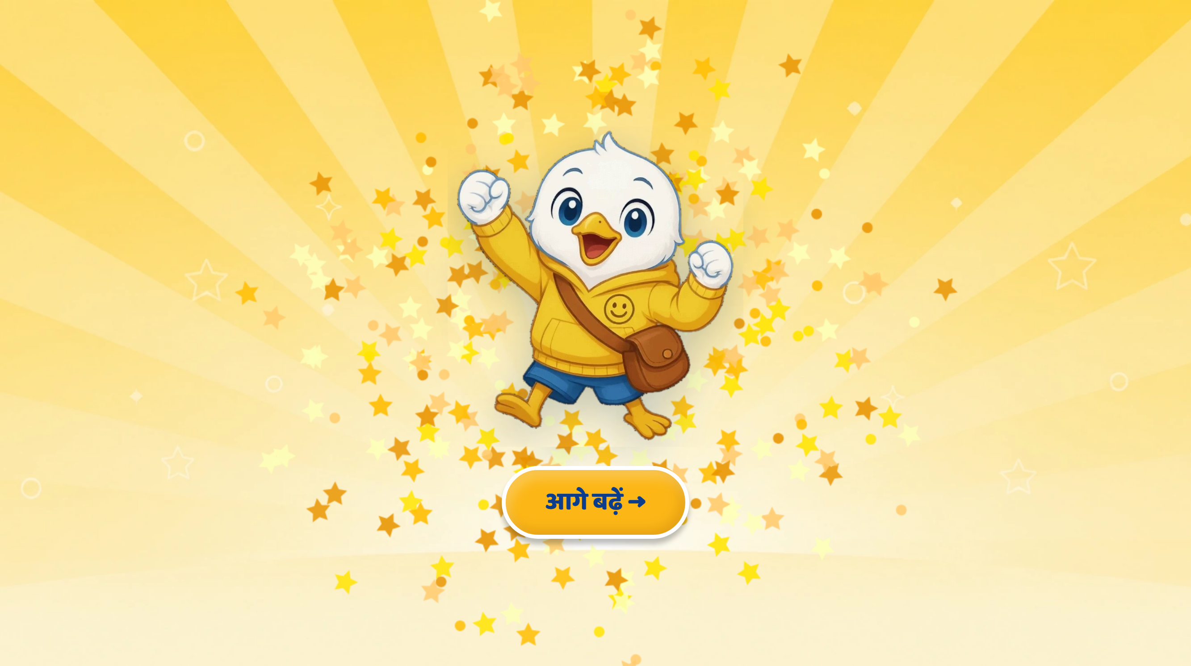
Page 17 · 17_CELEBRATION.png

