Slide 1
HI02H11_L02_S04 · मात्राओं की रेल · ओ / औ
Page-by-page review · 17 pages

Slide 2
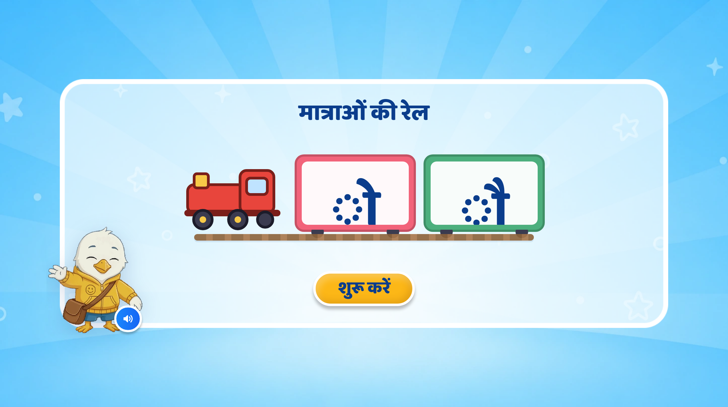
Page 1 · 01_landing.png
Notes:
Recommendations: मात्राओं की रेल
Screen Changes:
Remove all extra text that is not required.
Keep the screen clean and minimal.
Show only two matra boxes/cards:
1st box: ‘ओ’ (◌ो)
2nd box: ‘औ’ (◌ौ)
Keep the existing mascot and overall UI/UX style unchanged.
Follow the same train-theme visual treatment used in the previous PPT. The matras can be shown inside two train bogies/cards so that the lesson visually continues as a “मात्राओं की रेल” journey.
Animation:
If possible, bring the train onto the screen with a smooth right-to-left animation.
The two matra boxes/bogies can appear one by one with a soft pop/fade animation.
First show ◌ो, followed by ◌ौ.
Keep animations subtle and child-friendly.
SFX:
Add a soft train arrival/whistle SFX when the train enters.
Add a light sparkle/pop SFX when each matra appears.
VO:
“हेलो दोस्त! मैं हूँ स्विफ्टी। आज हम मात्राओं के बारे में जानेंगे।”
After this VO, the two matras ‘ओ’ (◌ो), ‘औ’ (◌ौ) can appear one by one on screen.

Slide 3
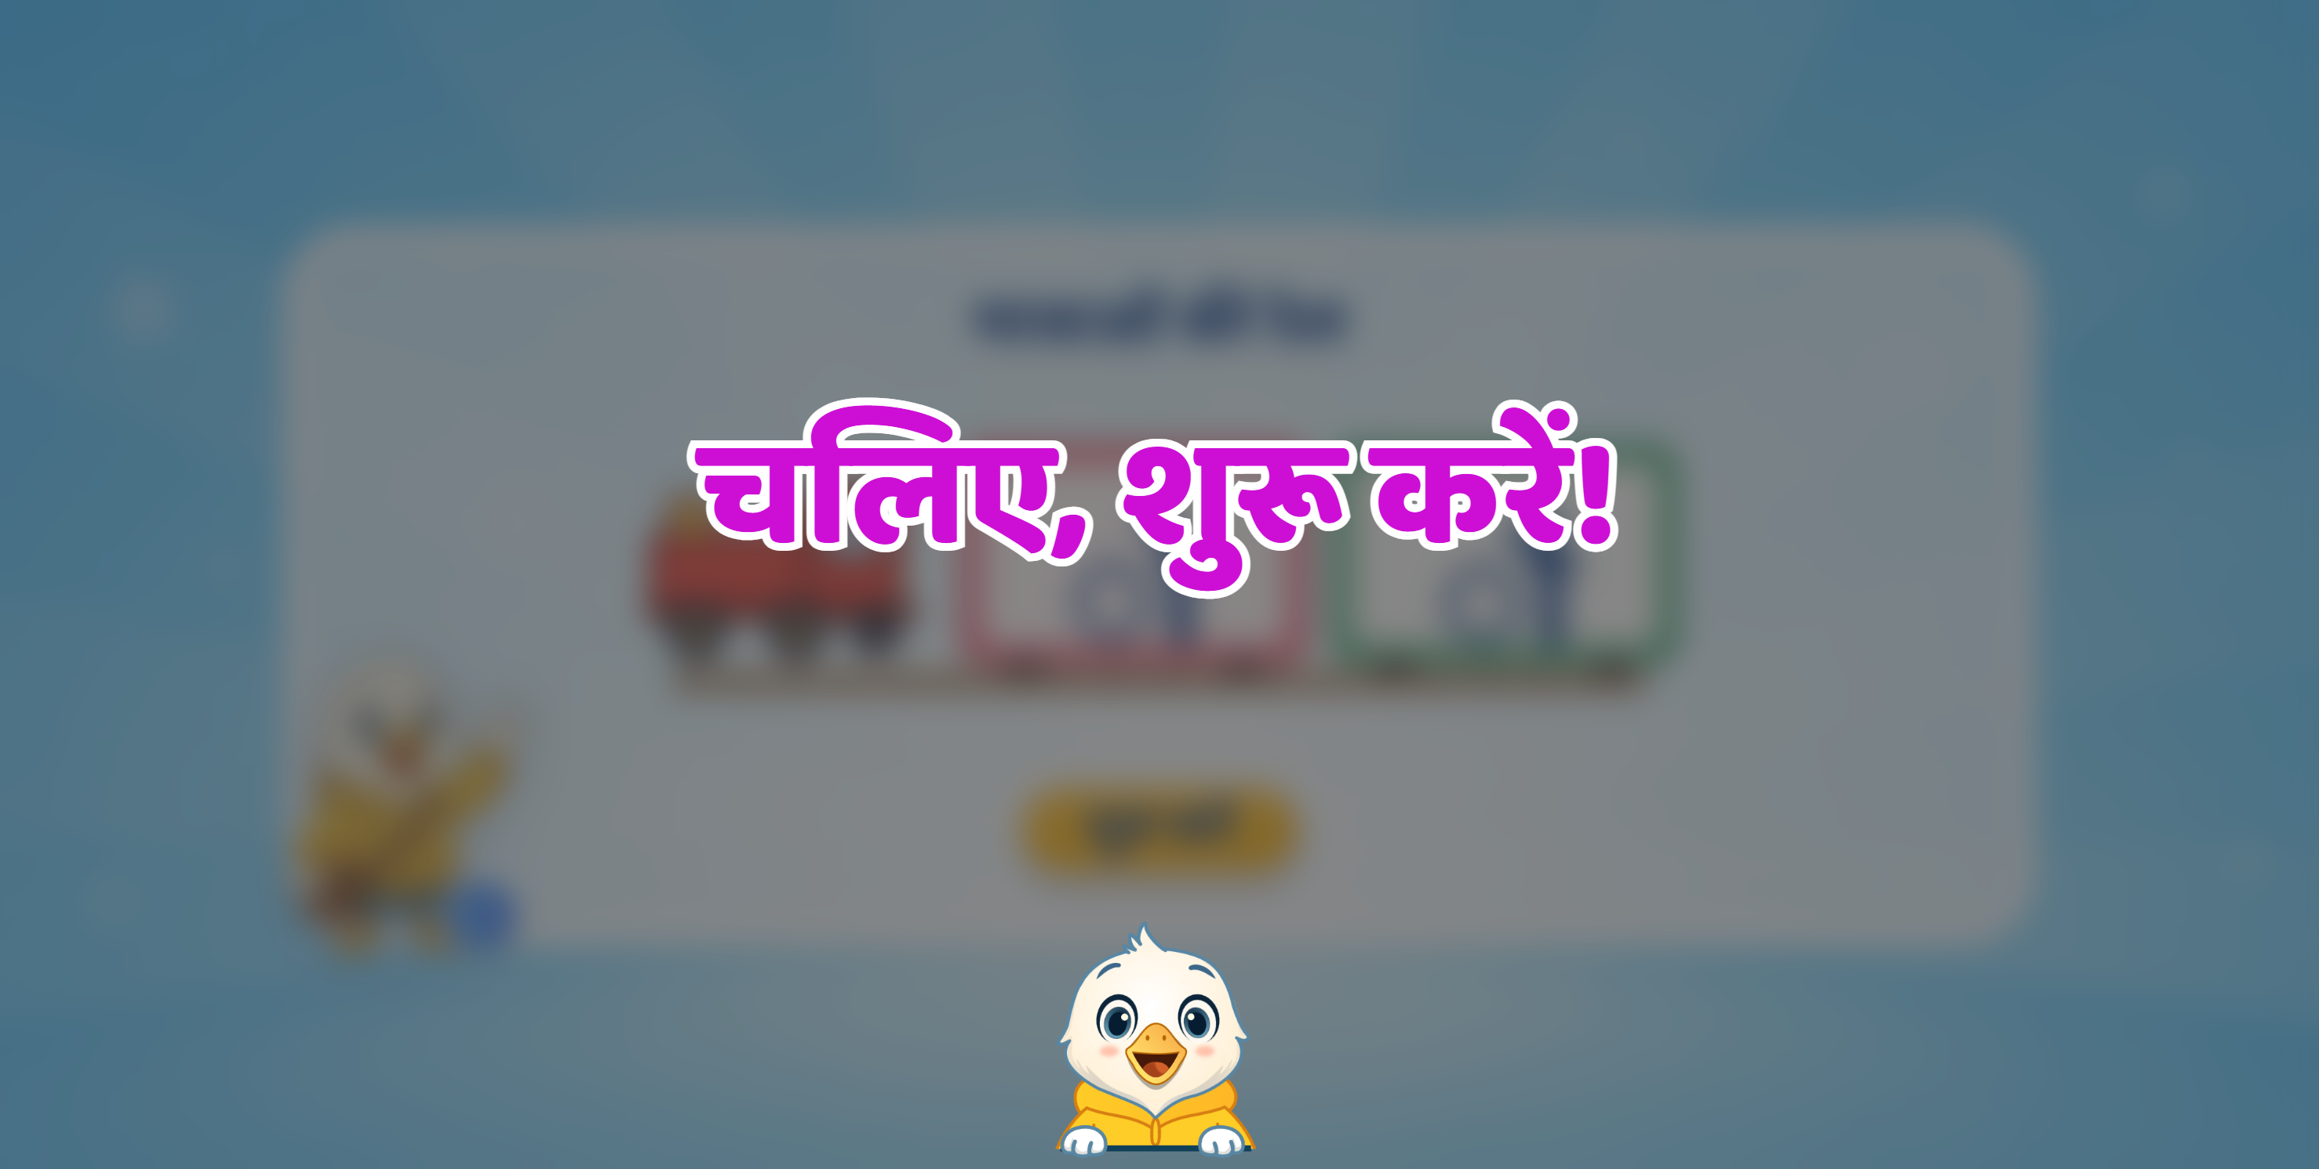

Slide 4
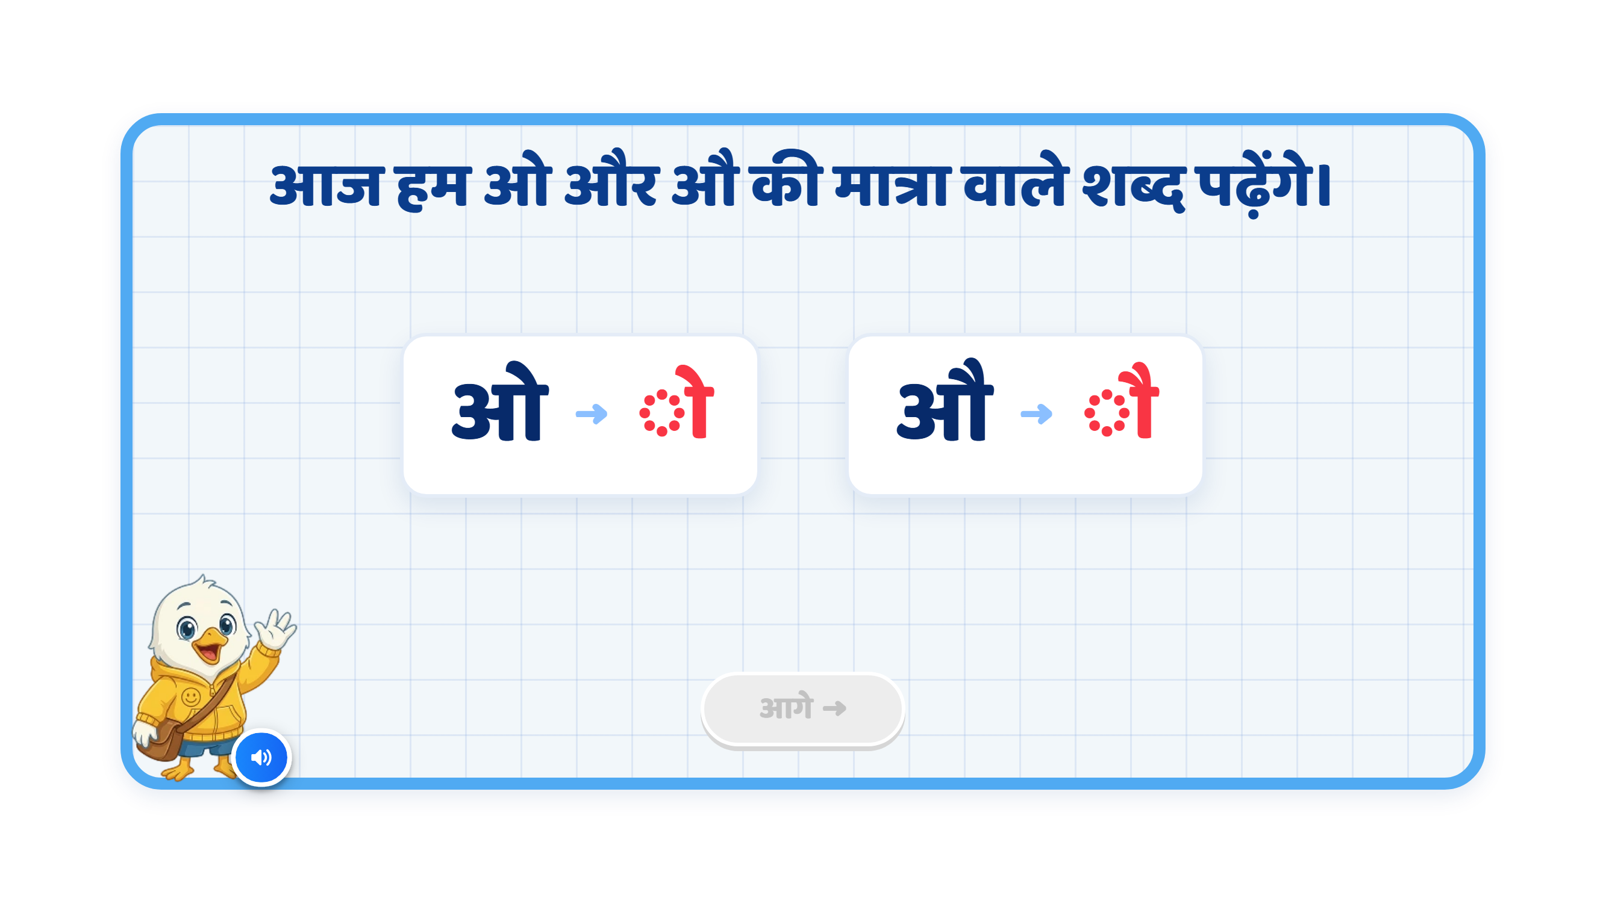
Page 2 · 02_MATRA_INTRO.png
Notes:
Recommendation
VO:
“आज हम ओ और औ की मात्रा वाले शब्द पढ़ेंगे।”
इसके बाद pair-wise VO इस तरह चल सकती है:
“यह है ओ। इसकी मात्रा देखिए।”
“यह है औ। इसकी मात्रा देखिए।”
On Screen:
Keep the heading: “आज हम ओ और औ की मात्रा वाले शब्द पढ़ेंगे।”
Remove any additional text so the screen stays clean and focused.
Show the letter and its corresponding matra symbol as a pair, one by one.
Keep only one pair active at a time.
Highlight each active pair when its VO plays.
Follow this sequence: ओ → ◌ो, then औ → ◌ौ.
Keep the existing mascot and overall UI/UX style unchanged.
If possible, show each pair inside a train-style card or bogie to maintain the train theme.
Animation:
First ओ appears, then ◌ो appears beside it with a soft glow.
After its VO finishes, dim the first pair slightly.
Then औ appears, followed by ◌ौ beside it.
Highlight only the matra strokes in red. Keep the dotted circle neutral.
Use simple pop/fade animations, synchronised with the VO.
Keep animations subtle and child-friendly, without extra decorative elements.
SFX:
Add a soft pop/chime when each matra symbol appears.
Keep SFX subtle so the VO remains clear.
Next Button:
Keep the आगे button disabled during the sequence.
Activate it only after both pairs have been shown and spoken.
Note:
This slide introduces the two matras.
The child should clearly connect ओ → ◌ो and औ → ◌ौ.
Refer to them as ओ की मात्रा and औ की मात्रा. Do not use “छोटी” or “बड़ी”.
The dotted circle only helps display the matra; it is not part of the matra.
Show only these two pairs to keep the screen focused.

Slide 5
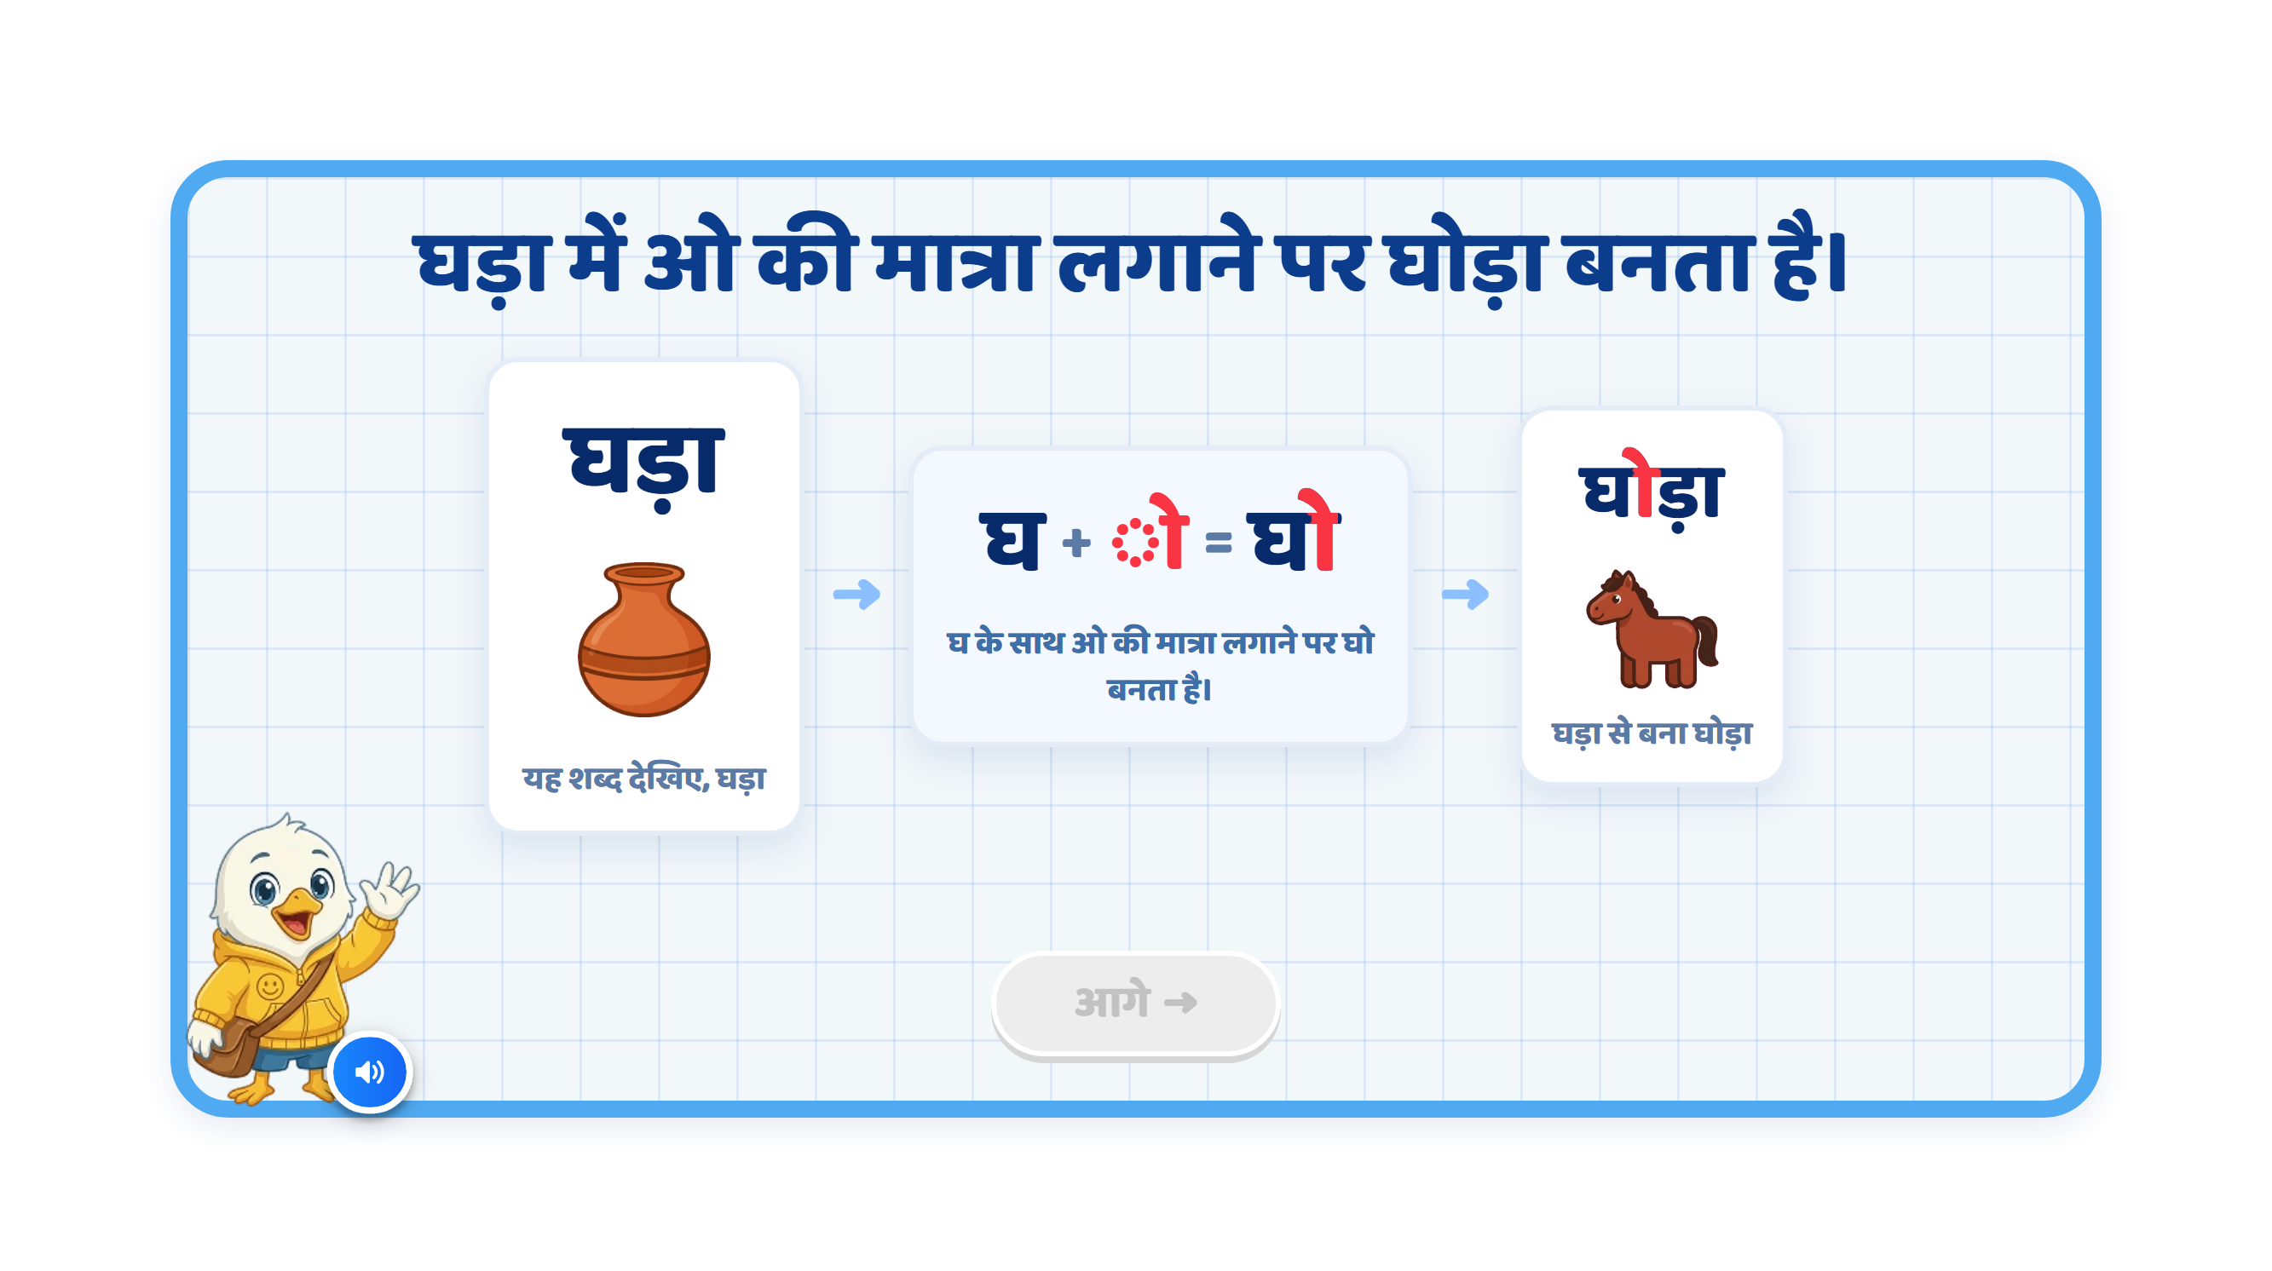
Page 3 · 03_MATRA_BUILD.png
Notes:
Recommendation
VO:
“आइए, देखें कि ओ की मात्रा लगने से शब्द की आवाज़ कैसे बदलती है।”
पहले:
“यह शब्द देखिए — घड़ा।”
फिर:
“घ के साथ ओ की मात्रा लगाने पर ‘घो’ बनता है।”
अंत में:
“अब ‘ड़ा’ जुड़ने पर ‘घोड़ा’ बनता है।”
On Screen:
Keep the screen focused on one word transformation.
First show घड़ा clearly on the left.
Below or beside घड़ा, show a clear earthen pot image.
In the centre, show: घ + ◌ो = घो
Highlight only the ो मात्रा in red when it is introduced.
After that, show the final word: घोड़ा.
In घोड़ा, highlight only ो in red so the child notices its position above and to the right of घ.
Show a clear horse image below or beside घोड़ा.
Keep the existing mascot and overall UI/UX style unchanged.
Keep the screen clean. Avoid unnecessary explanatory text beneath the cards.
Image Requirements:
घड़ा: A recognisable earthen water pot with a rounded body and narrow opening.
घोड़ा: A recognisable horse with its full body, legs, mane and tail clearly visible.
Use a consistent, child-friendly illustration style for both images.
Keep the pot image associated with घड़ा and the horse associated with घोड़ा. Do not animate the pot changing into a horse.
Sequence:
घड़ा appears on the left.
The earthen pot image appears below or beside it.
VO: “यह शब्द देखिए — घड़ा।”
Highlight घ in घड़ा.
Show घ + ◌ो = घो in the centre.
VO: “घ के साथ ओ की मात्रा लगाने पर ‘घो’ बनता है।”
Move ो into its correct position above and to the right of घ, forming घो.
Then ड़ा joins.
VO: “अब ‘ड़ा’ जुड़ने पर ‘घोड़ा’ बनता है।”
The final word घोड़ा appears.
Highlight only ो inside घोड़ा.
The horse image appears below or beside घोड़ा.
Animation:
Use a simple step-by-step animation.
Do not show all stages together at the beginning.
First reveal घड़ा and its pot image with a soft fade.
Then shift attention to घ.
The ो मात्रा should softly slide into its correct position around घ, synchronised with the VO.
Visually transform घ → घो.
Then ड़ा slides in to form घो + ड़ा = घोड़ा.
Reveal the horse image only after घोड़ा is complete.
Keep animations subtle and child-friendly.
Sound Differentiation:
Make the pronunciation difference clear:
घ → घो → घोड़ा
Give a short pause between each sound so the child can hear how adding ो changes the sound.
SFX:
Add a soft pop when each image or the matra appears.
Add a light chime when घ changes to घो.
Add a small success sound when घोड़ा is completed.
Keep SFX subtle so the pronunciation remains clear.
Next Button:
Keep the आगे button disabled during the complete sequence.
Activate it only after घड़ा and its image have been introduced, घ → घो → घोड़ा has been demonstrated, and the horse image has appeared.
Note:
Use: “घ के साथ ओ की मात्रा लगाने पर ‘घो’ बनता है।”
Refer to it as ओ की मात्रा, without “छोटी” or “बड़ी”.
Highlight the complete ो मात्रा, including its upper stroke and right-side vertical stroke, in red.
Keep the consonants, headline, nukta under ड़, and existing ा मात्रा in ड़ा unchanged.
Keep ड़ा together when it joins घो.
The dotted circle in ◌ो is a display aid. It should disappear when the matra joins घ.
The key visual learning should remain:
घड़ा (earthen pot) → घ + ◌ो = घो → घोड़ा (horse)

Slide 6
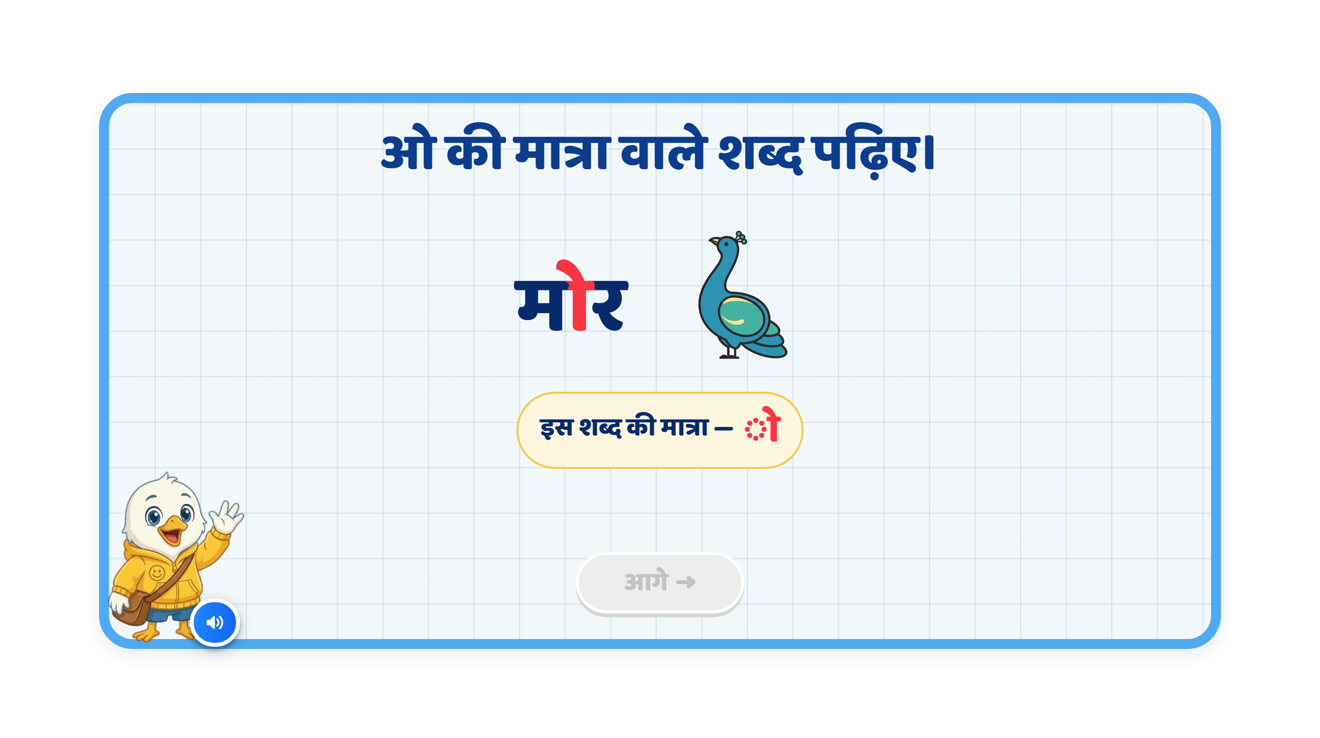
Page 4 · 04_MEET_PAIR.png
Notes:
Recommendation
VO:
“आइए, ओ की मात्रा वाले कुछ शब्द देखें।”
पहले:
“मोर — बोलकर देखिए। इसमें म पर ओ की मात्रा लगी है।”
फिर:
“कोयल — बोलकर देखिए। इसमें क पर ओ की मात्रा लगी है।”
On Screen:
Keep the heading: “ओ की मात्रा वाले शब्द पढ़िए।”
Keep only one example visible at a time.
First show मोर, followed by a clear peacock image.
Highlight only the ो मात्रा attached to म in मोर, using red.
After the first example finishes, show कोयल, followed by a clear koel image.
Highlight only the ो मात्रा attached to क in कोयल, using the same red.
Keep the existing mascot and overall UI/UX style unchanged.
If retaining the “इस शब्द की मात्रा” label, show ◌ो for both examples.
Image Requirements:
मोर: A recognisable peacock with a blue neck, head crest and clearly visible colourful tail feathers.
कोयल: A recognisable black koel with a slender body, long tail and red eye, perched on a simple branch.
Make the two birds visually distinct so children can identify them easily.
Use a consistent, child-friendly illustration style with minimal background detail.
Sequence:
मोर appears.
The peacock image appears.
VO: “मोर — बोलकर देखिए।”
Pause briefly so the child can repeat the word.
VO: “इसमें म पर ओ की मात्रा लगी है।”
Highlight only ो in मोर, synchronised with the explanation.
Fade out the first example.
कोयल appears.
The koel image appears.
VO: “कोयल — बोलकर देखिए।”
Pause briefly so the child can repeat the word.
VO: “इसमें क पर ओ की मात्रा लगी है।”
Highlight only ो in कोयल, synchronised with the explanation.
Animation:
Show the word first, followed by its image.
Use simple fade/pop-in animations.
When the VO explains the matra, softly highlight the complete ो मात्रा in red, including its upper stroke and right-side vertical stroke.
Keep the consonants and headline unchanged.
Complete one example before introducing the next.
SFX:
Add a soft pop when the word or image appears.
Add a soft chime when the matra highlights.
Keep SFX subtle so the VO and pronunciation remain clear.
Next Button:
Keep the आगे button disabled during the explanation.
Activate it only after both examples and their VO sequences finish.
Note:
Preserve the correct spellings: मोर and कोयल.
Highlight only ो, keeping the rest of each word in the regular text colour.
The learning focus is recognising ओ की मात्रा in both words: मोर, कोयल.

Slide 7
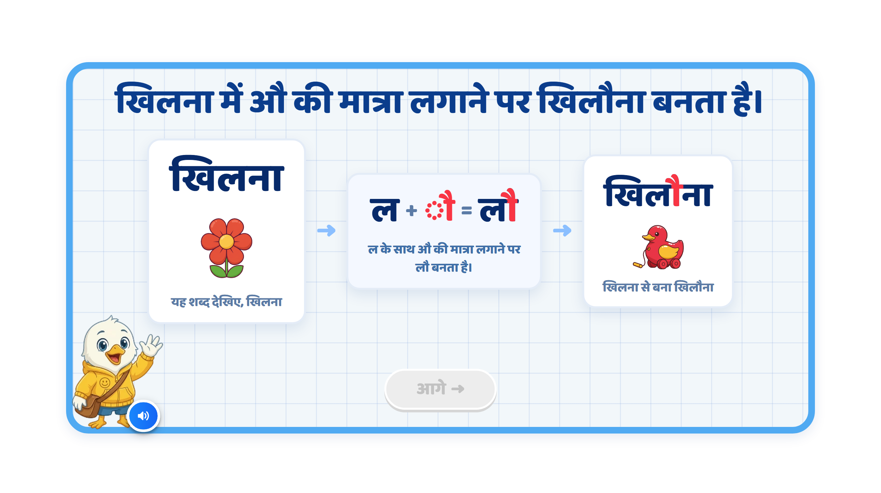
Page 5 · 05_MATRA_BUILD.png
Notes:
Recommendation
VO:
“आइए, देखें कि औ की मात्रा लगने से शब्द की आवाज़ कैसे बदलती है।”
पहले:
“यह शब्द देखिए — खिलना।”
फिर:
“ल के साथ औ की मात्रा लगाने पर ‘लौ’ बनता है।”
अंत में:
“अब ‘खि’, ‘लौ’ और ‘ना’ को जोड़ने पर ‘खिलौना’ बनता है।”
On Screen:
Keep the screen focused on one word transformation.
First show खिलना clearly on the left.
Below or beside खिलना, show a flower bud opening into a flower.
In the centre, show: ल + ◌ौ = लौ
Highlight only the ौ मात्रा in red when it is introduced.
After that, show the final word: खिलौना.
In खिलौना, highlight only ौ in red so the child notices its position above and to the right of ल.
Show a clear toy image below or beside खिलौना.
Keep the existing mascot and overall UI/UX style unchanged.
Keep the screen clean. Avoid unnecessary explanatory text beneath the cards.
Image Requirements:
खिलना: A flower bud opening into a flower. Show the opening action clearly through a short animation, rather than only a fully open flower.
खिलौना: A recognisable pull-along toy duck with visible wheels and a string, matching the attached screen.
Use a consistent, child-friendly illustration style.
Keep each image associated with its word. Do not animate the flower changing into a toy.
Sequence:
खिलना appears on the left.
The flower-bud image appears below or beside it.
VO: “यह शब्द देखिए — खिलना।”
Briefly animate the bud opening into a flower.
Highlight ल in खिलना.
Show ल + ◌ौ = लौ in the centre.
VO: “ल के साथ औ की मात्रा लगाने पर ‘लौ’ बनता है।”
Move ौ into its correct position above and to the right of ल, forming लौ.
Bring खि before लौ and ना after it.
VO: “अब ‘खि’, ‘लौ’ और ‘ना’ को जोड़ने पर ‘खिलौना’ बनता है।”
Show: खि + लौ + ना = खिलौना
Highlight only ौ inside खिलौना.
The toy image appears below or beside खिलौना.
Animation:
Use a simple step-by-step animation.
Do not show all stages together at the beginning.
First reveal खिलना and its flower-bud image with a soft fade.
Briefly animate the bud opening when खिलना is introduced.
Then shift attention to ल.
The ौ मात्रा should softly slide into its correct position around ल, synchronised with the VO.
Visually transform ल → लौ.
Then खि and ना slide into position to form खि + लौ + ना = खिलौना.
Reveal the toy image only after खिलौना is complete.
Keep animations subtle and child-friendly.
Sound Differentiation:
Make the pronunciation difference clear:
ल → लौ
Then read the complete word:
खिलौना
Give a short pause between the sounds so the child can hear how adding ौ changes ल to लौ.
SFX:
Add a soft pop when each image or the matra appears.
Add a light chime when ल changes to लौ.
Add a small success sound when खिलौना is completed.
Keep SFX subtle so the pronunciation remains clear.
Next Button:
Keep the आगे button disabled during the complete sequence.
Activate it only after खिलना and its image have been introduced, the word transformation has been demonstrated, and the toy image has appeared.
Note:
Use: “ल के साथ औ की मात्रा लगाने पर ‘लौ’ बनता है।”
Refer to it as औ की मात्रा, without “छोटी” or “बड़ी”.
Highlight the complete ौ मात्रा, including both upper strokes and the right-side vertical stroke, in red.
Keep the consonants, headline and existing ि and ा matras unchanged.
The dotted circle in ◌ौ is a display aid. It should disappear when the matra joins ल.
The key visual learning should remain:
खिलना (flower opening) → ल + ◌ौ = लौ → खिलौना (toy)

Slide 8
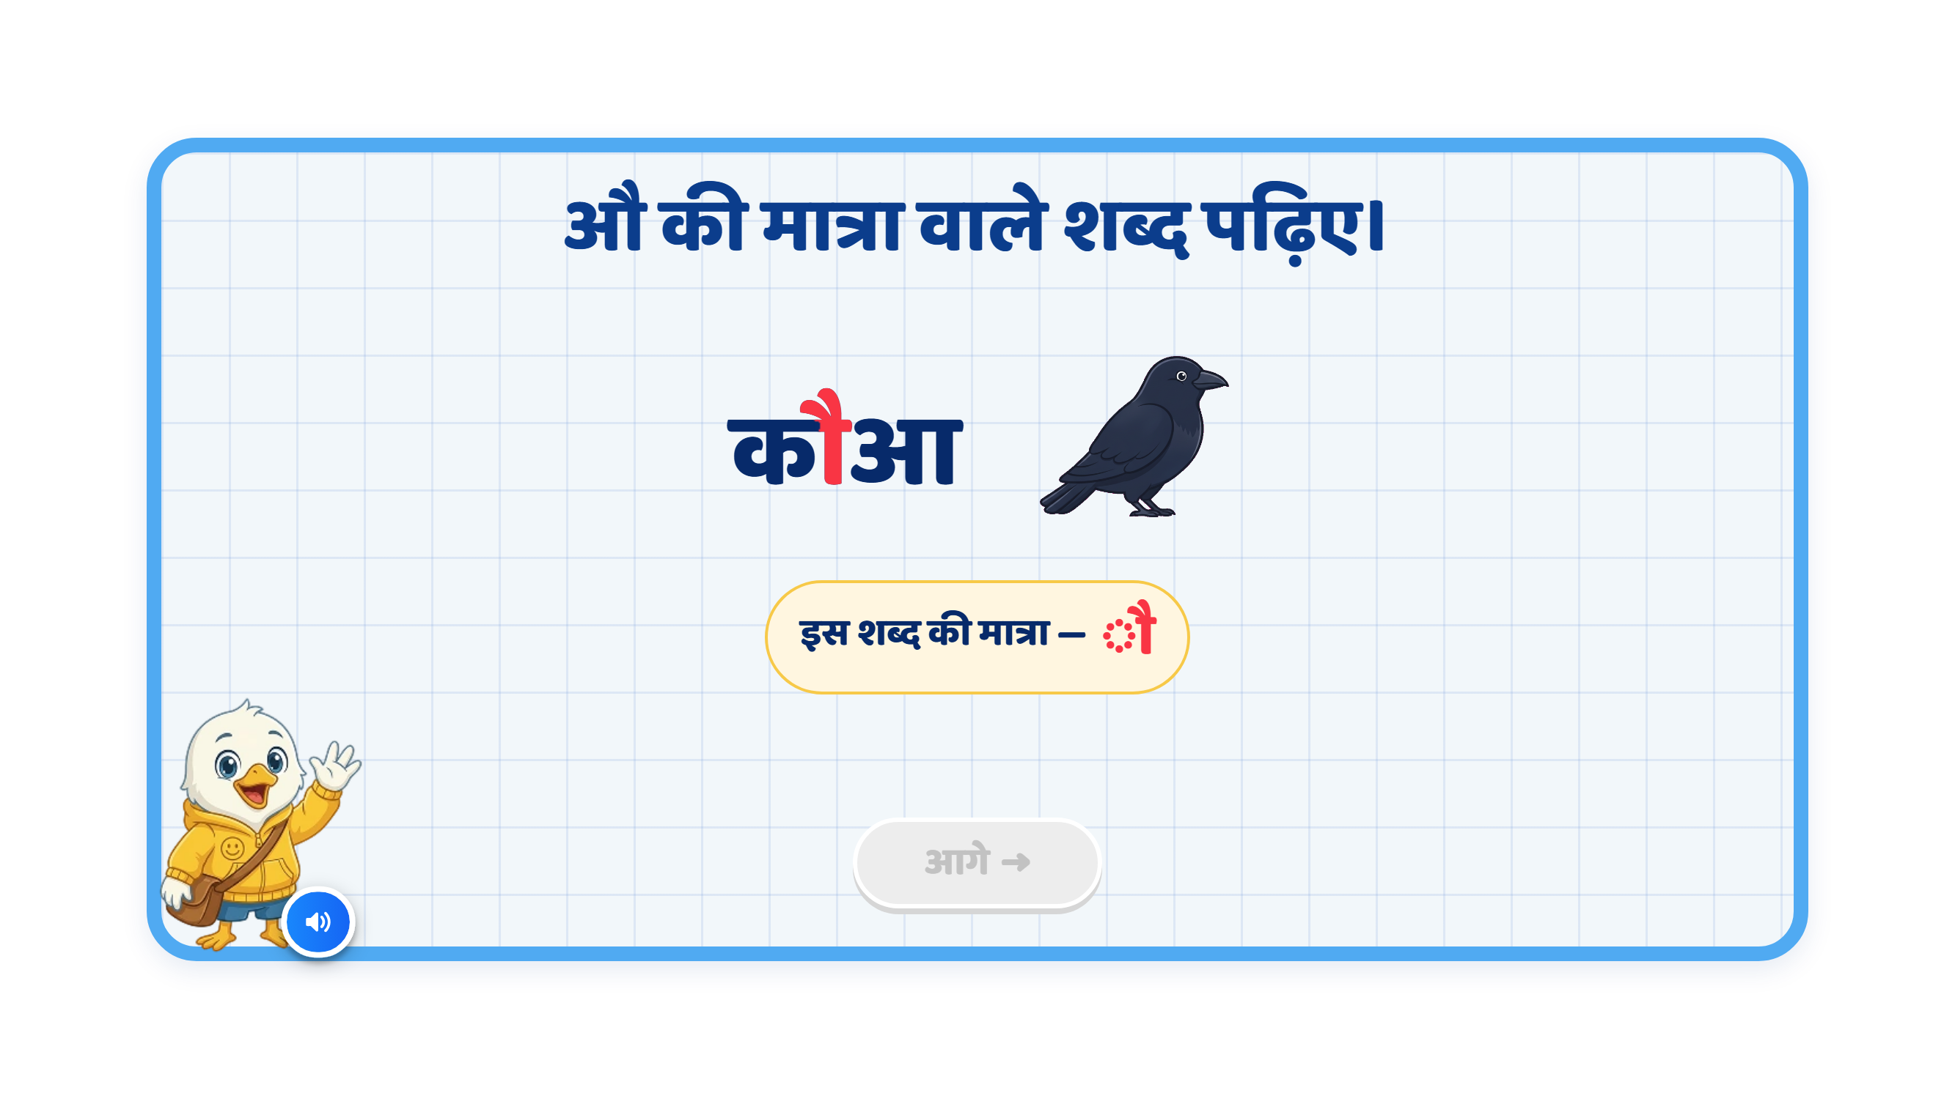
Page 6 · 06_MEET_PAIR.png
Notes:
Recommendation
VO:
“आइए, औ की मात्रा वाले कुछ शब्द देखें।”
पहले:
“कौआ — बोलकर देखिए। इसमें क पर औ की मात्रा लगी है।”
फिर:
“पौधा — बोलकर देखिए। इसमें प पर औ की मात्रा लगी है।”
On Screen:
Keep the heading: “औ की मात्रा वाले शब्द पढ़िए।”
Keep only one example visible at a time.
First show कौआ, followed by a clear crow image.
Highlight only the ौ मात्रा attached to क in कौआ, using red.
After the first example finishes, show पौधा, followed by a clear plant image.
Highlight only the ौ मात्रा attached to प in पौधा, using the same red.
Keep आ in कौआ and the ा मात्रा in पौधा in the regular text colour.
Keep the existing mascot and overall UI/UX style unchanged.
If retaining the “इस शब्द की मात्रा” label, show ◌ौ for both examples.
Image Requirements:
कौआ: A recognisable crow with dark feathers, a clear beak, wings and visible feet.
पौधा: A small green plant with a clearly visible stem and a few leaves, growing in soil.
Use a consistent, child-friendly illustration style with minimal background detail.
Sequence:
कौआ appears.
The crow image appears.
VO: “कौआ — बोलकर देखिए।”
Pause briefly so the child can repeat the word.
VO: “इसमें क पर औ की मात्रा लगी है।”
Highlight only ौ in कौआ, synchronised with the explanation.
Fade out the first example.
पौधा appears.
The plant image appears.
VO: “पौधा — बोलकर देखिए।”
Pause briefly so the child can repeat the word.
VO: “इसमें प पर औ की मात्रा लगी है।”
Highlight only ौ in पौधा, synchronised with the explanation.
Animation:
Show the word first, followed by its image.
Use simple fade/pop-in animations.
When the VO explains the matra, softly highlight the complete ौ मात्रा in red, including both upper strokes and the right-side vertical stroke.
Keep the consonants, headline, आ in कौआ and ा मात्रा in पौधा unchanged.
Complete one example before introducing the next.
SFX:
Add a soft pop when the word or image appears.
Add a soft chime when the matra highlights.
Keep SFX subtle so the VO and pronunciation remain clear.
Next Button:
Keep the आगे button disabled during the explanation.
Activate it only after both examples and their VO sequences finish.
Note:
Preserve the correct spellings: कौआ and पौधा.
In कौआ, highlight only ौ attached to क. The final आ is a separate vowel letter and should remain unchanged.
In पौधा, highlight only ौ attached to प. Do not include ा after ध in the red matra highlight.
The learning focus is recognising औ की मात्रा in both words: कौआ, पौधा.

Slide 9
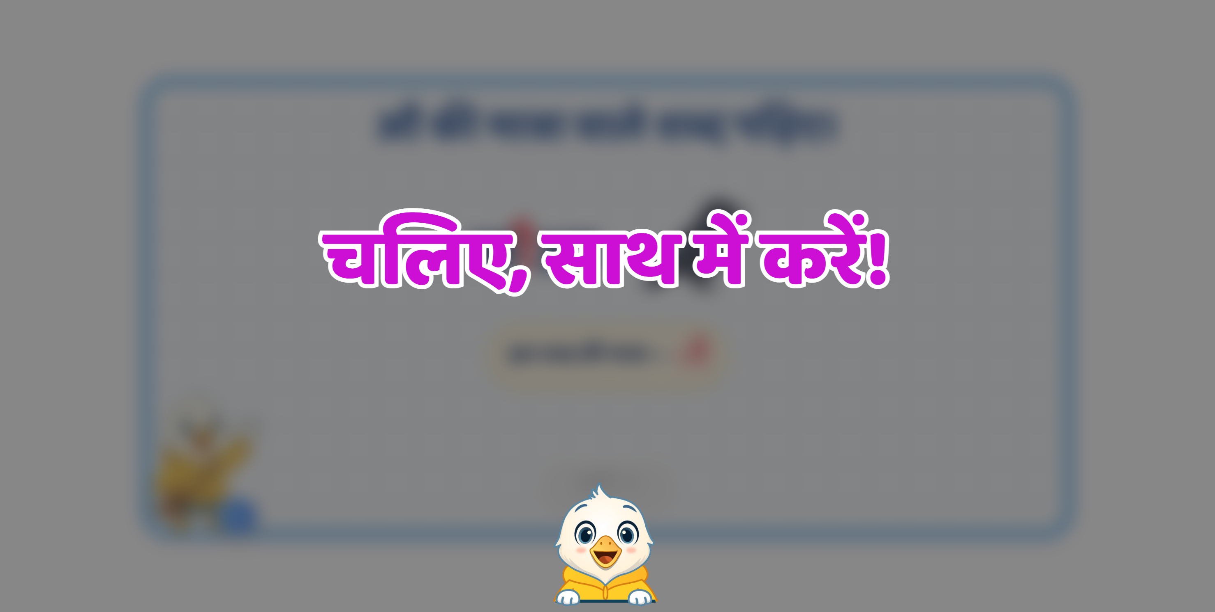

Slide 10
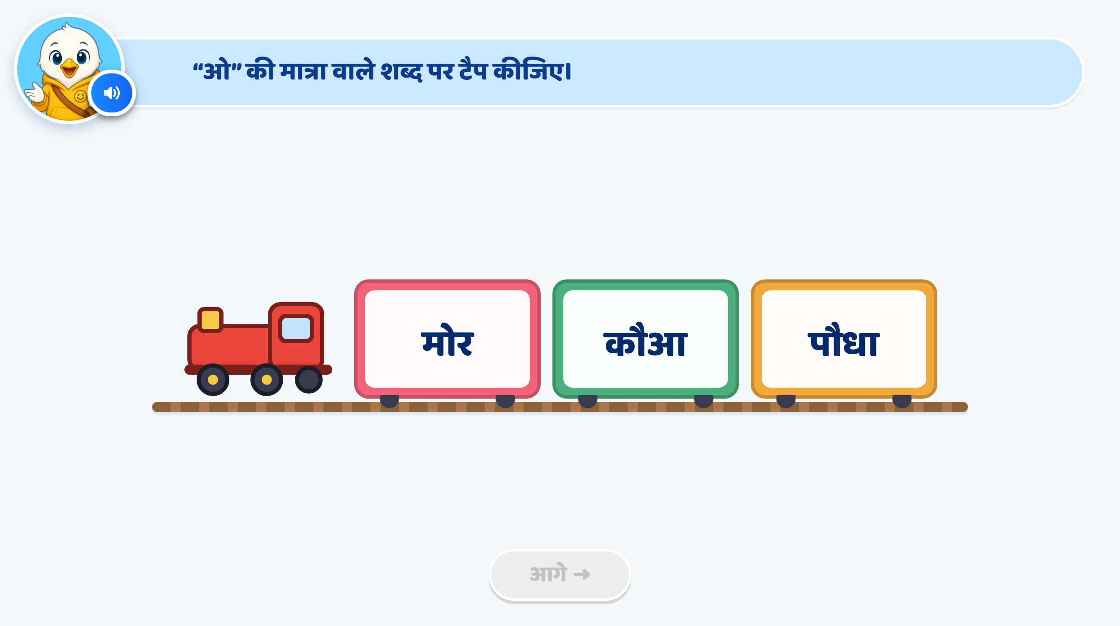
Page 7 · 07_TRAIN_TAP.png
Notes:
Recommendation
Option Change:
Keep मोर as the previously taught word.
Replace कौआ with दौड़.
Replace पौधा with चौक.
Updated options: मोर, दौड़, चौक.
दौड़ and चौक are short words not used in the preceding activities. Neither contains an additional vowel matra.
मोर remains the only correct answer for ओ की मात्रा.
Heading / Question Text:
“ओ” की मात्रा वाले शब्द पर टैप कीजिए।
Entry Animation:
The train enters smoothly from right to left.
It stops at the centre of the screen.
The three coaches show मोर, दौड़, चौक clearly.
Play the instruction VO after the train stops.
On Screen:
Keep the heading at the top: “ओ” की मात्रा वाले शब्द पर टैप कीजिए।
Keep the options in this order: मोर, दौड़, चौक.
Do not add extra instruction text in the play area.
Initially, keep all words in the regular text colour without matra highlights or answer cues.
Keep the existing mascot and overall UI/UX style unchanged.
Instruction VO:
“जिस डिब्बे में ओ की मात्रा वाला शब्द है, उस डिब्बे पर टैप कीजिए।”
Correct Answer: मोर
Accept a tap anywhere inside the मोर coach.
Show a small confetti/sparkle effect.
Give the मोर coach a soft glow.
Highlight the complete ो मात्रा attached to म in red.
Correct Response VO:
“शाबाश! मोर शब्द में ओ की मात्रा है।”
Hint 1: Clarify — After the 1st Wrong Attempt
If the child taps दौड़ or चौक, softly shake the selected coach, then return it to its original position.
Do not highlight any word or matra.
Do not show a hand nudge.
After the VO finishes, allow the child to choose from all three options again.
VO:
“फिर से पढ़िए। ओ की मात्रा वाले शब्द पर टैप कीजिए।”
Hint 2: Strong Hint — After the 2nd Wrong Attempt
Softly shake the wrongly selected coach.
Read all three words, one by one, from left to right.
As मोर is spoken, highlight the complete ो मात्रा attached to म in red.
As दौड़ is spoken, highlight the complete ौ मात्रा attached to द in red.
As चौक is spoken, highlight the complete ौ मात्रा attached to च in red.
Include the upper strokes and right-side vertical stroke of each matra.
Use the same highlighting style as the teaching screens.
Keep the consonants, headline and nukta under ड़ unchanged.
Retain the matra highlights in all three words so the child can compare.
Do not add a correct-answer coach glow or hand nudge.
After the VO finishes, keep all three options available.
VO, with a short pause between words:
“मोर। दौड़। चौक।”
Then:
“ओ की मात्रा वाले शब्द पर टैप कीजिए।”
Hint 3: Show the Answer — After the 3rd Wrong Attempt
Softly shake the wrongly selected coach.
Give the मोर coach a soft glow.
Show a hand nudge on the मोर coach.
Keep ो inside मोर highlighted in red.
Lock दौड़ and चौक.
After the VO finishes, allow only मोर to be selected.
Wait for the child to tap it. Do not select the answer or advance automatically.
VO:
“मोर शब्द में ओ की मात्रा है। मोर पर टैप कीजिए।”
Correct Response After Hint 3:
Accept the child’s tap on मोर.
Remove the hand nudge.
Show a small confetti/sparkle effect and play a success chime.
Keep the correct word’s matra highlighted.
Enable आगे after the feedback finishes.
No additional VO is needed because Hint 3 has already explained the answer.
SFX:
Soft train arrival/whistle sound during entry.
Light tap sound on selection.
Soft error sound on a wrong attempt.
Light success chime on the correct answer.
Keep all SFX below the VO volume.
Next Button:
Keep आगे disabled initially and throughout the hints.
Activate it only after the child selects मोर and the feedback finishes.
Developer Notes:
Update the option text and associated word audio to मोर, दौड़, चौक.
Disable all answer taps while any VO is playing.
Count wrong taps across both incorrect options. Switching from दौड़ to चौक must not reset the counter.
Trigger Hint 1 after the first wrong tap, Hint 2 after the second, and Hint 3 after the third.
If the child answers correctly at any earlier stage, accept the answer immediately and stop the hint sequence.
The hand nudge appears only in Hint 3 for this guided activity.

Slide 11
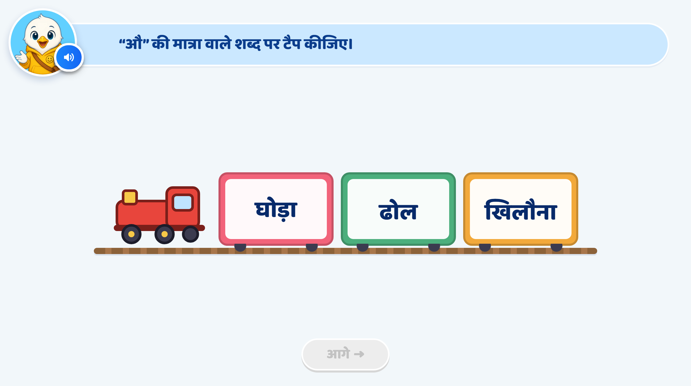
Page 8 · 08_TRAIN_TAP.png
Notes:
Recommendation
Option Change:
Use ढोल, कौआ, गोल.
Keep कौआ as the previously taught word.
Use ढोल and गोल as two new, simple words.
कौआ is the only correct answer for औ की मात्रा.
Heading / Question Text:
“औ” की मात्रा वाले शब्द पर टैप कीजिए।
Entry Animation:
The train enters smoothly from right to left.
It stops at the centre of the screen.
The three coaches show ढोल, कौआ, गोल clearly.
Play the instruction VO after the train stops.
On Screen:
Keep the heading at the top: “औ” की मात्रा वाले शब्द पर टैप कीजिए।
Keep the options in this order: ढोल, कौआ, गोल.
Do not add extra instruction text in the play area.
Initially, keep all words in the regular text colour without matra highlights or answer cues.
Keep the existing mascot and overall UI/UX style unchanged.
Instruction VO:
“जिस डिब्बे में औ की मात्रा वाला शब्द है, उस डिब्बे पर टैप कीजिए।”
Correct Answer: कौआ
Accept a tap anywhere inside the कौआ coach.
Show a small confetti/sparkle effect.
Give the कौआ coach a soft glow.
Highlight only the complete ौ मात्रा attached to क in red.
Keep the separate vowel letter आ in the regular text colour.
Correct Response VO:
“शाबाश! कौआ शब्द में औ की मात्रा है।”
Hint 1: Clarify — After the 1st Wrong Attempt
If the child taps ढोल or गोल, softly shake the selected coach, then return it to its original position.
Do not highlight any word or matra.
Do not show a hand nudge.
After the VO finishes, allow the child to choose from all three options again.
VO:
“फिर से पढ़िए। औ की मात्रा वाले शब्द पर टैप कीजिए।”
Hint 2: Strong Hint — After the 2nd Wrong Attempt
Softly shake the wrongly selected coach.
Read all three words, one by one, from left to right.
As ढोल is spoken, highlight the complete ो मात्रा attached to ढ in red.
As कौआ is spoken, highlight the complete ौ मात्रा attached to क in red.
As गोल is spoken, highlight the complete ो मात्रा attached to ग in red.
Include the upper strokes and right-side vertical stroke of each matra.
Use the same highlighting style as the teaching screens.
Keep the consonants, headline and separate आ in कौआ unchanged.
Retain the matra highlights in all three words so the child can compare.
Do not add a correct-answer coach glow or hand nudge.
After the VO finishes, keep all three options available.
VO, with a short pause between words:
“ढोल। कौआ। गोल।”
Then:
“औ की मात्रा वाले शब्द पर टैप कीजिए।”
Hint 3: Show the Answer — After the 3rd Wrong Attempt
Softly shake the wrongly selected coach.
Give the कौआ coach a soft glow.
Show a hand nudge on the कौआ coach.
Keep ौ inside कौआ highlighted in red.
Lock ढोल and गोल.
After the VO finishes, allow only कौआ to be selected.
Wait for the child to tap it. Do not select the answer or advance automatically.
VO:
“कौआ शब्द में औ की मात्रा है। कौआ पर टैप कीजिए।”
Correct Response After Hint 3:
Accept the child’s tap on कौआ.
Remove the hand nudge.
Show a small confetti/sparkle effect and play a success chime.
Keep the correct word’s matra highlighted.
Enable आगे after the feedback finishes.
No additional VO is needed because Hint 3 has already explained the answer.
SFX:
Soft train arrival/whistle sound during entry.
Light tap sound on selection.
Soft error sound on a wrong attempt.
Light success chime on the correct answer.
Keep all SFX below the VO volume.
Next Button:
Keep आगे disabled initially and throughout the hints.
Activate it only after the child selects कौआ and the feedback finishes.
Developer Notes:
Update the option text and associated word audio to ढोल, कौआ, गोल.
Disable all answer taps while any VO is playing.
Count wrong taps across both incorrect options. Switching from ढोल to गोल must not reset the counter.
Trigger Hint 1 after the first wrong tap, Hint 2 after the second, and Hint 3 after the third.
If the child answers correctly at any earlier stage, accept the answer immediately and stop the hint sequence.
The hand nudge appears only in Hint 3 for this guided activity.

Slide 12
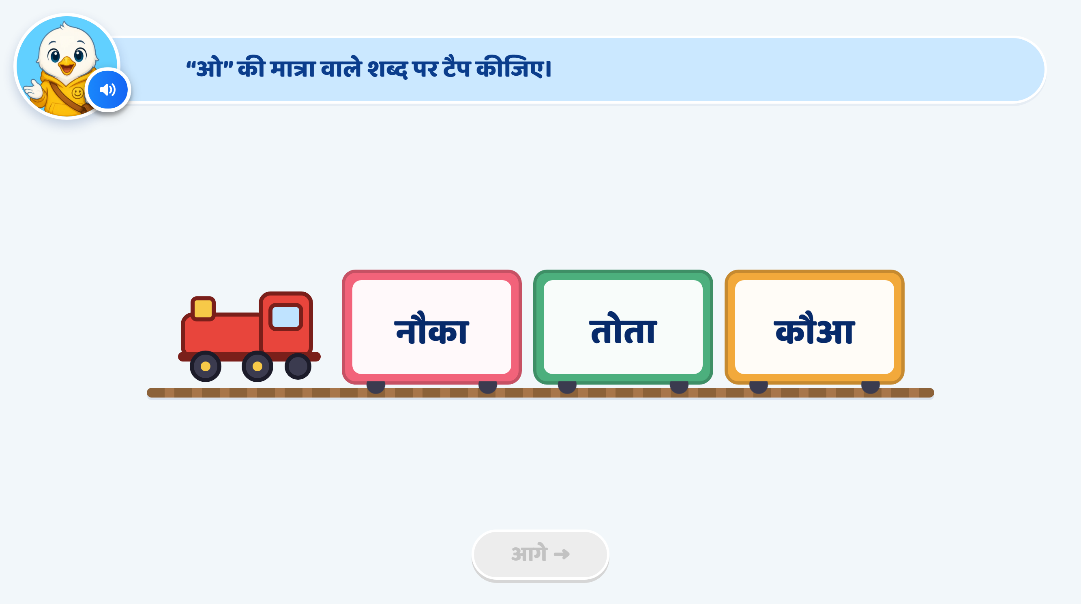
Page 9 · 09_TRAIN_TAP.png
Notes:
Recommendation
Heading / Question Text:
“ओ” की मात्रा वाले शब्द पर टैप कीजिए।
Entry Animation:
The train enters smoothly from right to left.
It stops at the centre of the screen.
The three coaches show नौका, तोता, कौआ clearly.
Play the instruction VO after the train stops.
On Screen:
Keep the heading at the top: “ओ” की मात्रा वाले शब्द पर टैप कीजिए।
Keep the three options in this order: नौका, तोता, कौआ.
Do not add extra instruction text in the play area.
Initially, keep all words in the regular text colour without matra highlights or answer cues.
Keep the existing mascot and overall UI/UX style unchanged.
Instruction VO:
“जिस डिब्बे में ओ की मात्रा वाला शब्द है, उस डिब्बे पर टैप कीजिए।”
Correct Answer: तोता
Accept a tap anywhere inside the तोता coach.
Show a small confetti/sparkle effect.
Give the तोता coach a soft glow.
Highlight only the complete ो मात्रा attached to the first त in तोता, using red.
Keep the remaining letters and the ा मात्रा in the regular text colour.
Correct Response VO:
“शाबाश! तोता शब्द में ओ की मात्रा है।”
Hint 1: Clarify — After the 1st Wrong Attempt
If the child taps नौका or कौआ, softly shake the selected coach, then return it to its original position.
Do not highlight any word or matra.
Do not show a hand nudge.
After the VO finishes, allow the child to choose from all three options again.
VO:
“फिर से पढ़िए। ओ की मात्रा वाले शब्द पर टैप कीजिए।”
Hint 2: Strong Hint — After the 2nd Wrong Attempt
Softly shake the wrongly selected coach.
Read all three words, one by one, from left to right.
As नौका is spoken, highlight the complete ौ मात्रा attached to न in red.
As तोता is spoken, highlight the complete ो मात्रा attached to the first त in red.
As कौआ is spoken, highlight the complete ौ मात्रा attached to क in red.
Include the upper strokes and right-side vertical stroke of each target matra.
Use the same highlighting style as the teaching screens.
Keep the consonants and headline unchanged.
Keep ा in नौका and तोता, and the separate आ in कौआ, in the regular text colour.
Retain the target matra highlights in all three words so the child can compare.
Do not add a correct-answer coach glow or hand nudge.
After the VO finishes, keep all three options available.
VO, with a short pause between words:
“नौका। तोता। कौआ।”
Then:
“ओ की मात्रा वाले शब्द पर टैप कीजिए।”
Hint 3: Show the Answer — After the 3rd Wrong Attempt
Softly shake the wrongly selected coach.
Give the तोता coach a soft glow.
Show a hand nudge on the तोता coach.
Keep ो inside तोता highlighted in red.
Lock नौका and कौआ.
After the VO finishes, allow only तोता to be selected.
Wait for the child to tap it. Do not select the answer or advance automatically.
VO:
“तोता शब्द में ओ की मात्रा है। तोता पर टैप कीजिए।”
Correct Response After Hint 3:
Accept the child’s tap on तोता.
Remove the hand nudge.
Show a small confetti/sparkle effect and play a success chime.
Keep the correct word’s ो मात्रा highlighted.
Enable आगे after the feedback finishes.
No additional VO is needed because Hint 3 has already explained the answer.
SFX:
Soft train arrival/whistle sound during entry.
Light tap sound on selection.
Soft error sound on a wrong attempt.
Light success chime on the correct answer.
Keep all SFX below the VO volume.
Next Button:
Keep आगे disabled initially and throughout the hints.
Activate it only after the child selects तोता and the feedback finishes.
Developer Notes:
Use the option text and associated word audio नौका, तोता, कौआ.
Disable all answer taps while any VO is playing.
Count wrong taps across both incorrect options. Switching from नौका to कौआ must not reset the counter.
Trigger Hint 1 after the first wrong tap, Hint 2 after the second, and Hint 3 after the third.
If the child answers correctly at any earlier stage, accept the answer immediately and stop the hint sequence.
The hand nudge appears only in Hint 3 for this guided activity.

Slide 13
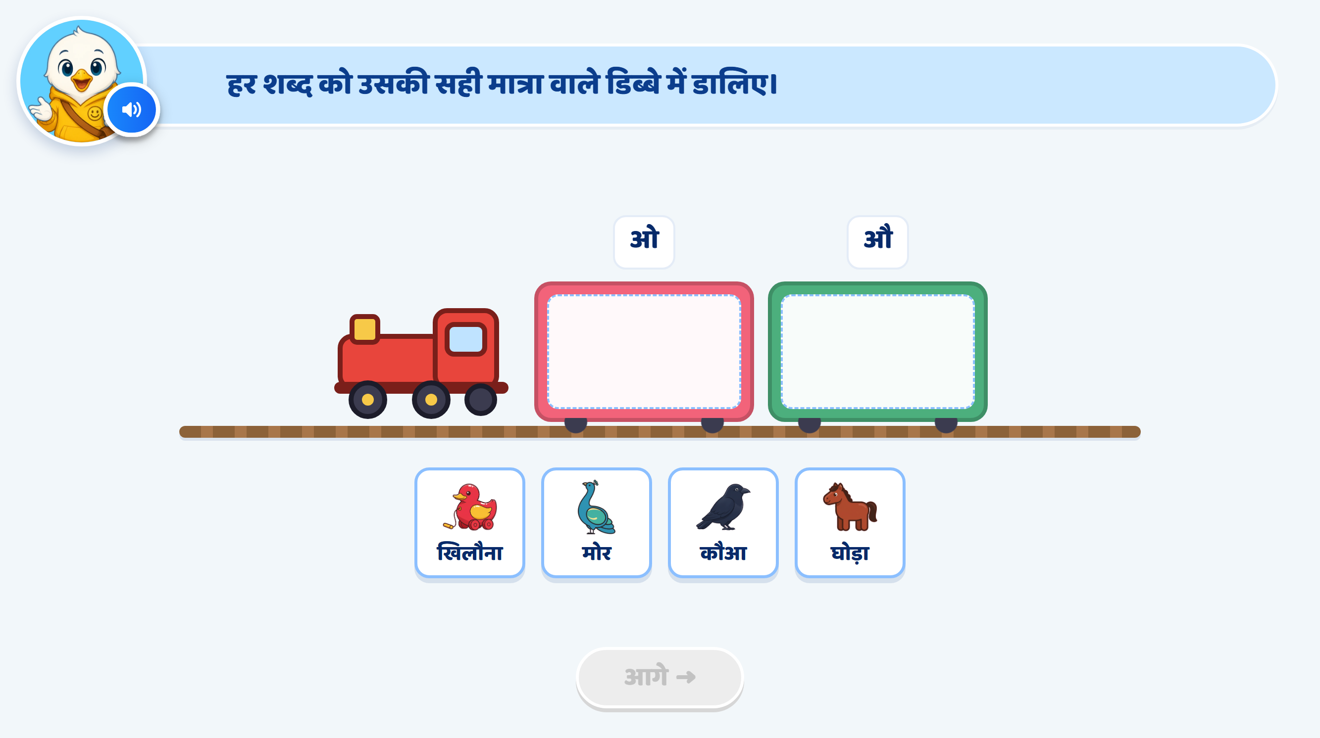
Page 10 · 10_TRAIN_SORT.png
Notes:
Recommendation
Word Changes:
Use ढोल, तोता, कौआ, पौधा, with clear picture support.
ओ की मात्रा: ढोल, तोता
औ की मात्रा: कौआ, पौधा
Replace the current cards खिलौना, मोर, कौआ, घोड़ा with the updated set.
Heading / Question Text:
“हर शब्द को उसकी सही मात्रा वाले डिब्बे में डालिए।”
Entry Animation:
The train enters smoothly from right to left.
It stops at the centre of the screen.
Show two coaches labelled ओ and औ.
Keep both drop areas empty.
Four draggable picture-and-word cards appear below the train in mixed order: पौधा, ढोल, कौआ, तोता.
Play the instruction VO, then read each card’s word aloud before enabling interaction.
On Screen:
Keep the heading at the top.
Use only ओ and औ as the coach labels.
Each card should show a clear picture with its word underneath.
Initially, keep all words in the regular text colour without matra highlights.
Do not add extra instruction text in the play area.
Keep the existing mascot and overall UI/UX style unchanged.
Image Requirements:
ढोल: A recognisable traditional drum with a cylindrical body, two drumheads and visible side lacing. Show it at an angle so its shape is clear.
तोता: A recognisable green parrot with a curved red beak and a long tail.
कौआ: A recognisable crow with dark feathers, a clear beak, wings and visible feet.
पौधा: A small green plant growing in soil, with a clearly visible stem and a few leaves.
Make the parrot and crow visually distinct.
Use consistent, child-friendly artwork with minimal background detail.
Pair every picture with its written word and spoken name.
Instruction VO:
“हर शब्द को उसकी सही मात्रा वाले डिब्बे में डालिए।”
Card-name VO:
“पौधा।” / “ढोल।” / “कौआ।” / “तोता।”
A tap on a card plays its name without counting as an answer attempt. Disable dragging while the word VO plays.
Drag and Drop:
The child drags each card into the correct coach.
Correct mapping:
WordCorrect डिब्बाढोलओतोताओकौआऔपौधाऔ
Allow two cards inside each coach without overlap.
Slightly enlarge the selected card while dragging.
Give either coach the same neutral hover highlight when a card moves over it. This should not indicate whether the answer is correct.
Correct Placement:
Snap the card inside the correct coach.
Show a small sparkle and play a success chime.
Highlight the target matra inside the word.
Lock the correctly placed card so it cannot be dragged again.
Correct Response VO — Play Only the Matching Line:
“शाबाश! ढोल शब्द में ओ की मात्रा है।”
“शाबाश! तोता शब्द में ओ की मात्रा है।”
“शाबाश! कौआ शब्द में औ की मात्रा है।”
“शाबाश! पौधा शब्द में औ की मात्रा है।”
Hint 1: Clarify — After the 1st Wrong Drop for That Card
Softly shake the wrongly dropped card.
Return it to its original position.
Do not highlight a matra or the correct coach.
Do not show a hand nudge.
After the VO finishes, allow another attempt.
VO:
“फिर से पढ़िए। इस शब्द को उसकी सही मात्रा वाले डिब्बे में डालिए।”
Hint 2: Strong Hint — After the 2nd Wrong Drop for That Card
Softly shake the card and return it to its original position.
Read only the wrongly dropped word.
Highlight its target matra in red using the teaching-screen style:
ढोल: Highlight the complete ो attached to ढ.
तोता: Highlight the complete ो attached to the first त.
कौआ: Highlight the complete ौ attached to क.
पौधा: Highlight the complete ौ attached to प.
Include the upper strokes and right-side vertical stroke of each target matra.
Keep ा in तोता and पौधा, and the separate आ in कौआ, in the regular text colour.
Keep the consonants and headline unchanged.
Do not highlight the correct coach or show a hand.
After the VO finishes, allow the child to try either coach.
Word VO — Play Only the Current Word:
“ढोल।” / “तोता।” / “कौआ।” / “पौधा।”
Then:
“इस शब्द को उसकी सही मात्रा वाले डिब्बे में डालिए।”
Hint 3: Show the Answer — After the 3rd Wrong Drop for That Card
Softly shake the card and return it to its original position.
Give the current card and its correct coach a soft glow.
Show a hand drag nudge from the card to the correct coach.
Lock the wrong coach as a destination for this card.
Temporarily disable other unfinished cards until this guided placement is complete.
After the VO finishes, allow the child to drag the current card only into its correct coach.
Do not place the card automatically.
VO — Play Only the Matching Line:
“ढोल शब्द में ओ की मात्रा है। इसे ओ वाले डिब्बे में डालिए।”
“तोता शब्द में ओ की मात्रा है। इसे ओ वाले डिब्बे में डालिए।”
“कौआ शब्द में औ की मात्रा है। इसे औ वाले डिब्बे में डालिए।”
“पौधा शब्द में औ की मात्रा है। इसे औ वाले डिब्बे में डालिए।”
Correct Placement After Hint 3:
Snap the card into the correct coach.
Remove the hand nudge.
Show a small sparkle and play a success chime.
Keep the target matra highlighted and lock the placed card.
No additional VO is needed because Hint 3 has already explained the answer.
Re-enable the remaining unfinished cards.
Completion:
When all four cards are correctly placed, give both coaches a soft glow.
Play a brief train whistle with a subtle steam animation.
Enable आगे after the feedback finishes.
No extra completion VO is required.
SFX:
Soft train arrival/whistle sound.
Light pick-up sound when dragging begins.
Soft error sound on a wrong drop.
Light drop/success sound on correct placement.
Keep SFX below the VO volume.
Next Button:
Keep आगे disabled initially and throughout the activity.
Activate it only after all four cards are correctly placed and feedback finishes.
Developer Notes:
Update the card images, written words, word audio and answer mappings to the new set.
Disable all answer taps and drags while any VO is playing.
Maintain a separate wrong-attempt counter for each card. Each new card starts at zero.
If the child switches cards, preserve each unfinished card’s counter.
Count a drop into the wrong coach as one wrong attempt. A name-only tap or release outside both coaches does not count.
Trigger Hint 1 after the first wrong drop, Hint 2 after the second, and Hint 3 after the third for that card.
Keep correctly placed cards locked throughout later hints.
If the child places a card correctly earlier, stop its hint sequence immediately.
Show the hand drag nudge only in Hint 3 for this guided activity.

Slide 14
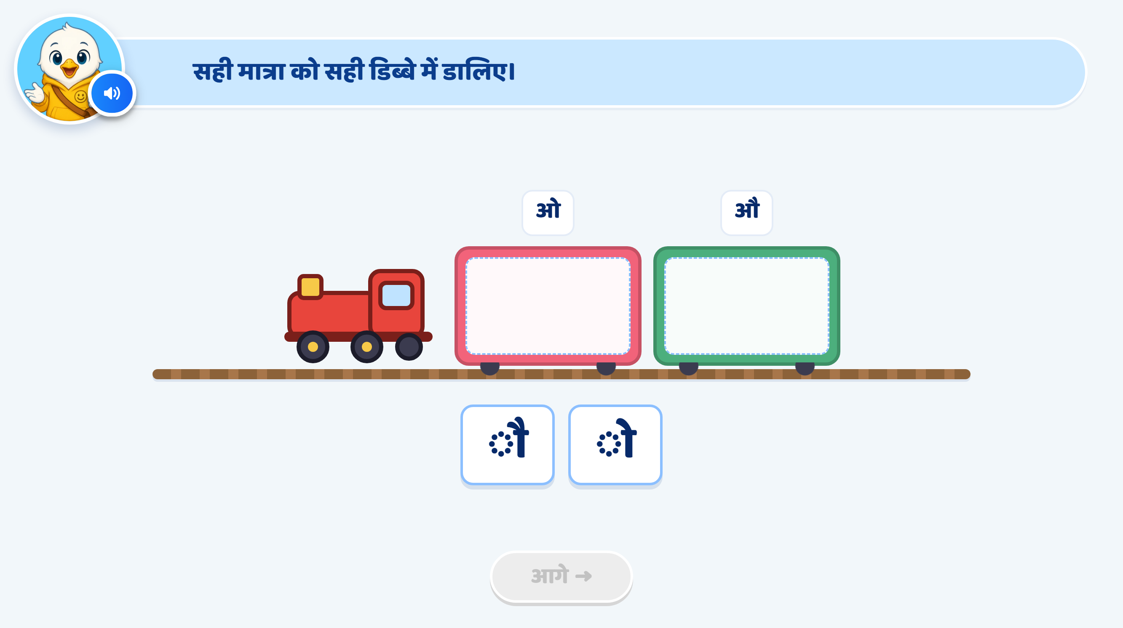
Page 11 · 11_TRAIN_SORT.png
Notes:
Recommendation
Heading / Question Text:
“सही मात्रा को सही डिब्बे में डालिए।”
Entry Animation:
The train enters smoothly from right to left.
It stops at the centre of the screen.
Show two coaches labelled ओ and औ.
Keep both drop areas empty.
Show two draggable matra cards below the train: ◌ौ and ◌ो, as in the attached screen.
Play the instruction VO before enabling interaction.
On Screen:
Keep the heading: “सही मात्रा को सही डिब्बे में डालिए।”
Keep only ओ and औ above the coaches.
Do not add matra symbols to the coach labels.
Keep both matra cards in the regular text colour initially.
Use a neutral dotted circle to display each matra clearly.
Keep the existing mascot and overall UI/UX style unchanged.
Instruction VO:
“सही मात्रा को सही डिब्बे में डालिए।”
Drag and Drop:
The child drags each matra card into its matching coach.
Correct mapping:
◌ो → ओ
◌ौ → औ
Allow only one matra card inside each coach.
Slightly enlarge the selected card while dragging.
Use the same neutral hover highlight for either coach. It should not reveal whether the destination is correct.
Do not announce the matra’s name on initial pick-up, as this would identify its matching coach.
Correct Placement:
Snap the matra card inside the correct coach.
Show a small sparkle and play a success chime.
Highlight only the complete matra strokes in red.
Keep the dotted circle neutral.
Lock the correctly placed card.
Correct Response VO — Play Only the Matching Line:
For ◌ो:
“शाबाश! यह ओ की मात्रा है।”
For ◌ौ:
“शाबाश! यह औ की मात्रा है।”
Hint 1: Clarify — After the 1st Wrong Drop for That Card
Softly shake the wrongly dropped card.
Return it to its original position.
Do not highlight the matra or either coach.
Do not show a hand nudge.
After the VO finishes, allow another attempt.
VO:
“फिर से देखिए। सही मात्रा को सही डिब्बे में डालिए।”
Hint 2: Strong Hint — After the 2nd Wrong Drop for That Card
Softly shake the card and return it.
Slightly enlarge only the wrongly dropped matra card.
Highlight its complete matra strokes in red using the teaching-screen style.
For ◌ो, trace its single upper stroke and right-side vertical stroke.
For ◌ौ, trace its two upper strokes and right-side vertical stroke.
Keep the dotted circle neutral.
Keep both coach labels visible without highlighting the correct one.
Do not announce the matra’s name or show a hand nudge.
After the VO finishes, return the card to its normal size and allow another attempt.
VO:
“मात्रा का आकार ध्यान से देखिए। इसे सही डिब्बे में डालिए।”
Hint 3: Show the Answer — After the 3rd Wrong Drop for That Card
Softly shake the card and return it.
Give the current matra card and its correct coach a soft glow.
Show a hand drag nudge from the card to the correct coach.
Lock the wrong coach as a destination for this card.
Temporarily disable the other unfinished card.
After the VO finishes, allow only the correct placement.
Wait for the child to complete the drag. Do not place the card automatically.
VO for ◌ो:
“यह ओ की मात्रा है। इसे ओ वाले डिब्बे में डालिए।”
VO for ◌ौ:
“यह औ की मात्रा है। इसे औ वाले डिब्बे में डालिए।”
Correct Placement After Hint 3:
Snap the card inside the correct coach.
Remove the hand nudge.
Show a small sparkle and play a success chime.
Lock the placed card.
No additional VO is needed because Hint 3 has already explained the answer.
Re-enable the remaining card, if any.
Completion:
When both matras are placed correctly, give both coaches a soft glow.
Play a brief train whistle with a subtle steam animation.
Enable आगे after the feedback finishes.
No extra completion VO is required.
SFX:
Soft train arrival/whistle sound.
Light pick-up sound when dragging begins.
Soft error sound on a wrong drop.
Light success chime on correct placement.
Keep SFX below the VO volume.
Next Button:
Keep आगे disabled initially and throughout the hints.
Activate it only after both matras are correctly placed and feedback finishes.
Developer Notes:
Disable all answer taps and drags while any VO is playing.
Maintain a separate wrong-attempt counter for each card.
Each card starts at zero. Switching cards must not reset an existing counter.
Count a drop into the wrong coach as one wrong attempt. Releasing outside both coaches simply returns the card without adding an attempt.
Keep correctly placed cards locked. A wrong drop onto an occupied coach should return the dragged card without disturbing the placed card.
If the child answers correctly earlier, stop that card’s hint sequence.
Show the hand drag nudge only in Hint 3 for this guided activity.
With only two cards, the second placement may be completed by elimination. Treat this screen as supported matching practice.

Slide 15
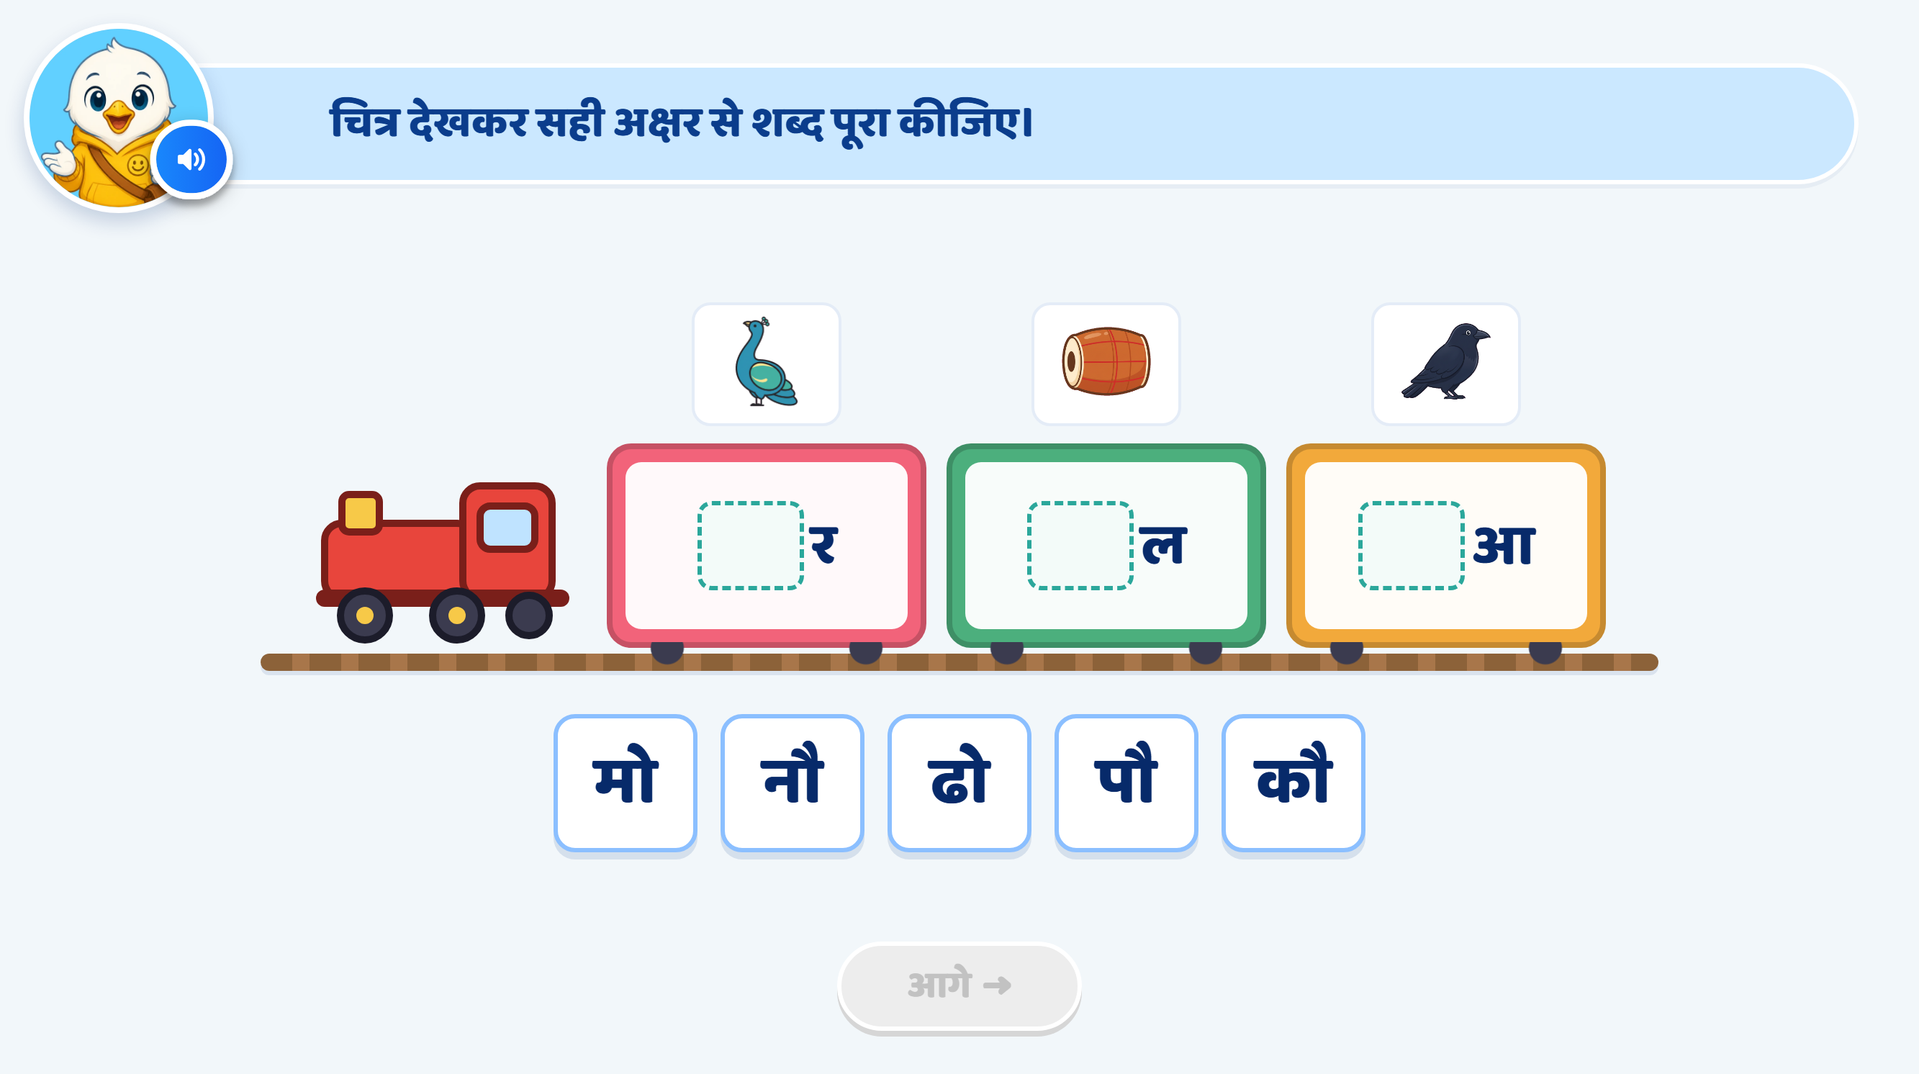
Page 12 · 12_WORD_BUILD.png
Notes:
Recommendation
Word Changes:
Use मोर, ढोल, पौधा. All three are familiar words that can be represented with clear pictures.
Keep मोर and ढोल.
Replace कौआ with पौधा.
Use मो, ढो, पौ as the correct अक्षर options.
Use नौ, कौ as distractors.
Activity Concept:
Keep the train with three coaches.
Each coach contains a blank for the first अक्षर, followed by the remaining part of the word.
The child looks at the picture and drags the correct अक्षर into the blank.
Use whole अक्षर options rather than separate matra symbols.
Heading / Question Text:
“चित्र देखकर सही अक्षर से शब्द पूरा कीजिए।”
On Screen:
Show these pictures and incomplete words:
PictureIncomplete WordCorrect OptionCompleted WordPeacock_रमोमोरDrum_लढोढोलPlant_धापौपौधा
Replace the crow picture above the third coach with a small green plant.
Change the third incomplete word from _आ to _धा.
Show five draggable options in this mixed order: मो, नौ, ढो, पौ, कौ.
नौ and कौ do not correctly complete any pictured word.
Do not show complete words or highlight matras initially.
Keep the existing mascot and train UI/UX style unchanged.
Image Requirements:
मोर: A recognisable peacock with a blue neck, head crest and clearly visible colourful tail feathers.
ढोल: A recognisable drum with a cylindrical body, two drumheads and visible side lacing. Keep its shape clear.
पौधा: A small green plant growing in soil, with a visible stem and a few leaves. Show a young plant rather than a large tree.
Keep all pictures large enough to recognise.
Use a consistent, child-friendly illustration style with minimal background detail.
Entry Animation:
The train enters smoothly from right to left and stops at the centre.
Picture cards appear above the coaches.
Incomplete words appear inside the coaches.
अक्षर options slide up from the bottom.
Play the instruction VO before enabling interaction.
Instruction VO:
“चित्र देखकर सही अक्षर से शब्द पूरा कीजिए।”
Option VO:
Tapping an अक्षर card plays only its sound:
“मो।” / “नौ।” / “ढो।” / “पौ।” / “कौ।”
A sound-only tap does not count as an answer attempt.
Disable dragging while the VO plays.
Drag and Drop:
The child drags an अक्षर into a word’s blank.
Correct combinations:
मो + र = मोर
ढो + ल = ढोल
पौ + धा = पौधा
Slightly enlarge the selected card while dragging.
Give each blank the same neutral hover highlight, without indicating whether the option is correct.
Accept a placement only when the completed word matches the picture.
Correct Placement:
Snap the अक्षर into the blank.
Show the completed word.
Highlight only its target matra in red:
मोर: Highlight ो attached to म.
ढोल: Highlight ो attached to ढ.
पौधा: Highlight ौ attached to प.
Keep ा in धा in the regular text colour.
Show a small sparkle and play a success chime.
Lock the completed word and its used अक्षर card.
Correct Response VO — Play Only the Matching Line:
“शाबाश! मोर बन गया।”
“शाबाश! ढोल बन गया।”
“शाबाश! पौधा बन गया।”
Hint 1: Clarify — After the 1st Wrong Drop
Softly shake the wrongly dropped अक्षर card.
Return it to its original position.
Do not highlight the correct अक्षर or blank.
Do not show a hand nudge.
After the VO finishes, allow another attempt.
VO:
“फिर से देखिए। चित्र देखकर सही अक्षर से शब्द पूरा कीजिए।”
Hint 2: Strong Hint — After the 2nd Wrong Drop
Softly shake the card and return it.
Read only the wrongly dropped अक्षर.
Slightly enlarge that card and highlight its matra in red:
मो, ढो: Highlight the complete ो मात्रा.
नौ, पौ, कौ: Highlight the complete ौ मात्रा.
Include the upper strokes and right-side vertical stroke of the matra.
Keep the consonant and headline unchanged.
Keep the relevant picture and incomplete word clearly visible so the child can compare.
Do not highlight the correct option or show a hand nudge.
After the VO finishes, return the card to its normal size and allow another attempt.
Option VO — Play Only the Wrongly Dropped अक्षर:
“मो।” / “नौ।” / “ढो।” / “पौ।” / “कौ।”
Then:
“चित्र देखकर सही अक्षर से शब्द पूरा कीजिए।”
Hint 3: Show the Answer — After the 3rd Wrong Drop
Return the wrong card to its original position.
Give the correct अक्षर and its matching blank a soft glow.
Temporarily lock all other options and destinations.
After the VO finishes, allow only the correct placement.
Wait for the child to drag the अक्षर into the blank. Do not complete the word automatically.
VO for मोर:
“मो लगाने से मोर बनता है। मो को खाली जगह में डालिए।”
VO for ढोल:
“ढो लगाने से ढोल बनता है। ढो को खाली जगह में डालिए।”
VO for पौधा:
“पौ लगाने से पौधा बनता है। पौ को खाली जगह में डालिए।”
Practice-Round Hand Nudge:
Confirm with Ankita whether Hint 3 should include a hand drag nudge.
Pending confirmation, use glow and lock without a hand, following the earlier practice QA feedback.
If approved, animate the hand from the correct अक्षर to its matching blank.
Distractor Handling and Attempt Counts:
Keep a separate wrong-attempt counter for each correct अक्षर card: मो, ढो, पौ.
Preserve its counter if the child switches cards. Each new card starts at zero.
At Hint 3, guide that अक्षर to its matching word.
A wrong drop of नौ or कौ also counts as an attempt. Track these errors against the unfinished blank where the distractor was dropped.
Switching between नौ and कौ must not reset that blank’s distractor counter.
After the third distractor error for a blank, reveal the correct अक्षर for that blank.
A release outside all blanks simply returns the card and does not count as an answer attempt.
Correct Placement After Hint 3:
Snap the correct अक्षर into place.
Show the completed word and highlight its target matra.
Remove any hand nudge.
Show a small sparkle and play a success chime.
No additional VO is needed because Hint 3 has already explained the answer.
Lock the completed word and re-enable the remaining unfinished items.
Completion:
Finish when मोर, ढोल and पौधा are complete.
Leave the unused distractors in the tray and disable them.
Give all three coaches a soft glow.
Play a brief train whistle with a subtle steam animation.
Enable आगे after feedback finishes.
No extra completion VO is required.
SFX:
Soft train arrival/whistle sound.
Light pick-up sound.
Soft error sound on a wrong drop.
Light success chime on correct completion.
Keep all SFX below the VO volume.
Next Button:
Keep आगे disabled initially and throughout the activity.
Activate it only after all three words are complete and feedback finishes.
Developer Notes:
Update the third picture, incomplete word and answer mapping to पौधा, _धा, पौ.
Disable all answer taps and drags while any VO is playing.
Keep completed words locked throughout later hints.
Stop an item’s hint sequence immediately if the child answers correctly earlier.
Keep धा together in the third coach. The child adds पौ to complete पौधा.
Highlight only the target ो / ौ मात्रा, keeping consonants, headline and the existing ा मात्रा unchanged.

Slide 16
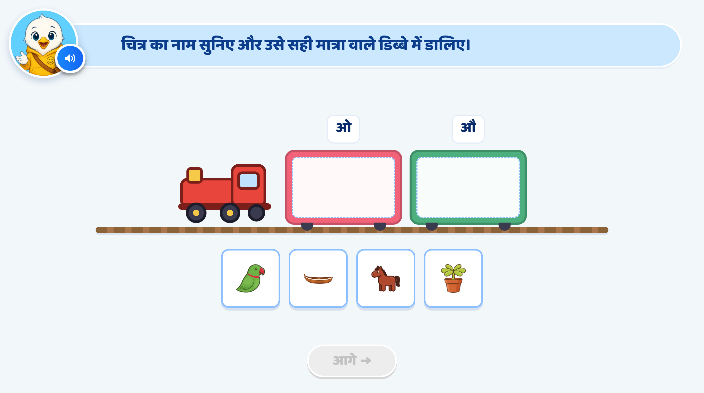
Page 13 · 13_TRAIN_SORT.png
Notes:
Recommendation
Picture Change:
Use these four picture options in this order: दौड़, तोता, घोड़ा, हथौड़ा.
Activity Concept:
Show a train with two coaches, labelled ओ and औ.
Keep the inside of each coach empty as a drop zone.
Show picture cards only below the train.
The child listens to each picture’s name and drags it into the correct डिब्बा.
Keep the initial question free of written picture names.
During Hint 2, temporarily show the wrongly dropped picture’s word and highlight its target matra.
Heading / Question Text:
“चित्र का नाम सुनिए और उसे सही मात्रा वाले डिब्बे में डालिए।”
Entry Animation:
The train enters smoothly from right to left.
It stops at the centre.
Coach labels ओ and औ appear.
Picture cards दौड़, तोता, घोड़ा, हथौड़ा appear below the train.
Play the instruction VO before enabling interaction.
On Screen:
First coach label: ओ
Second coach label: औ
Do not add matra symbols to the coach labels.
Keep the four pictures clear and equally prominent.
Do not show picture names or correct-answer cues initially.
Keep the existing mascot and train UI/UX style unchanged.
Image Requirements:
दौड़: Two children running, with bent arms, lifted feet and forward movement clearly visible. Use a simple running track and minimal background detail. The action should look like running rather than walking.
तोता: A recognisable green parrot with a curved red beak and a long tail.
घोड़ा: A recognisable horse with its full body, four legs, mane and tail clearly visible.
हथौड़ा: A familiar hammer with a wooden handle and a clearly visible metal head. Show only the hammer without extra tools.
Use consistent, child-friendly artwork.
For दौड़, use the exact spoken word “दौड़” so the child connects the action picture with the intended word.
Instruction VO:
“चित्र का नाम सुनिए और उसे सही मात्रा वाले डिब्बे में डालिए।”
Picture-name VO:
When the child taps a picture, play only its name:
“दौड़।” / “तोता।” / “घोड़ा।” / “हथौड़ा।”
A name-only tap does not count as an answer attempt.
If a drag begins before the name has been heard, play the name first and enable dragging after the VO finishes.
Drag and Drop:
The child drags each picture into its correct coach.
Each coach accepts two pictures.
Slightly enlarge the selected picture while dragging.
Use the same neutral hover highlight for either coach, without indicating correctness.
Correct Mapping:
PictureCorrect डिब्बादौड़औतोताओघोड़ाओहथौड़ाऔ
Correct Placement:
Snap the picture inside the correct coach.
Show a small sparkle and play a success chime.
Lock the placed picture.
Keep placed pictures clearly visible without overlap.
Correct Response VO — Play Only the Matching Line:
“शाबाश! दौड़ में औ की मात्रा है।”
“शाबाश! तोता में ओ की मात्रा है।”
“शाबाश! घोड़ा में ओ की मात्रा है।”
“शाबाश! हथौड़ा में औ की मात्रा है।”
Hint 1: Clarify — After the 1st Wrong Drop for That Picture
Softly shake the wrongly dropped picture card.
Return it to its original position.
Replay only that picture’s name.
Do not show its written name, highlight a coach or add a hand nudge.
After the VO finishes, allow another attempt.
VO:
“फिर से सुनिए।”
Play the current picture’s name, then:
“चित्र को सही मात्रा वाले डिब्बे में डालिए।”
Hint 2: Strong Hint — After the 2nd Wrong Drop for That Picture
Softly shake the picture card and return it.
Replay only the wrongly dropped picture’s name.
Temporarily display its word underneath the picture.
Highlight its target matra in red using the teaching-screen style:
दौड़: Highlight the complete ौ attached to द.
तोता: Highlight the complete ो attached to the first त.
घोड़ा: Highlight the complete ो attached to घ.
हथौड़ा: Highlight the complete ौ attached to थ.
Include the upper strokes and right-side vertical stroke of the target matra.
Keep the consonants, headline and nukta dots unchanged.
Keep ा in तोता, घोड़ा and हथौड़ा in the regular text colour.
Keep this word support visible for the next attempt.
Do not highlight the correct coach or show a hand nudge.
After the VO finishes, allow either destination.
Word VO — Play Only the Current Word:
“दौड़।” / “तोता।” / “घोड़ा।” / “हथौड़ा।”
Then:
“मात्रा देखिए। चित्र को सही मात्रा वाले डिब्बे में डालिए।”
Hint 3: Show the Answer — After the 3rd Wrong Drop for That Picture
Return the wrongly dropped picture to its original position.
Give the picture and its correct coach a soft glow.
Lock the wrong coach as a destination for that picture.
Temporarily disable other unfinished pictures.
After the VO finishes, allow only the correct placement.
Wait for the child to drag the picture. Do not place it automatically.
VO — Play Only the Matching Line:
“दौड़ में औ की मात्रा है। इसे औ वाले डिब्बे में डालिए।”
“तोता में ओ की मात्रा है। इसे ओ वाले डिब्बे में डालिए।”
“घोड़ा में ओ की मात्रा है। इसे ओ वाले डिब्बे में डालिए।”
“हथौड़ा में औ की मात्रा है। इसे औ वाले डिब्बे में डालिए।”
Practice-Round Hand Nudge:
Confirm with Ankita whether Hint 3 should include a hand drag nudge.
Pending confirmation, use glow and lock without a hand, following the earlier practice QA feedback.
If approved, show the hand moving from the current picture to its correct coach.
Correct Placement After Hint 3:
Snap the picture into the correct coach.
Remove the temporary word support and any hand nudge.
Show a small sparkle and play a success chime.
Lock the placed picture.
No additional VO is needed because Hint 3 has already explained the answer.
Re-enable the remaining unfinished pictures.
Completion:
When all four pictures are correctly sorted, give both coaches a soft glow.
Play a brief train whistle with a subtle steam animation.
Enable आगे after feedback finishes.
No extra completion VO is required.
SFX:
Soft train arrival/whistle sound.
Light tap or pick-up sound.
Soft error sound on a wrong drop.
Light success chime on correct placement.
Keep SFX below the VO volume.
Next Button:
Keep आगे disabled initially and throughout the hints.
Activate it only after all four pictures are correctly placed and feedback finishes.
Developer Notes:
Update the picture assets, associated word audio and answer mappings to दौड़, तोता, घोड़ा, हथौड़ा.
Disable all answer taps and drags while any VO is playing.
Maintain a separate wrong-attempt counter for each picture.
Each new picture starts at zero. Switching pictures must not reset an existing counter.
Count a drop into the wrong coach as one wrong attempt. Name-only taps and releases outside both coaches do not count.
Keep correctly placed pictures locked during later hints.
Remove temporary word support whenever its picture is correctly placed.
If the child answers correctly earlier, stop that picture’s hint sequence immediately.
Preserve the nukta under ड़ in दौड़, घोड़ा and हथौड़ा. Do not include it in the matra highlight.

Slide 17
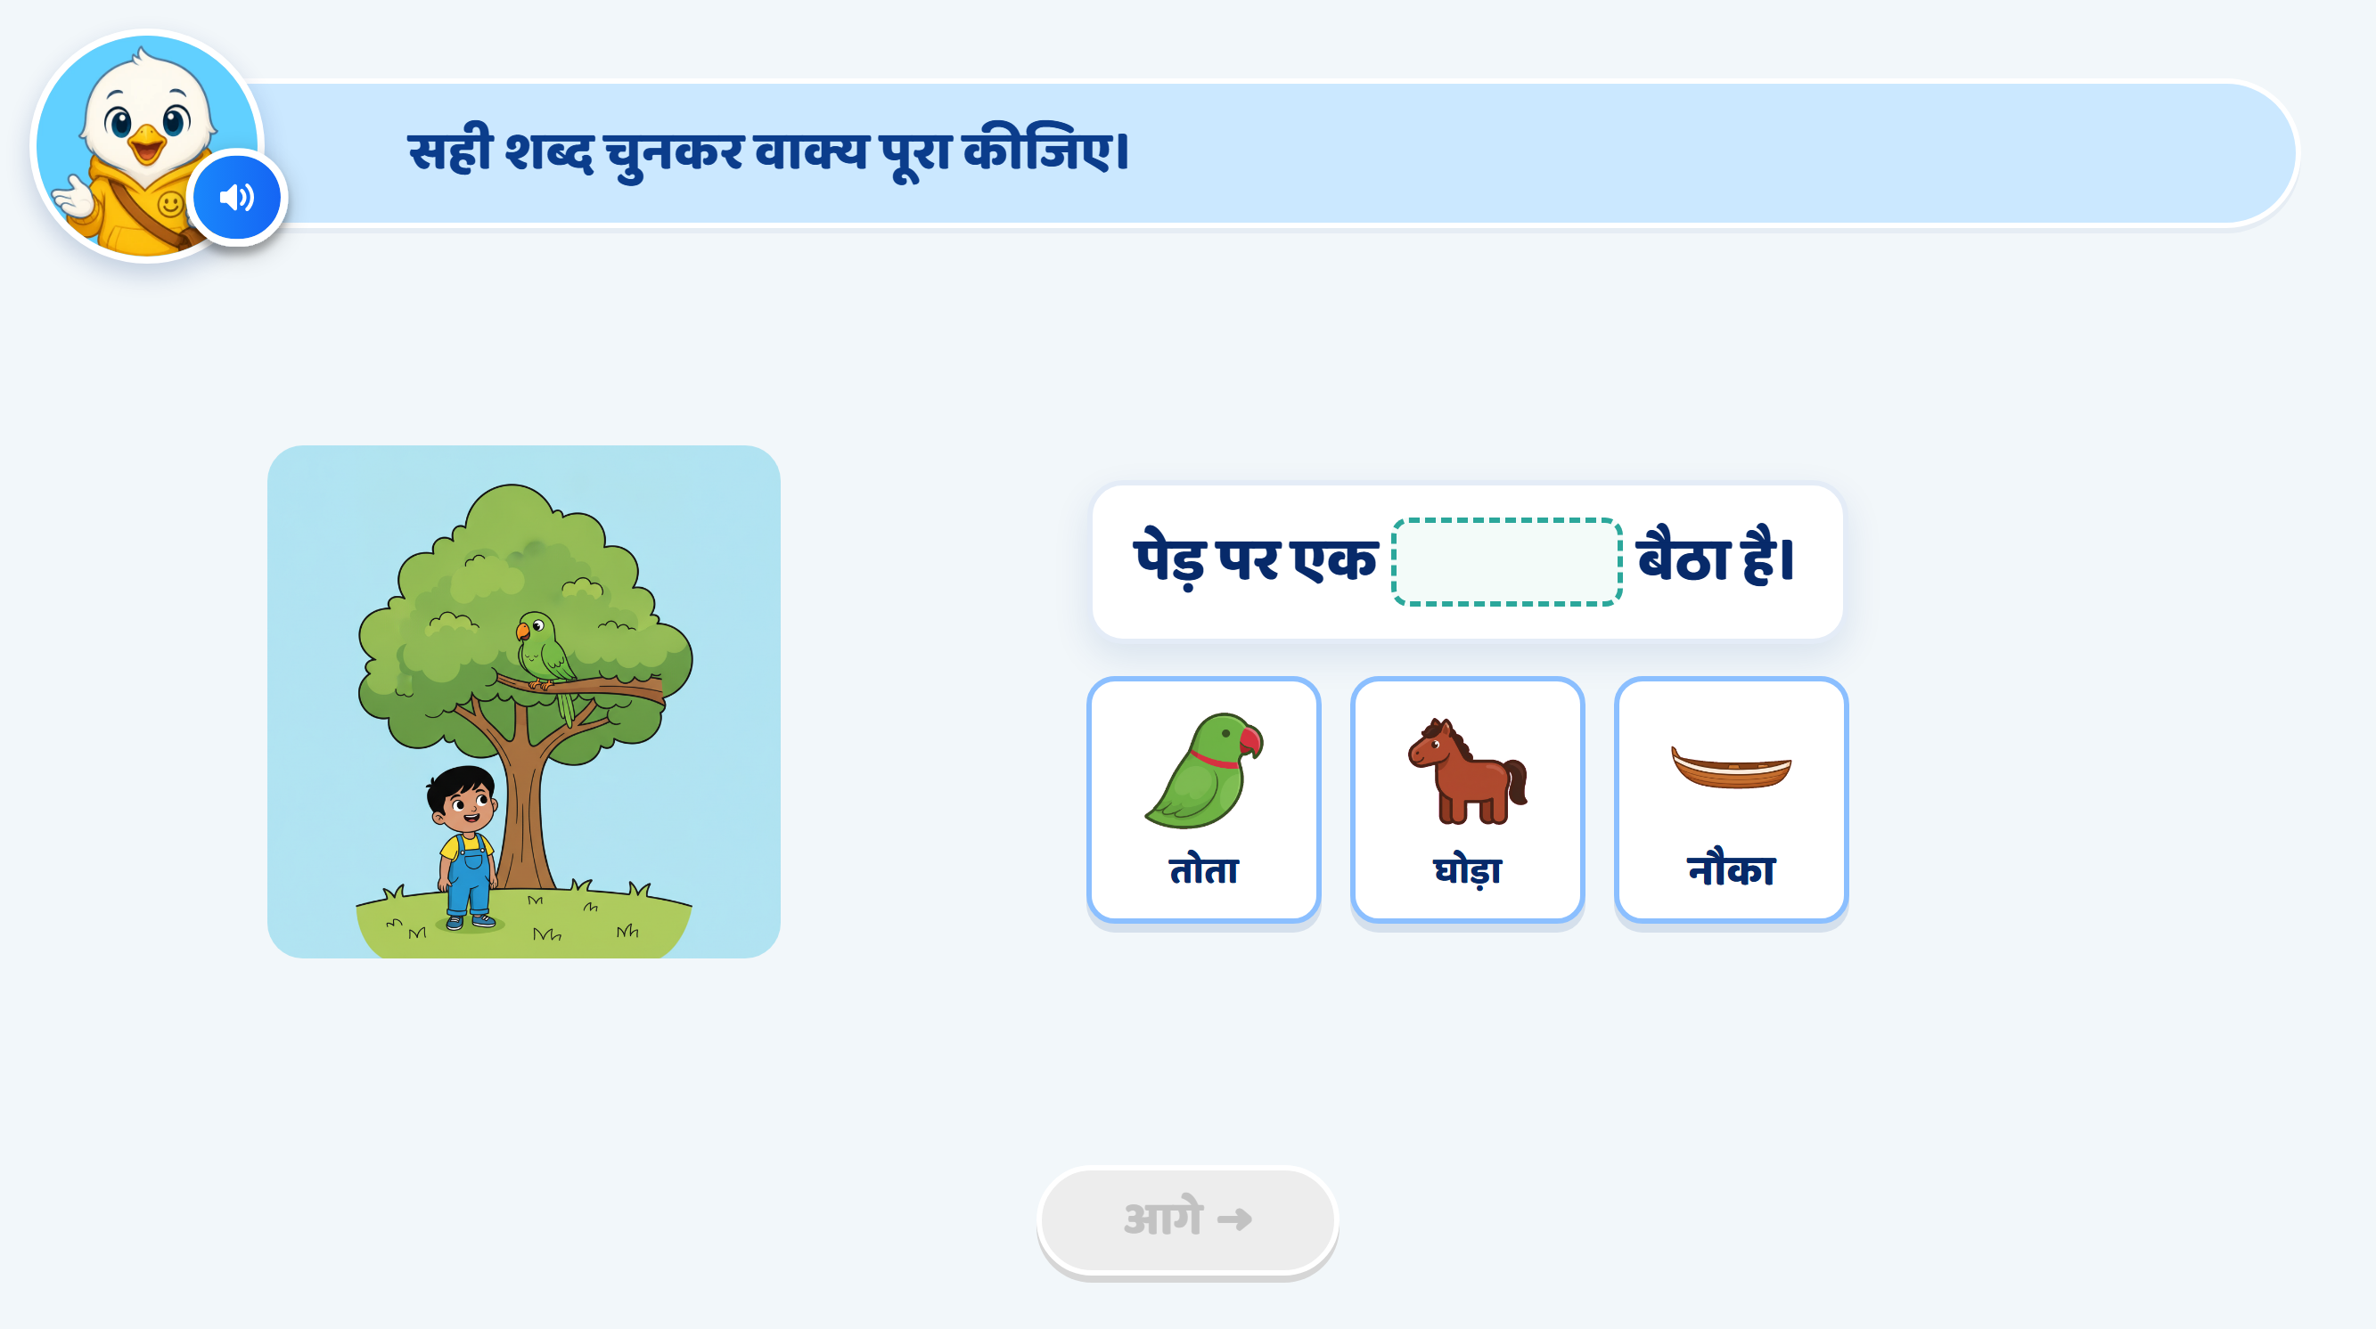
Page 14 · 14_SENTENCE_COMPLETE.png
Notes:
Recommendation
Activity Concept:
This is a picture-based sentence completion activity.
The child looks at the scene, listens to the sentence and drags the correct word card into the blank.
The focus is on connecting the picture with the sentence meaning.
Sentence and Option Changes:
Use the sentence: “पेड़ पर एक ___ बैठा है।”
Replace तोता with कौआ.
Replace नौका with मोर.
Keep घोड़ा as the other option.
Updated options: कौआ, घोड़ा, मोर.
Correct completed sentence: “पेड़ पर एक कौआ बैठा है।”
Heading / Question Text:
“सही शब्द चुनकर वाक्य पूरा कीजिए।”
On Screen:
Keep the main scene on the left and the sentence on the right.
Show “पेड़ पर एक ___ बैठा है।” with an empty blank.
Show three picture-and-word options below the sentence:
कौआ
घोड़ा
मोर
Update the main scene to show one crow sitting clearly on a tree branch.
Remove the existing parrot from the scene.
Remove the child and unnecessary background details so the bird remains the main focus.
Do not highlight the crow or the correct option initially.
Keep the existing mascot and overall UI/UX style unchanged.
Image Requirements:
Main scene: A tree with one recognisable crow perched on a visible branch. Make the crow large enough to identify, with its dark body, beak, wings and feet clearly visible.
कौआ option: A clear crow matching the appearance of the crow in the main scene.
घोड़ा option: A recognisable horse with its full body, legs, mane and tail visible.
मोर option: A recognisable peacock with a blue neck, head crest and colourful tail feathers.
Keep the crow and peacock visually distinct.
Use consistent, child-friendly artwork with minimal background detail.
Entry Animation:
The main picture appears first.
The sentence appears with an empty blank.
The three option cards fade in one by one.
Play the instruction and sentence VO before enabling interaction.
Instruction VO:
“चित्र देखकर सही शब्द चुनकर वाक्य पूरा कीजिए। शब्द को खाली जगह में डालिए।”
Sentence VO:
Read “पेड़ पर एक…”, pause at the blank, then say “बैठा है।”
Do not say the missing word.
Option VO:
When an option is tapped, play only its name:
“कौआ।” / “घोड़ा।” / “मोर।”
A tap plays the word’s name.
A drag into the blank submits the answer.
Disable dragging while any VO plays.
Correct Answer: कौआ
Snap the कौआ card into the blank.
Display the completed sentence:
“पेड़ पर एक कौआ बैठा है।”
Give the correct answer a soft glow.
Show a small sparkle/confetti effect.
Lock the completed sentence.
Correct Response VO:
“शाबाश! पेड़ पर एक कौआ बैठा है।”
Hint 1: Clarify — After the 1st Wrong Drop
If the child drops घोड़ा or मोर into the blank, softly shake the wrong card.
Return it to its original position.
Do not highlight the crow, any option or a matra.
Do not show a hand nudge.
After the VO finishes, allow another attempt.
VO:
“फिर से देखिए। चित्र देखकर सही शब्द चुनकर वाक्य पूरा कीजिए।”
Hint 2: Strong Hint — After the 2nd Wrong Drop
Softly shake the wrong card and return it.
Read the full sentence with each option, one at a time, from left to right.
Briefly preview each word in the blank while its sentence is spoken.
Use the same neutral preview style for all three words. Do not show success feedback.
Highlight the crow sitting on the branch in the main scene, using a soft outline or glow.
Keep its body and beak clearly visible so the child can compare it with the option pictures.
After all three readings, restore the empty blank.
Do not glow the correct option or show a hand nudge.
After the VO finishes, keep all three options available.
VO — Separate Clips with a Short Pause Between Them:
“पेड़ पर एक कौआ बैठा है।”
“पेड़ पर एक घोड़ा बैठा है।”
“पेड़ पर एक मोर बैठा है।”
Then:
“चित्र देखकर सही शब्द चुनकर वाक्य पूरा कीजिए।”
Hint 3: Show the Answer — After the 3rd Wrong Drop
Softly shake the wrong card and return it.
Give the कौआ option and the sentence blank a soft glow.
Lock घोड़ा and मोर.
After the VO finishes, allow only कौआ to be dragged into the blank.
Wait for the child to complete the action. Do not fill the blank automatically.
VO:
“चित्र में पेड़ पर एक कौआ बैठा है। कौआ को खाली जगह में डालिए।”
Practice-Round Hand Nudge:
Confirm with Ankita whether Hint 3 should include a hand drag nudge.
Pending confirmation, use glow and lock without a hand, following the earlier practice QA feedback.
If approved, show the hand moving from कौआ to the sentence blank.
Correct Response After Hint 3:
Snap कौआ into the blank.
Show the completed sentence.
Remove any hand nudge.
Show a small sparkle and play a success chime.
Lock the answer.
No additional VO is needed because Hint 3 has already explained it.
Enable आगे after the feedback finishes.
SFX:
Soft pop when the picture, sentence or options appear.
Light tap/pick-up sound.
Soft error sound on a wrong drop.
Light success chime on the correct answer.
Keep SFX below the VO volume.
Next Button:
Keep आगे disabled initially and throughout the hints.
Activate it only after कौआ is correctly placed and feedback finishes.
Developer Notes:
Update the main scene, option images, written words and associated VO to match कौआ, घोड़ा, मोर.
Use the spelling कौआ consistently.
Disable all answer taps and drags while any VO is playing.
Use one wrong-attempt counter for this sentence blank.
Switching between घोड़ा and मोर must not reset the counter.
A name-only tap or release outside the blank does not count as a wrong answer.
Trigger Hint 1 after the first wrong drop, Hint 2 after the second, and Hint 3 after the third.
If the child answers correctly earlier, accept the answer and stop the hint sequence.
Hint 2 previews are temporary comparisons, not accepted answers.
Highlight the relevant scene detail in Hint 2 because the task tests picture understanding and sentence meaning.

Slide 18
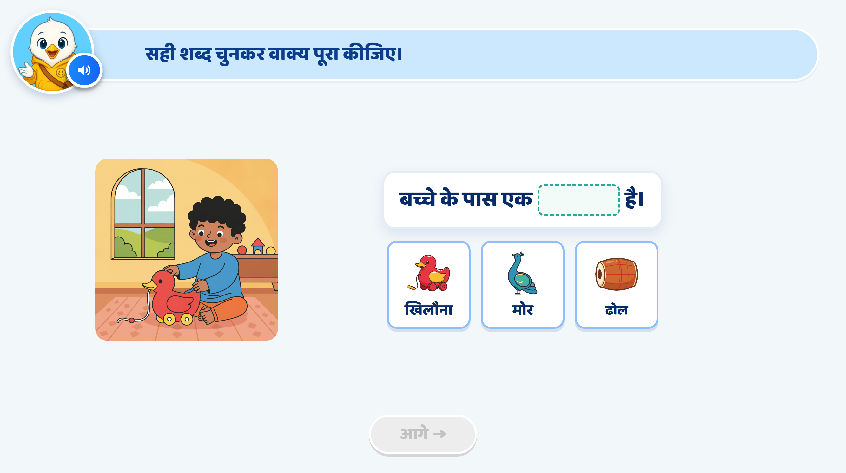
Page 15 · 15_SENTENCE_COMPLETE.png
Notes:
Recommendation
Activity Concept:
This is a picture-based sentence completion activity.
The child looks at the scene, listens to the sentence and drags the correct word card into the blank.
The focus is on using मात्रा वाले शब्द in a meaningful sentence.
Heading / Question Text:
“सही शब्द चुनकर वाक्य पूरा कीजिए।”
On Screen:
Keep the child-with-toy scene on the left and the sentence on the right.
Sentence: “बच्चे के पास एक ___ है।”
Show three picture-and-word options below the sentence:
खिलौना
मोर
ढोल
Make the toy in front of the child clearly visible.
Remove extra toys from the background so the scene focuses on one toy.
Do not highlight the toy or the correct option initially.
Keep the existing mascot and overall UI/UX style unchanged.
Image Requirements:
Main scene: A child sitting with a pull-along toy duck. Show its wheels and string clearly so it is recognisable as a toy.
खिलौना option: The same type of toy duck, with visible wheels and string, matching the main scene.
मोर option: A recognisable peacock with a blue neck, head crest and colourful tail feathers.
ढोल option: A recognisable drum with a cylindrical body, two drumheads and visible side lacing.
Use consistent, child-friendly artwork with minimal background detail.
Entry Animation:
The main picture appears first.
The sentence appears with an empty blank.
The three option cards fade in one by one.
Play the instruction and sentence VO before enabling interaction.
Instruction VO:
“चित्र देखकर सही शब्द चुनकर वाक्य पूरा कीजिए। शब्द को खाली जगह में डालिए।”
Sentence VO:
Read “बच्चे के पास एक…”, pause at the blank, then say “है।”
Do not say the missing word.
Option VO:
When an option is tapped, play only its name:
“खिलौना।” / “मोर।” / “ढोल।”
A tap plays the word’s name.
A drag into the blank submits the answer.
Disable dragging while any VO plays.
Correct Answer: खिलौना
Snap the खिलौना card into the blank.
Display the completed sentence:
“बच्चे के पास एक खिलौना है।”
Give the correct answer a soft glow.
Show a small sparkle/confetti effect.
Lock the completed sentence.
Correct Response VO:
“शाबाश! बच्चे के पास एक खिलौना है।”
Hint 1: Clarify — After the 1st Wrong Drop
If the child drops मोर or ढोल into the blank, softly shake the wrong card.
Return it to its original position.
Do not highlight the toy, any option or a matra.
Do not show a hand nudge.
After the VO finishes, allow another attempt.
VO:
“फिर से देखिए। चित्र देखकर सही शब्द चुनकर वाक्य पूरा कीजिए।”
Hint 2: Strong Hint — After the 2nd Wrong Drop
Softly shake the wrong card and return it.
Read the full sentence with each option, one at a time, from left to right.
Briefly preview each word in the blank while its sentence is spoken.
Use the same neutral preview style for all three words. Do not show success feedback.
Highlight the toy duck in front of the child, including its wheels and string, using a soft outline or glow.
After all three readings, restore the empty blank.
Do not glow the correct option or show a hand nudge.
After the VO finishes, keep all three options available.
VO — Separate Clips with a Short Pause Between Them:
“बच्चे के पास एक खिलौना है।”
“बच्चे के पास एक मोर है।”
“बच्चे के पास एक ढोल है।”
Then:
“चित्र देखकर सही शब्द चुनकर वाक्य पूरा कीजिए।”
Hint 3: Show the Answer — After the 3rd Wrong Drop
Softly shake the wrong card and return it.
Give the खिलौना option and the sentence blank a soft glow.
Lock मोर and ढोल.
After the VO finishes, allow only खिलौना to be dragged into the blank.
Wait for the child to complete the action. Do not fill the blank automatically.
VO:
“चित्र में बच्चे के पास एक खिलौना है। खिलौना को खाली जगह में डालिए।”
Practice-Round Hand Nudge:
Confirm with Ankita whether Hint 3 should include a hand drag nudge.
Pending confirmation, use glow and lock without a hand, following the earlier practice QA feedback.
If approved, show the hand moving from खिलौना to the sentence blank.
Correct Response After Hint 3:
Snap खिलौना into the blank.
Show the completed sentence.
Remove any hand nudge.
Show a small sparkle and play a success chime.
Lock the answer.
No additional VO is needed because Hint 3 has already explained it.
Enable आगे after the feedback finishes.
SFX:
Soft pop when the picture, sentence or options appear.
Light tap/pick-up sound.
Soft error sound on a wrong drop.
Light success chime on the correct answer.
Keep SFX below the VO volume.
Next Button:
Keep आगे disabled initially and throughout the hints.
Activate it only after खिलौना is correctly placed and feedback finishes.
Developer Notes:
Use the option text and associated word audio खिलौना, मोर, ढोल.
Size the blank and option card so खिलौना fits clearly without reducing readability.
Disable all answer taps and drags while any VO is playing.
Use one wrong-attempt counter for this sentence blank.
Switching between मोर and ढोल must not reset the counter.
A name-only tap or release outside the blank does not count as a wrong answer.
Trigger Hint 1 after the first wrong drop, Hint 2 after the second, and Hint 3 after the third.
If the child answers correctly earlier, accept the answer and stop the hint sequence.
Hint 2 previews are temporary comparisons, not accepted answers.
Highlight the relevant scene detail in Hint 2 because the task tests picture understanding and sentence meaning.

Slide 19
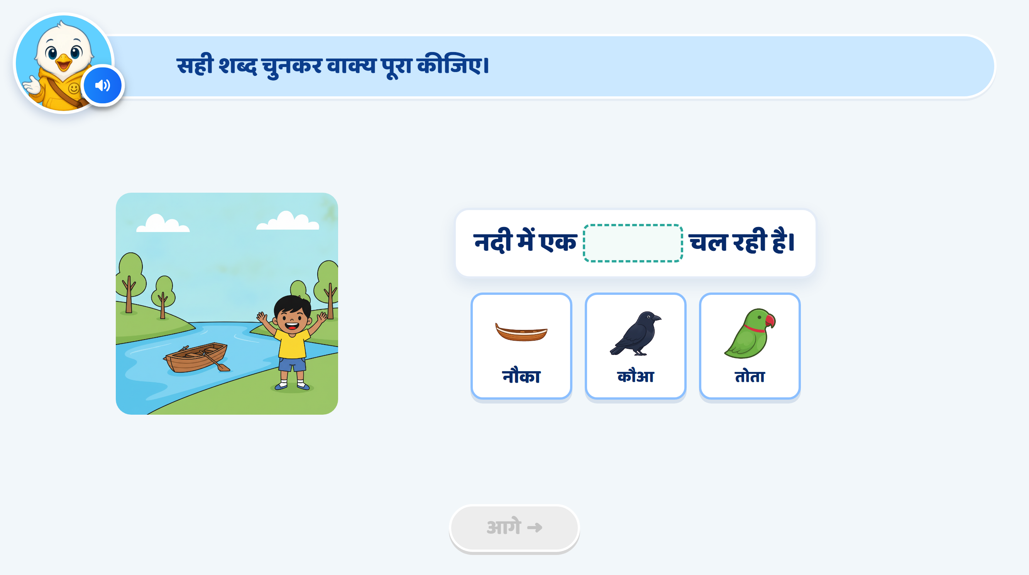
Page 16 · 16_SENTENCE_COMPLETE.png
Notes:
Recommendation
Activity Concept:
This is a picture-based sentence completion activity.
The child looks at the scene, listens to the sentence and drags the correct word card into the blank.
The focus is on using औ की मात्रा वाले शब्द in a meaningful sentence.
Sentence and Option Changes:
Replace the river-and-boat scene with a man holding a hammer.
Use the sentence: “आदमी के हाथ में एक ___ है।”
Show these options in order: ढोल, हथौड़ा, तोता.
Correct completed sentence: “आदमी के हाथ में एक हथौड़ा है।”
Heading / Question Text:
“सही शब्द चुनकर वाक्य पूरा कीजिए।”
On Screen:
Keep the main scene on the left and the sentence on the right.
Show “आदमी के हाथ में एक ___ है।” with an empty blank.
Show three picture-and-word options below the sentence:
ढोल
हथौड़ा
तोता
Make the hammer in the man’s hand clearly visible.
Do not highlight the hammer or the correct option initially.
Keep the existing mascot and overall UI/UX style unchanged.
Image Requirements:
Main scene: A man holding a hammer beside a simple workbench. Clearly show the wooden handle in his hand and the metal head above it. A wooden plank and a nail can appear on the workbench, but keep them secondary. Do not include other tools.
ढोल option: A recognisable drum with a cylindrical body, two drumheads and visible side lacing.
हथौड़ा option: A clear hammer matching the one in the man’s hand, with the same wooden handle and metal head.
तोता option: A recognisable green parrot with a curved red beak and a long tail.
Use consistent, child-friendly artwork with minimal background detail.
Keep the hammer large enough to identify in both the main scene and the option card.
Entry Animation:
The main picture appears first.
The sentence appears with an empty blank.
The three option cards fade in one by one.
Play the instruction and sentence VO before enabling interaction.
Instruction VO:
“चित्र देखकर सही शब्द चुनकर वाक्य पूरा कीजिए। शब्द को खाली जगह में डालिए।”
Sentence VO:
Read “आदमी के हाथ में एक…”, pause at the blank, then say “है।”
Do not say the missing word.
Option VO:
When an option is tapped, play only its name:
“ढोल।” / “हथौड़ा।” / “तोता।”
A tap plays the word’s name.
A drag into the blank submits the answer.
Disable dragging while any VO plays.
Correct Answer: हथौड़ा
Snap the हथौड़ा card into the blank.
Display the completed sentence:
“आदमी के हाथ में एक हथौड़ा है।”
Give the correct answer a soft glow.
Show a small sparkle/confetti effect.
Lock the completed sentence.
Correct Response VO:
“शाबाश! आदमी के हाथ में एक हथौड़ा है।”
Hint 1: Clarify — After the 1st Wrong Drop
If the child drops ढोल or तोता into the blank, softly shake the wrong card.
Return it to its original position.
Do not highlight the hammer, any option or a matra.
Do not show a hand nudge.
After the VO finishes, allow another attempt.
VO:
“फिर से देखिए। चित्र देखकर सही शब्द चुनकर वाक्य पूरा कीजिए।”
Hint 2: Strong Hint — After the 2nd Wrong Drop
Softly shake the wrong card and return it.
Read the full sentence with each option, one at a time, from left to right.
Briefly preview each word in the blank while its sentence is spoken.
Use the same neutral preview style for all three words. Do not show success feedback.
Highlight the hammer in the man’s hand, including its handle and metal head, using a soft outline or glow.
After all three readings, restore the empty blank.
Do not glow the correct option or show a hand nudge.
After the VO finishes, keep all three options available.
VO — Separate Clips with a Short Pause Between Them:
“आदमी के हाथ में एक ढोल है।”
“आदमी के हाथ में एक हथौड़ा है।”
“आदमी के हाथ में एक तोता है।”
Then:
“चित्र देखकर सही शब्द चुनकर वाक्य पूरा कीजिए।”
Hint 3: Show the Answer — After the 3rd Wrong Drop
Softly shake the wrong card and return it.
Give the हथौड़ा option and the sentence blank a soft glow.
Lock ढोल and तोता.
After the VO finishes, allow only हथौड़ा to be dragged into the blank.
Wait for the child to complete the action. Do not fill the blank automatically.
VO:
“चित्र में आदमी के हाथ में एक हथौड़ा है। ‘हथौड़ा’ शब्द को खाली जगह में डालिए।”
Practice-Round Hand Nudge:
Confirm with Ankita whether Hint 3 should include a hand drag nudge.
Pending confirmation, use glow and lock without a hand, following the earlier practice QA feedback.
If approved, show the hand moving from हथौड़ा to the sentence blank.
Correct Response After Hint 3:
Snap हथौड़ा into the blank.
Show the completed sentence.
Remove any hand nudge.
Show a small sparkle and play a success chime.
Lock the answer.
No additional VO is needed because Hint 3 has already explained it.
Enable आगे after the feedback finishes.
SFX:
Soft pop when the picture, sentence or options appear.
Light tap/pick-up sound.
Soft error sound on a wrong drop.
Light success chime on the correct answer.
Keep SFX below the VO volume.
Next Button:
Keep आगे disabled initially and throughout the hints.
Activate it only after हथौड़ा is correctly placed and feedback finishes.
Developer Notes:
Replace the old scene, sentence, option images and associated audio with the updated content.
Use the option text ढोल, हथौड़ा, तोता consistently.
Size the blank and option card so हथौड़ा fits clearly without reducing readability.
Preserve the nukta under ड़ in हथौड़ा.
Disable all answer taps and drags while any VO is playing.
Use one wrong-attempt counter for this sentence blank.
Switching between ढोल and तोता must not reset the counter.
A name-only tap or release outside the blank does not count as a wrong answer.
Trigger Hint 1 after the first wrong drop, Hint 2 after the second, and Hint 3 after the third.
If the child answers correctly earlier, accept the answer and stop the hint sequence.
Hint 2 previews are temporary comparisons, not accepted answers.
Highlight the relevant scene detail in Hint 2 because the task tests picture understanding and sentence meaning.

Slide 20
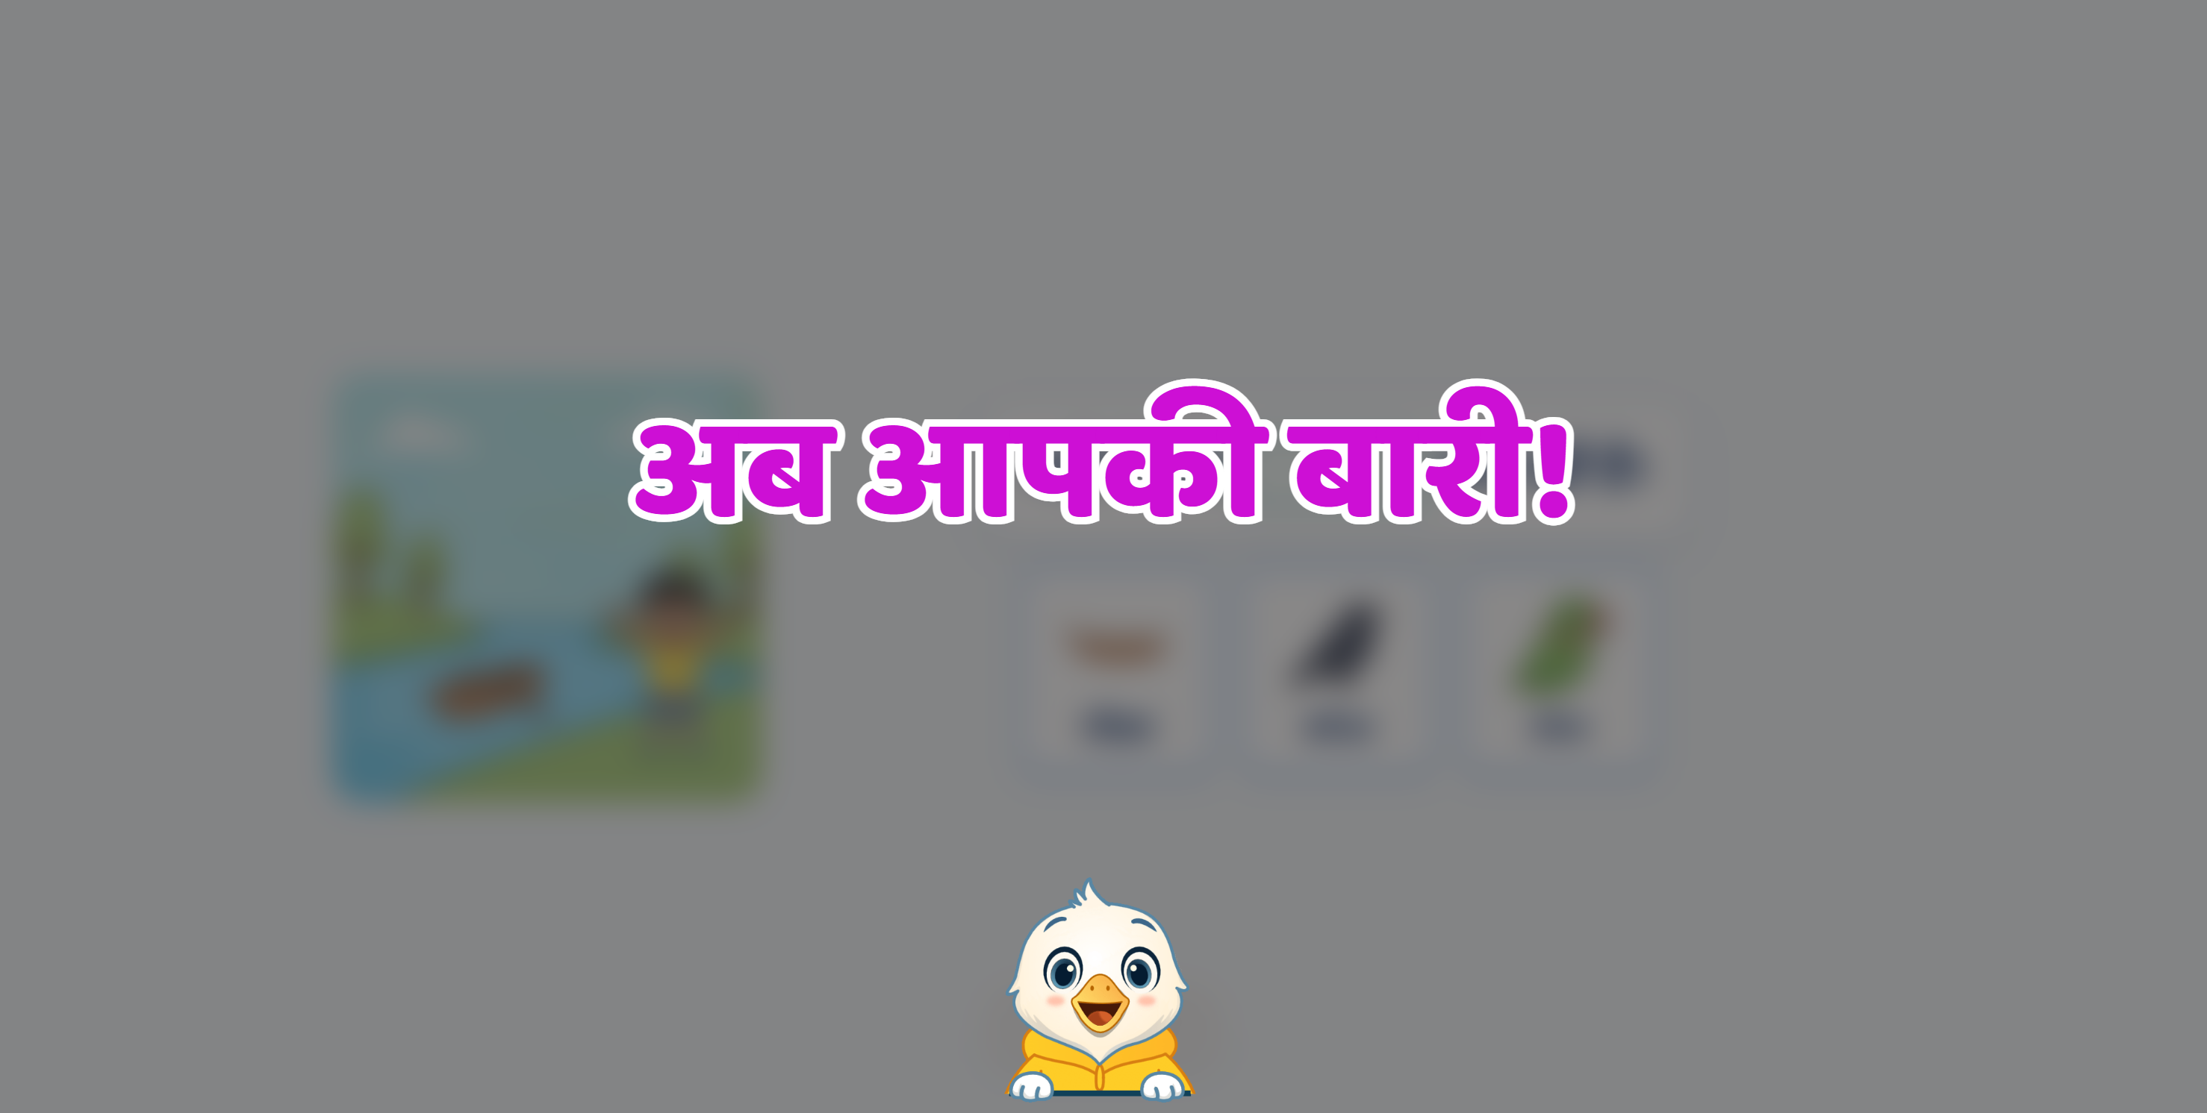

Slide 21
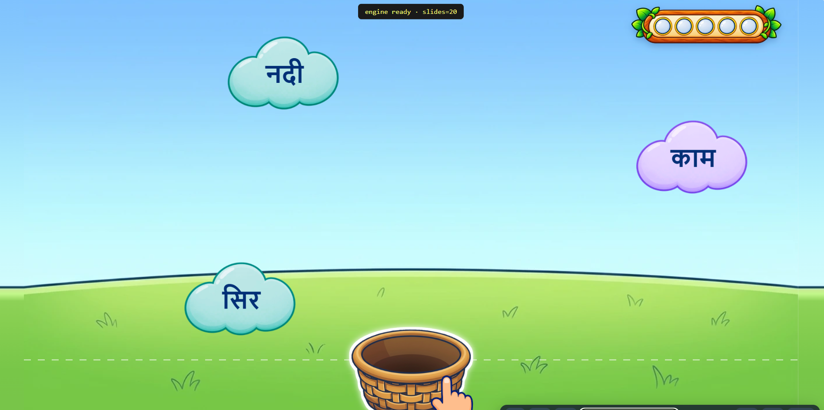
Notes:
ओ की मात्रा (◌ो) वाले 12 शब्द:
मोर, तोता, घोड़ा, ढोल, गोल, कोयल, टोपी, रोटी, गोभी, धोबी, कटोरा, खोना।
औ की मात्रा (◌ौ) वाले 12 शब्द:
कौआ, पौधा, दौड़, चौक, चौकी, चौड़ा, हथौड़ा, खिलौना, कचौड़ी, पकौड़ा, तौलिया, मौसम।
Full game logic same as in आ, इ, ई मात्रा वाले शब्द पढ़ता है। शब्दों में आने वाली मात्रा पहचानता है ।

Slide 22
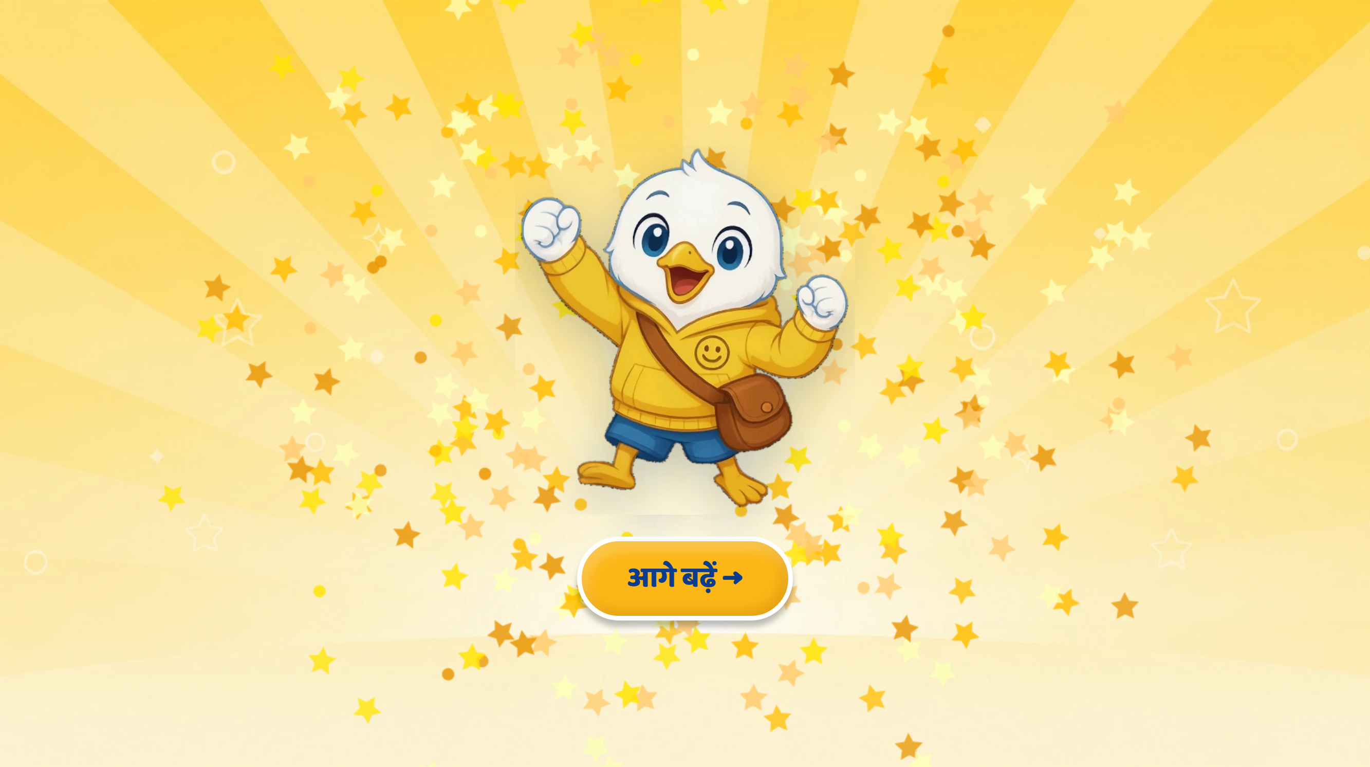
Page 17 · 17_CELEBRATION.png
Notes:
[DRAFT — generated from the card, in the format ratified in the S03 review (2026-09-30). Not yet reviewed by the SME.]
CELEBRATION — no text on the page. VO:
“शाबाश! आज हमने सीखा, ओ और औ की मात्रा पहचानना, और मात्रा वाले शब्द पढ़ना।”

