Slide 1
MTG2A04_L01_S01 · परी की पिकनिक की खरीदारी · round 2 build
Page-by-page review · 25 pages

Slide 2
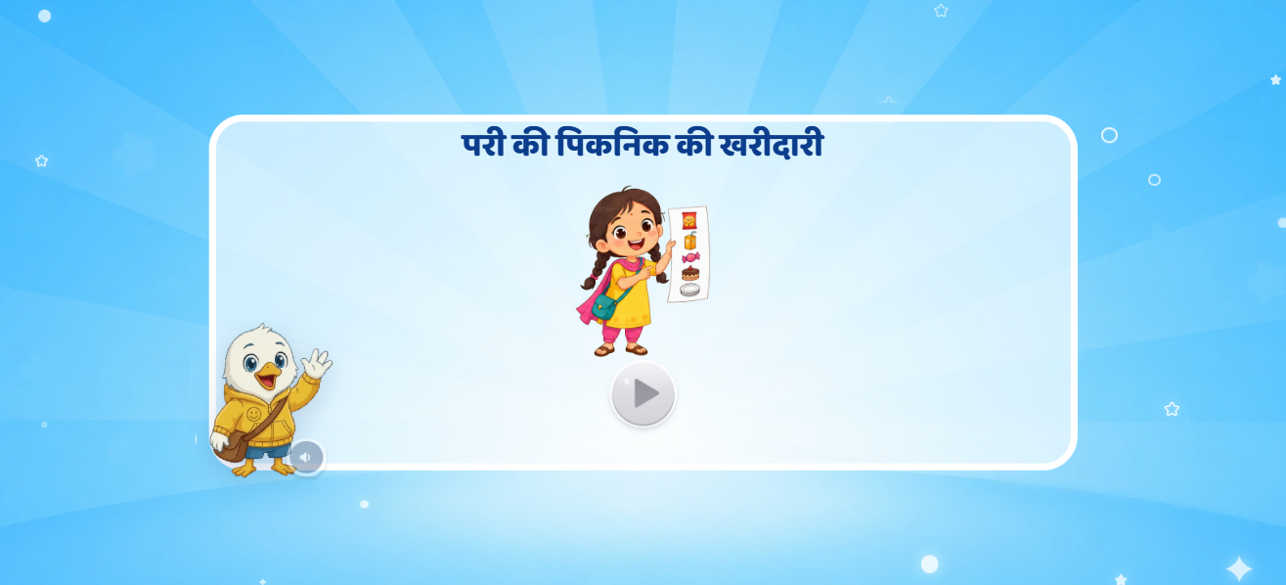
Page 1 · 01_landing.png
Recommendations
• Landing (deck p1) — title «परी की पिकनिक की खरीदारी», Pari with her list, Swiftie bottom-left with the audio chip, start button centre. VO: «नमस्ते दोस्त! मैं हूँ स्विफ्टी। …चलिए, उसकी मदद करते हैं!» No extra animation.

Slide 3
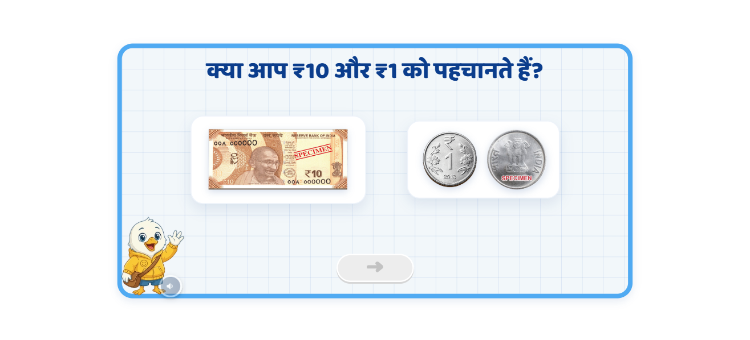
Page 2 · 02_T1_MONEY_SHOW.png
Recommendations
• Recall intro (p2) — «क्या आप ₹10 और ₹1 को पहचानते हैं?». ₹10 note + ₹1 coin (front AND back) pop in. Swiftie bottom-left, arrow centre. Currency = the team's own set (note: 000000 + SPECIMEN).

Slide 4
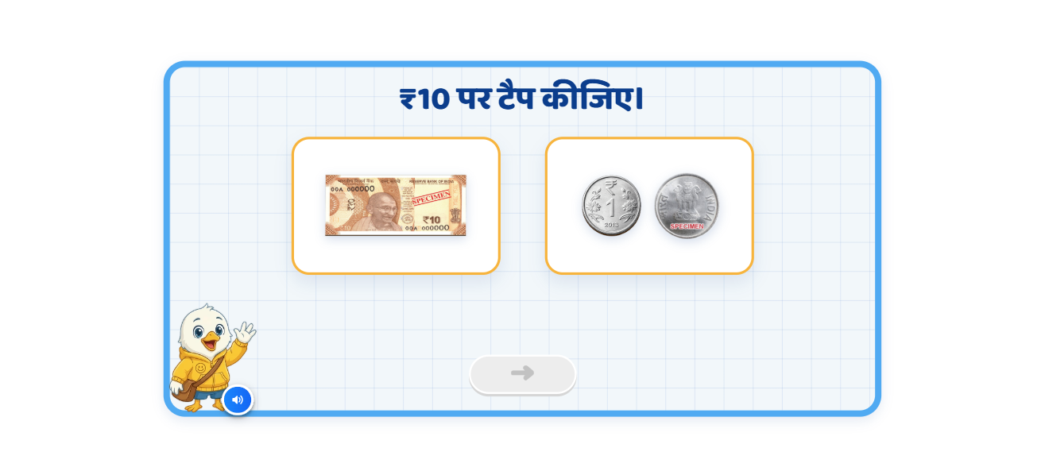
Page 3 · 03_T2_MONEY_PICK.png
Recommendations
• Identify ₹10 (p3) — two cards; entry VO «इनमें से दस रुपये का नोट पहचानिए।»; after 5 s with no tap the ₹10 card pulses.

Slide 5
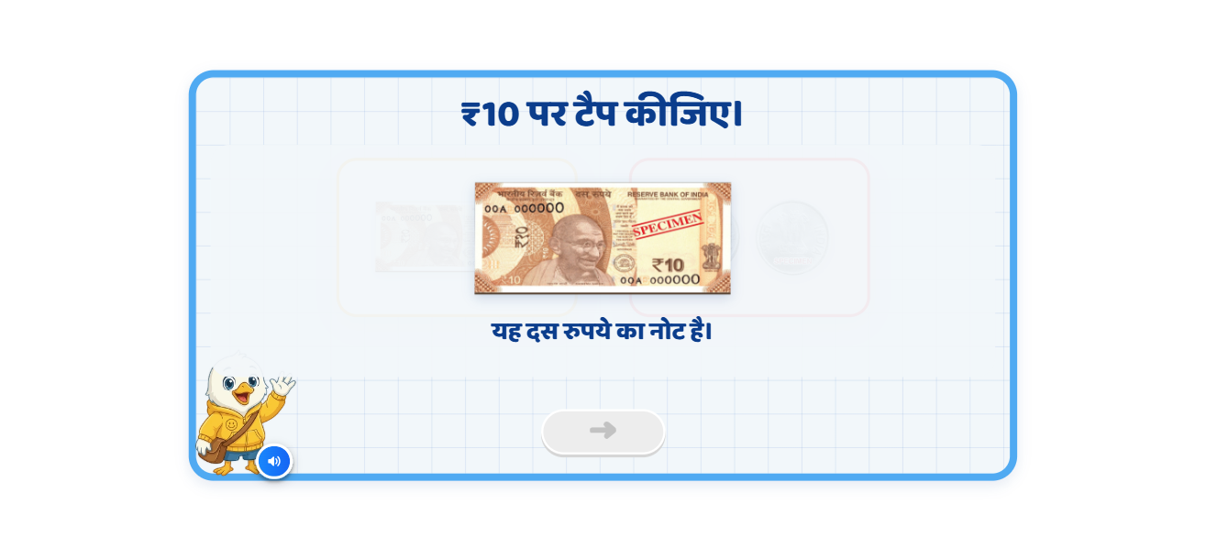
Page 4 · 04_T2_wrong.png
Recommendations
• Identify ₹10 — WRONG (p3): the ₹1 card vibrates + turns red, the ₹10 note appears big in the centre with «यह दस रुपये का नोट है।» (text + VO). The wrong card stays locked; the child then taps the note.

Slide 6
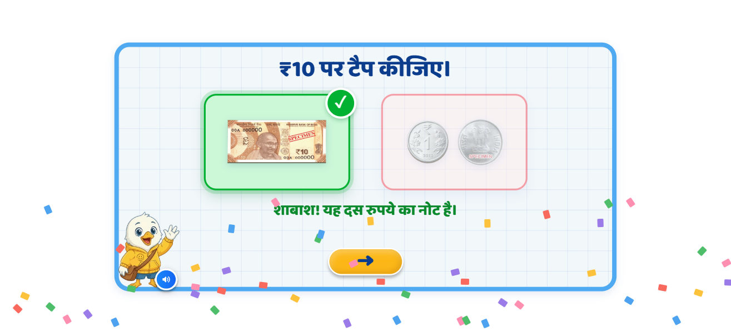
Page 5 · 05_T2_right.png
Recommendations
• Identify ₹10 — RIGHT (p4): note card turns green with a ✓, glow, chime + confetti; «शाबाश! यह दस रुपये का नोट है।» (text + VO). Arrow activates.

Slide 7
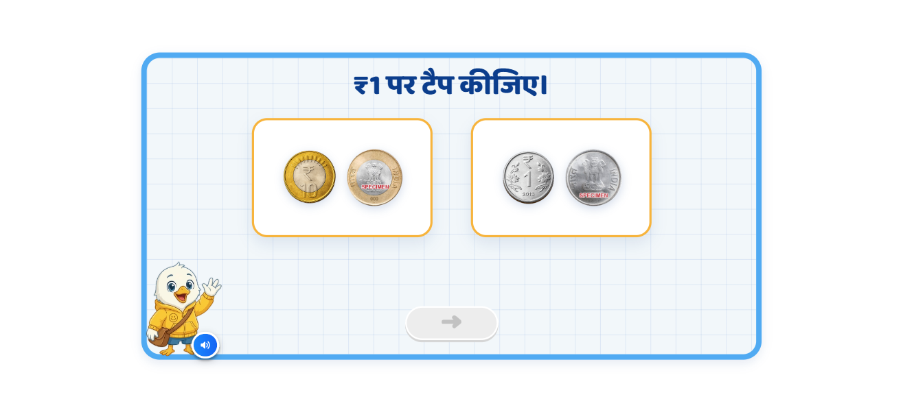
Page 6 · 06_T3_MONEY_PICK.png
Recommendations
• Identify ₹1 (p5/p6) — ₹10 COIN vs ₹1 coin (as in the mockup, decision D8). Wrong → «यह एक रुपये का सिक्का है। एक रुपये का सिक्का ऐसा दिखता है।»; right → «शाबाश! यह एक रुपये का सिक्का है।»

Slide 8
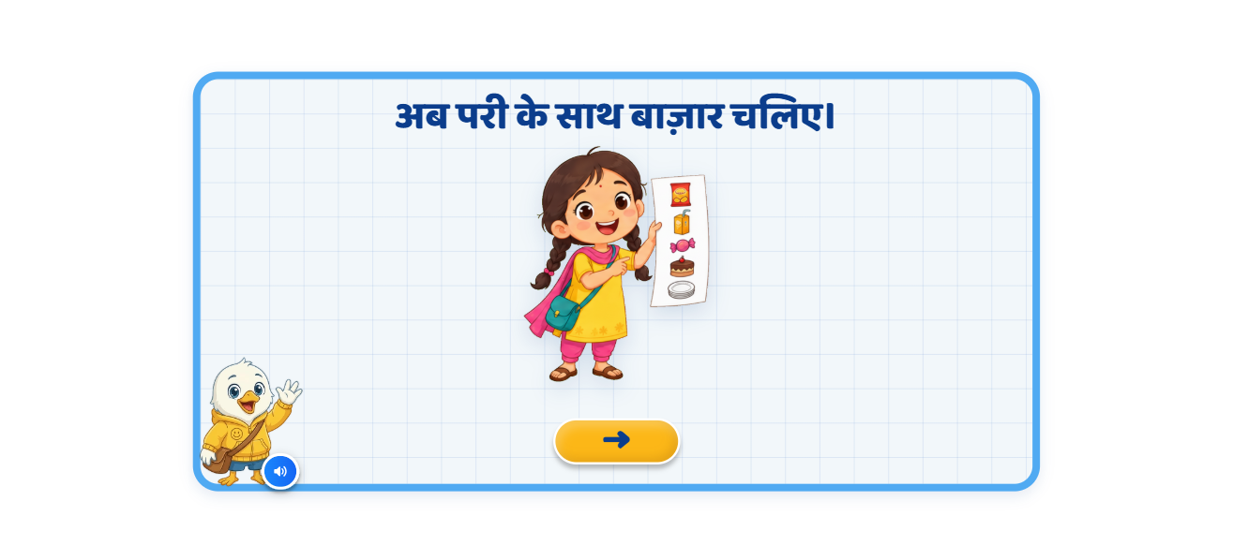
Page 7 · 07_T4_MONEY_SCENE.png
Recommendations
• Market (p7) — «अब परी के साथ बाज़ार चलिए।», Pari centre holding the list (list not readable here). Swiftie transition (‘चलिए, साथ में करें!’) follows this screen.

Slide 9
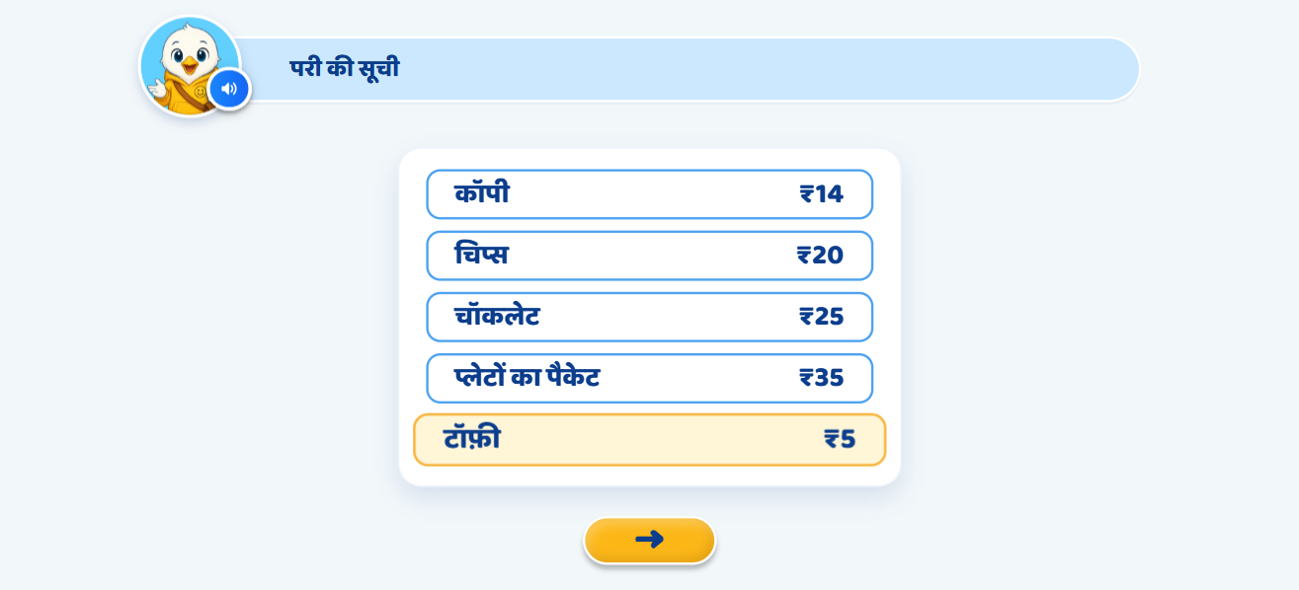
Page 8 · 08_G1_MONEY_LIST.png
Recommendations
• Pari's list (p8) — zooms in from the previous screen; each row pulses as the VO names it (cues measured off the clip). Arrow → guided teaching.

Slide 10
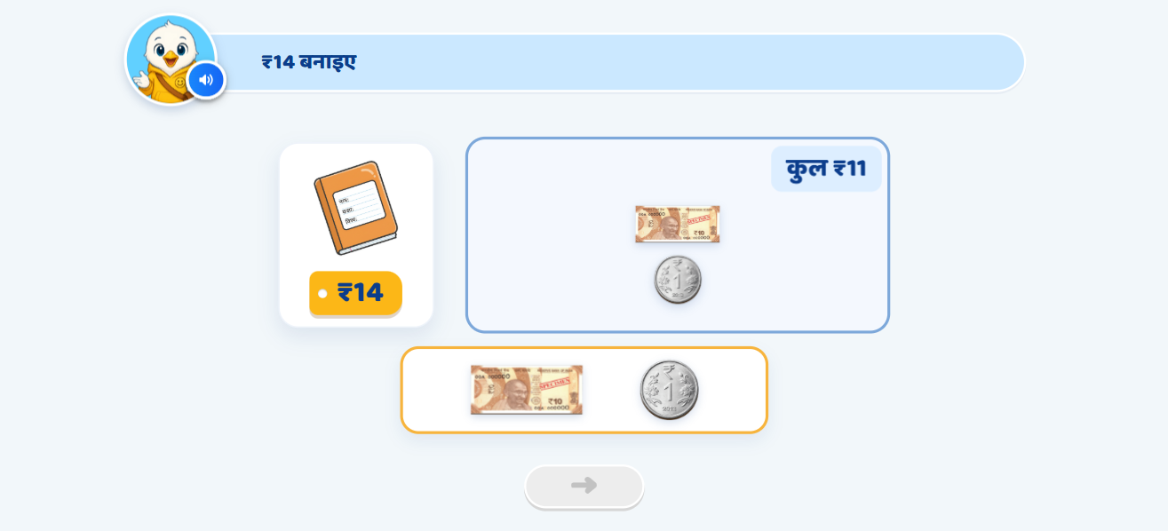
Page 9 · 09_G2_MONEY_BUILD.png
Recommendations
• Copy ₹14 teach (p9) — Swiftie demonstrates: ₹10 note moves in by itself (कुल ₹10), counter pulses, one ₹1 moves in (₹11); then the child drags three ₹1 coins, one per VO step. No action → coin pulses + «सिक्के को ऊपर ट्रे में रखो।»

Slide 11
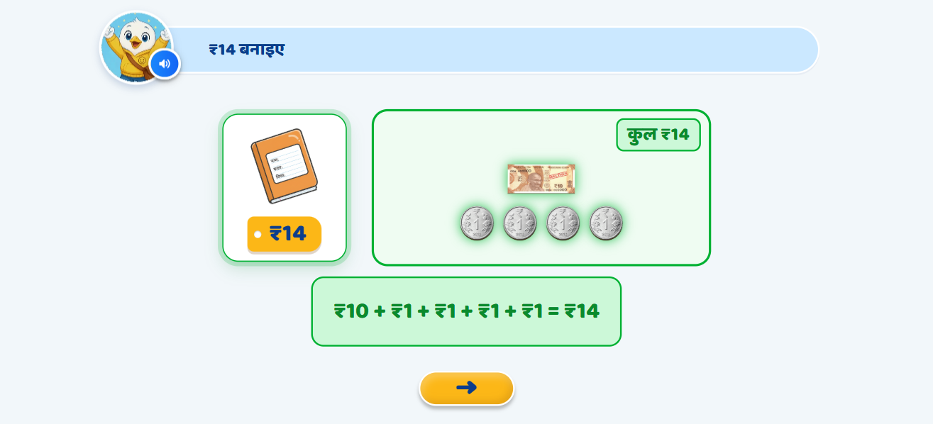
Page 10 · 10_G2_done.png
Recommendations
• Copy ₹14 done — OST in green, centre: ₹10 + ₹1 + ₹1 + ₹1 + ₹1 = ₹14; total green, tray glows, confetti, copy highlighted, arrow.

Slide 12
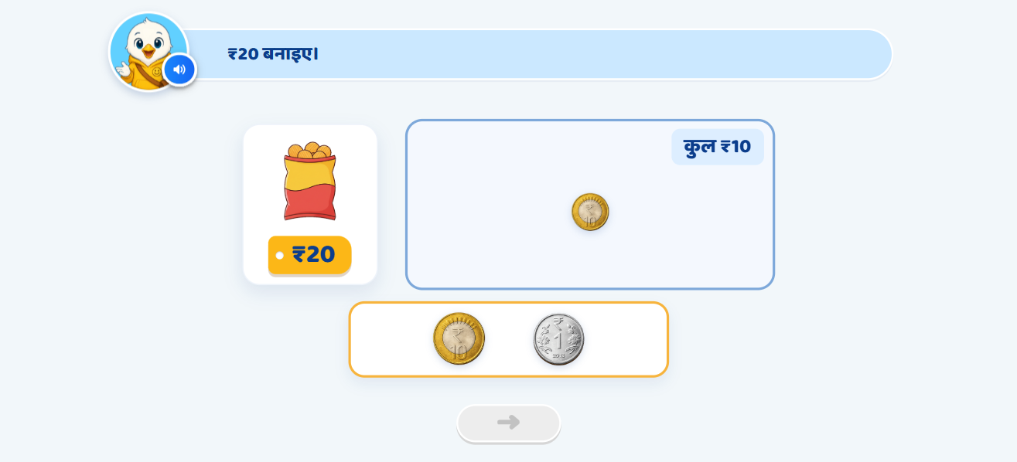
Page 11 · 11_G3_MONEY_BUILD.png
Recommendations
• Chips ₹20 teach (p11) — heading appears with the 2nd VO line; ₹10 coin demonstrated, child places the second. Dragging a ₹1 → it returns + «₹20 बनाने के लिए ₹10 के सिक्के लगेंगे।»; idle VO4/VO5.

Slide 13
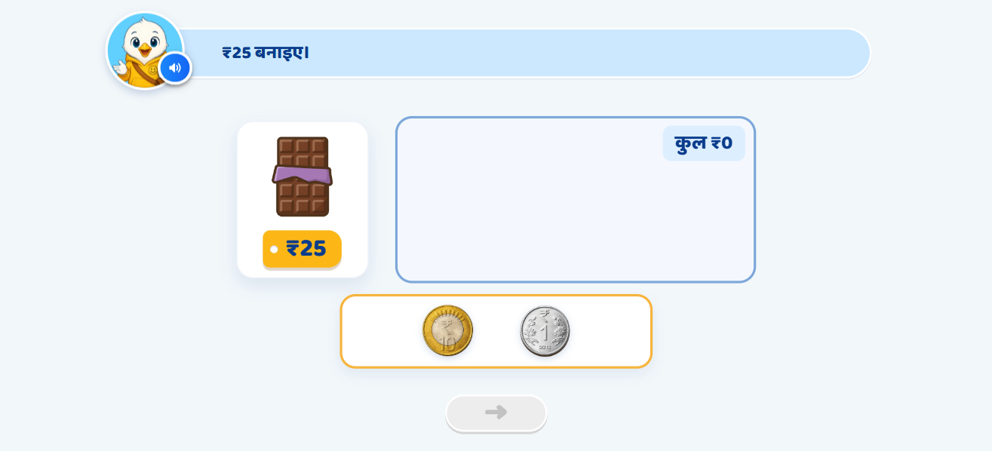
Page 12 · 12_G4_MONEY_BUILD.png
Recommendations
• Chocolate ₹25 guided practice (p12) — ₹10 coins + ₹1 coins; price tag pulses with the VO; any order allowed.

Slide 14
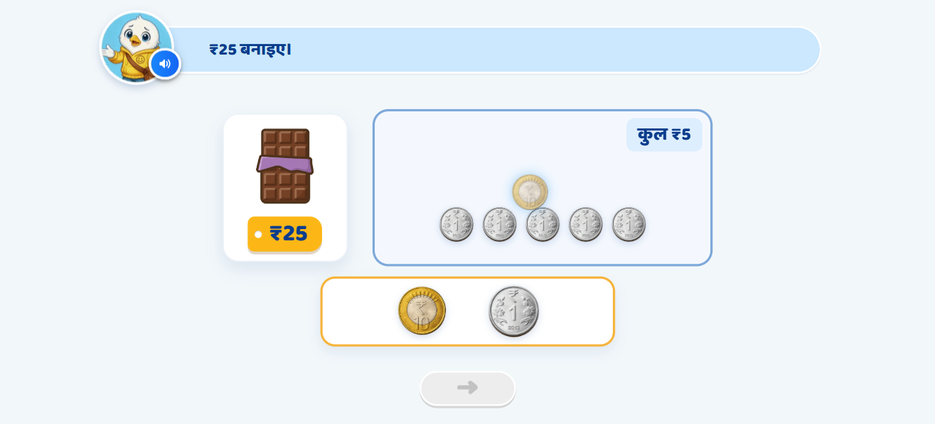
Page 13 · 13_G4_tol_a2.png
Recommendations
• ₹1 tolerance (p14/15), attempt 2 — after 5 ₹1 coins a 6th bounces; 2nd time: «कुल ₹5 हैं। ₹25 के लिए ₹20 और बनाओ।» + a ghost ₹10 coin travels to the tray.

Slide 15
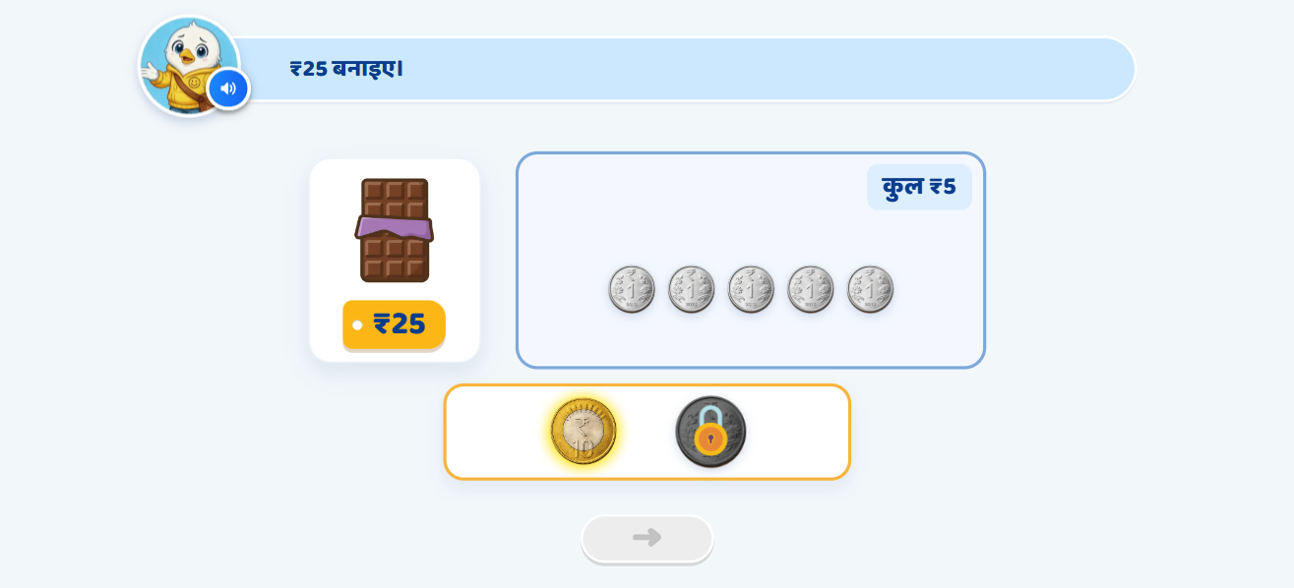
Page 14 · 14_G4_tol_a3.png
Recommendations
• Tolerance, attempt 3 — «₹20 बनाने के लिए ₹10 का सिक्का इस्तेमाल कीजिए।», ₹10 coin glows (team Glow art), ₹1 coin locks (team Lock art). Same ladder for a ₹10 dropped when <₹10 remains.

Slide 16
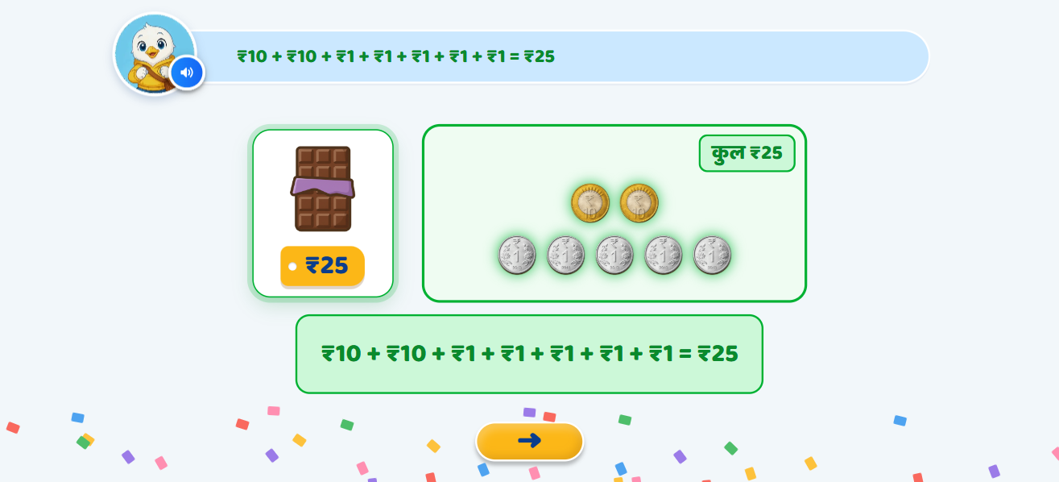
Page 15 · 15_G4_done.png
Recommendations
• Chocolate done — total green, instruction OST replaced by the equation, green equation centre, confetti, arrow.

Slide 17
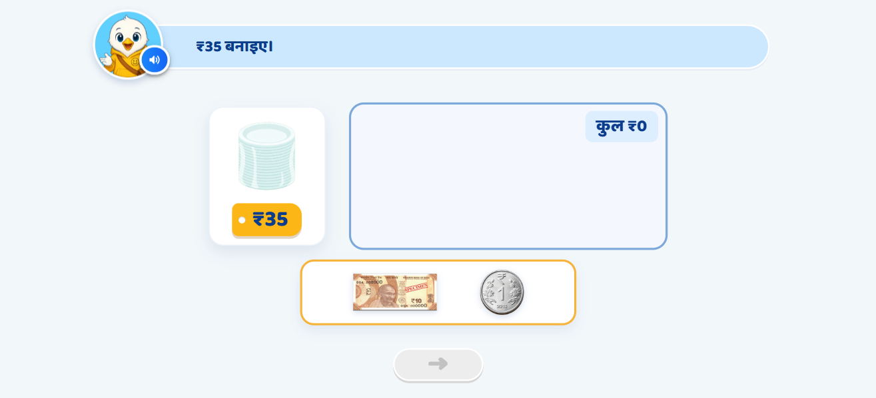
Page 16 · 16_P1_MONEY_BUILD.png
Recommendations
• Plates ₹35 practice (p13) — ₹10 notes + ₹1 coins; same bounce ladder + tolerance; VO now says «अब परी प्लेटों का पैकेट खरीद सकती है।» (deck said पेंसिल बॉक्स — D8).

Slide 18
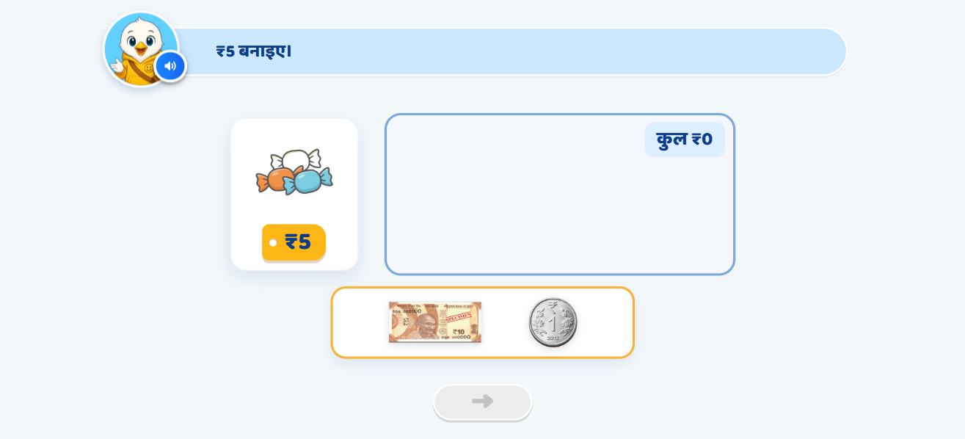
Page 17 · 17_P2_MONEY_BUILD.png
Recommendations
• Toffee ₹5 (ADDED, decision D5) — the list names toffee but the deck had no screen; plates pattern, ₹1 coins only needed.

Slide 19
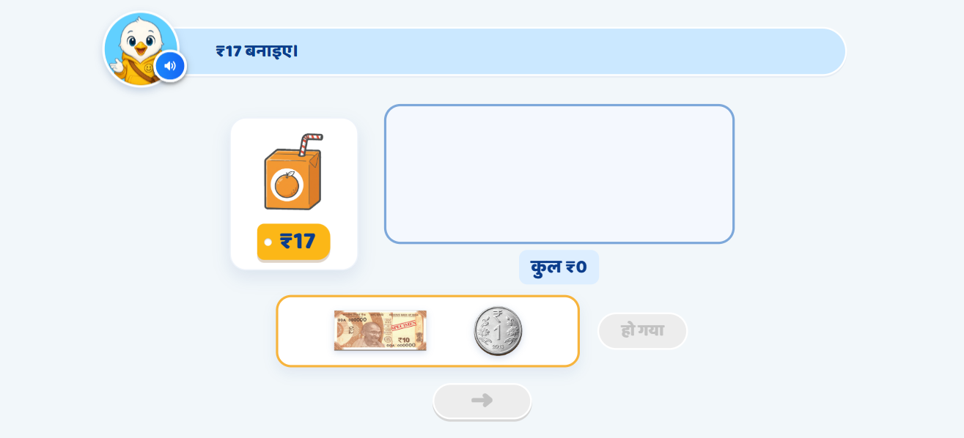
Page 18 · 18_P3_MONEY_BUILD.png
Recommendations
• Juice ₹17 (p16) — कुल shown under the tray, «हो गया» check (decision D2). Too little + हो गया → «अभी कुल ₹X हुए हैं। ₹17 के लिए ₹Y और चाहिए। और सिक्के या नोट रखिए।»

Slide 20
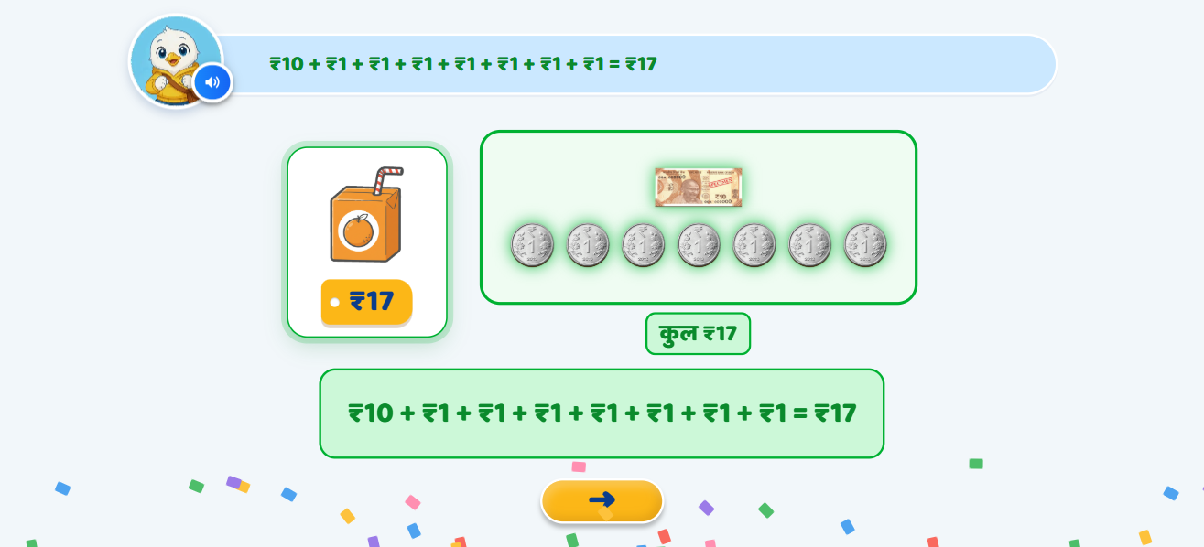
Page 19 · 19_P3_done.png
Recommendations
• Juice done — reaching ₹17 turns the total green and locks the tray; «हो गया» completes it.

Slide 21
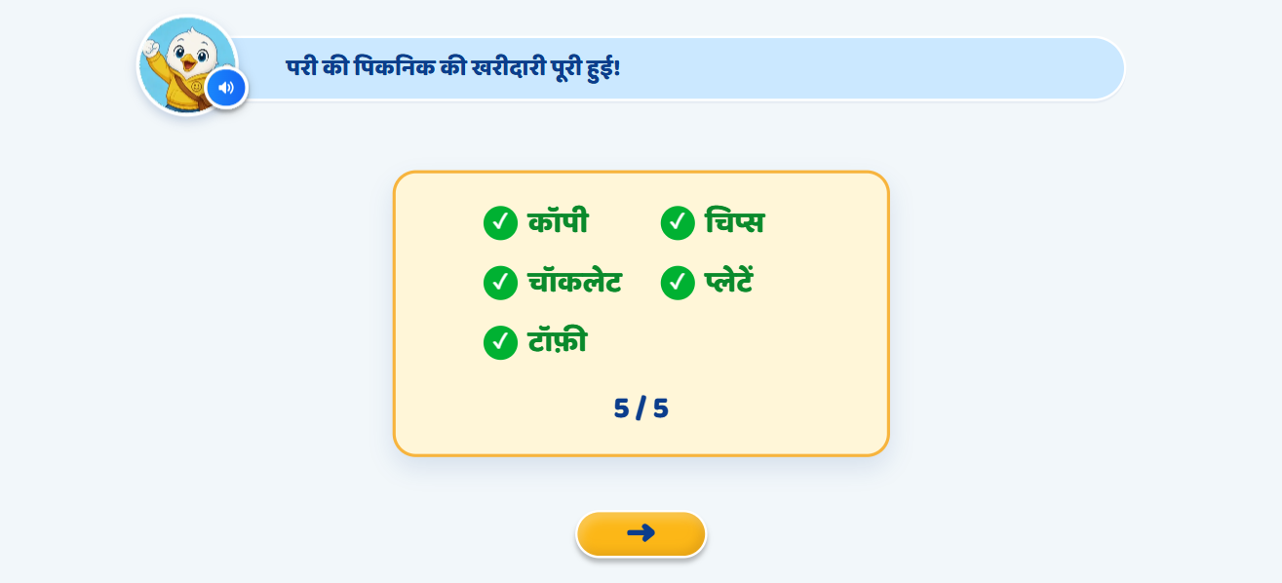
Page 20 · 20_P4_MONEY_DONE.png
Recommendations
• Completion (p18) — «परी की पिकनिक की खरीदारी पूरी हुई!», items tick one by one, 5 / 5, light confetti. Then the shop-game transition («खरीदारी का खेल!»).

Slide 22
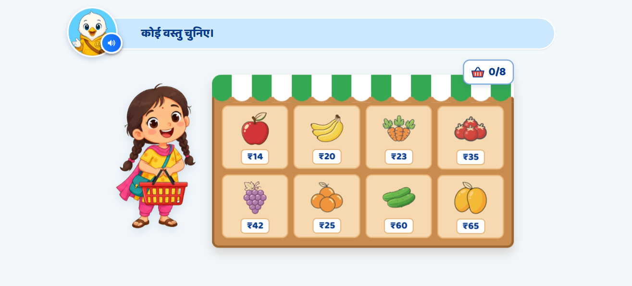
Page 21 · 21_M1_choose.png
Recommendations
• Mastery shop (p17/18) — Pari with an empty basket, 8 priced items idling, basket 0/8. «कोई वस्तु चुनिए।»; 5–6 s idle → an item glows + VO.

Slide 23
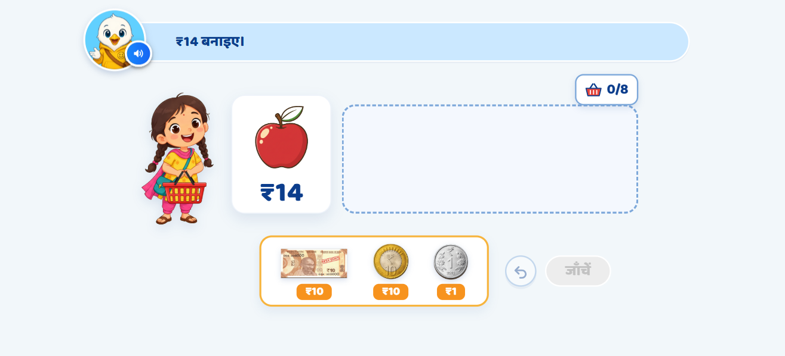
Page 22 · 22_M1_make.png
Recommendations
• Make ₹14 — the item comes to the centre with its price large; ₹10 note / ₹10 coin / ₹1 coin (tap OR drag), Undo, जाँचें (inactive until one piece is placed). No running total.

Slide 24
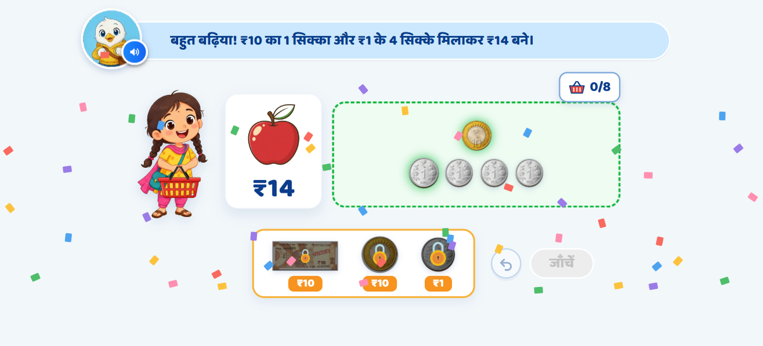
Page 23 · 23_M1_win.png
Recommendations
• Correct (p21) — pieces glow green in sequence; the FIRST purchase gets the decomposition line built from the currency actually used. Less/more → shake, all money returns, «ओह! रुपये कम/ज़्यादा हैं। फिर से बनाइए।»; after the 3rd wrong the caps switch on silently.

Slide 25
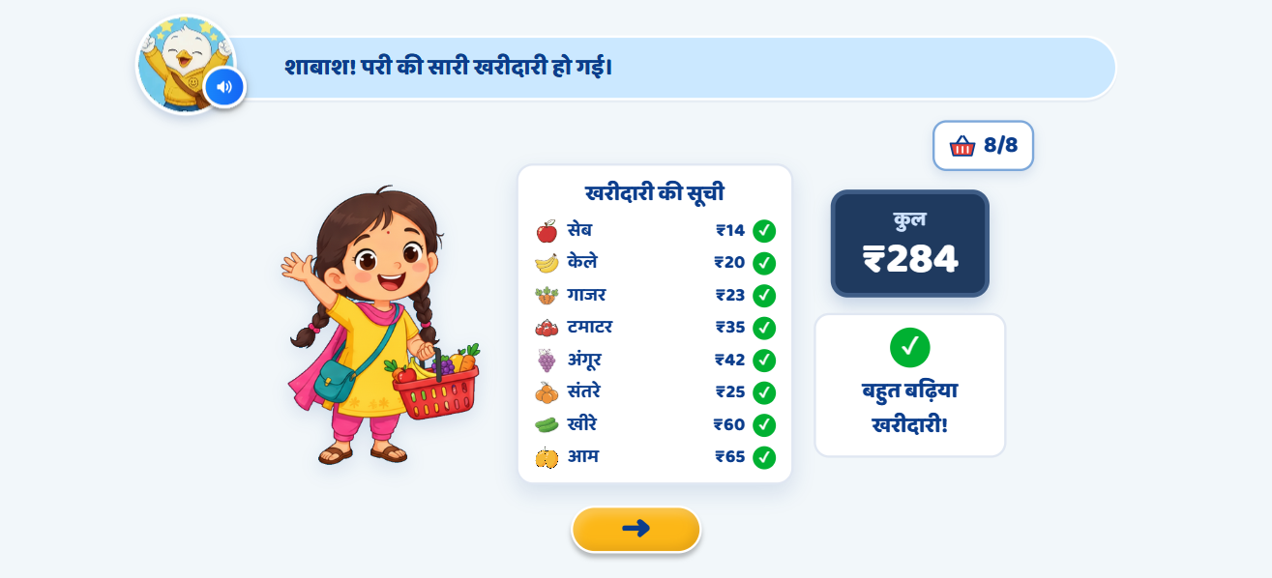
Page 24 · 24_M1_complete.png
Recommendations
• Shopping complete (p17 panel 6) — Pari with a full basket, ticked list, कुल ₹284, «बहुत बढ़िया खरीदारी!».

Slide 26

Page 25 · 25_CEL_CELEBRATION.png
Recommendations
• Celebration — the engine's standard end screen (no text by ruling), VO «शाबाश! आज आपने ₹10 और ₹1 से राशि बनाना सीखा।»

