Slide 1
MTG2A01_L04_S01 — संख्याओं का घटाव · build v2 (review 2 applied)
Page-by-page review · 13 pages

Slide 2
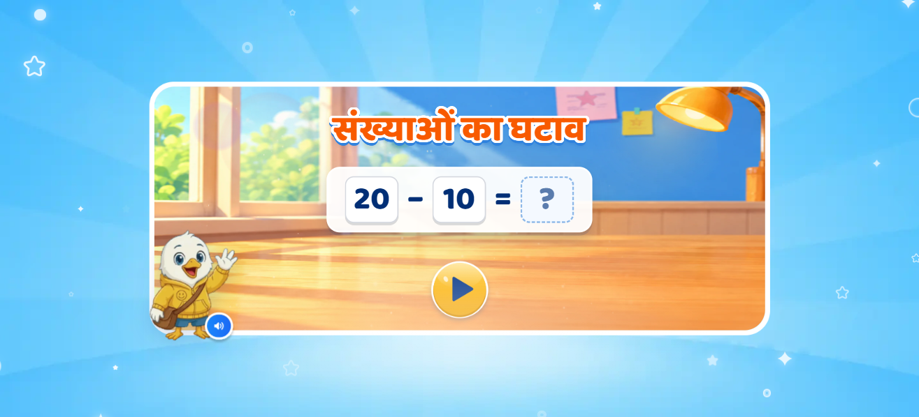
Page 1 · 01_landing.png
Recommendations
• Landing (deck p1): title 'संख्याओं का घटाव', equation 20 − 10 = ?, greeting VO. Shell (room card, play button, Swiftie) is MTG2A01_L03_S01's.

Slide 3
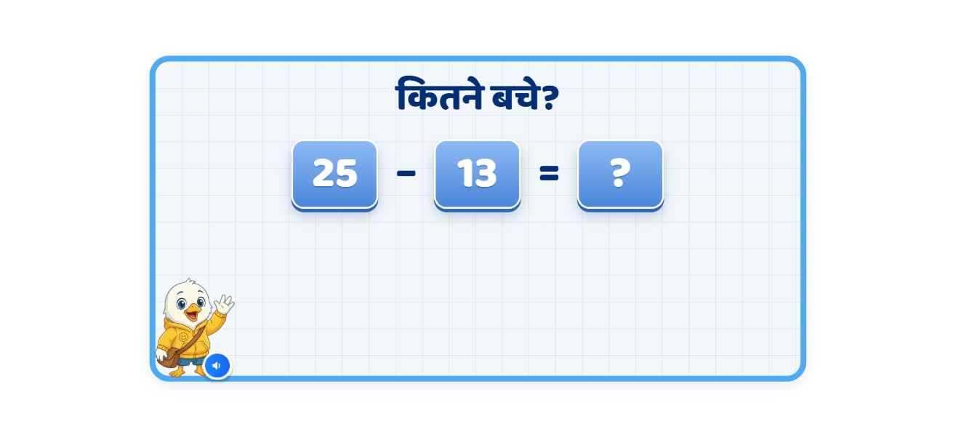
Page 2 · 02_T1_story.png
Recommendations
• T1 (deck p2): 'कितने बचे?' — 25, then − 13, then = ? appear as the Meera/Aman VO names them. The dangling 'मीरा के पास' at the end of the deck's first line is dropped.

Slide 4
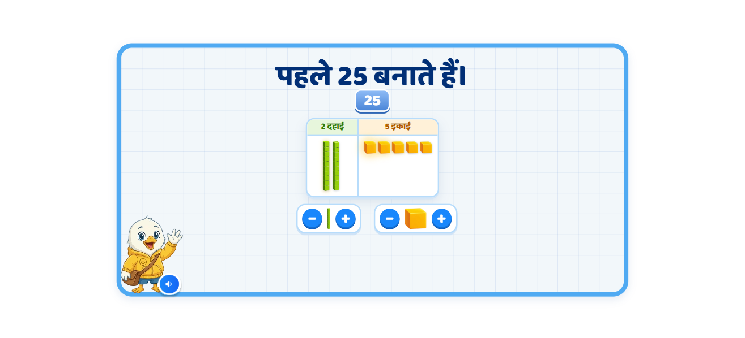
Page 3 · 03_T2_build.png
Recommendations
• T2 build (deck p3): only 25 + an empty table; Swiftee's hand taps दहाई + twice and इकाई + five times; the heads count along (2 दहाई / 5 इकाई).

Slide 5
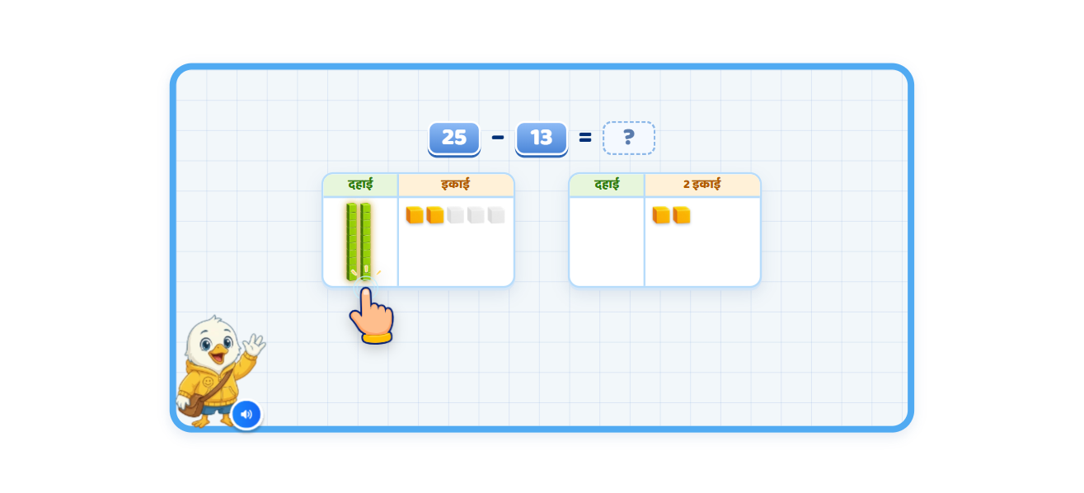
Page 4 · 04_T2_takeaway.png
Recommendations
• T2 take-away: 25 − 13; Swiftee takes 3 ones (grey copies stay, a copy flies to 13), 2 move to the answer table ('2 इकाई'); the CHILD takes 1 ten (3 s idle → hand), then '…यानी 12' and 12 fills the box. VO fixed: 13 = 1 दहाई और 3 इकाई (deck said 2).

Slide 6
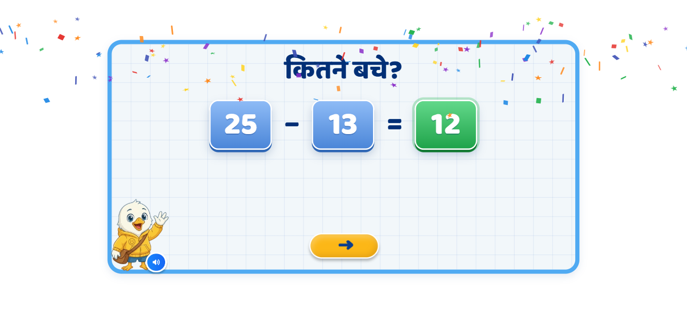
Page 5 · 05_T3_answer.png
Recommendations
• T3: the first screen again; the 12 lands in the box on '12 आएगा', then 'यानी मीरा के पास कुल 12 ब्लॉक्स बचे।'

Slide 7
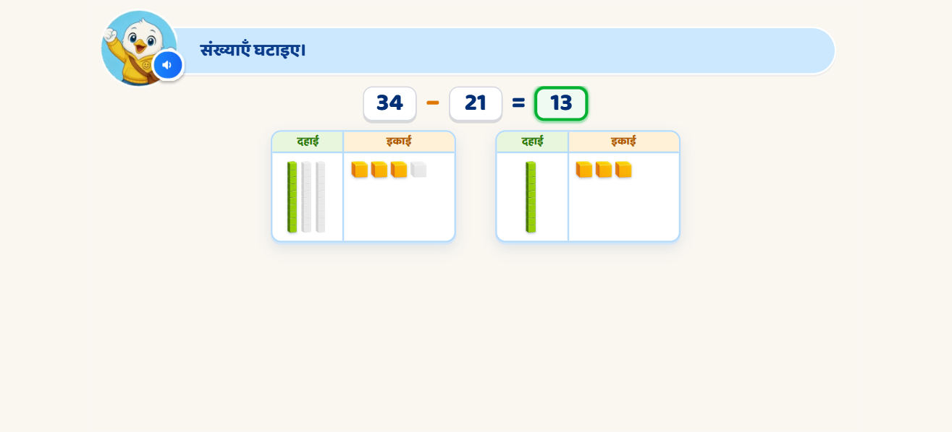
Page 6 · 06_G1_34-21.png
Recommendations
• G1 (deck p7): 34 − 21 — child builds with −/+, takes away (ladder: 1st wrong = column line, 2nd = 'इनमें से इतने हटाइए।' + only the needed blocks tappable), the left blocks move right, 13 fills the box, 'इसलिए 34 घटा 21 बराबर 13' in sync.

Slide 8
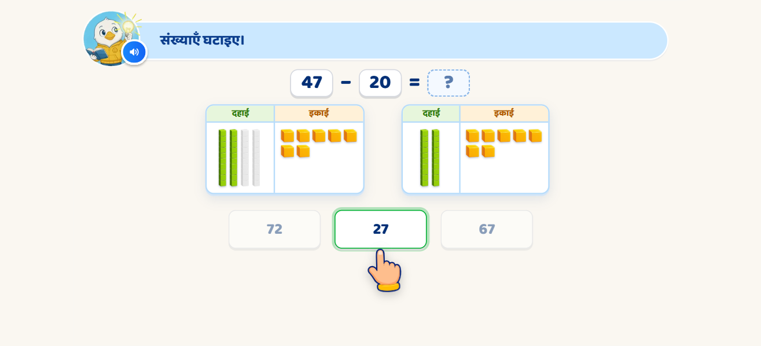
Page 7 · 07_G2_47-20.png
Recommendations
• G2 (deck p7b): 47 − 20, options 72 / 27 / 67. Shown: 2nd wrong pick → reveal VO, 27 glows, others locked, hand on it.

Slide 9
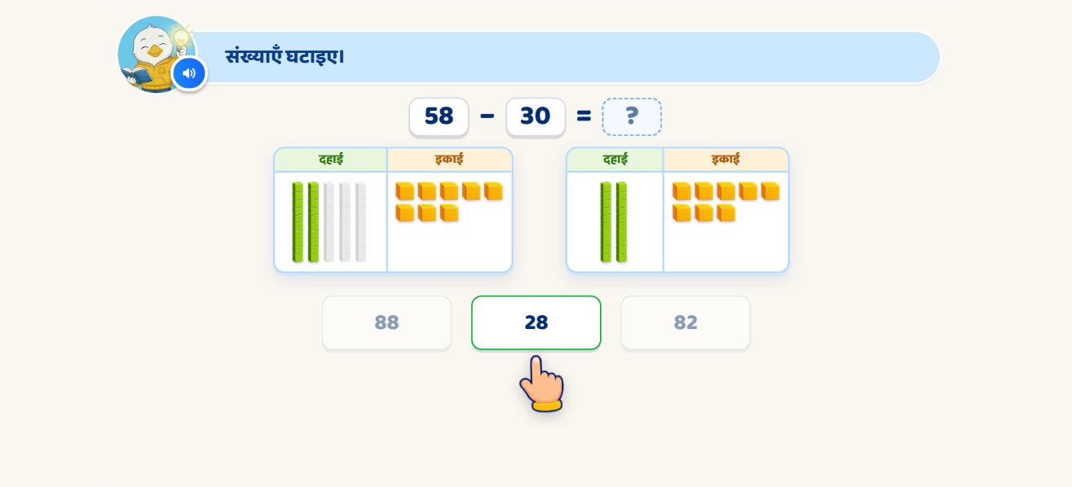
Page 8 · 08_G3_58-30.png
Recommendations
• G3 (deck p8): 58 − 30 (deck text said 58 − 38; the mockup, VO and options say 30). Step VO: '0 इकाई मतलब कुछ नहीं घटाएँगे इकाई में से।' then the tens.

Slide 10
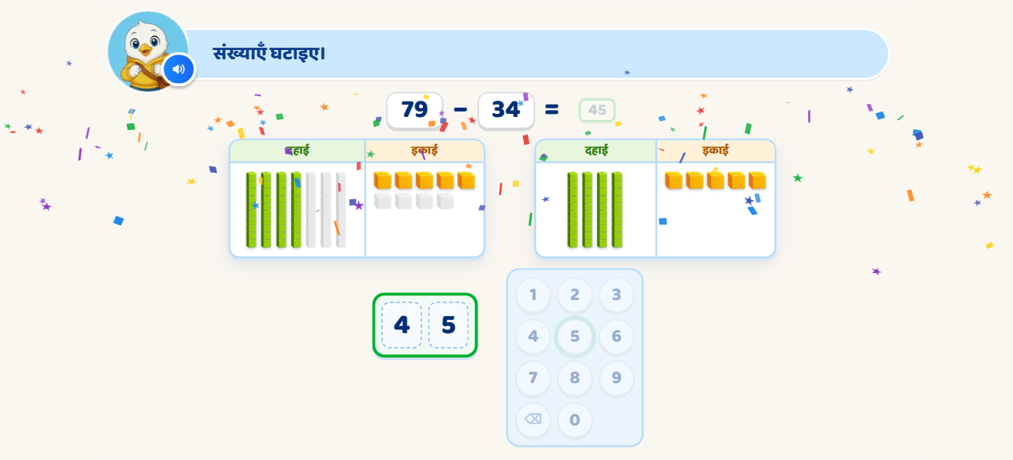
Page 9 · 09_P1_79-34.png
Recommendations
• P1 (deck p9): 79 − 34 → number pad. Shown: the right answer after the reveal (keys 4 then 5 lit one by one, the others locked).

Slide 11
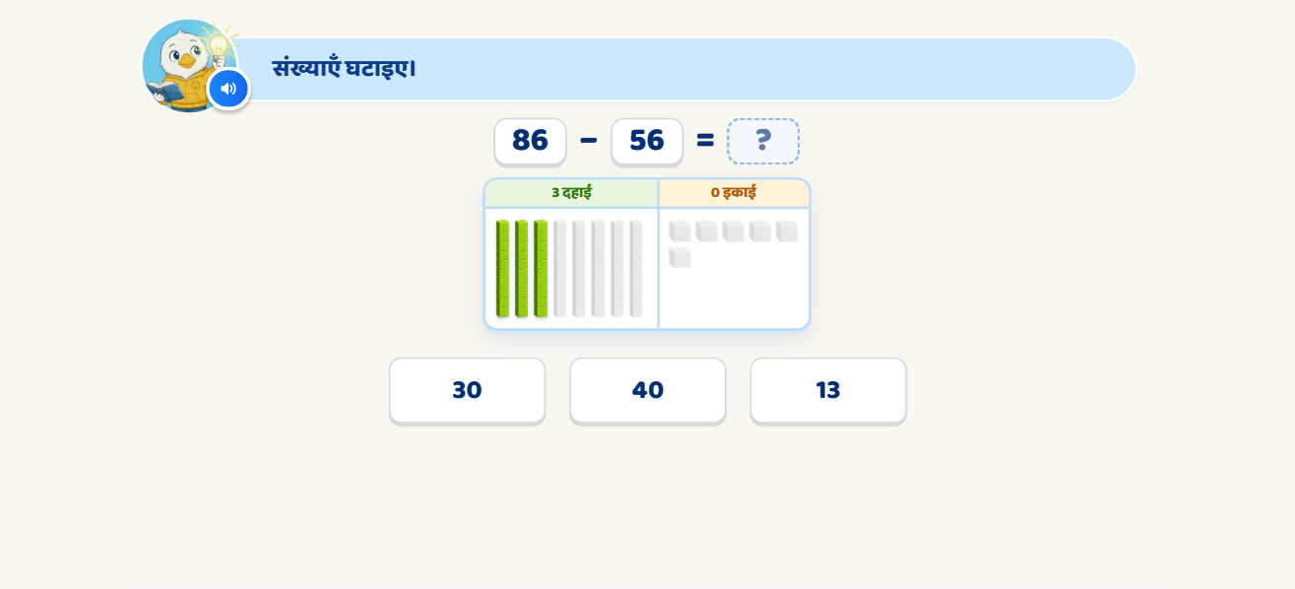
Page 10 · 10_P2_86-56.png
Recommendations
• P2 (deck p11): 86 − 56 given as blocks, no step VO; heads follow what is left (3 दहाई / 0 इकाई); options 30 / 40 / 13.

Slide 12
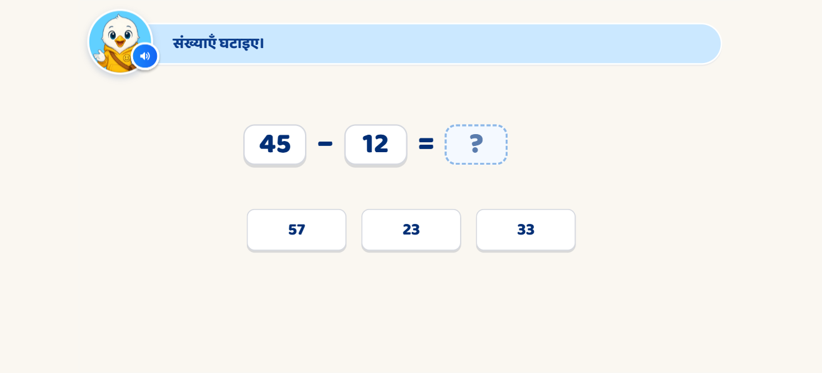
Page 11 · 11_P3_45-12.png
Recommendations
• P3 (deck p13): only 45 − 12 = ? and 57 / 23 / 33; 'फिर से घटाइए।' → reveal.

Slide 13
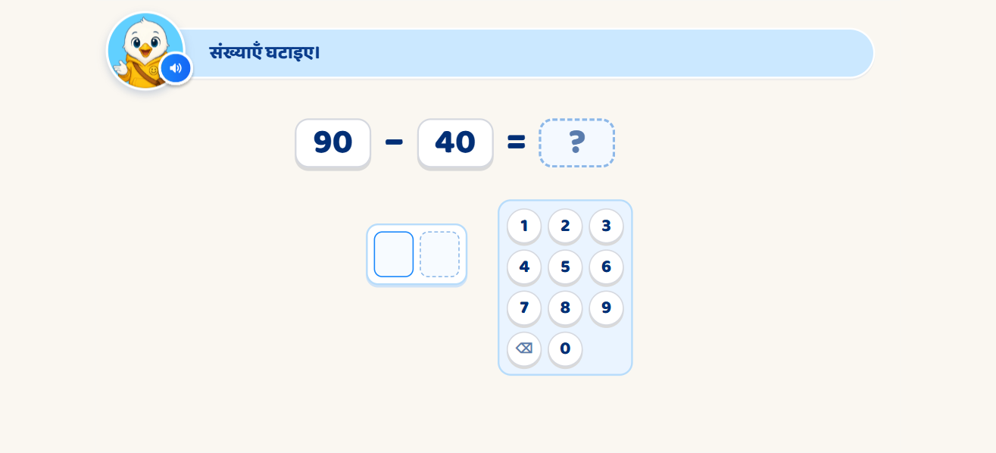
Page 12 · 12_P4_90-40.png
Recommendations
• P4 (deck p15): 90 − 40 (deck text said 96 − 40 / 55; mockup + correct VO + keys say 90 − 40 = 50); try again → place-value hint (ones digits, then tens digits light) → reveal.

Slide 14
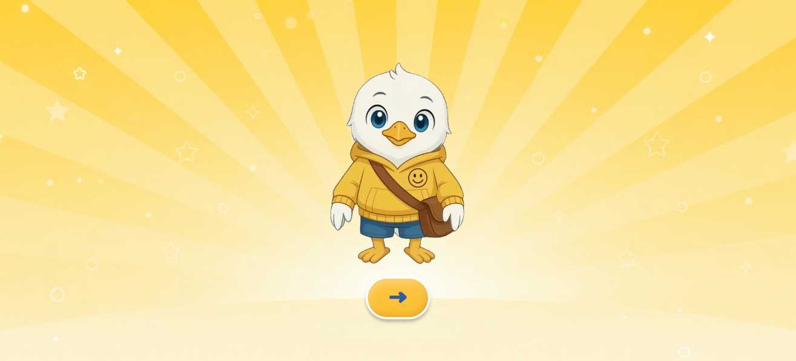
Page 13 · 13_CEL.png
Recommendations
• CEL (deck p16): MTG2A01_L03_S01's end screen; VO 'शाबाश! अब आप संख्याएँ घटाना सीख गए हैं।'

