Slide 1
MTG2A01_L04_S01 — दहाई और इकाई से घटाइए
Page-by-page review · 16 pages

Slide 2
Overall recommendations & open questions
• WHAT IT TEACHES — subtracting a 2-digit number from a 2-digit number horizontally, with NO regrouping, using NCERT Grade-2 base-ten blocks: a दहाई is a ten-rod, an इकाई is a single cube. The rule the game drills: दहाई दहाई से, इकाई इकाई से.
• HOW IT IS SHAPED — 3 phases. Phase 1 the game teaches by itself and the child only watches (the shop story from SME pathway 2, told in blocks: 57, take 23, 34 left). Phase 2 the child does it with support. Phase 3 the child works alone with a hint ladder that always ends in a reveal. No score, no timer.
• SIX PROBLEMS, none repeated — teach 57-23=34 · guided 68-25=43 · practice 79-34=45, 86-52=34, 45-12=33, 96-41=55. Each one is finished across TWO screens (the इकाई column, then the दहाई column) and the horizontal sentence is shown and spoken every time.
• FOUR DIFFERENT HAND ACTIONS across 11 test screens, no family over 27% — tap-each-leftover-into-the-tray (ENACT ×3), BUILD the rods that remain (PRODUCE ×3), count-then-record the digit by dragging (DRAG ×3, both drag modes), and pick-the-group (PICK ×2).
• WHY IT WORKS COLUMN BY COLUMN — the row's own pre-skills are 'subtract 1-digit numbers' and 'compose/decompose numbers'. Every screen is therefore exactly one 1-digit subtraction in one place-value column, and the answer is composed back from दहाई + इकाई. It also keeps this skill strictly no-regrouping, which is what separates it from its sibling MTG2A01_L04_S02 (with borrow).
• ✅ FIXED BEFORE YOU SAW IT (self-review pass): the landing title showed only 'घटाओ' (the engine strips text after a ':') and was informal तुम in an आप game — retitled; the collecting tray was rendering as a raw 🧺 emoji — real tray art supplied; and the first cut of the story scenes had the leftmost rod clipped by the picture frame — recomposed with a safe margin.
• ℹ THE STORY PICTURES ARE COMPOSED, NOT AI-DRAWN — they are assembled pixel-by-pixel from the same rod and cube art the interactive screens use. Image models do not reliably draw an exact count, and in this lesson the count is the content, so 5 rods + 7 cubes is guaranteed, not hoped for.
• TWO THINGS THE KIT WOULD NOT LET ME FIX — (a) there is NO take-away/place-value mechanic in this kit: nothing renders rods and cubes together and nothing lets a child REMOVE blocks and watch the remainder compose, so the take-away is enacted in the Phase-1 story art and narrated on the interactive screens while the child handles the REMAINDER; (b) the BUILD screens say 'डालो' (informal) on the chip while the game is polite आप — hardcoded in the shared engine. The engine is read-only in this kit, so both are written up as engine tickets. Proposed mechanic SUBTRACT_BLOCKS is spec'd in the build script header — it would put a whole 2-digit subtraction on ONE enacted screen.
• ❓ FOR YOU TO DECIDE — (1) are दहाई / इकाई the words your Grade 2 classrooms use, or do you prefer 'दस का बंडल / इकाई'? (2) the shop framing is SME pathway 2 but the manipulative is blocks, per your instruction — is dropping the pencils right? (3) is six problems the right amount, or would you ramp further (e.g. to 98-76)?
• कान से जाँचें / EAR-CHECK — all 60 Hindi lines are machine-generated (voice: Kore). One clip needs a specific listen: 'पाँच' (vo_num_5) — the TTS refuses that bare word, so it was cut out of a carrier phrase. Please confirm it sounds clean, and listen to the rest before this reaches children.
• REGISTER — polite आप throughout (देखिए, डालिए, बनाइए, गिनिए, रखिए), matching the kit's standard phase-change lines. Shown text always equals the spoken line.

Slide 3
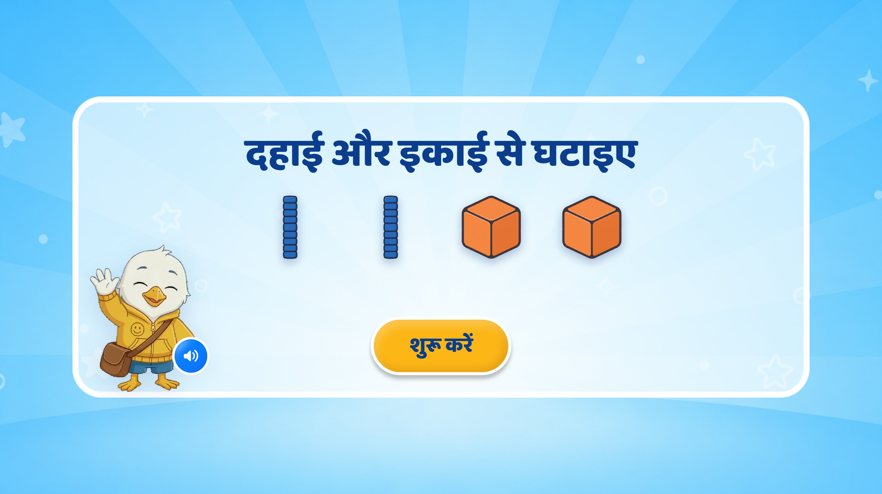
Page 1 · 01_landing.png
Recommendations
• LANDING. The strip is the whole idea at a glance: दहाई rods + इकाई cubes. ✅ FIXED: the title was 'घटाओ: दहाई और इकाई' — the engine strips everything after a ':' so it displayed as a bare 'घटाओ', AND घटाओ is informal तुम while this game is polite आप. Now 'दहाई और इकाई से घटाइए'.

Slide 4
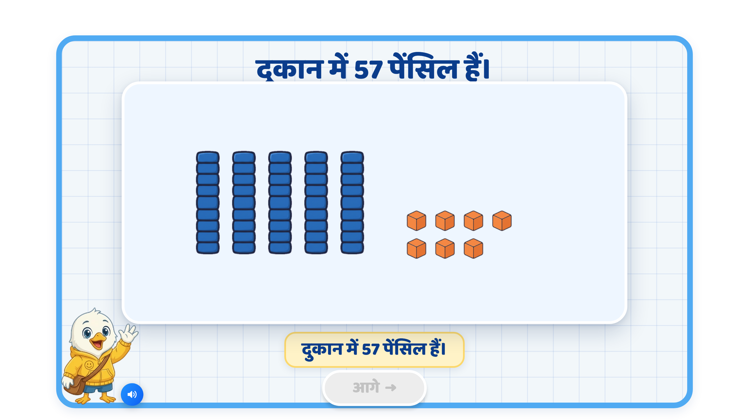
Page 2 · 02_STORY_SCENE.png
Recommendations
• PHASE 1 · TEACH — plays BY ITSELF, the child only watches (never a test). The shop has 57 pencils: FIVE tens-rods and SEVEN ones-cubes. The narration names the blocks — 'लंबी छड़ एक दहाई है, छोटा घन एक इकाई है' — before any screen depends on those words.

Slide 5
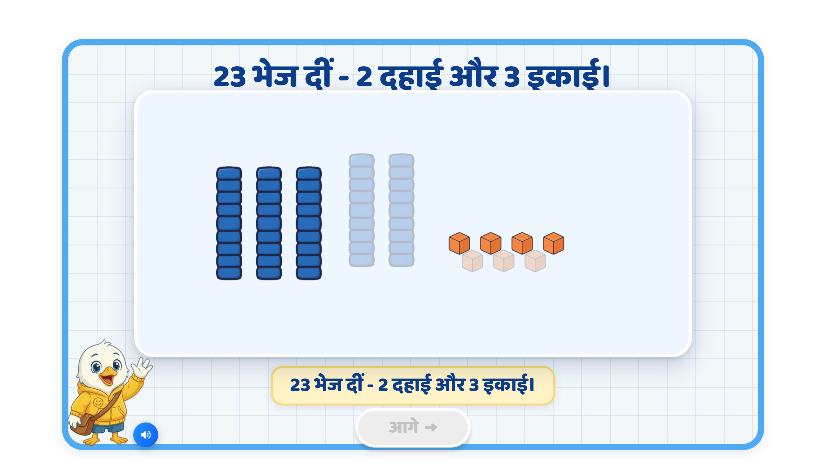
Page 3 · 03_STORY_SCENE.png
Recommendations
• PHASE 1 · TEACH — the take-away itself. 23 goes: TWO rods and THREE cubes fade and lift away, the rest stay solid. ℹ These three scenes are composed pixel-by-pixel from the real rod/cube art, NOT AI-generated as a picture — image models do not reliably draw an exact count, and here the count IS the maths.

Slide 6
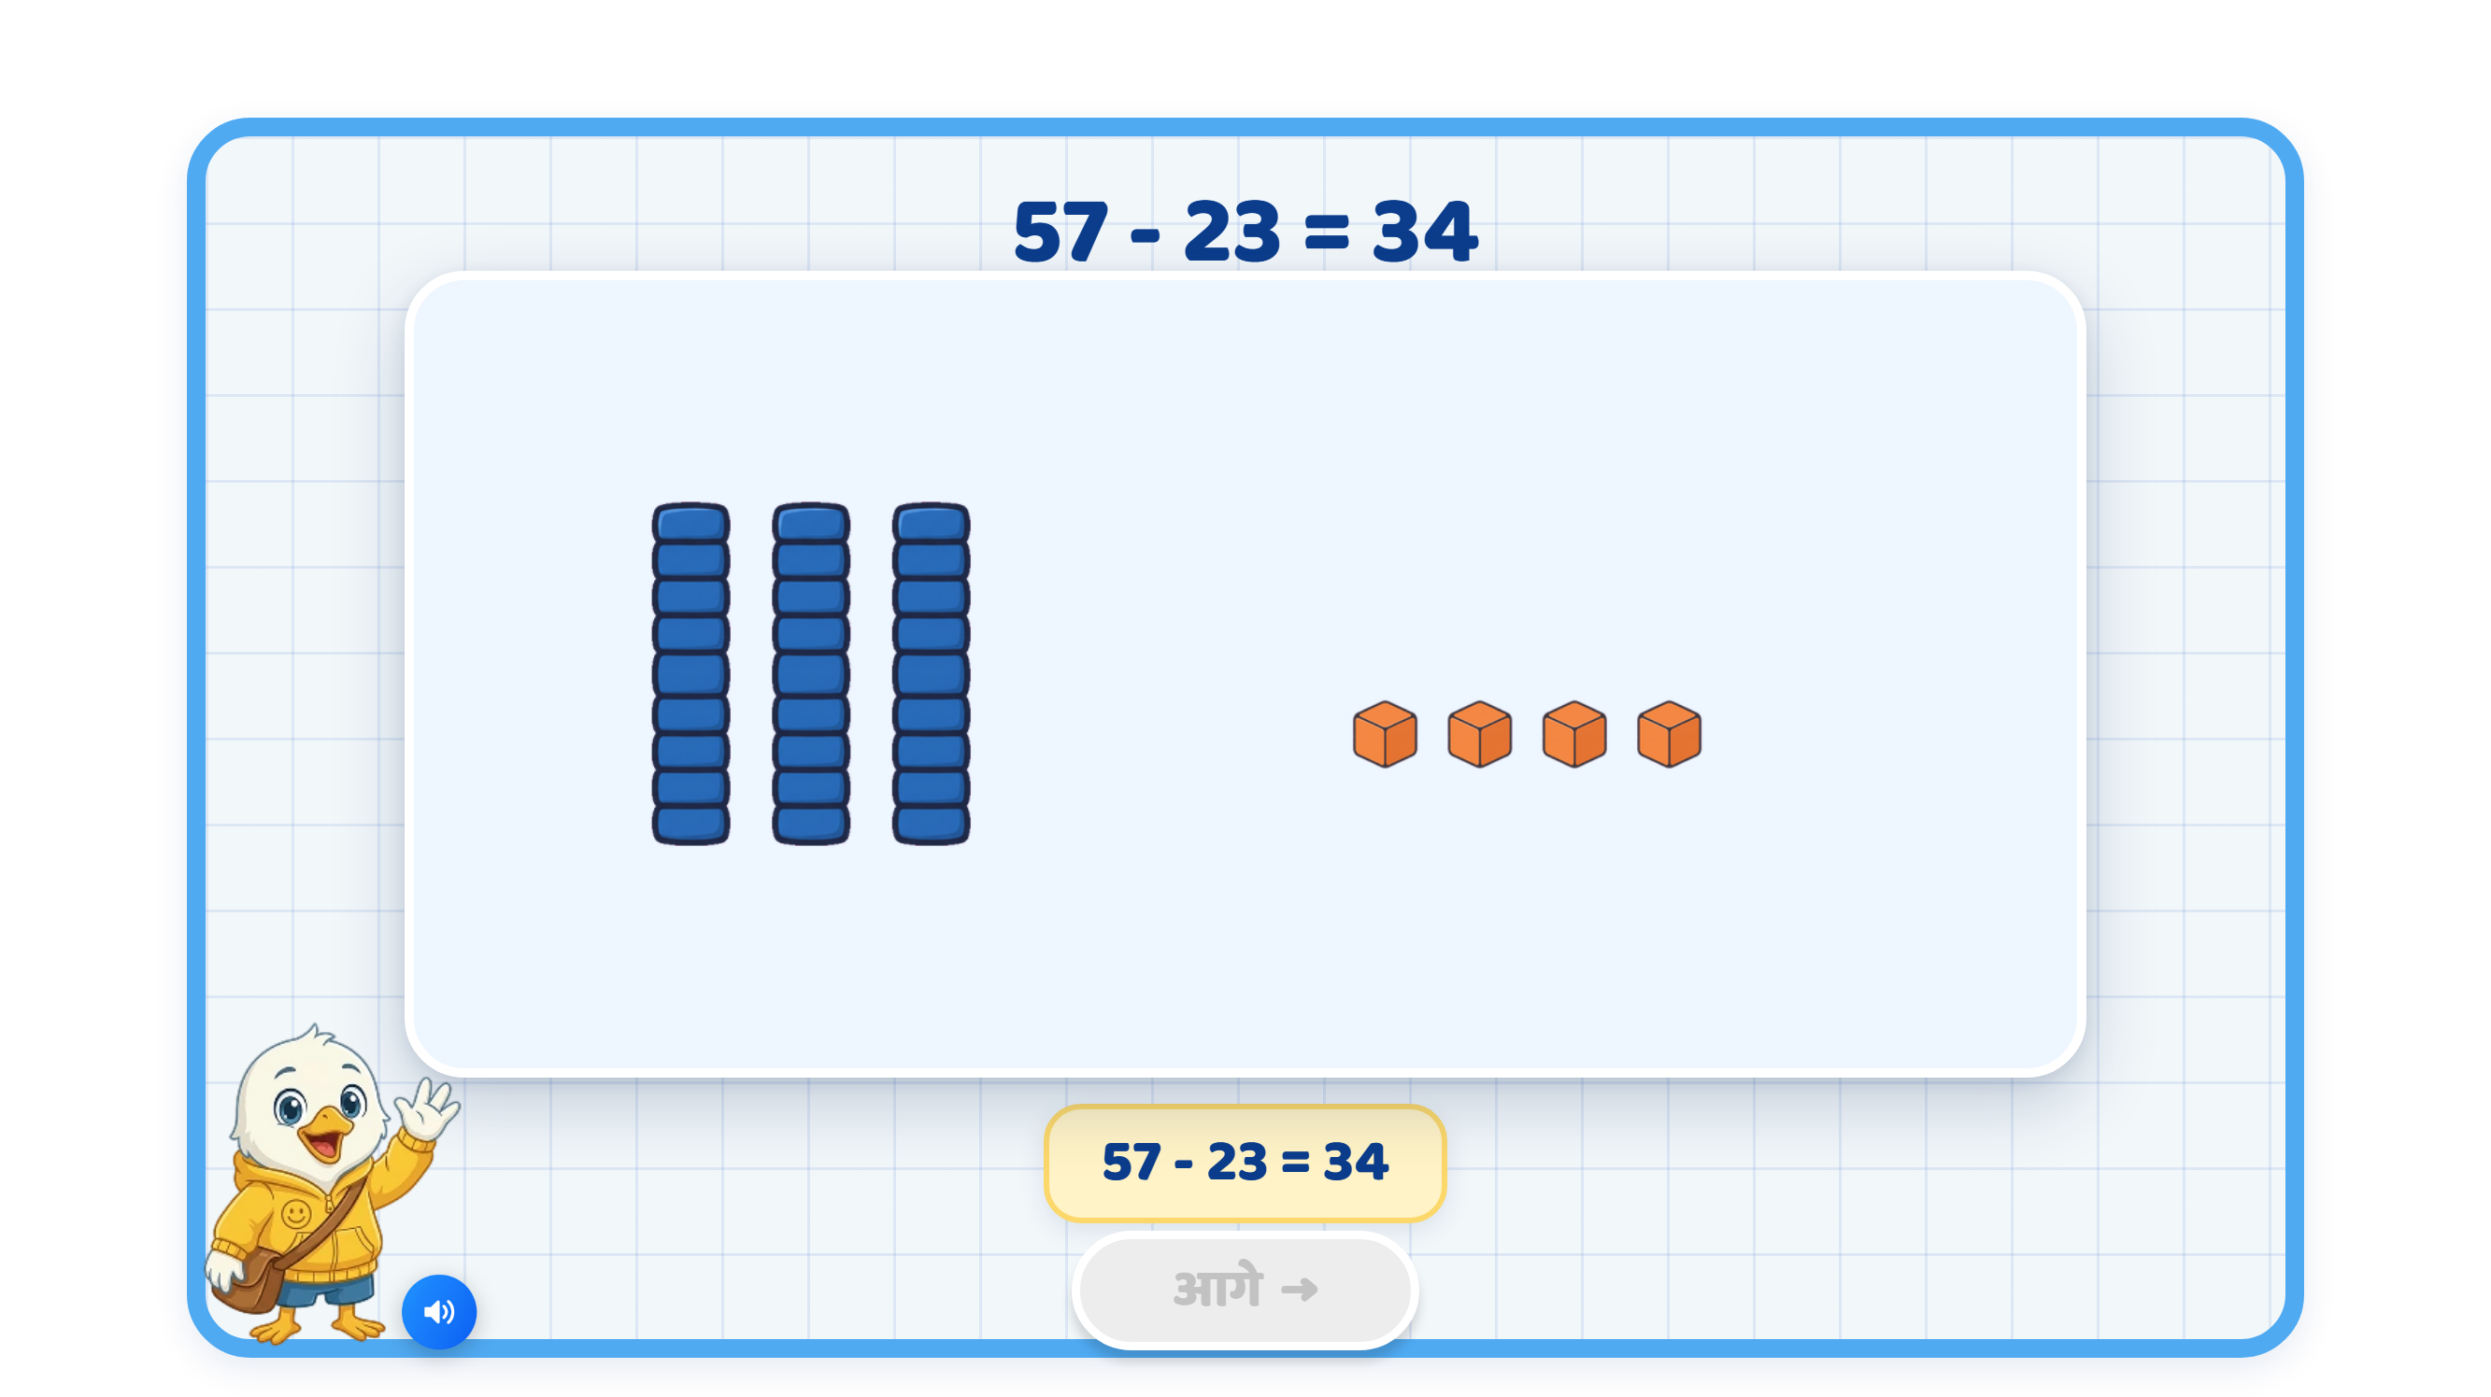
Page 4 · 04_STORY_SCENE.png
Recommendations
• PHASE 1 · TEACH — the result: THREE rods and FOUR cubes remain, and the caption is the horizontal sentence '57 - 23 = 34'. The narration states the rule the whole game runs on: दहाई दहाई से, इकाई इकाई से घटाइए.

Slide 7
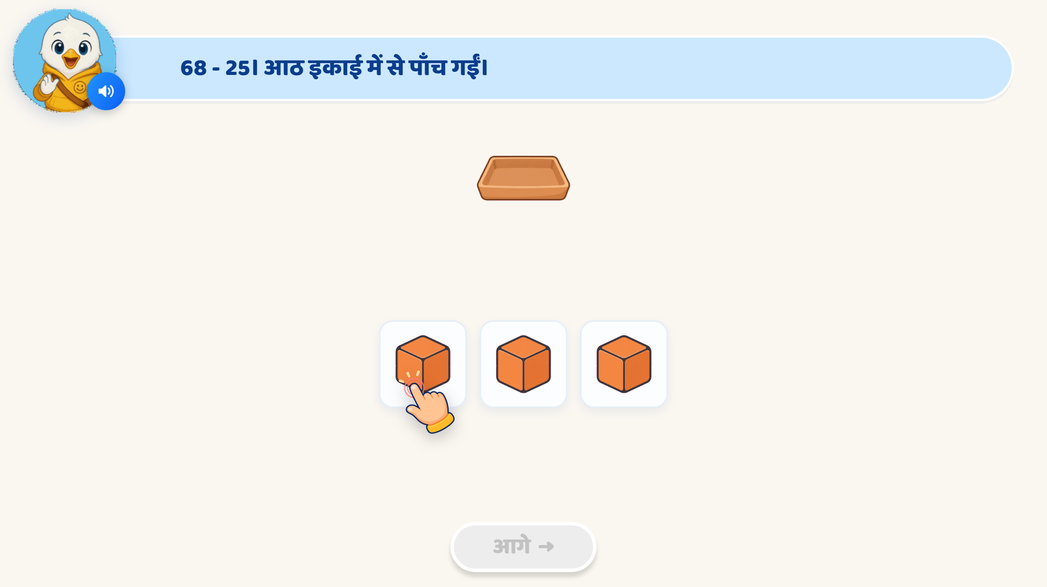
Page 5 · 05_COUNT_ACTION.png
Recommendations
• PHASE 2 · GUIDED — 68 - 25, इकाई column. 'आठ इकाई में से पाँच गईं' — the child taps each REMAINING cube into the tray and says how many are left (3). ✅ FIXED: the tray was rendering as a raw 🧺 emoji; the engine hardcodes that art key to obj_basket, so the tray art is now supplied.

Slide 8
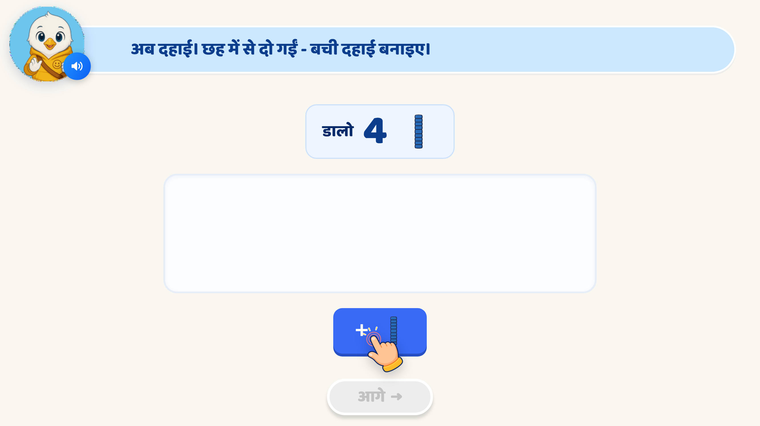
Page 6 · 06_MAKE_SET.png
Recommendations
• PHASE 2 · GUIDED — 68 - 25, दहाई column. A PRODUCE item: BUILD the four rods that remain. ❓ REGISTER CLASH (engine-level): the goal chip reads 'डालो' / 'और डालो' (informal तुम) while this game is polite आप. Hardcoded in the shared engine, which is read-only in this kit — raised as an engine ticket, same one the capacity game hit.

Slide 9
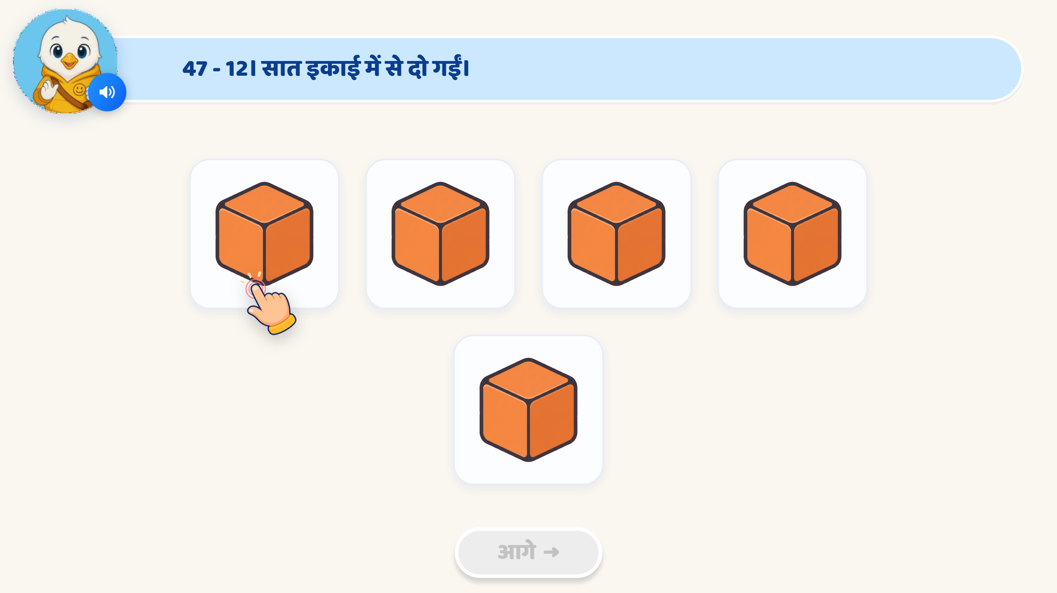
Page 7 · 07_COUNT_DRAG_MATCH.png
Recommendations
• PHASE 2 · GUIDED — a DIFFERENT gesture (drag, not tap). 47 - 12: count the remaining इकाई, then drag the number card into the box to RECORD it. This is SME pathway 1's 'record what remains'.

Slide 10
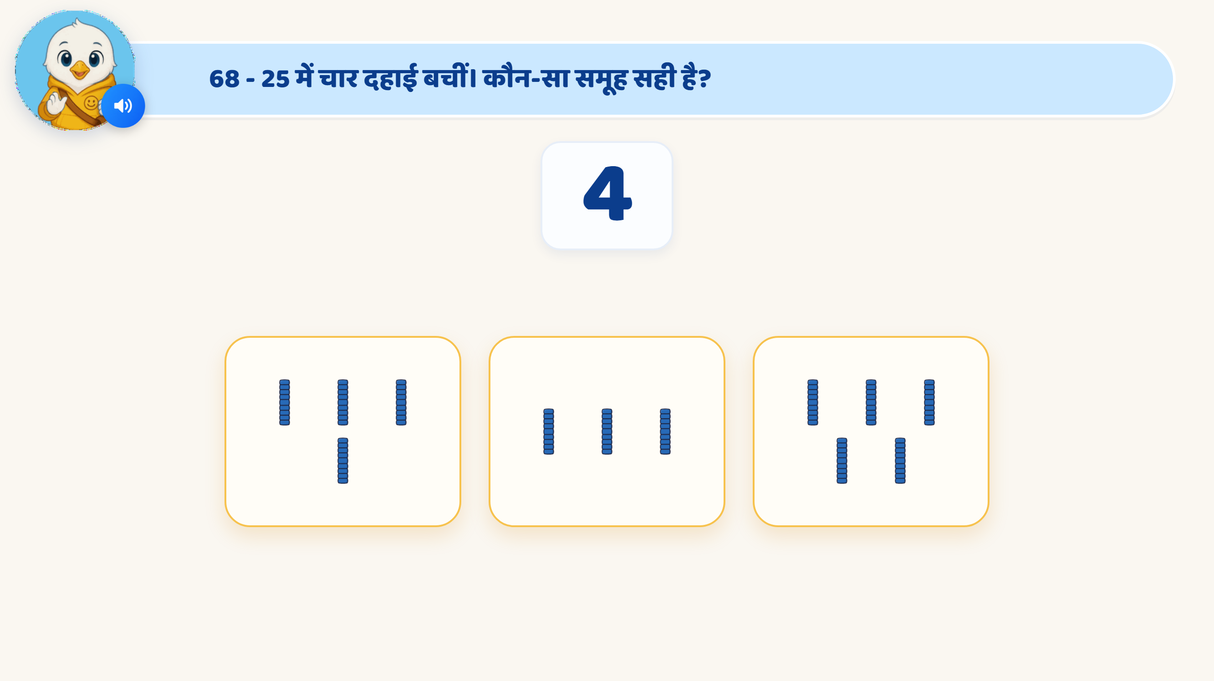
Page 8 · 08_PICK_SET_BY_NUMBER.png
Recommendations
• PHASE 2 · GUIDED — reverse direction: the number 4 is the question, pick the group that shows four दहाई. ▲ The rods render thin/small inside the option cards; that sizing is the engine's, not this game's, so I left it — they are still countable.

Slide 11
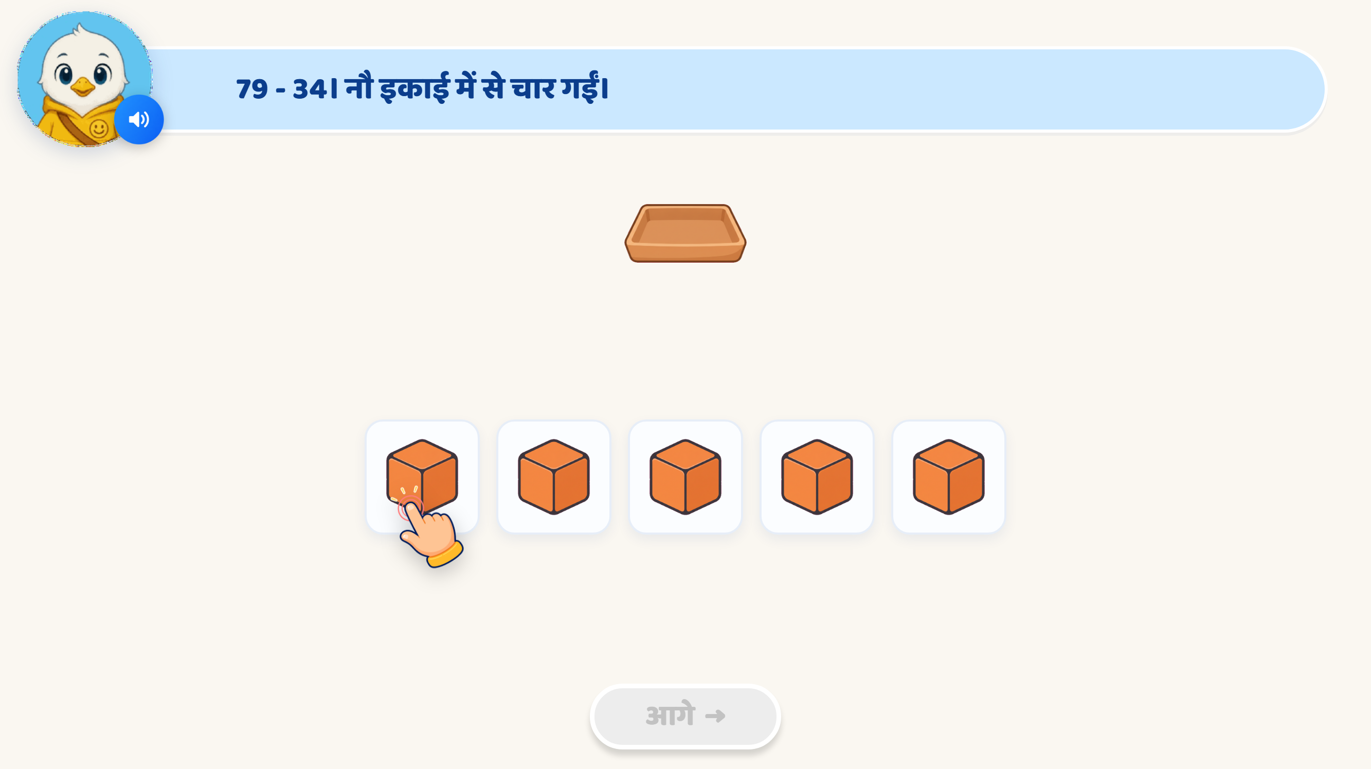
Page 9 · 09_COUNT_ACTION.png
Recommendations
• PHASE 3 · PRACTICE — child alone now, hint ladder as the net (try again → hint → reveal, so nobody gets stuck). 79 - 34, इकाई column: nine take four, five remain.

Slide 12

Page 10 · 10_MAKE_SET.png
Recommendations
• PHASE 3 · PRACTICE — 79 - 34, दहाई column: build the four rods that remain. That completes 79 - 34 = 45.

Slide 13
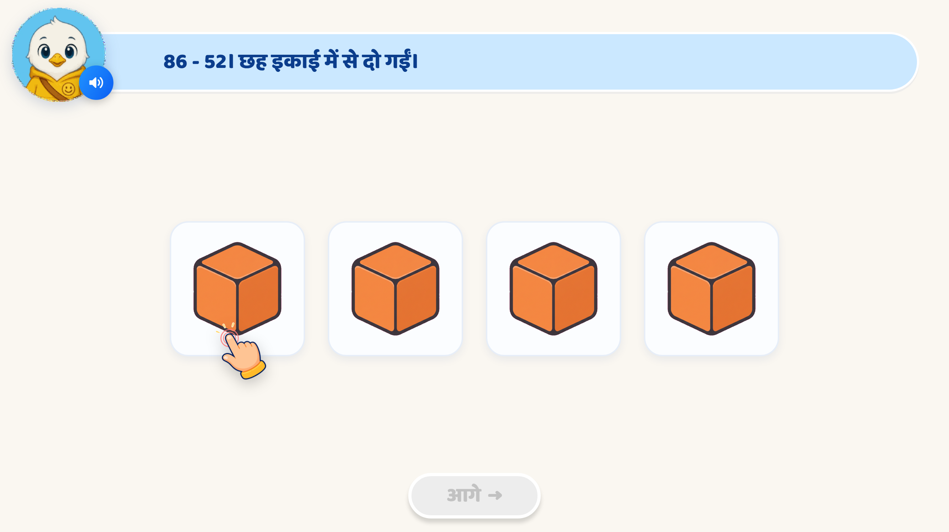
Page 11 · 11_COUNT_DRAG_MATCH.png
Recommendations
• PHASE 3 · PRACTICE — 86 - 52, इकाई column, using the OTHER drag mode (drag the cube onto the right number, rather than the number into a box), so the two drag screens are not the same gesture twice.

Slide 14

Page 12 · 12_MAKE_SET.png
Recommendations
• PHASE 3 · PRACTICE — 86 - 52, दहाई column: eight take five, three rods remain. Completes 86 - 52 = 34.

Slide 15

Page 13 · 13_COUNT_ACTION.png
Recommendations
• PHASE 3 · PRACTICE — 45 - 12, इकाई column: five take two, three remain.

Slide 16
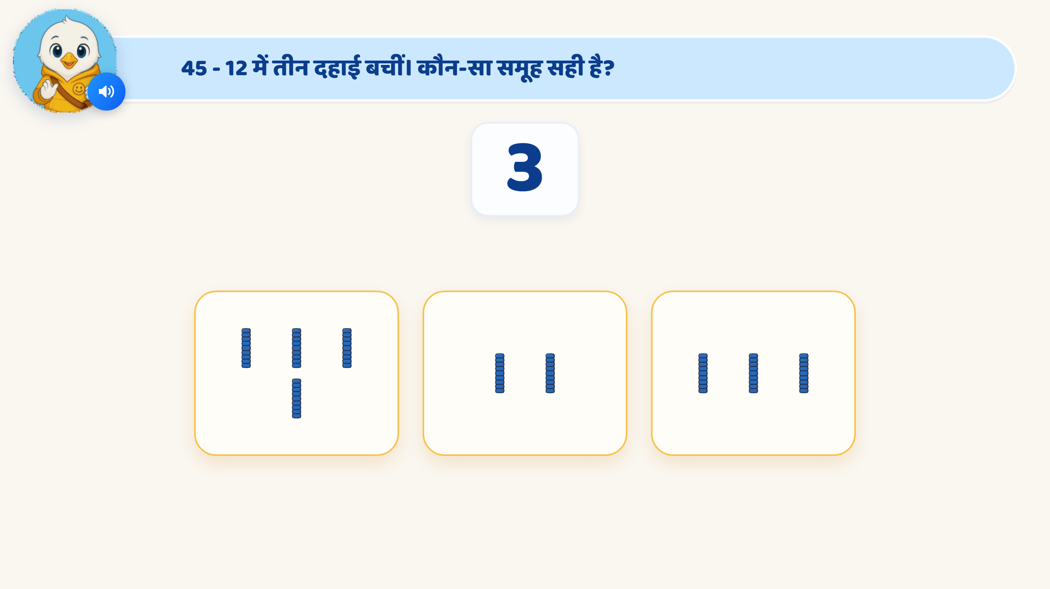
Page 14 · 14_PICK_SET_BY_NUMBER.png
Recommendations
• PHASE 3 · PRACTICE — 45 - 12, दहाई column as a pick: which group shows three दहाई? Completes 45 - 12 = 33.

Slide 17
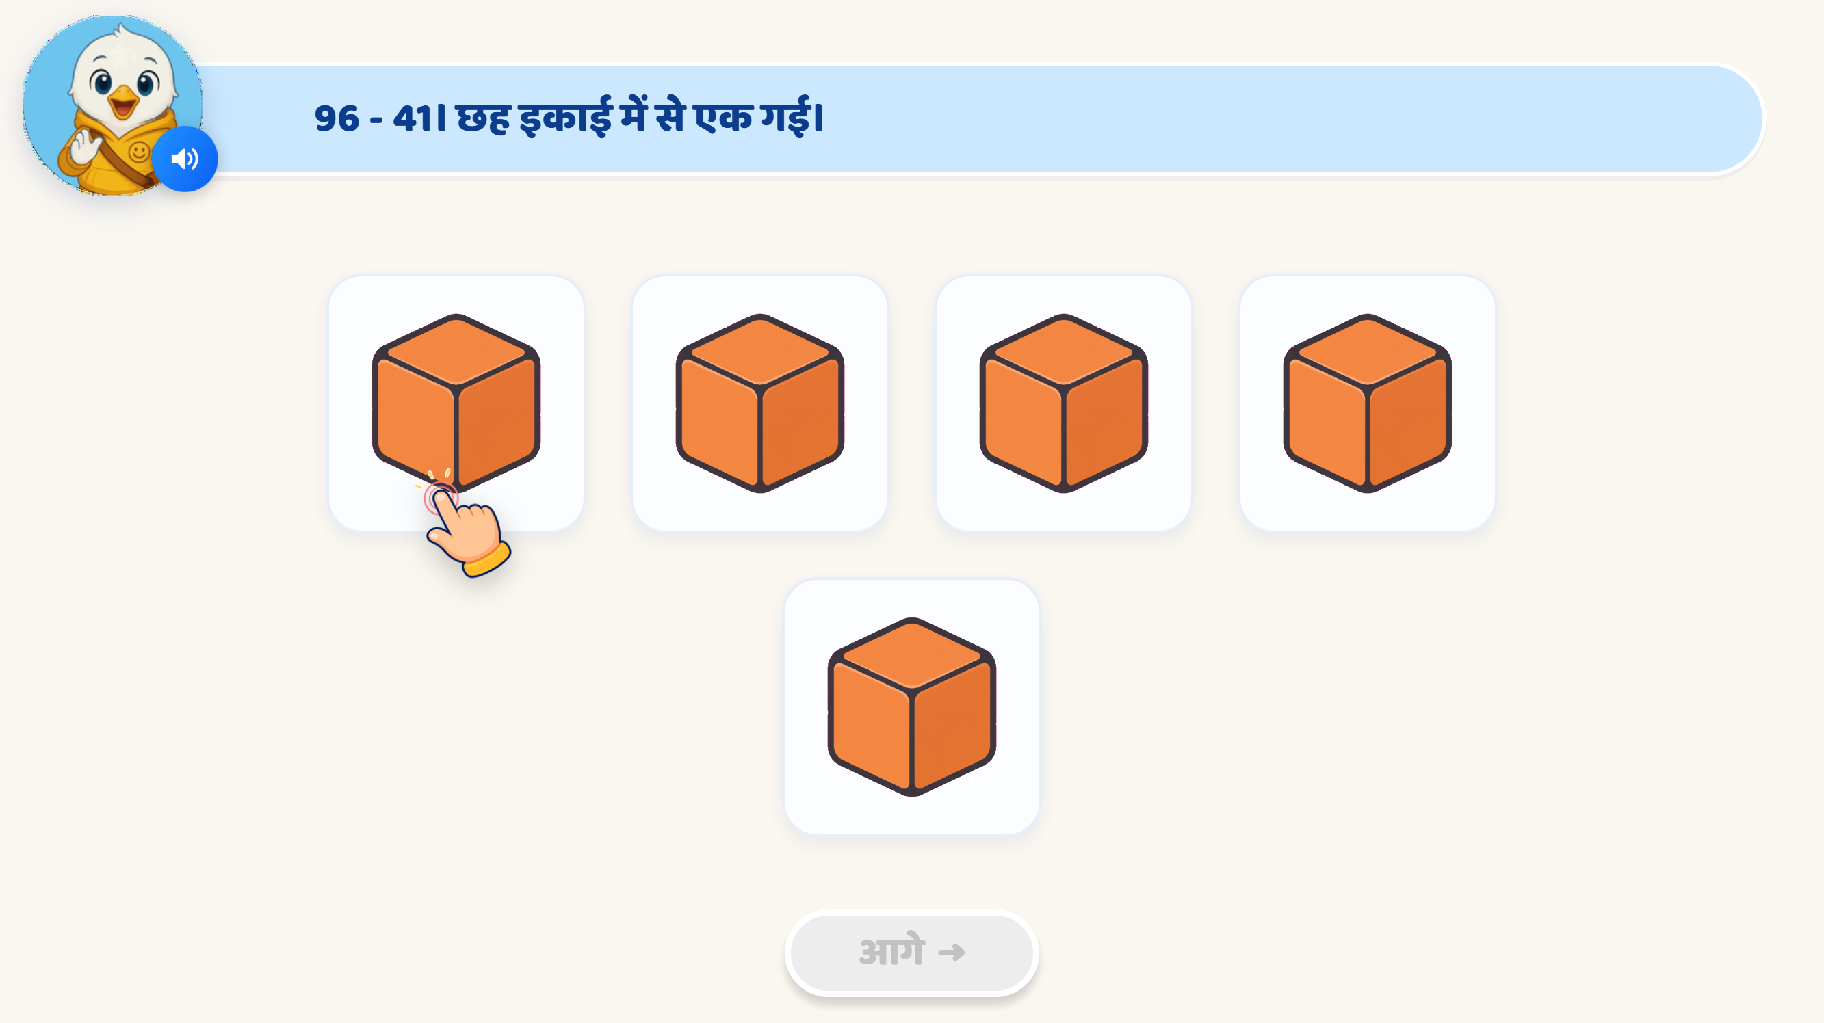
Page 15 · 15_COUNT_DRAG_MATCH.png
Recommendations
• PHASE 3 · PRACTICE — the last one, 96 - 41: six इकाई take one, five remain; record it. The reveal states the full sentence 96 - 41 = 55.

Slide 18

Page 16 · 16_CELEBRATION.png
Recommendations
• FINISH. 'शाबाश! अब आप दहाई और इकाई से घटा सकते हैं!' with the rule as the closing line — दहाई दहाई से, इकाई इकाई से. No score, no timer, by design.

