Slide 1
Amazon Sales Data Analysis
By: Priyank Goswami

Slide 2
Week - 1

Slide 3
Project Title | Analyzing Amazon Sales Data
Technologies | Data Science
Domain | E-Commerce
Project Difficulties Level | Advanced
Dataset : Download Dataset

Slide 4
Problem Statement:
Sales management has gained importance to meet increasing competition and the
need for improved methods of distribution to reduce cost and to increase profits. Sales
management today is the most important function in a commercial and business
enterprise.
Do ETL: Extract:
Transform-Load some Amazon dataset and find for me
Sales-trend -> month-wise, year-wise, yearly_month-wise
Find key metrics and factors and show the meaningful relationships between
attributes. Do your own research and come up with your findings.

Slide 5
Architecture
Data Pre-processing
Real World
Data Cleaning
Model Deployment
Exploratory Data Analysis(EDA)
Model Building
Reporting

Slide 6
Architecture Description
1. Raw Data Collection : The Dataset Provided by CollegeRanker Plateform.
2. Data Pre-Processing : Before building any model, it is crucial to perform data pre-processing to feed the correct data to the model to learn and predict. Model performance depends on the quality of data fed to the model to train.
3. Data Cleaning : is the process of fixing or removing incorrect, corrupted, incorrectly formatted, duplicate, or incomplete data within a dataset.

Slide 7
4. Exploratory Data Analysis (EDA) : refers to analyze and investigate data sets and summarize their main characteristics, often employing data visualization methods.
5. Reporting : is the process of collecting and formatting raw data and translating it into a digestible format to assess the ongoing performance of your organization. Your data reports can answer basic questions about the state of your business.
6. Dashboard : create using PowerBi Or Tableau.

Slide 8
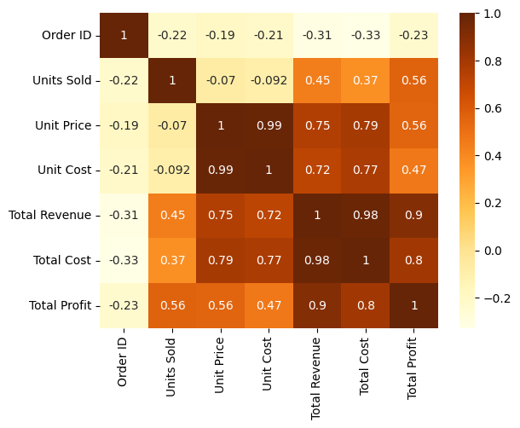
Python Graphs

Slide 9
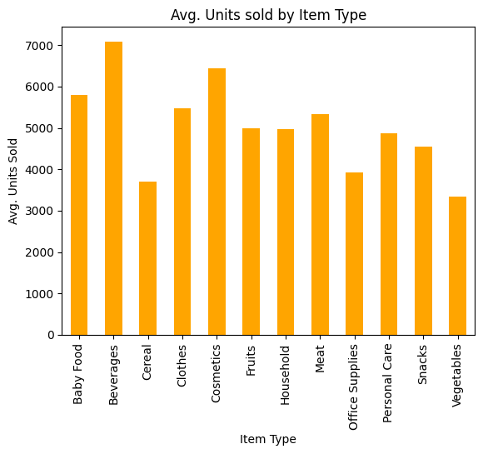

Slide 10
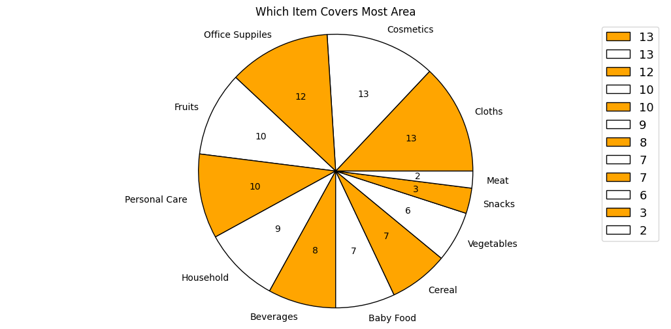

Slide 11
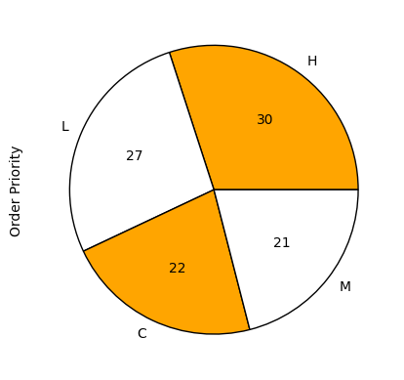
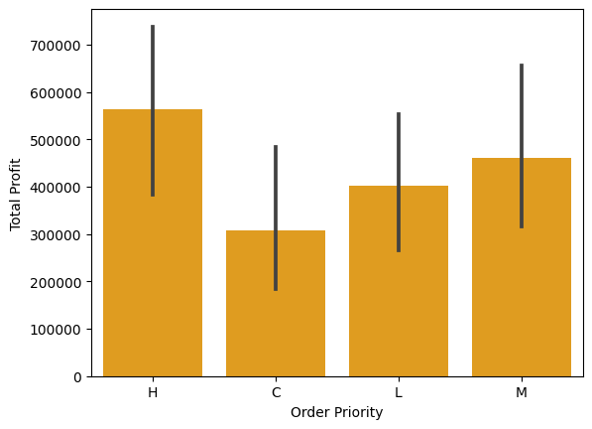

Slide 12
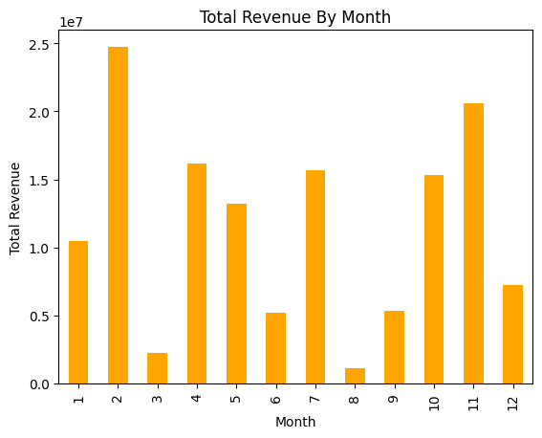

Slide 13
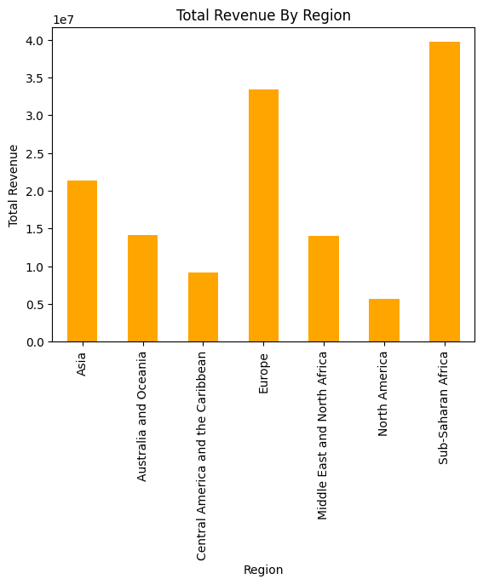

Slide 14
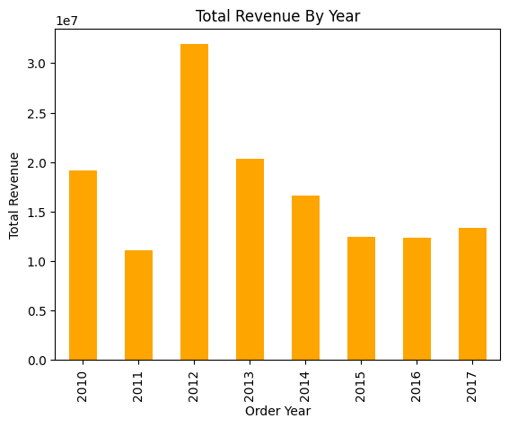

Slide 15
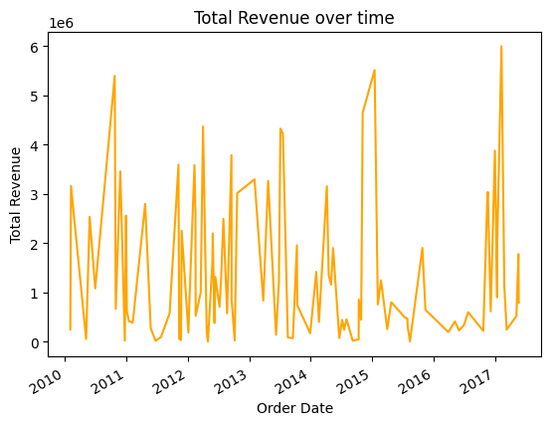

Slide 16
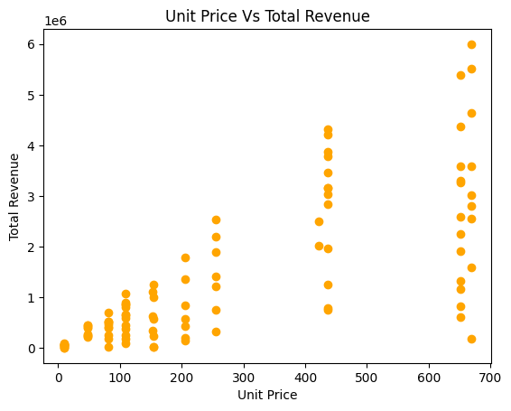

Slide 17
Week - 2

Slide 18
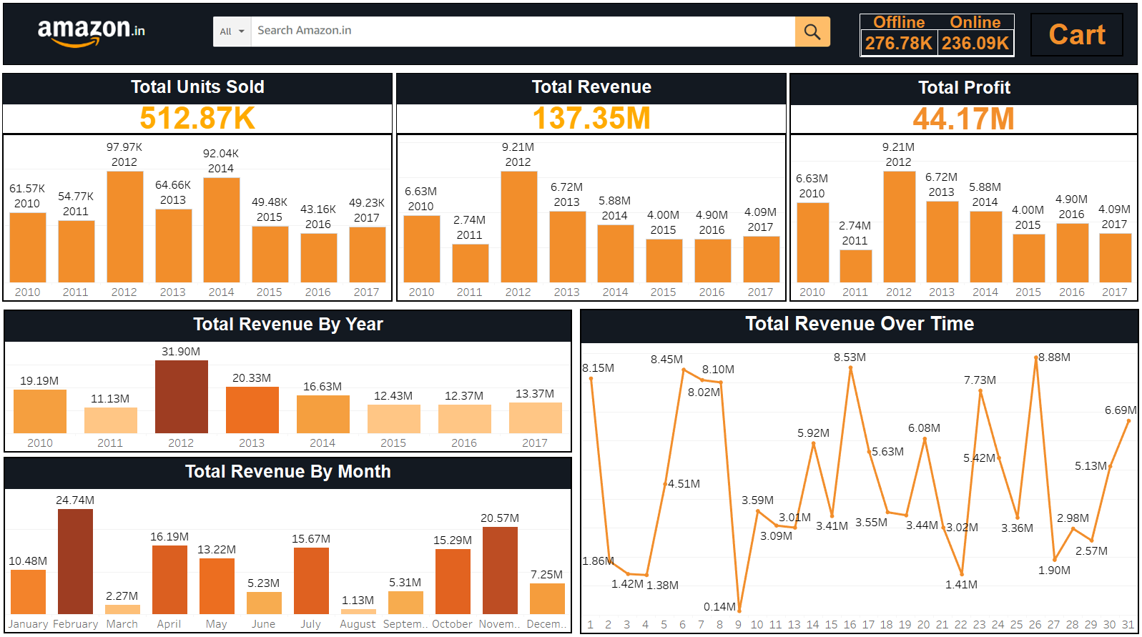

Slide 19
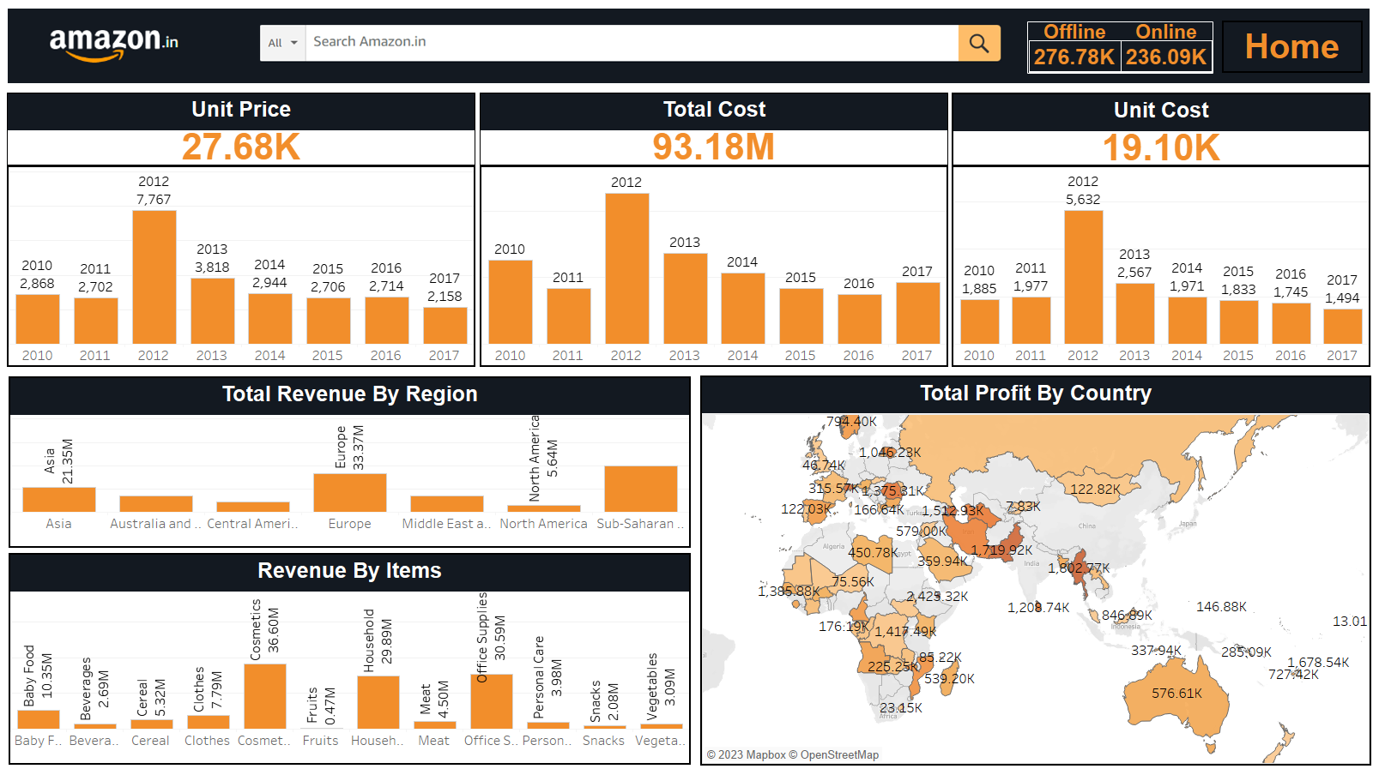

Slide 20
Conclusion
we need to focus on 5 lowest profitable items to increase the profit for distribution and for reduce cost of the items we need to open more warehouses. These will help us to improve the method of distribution and also reduce cost.

Slide 21
Thank You
Python Notebook : Click Here
Tableau Dashboard : click Here

Slide 22
Foreign Direct Investment
By: Priyank Goswami

Slide 23
Week - 3

Slide 24
Project Title | Analyzing Amazon Sales Data
Technologies | Data Science
Domain | Finance
Project Difficulties Level | Intermediate
Dataset : Download Dataset

Slide 25
Problem Statement:
Investment is a game of understanding historic data of investment objects under different events but it is still a game of chances to minimize the risk we apply analytics to find the equilibrium investment.
To understand the Foreign direct investment in India for the last 17 years from 2000-01 to 2016-17. This dataset contains sector and financial year-wise data of FDI in India Sector-wise investment analysis Year-wise investment analysis.
Find key metrics and factors and show the meaningful relationships between attributes. Do your own research and come up with your findings

Slide 26
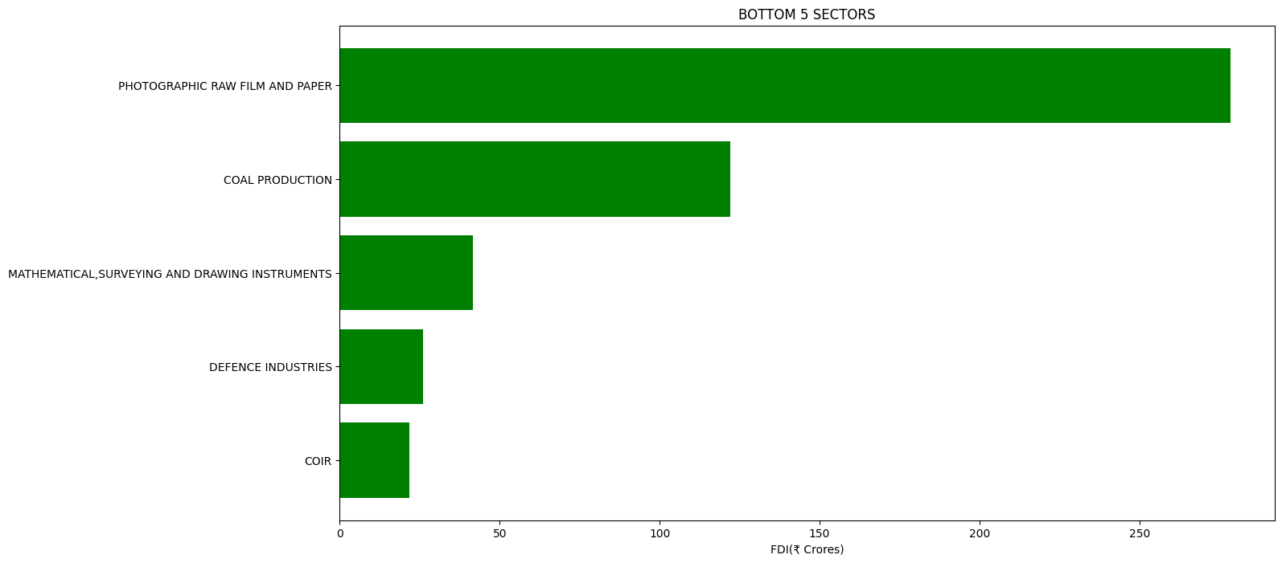

Slide 27
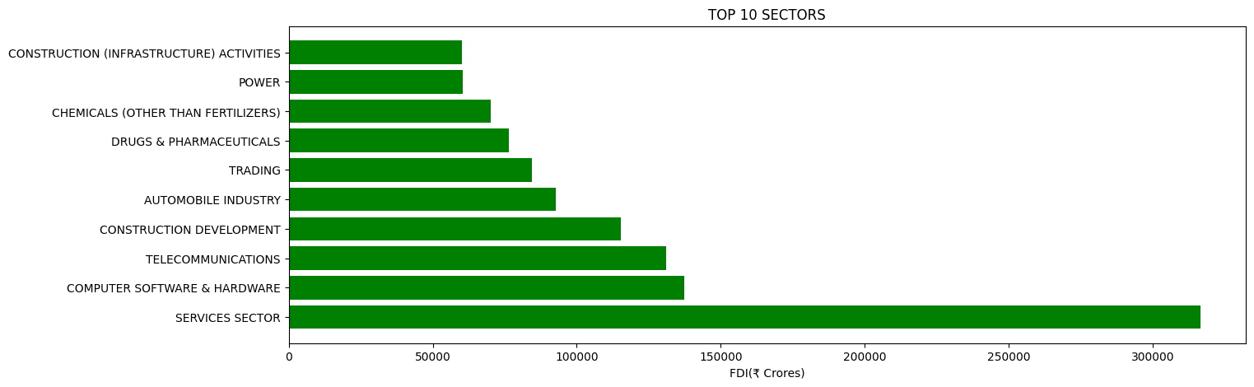

Slide 28
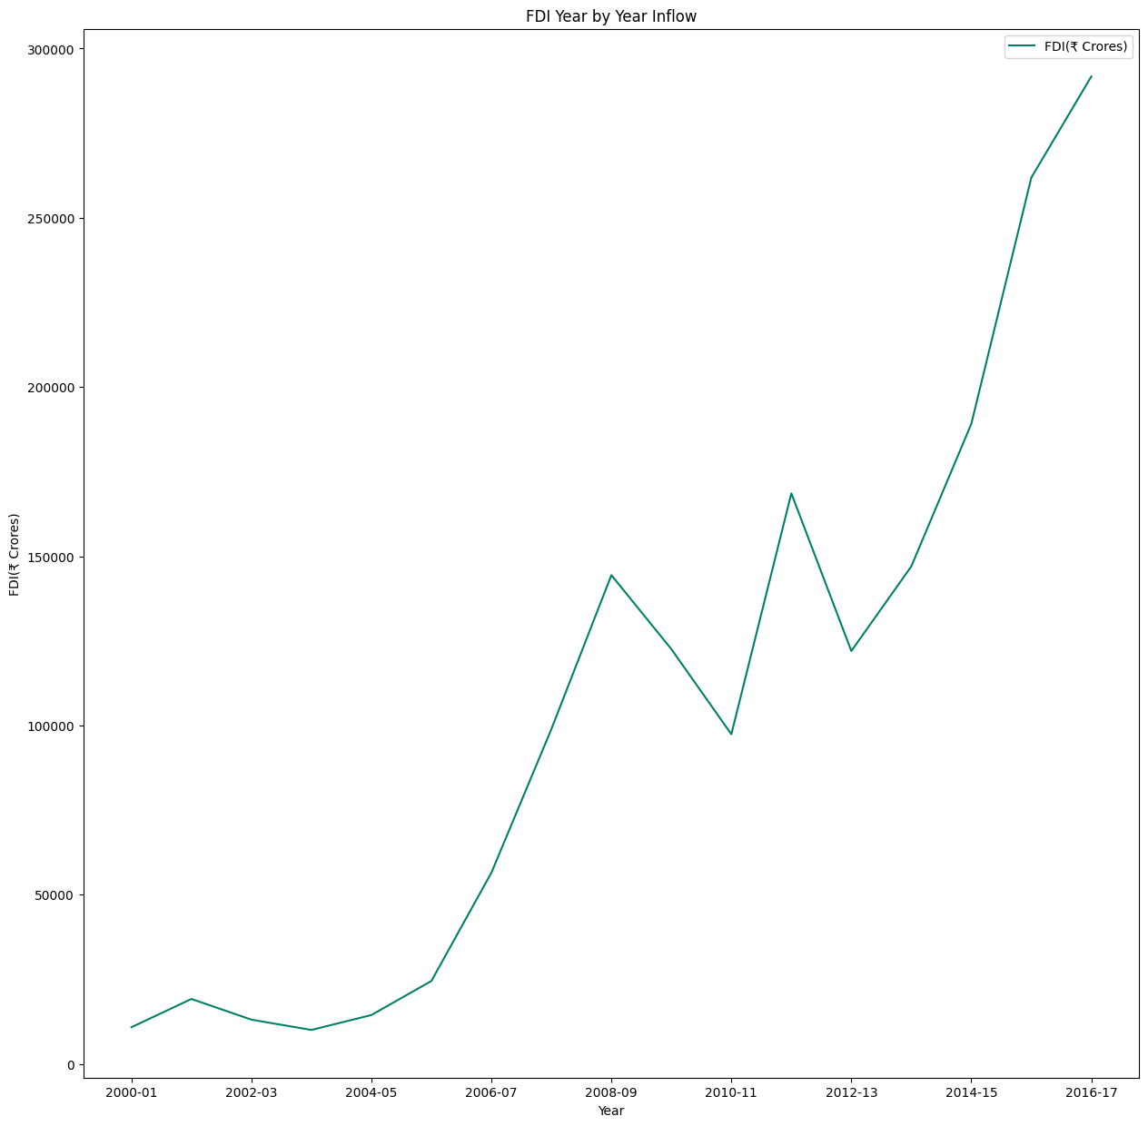

Slide 29
Week - 4

Slide 30
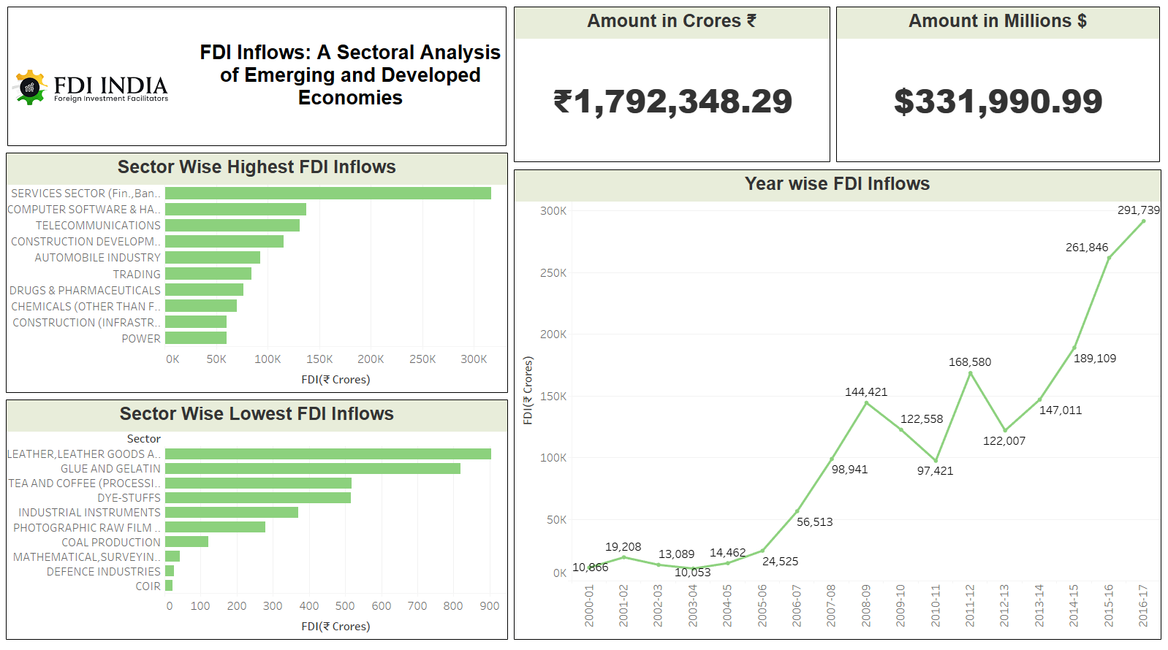

Slide 31
Thank You
Python Notebook : Click Here
Tableau Dashboard : click Here

