Slide 1
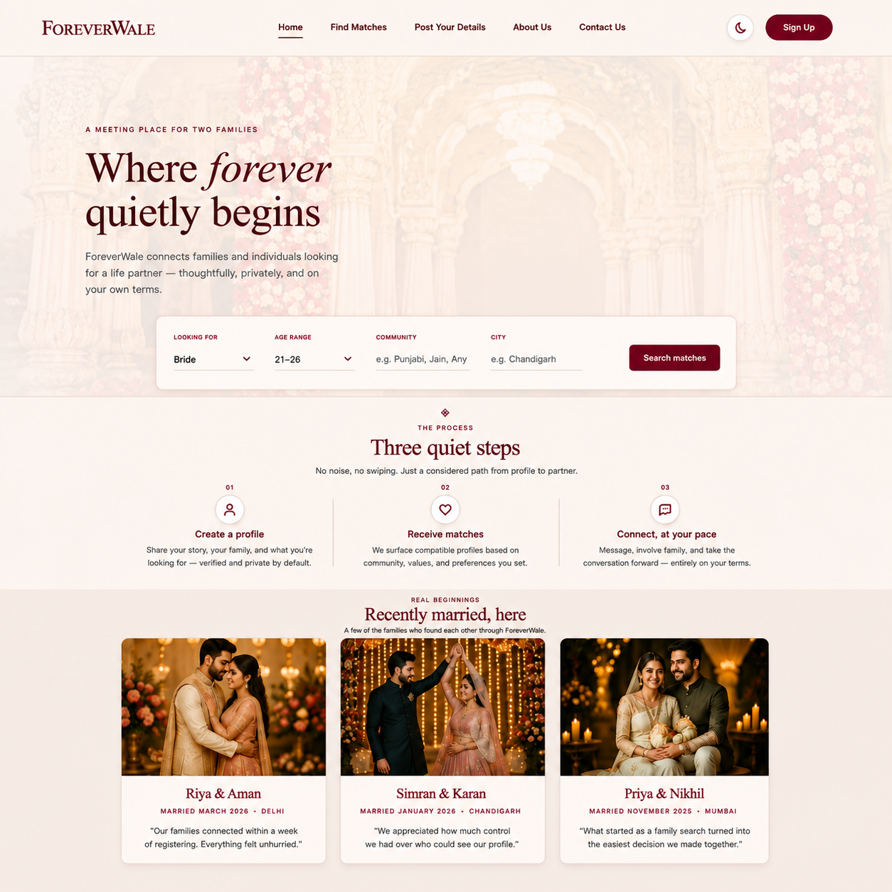
FW
ForeverWale
A Trusted & Family-Centric
Matrimonial Platform
PROJECT PRESENTATION • AUGUST 24-AUGUST 26
Prepared by: Project Team

Slide 2
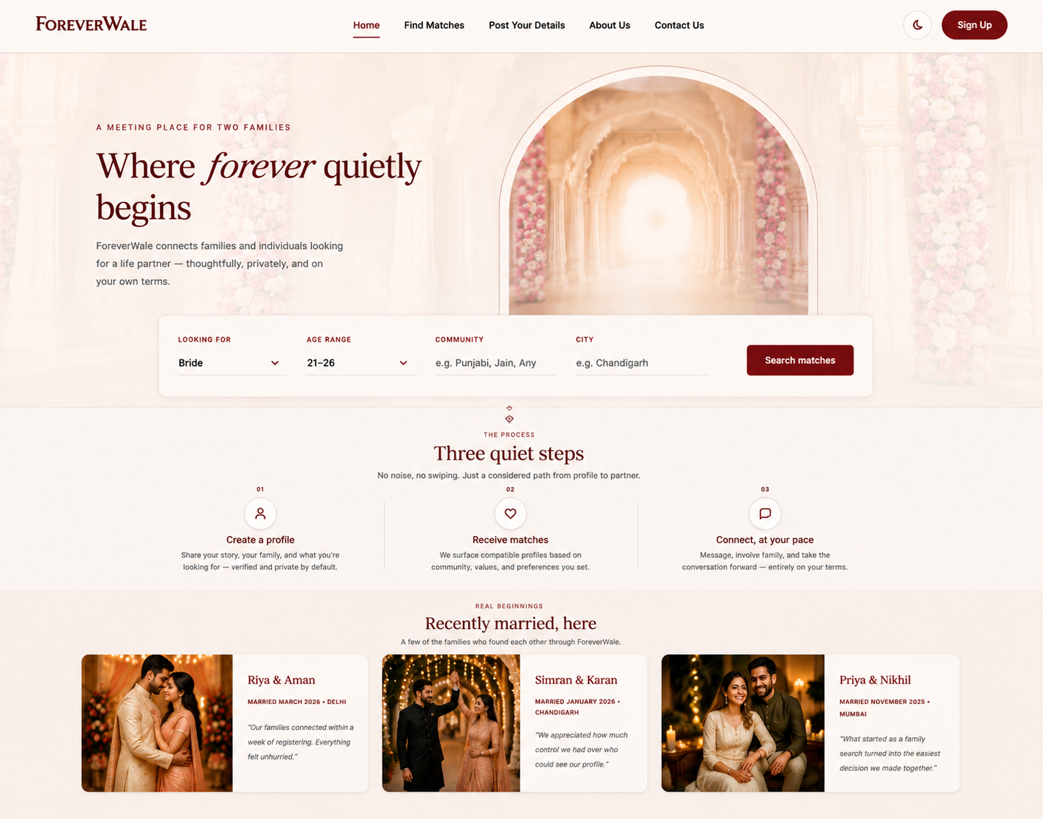
01
Project Overview
FOREVERWALE
Matchmaking built
around trust — and family.
ForeverWale is a family-oriented matrimonial website designed to make meaningful introductions feel safe, clear and respectful. It addresses the lack of trustworthy, family-first digital matchmaking through detailed profiles, useful filters and an easy-to-follow experience.
OBJECTIVE
A secure, approachable platform where families can discover compatible matches with confidence.

Slide 3
HOW IT'S BUILT
Technology stack
HTML5
CSS3
Vanilla JS
Responsive
SEMANTIC MARKUP
DESIGN SYSTEM
INTERACTIVITY
MOBILE-FIRST CSS
Shared header, nav, and footer structure across every page.
Custom properties for color and theme; Flexbox and CSS Grid for layout.
Theme toggle, mobile menu, form validation, and auth-state simulation.
Breakpoints tailored for mobile, tablet, and desktop viewports.
Shared assets/style.css and assets/app.js keep every new page visually and behaviorally consistent with the original homepage.
10

Slide 4
INFORMATION ARCHITECTURE
Site map
Home
Find Matches
Post Your Details
About Us
Contact Us
Sign Up
Sign In / Logout
→
Every page shares the same fixed navigation bar, so all six destinations are always one click away.
→
Sign Up / Sign In swap for Logout automatically once a session is active — simulated via localStorage.
→
The footer on every page mirrors the top navigation for quick access from anywhere on the site.
11

Slide 5
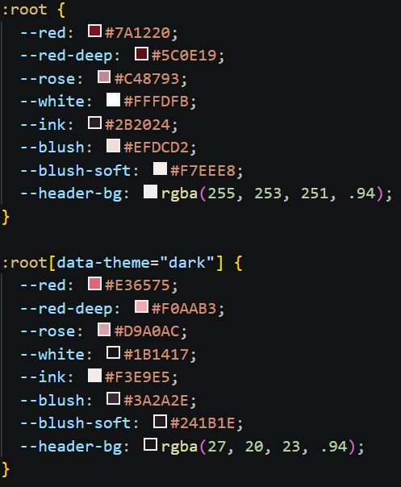
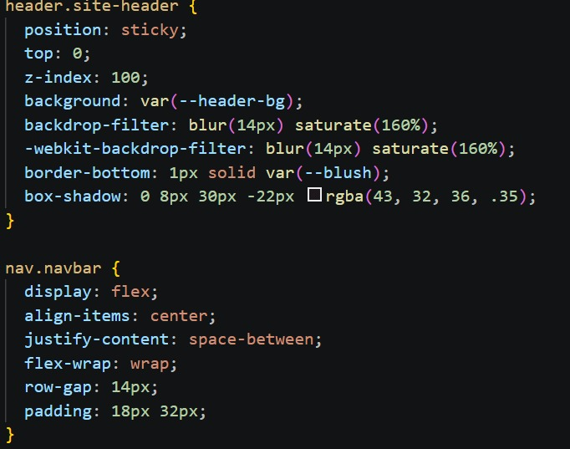
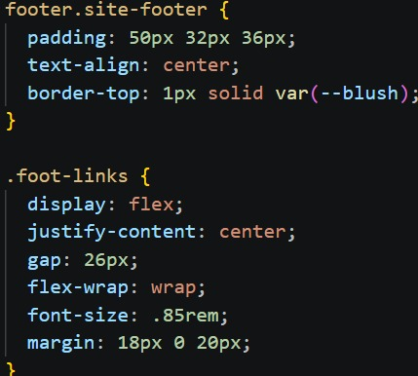
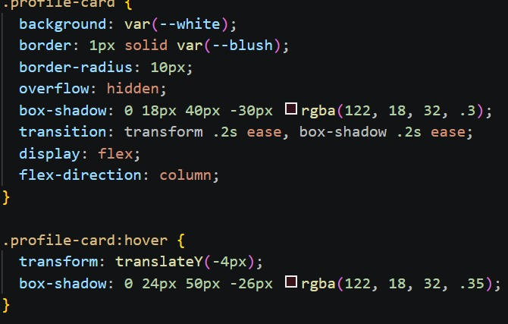
02
Common CSS
FOREVERWALE

Slide 6
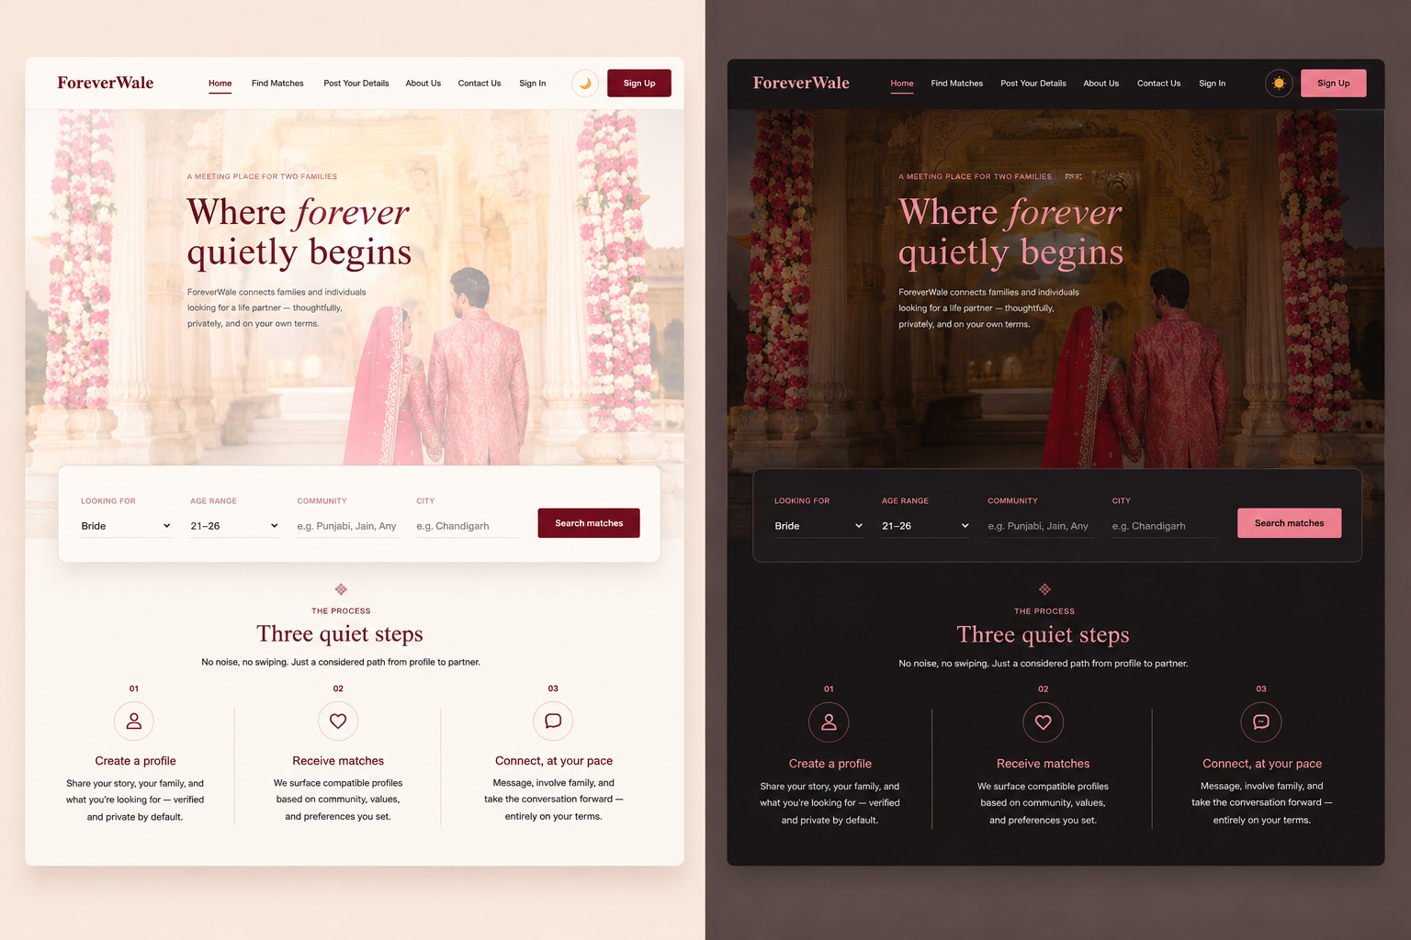
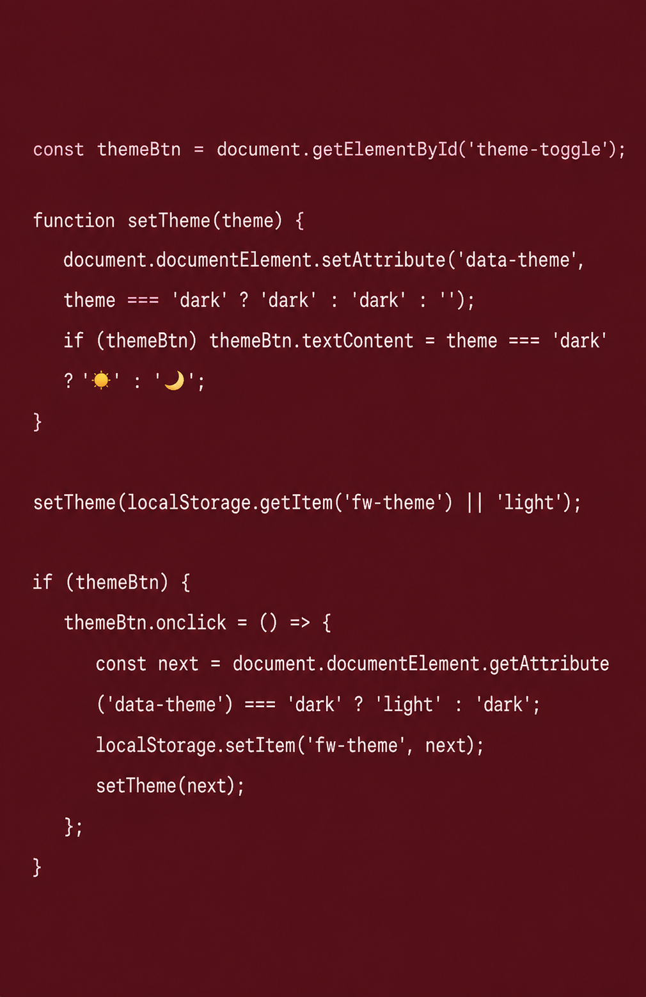
11
Light & Dark Mode
FOREVERWALE
:root[data-theme="dark"] {
--red: #E36575;
--red-deep: #F0AAB3;
--rose: #D9A0AC;
--white: #1B1417;
--ink: #F3E9E5;
--blush: #3A2A2E;
}
LIGHT ↔ DARK

Slide 7
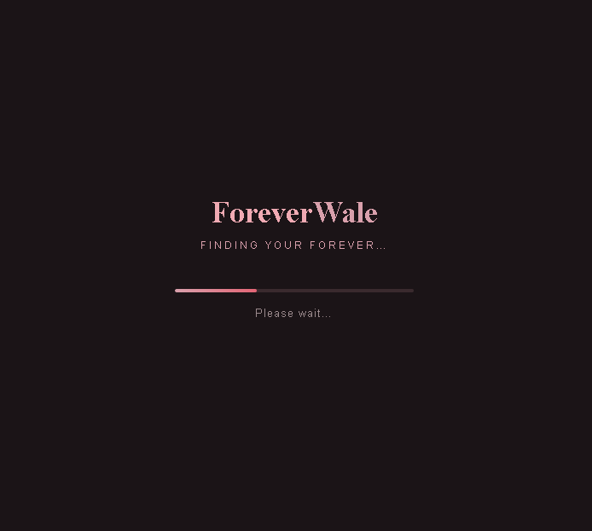
03
Loading UI
FOREVERWALE

Slide 8
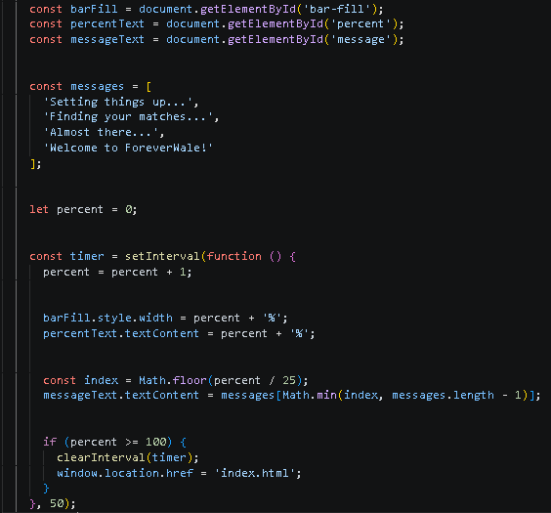
03
Loading UI JS
FOREVERWALE

Slide 9
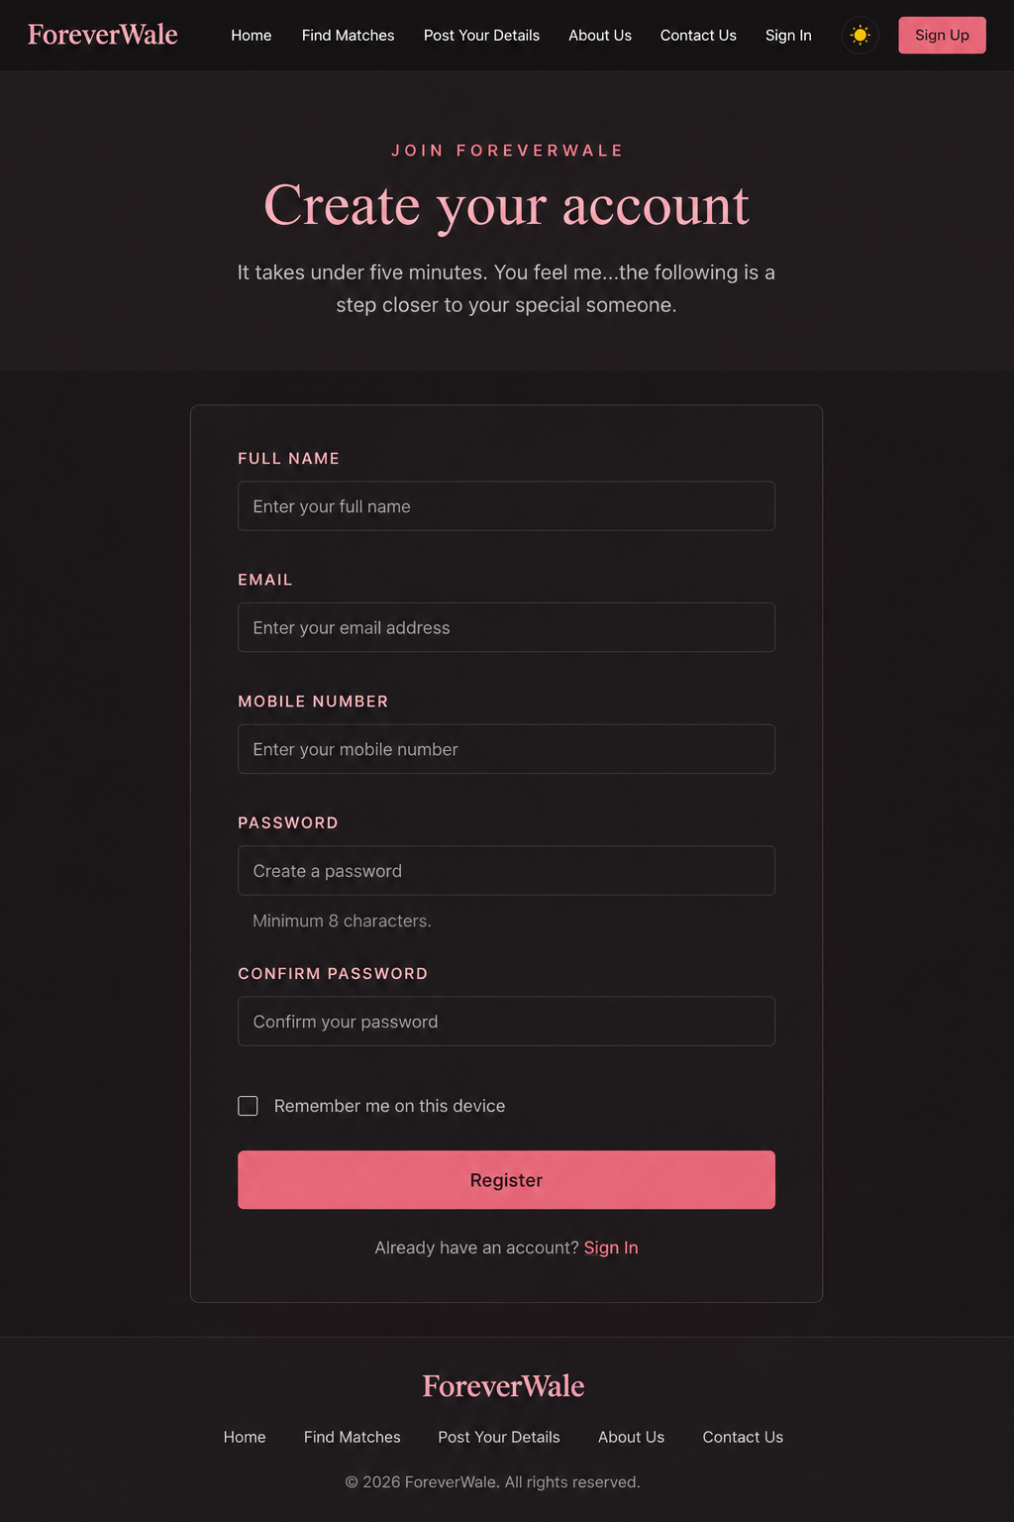
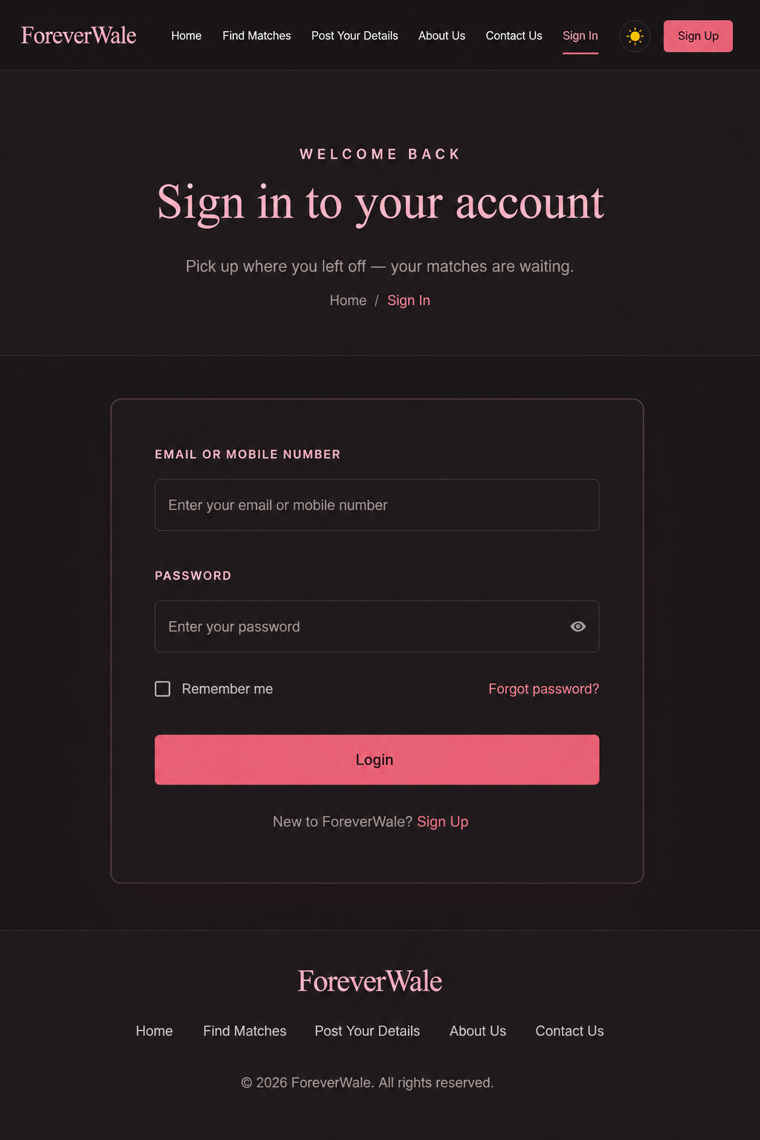
08
Sign UP AND Sign IN
FOREVERWALE

Slide 10
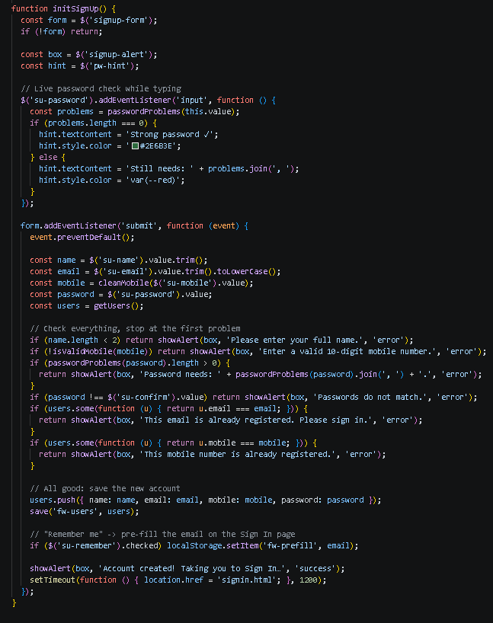
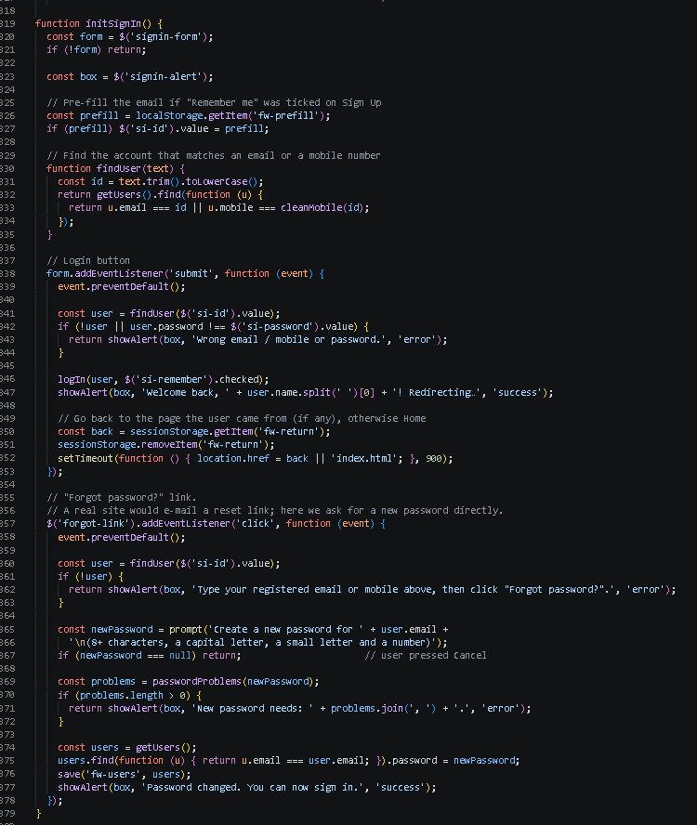
08
Sign UP AND Sign IN JS
FOREVERWALE

Slide 11
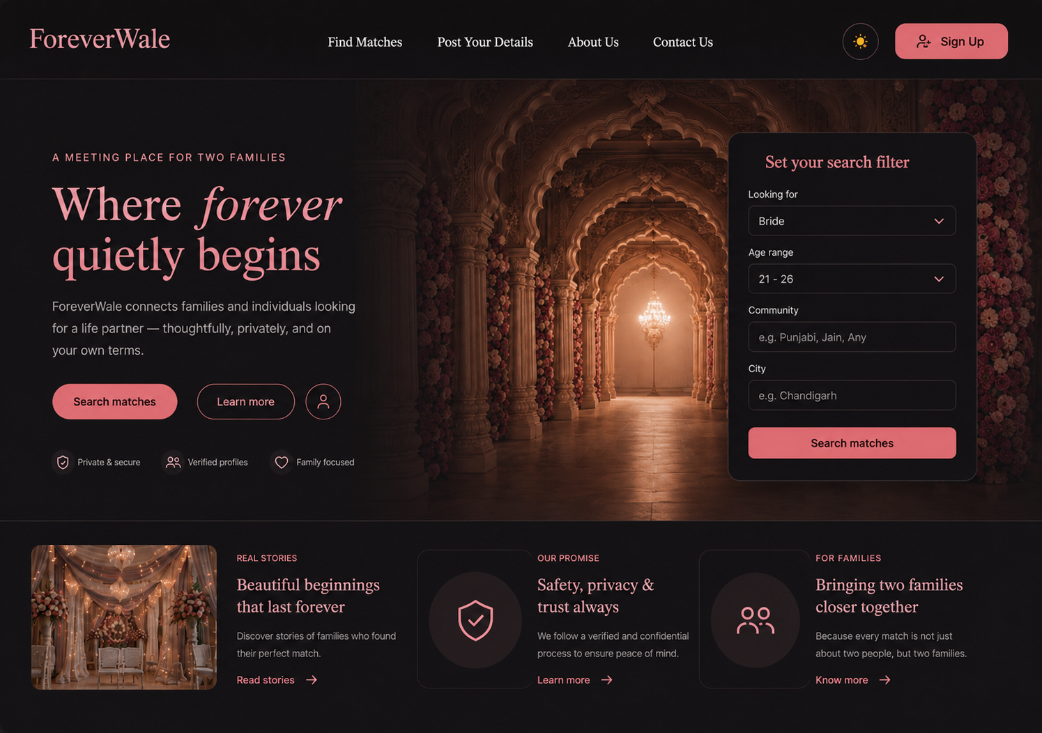
03
Homepage UI Breakdown
FOREVERWALE
Navigation + logo
Theme + sign up
Hero + primary CTA
Matching filters
Content sections
Footer
A clear path from emotional introduction → search → proof → action.

Slide 12
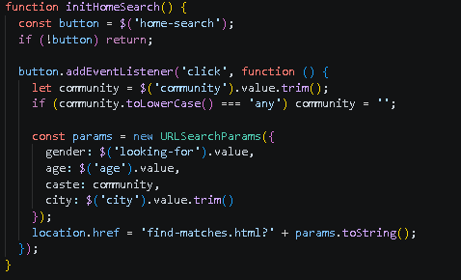
03
Homepage UI JS
FOREVERWALE

Slide 13
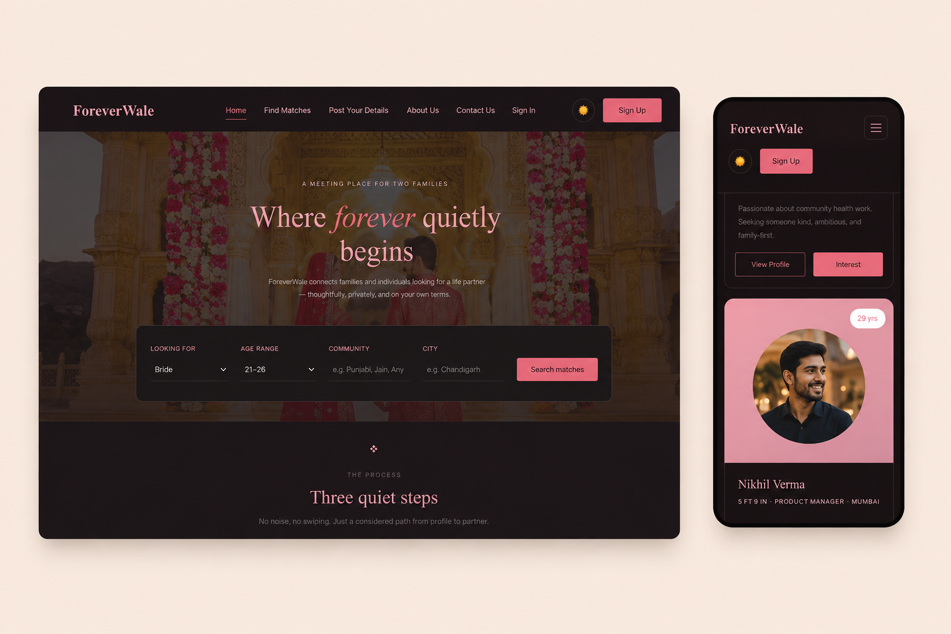
07
Responsive Design of Homepage UI
FOREVERWALE
@media (max-width: 880px) {
.nav-toggle { display: inline-flex; }
.nav-links {
width: 100%; max-height: 0;
overflow: hidden;
flex-direction: column;
}
}
Desktop → mobile: navigation becomes a clear vertical menu without sacrificing usability.

Slide 14
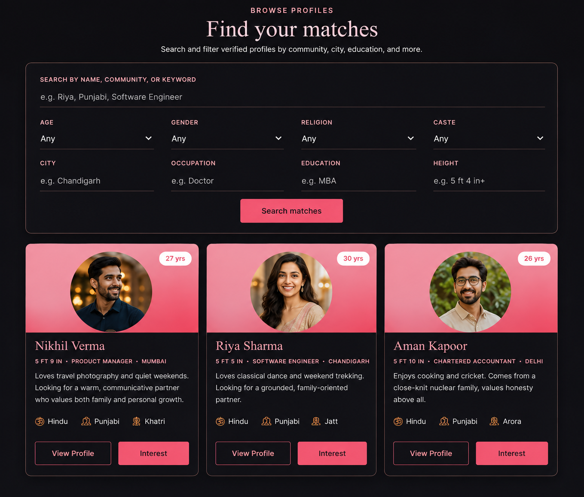
08
Find Matches UI
FOREVERWALE
Search Bar
Profiles

Slide 15
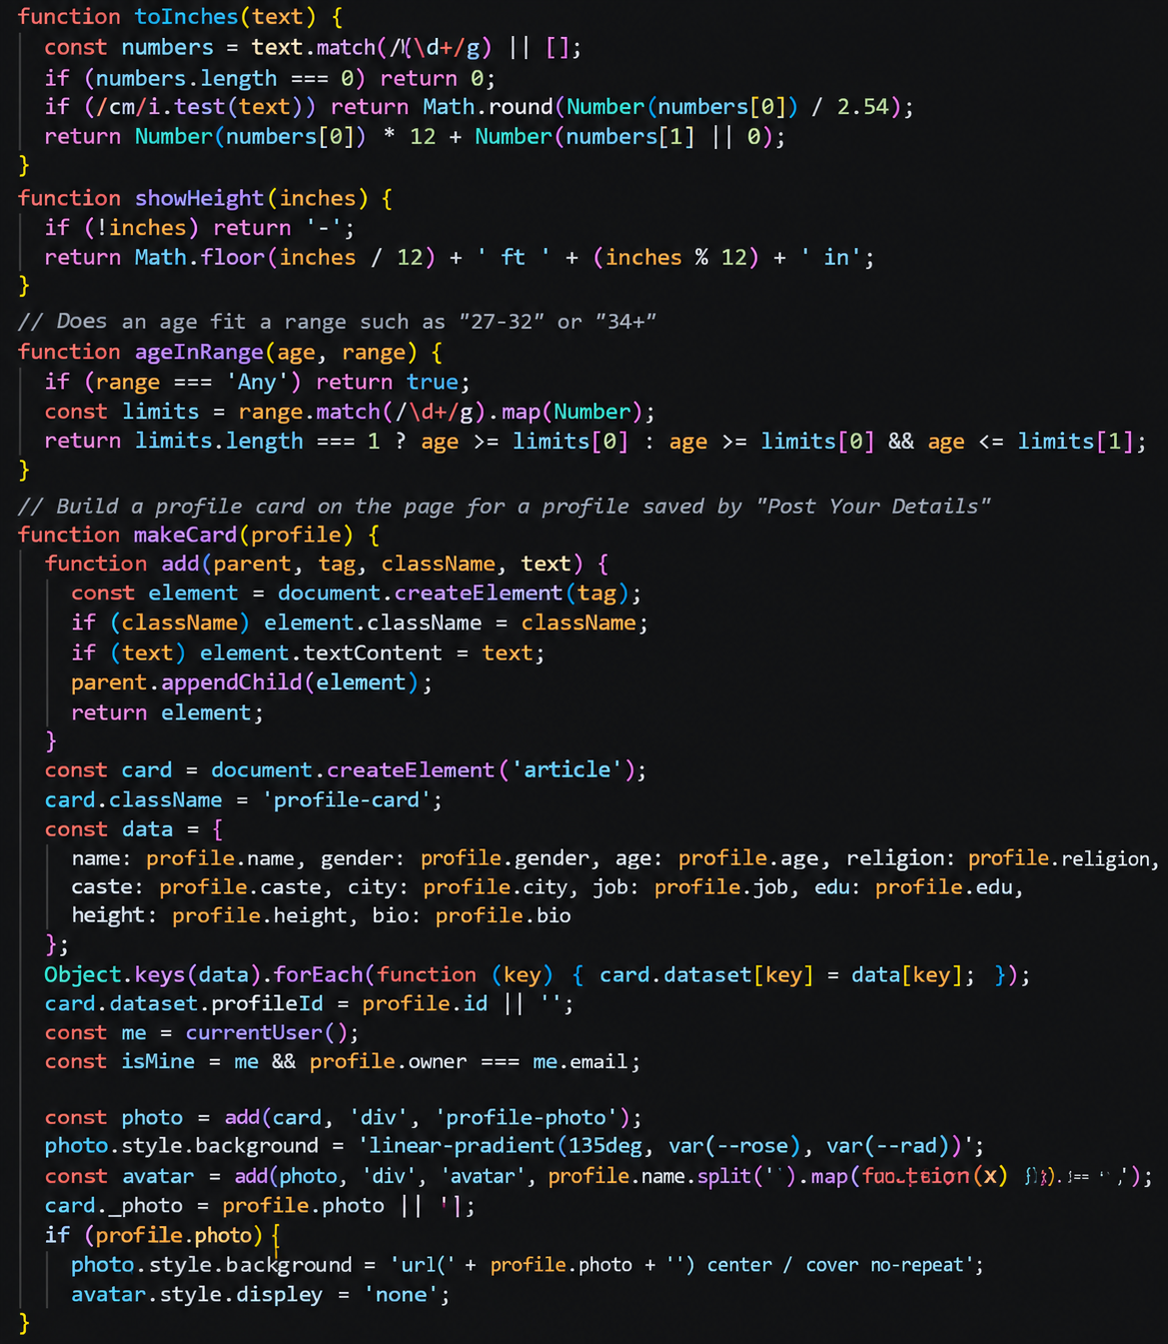
08
Find Matches UI JS
FOREVERWALE
Search Bar

Slide 16
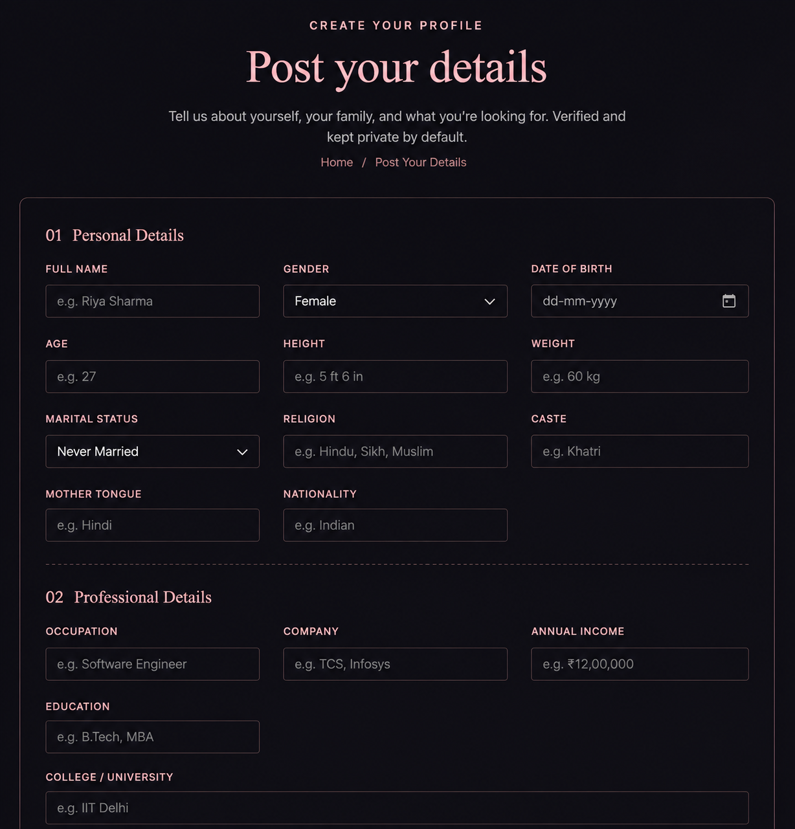
09
Post your details UI
FOREVERWALE
Details Posting
Personal Form

Slide 17
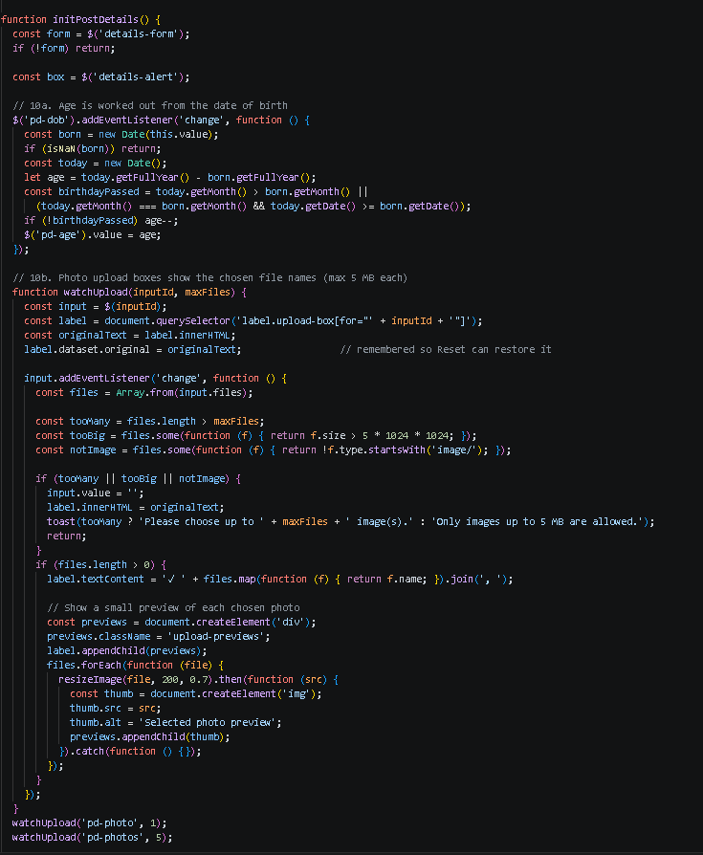
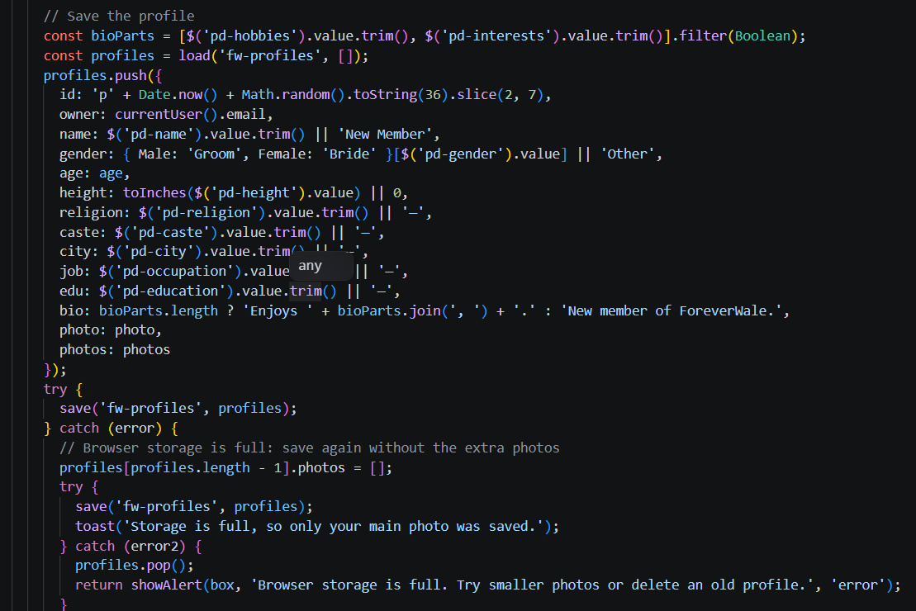
09
Post your details JS
FOREVERWALE

Slide 18
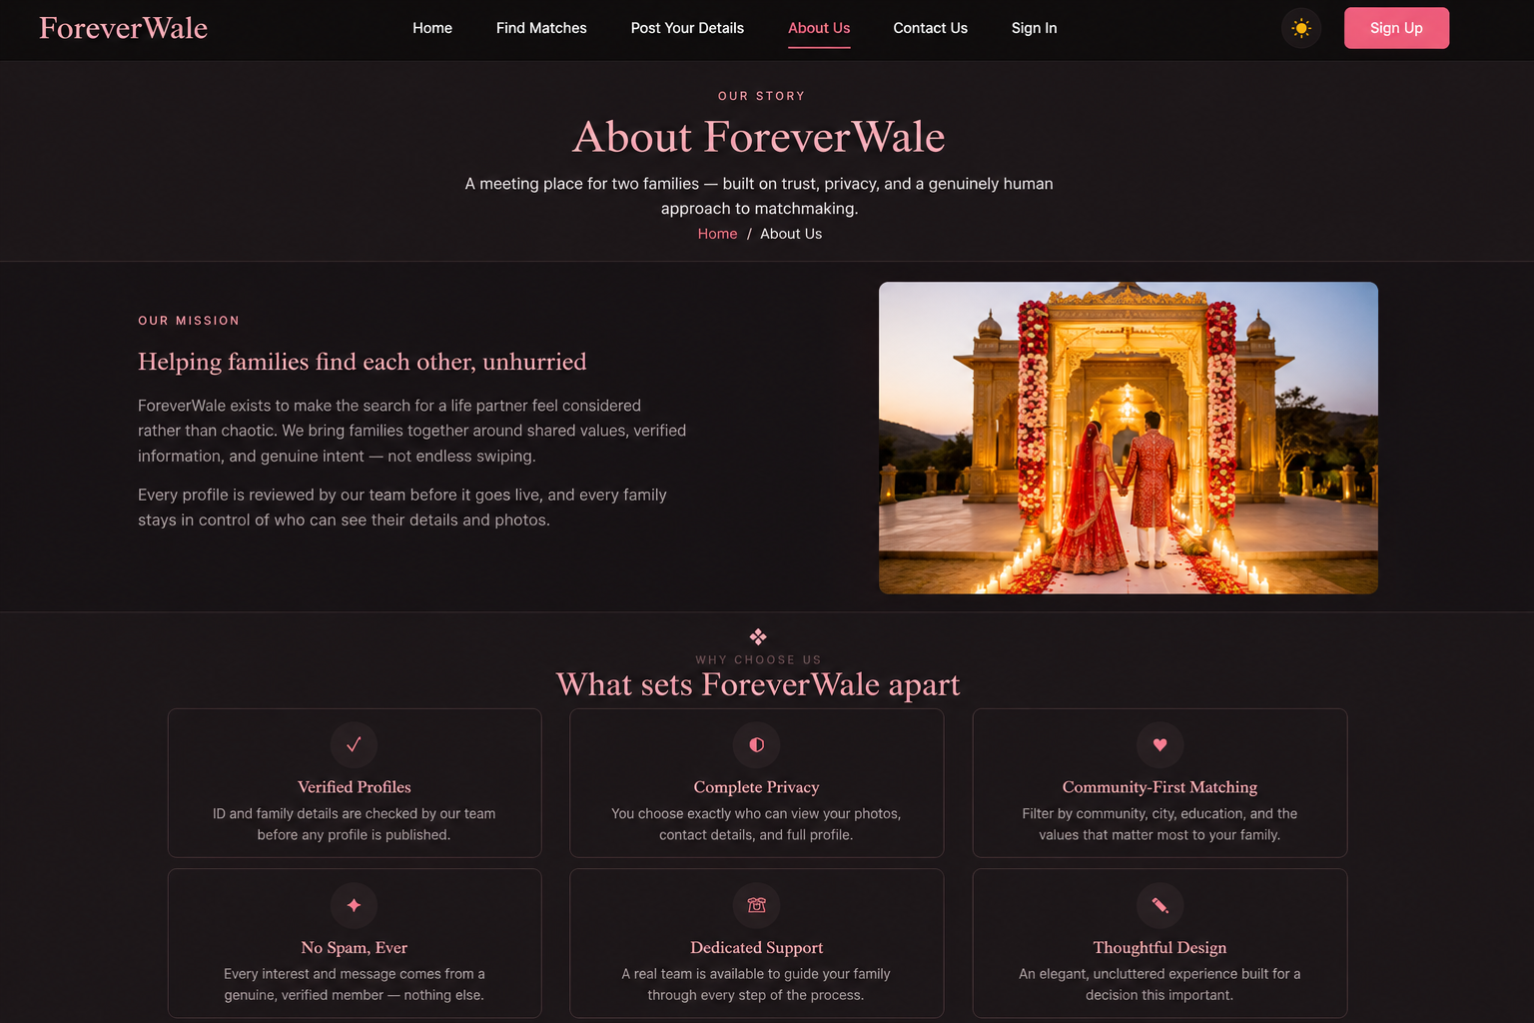
09
About Us UI
FOREVERWALE
Main Goal
Policies

Slide 19
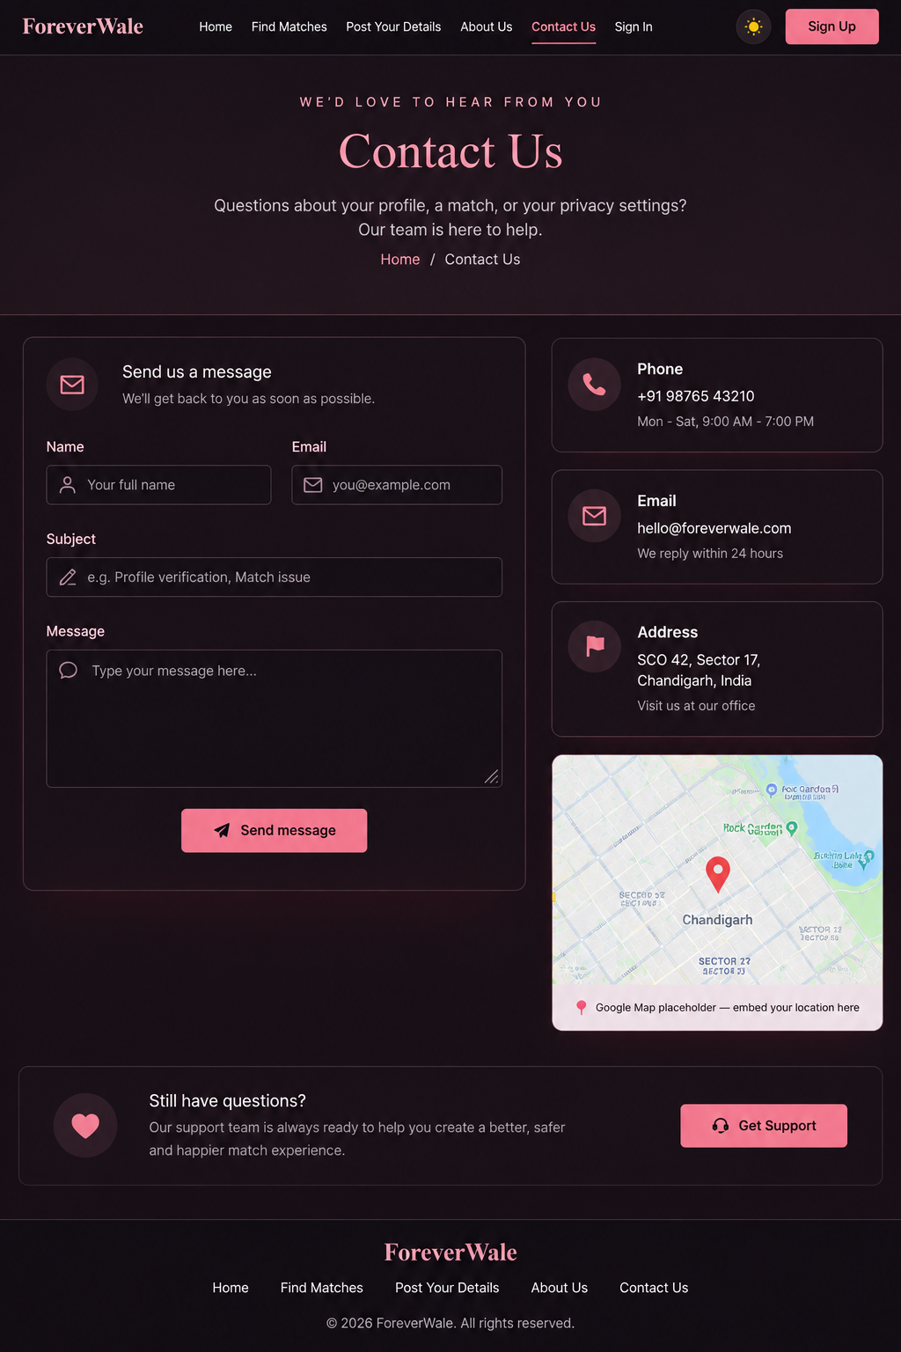
09
Contact Us UI
FOREVERWALE
Contact Details
Text Messages

Slide 20
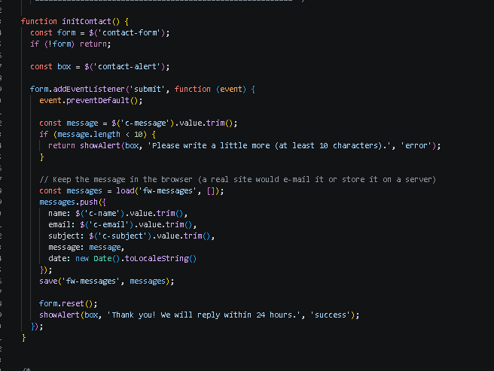
09
Contact Us UI JS
FOREVERWALE

Slide 21
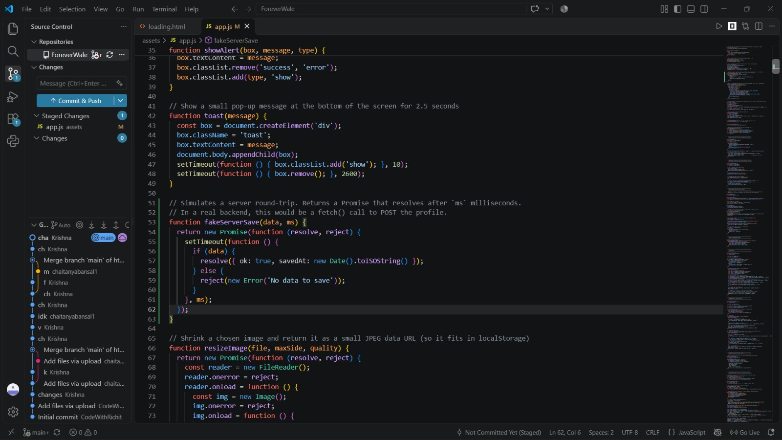
09
Promises JS
FOREVERWALE

Slide 22
13
Conclusion / Future Scope
FOREVERWALE
Built for trust.
Ready to grow.
FUTURE SCOPE
Backend + database
Verified authentication
Real-time messaging
Advanced match intelligence
Cloud deployment
Elegant family-centric experience
Responsive, accessible design system
Light and dark modes
Structured forms and navigation
Privacy-first UX
“ForeverWale — Bringing Families Together.”

