Slide 1
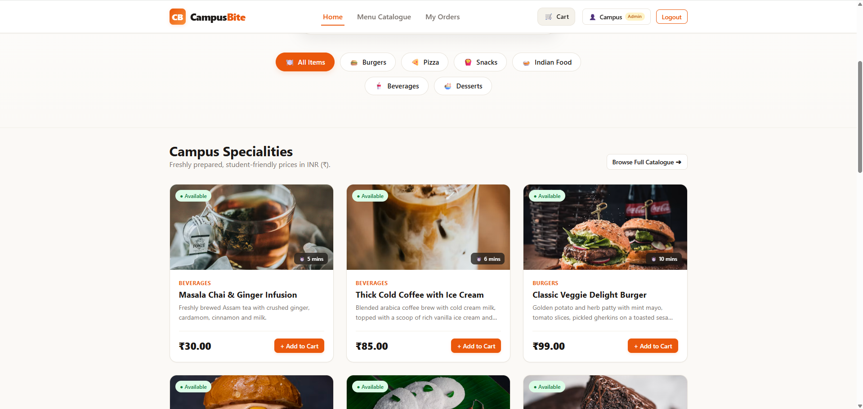
CSE326 WEB DEVELOPMENT ACADEMIC PROJECT
CampusBite
Smart Canteen Ordering System
An asynchronous, framework-free web platform engineered to eliminate peak-hour campus dining queues through digital ordering, transparent pricing, and real-time kitchen telemetry.
STUDENT PRESENTER: Pirzada Salik
COURSE & CODE: CSE326 — Web Development
OFFICIAL TEAM: [INSERT OFFICIAL TEAM NAME]
UNIVERSITY: [INSERT UNIVERSITY NAME]
● LIVE PRODUCTION APP | Native HTML5 + CSS3 + Vanilla ES6+ & Node.js
Notes:
Good morning respected faculty members and fellow classmates. My name is Pirzada Salik, and today I am excited to present CampusBite — a Smart Canteen Ordering System developed for our CSE326 Web Development course.
Campus dining is an essential part of university student life. However, during standard 15-minute lecture breaks, campus canteens face extreme physical bottlenecks. CampusBite solves this by digitizing the entire dining journey: from online menu discovery and transparent cart calculations to live kitchen telemetry and pickup tracking.
Over the next 8 minutes, I will guide you through the problem we tackled, the engineering and architectural decisions behind our framework-free tech stack, our live MongoDB Atlas integration, automated testing validation, and a live demonstration walkthrough. Let's begin.

Slide 2
CONTEXT & MOTIVATION
The Problem with Traditional Canteen Ordering
Why peak-hour campus dining operations break down during lecture intervals
01 Peak-Hour Counter Congestion
Lecture breaks release hundreds of students simultaneously into the canteen. Physical counters become overwhelmed as students attempt to view physical menus, place orders, and pay all at once.
02 Manual Order Taking & Verbal Friction
Handwritten slips and verbal orders lead to miscommunication, misplaced tokens, and wrong dishes prepared. Cash change shortages further delay transactions at payment registers.
03 Zero Real-Time Status Visibility
After paying, students wait in crowded waiting areas without knowing whether their food is queued, preparing, or ready. This creates anxiety, counter crowding, and missed class time.
04 Administrative Operational Blind Spots
Kitchen staff have no live visibility into incoming queue depth or item demand. Sold-out dishes cannot be dynamically hidden, resulting in frustrating manual cancellations and refunds.
CORE INSIGHT: The bottleneck in campus dining is not kitchen cooking speed — it is the synchronous friction of physical order placement and lack of status visibility.
CampusBite — Smart Canteen Ordering System | CSE326 Web Development
Slide 2 of 12
Notes:
To understand why CampusBite was needed, let's look at the daily reality of traditional university canteens.
Whenever classes dismiss, hundreds of students arrive at the canteen within a tight 10 to 15-minute window. This causes four distinct operational problems:
First, peak-hour counter congestion. Everyone crowds the register at the exact same moment to look at the printed menu, place an order, and pay.
Second, manual order-taking friction. Verbal and paper tickets lead to misplaced tickets, billing mistakes, and wasted time searching for cash change.
Third, zero real-time status visibility. Once a student pays, they have no idea whether their meal will take 5 minutes or 25 minutes. They are forced to wait near the counter, causing secondary crowd congestion.
And fourth, operational blind spots for canteen staff. Kitchen operators cannot see incoming queue depth or predict peak dish demands.
CampusBite was engineered specifically to decouple order placement from counter presence, turning chaotic physical queues into an orderly, asynchronous digital workflow.

Slide 3
PRODUCT OVERVIEW
Introducing CampusBite — Smart Digital Ordering
A full-stack, contactless canteen management ecosystem designed for modern campuses
✓ Digital Menu Discovery
Students browse categorized items with live stock badges, prices, and base preparation times.
✓ Transparent Cart & Pricing
Persistent client cart computing exact subtotal, 5% GST, and flat ₹10 convenience fee with zero ambiguity.
✓ Unique Order Token Engine
Issues unique tokens (e.g. #CB-521323) upon checkout for quick, error-free counter food pickup.
✓ Live 4-Stage Status Tracking
Students track orders through Placed, Preparing, Ready, and Completed via automated 4.5s API polling.
✓ Centralized Kitchen Command
Single dashboard for canteen operators to adjust item availability, manage queue, and monitor revenue.
Actual Landing Page (/index.html) — Live Food Categories & Real-Time Stock Status
CampusBite — Smart Canteen Ordering System | CSE326 Web Development
Slide 3 of 12
Notes:
CampusBite introduces a modern digital transformation for university dining.
Instead of rushing to a physical counter, students open CampusBite from any browser on their mobile phone or laptop. They browse a clean, categorized menu showing live dish availability and base preparation times. They add items to their cart, review an exact, transparent bill with 5% GST and campus convenience fees, and confirm their order in seconds.
Upon checkout, the system issues a unique, 6-digit order token — such as `#CB-521323`. The student can sit comfortably in the library or campus quad while tracking their order through four clear stages: Placed, Preparing, Ready, and Completed.
Meanwhile, canteen staff manage incoming orders on a centralized dashboard. They can adjust item availability with a single click, advance order statuses as meals are cooked, and monitor daily revenue streams.
The screenshot on the right is captured directly from our running application — clean, modern, and built entirely using standard web technologies.

Slide 4
CORE FUNCTIONALITY
One Platform, Two Dedicated Experiences
Tailored, synchronized workflows for students and canteen administrators
STUDENT PORTAL (Self-Service Ordering)
• User Authentication: Secure registration & login with persistent session cookies
• Menu Search & Filters: 6 food categories (Burgers, Pizza, Snacks, Indian, Drinks, Desserts)
• Persistent Shopping Cart: Client-side storage with quantity clamps (1–20 per item)
• Counter Payment Support: Select 'Cash at Counter' or 'UPI at Counter' (GPay/PhonePe)
• Live Kitchen Tracking: Visual progress stepper with estimated prep time countdown
• Self-Service Cancellation: Immediate cancellation allowed exclusively in 'Placed' status
• Order History Ledger: Access all past and active orders with digital receipts
CANTEEN ADMIN PORTAL (Kitchen Operations)
• Command Overview Dashboard: Live KPIs: Total Orders, Gross Revenue, Active In-Kitchen volume
• Live Kitchen Order Queue: Sortable order stream with direct status dropdown controls
• 4-Stage Lifecycle Control: Enforce transitions: Placed ➔ Preparing ➔ Ready ➔ Completed
• Counter Payment Settlement: Collect and verify Cash/UPI; auto-settles to 'Paid' on completion
• Menu Management CRUD: Add dishes, update prices, edit prep times, and toggle sold-out state
• Sales & Demand Analytics: 7-day revenue trajectory bar charts and top-selling food items
• Role-Based Route Guards: Strict authorization blocking unauthorized student access to admin APIs
Architectural Scope: Single centralized canteen administration. No separate multi-vendor panel required.
CampusBite — Smart Canteen Ordering System | CSE326 Web Development
Slide 4 of 12
Notes:
CampusBite is structured around two dedicated experiences: the Student experience and the Administrator experience.
For students, the platform provides a complete self-service portal. They can register, log in, filter dishes by category, customize orders with special kitchen instructions, select counter payment options, and monitor their order progress. If their plans change, they can even cancel their order directly from their dashboard — provided the kitchen hasn't started preparation yet.
For canteen operators, CampusBite acts as an operational command center. Staff can view active orders in real time, transition order statuses as food moves through the kitchen, mark payments collected at the counter, toggle out-of-stock items instantaneously, and analyze 7-day revenue trends.
Importantly, we architected this as a focused single-canteen administration system, avoiding unnecessary multi-vendor abstractions while delivering production-grade reliability.

Slide 5
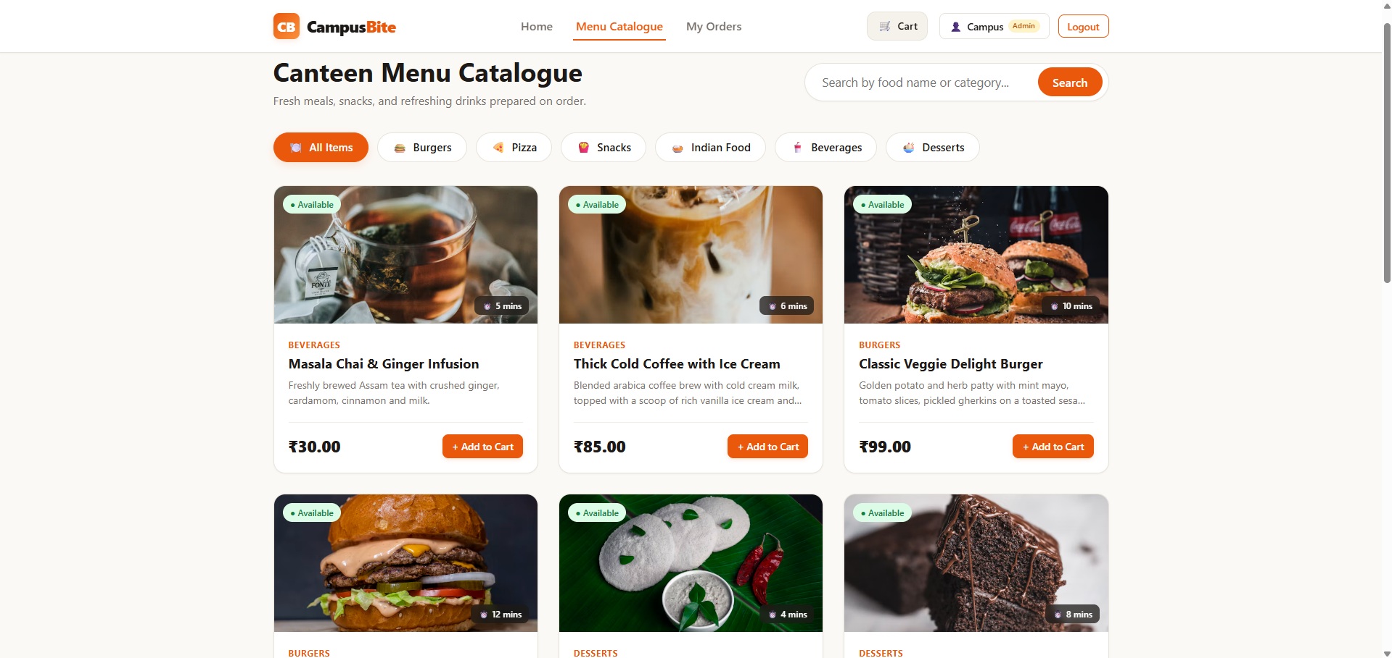
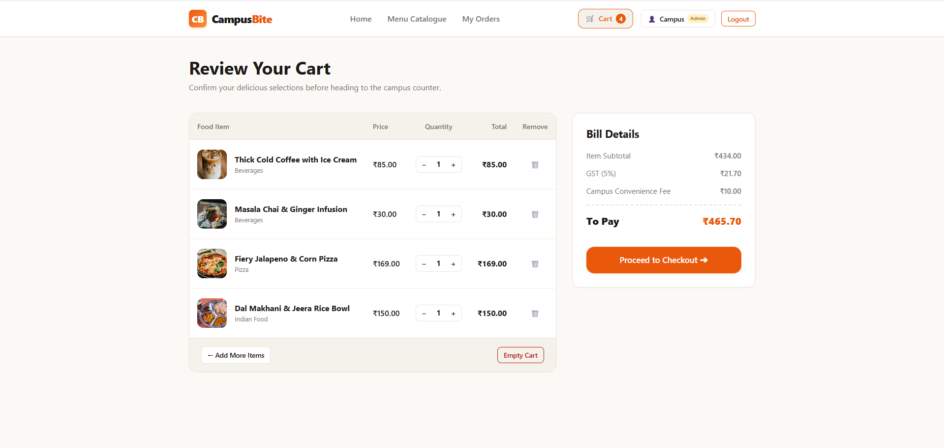
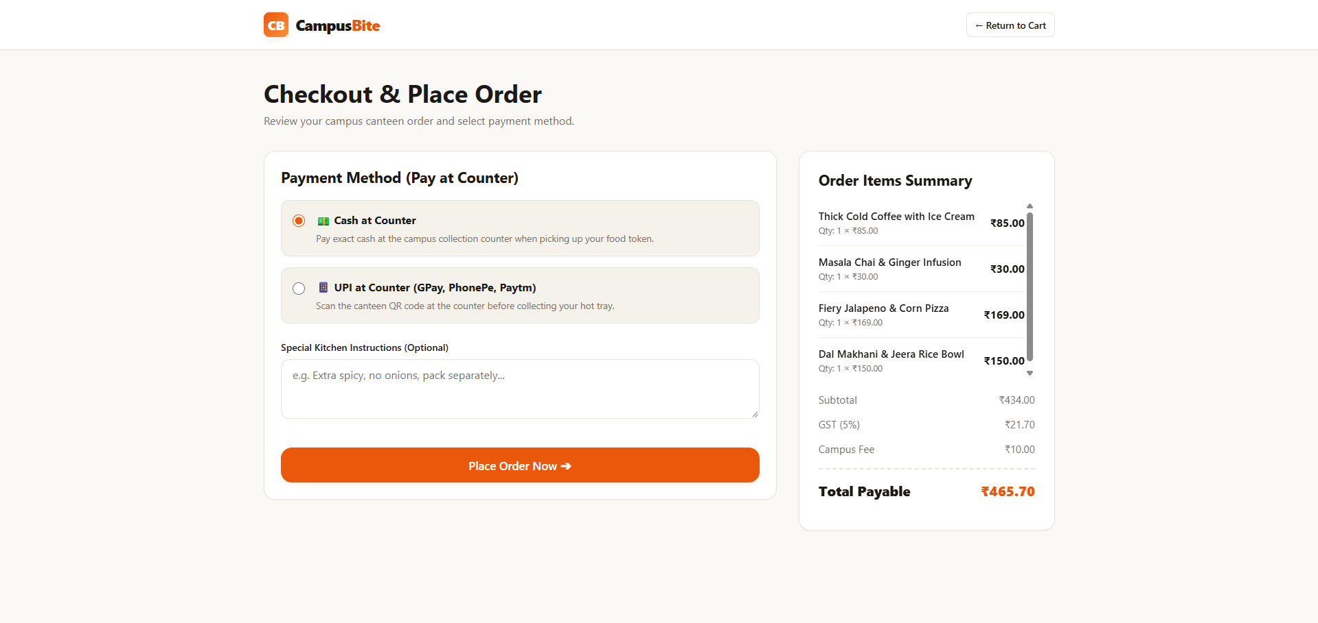
USER EXPERIENCE & FLOW
Student Experience: From Browsing to Ordering
A 3-step streamlined path from campus discovery to order token generation
STEP 1: DISCOVER
Menu Catalogue
STEP 2: REVIEW
Shopping Cart
STEP 3: CHECKOUT
Payment & Notes
Instant category filtering, search by dish name, live availability indicators, and base preparation times (5m, 10m).
Transparent bill calculation: Item subtotal (₹434.00), 5% GST (₹21.70), and flat ₹10.00 campus fee = ₹465.70.
Select 'Cash at Counter' or 'UPI at Counter', add optional kitchen instructions, and submit with duplicate protection.
CampusBite — Smart Canteen Ordering System | CSE326 Web Development
Slide 5 of 12
Notes:
Let's look at the actual student journey through these three high-resolution screenshots captured directly from our running application.
In Step 1, the student visits the Menu Catalogue. They can filter across categories like Beverages, Burgers, and Indian Food, or use the instant search bar. Every dish displays high-definition imagery, pricing, and base preparation times so students can make informed dining decisions.
In Step 2, items added to the cart are reviewed. Notice the bill breakdown on the right: the item subtotal of ₹434, the exactly calculated 5% GST of ₹21.70, and our flat ₹10 campus convenience fee, totaling ₹465.70.
In Step 3, the student proceeds to Checkout. Since our campus canteen uses counter payments, the student selects either Cash at Counter or UPI at Counter (for Google Pay, PhonePe, or Paytm). They can attach kitchen notes — such as 'extra spicy' or 'pack separately' — and submit their order.
All of this is implemented using pure HTML5 and vanilla JavaScript — zero front-end frameworks, zero external UI libraries.

Slide 6
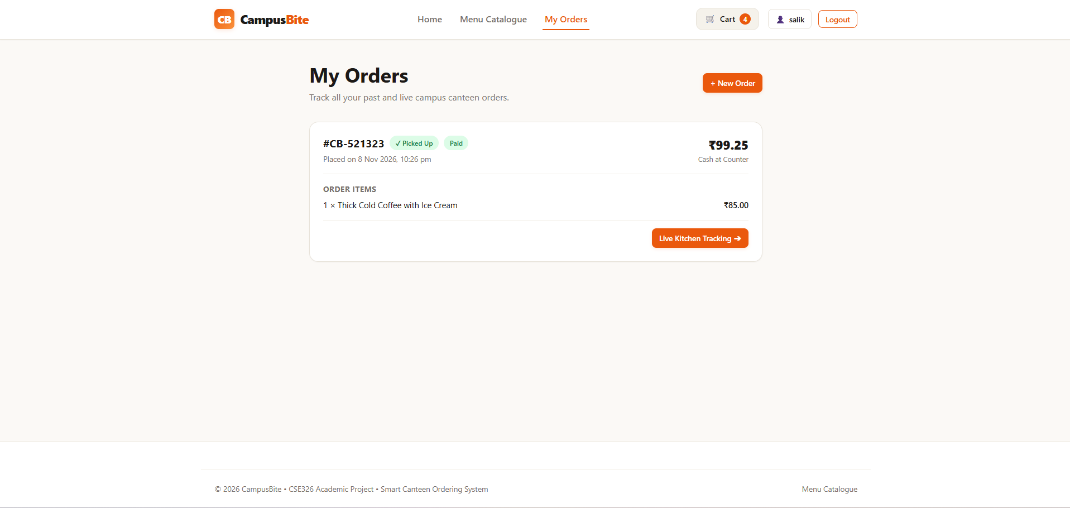
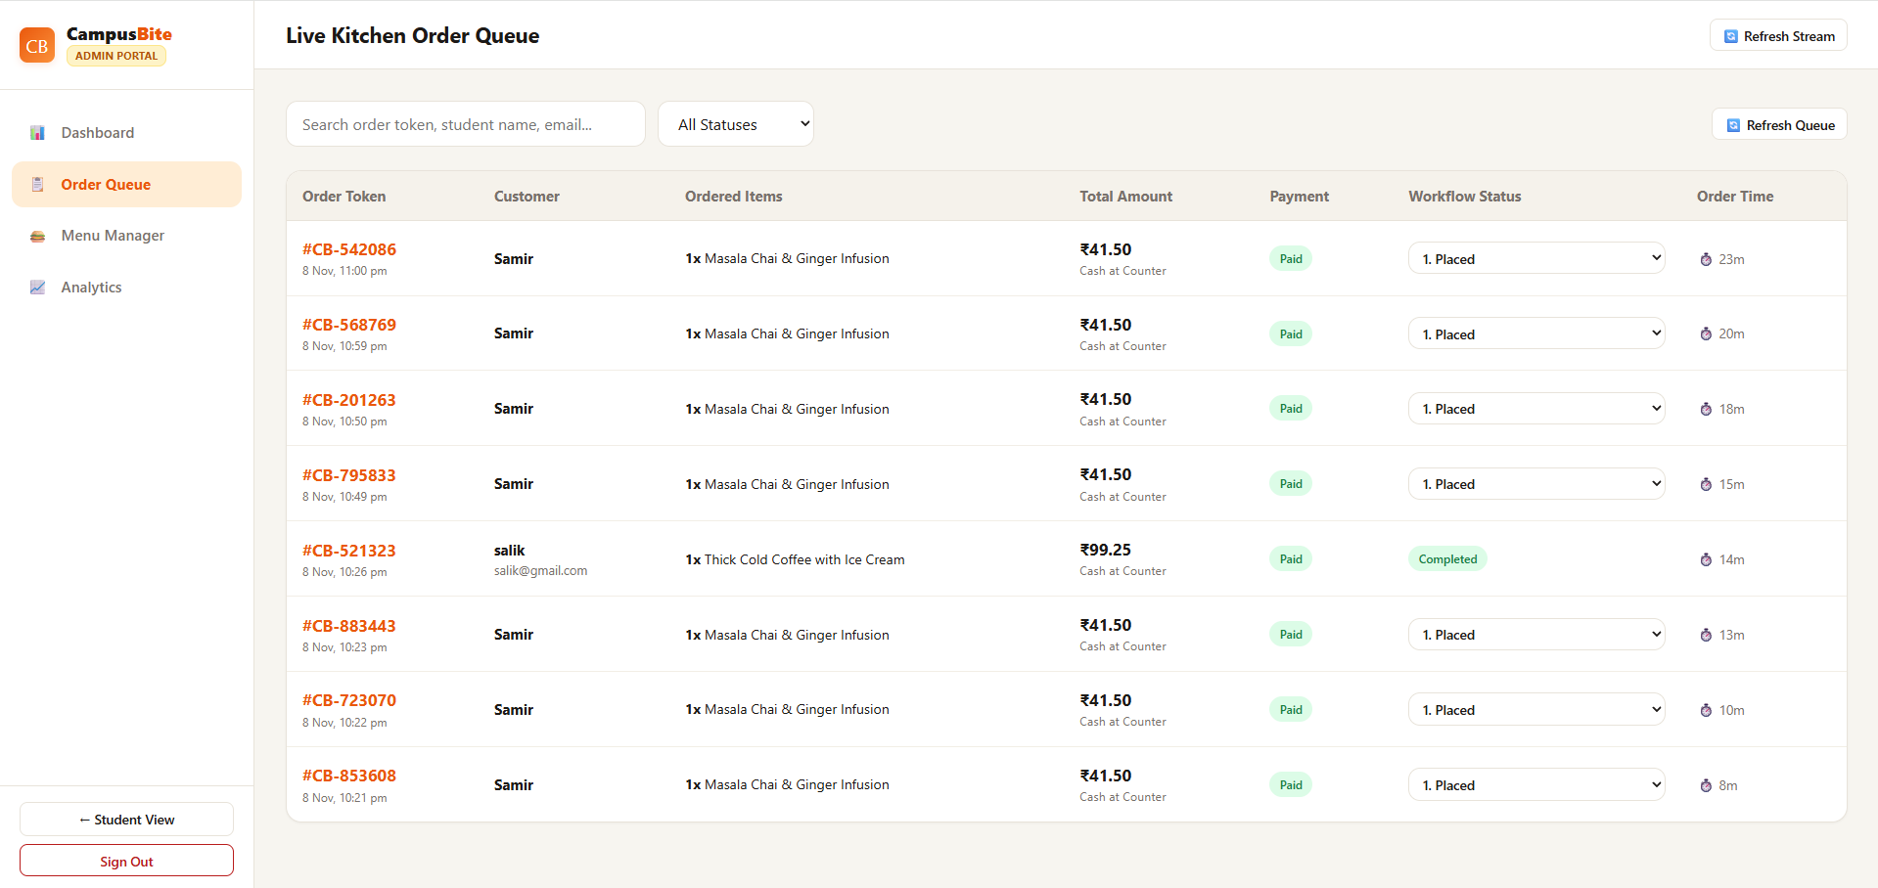
OPERATIONAL SYNCHRONIZATION
Complete Order Visibility & Kitchen Workflow
Real-time coordination connecting student status tracking with kitchen fulfillment
STUDENT VIEW: ORDER STATUS & TRACKING
ADMIN VIEW: LIVE KITCHEN ORDER QUEUE
Unique token #CB-521323 with live kitchen tracking trigger & pickup indicators.
Kitchen coordinators advance statuses, inspect items, and track elapsed order times.
ORDER LIFECYCLE STATE MACHINE (SERVER-ENFORCED):
1. Placed ➔ 2. Preparing ➔ 3. Ready ➔ 4. Completed
• Cancellation Guard: Allowed ONLY in 'Placed' state. Once 'Preparing' begins, kitchen lock prevents cancellation.
• Update Protocol: Client polls GET /api/orders/:id every 4.5 seconds for instant reflection without WebSocket overhead.
CampusBite — Smart Canteen Ordering System | CSE326 Web Development
Slide 6 of 12
Notes:
Here we see how CampusBite synchronizes the student and the kitchen staff.
On the left, the student sees their personal Orders page. Each order receives a unique, human-readable token like `#CB-521323`. Students can click 'Live Kitchen Tracking' to view a real-time progress bar. The client polls our REST API every 4.5 seconds to refresh the order state smoothly without the complexity and resource overhead of persistent WebSockets.
On the right is the Administrator's Live Kitchen Order Queue. Kitchen staff see incoming orders immediately, complete with customer names, ordered items, and total bills. Using the status dropdown, the kitchen manager transitions orders through our strict state machine:
First, Placed. While in Placed, students can cancel if needed.
Second, Preparing. Once the kitchen switches the order to Preparing, the backend locks cancellation permanently.
Third, Ready. When cooking is finished, the order is marked Ready, alerting the student to approach the counter.
And fourth, Completed. When the food is handed over, the order moves to Completed, automatically marking the counter payment as Paid. Completed orders cannot be reopened.

Slide 7
SYSTEM ARCHITECTURE
System Architecture: Three-Tier Foundation
Framework-free engineering meeting CSE326 faculty requirements with production rigor
TIER 1: PRESENTATION
Client Browser
• Frontend Stack: Pure HTML5, Semantic CSS3, Vanilla ES6+ JavaScript
• No Frameworks: Zero React, Vue, Angular, TypeScript, Tailwind, or Bootstrap
• DOM & State: Native Fetch API, DOM manipulation, responsive CSS Grid & Flexbox
• Persistence: Session cookies & localStorage for responsive client state
TIER 2: APPLICATION
Node.js + Express 5
• Server Runtime: Node.js v24 LTS + Express.js 5.3 REST API engine
• Security Layers: Helmet security headers, express-rate-limit protection
• Clean Structure: Controllers delegate logic to services (orderService, menuService)
• Session Auth: express-session authenticated via connect-mongo & bcryptjs
TIER 3: DATA TIER
MongoDB Atlas Cloud
• Cloud Cluster: AWS-hosted MongoDB Atlas with TLS encryption & replica sets
• Official Driver: Native MongoDB Node.js Driver v7 (Strictly No Mongoose)
• Direct Operations: BSON ObjectIds, native aggregation pipelines, atomic updates
• Index Optimization: Unique email, unique orderNumber, and query status indexes
END-TO-END HTTP REQUEST / RESPONSE PIPELINE:
Student/Admin Browser ➔ Express Router ➔ Auth Middleware ➔ Controllers ➔ Services ➔ MongoDB Atlas
Every endpoint responds with uniform JSON shape: { success: true|false, data?: ..., message?: ... }
CampusBite — Smart Canteen Ordering System | CSE326 Web Development
Slide 7 of 12
Notes:
Let's examine the system architecture of CampusBite. The application is built upon a clean, decoupled three-tier architecture adhering strictly to the CSE326 course requirements.
At the Presentation Tier, we run a pure, framework-free frontend. We use standard HTML5, CSS3 with CSS variables and responsive Grid layouts, and vanilla ECMAScript 6+. We do not use React, Angular, Vue, Tailwind, or jQuery. Everything is native, lightweight, and loads instantly.
At the Application Tier, we have a Node.js server running Express.js 5. The server enforces security through Helmet headers, rate-limits sensitive authentication endpoints, and manages user sessions. The backend follows a clean separation of concerns: route handlers pass requests through authentication middleware into thin controllers, which delegate business logic to isolated domain services.
At the Data Tier, we connect directly to a cloud MongoDB Atlas cluster using the official MongoDB Node.js driver — no Mongoose ORM. Session state is stored persistently in MongoDB via connect-mongo, ensuring logins survive server restarts.
This request pipeline guarantees that every incoming API call is validated, authorized, and processed with predictable latency.

Slide 8
DATABASE ENGINEERING
Database Design: Collections & Document Schemas
High-performance document storage using the official MongoDB Node.js driver
db.users — User Authentication & Profiles
• Fields: _id, name, email, passwordHash, role, createdAt
• Roles: 'student' | 'admin' (strictly validated)
• Security: Passwords hashed via bcrypt (10 rounds); never stored in plain text
• Indexes: Unique index on email (prevents duplicate registrations)
db.menuItems — Food Catalogue & Availability
• Fields: _id, name, description, price, category, isAvailable, preparationTime
• Categories: Burgers, Pizza, Snacks, Indian Food, Beverages, Desserts
• Prep Times: Individual dish cooking durations in minutes (e.g. 5m, 12m)
• Indexes: Secondary indexes on category and isAvailable for fast lookups
db.orders — Order Lifecycle & Transactions
• Fields: orderNumber, userId, items[], subtotal, tax, campusFee, totalAmount
• State Machine: status: 'Placed' | 'Preparing' | 'Ready' | 'Completed' | 'Cancelled'
• Payment: paymentMethod ('Cash/UPI at Counter'), paymentStatus ('Pending'|'Paid')
• Integrity: Unique index on orderNumber; sparse index on idempotencyKey
db.sessions — MongoDB Session Persistence
• Engine: connect-mongo v6 storing Express session state directly in Atlas
• Fields: _id (session ID), session (JSON payload), expires (timestamp)
• Durability: User authentication persists seamlessly across server reboots
• TTL Index: Automatic background expiration of inactive sessions
CampusBite — Smart Canteen Ordering System | CSE326 Web Development
Slide 8 of 12
Notes:
Moving to the database design: CampusBite stores all persistent data across four core collections in MongoDB Atlas.
First is the 'users' collection. It stores user credentials with roles of either 'student' or 'admin'. To prevent duplicate accounts, a unique index is enforced on the email field. Passwords are never stored in plain text; they are hashed with bcrypt.
Second is the 'menuItems' collection. Each document contains the dish name, description, price, category, estimated prep time, and an 'isAvailable' boolean flag. We created secondary indexes on category and availability to enable lightning-fast menu queries.
Third is the 'orders' collection. When an order is placed, we embed a snapshot of the ordered items containing the item name, price, and quantity at the time of purchase. This guarantees historical financial integrity even if menu prices change later. The collection features a unique index on orderNumber and a sparse index on idempotencyKey.
Finally, the 'sessions' collection is maintained automatically by connect-mongo. When a user logs in, Express creates a session cookie that maps to this collection. MongoDB uses a TTL index to expire inactive sessions automatically.

Slide 9
BACKEND ALGORITHMS & LOGIC
Engineering Beyond the Interface: Backend Integrity
Defensive programming, zero client trust, and mathematical precision
1. Zero-Client-Trust Price Recalculation
Client sends only menuItemId and quantity. The server queries authoritative prices directly from MongoDB, recalculating subtotals to completely prevent client-side tampering.
2. Idempotency-Based Duplicate Prevention
Every checkout submits an idempotencyKey. Rapid double-clicks or browser retries return the existing order without creating duplicate kitchen tickets or double charges.
3. Controlled State Machine & Auto-Settlement
State transitions follow strict rules: Placed ➔ Preparing ➔ Ready ➔ Completed. Transition to Completed automatically marks counter payment as 'Paid'.
4. Smart Preparation Time Estimation Algorithm
Estimated Time = Max(dishPrepTimes) + (totalItems - 1)*2 + (activeQueueOrders)*3. Clamped realistically between 5 and 45 minutes.
ACTUAL CALCULATION EXAMPLE (FROM CART):
Thick Cold Coffee w/ Ice Cream = ₹85.00
Masala Chai & Ginger Infusion = ₹30.00
Fiery Jalapeno & Corn Pizza = ₹169.00
Dal Makhani & Jeera Rice Bowl = ₹150.00
─────────────────────── ─────────
Subtotal ₹434.00
GST Tax (5%) ₹21.70
Campus Convenience Fee ₹10.00
─────────────────────── ─────────
TOTAL PAYABLE ₹465.70
✓ Exactly matches the live cart & checkout screenshots shown on Slide 5.
CampusBite — Smart Canteen Ordering System | CSE326 Web Development
Slide 9 of 12
Notes:
A critical principle in modern software engineering is 'never trust the client.' In CampusBite, we implemented several rigorous defensive engineering mechanisms.
First, server-side price recalculation. When a student checks out, the frontend sends only the item IDs and quantities. The backend fetches live prices directly from the database and recalculates everything from scratch. If an attacker attempts to modify prices in the browser's developer tools, the tampered values are completely ignored.
Second, our financial math is exact. For example, in the order shown on our cart screenshot: an item subtotal of ₹434 plus 5% GST of ₹21.70 and the ₹10 campus fee produces an exact total of ₹465.70.
Third, idempotency protection. We generate a unique idempotency key when the checkout page loads. If a student accidentally double-clicks the checkout button, the server catches the duplicate key and returns the original order instead of billing them twice.
Finally, our smart preparation time algorithm dynamically factors in the most complex dish in the cart, adds 2 minutes for each additional item, and adds 3 minutes for every active order currently in the kitchen queue, clamping the result realistically between 5 and 45 minutes.

Slide 10
RELIABILITY & QUALITY ASSURANCE
Security Architecture & Comprehensive QA Testing
Multi-layered defensive safeguards backed by automated integration & E2E verification
DEFENSE-IN-DEPTH SECURITY ARCHITECTURE
• Password Hashing: bcryptjs with 10 salt rounds; plain text passwords never reach DB
• Session Hardening: HTTP-only, SameSite cookies preventing Cross-Site Scripting (XSS)
• Role-Based Access Control: requireAuth, requireAdmin & protectAdminPages route guards
• Cross-Student Privacy: HTTP 403 Forbidden enforced if student accesses other orders
• Brute-Force Rate Limiting: loginLimiter restricts login attempts to 10 requests / 15 minutes
• HTTP Security Headers: Helmet-configured CSP, X-Content-Type-Options, & Frameguard
• Server-Side Input Validation: Strict type, range, and sanitization checks on all payloads
VERIFIED AUTOMATED QA SUITES (100% PASS)
✓ 41 / 41 Integration Tests [npm test]
Verifies technology compliance (0 prohibited frameworks), port binding, security headers, auth lifecycle, pricing enforcement, idempotency, privacy locks, and all 8 frontend routes.
✓ 8 / 8 End-to-End Workflows [npm run test:e2e]
Validates complete student journeys: ordering, polling tracking, admin status transitions, counter cash settlement, cross-student privacy rejection, price tampering blocks.
✓ 8 / 8 Live Atlas Cloud Metrics [npm run audit:atlas]
13 internal deep verification steps: ping, CRUD permissions, indexing, menu seeding, reconnect persistence, student auth, Atlas session storage, aggregation analytics, and graceful offline failover.
CampusBite — Smart Canteen Ordering System | CSE326 Web Development
Slide 10 of 12
Notes:
Security and reliability were prioritized from day one.
From a security standpoint: we use bcrypt with 10 salt rounds to hash all user passwords. Sessions are secured with HTTP-only cookies stored in MongoDB Atlas, meaning they cannot be read by malicious client-side scripts. Our role-based access control middleware guards all admin APIs and pages. Furthermore, we enforce strict ownership checks — if Student A tries to look up or cancel Student B's order, the server immediately returns a 403 Forbidden.
To ensure system stability, we built three comprehensive automated test suites:
First, our unit and integration test suite has 41 out of 41 tests passing, covering compliance, security headers, and the order state machine.
Second, our end-to-end workflow suite has 8 out of 8 complete user workflows passing with zero errors.
And third, our live cloud Atlas audit suite passed all 8 core reliability metrics across 13 deep verification steps, confirming seamless cloud persistence, reconnect safety, and aggregation pipeline analytics.
Everything is automated and verifiable with simple npm commands.

Slide 11
LIVE DEMONSTRATION & SCOPE
Live Demonstration & Architectural Roadmap
Demonstrating end-to-end capabilities today, expanding features tomorrow
LIVE CLASSROOM DEMONSTRATION SEQUENCE (7–10 MINUTES):
1. Student Login: Authenticate as student salik@gmail.com; session cookie issued | 2. Menu Selection: Filter by 'Beverages' & 'Burgers'; add items to cart | 3. Checkout: Select 'Cash at Counter', review bill, receive token #CB-XXXXXX | 4. Admin Queue: Switch to /admin-orders.html; kitchen updates Placed ➔ Preparing | 5. Live Tracking: Student /orders.html reflects Preparing with countdown via polling | 6. Completion: Kitchen marks Ready ➔ Completed; payment auto-settles to Paid |
FUTURE ARCHITECTURAL ROADMAP (PLANNED ENHANCEMENTS):
• Multi-Vendor Stalls: Extend data model with stallId to support distinct canteen vendor portals (Planned enhancement — not in current baseline)
• Online Payment Gateway: Integrate Razorpay or Paytm UPI Intent for direct in-app payments (Planned enhancement — not in current baseline)
• WebSockets / Server-Sent Events: Push notifications replacing 4.5s polling for ultra-low latency updates (Planned enhancement — not in current baseline)
• SMS & WhatsApp Alerts: Twilio-powered SMS when order transitions to 'Ready' for counter pickup (Planned enhancement — not in current baseline)
• Predictive Demand Analytics: Machine learning forecasting ingredient requirements based on weekday schedules (Planned enhancement — not in current baseline)
CampusBite — Smart Canteen Ordering System | CSE326 Web Development
Slide 11 of 12
Notes:
Now, we are ready for the live demonstration. Our demonstration follows the natural lifecycle of a campus meal:
First, a student logs into the portal.
Second, they browse the menu, customize their cart, and proceed to checkout.
Third, an order token is generated.
Fourth, we switch to the Administrator screen, where the kitchen manager moves the order from Placed to Preparing and then Ready.
Fifth, the student's screen updates via polling to show their meal is ready for collection.
And sixth, the order is marked Completed, settling the payment and updating our real-time revenue analytics.
Looking ahead to future scope: we have structured CampusBite's modular architecture so it can easily expand. Planned enhancements include multi-canteen vendor portals for university food courts, integrated payment gateways like Razorpay, WebSocket push updates, SMS pickup alerts, and predictive sales analytics.

Slide 12
CSE326 ACADEMIC PROJECT SUMMARY
CampusBite — Making Campus Dining Smarter
✓ Eliminated Congestion: Asynchronous digital ordering replaces chaotic physical counter bottlenecks
✓ Operational Clarity: Live 4-stage tracking gives students certainty and kitchen staff full queue control
✓ Strict Compliance: 100% compliant with CSE326 rules: HTML5, CSS3, Vanilla JS, Node.js, MongoDB Atlas
✓ Production Reliability: Validated by 41 integration tests, 8 E2E workflows, and live Atlas persistence
Thank You! — Questions & Answers
Pirzada Salik | Course Code: CSE326 | [INSERT UNIVERSITY NAME]
Notes:
To conclude: CampusBite successfully bridges the gap between hungry campus students and busy canteen operators.
By digitizing the ordering journey, we have eliminated chaotic peak-hour counter queues, provided complete operational visibility, and streamlined kitchen preparation. We accomplished this while strictly adhering to our CSE326 course constraints — proving that modern, robust, and beautiful web applications can be built using pure, native web standards without relying on heavy frontend frameworks.
The application is fully functional, backed by a live MongoDB Atlas cloud database, and backed by a comprehensive QA test suite.
Thank you for your time and attention. I would now be delighted to answer any questions from the faculty and class.

