Slide 1
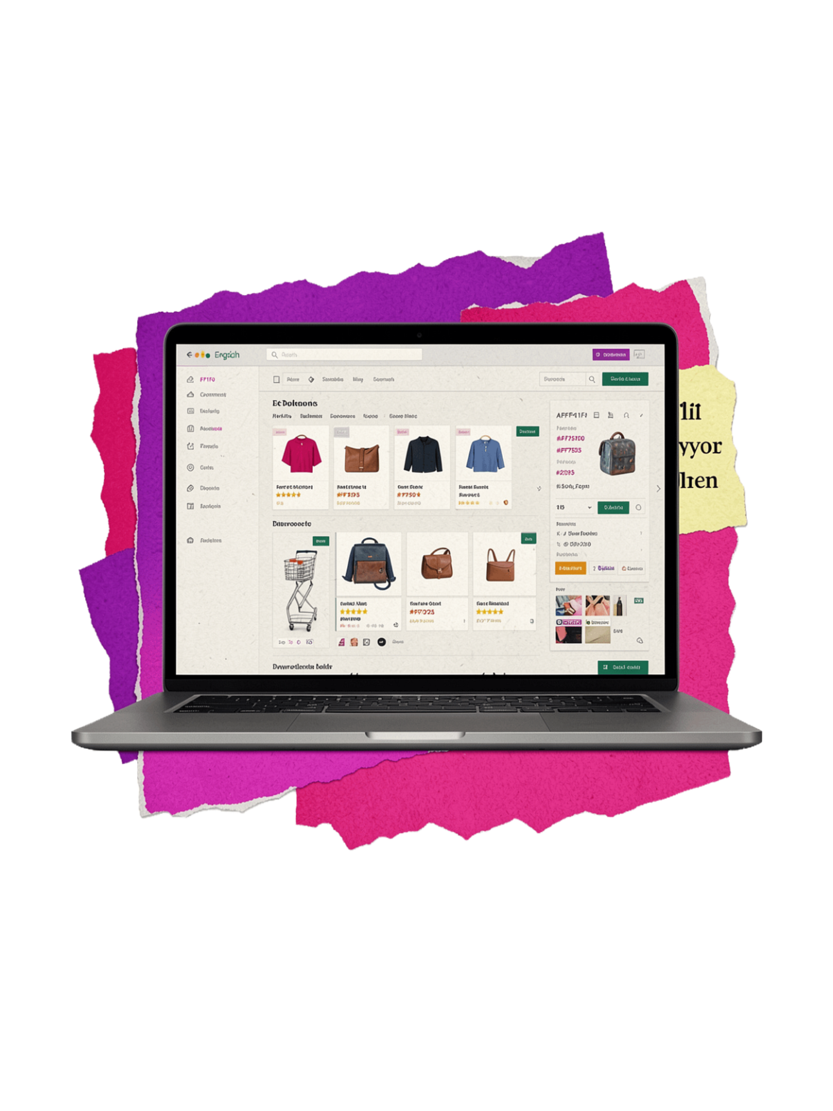
E-COMMERCE SALES — Data Analysis
Period: Jan 1 — Feb 10, 2026 · 10,000 orders · 21 columns
SOURCES: PYTHON NOTEBOOK · POWER BI
PREPARED FOR MANAGEMENT REVIEW

Slide 2
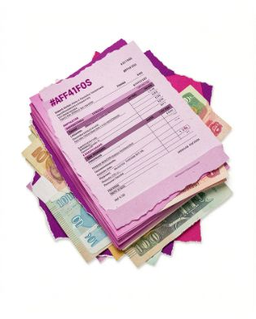


Executive Summary
Total Revenue
Top Categories
Time
₹642.13M · 10,000 orders · AOV ₹64,212.91
Electronics (rev), Home (orders), Fashion
January strongest (partial Feb)

Slide 3
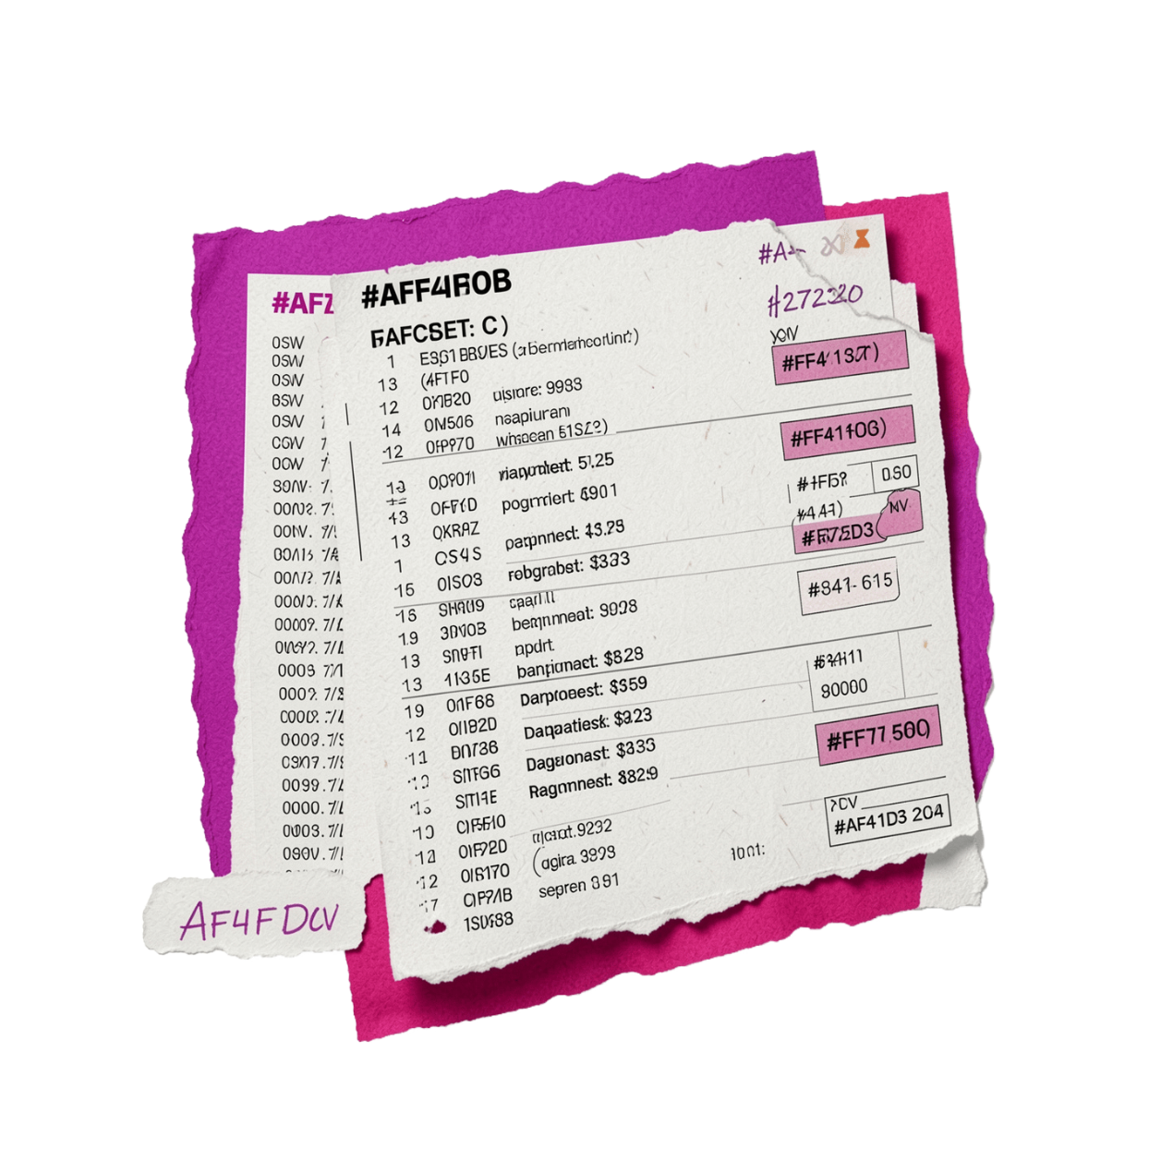

Dataset Overview
Contents
10,000 rows · 21 columns · complete (no nulls)
Orders, customers, product, pricing, shipping, payment
Key fields: order_id, dates, customer_id, product_id, total_sales
Power BI uses the same dataset with interactive slicers for category, state, and payment method.

Slide 4
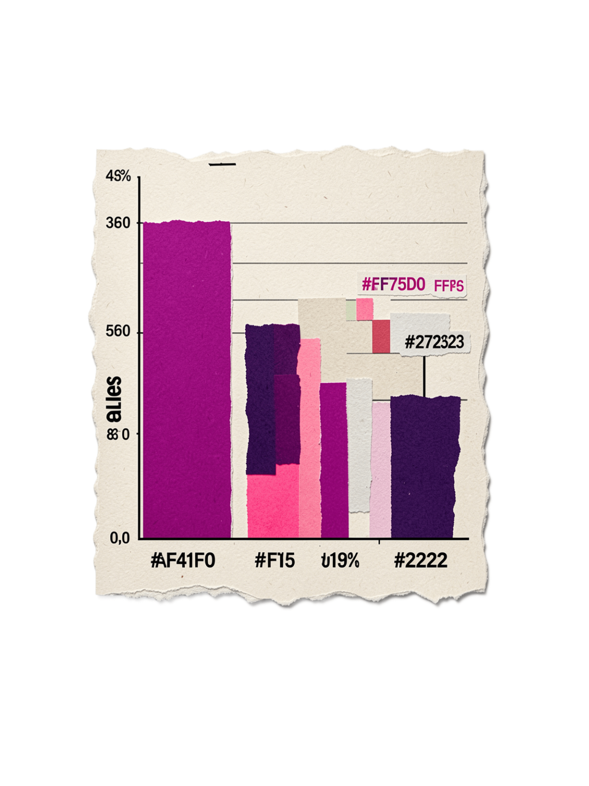
Data Cleaning & Quality Checks
Integrity
Value Checks
Outliers
Datetime conversions done; df.info() & df.isna().sum() show no nulls
No negative quantity/unit_price/shipping/total_sales values
163 records above IQR upper bound (not removed)
Critical Issue
4,915 records have ship_date earlier than order_date → blocked fulfillment analysis

Slide 5
Sales Analysis — Key Metrics
Total Revenue
Avg Order
₹642,129,105.55
₹64,212.91
Units Sold
Avg Discount
30,144
15.00%
Top single sale ₹249,155.53 · Lowest ₹309.94

Slide 6

Category & Product Highlights
Category Revenue Share
Electronics 34.16% · Home 33.45% · Fashion 32.39%
Top by Revenue
Electronics ₹219.36M · Home ₹214.76M · Fashion ₹208.01M
Top Sub-category
Furniture ₹111.84M
Top Product
“maintain” ₹2.10M · Top qty 78 units

Slide 7



Order & Customer Analysis
Orders
Customers
Top Customers
10,000 orders · 100% Delivered · Avg quantity 3.01
6,016 unique customers · Avg spend per customer ₹106,736.89
Megan Johnson ₹519,128.22 · John Smith ₹437,475.71

Slide 8
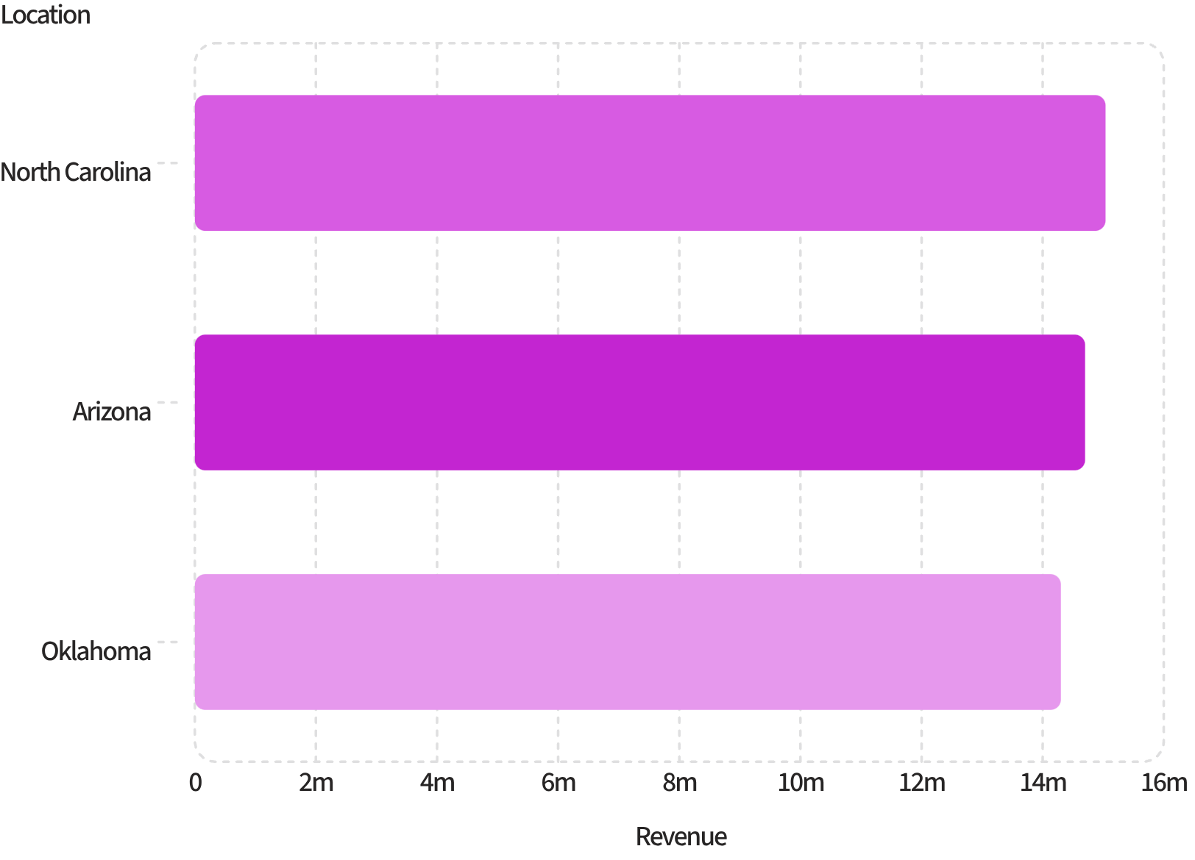
Geographic Analysis
Top Points
Top state by revenue: North Carolina ₹15,037,672.64
Top state by orders: Arizona 238 orders
Top city: Lake Michael ₹806,828.24 · 13 orders
Power BI provides interactive state-level filtering.

Slide 9
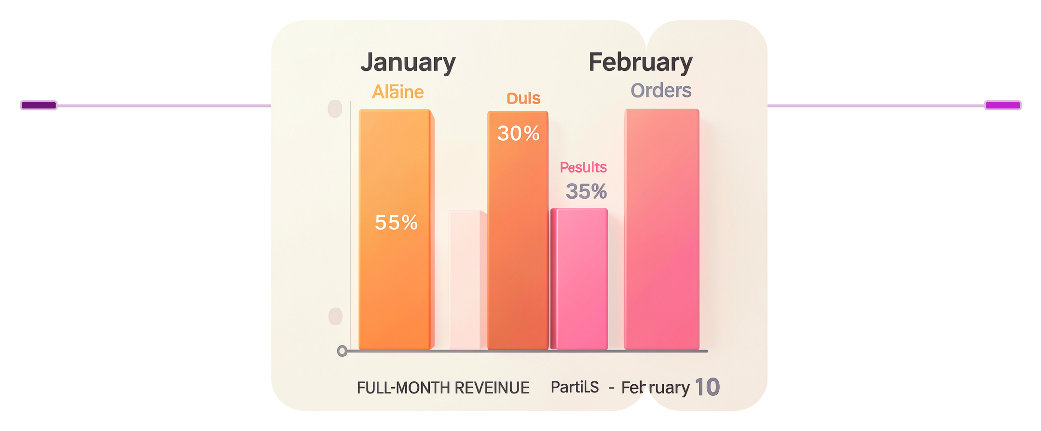
Time Analysis
Summary
January ₹489.99M · 7,653 orders
Feb (partial) ₹152.14M · 2,347 orders
January (Full)
February (Through 10)
Revenue ₹489.99M · 7,653 orders
Revenue ₹152.14M · 2,347 orders
Weekday
Top weekday by revenue: Monday ₹95,371,920 · Wednesday lowest

Slide 10


Findings, Recommendations & Limitations
Key Findings
Recommendations
Limitations
₹642.13M revenue · Electronics leads revenue & units · Home leads orders · Data-quality: 4,915 date inconsistencies · 163 outliers flagged
Invest in Electronics · Investigate Home order/value gap · Retain high-value customers (Megan Johnson) · Fix date validation · Review brand capture
Short period (Jan–Feb 10) · Shipping/delivery analysis blocked by date errors · Brand-level figures unreliable
Power BI Overview
3 pages: Executive KPIs · Sales & Product · Customer & Geographic. Interactive slicers for category/state/payment.
Power BI Dashboard
3 interactive pages with filters for category, state, and payment method.

