Slide 1
POWERGRID
Contract Performance Guarantee (CPG)
Management System — Database ER Diagram
PostgreSQL • Prisma ORM • Railway • June 2026

Slide 2
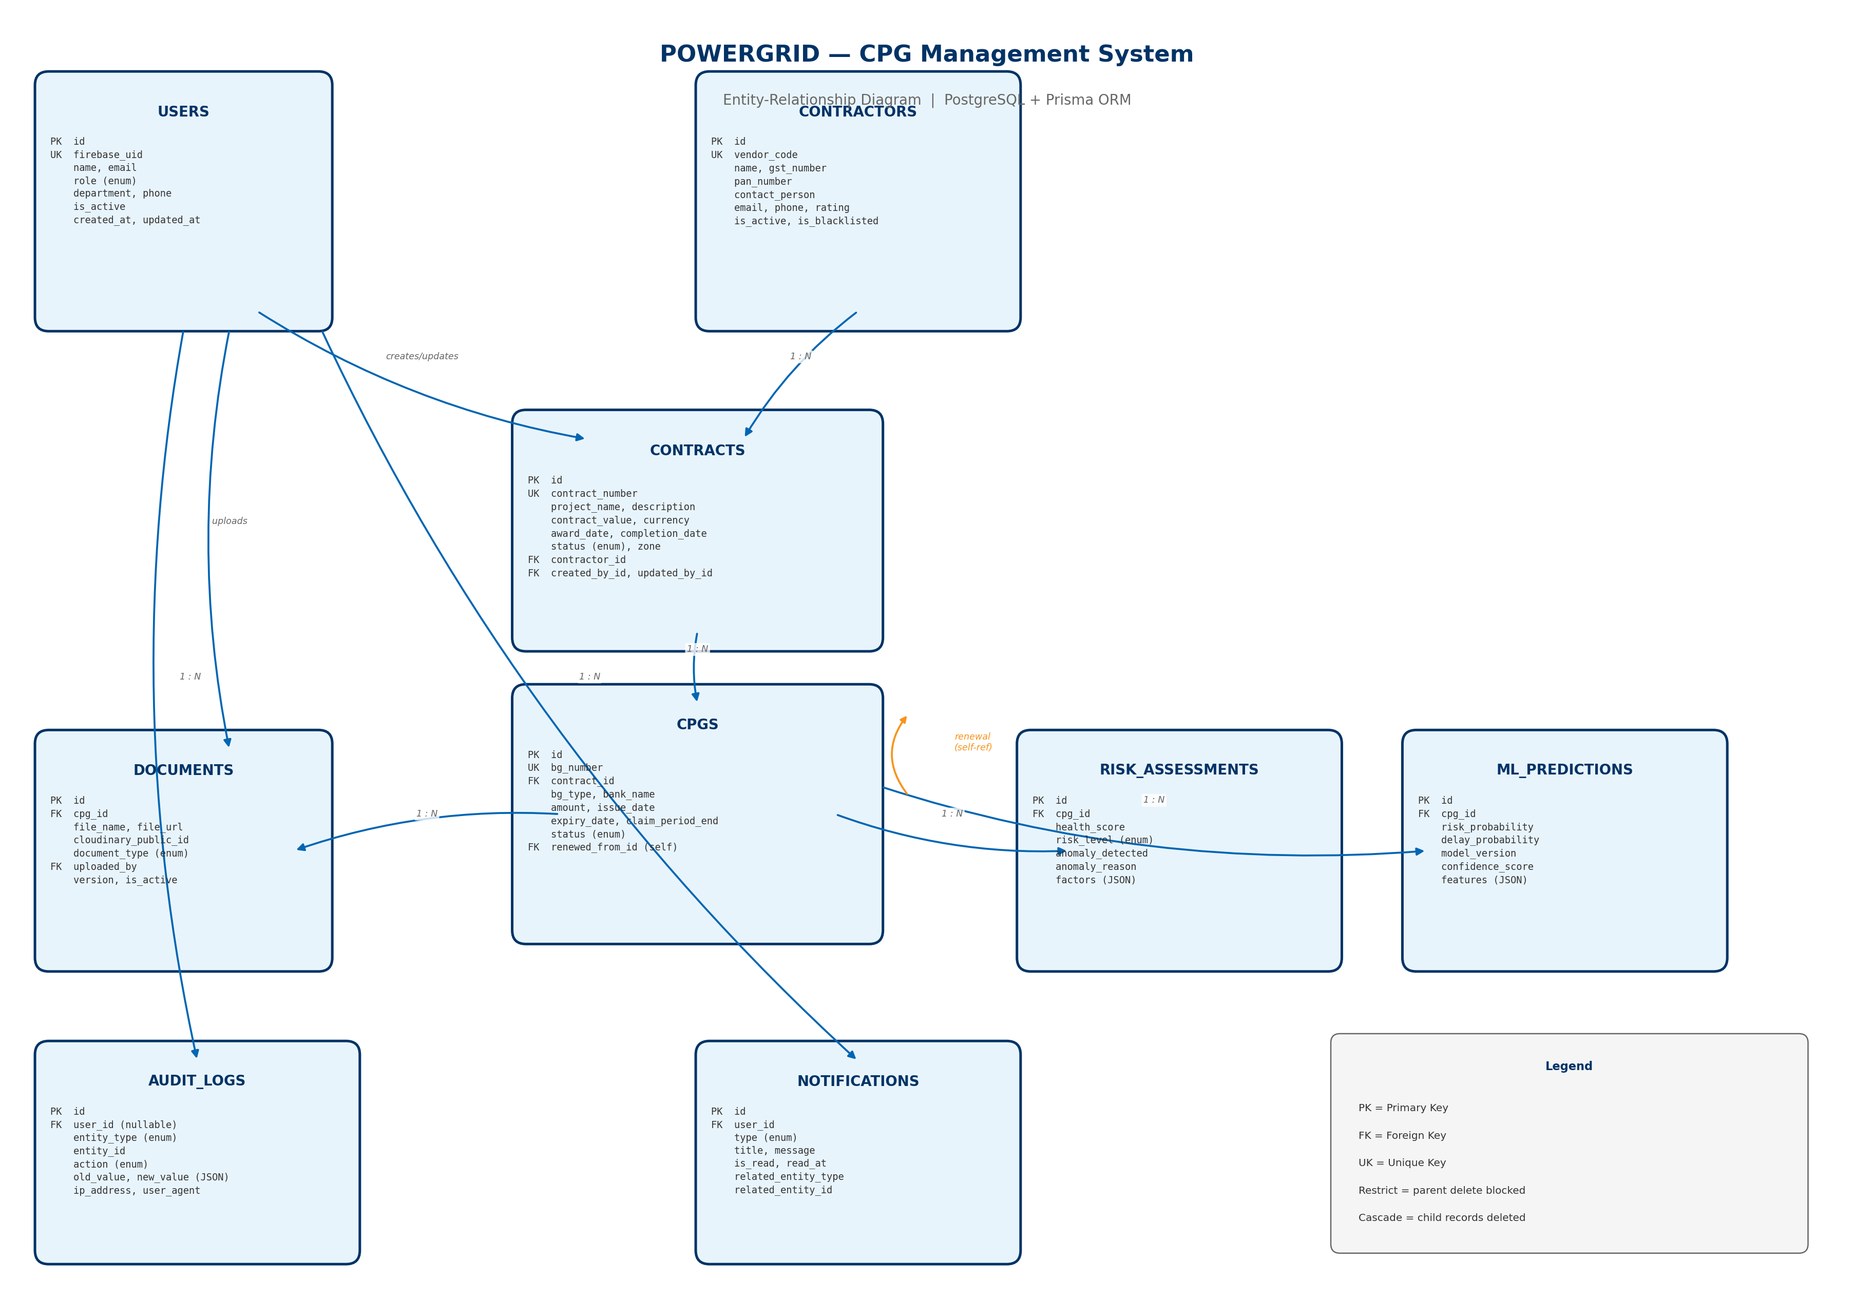
Complete Entity-Relationship Diagram

Slide 3
Architecture Overview
Tech Stack: Node.js • Express • TypeScript • Prisma • PostgreSQL
9 core tables modelling the full CPG lifecycle for POWERGRID
PostgreSQL on Railway with Prisma ORM for type-safe data access
Firebase Authentication — users linked via firebase_uid
Cloudinary for document storage — metadata tracked in documents table
Append-only AI tables: risk_assessments & ml_predictions (time-series per CPG)
Immutable audit_logs for compliance and forensic review
Polymorphic references in audit_logs & notifications (entity_type + entity_id)

Slide 4
Core Domain Hierarchy
Contractor → owns → Contract → governs → Cpg
Cpg → has many → Documents (Cloudinary files)
Cpg → has many → RiskAssessments (Health Score Engine)
Cpg → has many → MlPredictions (ML Risk Prediction)
Cpg → self-renews via → renewed_from_id (renewal chain)
User → uploads → Documents
User → receives → Notifications (expiry alerts, anomalies)
User → generates → AuditLogs (all CRUD & status changes)

Slide 5
Relationships & Cascade Rules
Parent | Child | Cardinality | onDelete
Contractor | Contract | 1 : N | Restrict
Contract | Cpg | 1 : N | Restrict
Cpg | Document | 1 : N | Cascade
Cpg | RiskAssessment | 1 : N | Cascade
Cpg | MlPrediction | 1 : N | Cascade
Cpg | Cpg (renewal) | 1 : N | SetNull
User | Document | 1 : N | Restrict
User | AuditLog | 1 : N | SetNull
User | Notification | 1 : N | Cascade
User | Contract | 1 : N | SetNull

Slide 6
Prisma Enums
UserRole
ADMIN, ENGINEER, FINANCE, VIEWER
ContractStatus
DRAFT, ACTIVE, COMPLETED, TERMINATED, SUSPENDED
CpgStatus
ACTIVE, EXPIRED, CLAIMED, INVOKED, RELEASED, RENEWED, CANCELLED
BankGuaranteeType
PERFORMANCE_BANK_GUARANTEE, ADVANCE_BANK_GUARANTEE, SECURITY_DEPOSIT, OTHER
DocumentType
BANK_GUARANTEE, CONTRACT_COPY, EXTENSION_LETTER, CLAIM_NOTICE, ...
RiskLevel
LOW, MEDIUM, HIGH, CRITICAL
AuditAction
CREATE, UPDATE, DELETE, STATUS_CHANGE, UPLOAD, INVOCATION, ...
NotificationType
EXPIRY_ALERT, ANOMALY_DETECTED, STATUS_CHANGE, RISK_ESCALATION, ...

Slide 7
Key Indexes (Performance)
cpgs (status, expiry_date) — expiry dashboard & alert cron jobs
cpgs (claim_period_end) — claim window monitoring
notifications (user_id, is_read) — unread badge & inbox queries
audit_logs (entity_type, entity_id) — entity history lookup
risk_assessments (cpg_id, created_at) — latest health score per CPG
ml_predictions (cpg_id, created_at) — latest ML inference per CPG
contracts (contractor_id) — all contracts for a vendor
users (firebase_uid) — Firebase auth sync on every request

Slide 8
Phase 2 — Recommended Extensions
Not yet in schema — add when features are implemented
cpg_status_history — immutable status transition log with actor & reason
cpg_claims — formal BG invocation workflow (claim amount, bank response)
cpg_renewal_requests — Engineer → Finance → Admin approval workflow
expiry_alert_rules — configurable 90/60/30-day thresholds per zone
banks — master bank table with IFSC validation
user_zone_assignments — scoped RBAC (Engineer sees only NR zone)
ai_assistant_sessions — chat history for AI Assistant feature

