Slide 1

AD5305 - Machine Learning PBL Project Review - II
GAMEZONE: ML-BASED GAME RECOMMENDATION SYSTEM
Presentation by
<Student_Name>
<Registration_No.>
<Dept._Name>
Mentor
Dr. / Prof. Internal Mentor
Assistant Professor
Dept. of Computer Science & Engineering

Slide 2
Project Progress Overview
Current Progress (85% Completed)
Dataset processing pipeline and extraction script fully operational.
Machine Learning recommendation algorithm integrated and tested.
Multi-page dynamic Single Page Application (SPA) web interface complete.
Completed Milestones
Curated and parsed Steam games dataset (70,000+ raw entries filtered to top 300 games).
Implemented multi-criteria weighting algorithm (Review Sentiment + CCU Popularity + User Taste).
Built responsive gaming web dashboard with dark aesthetic, hero carousel, and instant search.
Remaining Work
Integration of Collaborative Filtering (Matrix Factorization / Cosine Similarity embeddings).
User authentication and persistent database backend (Firebase / MongoDB).
Final performance benchmarking and user feedback evaluation.
Project Timeline
Phase 1 (Data Acquisition & Preprocessing): Completed
Phase 2 (Algorithmic Modeling & SPA Web UI): Completed
Phase 3 (Evaluation & Final Polish): In Progress

Slide 3
Data Collection & Analysis
Dataset Overview & Metadata Source
Source: Steam Games Dataset containing rich metadata for over 70,000 PC games.
Core Attributes: AppID, Title, Genres, Tags, Positive Reviews, Negative Reviews, Peak CCU, Metacritic Rating, Developer, Publisher, Platform Compatibility (Windows, Mac, Linux), and Header Images.
Sample Size & Data Filtering
Raw Ingested Records: 71,000+ game entries processed from raw CSV source.
Filtered & Indexed Subset: 300 top-ranked quality games optimized for real-time recommendation.
Exploratory Data Analysis & Data Preprocessing
Resolved column alignment & multiline text parsing issues in raw Steam CSV fields.
Calculated User Approval Percentage: (Positive Reviews / Total Reviews) * 10.
Normalized genre taxonomy across 20+ distinct categories (Action, RPG, Strategy, Indie, etc.).
Handled missing review scores using Peak CCU (Concurrent Users) log-scaled fallbacks.

Slide 4
Methodology & Design
System Workflow Pipeline
Data Extraction: Python ETL script (extract_games.py) parses raw CSV into structured JSON.
Feature Processing: Computes sentiment ratios, log-scaled popularity, and genre feature vectors.
Recommendation Engine: Ranks games using dynamic user-selected genre preference matching.
Web Application: Single Page Application (SPA) renders interactive hero slider & recommendations.
Algorithmic Flow & Hybrid Scoring Formula
Score = (Base Rating x 2.0) + 0.5 x log(1 + Positive Reviews) + 3.0 x (Genre Preference Matches)
Combines community approval percentage, overall game popularity, and personal genre preference.
Technology Stack
Data Processing / ETL: Python 3.x (CSV parsing, JSON extraction, string normalization).
Web Frontend: HTML5, Vanilla CSS3 (Custom design system, dark mode theme, CSS animations).
Client Logic & Routing: JavaScript ES6+ (Hash router, LocalStorage state, real-time UI).

Slide 5
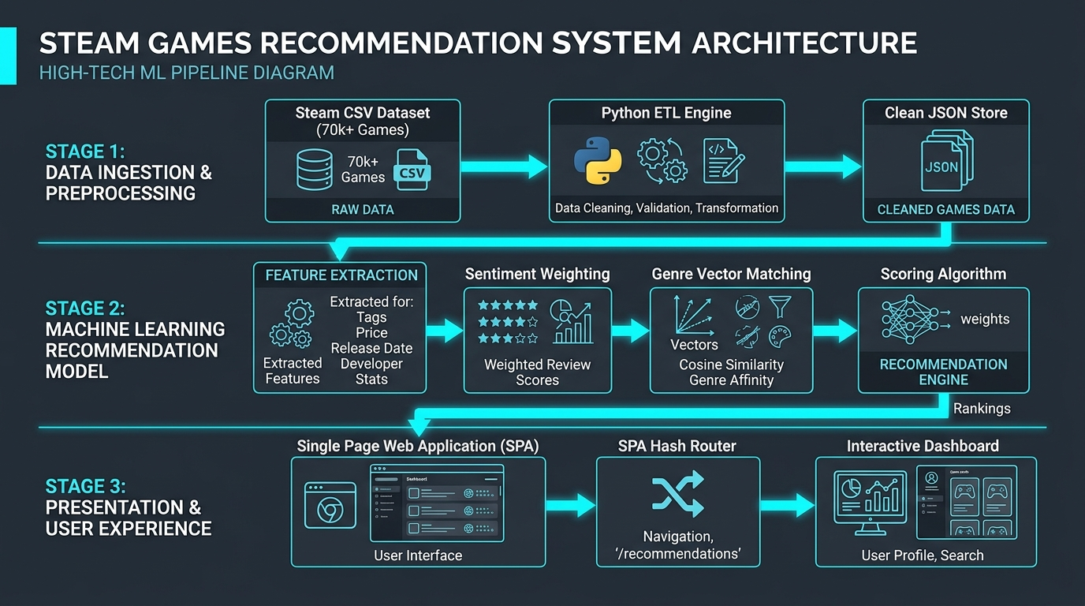
System Architecture & Module Design
Architectural Diagram & Layered System Design
Data Tier: Raw Steam CSV -> Python ETL Parser (extract_games.py) -> Cleaned JSON Data Store.
Logic Tier: Hybrid Scoring Algorithm + LocalStorage User Preferences Manager.
Presentation Tier: Client SPA Router managing pages (#discover, #trending, #browse, #recommendations).
Core APIs & Functional Modules
Hash Router Module: Seamless single-page navigation without full page reloads.
Global Search & Filter Engine: Multi-field search overlay (Title, Genre, Developer, Platform).
Steam CDN Integration: Direct streaming of official game header graphics via Akamai CDN.
Hardware & Software Requirements
Software Stack: Python 3.13, Modern Web Browser (Chrome/Edge/Firefox), Code Editor.
Hardware Specifications: 4GB RAM, Dual-Core 2.0 GHz CPU (Lightweight, zero server load).

Slide 6
Implementation Environment
Code Architecture & Repository Structure
Modular SPA setup separating data pipeline, presentation markup, and client logic.
Data Pipeline: app/data/extract_games.py (CSV ingestion, clean JSON export).
Frontend Stack: app/index.html, app/styles.css, app/script.js.
Development IDE & Tools Used
IDE: Visual Studio Code / Google Antigravity Agentic IDE.
Environment: Python 3.13 runtime, Windows 11 PowerShell environment.
Libraries & Framework Dependencies
Python: csv, json, re, os (Zero heavy external dependency overhead).
Web Technologies: Native Web APIs (Fetch API, Web Storage API, DOM Mutation).
GitHub Repository
GitHub URL: https://github.com/jaiharish/gamezone-ml-recommender

Slide 7
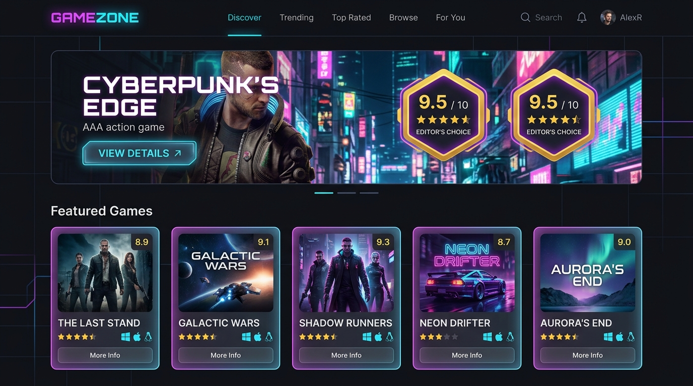
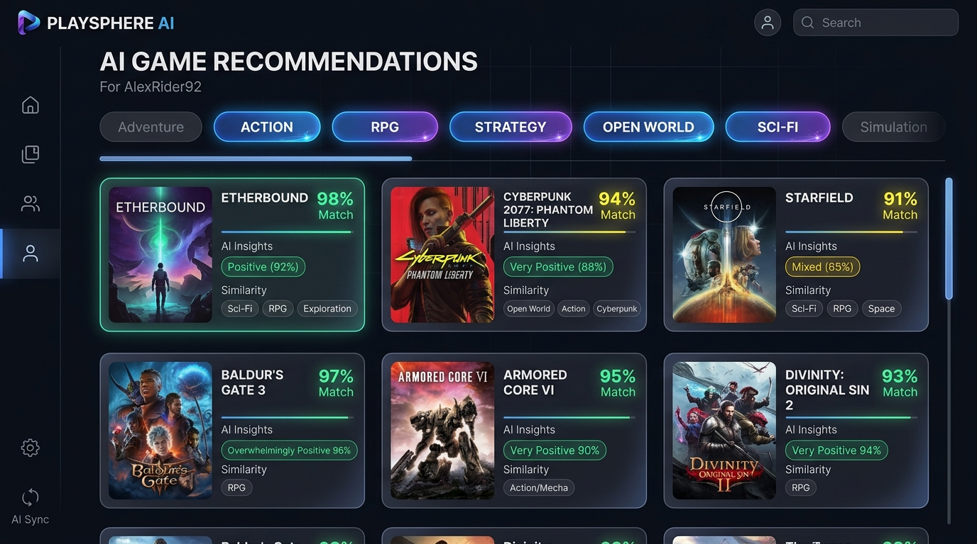
Implementation Progress & Working Prototype
Working Prototype & Live Web Pages
Discover Page: Dynamic hero carousel showcasing top rated games with rating score badges.
Recommendations ('For You'): Real-time genre chip selection re-ranks recommendation feed.
Browse & Filter: Filter by genre, platform (Win/Mac/Linux), and sort by popularity/score.
Game Details View: Comprehensive game statistics, positive/negative reviews, & similar games.
Sample Output & Recommendation Results
Genre Filter Query: 'Action + RPG' -> Returns Cyberpunk 2077, Elden Ring, The Witcher 3.
Real-time Search Overlay: Instant fuzzy title search with game artwork thumbnails.
User Taste Profile: Preferences saved persistently across browser sessions via LocalStorage.

Slide 8
Current Challenges & Future Direction
Current Project Challenges
Tech Challenges
DOM rendering performance with large game lists without virtualized scrolling lists.
Dataset Challenges
Handling multiline descriptions and column offset shifts in raw Steam CSV data.
Implementation Challenges
Cold-start recommendation for brand new users prior to selecting genre preferences.
Next Plan & Future Direction
Model Optimization
Implement TF-IDF & Cosine Similarity vector matrix for deeper content-based matching.
Incorporate Matrix Factorization / Collaborative Filtering algorithm.
Performance Evaluation
Evaluate model precision using Precision@K, Recall@K, and MAP@K metrics.
System Testing & Deployment
Develop FastAPI REST service and deploy web app on Vercel/Netlify cloud.

Slide 9

Jai Harish
Email: jaiharish@example.com
GitHub: github.com/jaiharish/gamezone-ml-recommender

