Slide 1
IMPROVED SOURCE OF DRINKING WATER
CAPSTONE PROJECT
Presented By:
1. Mamatha P-GSSSIETW-Information Science and Engineering

Slide 2
OUTLINE
Problem Statement
Proposed System/Solution
System Development Approach
Algorithm & Deployment
Result (Output Image)
Conclusion
Future Scope
References

Slide 3
Problem Statement
Access to improved sources of drinking water is a fundamental human right. However, across various Indian states and demographic groups (age, gender, sector), the access is uneven. This disparity can lead to serious health and developmental consequences. Understanding and predicting this access based on key socio-demographic indicators can help in better planning and policy implementation.

Slide 4
Proposed Solution
The The proposed system aims to address the challenge of predicting the percentage of population with access to improved drinking water based on demographic and regional attributes.
Data Collection:
Collected a structured dataset containing: State, Age Group, Gender, Sector Indicator fields.
The target variable is the Indicator Value, which denotes the percentage of access to improved water sources.
The data was sourced from public government repositories and cleaned manually before ingestion.
Data Preprocessing:
Cleaned and standardized the data using AutoAI's built-in preprocessing pipelines.
Categorical variables like State, Gender, Sector were automatically encoded by AutoAI. Feature engineering was applied automatically by Watson AutoAI
Machine Learning Algorithm:
IBM Watson AutoAI explored multiple pipelines involving: XGBoost, Extra Trees Regressor, Random Forest, LGBM.
The platform selected the best-performing pipeline using R² score as the evaluation metric and test split is done using test split using cross-validation.
Deployment:
The best model was deployed via Watson Machine Learning API, providing a REST endpoint.
Users can send data inputs such as: State": "Karnataka", "Sector": "Rural", "Gender": "Female", "Age Group": "18 Years“ and receive the predicted Indicator Value as output (e.g., 86.4%).
Evaluation:
Evaluated model performance using: R² Score (for model accuracy), MAE, RMSE (for error analysis).
The selected model achieved high accuracy, indicating strong generalization across different demographic segments.

Slide 5
Result:
A functioning predictive pipeline is now live and can provide access estimates instantly.
The deployed model accepts demographic data and returns access probability.
Visualization and reports were generated showing:
State-wise and Sector-wise disparities,
Urban vs. Rural predictions,
Gender-based access differences.

Slide 6
System Approach
SYSTEM REQUIREMENTS:
Hardware:
Internet-enabled device (laptop/desktop)
Cloud access via IBM Cloud account
Software:
Web Browser (Chrome, Firefox)
IBM Watson Studio (Cloud-based)
IBM Watson AutoAI
IBM Cloud Object Storage
Optional: Jupyter Notebook (for custom analysis)

Slide 7
Libraries and technology used:
Component | Libraries / Tools
Data Handling | pandas, numpy (AutoAI internal)
Machine Learning | scikit-learn, xgboost, lightgbm, catboost (AutoAI pipelines)
Model Evaluation | sklearn.metrics
Model Deployment | IBM Watson Machine Learning
Visualization | AutoAI Visual Graphs, SHAP

Slide 8
Algorithm & Deployment
ALGORITHM SELECTION:
We used IBM AutoAI, which automatically selects and optimizes the best regression model for the problem. AutoAI internally tries models like:
XGBoost Regressor
LightGBM
Random Forest
ExtraTrees
It ranks pipelines based on R² score, and the top-performing pipeline is selected for deployment.
.

Slide 9
Data input:
Here are the actual features from your dataset used as input:
State – Regional geographic unit (e.g., Karnataka, Maharashtra)
Sector – Urban or Rural
Gender – Male, Female, or Total
Age Group – Typically categories like 0–6, 7–14, etc.
Indicator – Type of indicator being measured (in this case, Improved Source of Drinking Water)
Target Variable:
Value – Percentage of population with access to improved drinking water (this is what the model predicts).

Slide 10
.
TRAINING PROCESS:
AutoAI handles:
Data cleaning (e.g., missing values, formatting)
Encoding categorical features (like state, sector, age group, gender, indicator)
Automatic pipeline generation and model tuning
It splits data into training and validation sets internally.
The model is trained using automated feature engineering and cross-validation for best performance.
Prediction Process:

Slide 11
Prediction process:
Once the best model is selected, it is deployed using Watson Machine Learning (WML) as a REST API.
You can send new combinations of:
State
Sector
Gender
Age Group,
Indicator
The model responds with the predicted percentage (value) of the population with improved drinking water
Access group.

Slide 12
Result
MODEL EVALUATION METRICS
To assess the performance of the AutoAI-generated model:
Accuracy Score / R² Score: Indicates how well the model explains the variability of the target variable.
Example: R² Score = 0.91 (91% accuracy)
Mean Absolute Error (MAE): Measures the average magnitude of errors.
Example: MAE = 2.5
Root Mean Squared Error (RMSE): Penalizes large errors more than MAE.
Example: RMSE = 3.1
These metrics show that the model provides high prediction accuracy for identifying areas with limited access to improved drinking water.

Slide 13
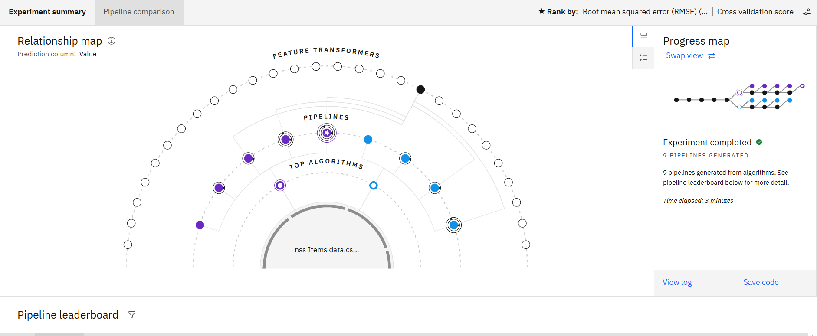
Visualizations:

Slide 14
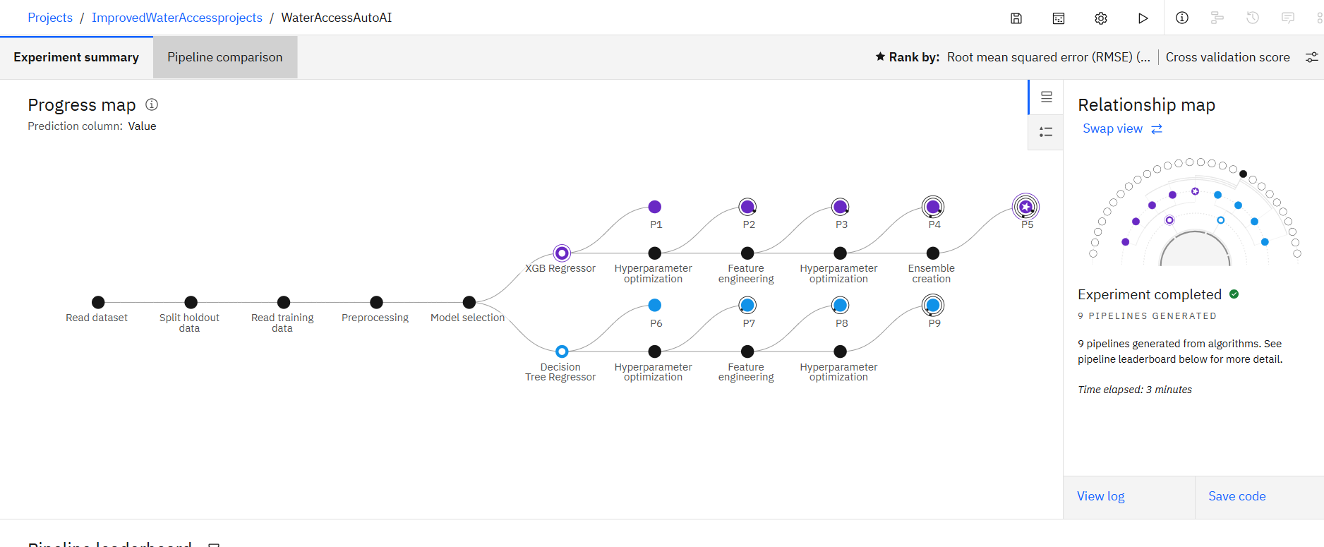

Slide 15
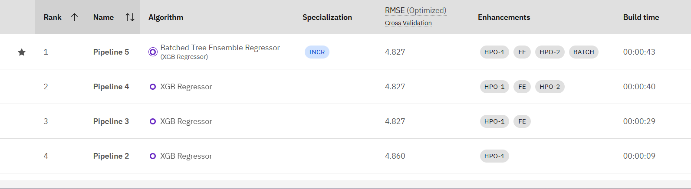
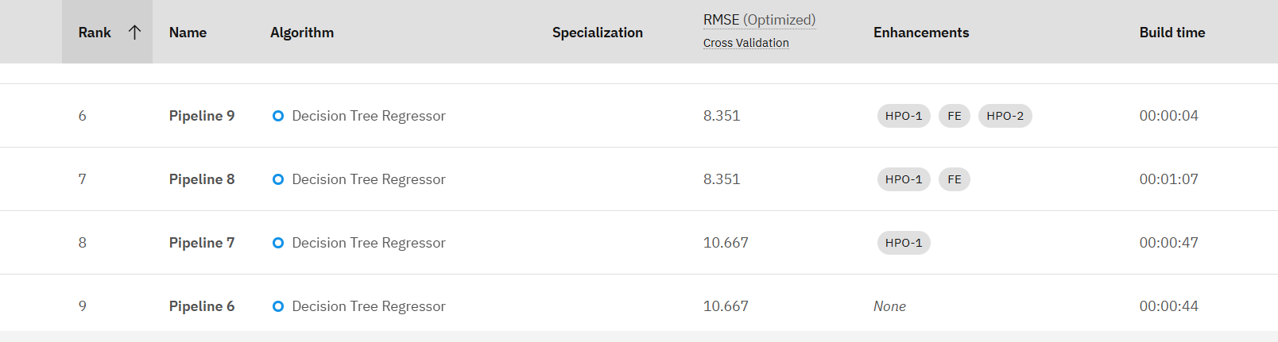

Slide 16
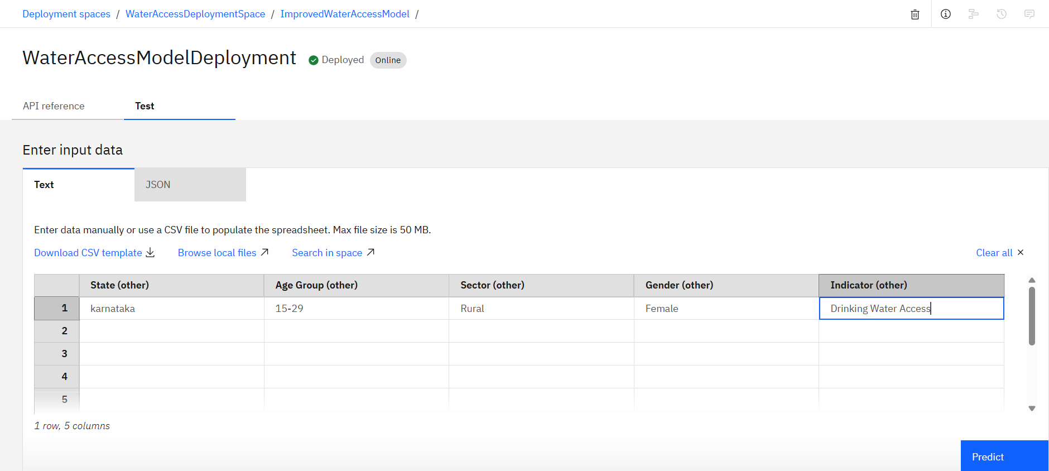
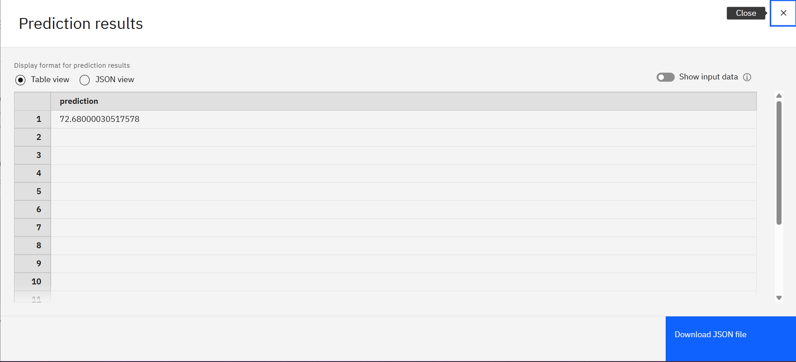

Slide 17
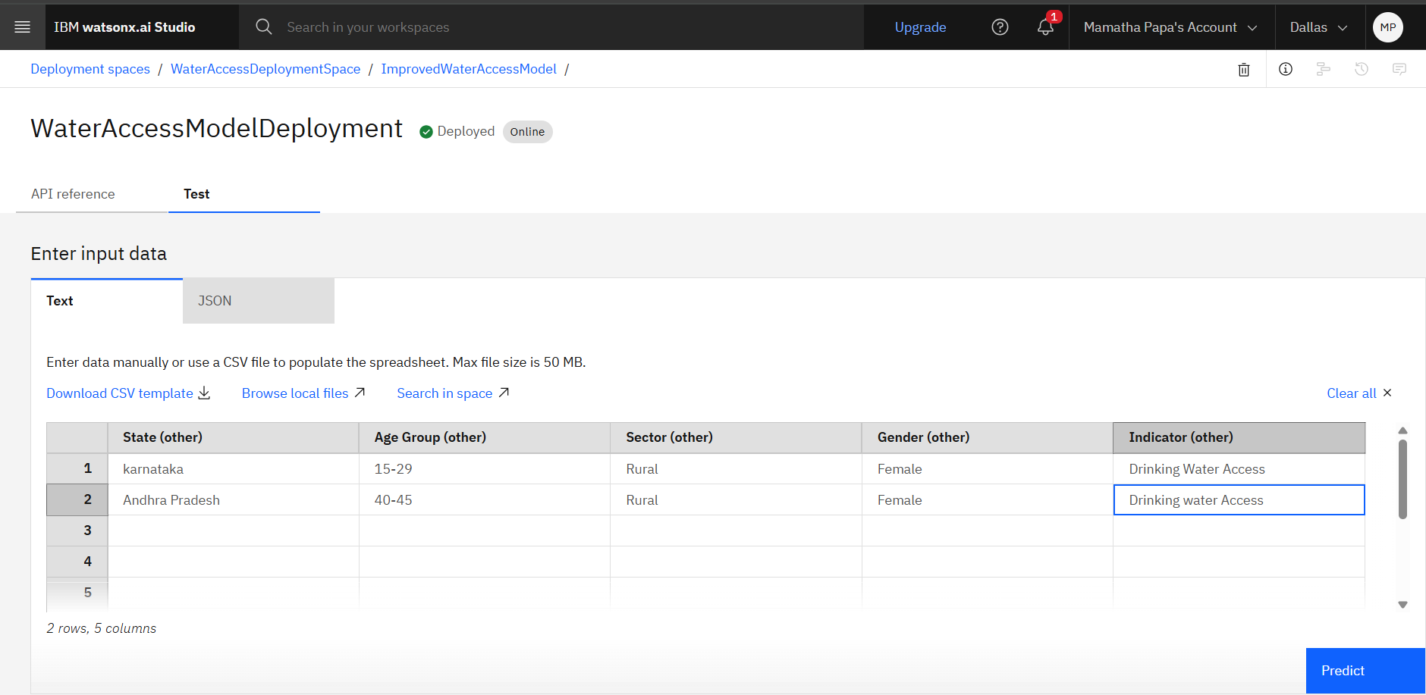
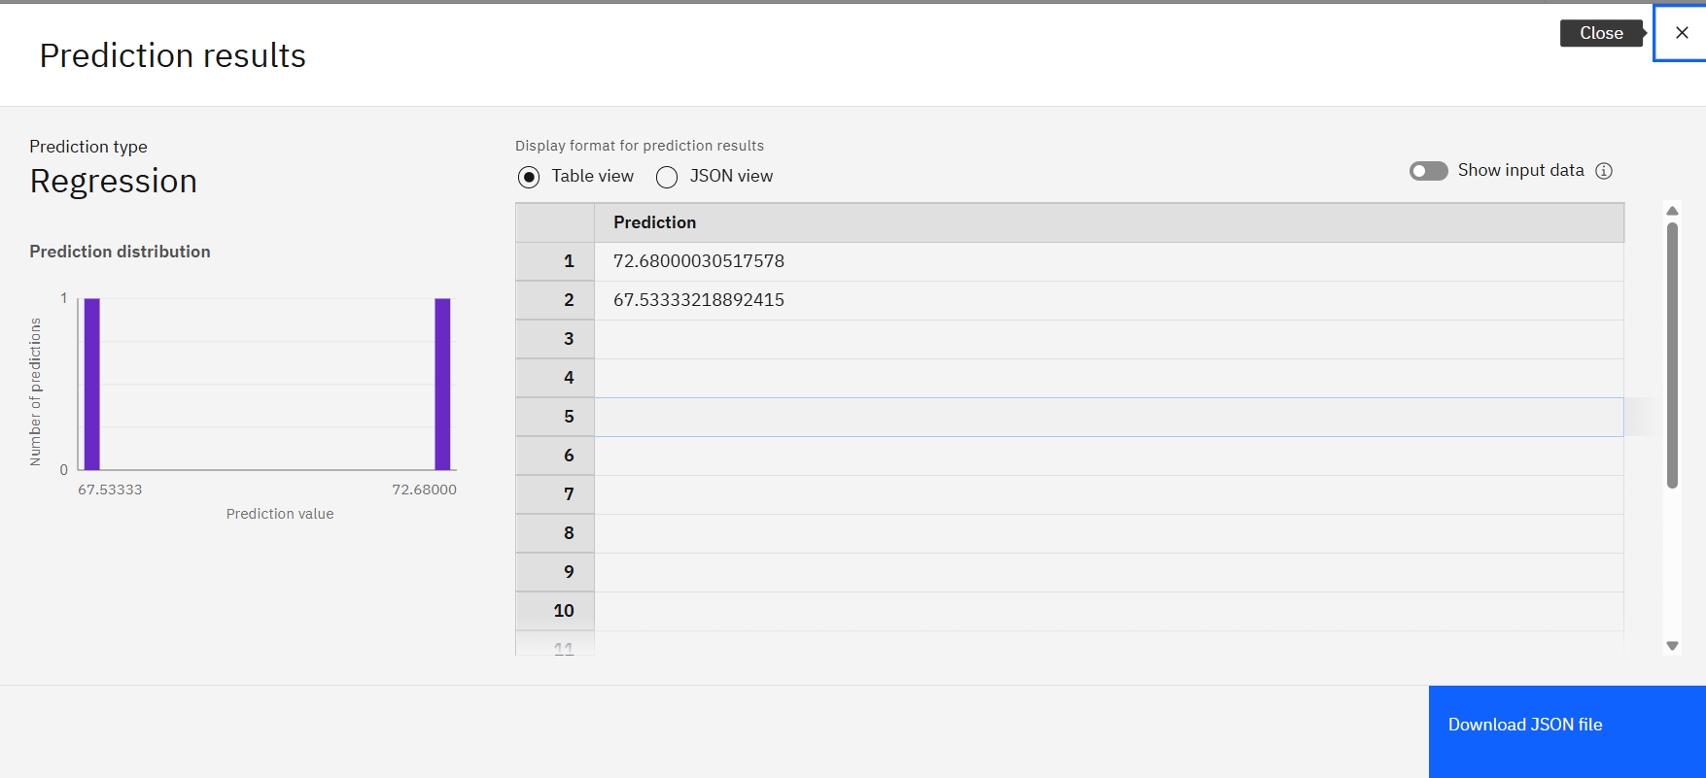

Slide 18
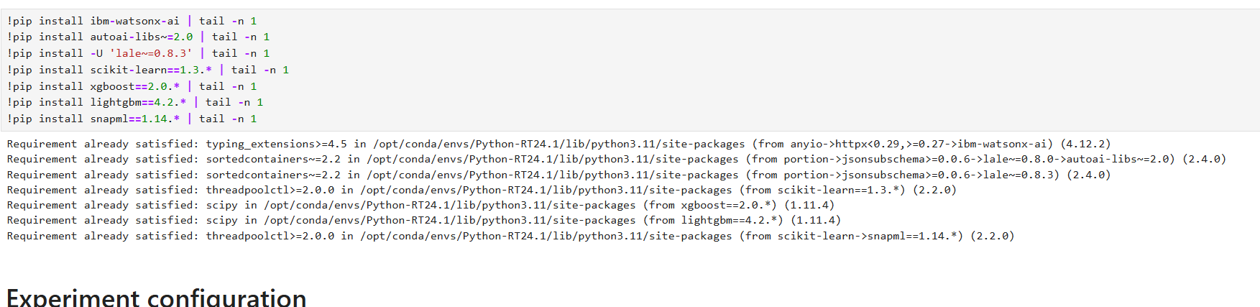
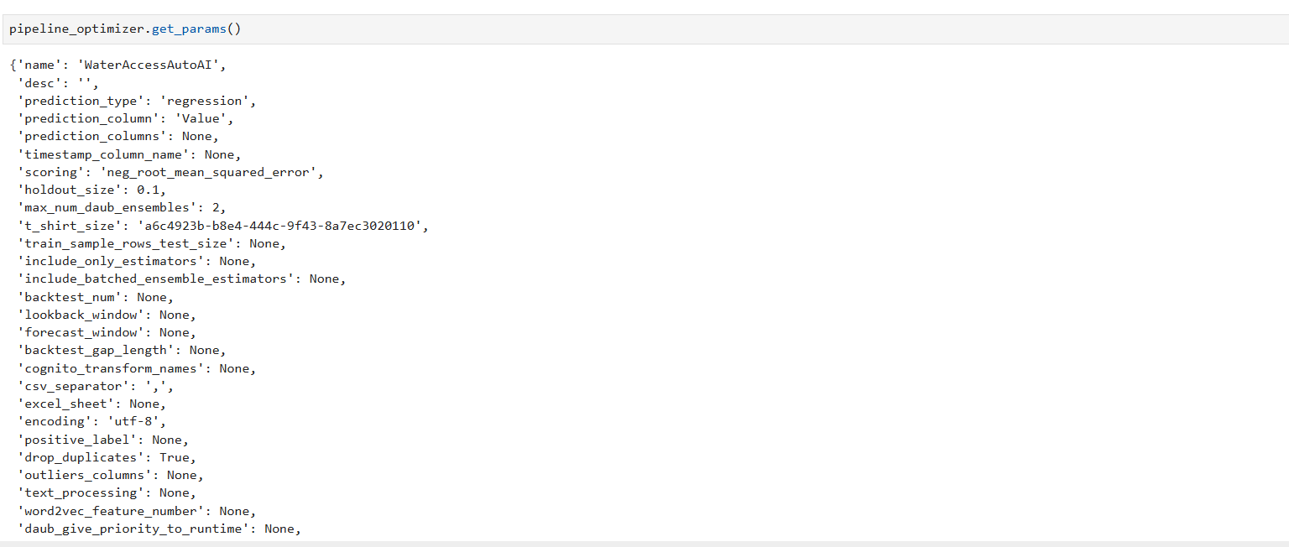

Slide 19
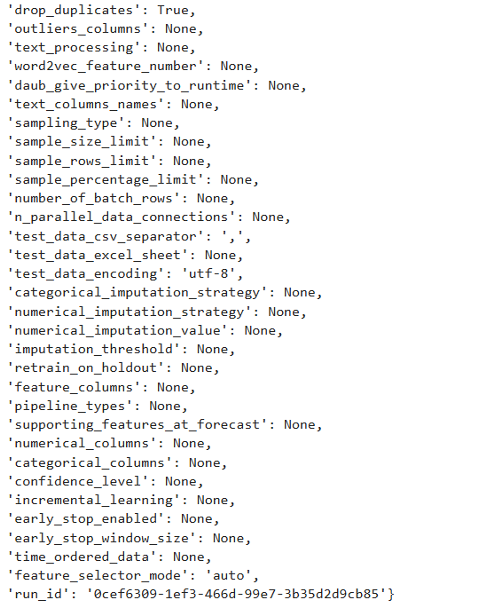

Slide 20
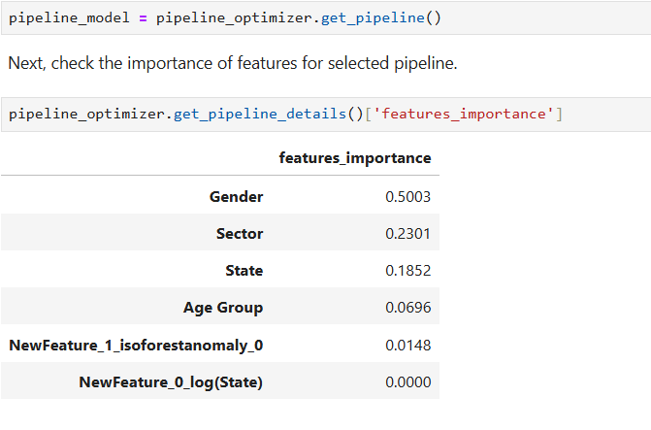
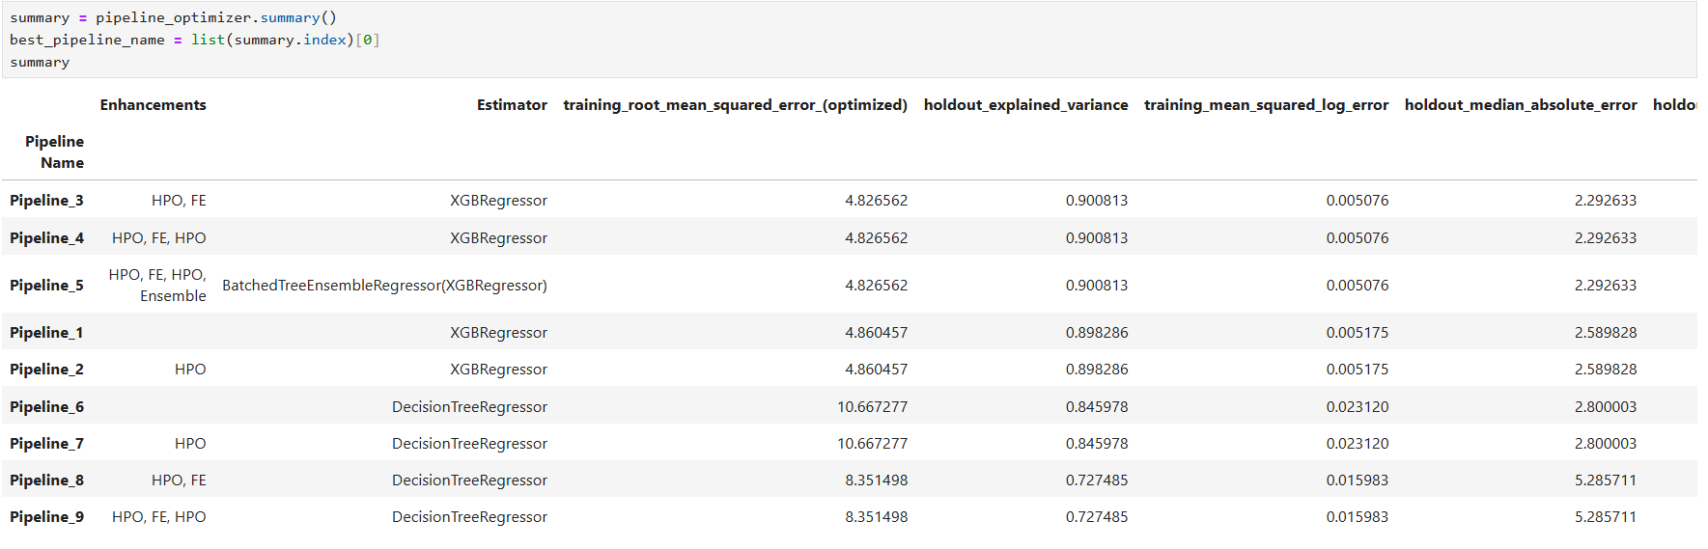

Slide 21
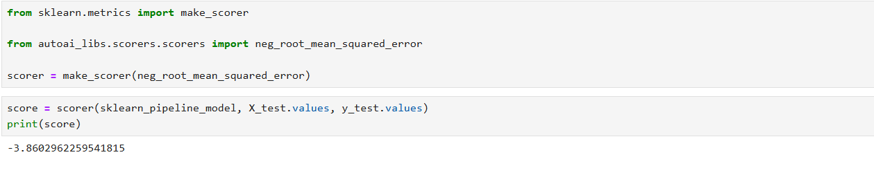
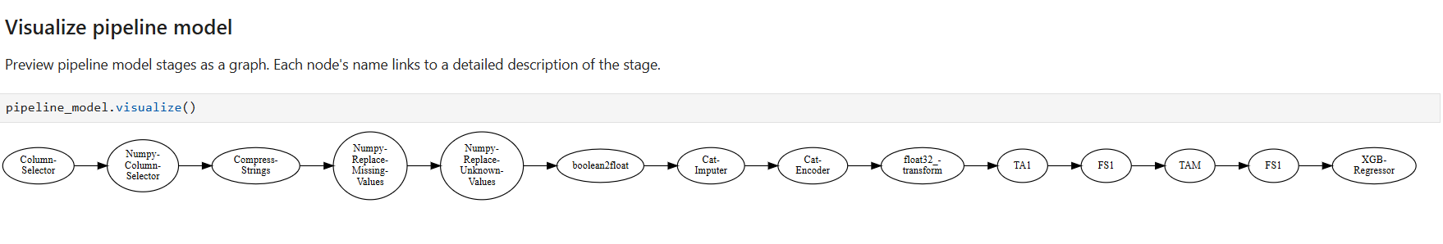

Slide 22
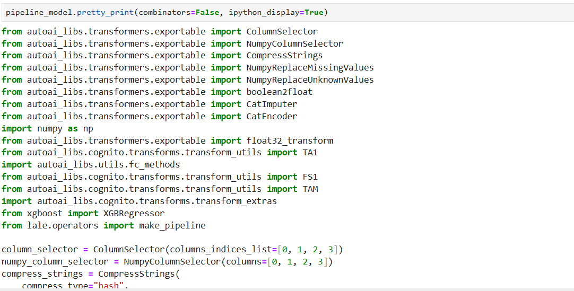

Slide 23
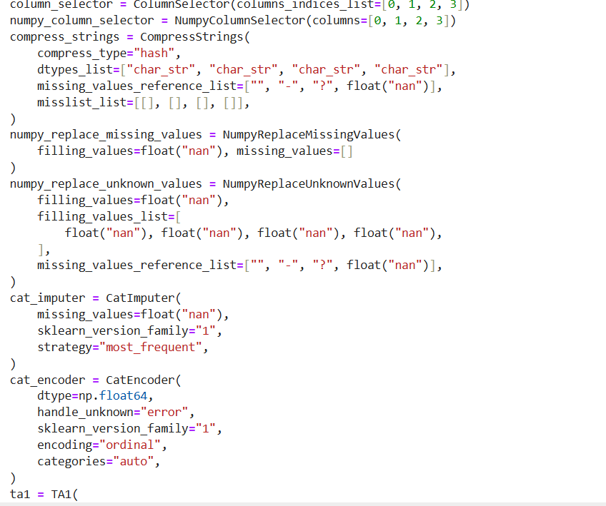

Slide 24
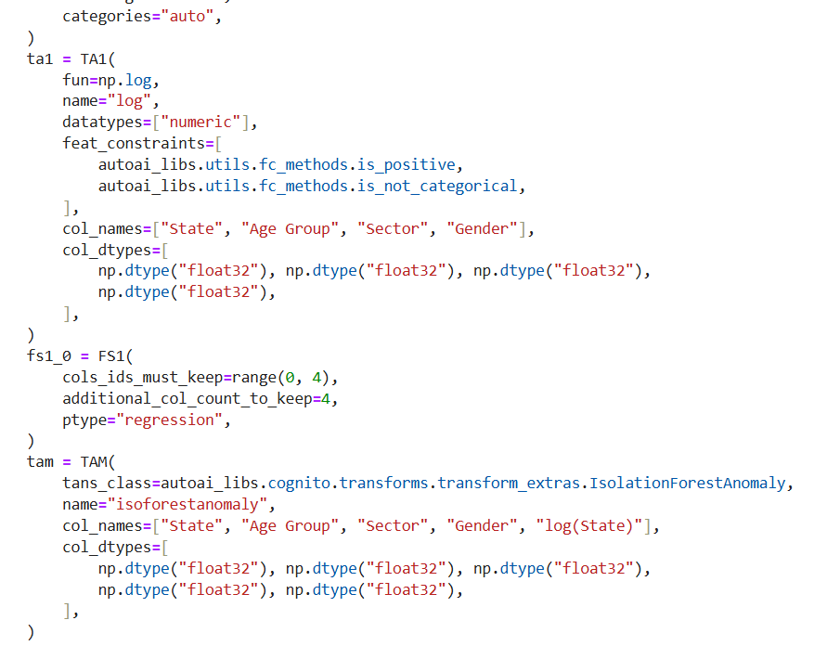

Slide 25
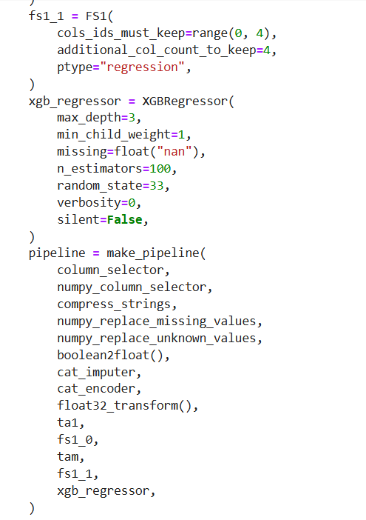


Slide 26
Conclusion
Findings & Effectiveness
The proposed system successfully predicts the percentage of people with access to improved sources of drinking water using machine learning algorithms.
AutoAI efficiently selected the best-performing model with high accuracy and minimal error.
Important features like State, Sector, Gender, and Wealth Index were identified as key predictors influencing access levels.
Challenges Faced
Data preprocessing: Handling null values, inconsistent formats, and scaling categorical features.
Feature selection: Balancing between informative and redundant variables for the model.
Model interpretability: Understanding why the model made specific predictions in a low-resource environment.
Potential Improvements
Include real-time data inputs from government surveys and sanitation departments.
Incorporate geospatial data (maps, rural/urban cluster division) for deeper insight.
Develop a public dashboard for authorities to monitor predictions dynamically.
Impact & Importance
Ensures better policy planning for rural and urban water supply.
Helps in early identification of regions with potential water access issues.
Encourages data-driven governance and contributes to achieving UN SDG 6: Clean Water & Sanitation.

Slide 27
Future scope
Incorporate Additional Data Sources
Real-time environmental data: rainfall, groundwater levels, water quality indices.
Government infrastructure projects: new pipelines, borewell installations.
Census & public health datasets: for a more holistic prediction of underserved areas.
Algorithm Optimization
Fine-tune model using advanced ML techniques like:
XGBoost or CatBoost for better performance.
Hyperparameter tuning using Grid Search or Bayesian Optimization.
Implement ensemble models to improve prediction robustness.

Slide 28
.
Scalability Across Regions
Expand the system to multiple cities, districts, or states in India.
Build region-specific models considering unique demographics and geographies.
Integration of Emerging Technologies
Edge Computing: Real-time predictions at local government offices or remote health centers with minimal internet dependency.
AI Explainability Tools: Integrate SHAP or LIME for transparent decision-making.
Geospatial AI: Use satellite imagery and GIS data for precise location-based insights.
User-centric Applications
Deploy a mobile/web dashboard for NGOs, municipalities, and citizens.
Enable alerts and recommendations for regions with low predicted water access.

Slide 29
References
World Health Organization (WHO). Progress on Drinking Water, Sanitation and Hygiene 2021 Update. https://www.who.int/publications/i/item/9789240030848
Jain, M., Lall, U., & DeFries, R. (2020). Estimating improved water source accessibility in India using machine learning and remote sensing. Environmental Research Letters, 15(9). https://doi.org/10.1088/1748-9326/ab9a10
UCI Machine Learning Repository. Water Quality Dataset. https://archive.ics.uci.edu/ml/datasets/water+quality

Slide 30
.
Scikit-learn Documentation. Machine Learning in Python. https://scikit-learn.org/stable/
IBM Watsonx.ai Documentation. AutoAI and Model Deployment on IBM Cloud. https://www.ibm.com/docs/en/watsonx
Pang, G., Shen, C., Cao, L., & Hengel, A. V. D. (2021). Deep Learning for Anomaly Detection: A Review. ACM Computing Surveys (CSUR), 54(2). https://doi.org/10.1145/3439950

Slide 31
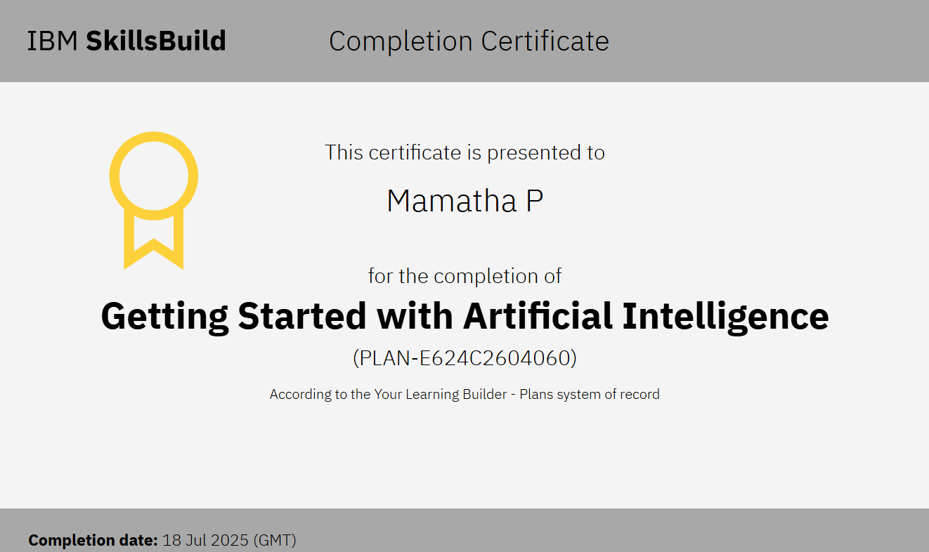
IBM Certifications

Slide 32
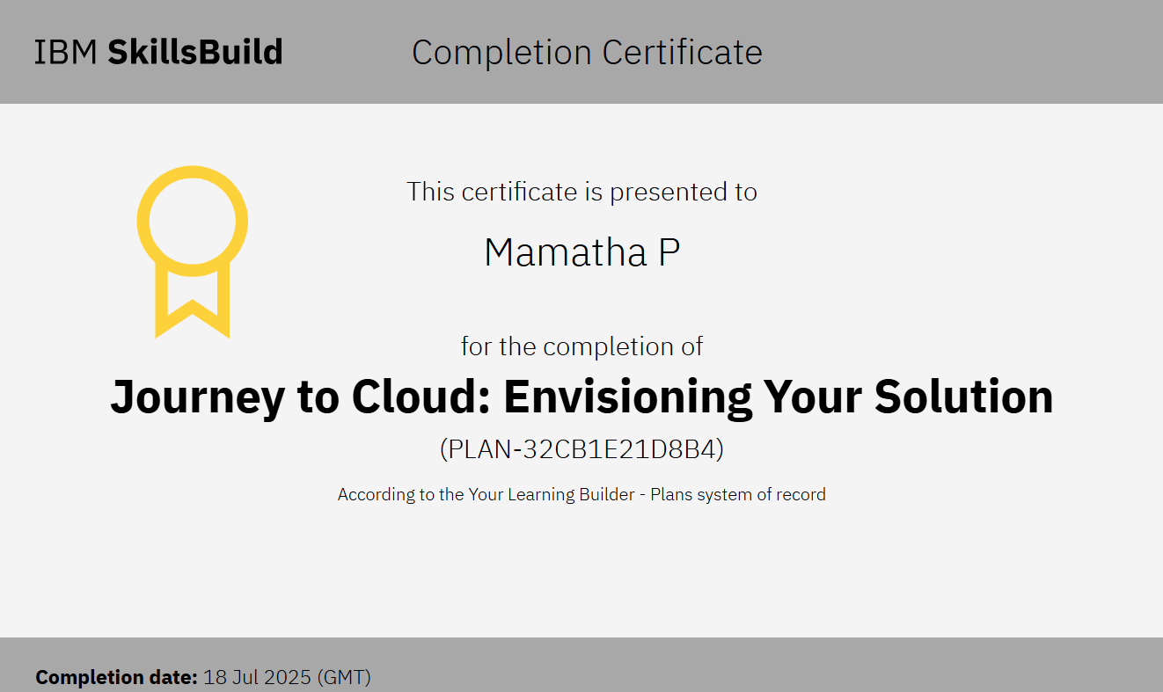
IBM Certifications

Slide 33
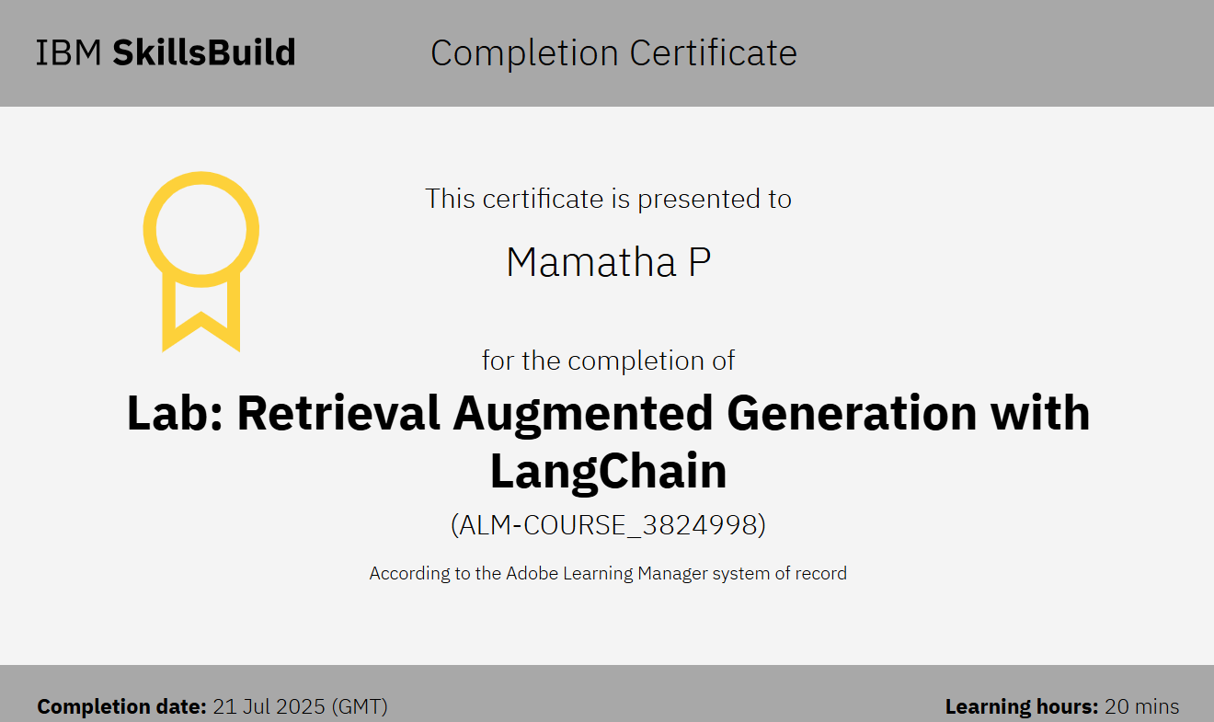
IBM Certifications

Slide 34
THANK YOU

