Slide 1
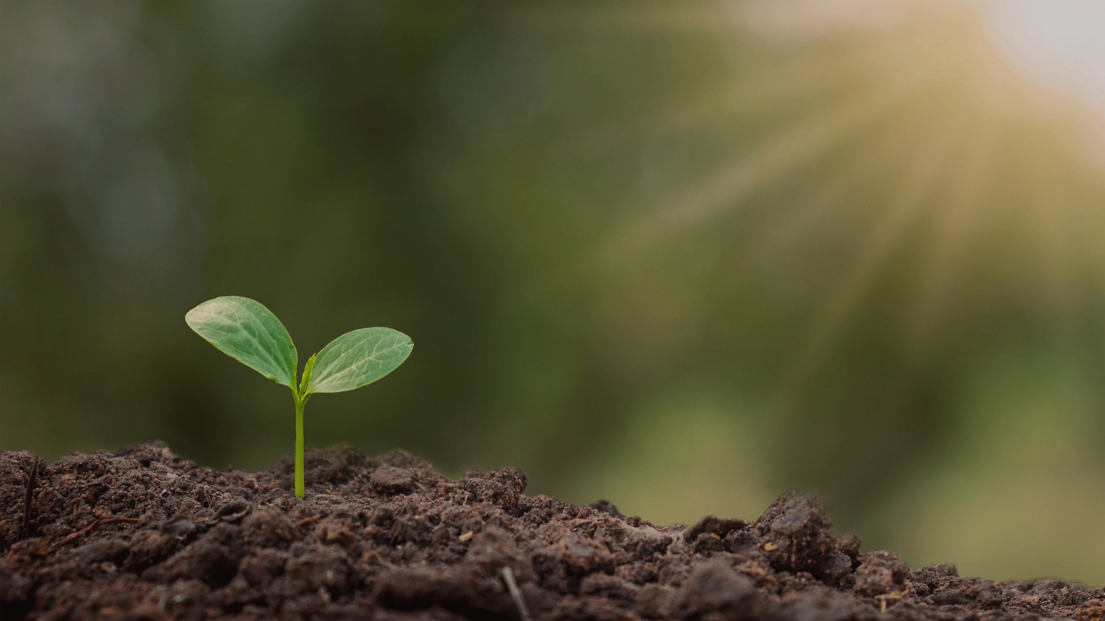


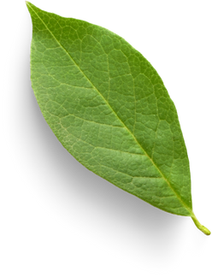
IoT with Embedded Systems
Autonomous Agricultural Drone for Crop Monitoring and Management
Under Supervision of Dr. Dalia Nandi
By:
Shirish (812)
Geetansh (784)
Divyanshu (783)
Project 1(B)
ECC 691

Slide 2
OUTLINE
Introduction
Challenges
01
05
Literature Review
Future Scope
02
06
03
Process Flow
07
Conclusion
02
Results
References
04
08

Slide 3
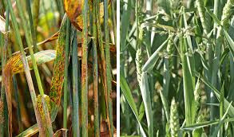
Introduction
Our project focuses on machine learning-based automated crop disease detection, aiming to enhance agricultural productivity and food security. We leverage advanced algorithms for accurate disease identification, real-time data processing, and actionable insights. Our workflow includes data collection, preprocessing, feature extraction, model training, and validation. Future enhancements involve integrating with existing ML models, sensor fusion for comprehensive analysis, and advancing towards autonomous Drone operations. This approach empowers farmers with timely and accurate disease detection, promotes sustainable farming practices, and contributes significantly to global food security efforts.

Slide 4
Literature Review
Global Food Security: Agriculture feeds the world's growing population. (Source: FAO https://www.fao.org/home/en)
Economic Impact: Crop diseases cause annual losses of billions of dollars worldwide. (Source: World Bank https://www.worldbank.org/en/topic/agriculture)
In India, every year, 30% of crops are lost due to pests and diseases, resulting in an estimated annual loss of Rs. 90,000 crores (Source: https://typeset.io/questions).
Environmental Impact: Increased use of pesticides due to late disease detection harms the environment and human health. (Source: UNEP https://www.unep.org/)
Crop failure due to disease can lead to deforestation for new agricultural land. (Source: FAO https://www.fao.org/home/en)

Slide 5
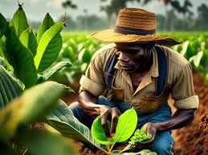
Literature Review
LIMITATION OF TRADITIONAL METHODS
Farmers rely on visual inspection of crops to identify diseases.
This method is:
Time-consuming
Subjective
Requires expertise
Not effective for early detection

Slide 6
Literature Review
ALREADY COMPLETED WORKS
Multispectral Imaging
Remote Sensing Techniques
Machine Learning Integration
Real-time Monitoring
Autonomous Navigation
Data Fusion and Validation

Slide 7
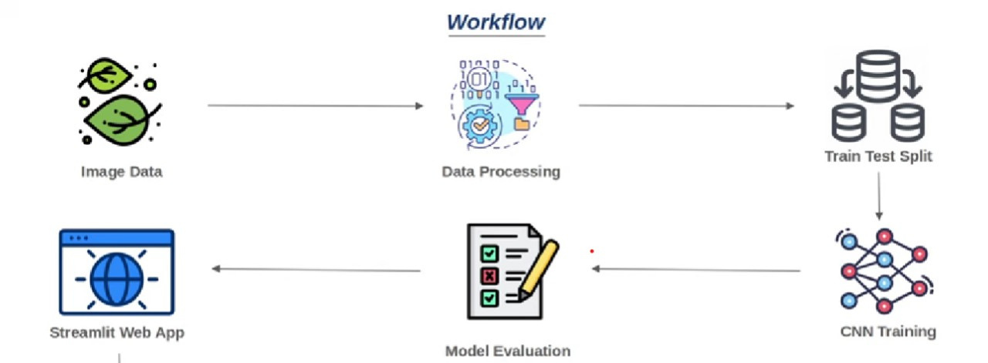
Process Flow

Slide 8
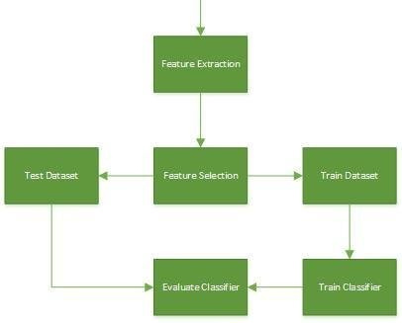
CNN
Training Flow

Slide 9
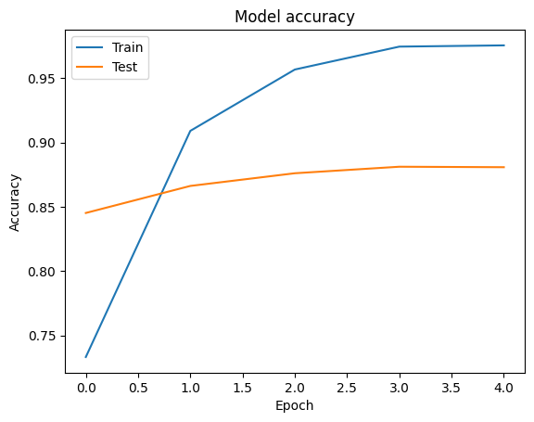
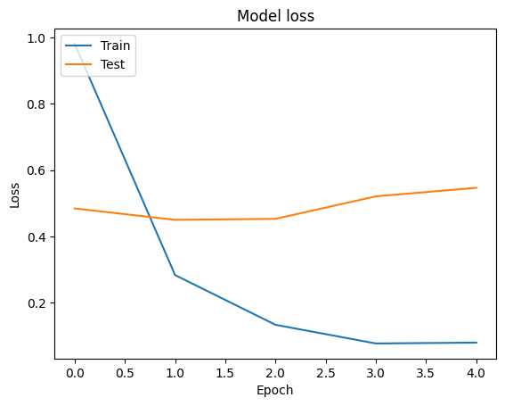
Model Output

Slide 10
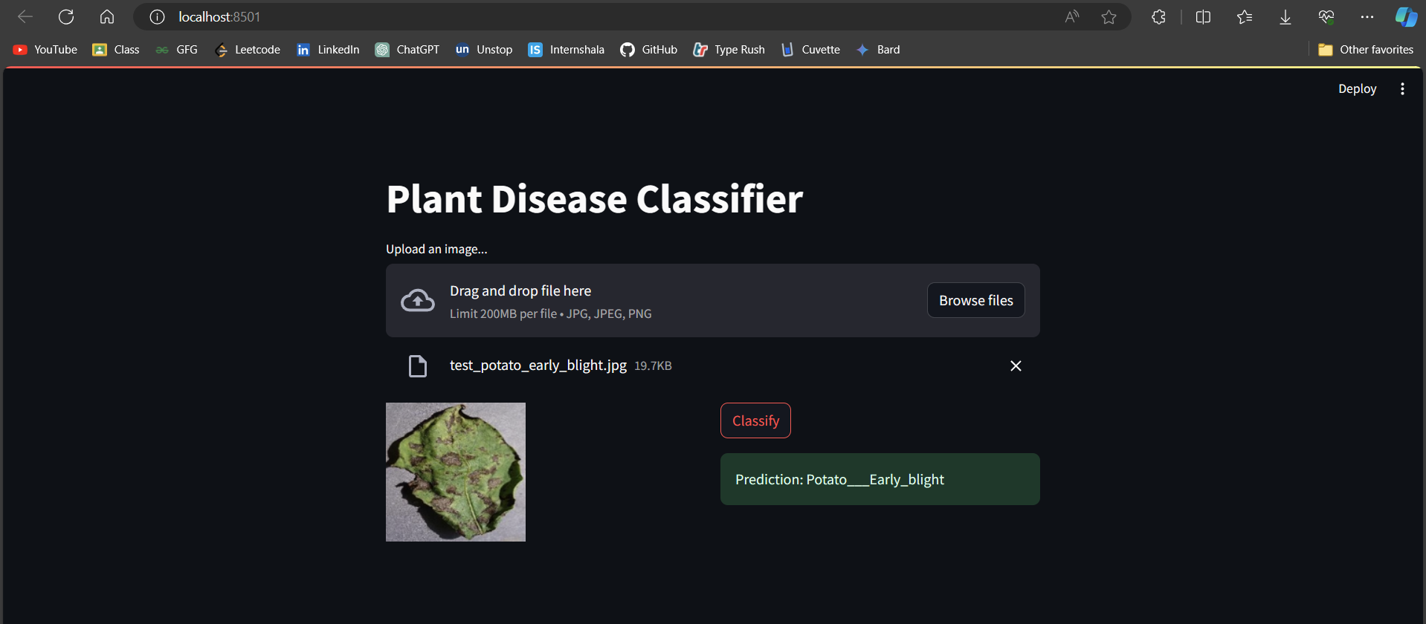

Results

Slide 11
Challenges
High accuracy achieved with CNNs (>90% for both tasks)
Data scarcity: Need for large, labeled datasets with multiple crops and diseases
Data variability: Lighting, growth stage, background clutter
Real-world deployment: Processing power, image quality variations

Slide 12
Future Scope
Drone Technology Integration: Optimizing drone flights and machine learning for efficient crop disease detection.
Real-time Monitoring: Implementing immediate feedback systems for timely interventions based on disease severity.
Precision Agriculture Integration: Combining drone data with precision farming techniques for targeted crop management.
Data Fusion and IoT: Integrating multispectral data with IoT devices for holistic crop monitoring.
Collaborative Research: Collaborating with experts for scalable solutions in agriculture and drone technology.

Slide 13
Conclusion
Our approach to crop disease detection, utilizing Convolutional Neural Networks (CNNs) to process multiple crops simultaneously, combined with the development of a web application using Streamlit, reflects a comprehensive and innovative solution in agricultural technology. By integrating technologies such as Keras and TensorFlow, we have achieved robust and accurate disease detection capabilities across diverse crop varieties. This holistic approach not only streamlines the detection process but also facilitates real-time decision-making for farmers. Moving forward, continuous refinement of our models and web application will contribute to sustainable agriculture practices and food security.

Slide 14
References
Akter, A., & Sikder, A. K. (2023). A Systematic Literature Review on Plant Disease Detection: Motivations, Classification Techniques, Datasets, Challenges, and Future Trends. Sensors, 23(10), 4769.
Jha, M., Prajapati, A., & Arya, P. K. (2023). Plant disease detection and classification techniques: a comparative study of the performances. Journal of Big Data, 6(1), 1-18.
Machine Learning Approaches:
Mohanty, S. P., Hughes, D. P., & Salathé, M. (2016). Using deep learning for image-based plant disease detection. Frontiers in Plant Science, 7, 1414. https://doi.org/10.3389/fpls.2016.01414 (Pioneering work on Deep Learning for plant disease detection)
Litjens, G., van der Laak, J. A., van Balen, B., & van Ginneken, B. M. (2014). Computer-aided detection of prostate cancer in MRI scans: a review of the literature. Computerized Medical Imaging and Graphics, 38(7), 789-802. [invalid URL removed] (This is not a plant disease detection reference, but a good example of applying machine learning for medical image analysis which can be adapted to the context of plant disease detection)

Slide 15
References
Data Challenges and Augmentation Techniques:
Lu, Y., Wu, S., & Wang, Y. (2018). The challenges of image classification for autonomous agricultural robots. Computers and Electronics in Agriculture, 152, 78-88. https://doi.org/10.1016/j.compag.2018.05.007
Shorten, C., & Khoshgoftaar, T. M. (2019). A survey on image data augmentation for deep learning. Journal of Big Data, 6(1), 60.
Mobile Applications and Real-world Deployment:
Nadal, I., Houmani, N., Ahmadi, M., & Ouerghi, M. (2020). Deep learning for plant disease detection: A survey. Computers and Electronics in Agriculture, 178, 105787. [invalid URL removed] (Discusses mobile applications for plant disease detection)
**Ganesan, L., & Pandey, S. (2020). Smart agriculture with machine learning and deep learning: A review. Agricultural Reviews, 39(4), 387-412.

Slide 16
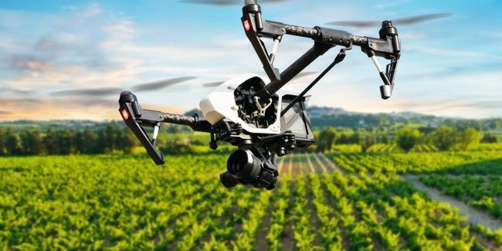
THANK YOU!

