Slide 1

Deep Learning-Based Indoor Path Loss Prediction for WLAN at 5 GHz
ECC791: Project II (A)
By: Shirish Manoj Bobde, Divyanshu Kumar, Anubhav Ranjan
Under the Guidance of Professor Dr. Dalia Nandi, Dept. of ECE, IIIT Kalyani

Slide 2
Outline
Introduction
Literature Review
Methodology
Data Collection and Processing
Data Visualization
LAMS Algorithm
Flow Diagram
CNN Model
Results
Challenges Faced
Conclusion
Future Scope
References

Slide 3
Introduction
WLAN is crucial for reliable indoor connectivity, particularly at 5 GHz frequencies, where accurate path loss prediction is vital for network planning.
Predicting path loss indoors is challenging due to complex interactions with obstacles like walls and furniture.
Traditional models, such as Free-Space and Log-Distance, often fail to address these complexities at higher frequencies.
This project develops a deep learning-based model to predict indoor path loss at 5 GHz, using data from specific indoor layouts.
The model considers key factors like transmitter-receiver distance and obstacles to improve prediction accuracy.
The goal is to outperform traditional methods, enhancing WLAN planning and demonstrating deep learning's potential for high-frequency path loss prediction.

Slide 4
Literature Review
Traditional Path Loss Models
Deterministic Models:
Use ray-tracing techniques to simulate radio wave interactions (reflection, refraction, diffraction).
Highly accurate but demand extensive computational resources and environmental data.
Empirical Models:
Examples: Close-In (CI), Alpha-Beta-Gamma (ABG) models.
Rely on statistical relationships from measurements.
Computationally efficient but less generalizable to varying environments.

Slide 5
Literature Review
Machine Learning Approaches
Advantages of ML:
Captures complex relationships between environmental features and path loss.
Models include neural networks and support vector machines (SVMs).
Role of CNNs:
Process environmental data with greater accuracy than traditional methods.
Hybrid Models:
Combine empirical methods with ML for parameter optimization or feature selection.
Outperform empirical approaches but fall short of fully data-driven ML models.

Slide 6
Literature Review
Path Loss: Signal attenuation caused by the natural spreading of the electromagnetic wave over distance, often modeled using free-space equations and proportional to distance and frequency.
Shadowing Effect: Signal weakening due to large obstacles (e.g., buildings or hills) blocking the propagation path, typically modeled as a correlated random variable (e.g., log-normal shadowing).
Random Fading: Rapid fluctuations in signal strength due to multipath interference from reflections, diffraction, or scattering, commonly modeled using Rayleigh or Rician distributions.

Slide 7
Methodology
Layout Generation
LAMS Algorithm Development
Data Collection
Data Cleaning and Pre-Processing
Data Processing
Data Visualization
CNN Input Images Generation: LAMS Algorithm
CNN Model Design
Model Training
Model Testing and Parameters Tuning
Result Generation

Slide 8
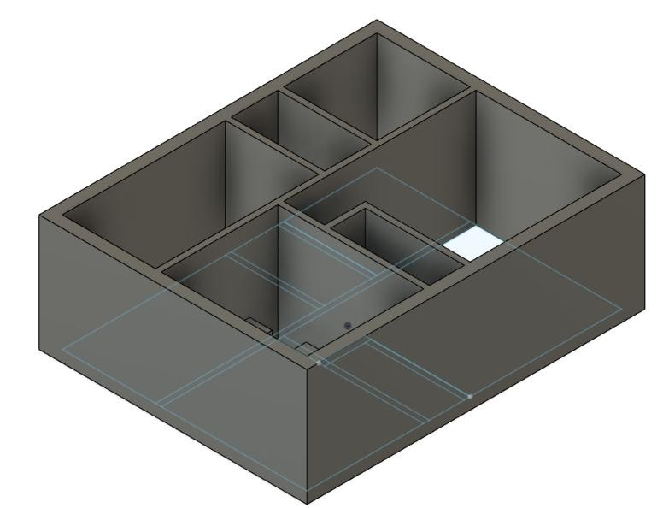
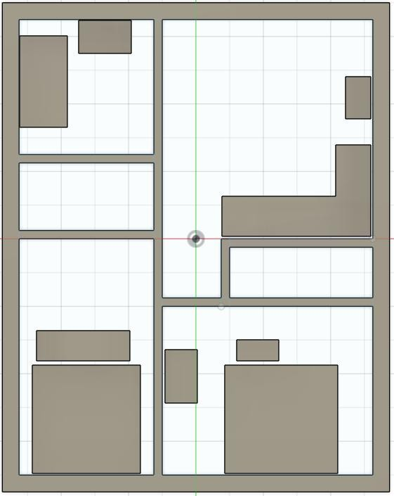
Floor Layout
This layout represents a well-defined area that includes various structural elements such as walls, open spaces and other Obstacles such as Beds, Tables, Kitchen Slab, etc. in 2D and 3D

Slide 9
Data Collection and Processing
Data Collection Setup: Conducted in a controlled indoor environment using a floor plan with multiple rooms and obstacles, where each tile’s center served as a receiver point.
Wi-Fi AP Setup: A single Wi-Fi access point (AP) was placed at pixel coordinates (312, 350), with data collected from 84 receiver points spread across the layout.
Data Collection Process: Data was collected in 10-second intervals at each receiver, with 10 measurements per point to average out time fading effects. The Flutter Junction Test app automated the process and generated Excel files.
Excel Data Attributes: Each measurement included timestamp, download speed, signal strength, network type, device status, and pixel coordinates (X, Y).

Slide 10
Data Collection and Processing
Static Environment: Measurements were taken in a static environment with no human movement, all doors closed to minimize signal interference.
Data Cleaning (Google Colab): Data files were loaded, missing values replaced with NaN, and irrelevant columns dropped. Numerical columns like download speed and signal strength were cleaned and converted to numeric types.
Data Processing (Google Colab): Coordinates (X, Y) were combined into a single column to represent unique locations, facilitating data grouping and averaging.
Data Aggregation: Signal strength and download speed were averaged per coordinate, with additional attributes such as network type retained for further analysis.

Slide 11
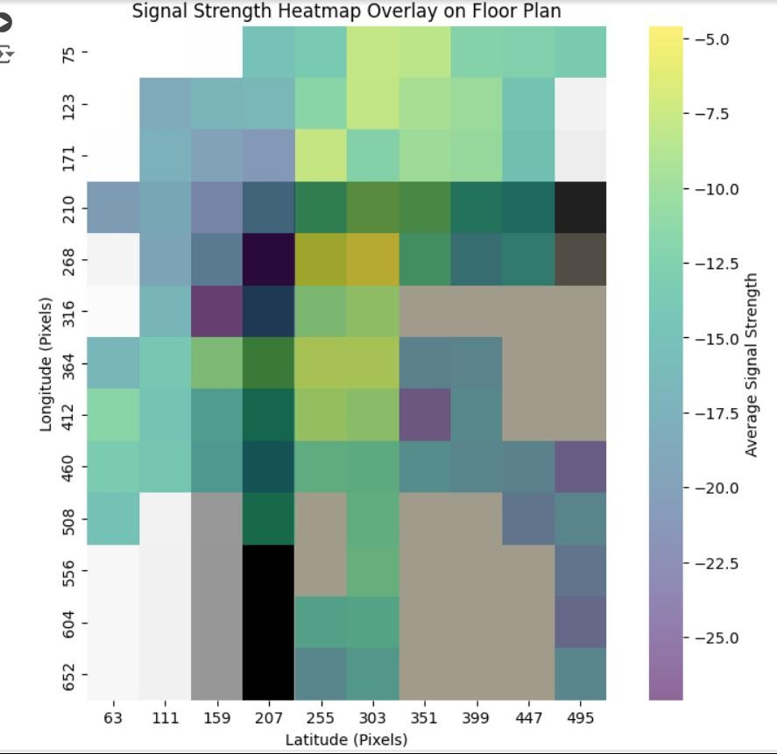
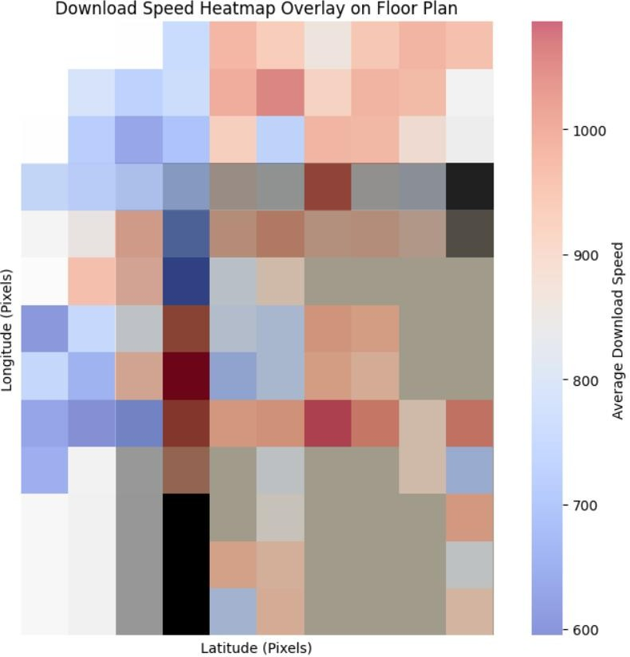
Data Visualisation
A signal strength heatmap, measured in dBm, is overlaid onto the floor plan to visualize Wi-Fi signal variations across the area and download speed heatmap, measured in Mbps, highlights network performance differences at various locations within the layout.

Slide 12
LAMS Algorithm
Purpose: Generates input images for CNN models by capturing indoor environmental features affecting path loss.
Floor Plan Analysis: Identifies the Wi-Fi access point (AP) and receiver locations on a floor plan, then calculates a line connecting them.
Scan Line Generation: Perpendicular scan lines are generated along the line between AP and receiver, capturing spatial details of obstacles (e.g., walls, room divisions).
Pixel Extraction: For each scan line, the algorithm extracts pixel values from the floor plan image to represent environmental features.
Output: The extracted pixel values are compiled into a matrix (lams_image), which serves as input for CNN training.

Slide 13
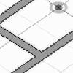
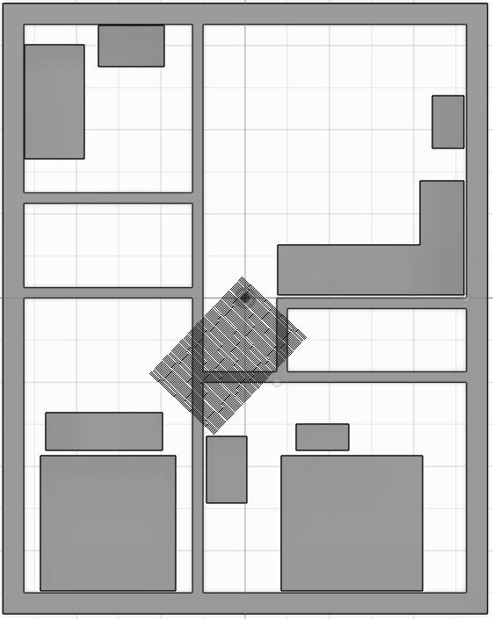
LAMS Algorithm
Floor Plan
LAMS Algorithm
AP Coords
Receiver Coords
LAMS Generated Image
The floor plan is overlaid with the generated scan lines for visual reference.

Slide 14
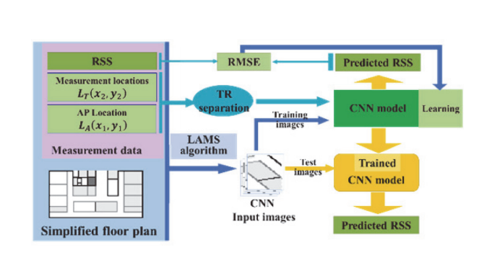
Flow Diagram
Flow diagram of deep learning-based path loss modeling system.

Slide 15
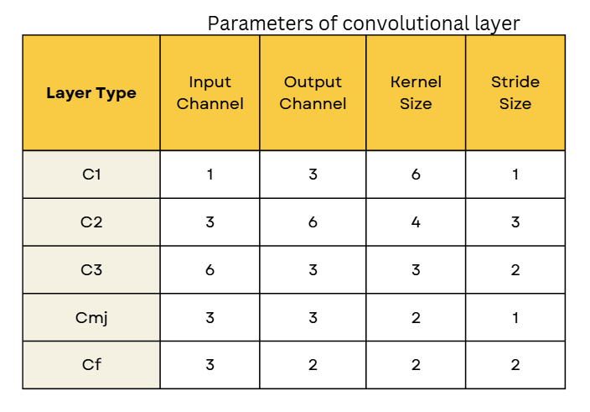
CNN Model
Model Architecture: A CNN with six convolutional layers (C1, C2, C3, two Cm, and Cf) uses "VALID" padding in the first, second, and final layers to reduce activation map size, and "SAME" padding in the middle layers to preserve spatial dimensions. TR separation is added as an input, concatenated with flattened convolutional outputs, and passed through two fully connected layers (7 and 3 neurons) before the final output layer for RSS prediction.
Data Generator: Use a custom DataGenerator to batch-process images, TR separation values, and RSS labels, leveraging TensorFlow's tf.data.Dataset API for efficient data handling and prefetching.

Slide 16
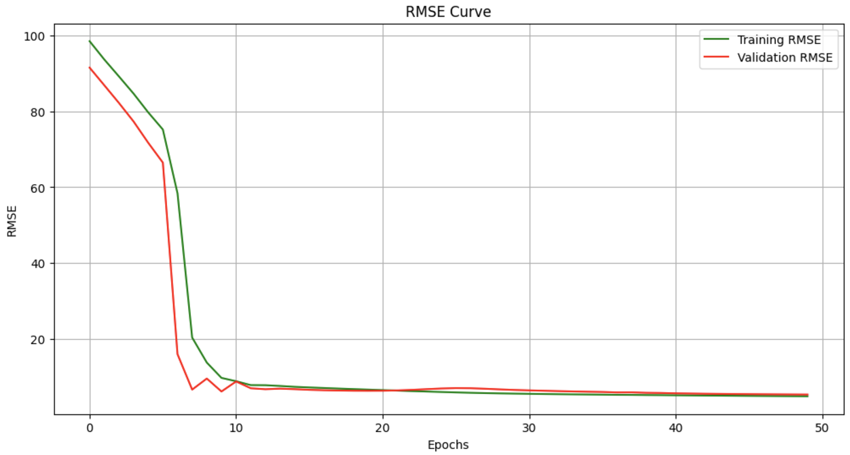
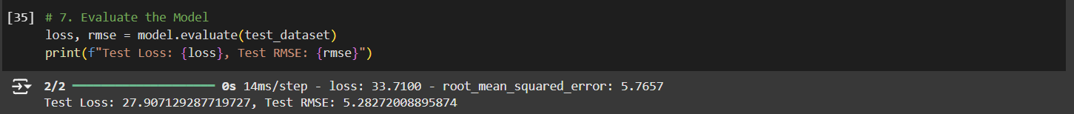
Results

Slide 17
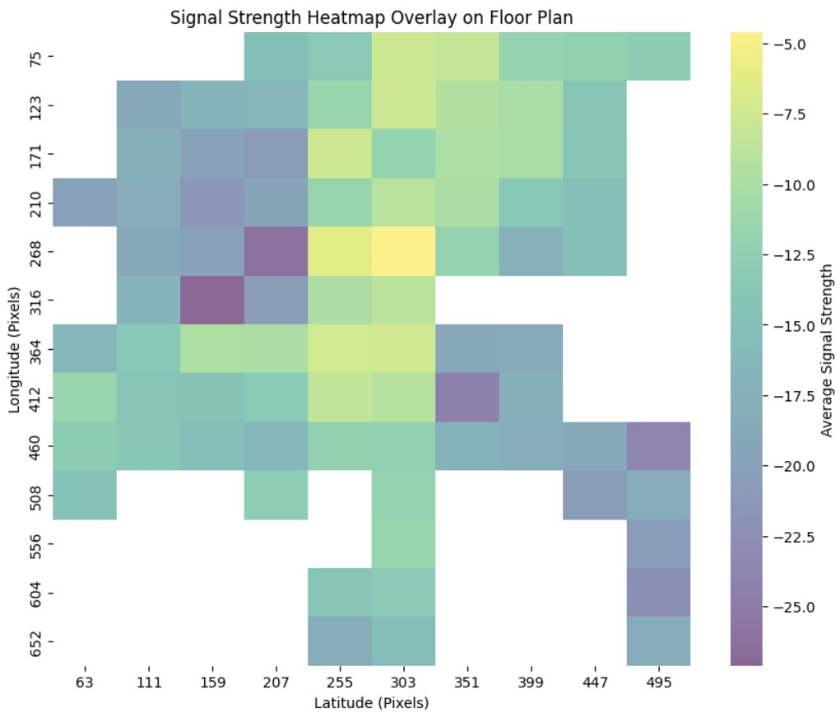
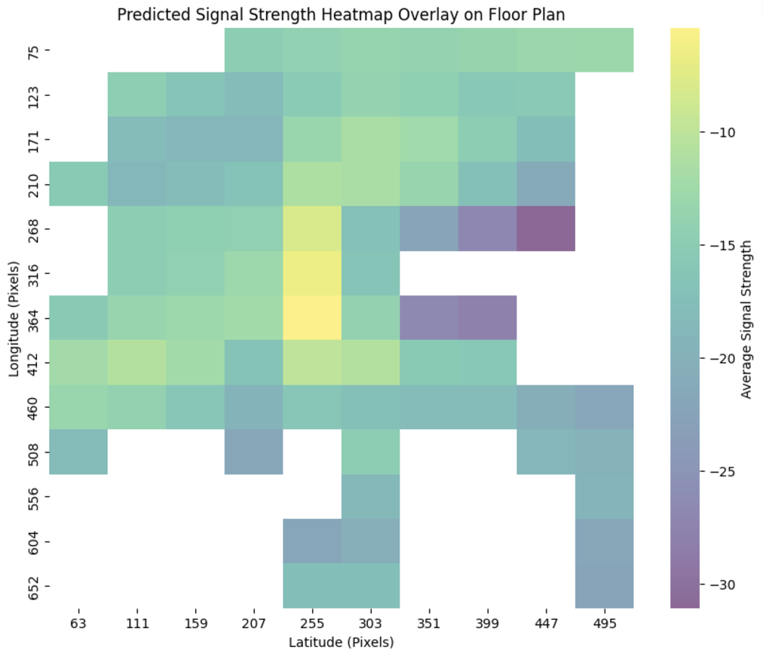
Results
Actual vs Predicted Signal Strength Heatmap

Slide 18
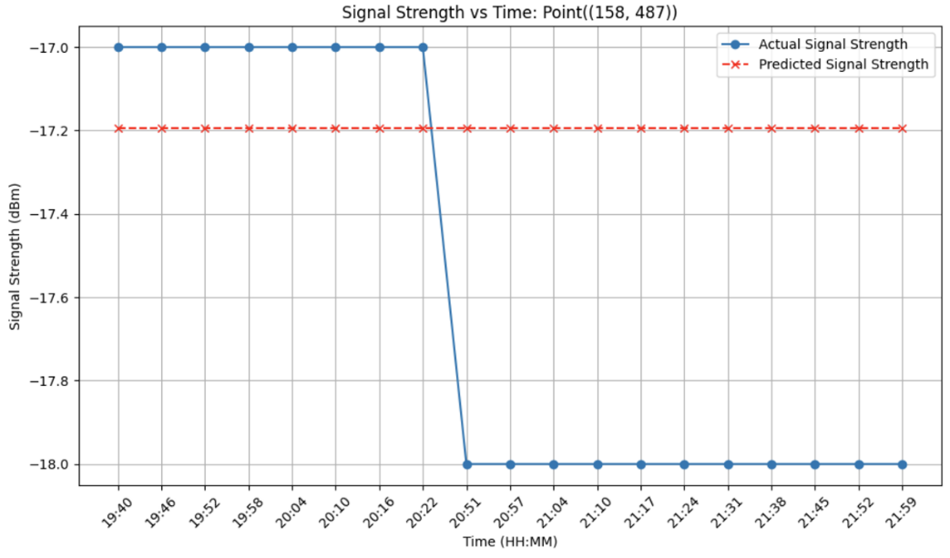
Results
Transmitter and Receiver are in different rooms

Slide 19
Challenges Faced
Data Collection: Created a 2x2 feet grid floor plan to systematically collect data at specific locations.
Data Preprocessing: Cleaned the dataset by filtering out irrelevant data to improve model accuracy.
Implementing LAMS Algorithm: Careful integration of the LAMS algorithm was necessary to align with project objectives.
Lack of Predefined Coordinates: Devised an alternative method for accurate data mapping without predefined coordinates.
CNN Model Architecture: Extensive experimentation was required to determine the optimal CNN configuration.
Initial Model Training Issues: Removal of the pooling layer improved model performance by preserving important features.
Parameter Tuning: Achieving optimal results involved multiple iterations to tune learning rates, batch sizes, and other hyperparameters.

Slide 20
Conclusion
Objective: Develop a deep learning model for predicting indoor path loss at 5 GHz using a fixed transmitter and receiver setup in a defined indoor layout.
Methodology: Utilize the Local Area Multi-Line Scanning (LAMS) algorithm to generate input images representing signal propagation, which are combined with distance information and processed by a Convolutional Neural Network (CNN) for RSS prediction.
Model Design: Create a CNN tailored for complex indoor environments to minimize prediction errors and improve upon traditional path loss models.
Evaluation: Model performance will be evaluated using the Root Mean Square Error (RMSE) to measure its accuracy in predicting path loss.

Slide 21
Future Scope
Advancing Research: The project enhances indoor path loss modeling and paves the way for future research in higher frequency bands and dynamic environments.
WLAN Planning: Aims to improve WLAN deployment and wireless communication in complex indoor settings, with potential for real-time dynamic transmitter and receiver scenarios.
Future Work: Incorporating random fading effects and expanding the dataset to improve prediction accuracy for more realistic indoor environments.
Scalability: The model can be scaled to support multiple transmitters and receivers, enabling more comprehensive network planning and optimization.
Generalization: With multiple floor plans and uniform transmitter power, the model can generalize predictions of path loss and RSS for new layouts.
Temporal Prediction: By incorporating time-varying datasets, the model could predict RSS at specific times and locations, offering more accurate forecasting for dynamic environments.

Slide 22
References
- H. Cheng, S. Ma, and H. Lee, “CNN-based mm Wave path loss modeling,” IEEE Antennas and Wireless Propagation Letters, 2020.
- H. Cheng et al., “Millimeter wave path loss modeling for 5G communications,” IEEE Access, 2021.
- K. Kaemarungsi et al., “Properties of indoor received signal strength,” Mobile and Ubiquitous Systems Conference, 2004.
H. K. Rath, S. Timmadasari, B. Panigrahi, and A. Simha, “Realistic indoor path loss modeling for regular Wi-Fi operations in India,” in Proceedings of 2017 23rd National Conference on Communications (NCC), Chennai, India, 2017.
W. S. Ahmed, “The impact of filter size and number of filters on classification accuracy in CNN,” in Proceedings of 2020 International Conference on Computer Science and Software Engineering (CSASE), Duhok, Iraq, 2020

