Slide 1
Introduction
Cybersecurity is critical due to evolving threats like brute-force attacks and malware.
"AI-Powered Cyber Threat Reasoning" uses AI to analyze logs and generate reports.
Built with Flask and Gemini 1.5 Flash for real-time insights and downloads.
Aims to empower users with actionable security recommendations.

Slide 2
Methodology
Defined goal: Analyze logs, generate reports, and enable downloads.
Selected tools: Python, Flask, Gemini, Pandas, python-docx.
Designed architecture: File upload, AI analysis, streaming, and export.
Prepared resources: API key, sample logs, environment setup.
Planned timeline: 4 weeks for development and testing.

Slide 3
Result
Technical: Python, web dev, API integration, doc generation.
Analytical: Data processing, pattern recognition, debugging.
AI/NLP: Prompt crafting, response parsing with regex.
Design: UI/UX, real-time streaming.
Problem-Solving: Adapted to formats, added downloads.

Slide 4
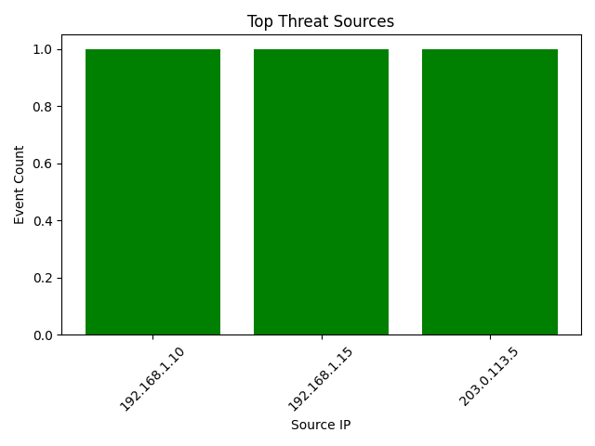
Output
Top Threat Sources: IP frequency list.
High-Risk Events: Filtered log details.
Report: Summary, patterns, actions streamed in UI.
Download: Word doc with structured report.

Slide 5
Conclusion
Successfully built an AI-driven cybersecurity tool.
Enhanced skills in coding, AI, and UX design.
Offers practical value for threat analysis.
Future scope: Multi-user support, advanced AI models.

