Slide 1
Enhancement to XOS educational operating system and XFS file system
Guide : Dr. K. Muralikrishnan
Members: Kruthika Suresh Ved B110300CS
Sikha V Manoj B110572CS
Sonia V Mathew B110495CS

Slide 2
What is eXpOS?
Educational platform to develop an OS.
Undergraduate student can implement in one semester.
Better insight of Operating System concepts.
Minimum external supervision required.
www.exposnitc.github.io
Notes:
Undergraduate stdent can implemnt in one sem. Provide the environment for this. Mention the modules that were done by us. Revised spec and os redesigned dev algos and ds and documented and documented in accessible form. Existing sys lacks so n so features bt they are relevant to education…wht are enhancements are described below. Supporting arch is there and roadmap has to be done..mention abt compiler also.
Mention why xos was enhanced
<number>

Slide 3
Why eXpOS?
Previous version – XOS
XOS has limited set of features
Following features were added:
Non blocking disk access
Access Control
Dynamic Memory Allocation

Slide 4
Objective
Specification,
Design, and
Documentation
of the eXpOS Kernel.

Slide 5
Why do we need expos? Implement with min supervision, done in a sem, sufficiently rich in info
What is new?
The spec was redesigned.
Talk abt the features added.
Spec design and documentation
Os kernel – abstraction to appln programmer NOT TO USER
Objective, problm defn, work is on the os kernel
Old features, new features, sep mention abt change in semantics,pragmatics,etc api remains same bt designis diff
www.exposnitc.gitbub.io
Notes:
Give atree structure..state dgm..prep on proc mangmt, mem mngmnt, file mngmnt etc.
Mention abt arch and compiler at last
<number>

Slide 6
Specification

Slide 7
eXpFS File System
File - a continuous stream of data
Files organized in a single directory - root
Types of eXpFS files - root, data and executable
Root File
Root entry - file name, file-size and file-type
Open, Close, Read and Seek
www.exposnitc.github.io

Slide 8
Data File
Sequence of words
Create, Delete,Open, Close, Read, Write, Seek, FLock and FUnLock
Executable File
Cannot be created by application programs
Loaded externally to disk
XEXE format - header and the code section
Cannot be read/written by user program
www.exposnitc.github.io

Slide 9
Process Model
Created when an existing process invokes Fork
Unique process id for each process
A process may open files or semaphores
Fork and Exec
Exit, Wait, Signal, Getpid, Getppid.
www.exposnitc.github.io

Slide 10
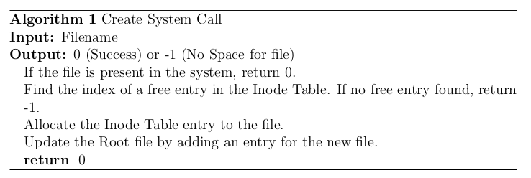
Create System Call
www.exposnitc.github.io

Slide 11
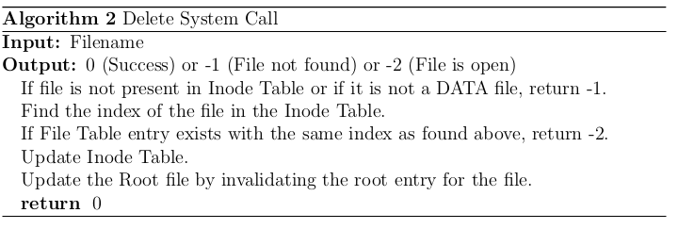
Delete System Call
www.exposnitc.github.io

Slide 12
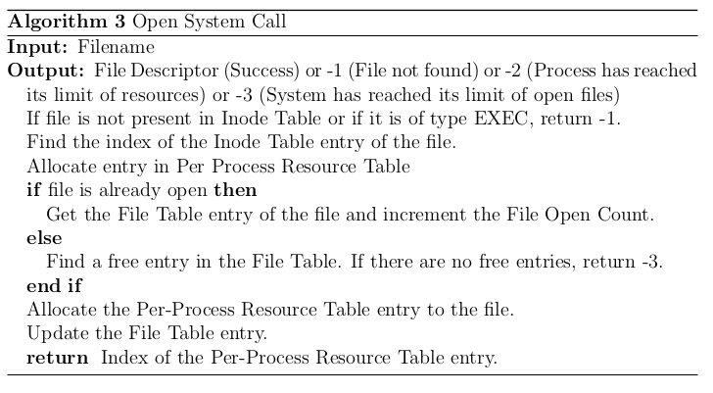
Open System Call
www.exposnitc.github.io

Slide 13
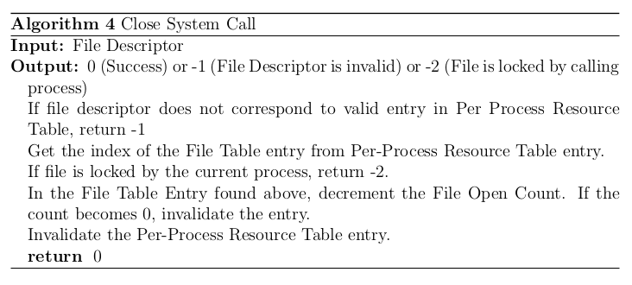
Close System Call
www.exposnitc.github.io

Slide 14
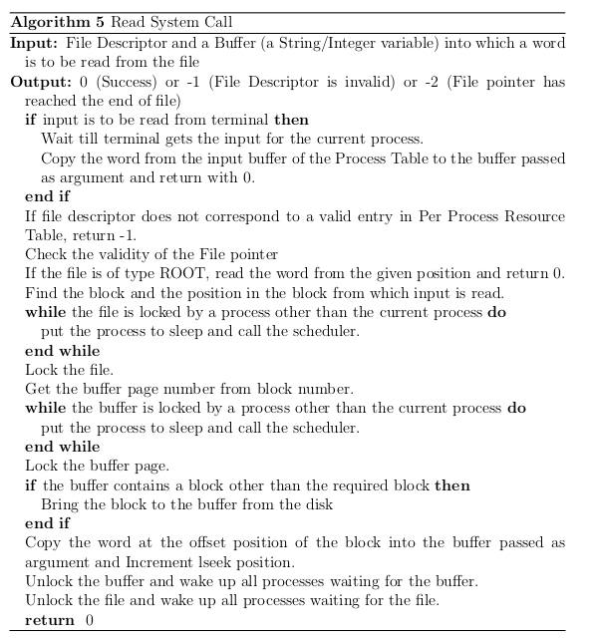
Read System Call

Slide 15
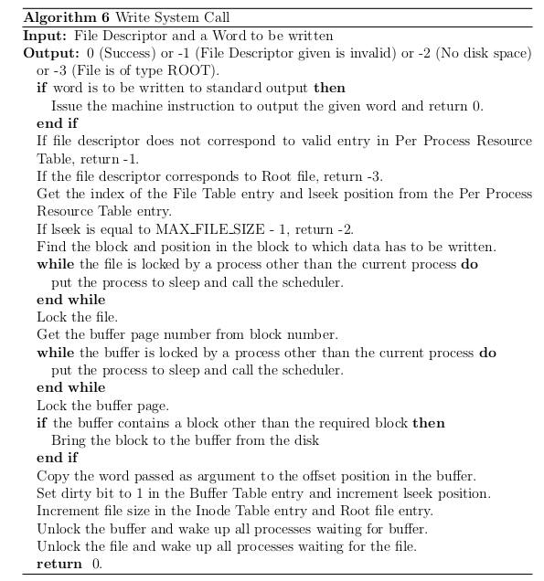
Write System Call

Slide 16
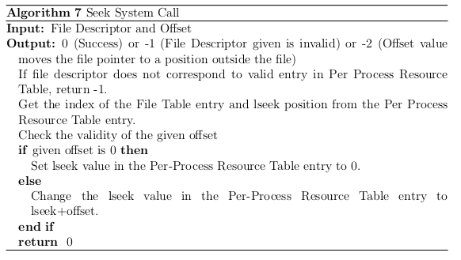
Seek System Call
www.exposnitc.github.io

Slide 17
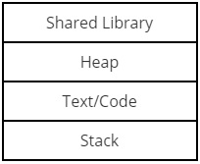
Virtual memory model
www.exposnitc.github.io

Slide 18
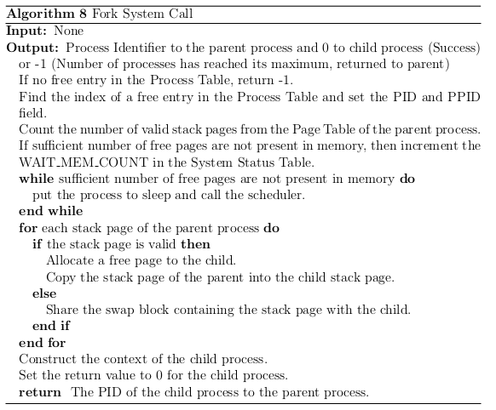
Fork System Call
www.exposnitc.github.io

Slide 19
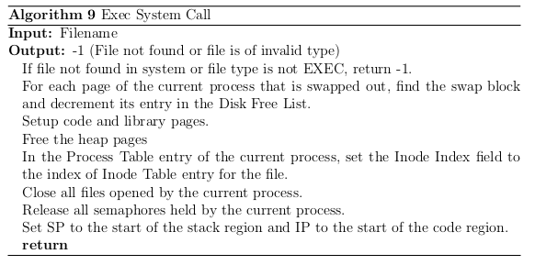
Exec System Call
www.exposnitc.github.io

Slide 20
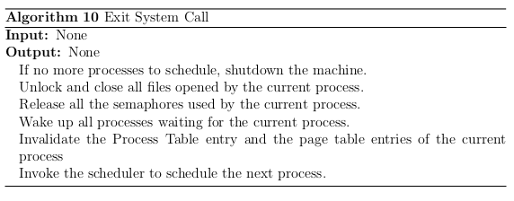
Exit System Call
www.exposnitc.github.io

Slide 21
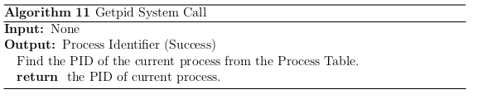
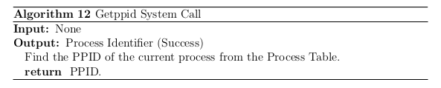
Getpid and Getppid
www.exposnitc.github.io

Slide 22
Process Synchronization
www.exposnitc.github.io
Notes:
<number>

Slide 23
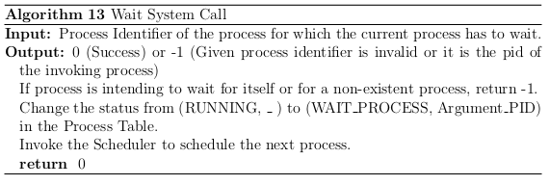
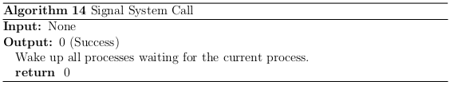
Wait and Signal
www.exposnitc.github.io

Slide 24
Access Control
www.exposnitc.github.io

Slide 25
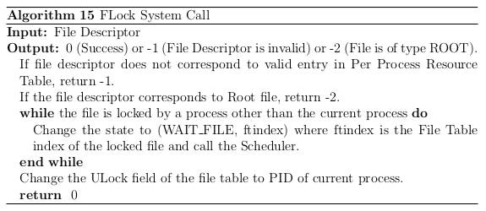
FLock System Call
www.exposnitc.github.io

Slide 26
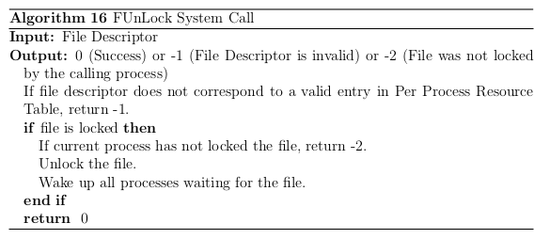
FUnlock System Call
www.exposnitc.github.io

Slide 27
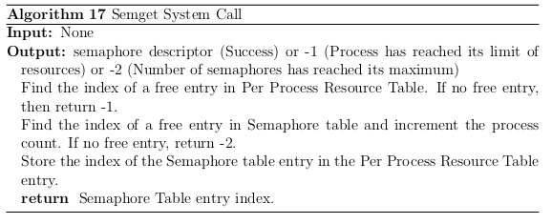
Semget System Call
www.exposnitc.github.io

Slide 28
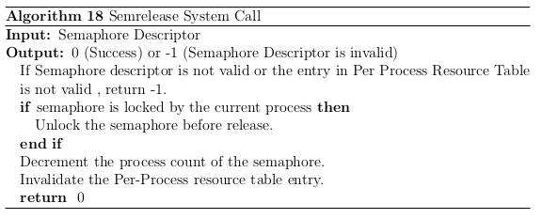
Semrelease System Call
www.exposnitc.github.io

Slide 29
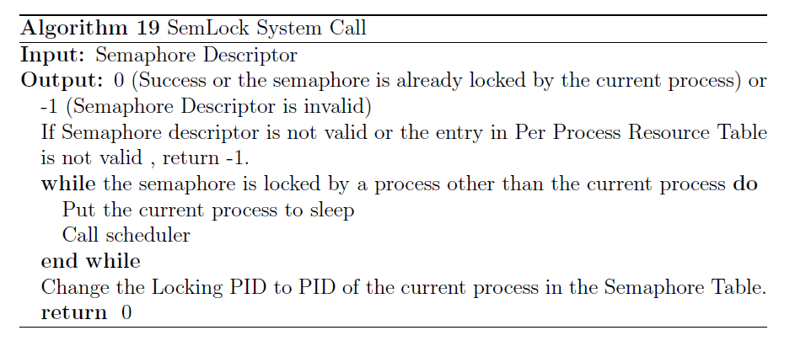
SemLock System Call
www.exposnitc.github.io

Slide 30
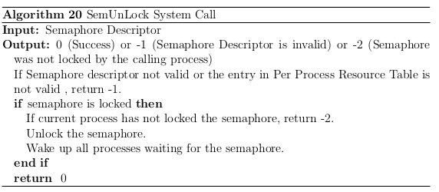
SemUnLock System Call
www.exposnitc.github.io

Slide 31
Hardware Interrupt handlers and Exception handler
www.exposnitc.github.io

Slide 32
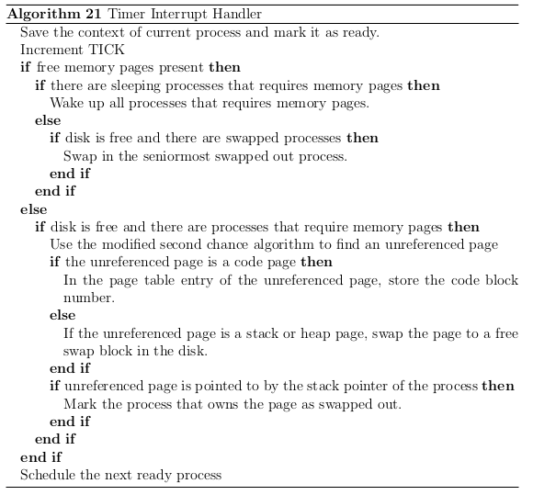
Timer Interrupt Handler

Slide 33
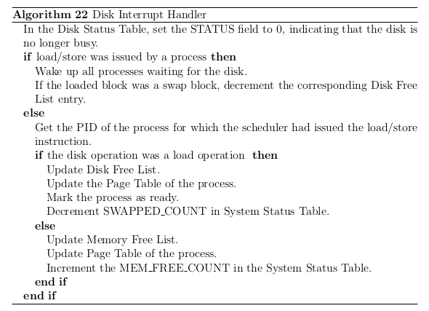
Disk Interrupt Handler
www.exposnitc.github.io

Slide 34
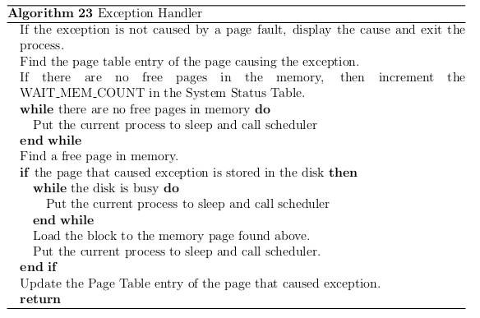
Exception Handler

Slide 35
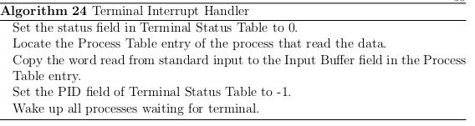
Terminal Interrupt Handler
www.exposnitc.github.io

Slide 36
Disk Data Structures
Inode Table
Disk Free List
Information about the disk block usage, 512 entries
Root File
www.exposnitc.github.io

Slide 37
Memory Data Structures
Process Table
Machine State
www.exposnitc.github.io

Slide 38
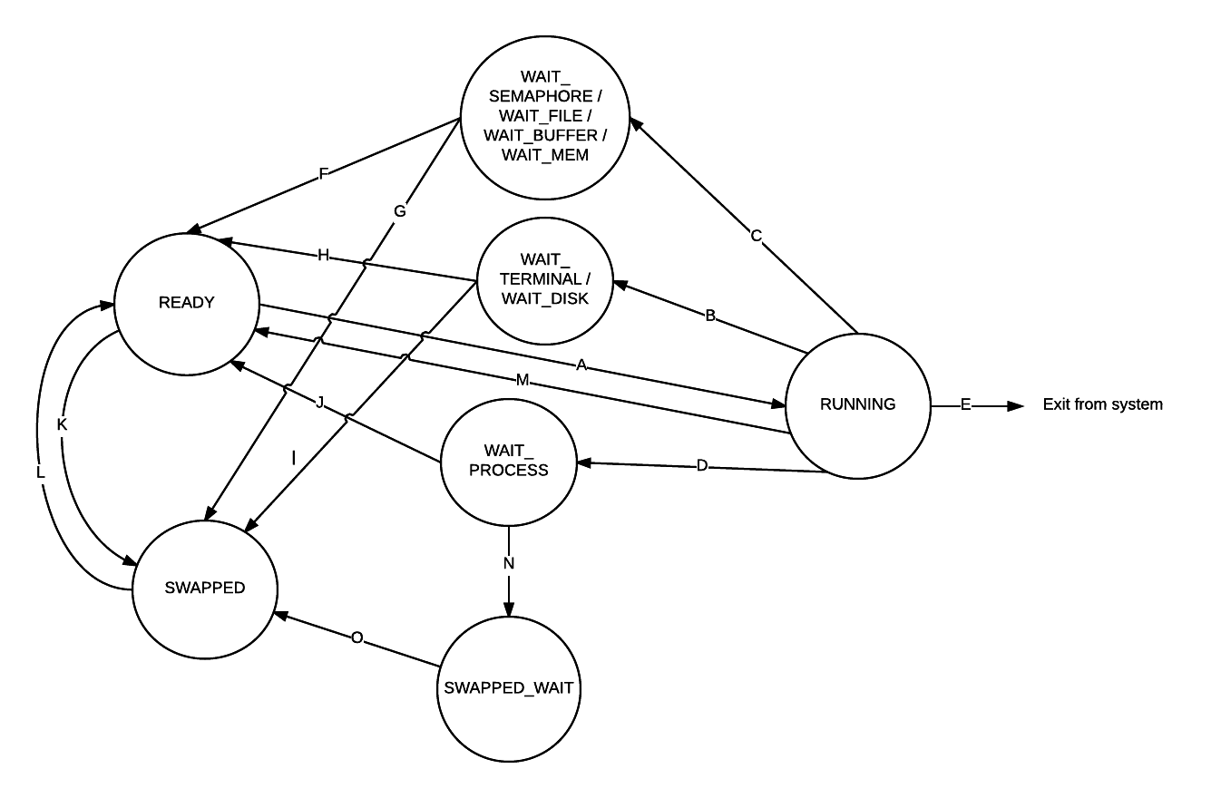
State Transitions
www.exposnitc.github.io

Slide 39
Per-Process Resource Table
Per-Process Page Table
www.exposnitc.github.io

Slide 40
File Table
Semaphore Table
Buffer Table
www.exposnitc.github.io

Slide 41
System Status Table
Terminal Status Table
Disk Status Table
Memory Free List
Information about memory page usage, 512 entries
www.exposnitc.github.io

Slide 42
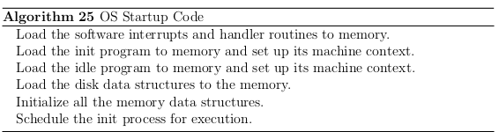
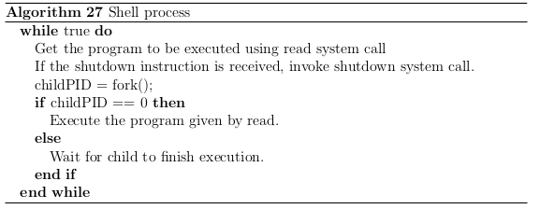
OS Startup Code and Shell process
www.exposnitc.github.io

Slide 43
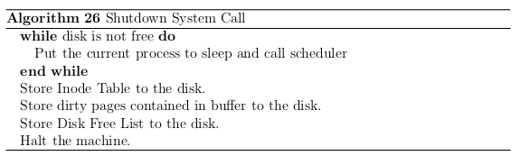

Shutdown System Call
Idle Process
www.exposnitc.github.io

Slide 44
Work Done
Redesign of existing OS data structures.
Design of new data structures.
Design of executable file format.
Design of algorithms for system calls and interrupt handlers.
Webpage for Project eXpOS was created http://exposnitc.github.io/

Slide 45
Future Work
Building a Roadmap for guidance.
Implementing and testing the algorithms designed
Adding more features like file permissions and Super-User previleges.
Adding Multi-Threading feature.
Adding a Directory structure in eXpFS.
www.exposnitc.github.io

Slide 46
Conclusion
Easy to implement
More informative
Better comprehension of OS concepts
www.exposnitc.github.io

Slide 47
References
Shamil C. M., Sreeraj S, and Vivek Anand T.Kallampally, ”XOS - An Experimental Operating System”, http://xosnitc.github.io/
Saman Hadiani, Niklas Dahlbck, and Uwe Assmann, ”Nachos Beginner’s Guide”, http://www.ida.liu.se/TDDB63/material/begguide/
George Fankhauser, Christian Conrad, Eckart Zitzler, Bernhard Plattner, ”Topsy - A Teachable Operating System”, Version 1.1, http://www.tik.ee.ethz.ch/topsy/Book/Topsy1.1.pdf
Maurice J. Bach, ”The Design of Unix Operating System”
Thomas W. Doeppner, ”Operating Systems in Depth”, Wiley, 2011.
www.exposnitc.github.io

