Slide 1

Basic Details of the Team and Problem Statement
Ministry/Organization Name/Student Innovation : Ministry Of AYUSH
PS Code : SIH1343
Problem Statement Title : Identification of different Medicinal plants/Raw materials through Image Processing using Machine Learning Algorithms
Team Name : CodeXccelrate
Team Leader Name : Shubham Tiwari
Institute Code (AISHE) : C-33758
Institute Name : LOKMANYA TILAK COLLEGE OF ENGINEERING, KOPARKHAIRANE, NAVI MUMBAI, MAHARASHTRA
Theme Name : MedTech/BioTech/HealthTech

Slide 2
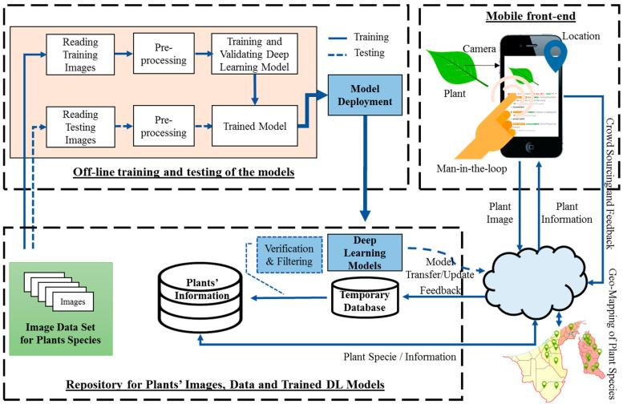












Idea/Approach Details:
Idea is to provide a platform where User will be able to find information about plant, where they grow, and check if the plants are endangered for ethical sourcing and medicinal purposes.
Why is it Different? - Our platform provides various uses of the identified plant/raw material, History and also habitat of that particular identified plant.
Users can easily upload the images through Web interface and passed on for Identification and fetching the information about the plant.
API-driven plant detection provides comprehensive information, conservation status, and locations through an interactive G-maps API via S3 bucket cloud platform.
AWS S3 Bucket
TECHNOLOGY STACK:
: Designing and WebApp
:Python modules for r preprocessing,labeling.
: Image Processing via deep learning.
: ML Integration.
:Server Side rendering.
: Data storage and Google-OAuth.
Product Status:
40% product building is completed and further build is on progress.Testing and Validations steps are next to be undergone.

Slide 3
Use cases :
Dependencies:
Pharmacists/ Herbalists: Enhancing product quality and safety and resources of medicinal raw materials for Ayurveda and other Medicinal Purposes.
Agriculture and Farming: Farmers can optimize the crop planning for endangered plant species and sustainable agriculture.
Conservation Efforts : Monitoring and protecting endangered plants species.
Education and Awareness : Fostering knowledge and conservation awareness to individuals having interests in the field of Reasearch and practicing the Medicine.
Government Regulation: Consumers can verify the authenticity of herbal products by using the software to identify the plants listed on product labels.
Wild Harvesting Management: Organizations engaged in wild plant harvesting for commercial purposes can monitor and manage their plants.
API Integration : Integration with external APIs for real-time geographical data and to fetch the features of plants.
Temporary Data Storage : Utilization of AWS S3 bucket for temporary storage of data during various stages of processing and user interactions.
Database Management : Utilization of Firebase and MongoDB for storing and retrieving plant-related information and user profiles.
Show stopper:
Geographical Mapping : Implementing accurate geographical mapping for medicinal plant locations on the website .
Cloud Hosting : Utilizing AWS for hosting provides the project with scalability and reliability, ensuring it can handle large traffic spikes and user growth effectively.
Cross-Platform Compatibility : Supports multiple platforms (e.g., mobile, web,Android,IOS) enhances accessibility and user reach, making the platform versatile, user-friendly and responsive.
Channels: Govt Portals, Industries, Organizations,etc.
Revenue Streams : Service Based Model.

Slide 4
Team Member Details:
Team Leader Name : Shubham Tiwari
Branch (Btech/Mtech/PhD etc): BE Stream (ECE, CSE etc):CSE Year (I,II,III,IV):III
Team Member 1 Name : Pravin Singh
Branch (Btech/Mtech/PhD etc): BE Stream (ECE, CSE etc):CSE Year (I,II,III,IV):III
Team Member 2 Name : Ajay Gupta
Branch (Btech/Mtech/PhD etc): BE Stream (ECE, CSE etc):CSE Year (I,II,III,IV):III
Team Member 3 Name : Ashutosh Singh
Branch (Btech/Mtech/PhD etc): BE Stream (ECE, CSE etc):CSE Year (I,II,III,IV):II
Team Member 4 Name : Ragini Kaushal Kishor
Branch (Btech/Mtech/PhD etc): BE Stream (ECE, CSE etc):CSE Year (I,II,III,IV):III
Team Member 5 Name : Hrugwed Dalvi
Branch (Btech/Mtech/PhD etc): BE Stream (ECE, CSE etc):CSE Year (I,II,III,IV):III
Team Mentor 1 Name : Prof. Jayendra Jadhav
Category (Academic/Industry): Academic Expertise (AI/ML/Blockchain etc):AI/ML Domain Experience (in years):10 Years
Team Mentor 2 Name : Prof. Rajendra Gawali
Category (Academic/Industry): Academic Expertise (AI/ML/Blockchain etc):AI/ML Domain Experience (in years):10 Years

