Slide 1
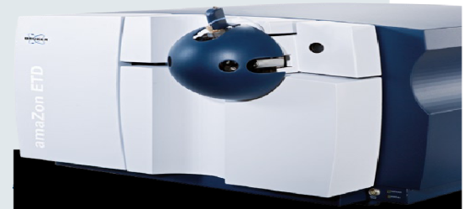
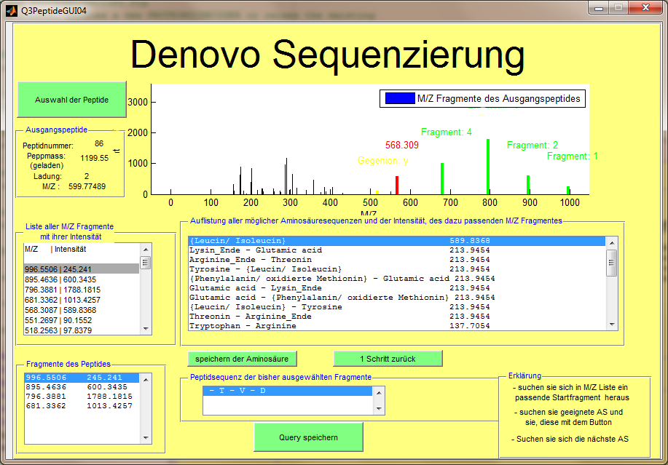
MetaProteomeAnalyzer
Client – Server System to handle MS-Experiments
Identification by
de novo sequencing
and BLAST search
Identification by combined database search
Identification by spectral library search
Protein/Peptide View
Label-free quantification
Interface to metabolic networks
Evaluation of results by cluster analysis and PCA

