Slide 1

Finding Issues:
Monitoring and Logging
Christian Nagel
https://csharp.christiannagel.com

Slide 2

Christian Nagel
Training
Coaching
Consulting
Development
Microsoft MVP
www.cninnovation.com
csharp.christiannagel.com
@christiannagel

Slide 3

Topics
Logging
Metrics
Distributed Tracing
Azure Services

Slide 4

Diagnostics with .NET

Slide 5
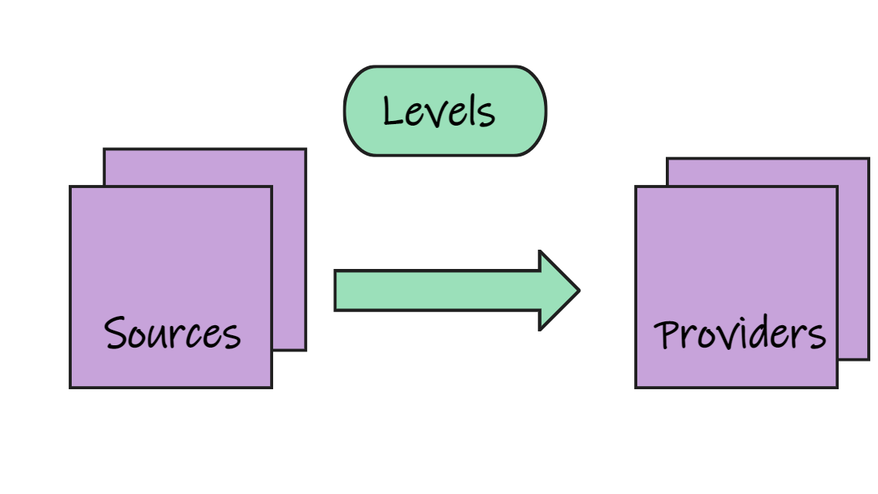
Logging

Slide 6
Log Providers
EventLog
Windows
Defaults to Warning
Console
Console, SimpleConsole, JsonConsole
Debug
Uses Debug class
EventSource
Cross-platform
Microsoft-Extensions-Logging

Slide 7
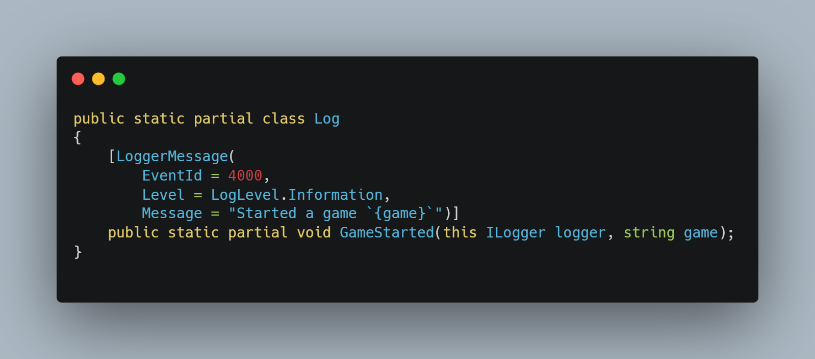
Logging Source Generator
High-performance logging
Cached delegates

Slide 8

Metrics
Numerical measurements
Traditional API
EventSource (System.Diagnostics.Tracing)
New Simple API
System.Diagnostics.Metrics

Slide 9

Built-in .NET Counters
.NET Runtime
DI Container
System.Net
ASP.NET Core
EF Core
…

Slide 10
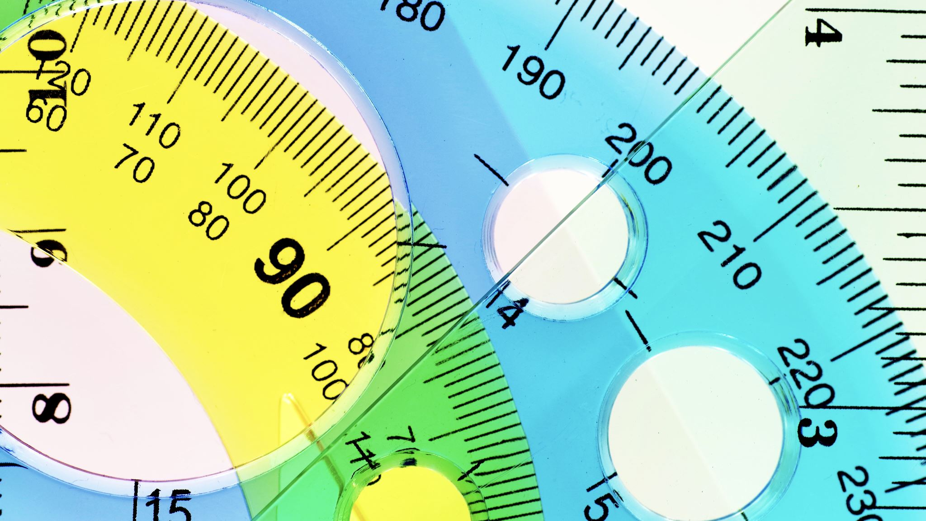
System.Diagnostics.Metrics
Meter
Track instruments
Counter
Requests per second or cumulative total
Histogram
Arbitrary values
UpDownCounter (7.0)
Change in sizes
ObservableCounter
Increasing values
ObservableGauge
Non-additive values
Notes:
Histogram – arbitrary values likely to be statistically meaningful
UpDownCoutner – e.g. change in queue size, change in active request size

Slide 11

Distributed Tracing
Tracing within applications, may be distributed across machines
Track correlating work

Slide 12
.NET Activity
Id
Hierarchical structure
separated by '.' or '_'
Tags
Information logged with activity
Baggage
Logged with activity and passed to child
Events
Time-stamped messages (e.g. "done now")

Slide 13

.NET Tools
dotnet trace
Performance analysis
dotnet counters
Investigate performance counters
dotnet monitor
Processes, dumps traces, metrics, logs, operations…

Slide 14

OpenTelemetry
https://opentelemetry.io
Instrumentation
C++, .NET, Erlang/Elixir, Go, Java, JavaScript, PHP, Python, Ruby, Rust, Swift
Collectors
Vendor-agnostic way to receive, process, export telemetry data

Slide 15
.NET
Logging
Metrics
Distributed Tracing

Slide 16

Microsoft Azure Services

Slide 17
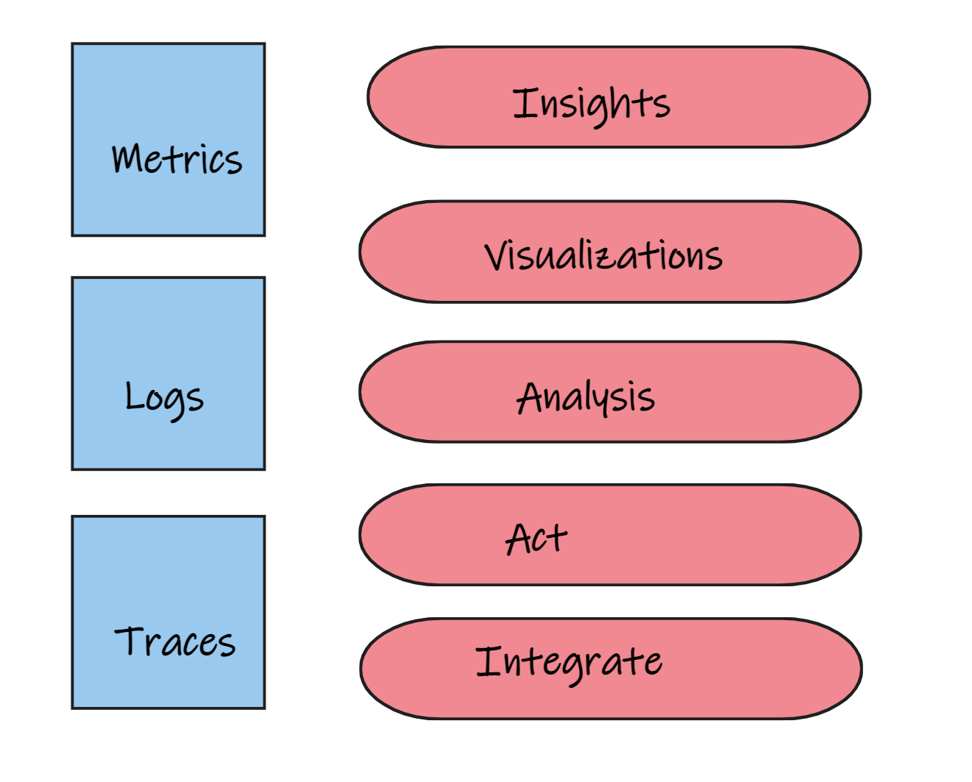
Azure Monitor

Slide 18

Logs
Kusto Query Language (KQL)
Explore data, patterns, explore anomalies
Tabular output
Visualize with Dashboards, PowerBI, Grafana

Slide 19
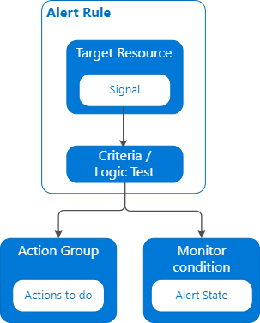
Alerts

Slide 20
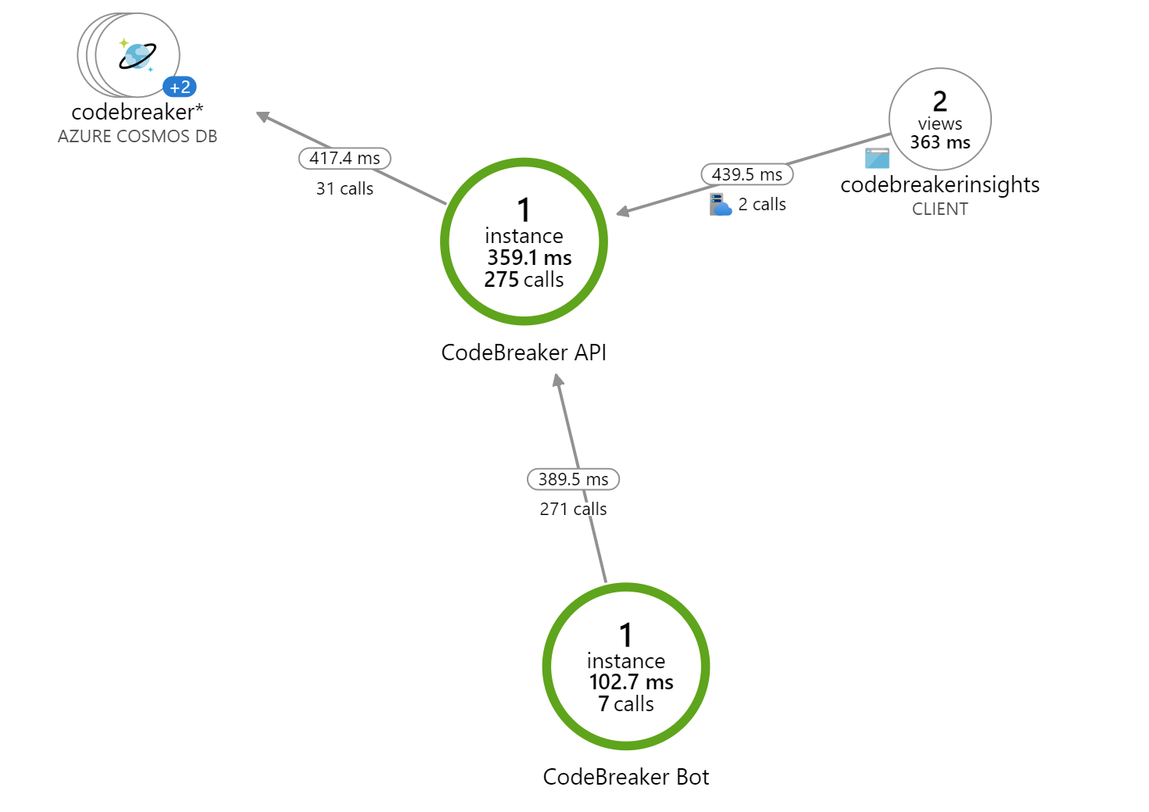
Application Insights
Application Performance Management
Live Monitoring
Automatically detect performance anomalies
See what users do

Slide 21
Take away
Use .NET features for logging, metrics, distributed tracing
Source code generator logging
System.Diagnostics.Metrics API
OpenTelemetry
Azure Monitor
Dashboards
Logging
Alerts
Application Insights

Slide 22
More information
Github Repo
https://github.com/codebreakerapp/Thrive2023
My blog
https://csharp.christiannagel.com
Dotnet Team Blog
https://devblogs.microsoft.com/dotnet/
Sites of .NET
https://sitesof.net

Slide 23

THANK YOU

