Slide 1


Reinforcement Learning for Optimizing Advertisement Selection in Digital Marketing: A Study of Multi-armed Bandit Algorithms
Paper ID: 167 (1571194953)
Authors
Pujyam Sathvika, John Pradeep Darsy, Y. V. Pavan Kumar
20-21 October 2025
Venue : Berkeley Hotel Pratunam, Bangkok Thailand

Slide 2


Presentation Outline
Introduction
Problem Statement and Proposed Solution
Literature Review
Methodology and Implementation
Results and Analysis
Conclusion
Important References

Slide 3
Introduction
Digital advertising is a major driver of online business revenue and brand visibility.
Advertisers aim to display the right ad to the right user at the right time to maximize engagement and click-through rates (CTR).
Traditional ad selection methods rely on static rules or historical data analysis, which cannot adapt to rapidly changing user behaviors and market trends.These methods fail to adapt to dynamic user behaviors.
Reinforcement Learning (RL) offers a dynamic, feedback-driven solution where systems learn optimal strategies through continuous interaction.
Multi-Armed Bandit (MAB) algorithms balance exploration vs. exploitation to optimize ad selection.

Slide 4
Problem Statement and Proposed Solution
Problem:
Difficulty in dynamically optimizing ads based on user engagement (CTR).
Static models don’t account for changing user preferences.
Proposed Solution:
Evaluate MAB algorithms (Random Selection, ε-Greedy, UCB).
Use artificial user interaction data to simulate real-world ad behavior.
Identify which algorithm achieves higher rewards, lower regret, and better selection accuracy.

Slide 5
Literature Review
Ref. | Focused Area | Methodology | Key findings | Relevance
[1] | Exploration–exploitation dilemma in reinforcement learning | Theoretical analysis of regret minimization; formulation of uniformly optimal policies | Demonstrated that logarithmic regret is achievable over time for all bounded reward distributions | Establishes the mathematical foundation for regret-based evaluation of MAB algorithms
[2] | Optimization of ad bids and budgets in digital marketing | Developed a parametric contextual bandit with bootstrapped Thompson sampling; tested on real and synthetic data | The proposed model achieved higher conversions and better performance under low data and tight budget conditions | Shows how MAB can effectively optimize marketing campaigns and improve conversions
[3] | Comparative performance of MAB algorithms in digital advertising | Experimental comparison of ε-Greedy, UCB, LinUCB, and Softmax algorithms using ad data | LinUCB achieved the highest cumulative return and accuracy by leveraging contextual information | Highlights the benefit of contextual learning for accurate, user-targeted ad recommendations
[4] | Handling dynamic user preferences in recommender and ad systems | Proposed a contextual bandit capable of detecting environmental changes and updating policies accordingly | Achieved robust performance with low regret in changing environments | Relevant for real-time ad optimization where user behavior and interests evolve continuously
[5] | Context-aware ad recommendation and CTR optimization | Modeled ad selection as a contextual MAB problem; introduced regret bounds for contextual settings | Provided theoretical regret bounds and practical insights for contextual decision-making in online ads | Core reference for applying contextual MABs to personalized advertising in search engines

Slide 6
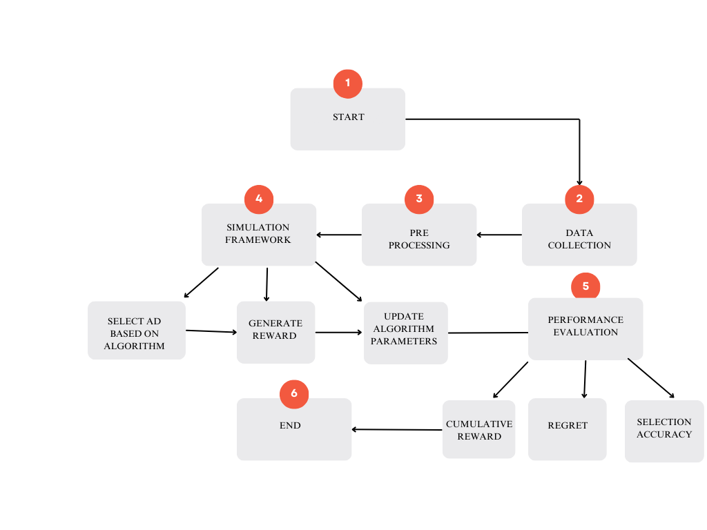
Methodology and Implementation
Data Collection
Five advertisements with predefined CTRs are chosen to mimic real-world engagement scenario
Algorithms used
Random selection, ε-greedy and UCB
Evaluation Metrics
Cumulative reward, selection accuracy, regret
Tools used
Simulations were carried on Python for 10000 iterations for each algorithm
Process flow
Input: Dataset with multiple ad options.
Agent: Applies MAB algorithm (Random, ε-Greedy, or UCB).
Output: Selection accuracy, cumulative reward, and regret
Fig. Proposed model implementation flow.

Slide 7
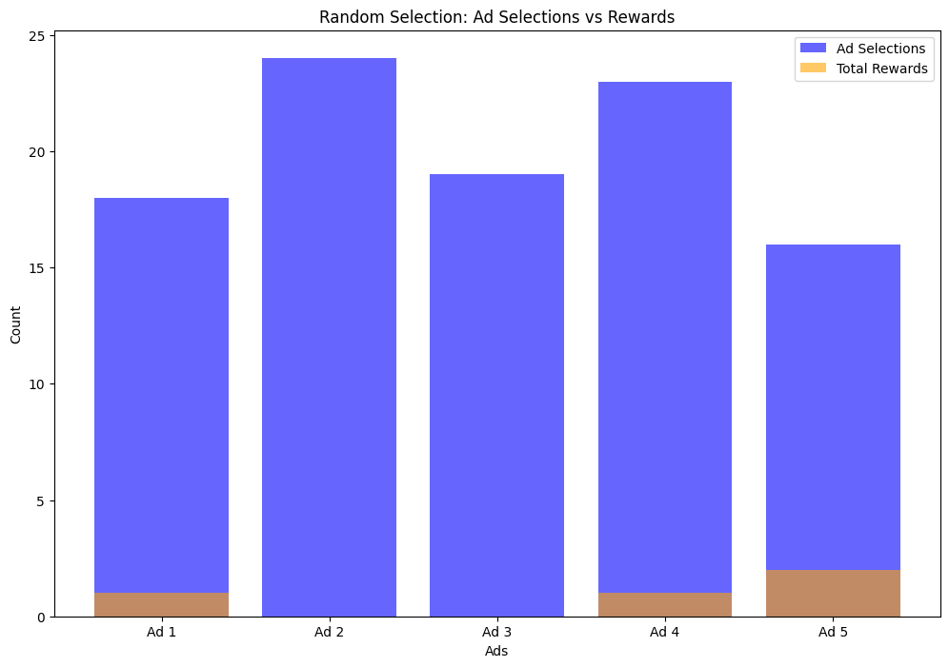
Results and Analysis
Random selection algorithm (RSA)
Fig. Frequency of ad selection for RSA

Slide 8
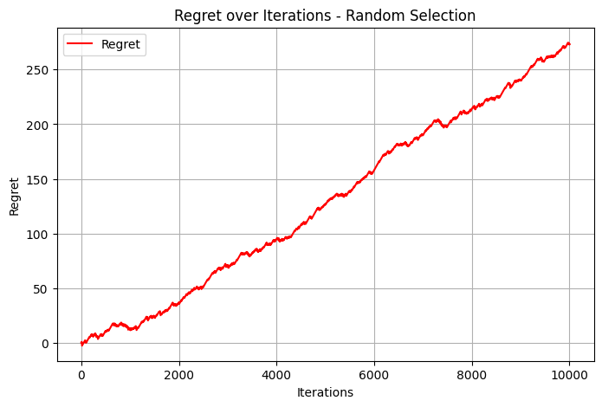
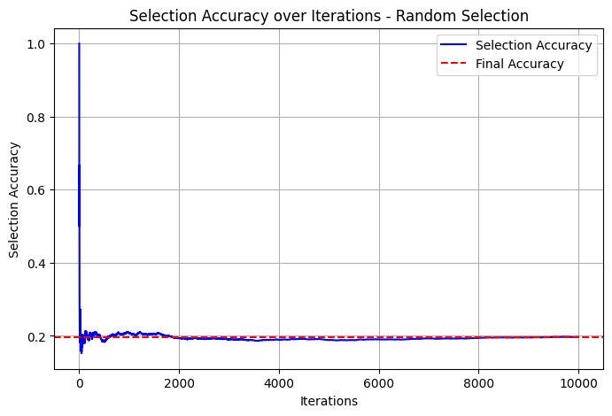
Results and Analysis
Random selection algorithm (RSA)
Fig. Regret characteristics for RSA
Fig. Selection Accuracy for RSA

Slide 9
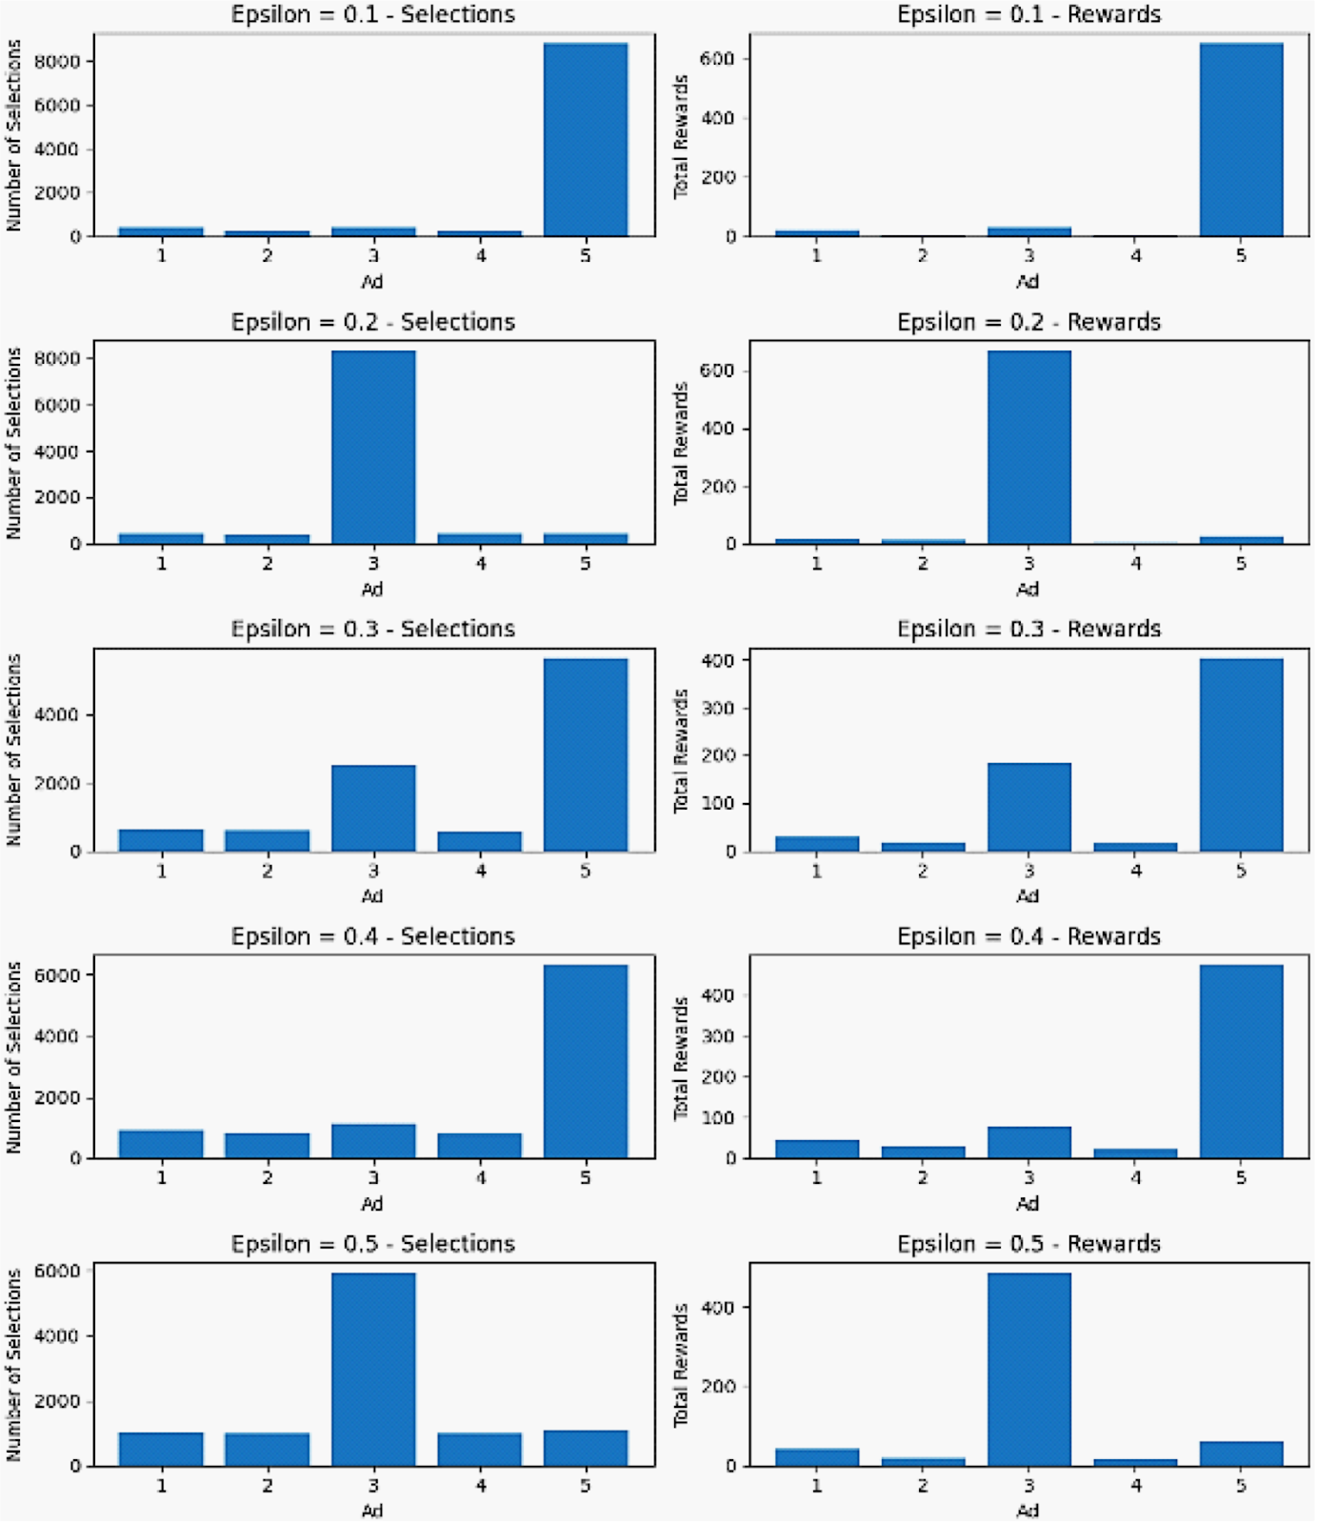
Results and Analysis
ε-greedy Algorithm
Fig. Frequency of ad selection for ε-greedy algorithm

Slide 10
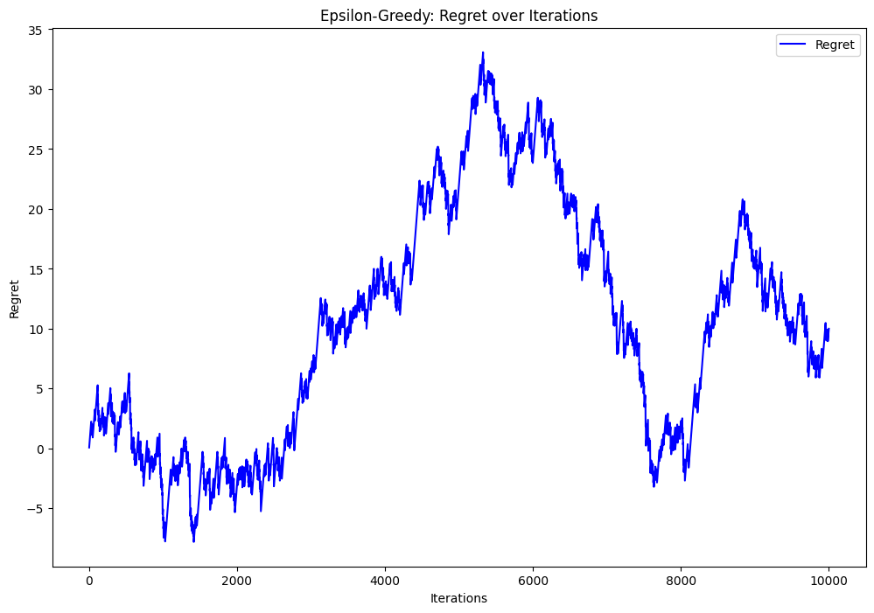
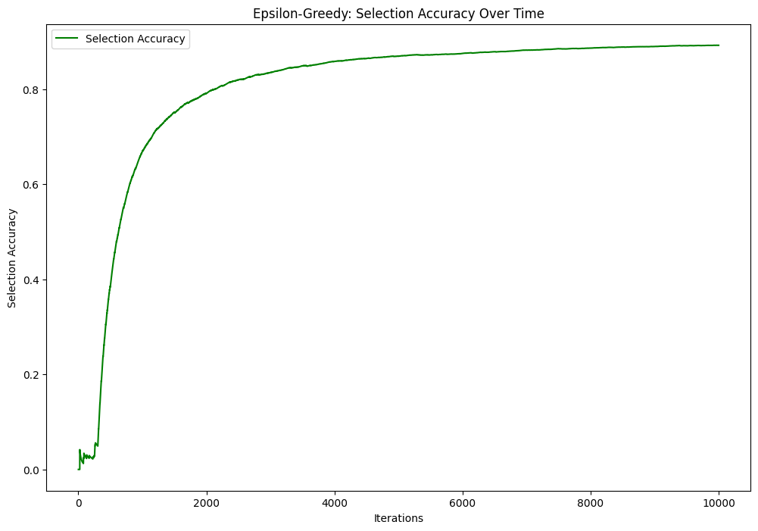
Results and Analysis
ε-greedy Algorithm
Fig. Regret characteristics for ε-greedy algorithm
Fig. Selection Accuracy for ε-greedy algorithm

Slide 11
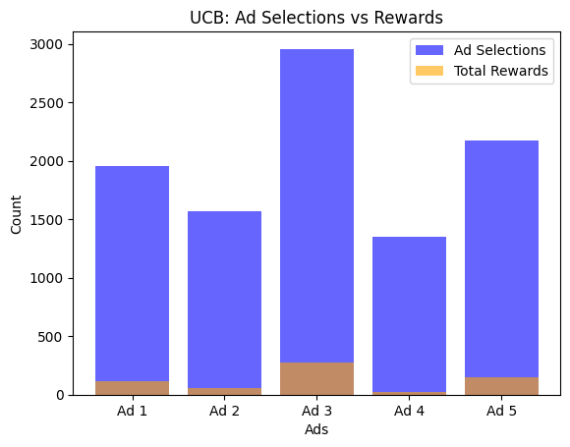
Results and Analysis
Upper Confidence Bound (UCB)
Fig. Frequency of ad selection for UCB

Slide 12
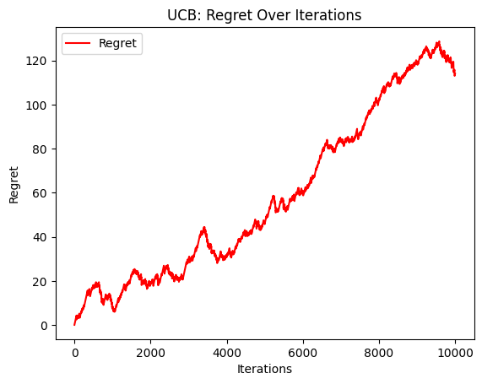
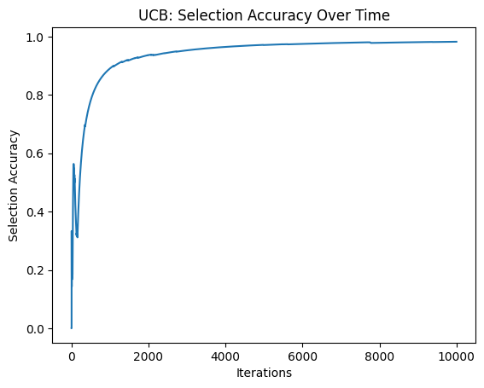
Results and Analysis
Upper Confidence Bound (UCB)
Fig. Regret characteristics for UCB
Fig. Selection Accuracy for USB

Slide 13
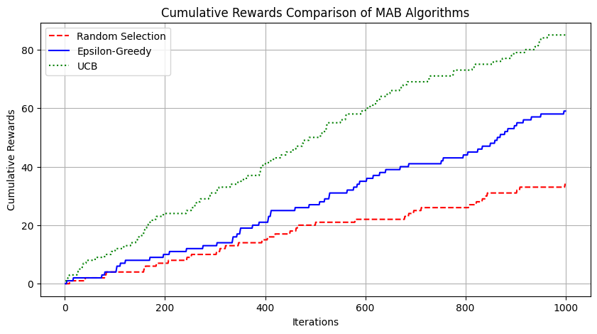
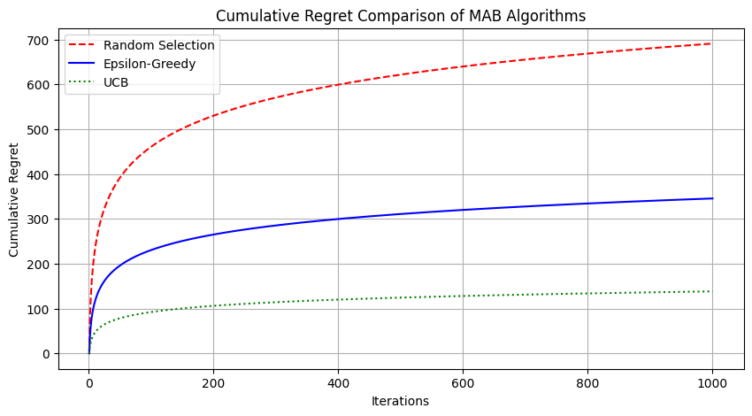
Results and Analysis
Fig. Cumulative rewards for MAB algorithms
Fig. Cumulative regret for MAB algorithms

Slide 14
Results and Analysis
UCB does well in terms of selection accuracy, avg. reward and regret
Hence, it can support personalization in ad delivery
Enables dynamic adaptation to user preferences and evolving environments.
The comparative analysis of three MAB algorithms is given in Table
Table. Comparative Performance of Algorithms
Algorithm | Avg. Reward | Regret | Accuracy
Random Selection | 0.053 | 304 | 19.58%
ε - greedy | 0.067 | 175 | 60.09%
UCB | 0.08 | 114 | 81.15%

Slide 15
Conclusion
This study explored the use of the Multi-Armed Bandit (MAB) framework combined with reinforcement learning for the optimization of advertisements.
Three MAB Algorithms - the Random Selection, Epsilon-Greedy, and Upper Confidence Bound (UCB) algorithms, were examined and probed for efficacy.
The findings showed that UCB performed better than the other strategies by effectively striking a balance between exploration and exploitation.
This paper highlights how parameter choices influence regret, reward, and accuracy, thus advertisers can reduce wasted impressions and increase click-through rates.
The personalized ad targeting can be made possible by contextual bandits, which combine both user features like gender, age etc.. and ad features like CTC, length of ad etc
Future Work

Slide 16
Important References
P. Auer, N. Cesa-Bianchi, and P. Fischer, “Finite-time Analysis of the Multiarmed Bandit Problem,” Machine Learning, vol. 47, no. 2–3, pp. 235–256, May 2002. doi: https://doi.org/10.1023/A:1013689704352.
M. Gigli and F. Stella, “Multi-armed Bandits for Performance Marketing,” International Journal of Data Science and Analytics, vol. 20, pp. 151–165, 2025. https://doi.org/10.1007/s41060-023-00493-7.
Z. Tian, “Bandit Algorithms for Advertising Optimization: A Comparative Study,” ITM Web Conf., vol. 73, p. 01019, 2025, doi: https://doi.org/10.1051/itmconf/20257301019.
Q. Wu, N. Iyer, and H. Wang, “Learning Contextual Bandits in a Non-stationary Environment,” SIGIR '18: The 41st International ACM SIGIR Conference on Research & Development in Information Retrieval, pp. 495-504, 2018. doi: https://doi.org/10.1145/3209978.3210051.
T. Lu, D. Pál, and M. Pál, “Contextual Multi-Armed Bandits,” Proceedings of Machine Learning Research (PMLR), vol. 9, pp. 485-492, 2010. https://proceedings.mlr.press/v9/lu10a.html.

Slide 17
Thank You

