Slide 1

IEEE
SAFE - RL IN HAZARDOUS-GRIDWORLD
Team Members:
Dhruv Aggarwal- 23BCE7474
K Mani Gopal- 23BCE7466
VIT-AP
Venue CB115

Slide 2


Presentation Outline
Introduction
Problem Statement and Proposed Solution
Literature Review
Methodology and Implementation
Results and Analysis
Conclusion
Important References

Slide 3
Introduction
The rapid advancement of autonomous systems—such as robotics and self-driving vehicles—has made safety a critical requirement in decision-making systems. Traditional Reinforcement Learning (RL) focuses on maximizing cumulative rewards, often ignoring safety constraints, which can lead to catastrophic failures in real-world environments.
To address this, Safe Reinforcement Learning (SafeRL) introduces the Constrained Markov Decision Process (CMDP) framework. In CMDPs, agents must not only maximize rewards but also adhere to safety constraints.
Two primary approaches exist:
Soft safety (Lagrangian methods): Penalize unsafe behavior
Hard safety (Shielding): Prevent unsafe actions entirely
This work provides a comparative evaluation of these approaches, supported by a multi-seed statistical validation framework to ensure reliability.

Slide 4
Problem Statement and Proposed Solution
Problem:
Standard RL agents:
Maximize reward without considering safety
May choose risky paths if rewards outweigh penalties
Are unsuitable for real-world deployment where violations are costly
Proposed Solution:
The problem is modeled as a CMDP, where:
Objective: Maximize reward
Constraint: Keep cumulative safety cost below threshold
The study evaluates five architectures:
Q-Learning (baseline)
SARSA (baseline)
Fixed Lagrangian
Adaptive Lagrangian
Shielded RL
Additionally, a Risk Maturity Profile is introduced to map algorithms to real-world deployment scenarios.

Slide 5
Literature Review
Ref. | Focused Area | Methodology | Key findings | Relevance
[1] | Foundations of Reinforcement Learning | Introduced Markov Decision Processes and value-based learning methods (Q-Learning, SARSA) with reward maximization framework. | Established that agents can learn optimal policies through trial-and-error interactions with environments | Provides the core RL framework, highlighting why traditional methods ignore safety constraints
[2] | Safe Reinforcement Learning via Shielding | Proposed a formal shielding mechanism that evaluates actions using a safety predicate and overrides unsafe actions | Demonstrated zero-violation guarantees during both training and deployment | Forms the basis of hard-safety approaches used in this paper
[3] | Reliability in Deep RL Experiments | Introduced multi-seed evaluation methodology to address randomness in RL training outcomes | Showed that single-run experiments are unreliable; statistical evaluation improves reproducibility | Justifies the multi-seed validation framework used in this work
[4] | Constrained Markov Decision Processes (CMDP) | Extended MDPs to include cost functions and constraints with optimization under safety thresholds | Provided a formal framework to balance reward maximization with constraint satisfaction | Serves as the mathematical foundation for modeling Safe RL problems
[5] | Reward-Constrained Policy Optimization | Reward-Constrained Policy Optimization | Demonstrated that safety constraints can be enforced on average using penalties | Forms the basis of Lagrangian methods evaluated in the study

Slide 6
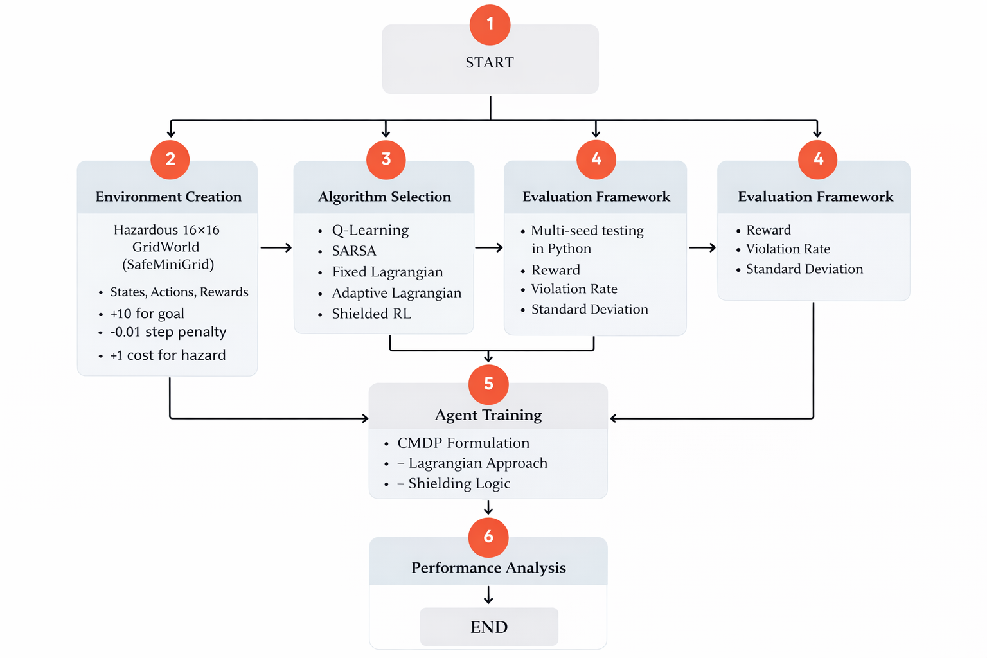
Methodology and Implementation
Environment Setup (Data Source)
A 16×16 GridWorld (SafeMiniGrid) environment is designed to simulate a safety-critical navigation problem.
Reward structure:
+10 → Goal reached −0.01 → Step penalty +1 cost → Hazard collision
Algorithms used
Qlearning, SARSA, Shielding, adaptive lagrangian,
Evaluation Metrics
Average episodic reward, violation rate,standard deviation and pareto efficiency
Tools used
Simulations were carried on Python for 10000 iterations for each algorithm
Fig. Proposed model implementation flow.

Slide 7
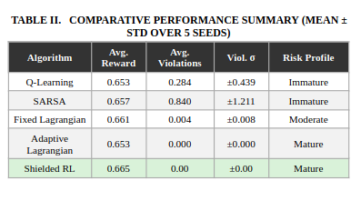
Results and Analysis
Learning Behavior Insights
Q-Learning: Exploits risky shortcuts
Adaptive Lagrangian: Learns safety gradually
Shielded RL:
Always safe
Slower learning initially
Converges to stable safe policy (~800 episodes)

Slide 8
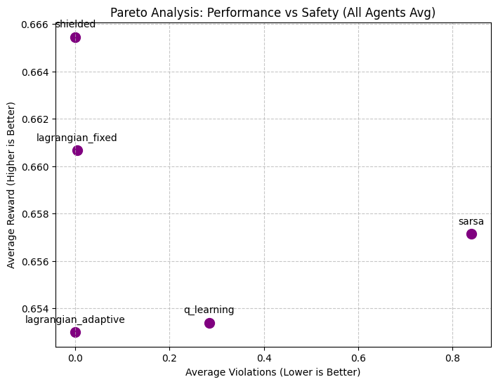
Results and Analysis
Pareto
Shielded RL → Lagrangian → middle ground Baselines → high reward but unsafe
\

Slide 9
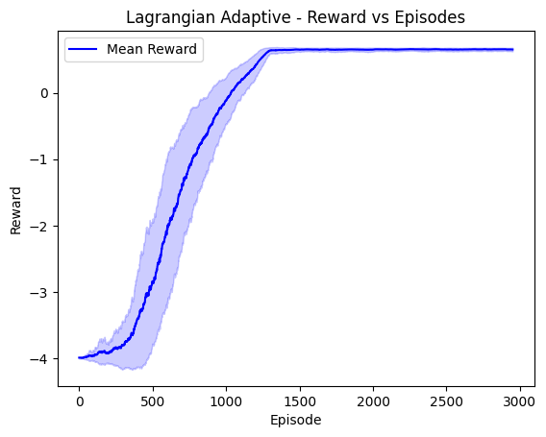
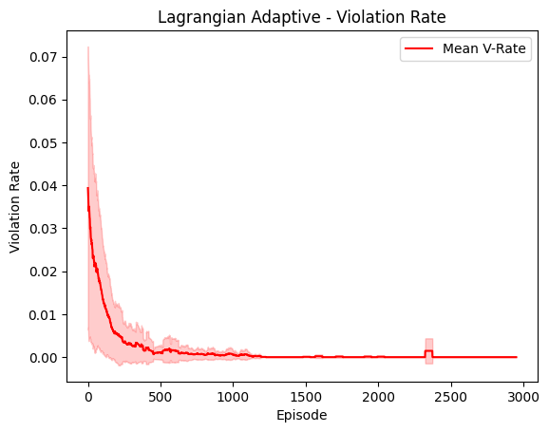
Results and Analysis
Lagrangian adaptive

Slide 10
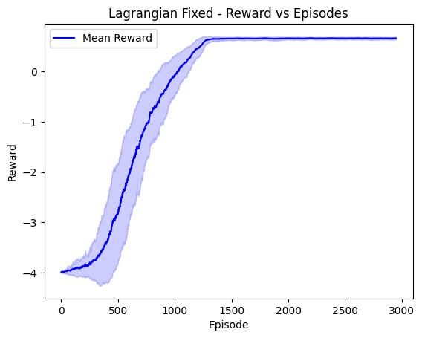
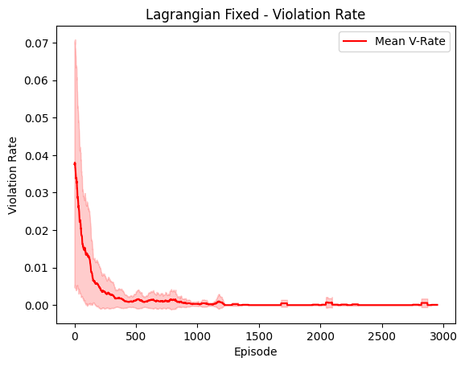
Results and Analysis
Lagrangian fixed

Slide 11
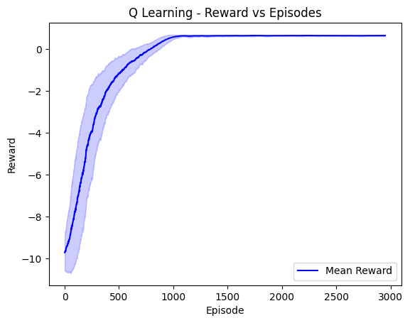
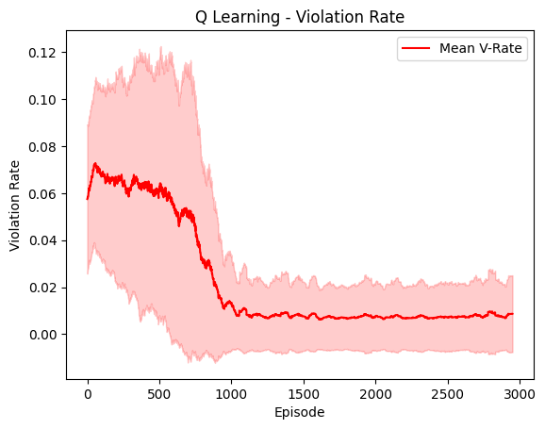
Results and Analysis
Q-learning

Slide 12
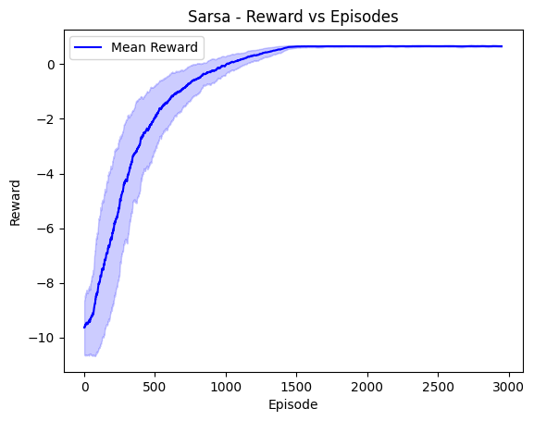
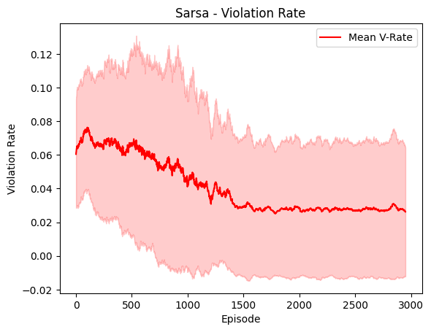
Results and Analysis
SARSA

Slide 13
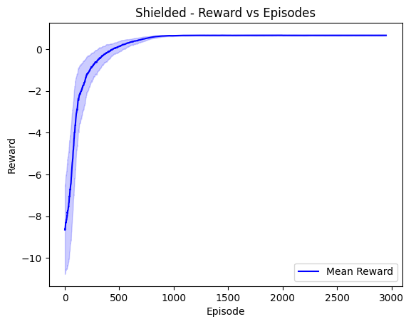
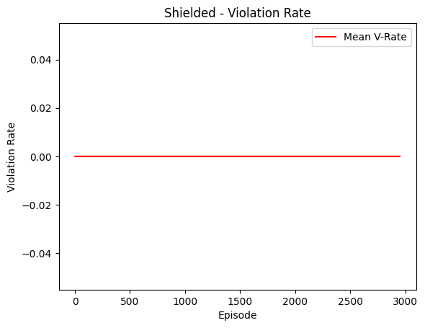
Results and Analysis
Shielded

Slide 14
Conclusion
This study shows that:
Reward-only RL is not suitable for safety-critical systems
Lagrangian methods provide flexible but imperfect safety
Shielded RL is the only method with guaranteed zero violations
Final Insight
There is a fundamental tradeoff:
More safety → slower learning / slightly lower reward
Less safety → faster but risky
Future Work
Extend to deep RL (continuous environments)
Use:
Constrained Policy Optimization
Safety-layer neural networks
Develop adaptive shielding mechanism

Slide 15
Important References
Sutton & Barto – Reinforcement Learning
Watkins & Dayan – Q-Learning
Alshiekh et al. – Safe RL via Shielding
Achiam et al. – Constrained Policy Optimization
Tessler et al. – Reward-Constrained RL
Garcia & Fernández – Safe RL Survey
Bertsekas – Lagrangian Optimization

Slide 16
Thank You

