Slide 1
Cyber Forensics
Semester: IV
Unit I - Computer Forensics

Slide 2
Computer Forensics
Technical standpoint, the goal of computer forensics is to spot, collect, preserve, and analyze data in a way that preserves the integrity of the evidence collected.
Computer forensic objectives is to recover, analyze and present computer based material in such the way that it's useable as evidence in an exceedingly court of law
Computer forensic priorities are primarily forensic procedures, rues of maintaining evidence, and following the legal processes.

Slide 3
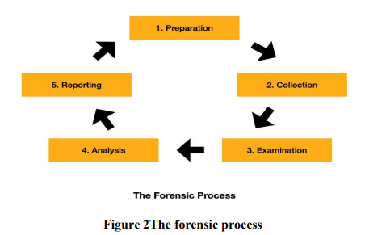
Standard procedure

Slide 4
Preparation:
Prior planning and preparation
policies and procedures
Software licensing
organized life cycle
Collection
first phase
responders handle incidents
phase is critical
minimize any loss of electronic evidence
data should be verified and hashed for integrity

Slide 5
Examination
holistic examination of the evidence
impartial take a look at the evidence
detect hidden, obscured, and encrypted data
unbiased examination report
Analysis
who, what, when, and where of a happening
evidence is scrutinized to see its value to a case
evidentiary value
Reporting
report should contain only relevant information for the requested services
procedures and notes taken during the examination are preserved for discovery and testimony
articulate the findings.

Slide 6
Incident Verification and System Identification
computer security incident as any unlawful, unauthorized, or unacceptable action that involves a computer system or a computer network.
Events
Theft of trade secrets
Email spam or harassment
Unauthorized or unlawful intrusions into computing systems
Embezzlement
Possession or dissemination of child pornography
Denial-of-service (DoS) attacks
Tortious interference of business relations
Extortion
Any unlawful action when the evidence of such action may be stored on computer media such as fraud, threats, and traditional crimes.

Slide 7
GOALS OF INCIDENT RESPONSE
Prevents a disjointed, non-cohesive response
Confirms or dispels whether an incident occurred
Promotes accumulation of accurate information
Establishes controls for proper retrieval and handling of evidence
Protects privacy rights established by law and policy
Minimizes disruption to business and network operations
Allows for criminal or civil action against perpetrators
Provides accurate reports and useful recommendations
Provides rapid detection and containment
Minimizes exposure and compromise of proprietary data
Protects your organization’s reputation and assets
Educates senior management
Promotes rapid detection and/or prevention of such incidents in the future

Slide 8
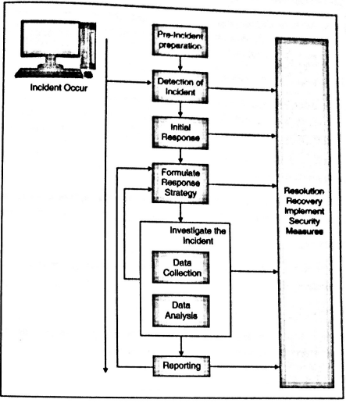
Incident Response methodology
Computer Security Incident Response Team(CSIRT)
– technical, legal and other specialist.

Slide 9
Pre-incident preparation – actions are taken to prepare the organization and the CSIRT before an incident occur.
Detection of incidents – potential computer security incidents is identified.
Initial Response – initial investigation, details surrounding the incident are recorded, appropriate individuals are notified about the incident.
Formulate response strategy – best response is determined, management approval based on results, appropriate actions to be taken are determined.
Investigate the incident – thorough collection of data, determine what and when happened, who did it, how such incident can be prevented.
Reporting – information is accurately reported.
Resolution – security measures are employed, procedural changes, recorded lessons are learnt, develop long term fixes are determined.

Slide 10
Recovery of Erased and damaged data
Recovering erased, damaged or deleted data.
Important part of computer forensics.
Concepts related to data recovery:
When the data is removed from the system, the data is deleted or overwritten.
Deleting the file doesn’t mean the data is gone permanently, operating system simply removes the pointer of the file but the data is still present there
On the magnetic media, data is recorded in the form of zeroes and ones when this data is overwritten, the disk detects only the new data leaving only remnants of the old data
deleted files are not truly deleted, they are merely marked for deletion
For example, when a file or directory is deleted from a FAT filesystem, the first letter of its filename is set to the sigma character (Ó), or, in hex, 0xE5. This means that these files will remain intact until new data has overwritten the physical area where these deleted files are located on the hard drive

Slide 11
Using Windows-Based Tools To Recover Files on FAT File Systems
The tools EnCase and FTK can be used for recovering files on FAT filesystems. Both EnCase and FTK have this capability built-in, and they automatically recover any files they can.
Using Linux Tools To Recover Files on FAT File Systems
Linux provides a flexible environment and a growing suite of tools that promote performing forensic analysis on Linux systems.
three Linux utilities that can recover data: Fatback, TASK, and Foremost
Using FatBack to Recover Deleted Files
Fatback offers a great way to perform file recovery on FAT12, FAT16, and FAT32 file systems from a Linux forensics platform. Some of its features include the following:
▼ Long filename support
■ Recursive undeletion of directories
■ Lost cluster chain recovery
▲ Ability to work within single partitions or entire disks

Slide 12
Using TASK to Recover Deleted Files
TASK is an open-source forensic toolkit used to analyze Microsoft and Unix file systems. It supports attempting to recover files from a variety of file systems, including FAT, FAT12, FAT16, FAT32, FreeBSD, EXT2, EXT3, OpenBSD, and UFS. TASK also works on binary image files, as long as there are no embedded checksum values. This means that TASK will currently not work on EnCase evidence files and SafeBack files. TASK works with only a single partition. Therefore, you must image each partition on a drive separately in order to use this tool. Using TASK, you may be able to recover previously deleted files in your binary image file created by dd.
Using Foremost to Recover Lost Files
Foremost is a Linux program used to recover or “carve out” files based on the file headers and footers.
Foremost is truly a portable, exceptional tool for data recovery.
Foremost consults a configuration file at runtime. This configuration file specifies the headers and footers that Foremost is looking for, so you can choose which ones you want to look for simply by editing the foremost.conf file.
In addition to looking for GIF files, JPG files, common Microsoft Office documents, and email repositories, Foremost can find HTML pages, PDF files, ZIP files, Windows Registry files, WordPerfect files, and even America Online (AOL) mail files. If you want to add more file types to the configuration file, merely consult the /etc/magic file to review well-known headers. For footers, simply pull up the appropriate file[s] in a hex editor and examine them for footer signatures

Slide 13
RECOVERING UNALLOCATED SPACE, FREE SPACE, AND SLACK SPACE
After you perform a forensic duplication of media, and you have recovered as many files as you can, there is still data left on the evidence media that you will want to review. The remaining data is stored in slack space, unallocated space, and free space.
Operating systems arrange all data stored on a hard drive into segments called allocation units (also called clusters)
Unallocated space is the area of the hard drive not currently allocated to a file. Fragments of deleted files are often strewn across unallocated space on a hard drive. Free space is the portion of the hard drive media that is not within any currently active partitions
MS-Dos tools have been written that peruse the data on a hard drive (actual restored image, not a forensic duplicate file) and produce files that contain all the data within the unallocated space, free space, and slack space on a drive.
Two different types of slack space, RAM slack and file slack
RAM slack contains a small portion of random data whose source is whatever contents of RAM that happened to be chosen to fill that space. Ordinarily, it is a tiny fragment of some executable file in memory. File slack contains data from previously deleted files or from the factory conditioning of the hard drive.

Slide 14
Disk Imaging and Preservation
A forensic duplicate is a file that contains every bit of information from the source, in a raw bitstream format. A 5GB hard drive would result in a 5GB forensic duplicate. No extra data is stored within the file, except in the case where errors occurred in a read operation from the original.
A qualified forensic duplicate is a file that contains every bit of information from the source, but may be stored in an altered form. Two examples of altered forms are in-band hashes and empty sector compression.
A restored image is what you get when you restore a forensic duplicate or a qualified forensic duplicate to another storage medium
A mirror image is created from hardware that does a bit-for-bit copy from one hard drive to another.

Slide 15
Duplicating with dd and dcfldd
Two tools that create a forensic duplicate are the Unix dd command and the U.S. Department of Defense (DoD) Computer Forensics Lab version of the dd command called dfcldd.
The dd utility is the most reliable tool for creating a true forensic duplicate image. As long as the operating system kernel (Linux, Solaris, OSx, or FreeBSD) recognizes the storage medium, dd will perform a complete, bit-for-bit copy of the original.
Other forensic duplication solutions have safety measures built in that make it more difficult (but not impossible) to confuse the source and destination of duplication process.
With dd, simply transposing a single character may destroy evidence. dd is a tool that you should be intimately familiar with before you need to use it on a real investigation.
dd’s close relative is dcfldd.
This tool adds a significant amount of functionality that satisfies the “old-school” examiners’ preference for block-based hashes and a progress indicator.

Slide 16
Duplicating with the Open Data Duplicator (ODD)
The Open Data Duplicator (ODD) is a new open-source tool.
This tool follows a client/server model that allows the investigator to perform forensic duplications on a number of computer systems simultaneously over a local LAN.
Of course, both halves can be run on the same computer system, so you can use the software on a single forensic workstation.
Another ODD feature is its ability to perform additional functions on the data as it is being processed.
ODD includes modules (plug-ins) that will calculate checksums and hashes, perform string searches, and extract files based on the file headers

Slide 17
Data Encryption and Compression
NTFS Compressed Files To improve data storage on disk drives,
NTFS provides compression is a Windows compression utility.
With NTFS, you can compress files and folders
On a Windows NT system, compressed data is displayed normally when you view it in Windows Explorer or applications such as Microsoft Word.
During an investigation, typically you work from an image of a compressed disk, folder, or file.
Most forensics tools can uncompress and analyze compressed Windows data.
However, forensics tools might have difficulty with thirdparty compression utilities, such as the .rar format.
If you identify third-party compressed data, you need to uncompress it with the utility that created it.

Slide 18
Whole disk encryption tools offer the following features that forensics examiners should be aware of:
Preboot authentication, such as a single sign-on password, fingerprint scan, or token (USB device)
Full or partial disk encryption with secure hibernation, such as activating a password protected screen saver
Advanced encryption algorithms, such as Advanced Encryption Standard (AES) and International Data Encryption Algorithm (IDEA)
Key management function that uses a challenge-and-response method to reset passwords or passphrases

Slide 19
Many of these tools encrypt the drive’s boot sector to prevent any efforts to bypass the secured drive’s partition.
To examine an encrypted drive, you must decrypt it first.
An encryption tool’s key management function typically uses a challenge-and-response method for decryption, which means you must run a vendor-specific program to decrypt the drive.
Many vendors use a bootable CD or USB drive that prompts for a one-time passphrase generated by the key management function.
If you need to decrypt the same computer a second time, you need a new one-time passphrase.

Slide 20
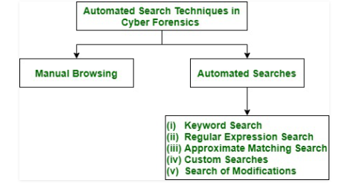
Automated Search Techniques
The goal of any given computer forensic examination is to find facts, and through these
facts they try to recreate truth of an event.
These Automated Search Techniques are used to find out whether given type of object such as hacking tools or pictures of specific type are present in information that is collected.

Slide 21
Automated Searches
An automated search procedure provides direct access to automated files of another party where response to search procedure is fully automated.
The types of automated Searches are : Keyword Search, Regular Expression Search, Approximate Matching Search, Custom Searches, Search of Modifications.

Slide 22
Keyword Search
The cyber forensic keyword search is feature used to find evidence from large amount of electronic data.
During the cyber crime investigation forensic email search is performed on basis of keywords that you enter in computer forensics tool.
It is widely used easy technique that speeds up manual browsing.
The list of found data objects is output of keyword search.
However, there are two problems with keyword search: False Positive and False Negative.

Slide 23
(i). False Positive : Keyword searches gives approximate required type of data objects. Because of this output of this could have false positives. False Positives means objects that do not belong to any particular type even though they contain specified keywords. A Forensic Analyst has to browse keyword search data objects manually to discard false positives.
(ii). False Negative : False Negatives means that there are objects of particular given type but they are missed by search. If search utility fails to correctly interpret data objects then result is false negative. Encryption, Compression or lack of ability of search utility to interpret new data might be reason for this to happen.

Slide 24
Regular Expression Search –
Regular expression (Regex) is powerful way used to search anything in text based files for data with an identifiable pattern.
This search gives more expressible language for describing object of interest than keywords.
These are also used to specify searches of e-mail addresses and files of precise type.
To perform regular expression searches Encase Tool is used.
Regular Expression Search also results in false positives and false negatives.

Slide 25
Approximate Matching Search
An expansion of regular expression search is Approximate Matching Search.
It uses Matching algorithm.
Approximate matching Search algorithm allows character mismatches while searching for keyword.
It detects misspelled words which gives mismatches and raises lot of false positives.

Slide 26
Custom Searches –
Heuristic procedure (A procedure for solving optimization problems that does not guarantee finding an optimal solution) is used by this tool to find full names of people in gathered information/data.
These programs are written for more complex searches like FILTER_1 tool from new Technologies Inc. because regular expressions have limited expressiveness.
This too suffers from false positives and false negatives.

Slide 27
Search of Modifications –
This is used for data objects that have been modified since specified instant in past.
The modifications of data objects that are not frequent like operating system utilities.
These utilities are detected by comparing their current hash with their expected hash.
A library of expected hashes is built before search.

