Slide 1
E-mail Forensics
E-mail forensics refers to the study of source and content of e-mail as evidence to identify the actual sender and recipient of a message, data/time of transmission, detailed record of e-mail transaction, intent of the sender, etc.
This study involves investigation of metadata, keyword searching, port scanning, etc. for authorship attribution and identification of e-mail scams.

Slide 2
e-mail analysis
E-mail forensic analysis is used to study the source and content of e-mail message as evidence, identifying the actual sender, recipient and date and time it was sent, etc. to collect credible evidence to bring criminals to justice.
Email content analysis is a useful process during the digital forensic investigation to detect the criminal activities occurs through the communication of the email messages.
Emails are widely used to formal and informal communication in everyday life. This Enormous growth in the use of internet and digital devices also cause the rapid increase in the rate of digital crimes.

Slide 3
Email structure
An email file is basically divided into three section “Header, Body & Attachment”.
The body is where the message appears and the header contains metadata, which includes details such as where the message originated, date of delivery and the destination address.
The Attachment section is normally included within the email body part. But during email attachment analysis process it will be considered as a separate section and also the attachments may be a video, image, document or other types of files.

Slide 4
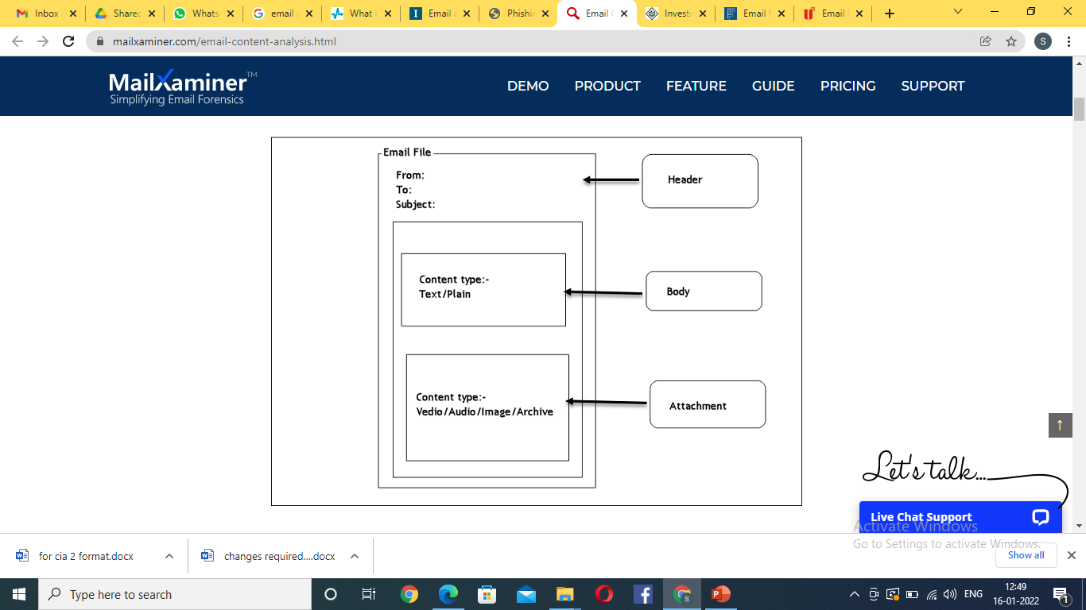

Slide 5
1) Email Header Analysis in Email Investigation
Email header play an important role in the identification of sender & receiver of the email and other additional information related to the email message. The analysis of email header allow the investigator to identify the following information:
Sender & Receiver of the email
Network path
Email client information
Time stamp
SMTP information
Encoding details
Generally the header field of the email is written from bottom to top. So the forensic email header analysis from bottom to top help the investigator obtain to data in the order they are occurred including the sender and receiver information.

Slide 6
2) Email Body Analysis
Email body is the field that is commonly used by the email users to communicate.
Generally emails are more briefly written file than the other text documents. Addition to textual data it also contains “URL, non textual attachments, HTML “etc.
During the analysis of email header field the investigator get the meta details that are related to the email message.
But through the proper email body analysis the investigator can extract the hidden information that is try to communicate by the users.

Slide 7
3) Email Attachment analysis
Email attachments are the computer files which contain the data that are not included in main body of the email file.
Attachments are usually used to simplify the sharing of large amount textual and non textual data across the internet.
Normally attachments are included within the email body so that, we can say that the email files are act as the carrier for attachments.
These files can be open and save independently after receiving the email.
The email attachments can contain different types of “Text files, Audio files, Video files, images, Archive files”.
For the cyber attacks and all the malware and pornographic content distributions are mainly occurred through the attachment.
Hence the email attachment analysis help to find the these types of data and also help to extract all type of information that are invisibly communicate by the users.

Slide 8
Some of the common techniques which can be used for email forensic investigation are
Header Analysis
Server investigation
Network Device Investigation
Sender Mailer Fingerprints
Software Embedded Identifiers

Slide 9
Header Analysis
Email header analysis is the primary analytical technique. This involves analyzing metadata in the email header. It is evident that analyzing headers helps to identify the majority of email-related crimes. Email spoofing, phishing, spam, scams and even internal data leakages can be identified by analyzing the header.
Server Investigation
This involves investigating copies of delivered emails and server logs. In some organizations they do provide separate email boxes for their employees by having internal mail servers. In this case, investigation involves the extraction of the entire email box related to the case and the server logs.
Network Device Investigation
In some investigations, the investigator requires the logs maintained by the network devices such as routers, firewalls and switches to investigate the source of an email message. This is often a complex situation where the primary evidence is not percent (when the ISP or proxy does not maintain logs or lacks operation by ISP [2]).

Slide 10
Software Embedded Analysis
Some information about the sender of the email, attached files or documents may be included with the message by the email software used by the sender for composing the email. This information may be included in the form of custom headers or in the form of MIME content as a Transport Neutral Encapsulation Format (TNEF).
Sender Mail Fingerprints
The “Received” field includes tracking information generated by mail servers that have previously handled a message, in reverse order. The “X-Mailer” or “User-Agent” field helps to identify email software. Analyzing these fields helps to understand the software, and the version used by the sender.
Use of Email Trackers
In some situations, attackers use different techniques and locations to generate emails. In such situations it is important to find out the geographical location of the attacker. To get the exact location of the attacker, investigators often use email tracking software embedded into the body of an email. When a recipient opens a message that has an email tracker attached, the investigator will be notified with the IP address and geographical location of the recipient. This technique is often used to identify suspects in murder or kidnapping cases, where the criminal communicates via email.

Slide 11
Volatile Memory Analysis
Recent research has been conducted in analyzing spoofed mails from volatile memory. Since everything passes through volatile memory, it is possible to extract email related evidence (header information) from volatile memory.
Attachment Analysis
Most viruses and malware are sent through email attachments.
Investigating attachments is crucial in any email-related investigation.
Confidential information leakage is another important field of investigation.
There are software tools available to recover email-related data, such as attachments from computer hard discs. For the analysis of suspicious attachments, investigators can upload documents into an online sandbox such as VirusTotal to check whether the file is malware or not.
However, it is important to bear in mind that even if a file passes a test such as VirusTotal’s, this is not a guarantee that it is fully safe. If this happens, it is a good idea to investigate the file further in a sandbox environment such as Cuckoo.

Slide 12
e-mail headers and spoofing
Email spoofing is a technique used in spam and phishing attacks to trick users into thinking a message came from a person or entity they either know or can trust.
In spoofing attacks, the sender forges email headers so that client software displays the fraudulent sender address, which most users take at face value.
The goal of email spoofing is to get recipients to open, respond and engage with the email message.

Slide 13
Reasons for Email Spoofing
To hide the email sender's true identity
Avoid spam blacklists
Pretend to be a trusted person
Pretend to be a trusted organization
To tarnish the reputation of the sender
To commit identity theft
To spread malware
As part of a man-in-the-middle attack
To gain access to your sensitive information from third-party vendors

Slide 14
How to Stop Email Spoofing
While Simple Mail Transfer Protocol (SMTP) lacks authentication, there are now several frameworks designed to authenticate incoming emails:
Sender Policy Framework (SPF): SPF checks whether a certain IP address is authorized to send email from a given domain name. SPF can lead to false positives and requires the receiving server to check an SPF record and validate the sender. Implementing SPF requires publishing new DNS records.
Domain Key Identified Mail (DKIM): DKIM uses a pair of cryptographic keys that sign outgoing messages and validate incoming messages. However, DKIM is only used to sign specific pieces of a message, allowing messages to be forwarded without breaking the validity of the signature. This is known as a replay attack. Like SPF, DKIM requires publishing new DNS records.

Slide 15
Domain-Based Message Authentication, Reporting, and Conformance (DMARC): DMARC gives the sender the option to let the receiver know it is protected by SPF or DKIM and what to do when mail fails authentication. As with SPF and DKIM, DMARC relies on DNS records.
Sender ID: Sender ID is an anti-spoofing proposal from the MARID IETF working group that tried to join SPF and Caller ID. It is heavily based on SPF with a few improvements namely verifying message headers that indicate the claimed sender, rather than just the MAIL FROM: address.
SSL/TLS: SSL/TLS system can be used to encrypt server-to-server email traffic and enforce authentication but in practice is seldom used.

Slide 16
Laws against e-mail Crime
The Information Technology Act, 2000 deals with the offences relating to e-mail hacking.
Hacking of email includes Identity theft. Identity theft is forgery and punishable under Section 464 of Indian Penal Code and it is punishable for imprisonment for a term which may extend upto two years or fine or with both.
Under Section 66 of the Information Technology Act, 2000, any person, dishonestly or fraudulently does any act to damage the computer resources shall be punished with imprisonment for a term which may extend upto three years or fine with 5 lakh rupees or both.

Slide 17
Section 66-C of the Act provides with the punishment for identity theft. When any person makes use of electronic signature, passwords and other unique identification feature of any other person, fraudulently shall be punished with imprisonment for a term which extends upto three years and fine of 1 lakh.
In case of publishing or transmitting any sexually implicit content through electronic form, such act shall be punished in first term with imprisonment for a period which may extend up to 3 years with fine of 5 lakhs and during second term the punishment may extend up to 5 years with fine of 10 lakhs.

