Slide 1
CYBER FORENSIC
UNIT 2 - CONTINUED

Slide 2

MESSENGER FORENSICS

Slide 3
Instant message applications offer the possibility of real-time exchange of both message and files
There are several protocols for instant messaging, including IRC (Internet Relay Chat) which is used to create ‘chat rooms’ for multiple users.
Most current applications use either a proprietary protocol (Skype, Yahoo Messenger) or XMPP (Extensible Message and Presence Protocol), an open standard adopted by many popular IM clients such as Facebook and Google Chat.
The security issues here are quite similar to the email scenario: illegitimate or abusive use branding from spam, phishing and malicious code distribution, cyberbullying, sending hate messages or racial abuse content, unauthorized disclosure of sensitive information, distributing child pornography and sexual harassment.

Slide 4
The first challenge for IMs investigation is quite obvious: there are several applications, each storing information in different areas.
An expert forensic investigator must be acquainted with all those places such as the registry or system folders (i.e., AppData, Program Files, Documents and Settings) which may vary according to the operating system language.
Adding to this situation is the great variety of ways IMs indicate time: some may store local time, while others use UTC, but quite a few will have a particular (and not publically disclosed) way of timestamping messages.
Similar variations also occur due to the constant evolution in history format that may be changed each time an IM application is updated.

Slide 5
Yahoo! Messenger
Yahoo! Messenger is one of the popular instant messaging clients from Yahoo.
Once logged in, users can send instant messages and chat with other Yahoo users in their contact/buddy list.
Users can also share photos, send/receive files, video chat, conference, and Internet phone calls along with instant messaging.
Once YM is loaded on a machine, it has certain default preferences with respect to chats, archives, messages, privacy and all other general preferences like sounds, alerts, and signing into YM.
Yahoo! Messenger (YM), among other forms of online communication, is used extensively by online predators to communicate with other predators

Slide 6
By default, all chat messages are archived and saved, but these messages are cleared out once the user signs out of YM.
If a user does not log out of YM while closing the application, it is possible to view these archived messages.
The user has an option to view and save these messages as a file before logging out of the YM session.
A user can also change this default message archive option and opt to either save the messages at all times or to not save the messages at all.
If a user decides to save the YM chat session in Windows Vista and Windows 7, by default these conversations are saved in the Documents folder as a text file.
The chat messages can alternatively be saved at any specified location on the computer as per the user’s preference.
These conversations need to be saved before logging out of the YM application.

Slide 7
Methodology
For the purpose of testing YM communication, two virtual machines were created on a Mac Pro environment running OS X 10.5 (Leopard).
In each virtual machine Windows Vista Business Edition and Windows 7 Ultimate Edition were installed. These virtual machines were installed using the freely available VirtualBox software.
The latest version of Yahoo! Messenger, version 10.0.0.1258 was installed on each of the virtual machines. This YM version was installed without the toolbar, browser, nor the extra options.
Three Yahoo accounts were set up in order to test the messenger. Two of these test accounts were created as potential “Bad guys” or predators, and one account as a potential victim.
Several mock interactions were conducted in which chats, file transfers, and photo sharing were initiated. Different scenarios were conducted in which one user initiated photo sharing with another user and one user initiated photo sharing with multiple users simultaneously was also tested.
The data and the evidence left behind from these interactions were then tracked using screen shots for each of these interactions, as well as, specific evidential tracking.

Slide 8
Data Analysis
The evidence examination was first started by inspecting the registry structure for Windows Vista and Windows 7 using the built in registry editor for Windows.
The registry was examined with respect to the YM files. It was found that this registry structure is fairly similar to the YM registry structure for Windows XP found in the Access Data Registry Quick Find Chart.
In order to better convey the findings, the registry evidence was placed in a tabular format similar to that of Access Data’s chart. For both Windows Vista and Windows 7, at the following location: \User\Software\Yahoo\Pager, an investigator can expect to find the Yahoo user id of the person using the account, the version of YM installed on the computer, all the revisions made to the YM version, if the save password option is turned on and also if the Auto sign in has been enabled.
Windows Vista has an extra feature of P2P count that is not included in Windows 7. P2P count is the number of allowed P2P users who can send large data amongst each other.

Slide 9
For both Windows Vista and Windows 7, information related to chat sessions can be found under the following location: User\Software\Yahoo\Pager\profiles\profile_name\chat, which gives the last selected chat room category, but not necessarily the exact chat room entered.
This information can prove useful for investigators to understand the chat room category that the predators potentially use and frequent.
User\Software\Yahoo\Pager\profiles\profile_name\chat\favorite_rooms gives the list of saved favorite rooms for the user. This stands true for both Windows Vista and Windows 7. This information can be important to understand the different chat rooms that the predator frequents.
For both Windows Vista and Windows 7, User\Software\Yahoo\Pager\profiles\profile_name\FT gives the last saved location of a received file.
It also gives the last sent location of a transferred file, that is, the location from where the last sent file was uploaded. This is important data when validating whether a user has been sharing or receiving files.
User\Software\Yahoo\Pager\profiles\profile_name\FriendIcons gives the icon that the user has set for himself/herself that will be displayed to the user’s friends. The name of the file used will be visible in the path as well as where it is located on the hard drive.

Slide 10
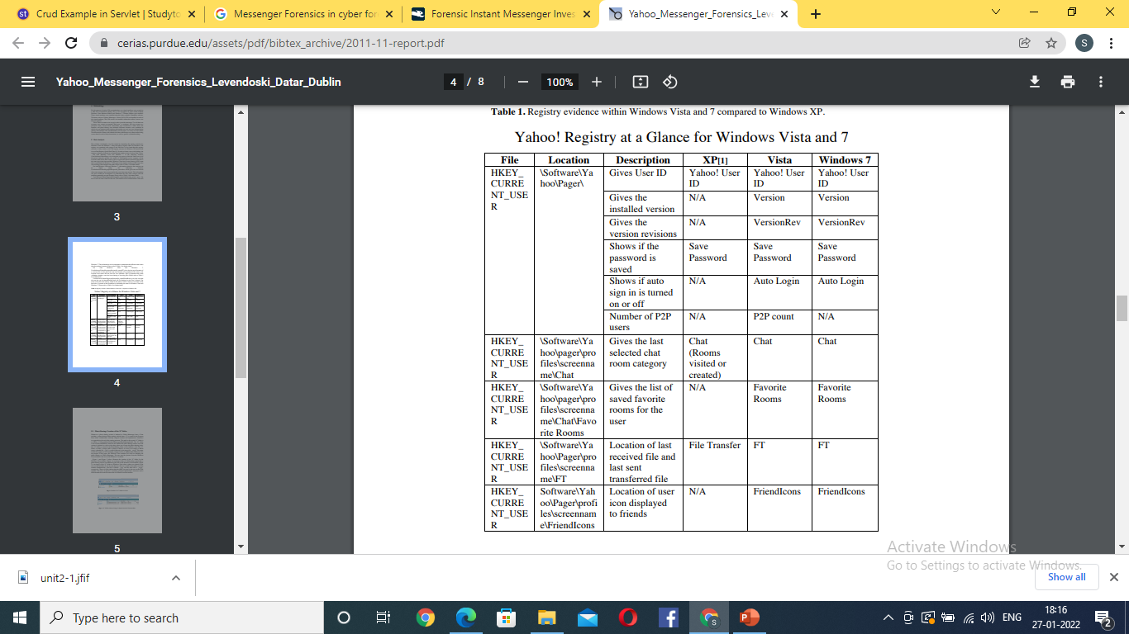

Slide 11
Photo Sharing: Creation of the “S” folder
Whenever a photo sharing session is initiated in Yahoo Messenger from a Vista machine, a photo sharing folder starting with the letter “S” is created in the Program Data folder.
Additionally, randomly assigned numbers and alphanumeric characters are appended to the end of the naming structure.
The path for the created “S” folder is as follows: C:\ProgramData\Yahoo!\Messenger\PhotoSharing\Sc8b0.
The “S” folder is not created immediately when the user initiates the photo sharing session. Once the session is initiated, as soon as the other yahoo user accepts the photo sharing invite, the “S” folder is created in the PhotoSharing folder on the initiator’s side.
The “S” folder, in itself, is empty until a picture is shared. As soon as an image is shared (sent), a thumbs file ‘_t.jpg’ is created followed by the image file ‘_m.jpg’.
The name of this file appears to be a randomly assigned series of alphanumeric characters.

Slide 12
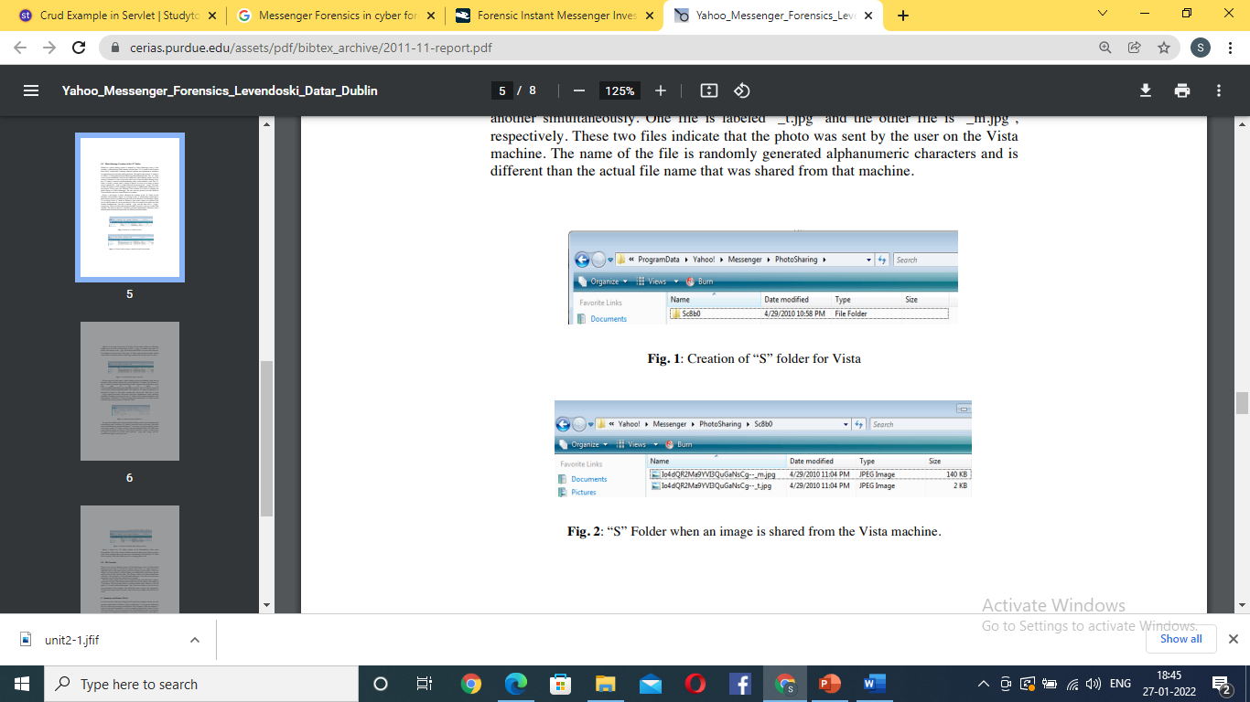
Figure 1 and Figure 2 below; illustrate the creation of the “S” folder for the Windows Vista machine. Figure 1 is an image of the “S” folder being created after a photo sharing session was initiated by the user on the Windows Vista machine.
Figure 2 is an image of the “S” folder on Windows Vista when a photo was shared by the user on that machine. It can be seen that two files are created in the folder one after another simultaneously. One file is labeled ‘_t.jpg’ and the other file is ‘_m.jpg’, respectively.
These two files indicate that the photo was sent by the user on the Vista machine. The name of the file is randomly generated alphanumeric characters and is different than the actual file name that was shared from that machine.

Slide 13
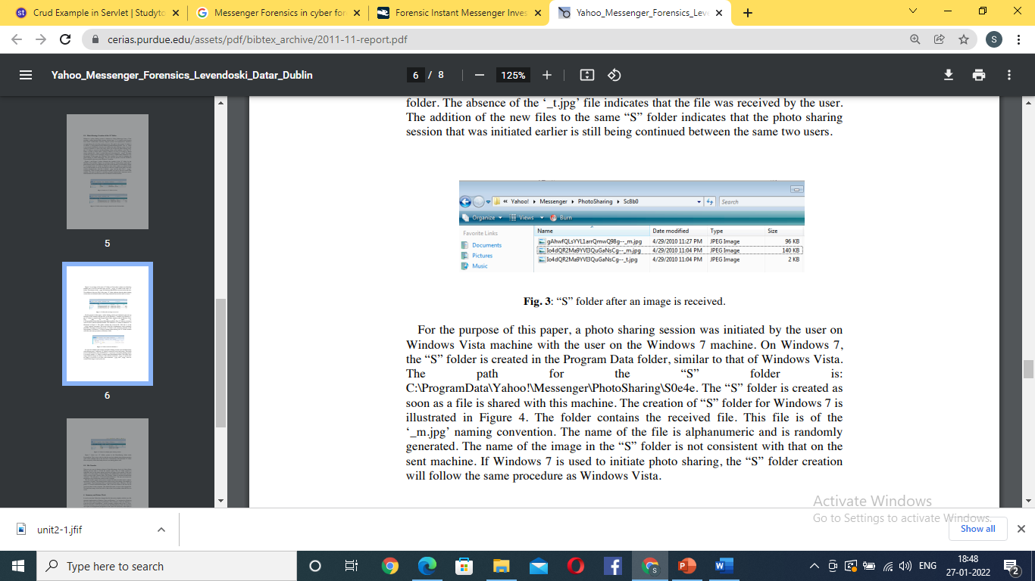
Figure 3 is an image of the same “S” folder on Vista when a photo was shared by another user. It can be seen that only one file ‘_m.jpg’ is created in the same “S” folder.
The absence of the ‘_t.jpg’ file indicates that the file was received by the user. The addition of the new files to the same “S” folder indicates that the photo sharing session that was initiated earlier is still being continued between the same two users.

Slide 14
On Windows 7, the “S” folder is created in the Program Data folder, similar to that of Windows Vista.
The path for the “S” folder is: C:\ProgramData\Yahoo!\Messenger\PhotoSharing\S0e4e. The “S” folder is created as soon as a file is shared with this machine.
This file is of the ‘_m.jpg’ naming convention. The name of the file is alphanumeric and is randomly generated. The name of the image in the “S” folder is not consistent with that on the sent machine. If Windows 7 is used to initiate photo sharing, the “S” folder creation will follow the same procedure as Windows Vista.
If a user has multiple chat sessions and photo sharing sessions open simultaneously with different users, a different “S” folder is created for each chat session. This holds true for both Windows Vista and Windows 7. As soon as a new photo-sharing request is accepted, another “S” folder is created in the PhotoSharing folder.
The folder stays empty until the images are shared. A file with the extension ‘_m.jpg’ is created once an image is received or two files with extensions ‘_t.jpg’ and ‘_m.jpg’ each are created if the image is sent by the user.

Slide 15
File Transfer
There are two ways of sharing a photo in Yahoo Messenger. One is via Yahoo Photo Sharing and the other is via the file transfer option.
The “S” folder creation is applicable only for the photo sharing and does not apply to file transfer. If the user wishes to save the photos via Photo Sharing, the default folder where these pictures will be saved is in the ‘Picture’ folder. The ‘Picture’ folder is a shortcut located under ‘Libraries’. The full path is ‘C:\Users\UserName\Pictures’.
The user can in turn save the photos to any location they desired on the computer. The file transfer option can be used to transfer all kinds of media such as, photos, documents, or music. The default location while saving a file during a file transfer is “Documents”.
The Documents folder is a shortcut located under ‘Libraries’. The full path is ‘C:\Users\UserName\Documents’. But, if the user wishes to, the file can be saved anywhere on the computer. The default file name is same as the original file. The date-time stamp of the saved file is that of the local machine when the file was saved.

