Slide 1
Internet Forensic
Unit II

Slide 2
Introduction
The investigation of criminal activity that has occurred on the Internet.
analysis of the origins, contents, patterns and transmission paths of email and Web pages as well as browser history and Web server scripts and header messages
Internet forensics shifts that focus from an individual machine to the Internet at large.
Protocols that handle Internet traffic were not designed to address the problems of spam, viruses, and so forth.
The layout of files on a web site or the way that email headers are forged can play the same role as a fingerprint at a physical crime scene.

Slide 3
Internet Protocols
Internet Protocols are a set of rules that governs the communication and exchange of data over the internet.
Each network protocol defines the rules for how its data packets must be organized in specific ways according to the protocols the network supports.
we need protocols to manage the flow control of data, access control of the link being shared in the communication channel.
the access control decides the node which will access the link shared in the communication channel at a particular instant of time.

Slide 4
Types of Internet Protocols
Transmission Control Protocol (TCP)
Internet Protocol (IP)
User Datagram Protocol (UDP)
File Transfer Protocol (FTP)
Hyper Text Transfer Protocol (HTTP)
SMTP(Simple Mail Transfer Protocol)
Domain Name System (DNS)

Slide 5
Transmission Control Protocol (TCP)
TCP is a connection oriented protocol and offers end-to-end packet delivery. It acts as back bone for connection.
TCP ensures reliability by sequencing bytes with a forwarding acknowledgement number that indicates to the destination the next byte the source expect to receive.
It retransmits the bytes not acknowledged with in specified time period.
Transmitting the data in duplex mode means flow of data in both the directions at the same time.

Slide 6
Internet Protocol (IP)
Internet Protocol is connectionless and unreliable protocol.
It ensures no guarantee of successfully transmission of data.
In order to make it reliable, it must be paired with reliable protocol such as TCP at the transport layer.
Internet protocol transmits the data in form of a datagram. The Datagram is divided into two parts: header and data.
The header contains information for routing and delivery of the packet.

Slide 7
User Datagram Protocol (UDP)
UDP is connectionless and unreliable protocol.
It doesn’t require making a connection with the host to exchange data. Since UDP is unreliable protocol, there is no mechanism for ensuring that data sent is received.
UDP is used by the application that typically transmit small amount of data at one time.
UDP provides protocol port used i.e. UDP message contains both source and destination port number.

Slide 8
File Transfer Protocol (FTP)
This protocol is used for transferring files from one system to the other.
This works on a client-server model.
When a machine requests for file transfer from another machine, the FTO sets up a connection between the two and authenticates each other and, the desired file transfer takes place between the machines.

Slide 9
Hyper Text Transfer Protocol (HTTP)
HTTP is a communication protocol between browser and the web server.
It is also called request and response protocol because the communication between browser and server takes place in request and response pairs.
The first line i.e. the Request line specifies the request method i.e. Get or Post.
The second line specifies the header which indicates the domain name of the server from where index.html is retrieved.
HTTP response contains:
Status line
Headers
Message body

Slide 10
SMTP(Simple Mail Transfer Protocol)
These protocols are important for sending and distributing outgoing emails.
This protocol uses the header of the mail to get the email id of the receiver and enters the mail into the queue of outgoing mails.
And as soon as, it delivers the mail to the receiving email id, it removes the email from the outgoing list.
SMTP doesn't control how email clients receive messages, therefore, it requires other protocols to ensure email messages are sent and received properly.
SMTP can work with Post Office Protocol 3 or Internet Message Access Protocol

Slide 11
Domain Name System (DNS)
DNS is a database that includes a website's domain name and its corresponding IP addresses.
DNS translates the domain name into IP addresses. Servers can cache DNS data, which is required to access the websites.
DNS also includes the DNS protocol, which is within the IP suite and details the specifications DNS uses to translate and communicate.
DNS is important because it can quickly provide users with information, as well as access to remote hosts and resources across the internet.

Slide 12
World Wide Web Threats
A web threat is any threat that uses the World Wide Web to facilitate cybercrime.
Web threats pose a broad range of risks, including financial damages, identity theft, loss of confidential information/data, theft of network resources, damaged brand/personal reputation, and erosion of consumer confidence in e-commerce and online banking.

Slide 13
network-based threats in the following categories:
Private network threats - impact sub-networks connected to the wider global internet.
Host threats - impact specific network host devices. The term host often refers to corporate endpoints and personal devices.
Web server threats - impact dedicated hardware and software that serve web infrastructure and services.

Slide 14
Web threats have the potential to cause:
Access denial.
Prevention of entry to a computer and/or network services.
Access acquisition.
Unauthorized or unwanted entry into a private computer and/or network services.
Exposing private data without permission, such as photos, account credentials, and sensitive government information.

Slide 15
Most Common Web Threats
Spam(1-7)
Adware(8-14)
Trojan(15-21)
Virus(22-28)
Worms(29-35)
Phishing(36-42)
Spyware(43-49)
Keyloggers(50-56)
Pharming(57….remaining)

Slide 16
Hacking and Illegal access
Hacking is the activity of identifying weaknesses in a computer system or a network to exploit the security to gain access to personal data or business data.
using a password cracking algorithm
Infecting their PC with a malware
Computers get exposed to the outside world and hacking through Internet.
System hacking means using computers to commit fraudulent acts such as fraud, privacy invasion, stealing corporate/personal data, etc.

Slide 17
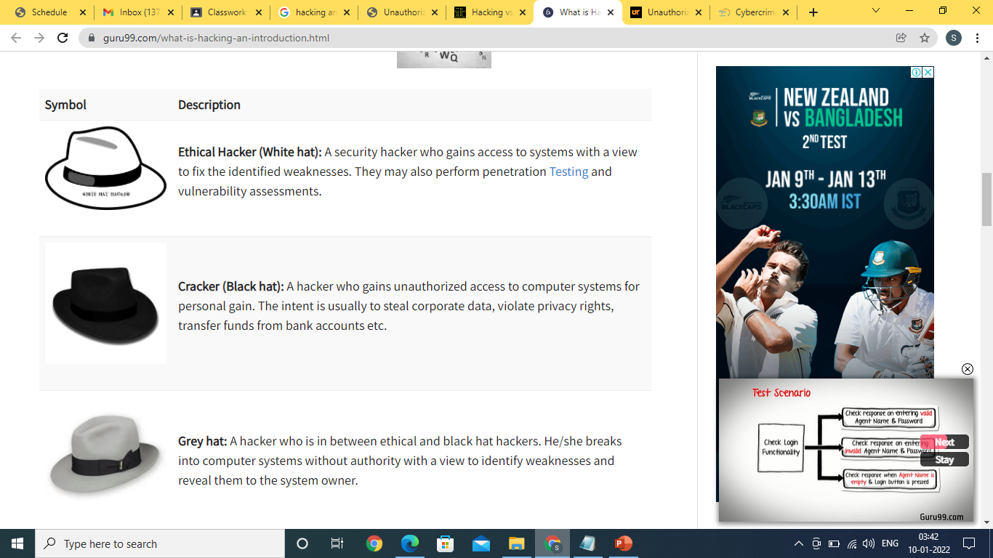
Hacker
A Hacker is a person who finds and exploits the weakness in computer systems and/or networks to gain access.
skilled computer programmer.
knowledge of computer security.
TYPES OF HACKERS

Slide 18
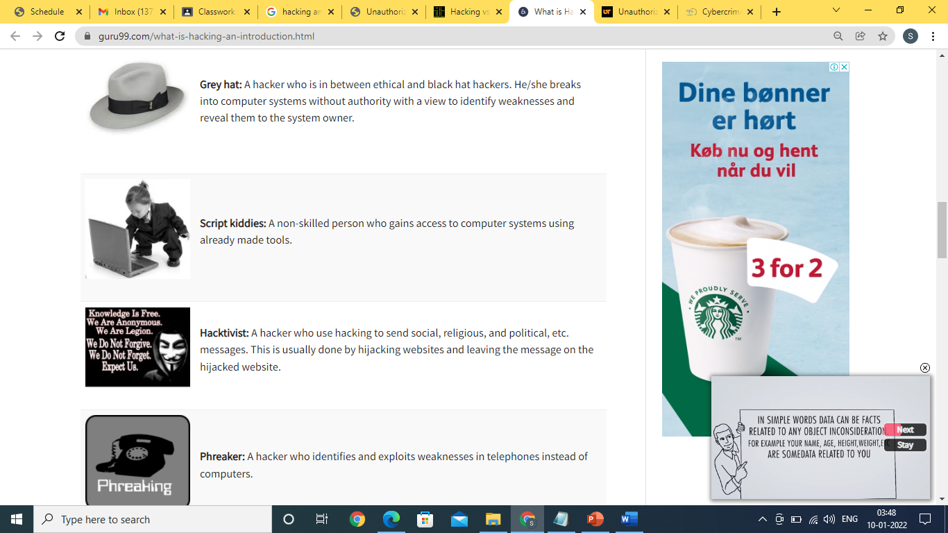

Slide 19
Prevention from Getting Hacked
Software Update
Use Unique Passwords for Different Accounts
HTTPS Encryption
Avoid Clicking on Ads or Strange Links
Change the Default Username and Password on Your Router and Smart Device
Download from First-party Sources
Install Antivirus Software
Use a VPN
Use Two-factor Authentication

Slide 20
Obscene and Indecent transmission
Obscenity is a global and complex issue because it involves other related issues like decency and morality which varies from society to society.
Cyber Obscenity is a threat to the internet users all over the world.
Dissemination of obscene materials is believed to one of the largest business on the internet today.
Pornography is not illegal in many countries, child pornography is strictly illegal in many countries.

Slide 21
Most of the obscene images seen in the pornographic sites are morphed photographs.
In certain cases ex-boy friend had morphed the picture of his girl friend as obscene image and publishes it in social networking sites.
In another case, disgruntled employee had morphed his employer's picture as obscene image and publishes it in social networking sites.
In these types of cases obscene materials can be removed from the social networking sites, you tube by lodging a complaint with the appropriate authorities with the help of a techno legal expert.
The offender can also be identified with the help of IP address from where the obscene materials were uploaded.

Slide 22
Cyber Crimes under IT Act
Transmission or publication of obscene material
Section 67 of the said Act punishes publication or transmission of obscene content in electronic form. On first conviction, imprisonment of a term upto three years and fine is prescribed which may extend upto Rs.5.00 Lacs.
Transmitting or publishing sexually explicit acts in electronic form
Section 67A provides punishment for publishing or transmitting obscene digital content containing sexual explicit acts. This could be any adult content videos or MMS or short clips or images including 'selfies' (self clicked images) . As per 67A of I.T. Act punishment on first conviction is imprisonment of a term which may extend to five years and fine which may extend upto Rs.10.00 Lacs.

Slide 23
Child pornography and child grooming
Section 67B punishes child pornography, child grooming or exploitation.This Section was added by IT (Amendment) Act, 2008. According to this Section, if any person publishes or transmits material depicting children in sexually explicit acts in electronic form or creates images text, collects, seeks, downloads, advertises, promotes or distributes content that depicts children in obscene or in sexually explicit manner, such person is punishable with imprisonment for a term which may extend upto five years and imposed fine which may extend upto Rs.10.00 Lacs.
Protection of Children from Sexual Offences Act, 2012 ( POCSO):-
In addition,the POCSO Act was enacted in year 2012 to provide legal protection against sexual assault, sexual harassment and child pornography. Section 12 provides that the offence of sexual harassment shall be punishable with imprisonment for a term which may extend to three years and also imposition of fine.

Slide 24
Domain Name Ownership Investigation
DomainTools research and monitoring tools give you access to the most comprehensive database of domain name registration data, hosting history, IP address change events, screenshots, and other related DNS intelligence.
There are several tools like Whois that can help to trace the owner of a domain.
Sometimes the domain name is hidden through privacy protection. In such instances, Cyber Forensic Investigators can help to reveal the cryptic owner of the domain.
There are a few things you need to know up front:
There is no guarantee that you will learn who owns a domain name.
Domain names are registered on an annual basis via domain name registrars, such as Network Solutions.
Domain names can be registered for as long as 10 years at a time;

Slide 25
WHOIS
When you register a domain name, ICANN, the Internet Corporation for Assigned Names and Numbers, requires your registrar to submit your personal contact information to the WHOIS database.
This listing will include your name, address, phone number, email address and domain name expiration date.
Your website hosting IP address and host name will also be listed.
Once your listing appears in this directory, it’s available to anyone who wants to check domain names using a WHOIS search tool.

Slide 26
Whois are public databases which allow to visualize all details about a domain name. They are published and updated by each extension's registry.
WHOIS Lookup results will reveal who or what entity owns or manages that domain name, including their contact information such as name, phone number and address.
Whois is a widely used Internet record listing that identifies who owns a domain and how to get in contact with them.
The Internet Corporation for Assigned Names and Numbers (ICANN) regulates domain name registration and ownership.
Whois records have proven to be extremely useful and have developed into an essential resource for maintaining the integrity of the domain name registration and website ownership process.

Slide 27
The purpose and value of the data in the Whois system:
Reinforcing the stability and security of the Internet by providing network operators, computer incident response teams and ISPs with appropriate contacts
Regulating the registration status of domain names
Supporting law enforcement officials participating in national and international investigations.
Assisting in the battle against abusive uses of information communication technology, including illegal and other acts, any form of child abuse, child pornography, and trafficking in humans.
Supporting inquiries and necessary steps to carry out trademark clearances and to help expose intellectual property infringement, theft and misuse in accordance with applicable international treaties and national laws.
Helping businesses and other users and organizations in fighting fraud and safeguarding public interest
Upholding overall user confidence in the Internet as an efficient and reliable means of communication by helping users to identify which entities or persons are responsible for services and content online

Slide 28
Domain Squatters
Some cyber criminals act as domain squatters in order to defraud you. They do this by registering a domain that contains names, or trademark of a particular business.
What they do next is put the domains out for sale at a high price — since they know you will be interested in buying the domain at some point.
When you fall victim to such a scheme, a Cyber Forensics Investigator can help you to trace the domain squatter and what their intent is.
Similarly, some domains are set up with popular brand names in order to collect personal information from people. In other words, they collect information without the consent of the “brand owner”.

Slide 29
Reconstructing past internet activities and events
Create a timeline to reconstruct the events that led to your system being corrupted. This can be particularly difficult when it comes to computers—clock drift, delayed reporting, and differing time zones can create confusion in abundance.
Do not change the clock on an affected system.
Record any clock drift and the time zone in use, as you will need this later, but changing the clock just adds in an extra level of complexity that is best avoided.
Synchronize the log files. Log files usually use timestamps to indicate when an entry was added, and these must be synchronized to make sense.
Use timestamps. You’re not just reconstructing events you are making a chain of events that must be accounted for as well.

Slide 30
Use the GMT time zone when creating your timestamps, because the incident may involve other time zones than your own. Using a common reference point can make things much easier.
Make sure you have a dedicated host for the job when analyzing backups. This examination host should be secure, clean, and isolated from any network—you don’t want it tampered with while you work, and you don’t want to accidentally send something nasty down the line.
Commence analysis of the backups once the system is available. Making mistakes at this point shouldn’t be a problem—you can simply restore the backups again if required.
Document everything you do. Remember the mantra.
Ensure that what you do is not only repeatable, but that you always get the same results.
Reconstruct the chain of events leading to and following the attacker’s break-in now that you have collected the data.

Slide 31
Methods of rebuilding past internet activities
Use DNS cache to find deleted browsing history
To recover lost browsing history files
To recover deleted history by using Google history

