Slide 1
Movieee.ug
Crowdsource Q&A for movies
Created by: ERIK, G, ZSÓFI

Slide 2
/GIT COMMITS
/ Mon
/PLANNING
/ Tues
/CSV->SQL
Set up the project
Merge previous sprint
Replace CSV to SQL
Working on rewrite AskMate1 to use sql data
/ Wed
/NEW FEATURES
/ Thurs
/FINAL PUSHES
Working on extra features
Implement new design
Finalise what we can
Finish ppt

Slide 3
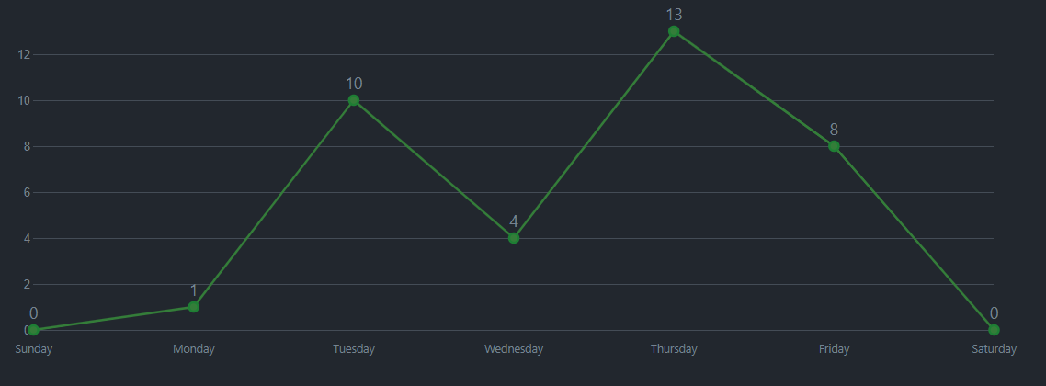

Created by: ERIK, G, ZSÓFI

Slide 4

/NEW ADVENTURES
0
25
50
75
100
/SQL
/SCRUM
Working with psql
Use a project managment tool
/CSS
/NEW TEAM
Experience the style world
Find the best way to work together

Slide 5
THANK YOU
Created by: ERIK, G, ZSÓFI

