Slide 1
YOUR LOGO HERE
Movieee.ug
Crowdsource Q&A for movies
Created by: ERIK, G, ZSÓFI

Slide 2
/GIT COMMITS
/ Mon
/CONCEPTS
/ Tues
/SQL
planning
Rewrite AskMate1 to use sql data
/ Wed
/FEATURES
/ Thurs
/EXERCISE
Working on extra features
Finalise what we can + ppt
INDEX.HTML

Slide 3
YOUR LOGO HERE
/CONCEPTS
/LANGUAGE
/PROGRAM
/ALGORITHM
Mercury is the closest planet to the Sun and the smallest one
Venus is terribly hot and is the second planet from the Sun
Despite being red, Mars is actually a cold place full of iron oxide dust
INDEX.HTML

Slide 4
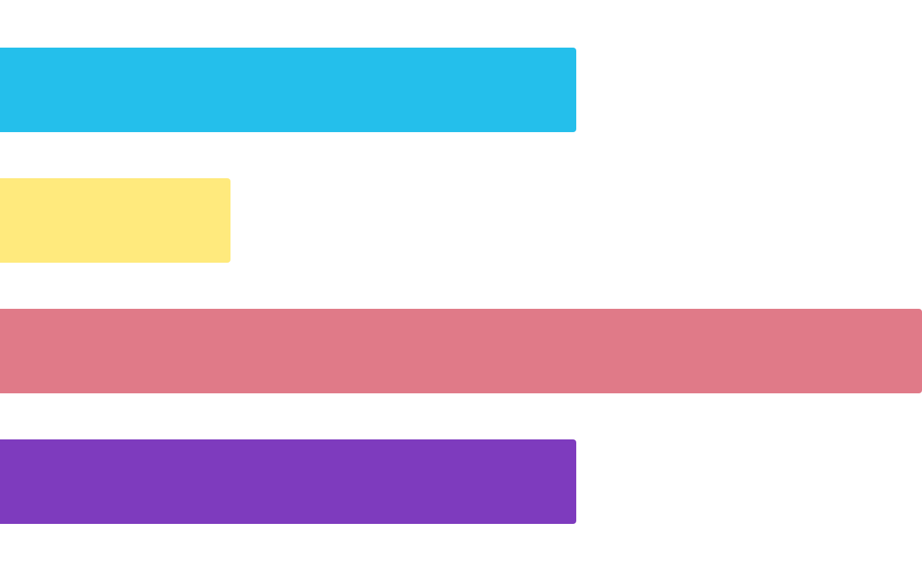
YOUR LOGO HERE
/NEW ADVENTURES
0
25
50
75
100
/SQL
/SCRUM
Jupiter is the biggest planet
Venus has a beautiful name
Follow the link in the graph to modify its data and then paste the new one here. For more info, click here
/CSS
/NEW TEAM
Jupiter is the biggest planet
Mars is a very cold planet
INDEX.HTML

Slide 5
YOUR LOGO HERE
/WHAT IS THIS TOPIC ABOUT?
/RUNNING A PROGRAM
/LEXICON AND OBJECTIVES
Mercury is the closest planet to the Sun and the smallest one in the Solar System—it’s only a bit larger than the Moon
Venus has a beautiful name and is the second planet from the Sun. It’s hot and has a very poisonous atmosphere
INDEX.HTML

Slide 6

YOUR LOGO HERE
/PROGRAMMING TOOLS WEBSITE
You can replace the image on the screen with your own work. Just right-click on it and select “Replace image”
INDEX.HTML

Slide 7
YOUR LOGO HERE
/PRACTICAL EXERCISE
Complete the following table about base changes:
/BINARY | /HEXADECIMAL | /DECIMAL
 |  | 128.75
10011101.11001
 | BE.A7
INDEX.HTML

Slide 8
YOUR LOGO HERE
/EXAMPLES
Coding of integer numbers with signs:
/BINARY
/DECIMAL
Natural binary | 223
 | -223
Sign and magnitude | 10100111
 | 10100111
2’s complement | 223
 | -223
INDEX.HTML

Slide 9
Fonts & colors used
This presentation has been made using the following fonts:
Oswald
(https://fonts.google.com/specimen/Oswald)
Fira Code
(https://fonts.google.com/specimen/Fira+Code)
#1e1e2c
#ffffff
#e2e2e2
#ffea7d
#e5a083
#e07a88
#24bfeb
#0887f2
#2b218d
#7e3bbe

