Slide 1
A Presentation By AskM8000-2
<number>

Slide 2
Our week:
Monday: HMMMMM
Tuesday: planning, csv to sql
Wednesday: csv to sql
Thursday: csv to sql, adding new features
<number>

Slide 3
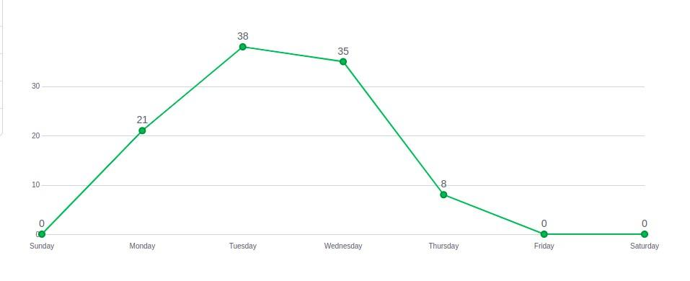
Commit graph:
<number>

Slide 4
Hardships & What we learnt:
Last Week:
This Week:
routing
sorting
GIT !! ? :,-)
Image handling
Sql
Cascade
GIT !! ?

Slide 5
Let's see the project PLEASE.
<number>

Slide 6
GREAT IDEA!
<number>

Slide 7
THANK YOU!
<number>

Slide 8
CREDITS.
Kis Lóránd
Szabó Imre
Cser Dániel
Nyitrai Balázs
<number>

