Slide 1
A Presentation By AskM8000-3
<number>

Slide 2
Our week:
Monday: HMMMMM
Tuesday: planning, workshop, create session, registering, login
Wednesday: worskhop, happy coding
Thursday: javascript, sql rewriting
<number>

Slide 3
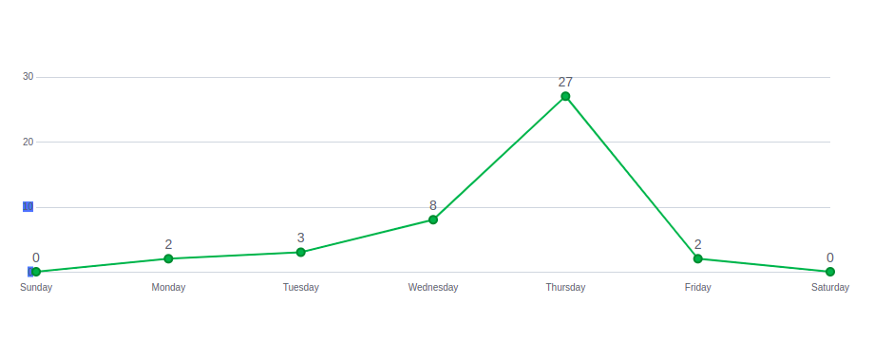
Commit graph:
<number>

Slide 4
Hardships & What we learnt:
First Week:
Second Week:
Third Week:
Routing
Sorting
GIT !! ? :,-)
Image handling
Sql
Cascade
GIT !! ?
Javascript
Session
Rewriting sql querries
GIT !! ?

Slide 5
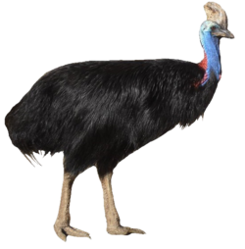

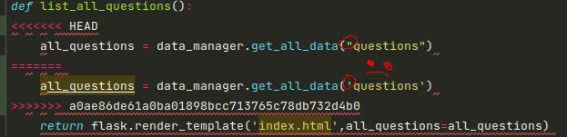
GIT EXTRAS

Slide 6
Code Snippets

Slide 7
Let's see the project PLEASE.
6

Slide 8
GREAT IDEA!
6

Slide 9
THANK YOU!
6

Slide 10
CREDITS.
Kis Lóránd
Szabó Imre
Cser Dániel
Nyitrai Balázs
6

