Slide 1

Hotel Ace Ventura
Friday, April 27th 2023
Slide <number>
Zinaida Jusufovic
Martin Egert

Slide 2

Wochenüberblick
Montag | Dienstag | Mittwoch | Donnerstag | Freitag
Lesen / Verstehen | Workshop SantaBot Lesen / Verstehen Entwurf Navigation Logik Lesen / Verstehen Entwurf Navigation Logik Lesen / Verstehen Entwurf Navigation Logik | Workshop Design Principles | GetOptimalPort. algorithm | Präsentation
 | Lesen / Verstehen | Start BufferService | DinnerService
 | Entwurf | Start DinnerService | Clean Code
 | Navigation Logik | Tests | Präsentation
Friday, April 27th 2023
Slide <number>
Zinaida Jusufovic
Martin Egert

Slide 3
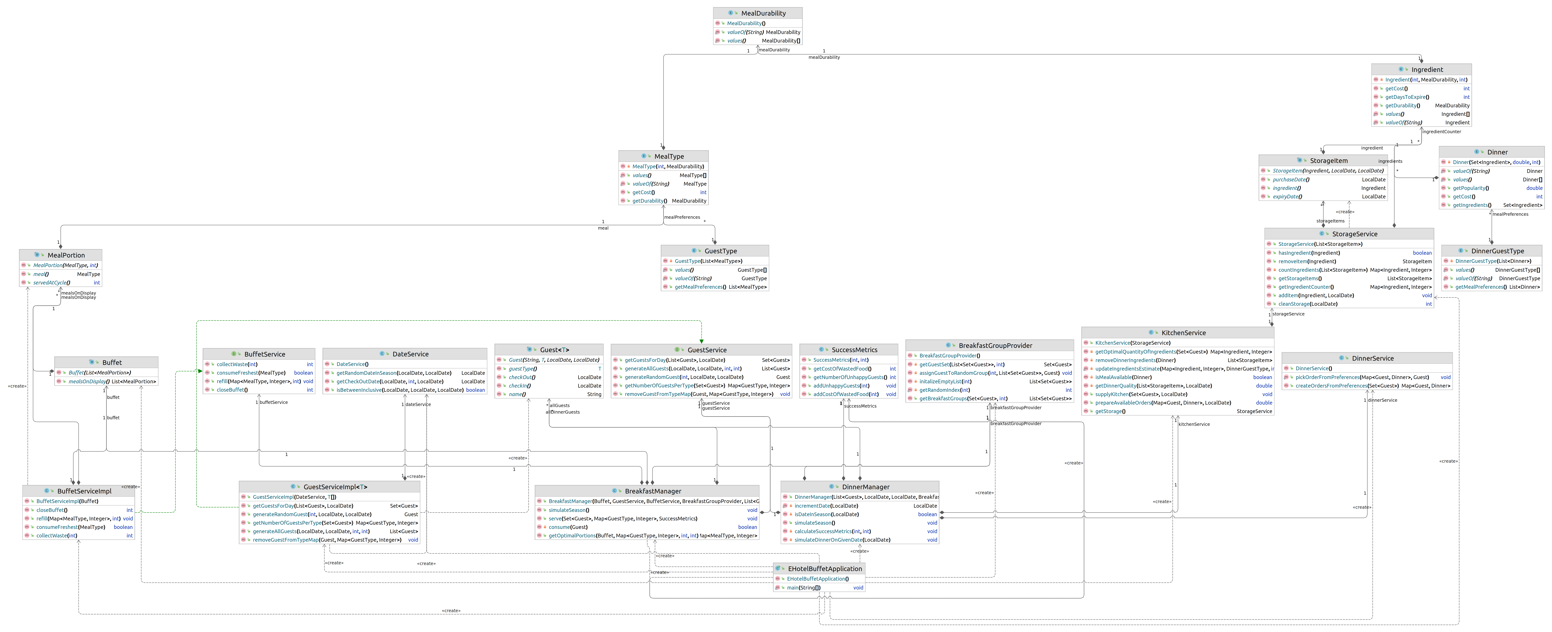
Breakfast Buffet
– Project structure
Dinner
– Project structure
Friday, April 27th 2023
Slide <number>
Zinaida Jusufovic
Martin Egert

Slide 4
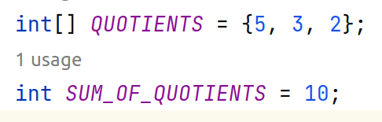
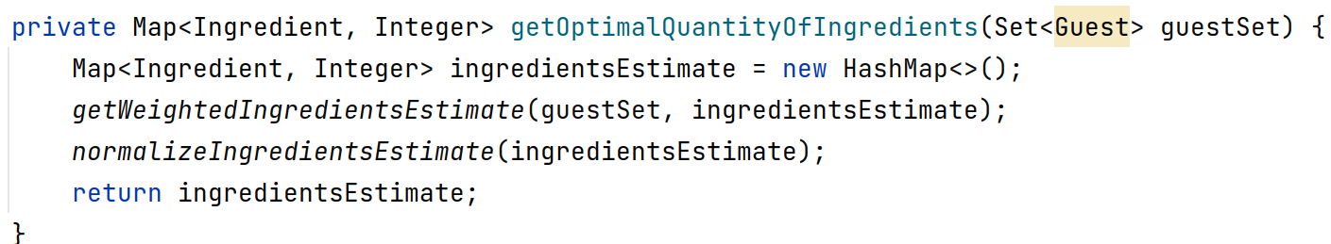
Optimal Portion Algorithm
Friday, April 27th 2023
Slide <number>
Zinaida Jusufovic
Martin Egert

Slide 5
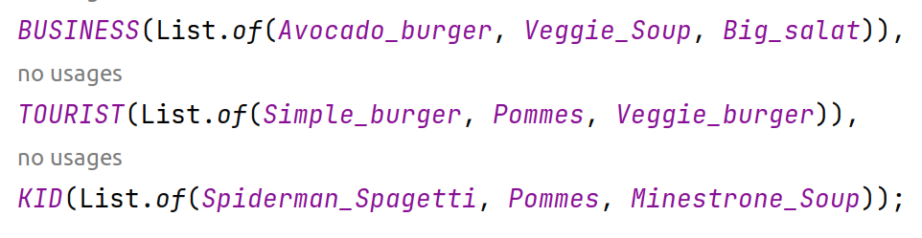
Optimal Portion Algorithm
1 Option – 50 %
2 Option – 35 %
3 Option – 15 %
(Quotient(Option) * Dinner_Ingredients )
Quotient_sum
1 2 3
Friday, April 27th 2023
Slide <number>
Zinaida Jusufovic
Martin Egert

Slide 6
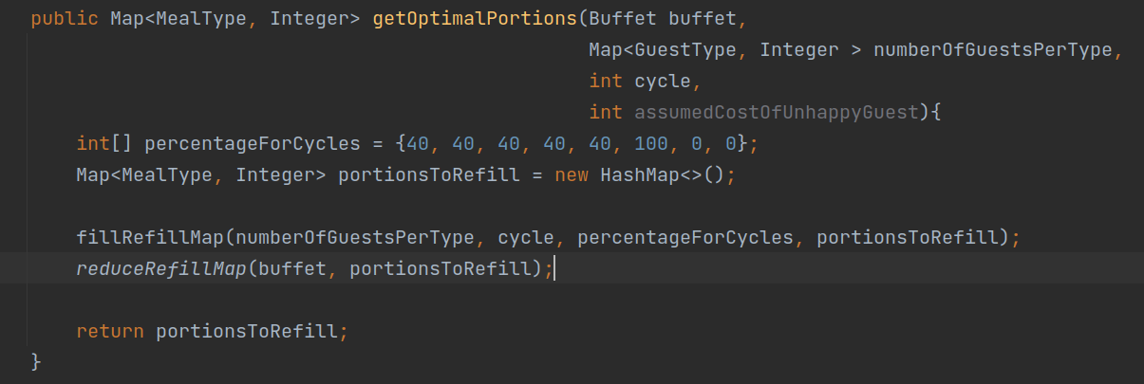
Optimal Portion Algorithm
Friday, April 27th 2023
Slide <number>
Zinaida Jusufovic
Martin Egert

Slide 7
Optimal Portion Algorithm
Friday, April 27th 2023
Slide <number>
Zinaida Jusufovic
Martin Egert

Slide 8
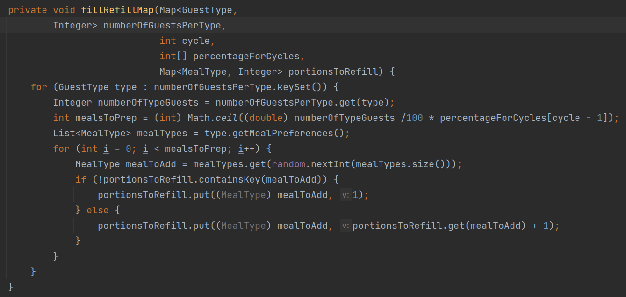
Optimal Portion Algorithm
Friday, April 27th 2023
Slide <number>
Zinaida Jusufovic
Martin Egert

Slide 9
Optimal Portion Algorithm
Friday, April 27th 2023
Slide <number>
Zinaida Jusufovic
Martin Egert

Slide 10
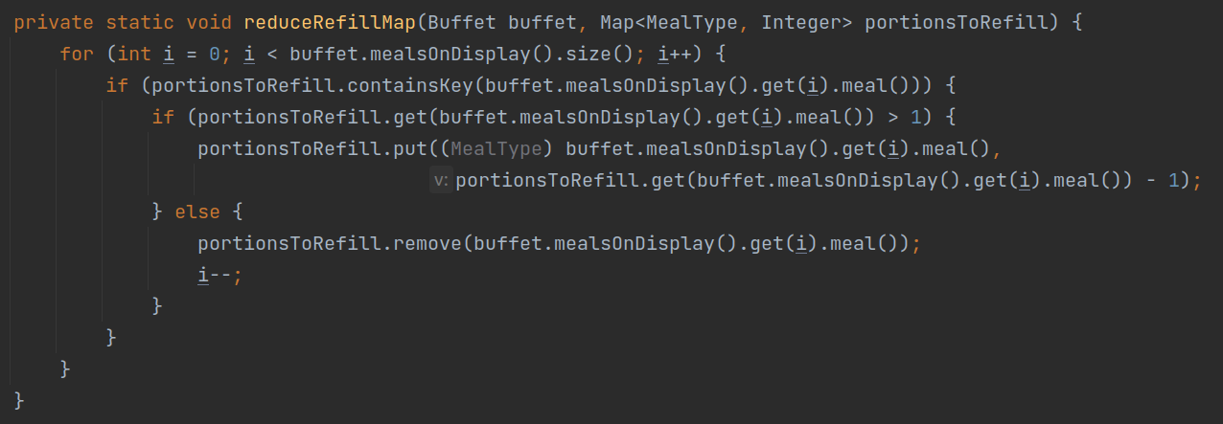
Optimal Portion Algorithm
Friday, April 27th 2023
Slide <number>
Zinaida Jusufovic
Martin Egert

Slide 11
Optimal Portion Algorithm
Friday, April 27th 2023
Slide <number>
Zinaida Jusufovic
Martin Egert

Slide 12
OUTPUT
Friday, April 27th 2023
Slide <number>
Zinaida Jusufovic
Martin Egert

Slide 13
Room for improvement
Every meal every day
Random numbers vs empirical data
Multiple unhappy-nesses
Different guest types same behavior
...
=>=> Lots of data to collect!
Friday, April 27th 2023
Slide <number>
Zinaida Jusufovic
Martin Egert

Slide 14
THANK YOU
Friday, April 27th 2023
Slide <number>
Zinaida Jusufovic
Martin Egert

