Slide 1
Freestyle MERN Project
(sprint 1)
Team: CrudeMovieDb

Slide 2
Our Week
Monday | Tuesday | Wednesday | Thursday | Friday
Team Creation Trello Board | Frontend Structure | Meeting for the Presentation What Tasks are left? | Testing Instead: Saving Favs to db | D E M O
Picking an API “What are we even building?” | React Components Mongoose. connect | Style Choices | Code Refactoring Instead: Favorites display | D A Y
React WS
MongoDB
WS

Slide 3
Challenges & Solutions
Collaborating with MongoDb
Routing with React
Handling multiple
Database & Network Access!
react-router-dom
Folder Structure, Variable Names...

Slide 4
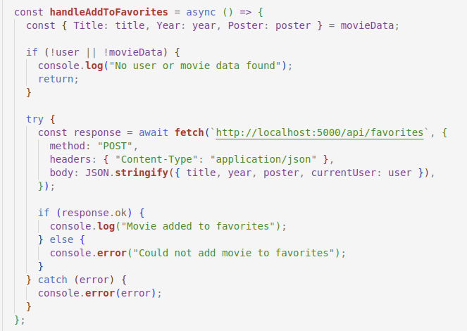
Code Snippet : ADD TO FAVs

Slide 5
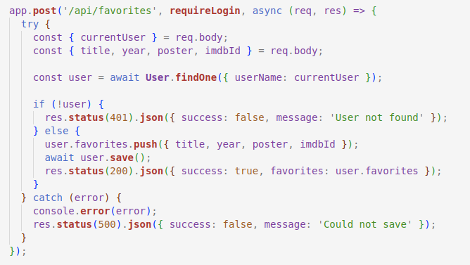
Code Snippet

Slide 6
Demo

