Slide 1




Slide 2


// summary: presentation
Summary of task
Summary of the week
Code snippets
Lessons learned
Demo of Game

Slide 3
// summary: task
Creating a text adventure game with Java
Planning Game Loop
Deciding features
Creating different classes
Using methods
Biggest challenges?
Learning new features of language
Getting code to work
Getting tasks finished in time

Slide 4
// summary: week
Saturday: | General game structure planning Dividing main areas of game - Adrian: Player mechanics, Game & Battle Logic - Agata: User Interface, Area & Game Details
Tue/Thu: | Discussing progress in session Discussing next steps
Week: | Working on individual tasks Frequent updates on Discord
Biggest challenges?
Agata sick, started work on Tuesday
Combining code

Slide 5
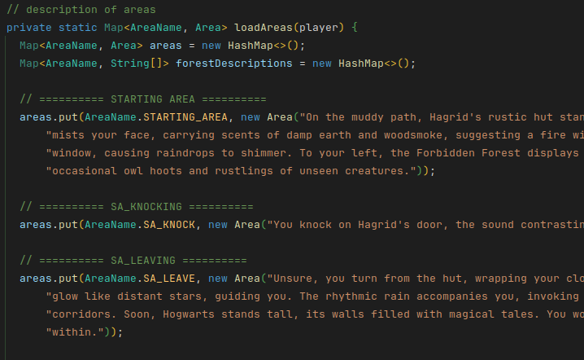
// snippets
before:

Slide 6
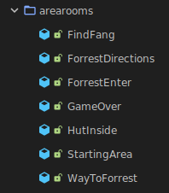
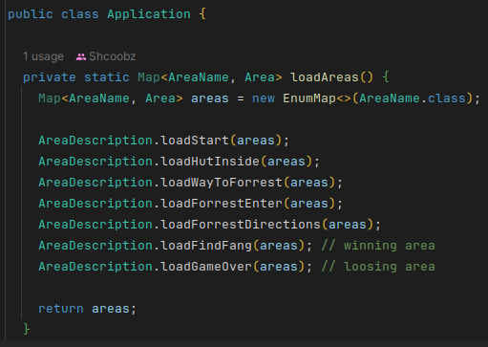
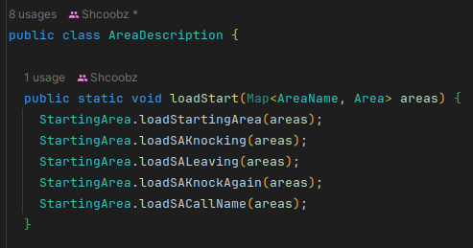
// snippets
after:

Slide 7
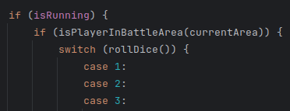
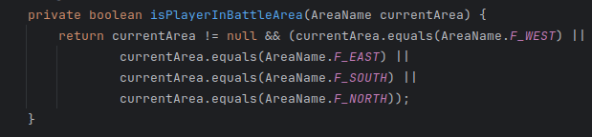
// snippets

Slide 8
// lessons learned
Good:
Communication: frequent & clear
Teamwork: Members working on their tasks
Time-management: as good as possible
Not yet:
Think more about general structure of game
Features?
Class “assignment”?
Structure: refactor more

Slide 9

// demo

