Slide 1
Red Sonics
András, Olivér

Slide 2
Search autocomplete; Conlict of eventlisteners;
Challanges

Slide 3
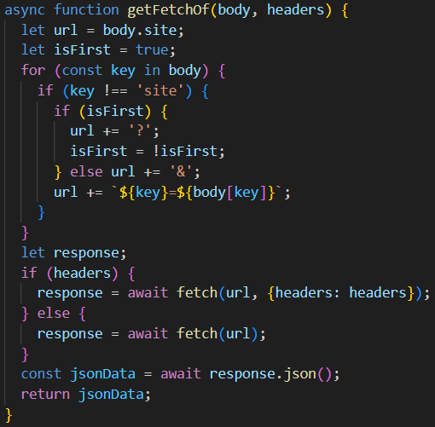
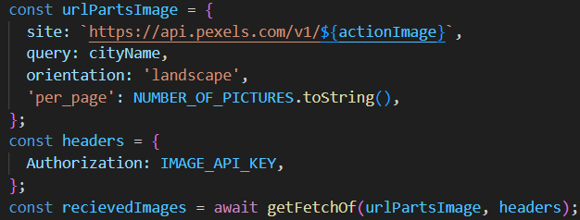

Slide 4
