Slide 1
Red Sonics
András, Olivér

Slide 2
Display weather by cities; Search for city name;
Project

Slide 3
Search autocomplete; Conlict of eventlisteners;
Challanges

Slide 4
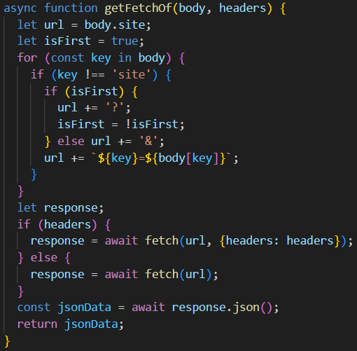
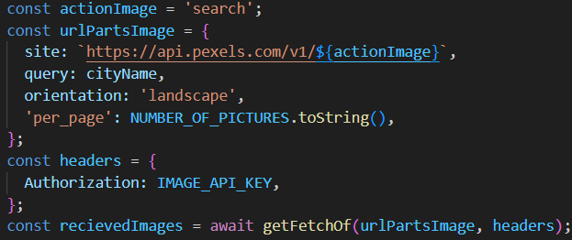

Slide 5
